Slide 1
Project: IEEE P802.15 Working Group for Wireless Personal Area Networks (WPANs)
Submission Title: [Efficient 11n-648 Based LDPC Codes for 15.4ab]
Date Submitted: [8th Nov. 2022]
Source: [Wei Lin, Xun Yang, Bin Qian, Chenchen Liu, Li Sun, Rani Keren, Shimi Shilo, Lei Huang, Edward Au] Company [Huawei]
Address [Huawei base, Shenzhen, CHINA & Huawei Israel & Huawei Singapore]
E-Mail:[lin.linwei@huawei.com]
Re: [Study Group 4ab: UWB Next Generation]
Abstract: [Efficient 11n-648 Based LDPC Codes for 15.4ab]
Purpose: []
Notice: This document has been prepared to assist the IEEE P802.15. It is offered as a basis for discussion and is not binding on the contributing individual(s) or organization(s). The material in this document is subject to change in form and content after further study. The contributor(s) reserve(s) the right to add, amend or withdraw material contained herein.
Release: The contributor acknowledges and accepts that this contribution becomes the property of IEEE and may be made publicly available by P802.15.

Slide 2
Technical Guidance
PAR Objective | Proposed Solution (how addressed)
Safeguards so that the high throughput data use cases will not cause significant disruption to low duty-cycle ranging use cases.
Interference mitigation techniques to support higher density and higher traffic use cases
Other coexistence improvement
Backward compatibility with enhanced ranging capable devices (ERDEVs).
Improved link budget and/or reduced air-time | New Channel Coding Schemes can provide improved link budgets and reduced air time
Additional channels and operating frequencies
Improvements to accuracy / precision / reliability and interoperability for high-integrity ranging;
Reduce complexity and power consumption;
Hybrid operation with narrowband signaling to assist UWB;
Enhanced native discovery and connection setup mechanisms;
Sensing capabilities to support presence detection and environment mapping;
Low-power low-latency streaming
higher data-rate streaming allowing at least 50 Mbit/s of throughput. | New Channel Coding Schemes with higher rates can support high data rate
Support for peer-to-peer, peer-to-multi-peer, and station-to-infrastructure protocols;
Infrastructure synchronization mechanisms.

Slide 3
Related Submissions
[1] 15-21-0506-02-04ab-Advanced Coding for Data Communications in 802.15.4ab, Carlos Aldana, et al
[2] 15-21-0592-00-04ab-high-data-rates, C. Murray, et al
[3] 15-22-0181-01-04ab-new-data-rates, C. Murray, et al
[4] 15-22-0050-00-04ab- Channel Coding Considerations for 802.15.4ab, Wei Lin, et al
[5] 15-22-0154-00-04ab-further-considerations-of-advanced-channel-coding-on-15-4ab, Wei Lin, et al
[6] 15-22-0265-01-04ab-discussion-on-advanced-channel-coding-for-15-4ab, Wei Lin, et al
[7] 15-22-0274-00-04ab-high-data-rates-and-coding, Carlos Aldana, et al
[8] 15-22-0296-01-04ab-a-higher-data-rate-proposal-for-uwb, Koorosh Akhavan, et al
[9] 15-21-0506-03-04ab-advanced-coding-for-data-comm, Carlos Aldana, et al
[10] 15-22-0391-01-04ab-preliminary-discussion-on-possible-ldpc-codes-for-15-4ab, Wei Lin, et al
[11] 15-22-0506-01-04ab-new-results-on-possible-ldpc-codes-for-15.4ab, Wei Lin, et al
[12] 15-22-0517-00-04ab-new-data-rates-and-coding, Carlos Aldana, et al

Slide 4
Discussions on Advanced Channel Coding
The consideration of introducing possible new advanced coding schemes were extensively discussed in [1]-[5]
  Some initial discussions on the new advanced coding can be found in [1]-[5], where extensive comparisons of BCC, Turbo, Polar, LDPC codes can be found in terms of performance, complexity, etc.
Most participants agreed to converge to LDPC codes during the May IEEE Meeting [6]-[10]
  In [7], some consensus among some co-authors were achieved, including to converge the selection of new advanced codes for 15.4ab to LDPC codes → Primary candidate is the 802.11n LDPC code
  In [6], we also suggested to further converge the candidates to LDPC codes after extensive evaluations, and also LDPC codes have been widely employed in current wireless standards.
  [9] provided further simulation results of short (e.g., 30 bytes) and very short (e.g., 10~5 bytes) payloads with 11n LDPC codes, and showed that 11n LDPC can perform well at lower effective coding rates
  In [10] [11], a set of Raptor-Like LDPC codes which share a single base matrix and single set of lifting factors were proposed, and extensive simulation results can be found therein
  In [12], some consensus were achieved → the candidate LDPC codes for 15.4ab were converged to original 11n LDPC codes (R = 1/2) or the 11n-Based LDPC codes

Slide 5
The Targets of New UWB LDPC Codes
Low Complexity is very important for UWB applications
  It is beneficial for the candidate LDPC codes to share a single base matrix, and possible different lifting coefficients for corresponding code lengths → similar to NR LDPC
The 11n LDPC codes have been widely implemented in industry
  The primary candidate is the 802.11n LDPC code with block lengths {648,1296,1944} [12]
  This scheme is well-known, field-tested, and supported by available implementations of known implementation loss, complexity, energy consumption, and latency [12]
  802.11n based LDPC codes are subject to further study [12]
Further results of 11n-648 based LDPC codes are provided in this proposal
  Both 11n-648 based medium (1296) and long (1944) code performs very close to the default 11n LDPC codes under various number of iterations (even very slightly surpass with large number of iterations)
  The 11n-648 based LDPC decoder can fully reuse the 11n-648 short decoder with a simple modulo operation at the addressing module if 1296 or 1944 code is enabled, and the decoder area occupation can be significantly reduced

Slide 6
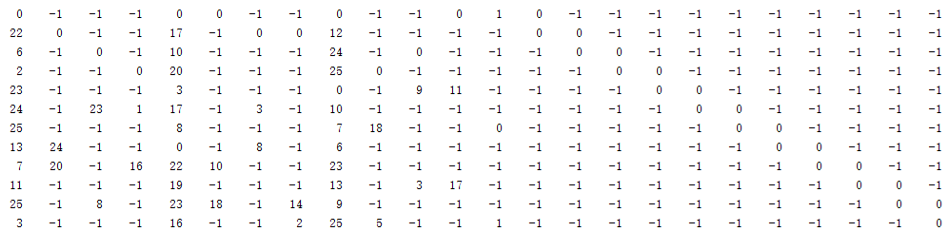
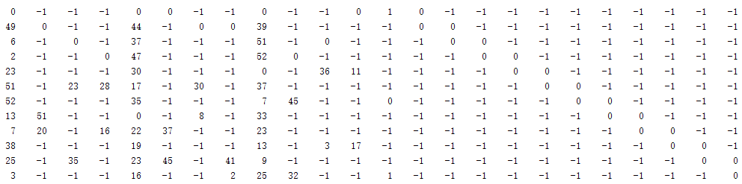
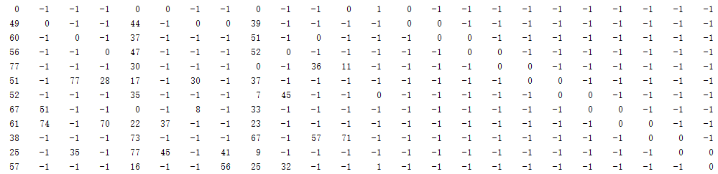
11n-648 Based LDPC → Single Base Matrix
If we want to maximally reuse the existing 11n LDPC codes, facilitate the implementation and save the area on chip, an alternative UWB LDPC solution can be considered
  The 11n LDPC of different lengths don‘t share the same base matrix, neither the same set of lifting factors
  We can consider to fully reuse the rate-1/2, length-648 11n LDPC matrix, and the 1296 and 1944 matrices can be obtained conveniently based on the same base matrix of 11n short LDPC code
  The set of 11n-648 Based LDPC codes of three lengths (short / medium / long) can also be embedded into a single base matrix with a single set of lifting factors
  Lifting factors of different lengths can be conveniently obtained by modulo operations (widely optimized in 5G LDPC decoders) → the short code is exactly the 11n-684 LDPC code of rate-1/2
Single Base Matrix for all lengths
11n-648 LDPC (R = 1/2)
Size: 12x24, Lifting = 27, n = 24 x 27 = 648 bits
Size: 12x24, Lifting = 27x2 = 54, n = 24 x 52 = 1248 bits
Size: 12x24, Lifting = 27x3 = 81, n = 24 x 81 = 1944 bits

Slide 7
11n-648 Based LDPC → Single Set of Lifting Factors
If we want to maximally reuse the existing 11n LDPC codes, facilitate the implementation and save the area on chip, an alternative UWB LDPC solution can be considered
  Lifting factors of different lengths can be conveniently obtained by modulo operations (widely optimized in 5G LDPC decoders) → the short code is exactly the 11n-684 LDPC code of rate-1/2
11n-648 LDPC (R = 1/2)
Size: 12x24, Lifting = 27, n = 20 x 27 = 648 bits
Size: 12x24, Lifting = 27x2 = 54, n = 24 x 54 = 1296 bits
  Examples for embedded lifting factors:
  Case A: 0 (0 % 27 = 0) ← 0 (0 % 54 = 0) ← 0 (long)
  Case B: 17 (44 % 27 = 17) ← 44 (44 % 54 = 44) ← 44 (long)
  Case C: 23 (23 % 27 = 23) ← 23 (77 % 54 = 23) ← 77 (long)
  All with one base matrix and one group of lifting coefficients
  → Reduces the implementation complexity of 3 lengths
Size: 12x24, Lifting = 27x3 = 81, n = 24 x 81 = 1944 bits

Slide 8
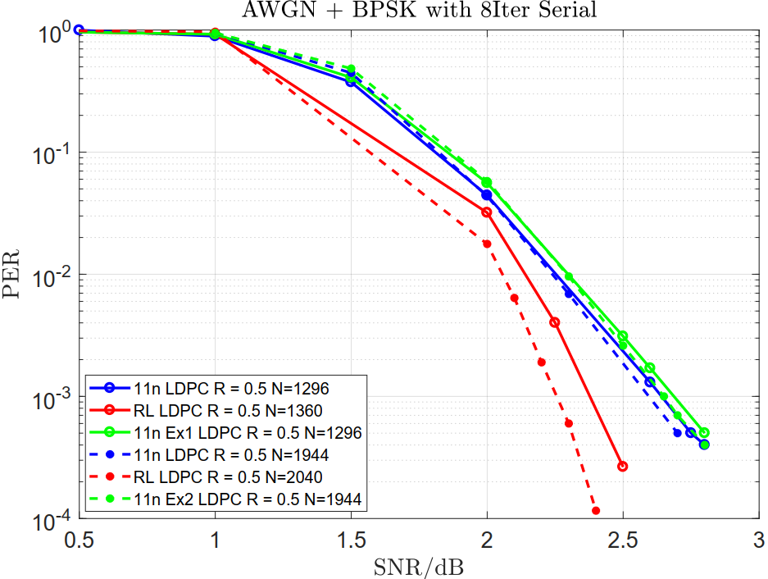
Simulation Results → 11n-648 Based LDPC Codes
  Simulations Settings:
  Full parity bits without puncturing
  Payload Size = 81 Bytes (648 Bits) for N = 1296 code
  Payload Size = 121.5 Bytes (972 Bits) for N = 1944 code
  The 1296 and 1944 11n-648 Based LDPC Codes performs very close to the default 11n LDPC codes
  The 648, 1296, 1944 11n-648 Based LDPC Codes share the same base matrix, and the same set of lifting factors
  The decoder can fully reuse the 11n-648 short code decoder with a simple modulo operation at the addressing module if 1296 or 1944 code is enabled
  Decoder area occupation can be significantly reduced
  Layered Normalized Min-Sum Decoder with (Alpha = 0.75)

Slide 9
Simulation Results → AWGN, N = 1296, PER
  Simulations Settings: K = 648, N = 1296
  Full parity bits without puncturing
  Payload Size = 81 Bytes (648 Bits)
  Offset Min-Sum Decoder (Beta = 0.6)
  Number of Iterations: 10, 15, 20, 25, 30
  10000000 Packets were simulated, and at least 100 Error Packets Collected for each point
81 Bytes with full parity bits
  For various number of iterations, the 11n-based 1296 LDPC code performs very close (or identical) to 11n 1296 LDPC code
  No error floor was observed at PER = 10⁻⁵
  For number of iterations >= 20, with the increase of iterations, performance improvement becomes negligible
SNR at 1% PER are marked

Slide 10
Simulation Results → AWGN, N = 1944, PER
  Simulations Settings: K = 972, N = 1944
  Full parity bits without puncturing
  Payload Size = 121.5 Bytes (972 Bits)
  Offset Min-Sum Decoder (Beta = 0.6)
  Number of Iterations: 10, 15, 20, 25, 30
  10000000 Packets were simulated, and at least 100 Error Packets Collected for each point
121.5 Bytes with full parity bits
  For various number of iterations, the 11n-based 1944 LDPC code performs very close (or identical, even slightly surpass) to 11n 1296 LDPC code
  No error floor was observed at PER = 10⁻⁵
  For number of iterations >= 20, with the increase of iterations, performance improvement becomes negligible
SNR at 1% PER are marked

Slide 11
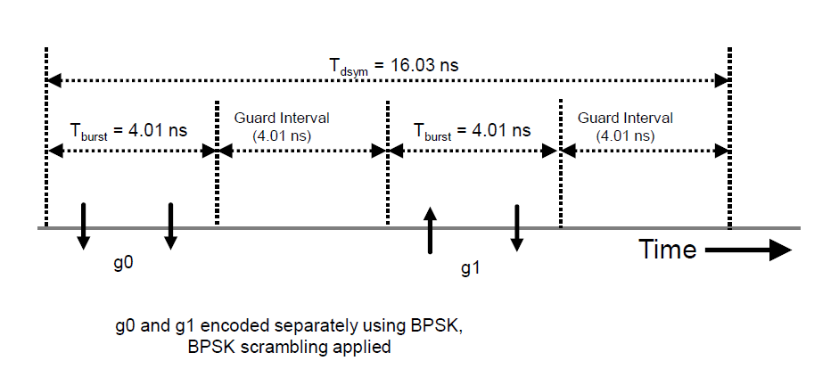
Simulation Results → CM1, 62.4Mbps, N = 1296
  Simulations Settings: K = 648, N = 1296
  Full parity bits without puncturing
  Payload Size = 81 Bytes (648 Bits)
  Layered BP Decoder with 10, 20, 30 iterations
  Perfect channel estimation at the rake receiver
  Perfect sync is applied
81 Bytes with full parity bits
81 Bytes
SNR at 1% PER are marked

Slide 12
Simulation Results → CM1, 62.4Mbps, N = 1944
  Simulations Settings: K = 972, N = 1944
  Full parity bits without puncturing
  Payload Size = 121.5 Bytes (972 Bits)
  Layered BP Decoder with 10, 20, 30 iterations
  Perfect channel estimation at the rake receiver
  Perfect sync is applied
81 Bytes with full parity bits
121.5 Bytes
SNR at 1% PER are marked

Slide 13
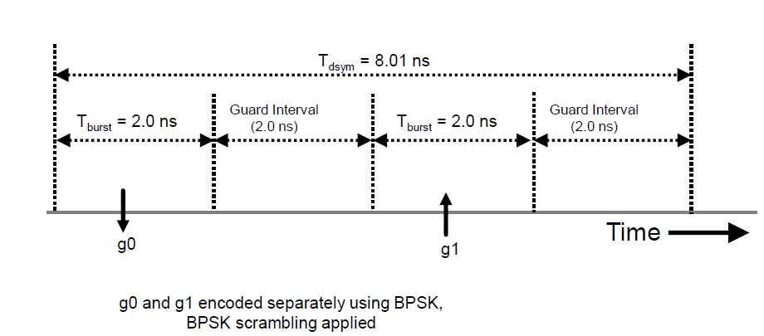
Simulation Results → CM1, 124.8Mbps, N = 1296
  Simulations Settings: K = 648, N = 1296
  Full parity bits without puncturing
  Payload Size = 81 Bytes (648 Bits)
  Layered BP Decoder with 10, 20, 30 iterations
  Perfect channel estimation at the rake receiver
  Perfect sync is applied
81 Bytes

Slide 14
Simulation Results → CM1, 124.8Mbps, N = 1944
  Simulations Settings: K = 972, N = 1944
  Full parity bits without puncturing
  Payload Size = 121.5 Bytes (972Bits)
  Layered BP Decoder with 10, 20, 30 iterations
  Perfect channel estimation at the rake receiver
  Perfect sync is applied
121.5 Bytes

Slide 15
Summary
The11n-648 based LDPC codes of three lengths (short / medium / long) can be embedded into a single base matrix with a single set of lifting factors → Similar to 5G LDPC codes
  The 11n-648 based LDPC decoder can fully reuse the 11n-648 short code decoder with a simple modulo operation at the addressing module if 1296 or 1944 code is enabled, and the decoder area occupation can be significantly reduced

Slide 16
Appendix: Complexity Analysis
Benefit of single matrix with least group of lifting factors have been widely discussed during the development of 5G
  Greatly facilitate the decoder implementations → single interconnection network which determined by the base matrices (routing network) and the corresponding lifting factors (shifting networks)
  Fewer number of base matrices and set of lifting factors need to be memorized → power consumption is reduced
The hardware adjustment based on existing 11n-648 LDPC is very simple
  To implement the original three 11n rate-1/2 codes, efforts have to be made to decouple (pick out and rearrange) the three H matrices from the full 12 H matrices inside 11n LDPC decoder
  The 11n-648 based LDPC decoder can fully reuse the 11n-648 short code decoder with a simple modulo operation at the addressing module if 1296 or 1944 code is enabled → Efforts are similar to decoupling (pick out and rearrange) the three 11n H matrices
To reduce 3 individual parity check matrices to single base matrix with single set of lifting factors, the decoder area occupation can be significantly reduced
  The memory for matrix descriptions can be reduced to 1/3 → single base matrix and single set of lifting factors
  The interconnection networks of the 3 lengths can be reused, instead of realizing 3 different interconnection networks → The interconnection networks include routing network (defined by the base matrix) and shift network (defined by the lifting factors) → The area of interconnection networks can be reduced to 1/3
[1] R1-1609066_Decoder Architecture for Length-Compatible Quasi-Cyclic LDPC Codes
[2] R1-1608584_Complementary turbo and LDPC codes for NR, motivated by a survey of over 100 ASICs
[3] R1-1608971 Consideration on flexibility of LDPC codes for NR

Slide 17
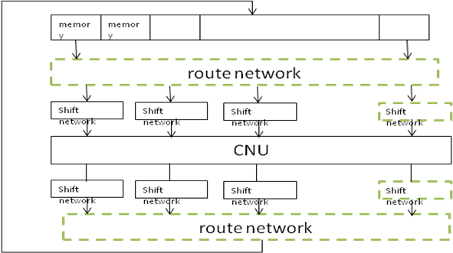
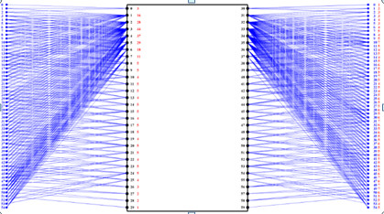
Appendix: Complexity Analysis
Example of row paralleled layered LDPC decoder, and the interconnection networks are marked
Example of route network of decoder for LDPC
[1] R1-1608971 Consideration on flexibility of LDPC codes for NR

Slide 18
Appendix: Decoder Area
The LDPC decoder occupies a large portion of the baseband chip areas of 11n/11ad implementations
  For UWB devices, the proportion of LDPC decoder would be around 40%~50% because of very simple baseband PHY designs → Reduction on the LDPC decoder area would also greatly reduce the UWB baseband area
    At 11n/ad baseband chips, the LDPC decoder occupies around 30%~40% of area
Inside an LDPC decoder, around 40%~60% percent of area would be dedicated to memory part, and the interconnection network (routing networks and shift networks) occupies a large amount of the rest area (can be estimated to around 30% of the whole area)
  For 3 different code implementations, the interconnection networks can’t be reused → 100% + 30% +30% = 160%
  For single base matrix implementations, interconnection networks can be fully reused → 100%/160% → around 37.5% decoder area can be reduced compared with 3 different codes implementation (The specific value varies depend on the specific implementation of 11n LDPC decoder, e.g., 20%)
[1] J. Jin and C.-Y. Tsui, "An Energy Efficient Layered Decoding Architecture for LDPC Decoder," in IEEE Transactions on Very Large Scale Integration (VLSI) Systems, vol. 18, no. 8, pp. 1185-1195, Aug. 2010.
[2] I. Tsatsaragkos and V. Paliouras, "A Reconfigurable LDPC Decoder Optimized for 802.11n/ac Applications," in IEEE Transactions on Very Large Scale Integration (VLSI) Systems, vol. 26, no. 1, pp. 182-195, Jan. 2018.
[3] A. Verma and R. Shrestha, "Low Computational-Complexity SOMS-Algorithm and High-Throughput Decoder Architecture for QC-LDPC Codes," in IEEE Transactions on Vehicular Technology, 2022.
[4] J. -Y. Lee and H. -J. Ryu, "A 1-Gb/s flexible LDPC decoder supporting multiple code rates and block lengths," in IEEE Transactions on Consumer Electronics, vol. 54, no. 2, pp. 417-424, May 2008.
[5] Y. Sun, J. R. Cavallaro and T. Ly, "Scalable and low power LDPC decoder design using high level algorithmic synthesis," 2009 IEEE International SOC Conference (SOCC), 2009, pp. 267-270.
[6] H. Cui, F. Ghaffari, K. Le, D. Declercq, J. Lin and Z. Wang, "Design of High-Performance and Area-Efficient Decoder for 5G LDPC Codes," in IEEE Transactions on Circuits and Systems I: Regular Papers, vol. 68, no. 2, pp. 879-891, Feb. 2021.

Slide 19
Thank You

