Slide 1
Project: IEEE P802.15 Working Group for Wireless Personal Area Networks (WPANs)
Submission Title: [Evaluation of IEEE 802.15.6ma Ultra-wideband Physical Layer Utilizing Super Orthogonal Convolutional Code]
Date Submitted: [11 March 2025]
Source: [Kento Takabayashi¹, Ryuji Kohno^{2,3} ] [1;Toyo University, 2;Yokohama National University, 3;YRP International Alliance Institute(YRP-IAI)]
Address [1: 2100 Kujirai, Kawagoe, Saitama, Japan 351-8585, Japan 719-1197,
2; 79-5 Tokiwadai, Hodogaya-ku, Yokohama, Japan 240-8501,
3; YRP1 Blg., 3-4 HikarinoOka, Yokosuka-City, Kanagawa, 239-0847 Japan]
Voice:[1; +81-866-94-2104, 2: +81-90-5408-0611],
Email:[1: takabayashi.kento.xp@gmail.com, 2:kohno@ynu.ac.jp]
Re: []
Abstract: [The performance of an IEEE 802.15.6ma ultra-wideband physical layer utilizing super orthogonal convolutional codes is evaluated. These slides may offer opportunity to discuss on revision for a dependable physical layer technology of a new standard IEEE802.15.6ma.] Purpose: [The discussion will lead definition and requirement of current ongoing research and development on dependable wireless networks.]
Notice: This document has been prepared to assist the IEEE P802.15. It is offered as a basis for discussion and is not binding on the contributing individual(s) or organization(s). The material in this document is subject to change in form and content after further study. The contributor(s) reserve(s) the right to add, amend or withdraw material contained herein. Release: The contributor acknowledges and accepts that this contribution becomes the property of IEEE and may be made publicly available by P802.15.
Notes:
doc.: IEEE 802.15-09-0117-00-0007
<month year>

Slide 2
Evaluation of IEEE 802.15.6ma Ultra-wideband Physical Layer Utilizing Super Orthogonal Convolutional Code
March 2025,
Hybrid Session ,
Atlanta Hilton, Atlanta, US
Kento Takabayashi¹, Ryuji Kohno^{2,3}
1. Toyo University, Japan
2. Yokohama National University, Japan
3. YRP International Alliance Institute, Japan

Slide 3
Motivation and aim
UWB is a promising technology that may satisfy the requirements of IoMT
IEEE 802.15.6 UWB PHY has limited transmission output and requires to ensure dependability
New consideration is given to the application of Super Orthogonal Convolutional Codes (SOCC) as a technique for improving dependability for higher priority case
We perform evaluation when SOCC is applied at the IEEE 802.15.6 UWB PHY, and confirm the effectiveness of these combinations
Notes:
SOCCs have attracted attention as error correction codes for code division multiple access (CDMA) using the spread spectrum
Therefore, SOCCs are considered to be compatible with the UWB, as they use a very wide bandwidth

Slide 4
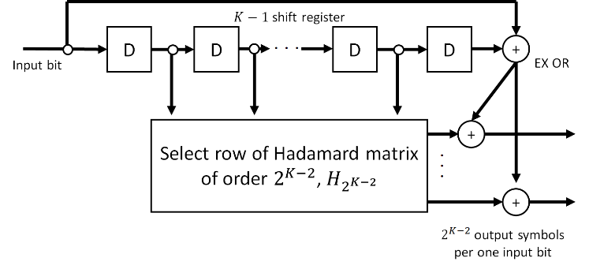
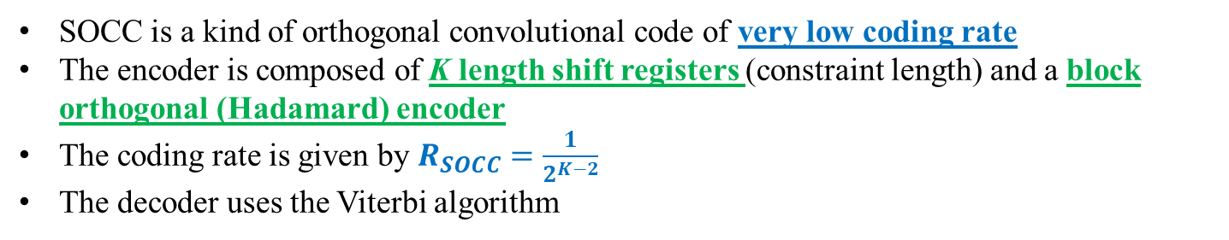
SOCC
Fig. SOCC encoder
SOCC is a kind of orthogonal convolutional code of very low coding rate
The encoder is composed of K length shift registers (constraint length) and a block orthogonal (Hadamard) encoder
The coding rate is given by $R_{SOCC}=\frac{1}{2^{K−2}}$
The decoder uses the Viterbi algorithm
Notes:
The inner (K- 2) bit memories are mapped into one Walsh sequence of length $2^{K−2}$ (two to the power of K-2)
The two outer bits are added to each binary number of the selected Walsh sequence by exclusive OR
One divided by two to the power of K-2
Therefore, SOCCs are considered to be compatible with the UWB, as they use a very wide bandwidth

Slide 5
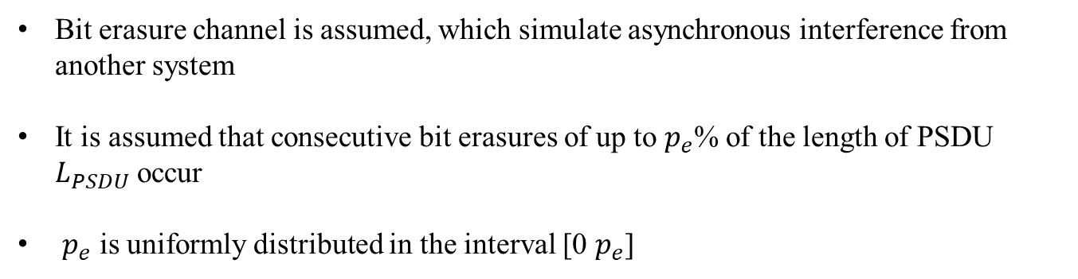
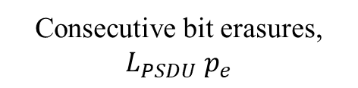
Bit erasure channel
0 1 1 0 0 1 0 0 1・・・0 1 1 1 ✕ ✕ ✕ ✕ ✕ ✕ ・・・0 1 1 0 0 0 1 1
Consecutive bit erasures, $L_{PSDU}$ $p_{e}$
Bit erasure channel is assumed, which simulate asynchronous interference from another system
It is assumed that consecutive bit erasures of up to $p_{e}$% of the length of PSDU $L_{PSDU}$ occur
$p_{e}$ is uniformly distributed in the interval [0 $p_{e}$]

Slide 6
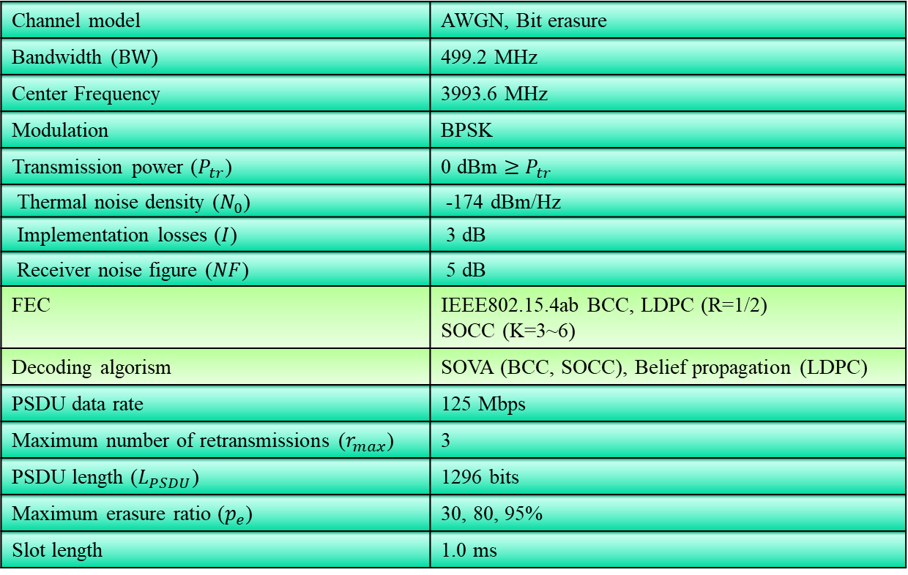
Evaluation
4. Evaluation
Table. Simulation Parameters
Channel model | AWGN, Bit erasure
Bandwidth ($BW$) | 499.2 MHz
Center Frequency | 3993.6 MHz
Modulation | BPSK
Transmission power ($P_{tr}$) | 0 dBm $≥$ $P_{tr}$
Thermal noise density ($N_{0}$) | -174 dBm/Hz
Implementation losses ($I$) | 3 dB
Receiver noise figure ($NF$) | 5 dB
FEC | IEEE802.15.4ab BCC, LDPC (R=1/2) SOCC (K=3~6)
Decoding algorism | SOVA (BCC, SOCC), Belief propagation (LDPC)
PSDU data rate | 125 Mbps
Maximum number of retransmissions ($r_{max}$) | 3
PSDU length ($L_{PSDU}$) | 1296 bits
Maximum erasure ratio ($p_{e}$) | 30, 80, 95%
Slot length | 1.0 ms
Notes:
This presentation focuses on bit error ratio (BER) as well as other evaluation metrics

Slide 7
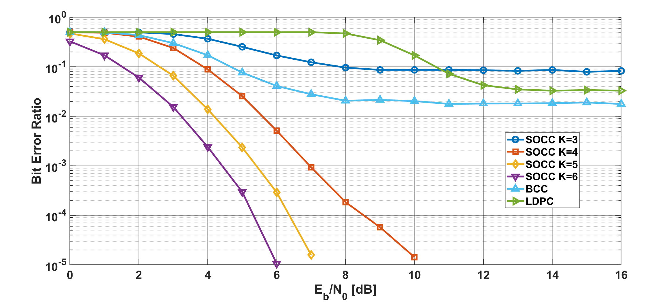

Results
Bit error ratio as a function of $E_{b}/N_{0}$ in the case of 15.4ab BCC, LDPC, and SOCC with random inter-leaver, $p_{e}=30$%
Notes:
SOCC with random inter-leaver had a very good performance.
Especially, low-rate case (1/4, 1/8, 1/16) had better in low EbN0 area.

Slide 8
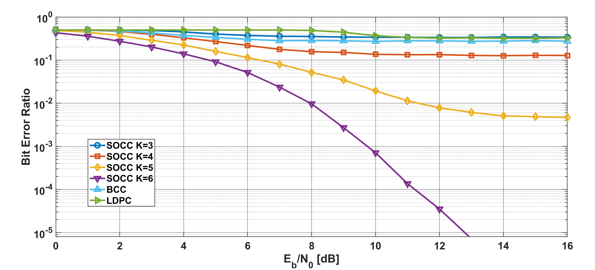

Results
Bit error ratio as a function of $E_{b}/N_{0}$ in the case of 15.4ab BCC, LDPC, and SOCC with random inter-leaver, $p_{e}=80$%
Notes:
This condition supposes strong interference case.
Under these conditions, the BER is less than 10^-2 when K=5 and K=6.
Especially, K=6 case has suitable performance.

Slide 9
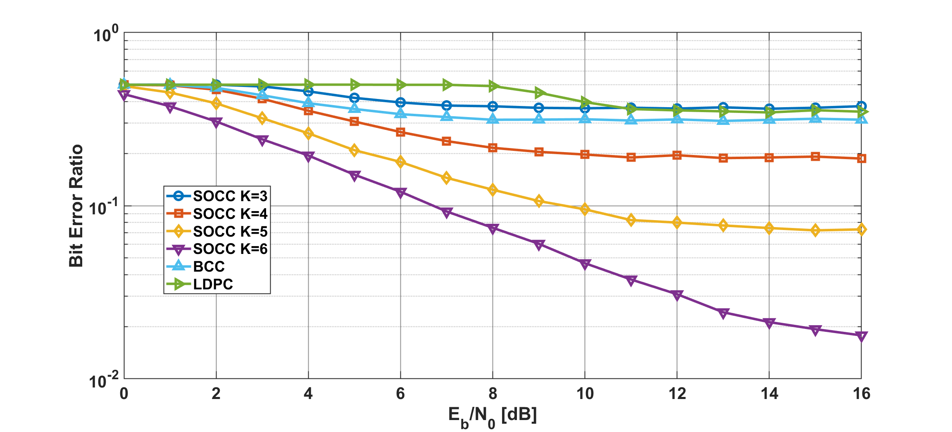

Results
Bit error ratio as a function of $E_{b}/N_{0}$ in the case of 15.4ab BCC, LDPC, and SOCC with random inter-leaver, $p_{e}=95$%
Notes:
This condition supposes much stronger interference case.
Under these conditions, the correction capability of low coding rates SOCC is not sufficient.
So, this case is required to be combined with other interference avoidance or mitigation techniques.

Slide 10
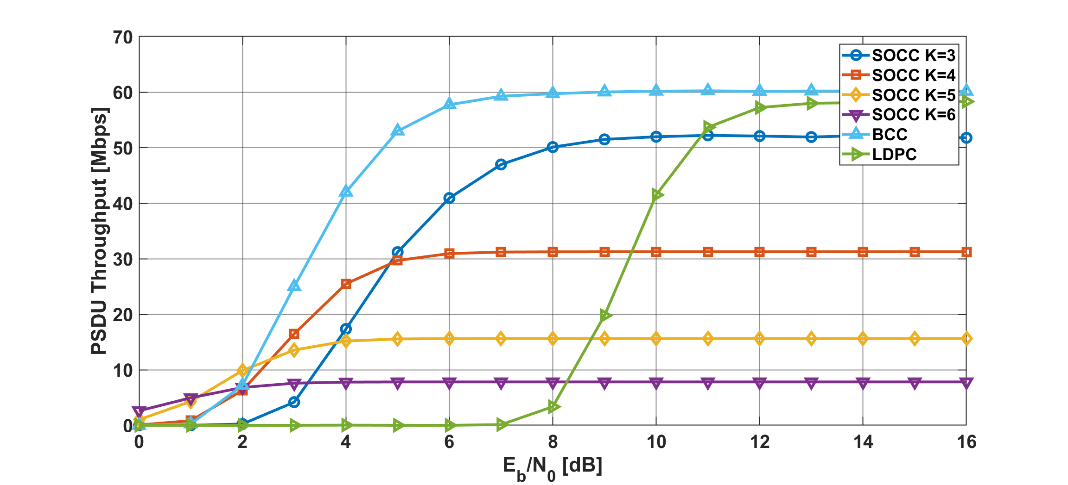

Results
PSDU throughput as a function of $E_{b}/N_{0}$ in the case of 15.4ab BCC, LDPC, and SOCC with random inter-leaver, $p_{e}=30$%
Notes:
Low-rate SOCCs had a less performance than other case, but at least 7.8Mbps or more can be achieved.

Slide 11
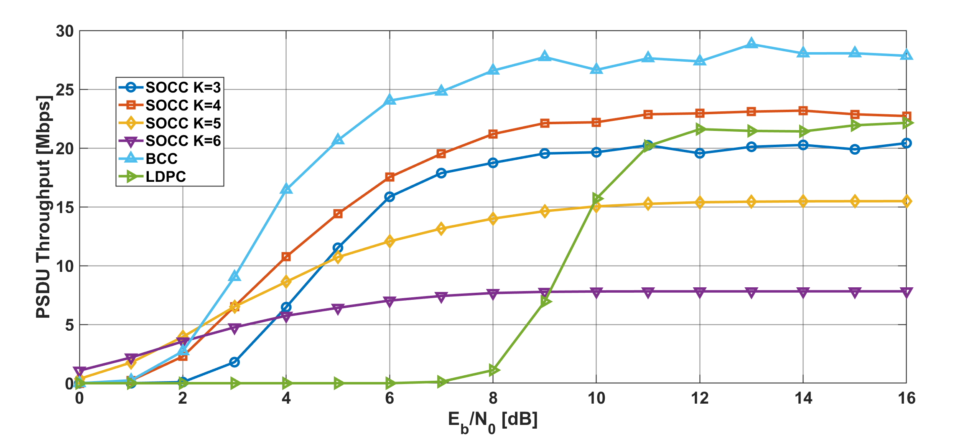

Results
PSDU throughput as a function of $E_{b}/N_{0}$ in the case of 15.4ab BCC, LDPC, and SOCC with random inter-leaver, $p_{e}=80$%
Notes:
In the strong interference case, about 15Mbps can be achieved with low-rate SOCCs while satisfying low BER.

Slide 12
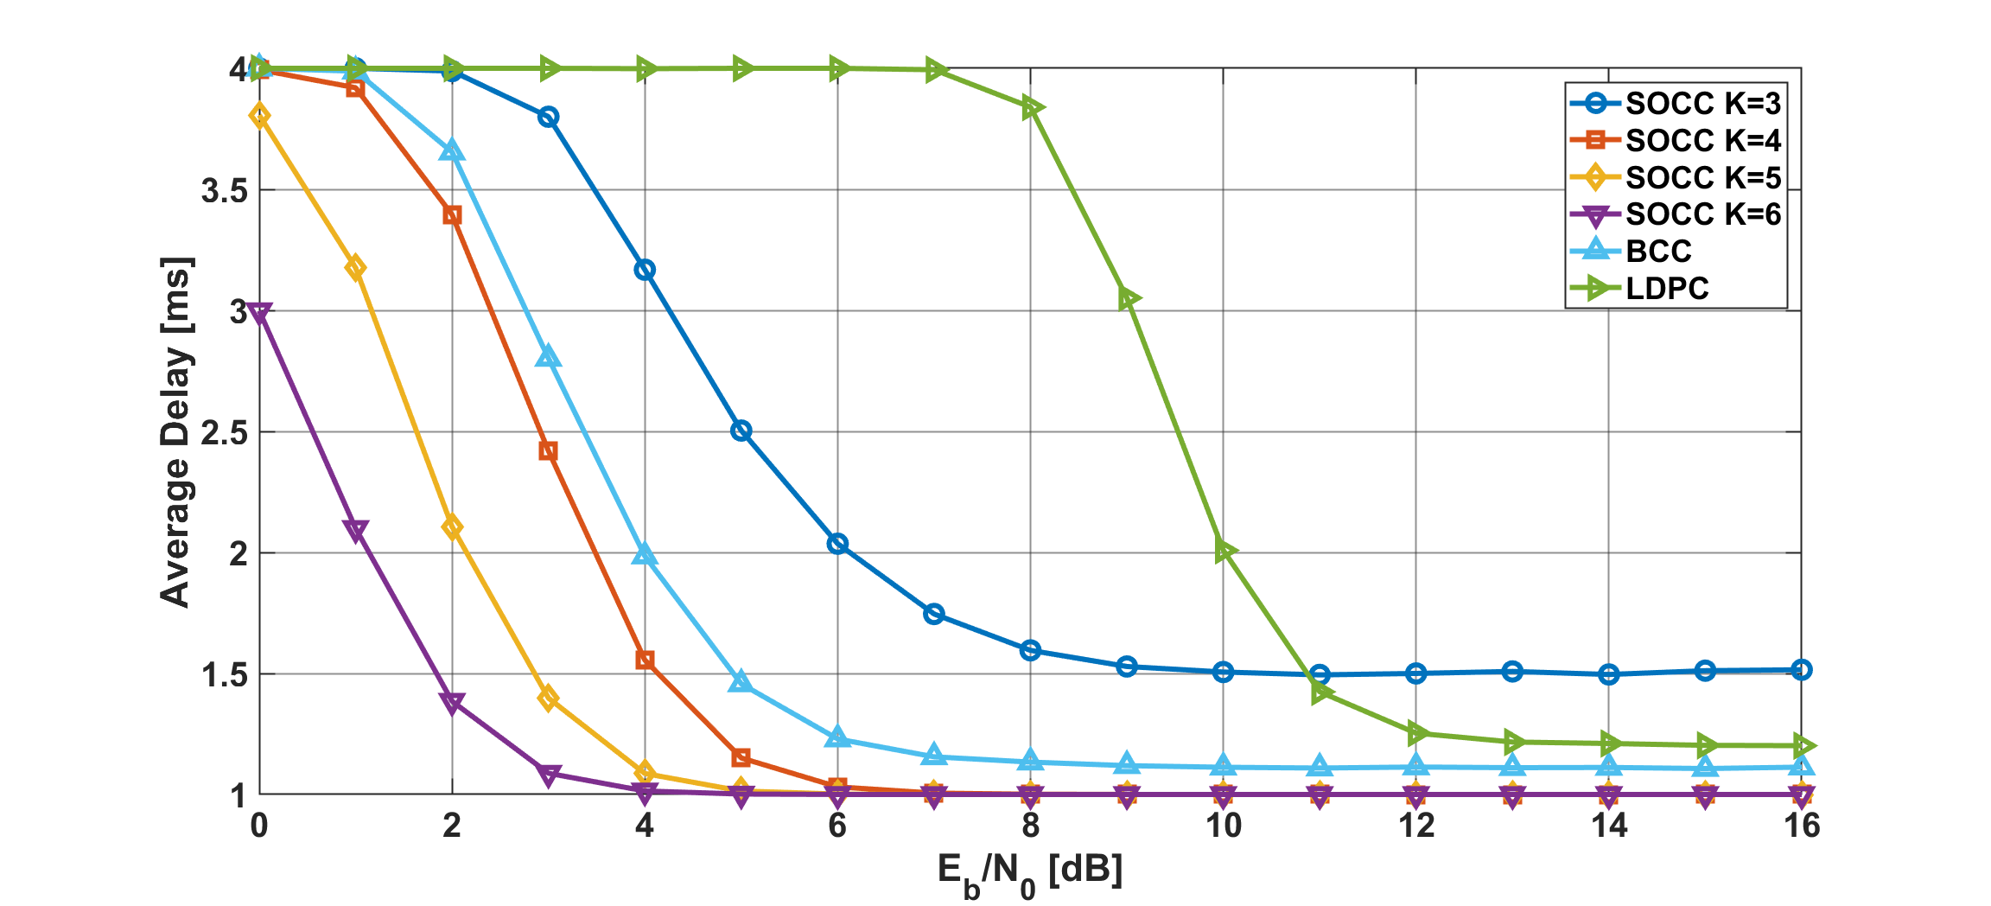
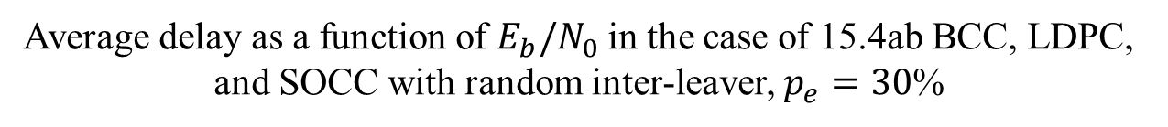
Results
Average delay as a function of $E_{b}/N_{0}$ in the case of 15.4ab BCC, LDPC, and SOCC with random inter-leaver, $p_{e}=30$%
Notes:
In addition, low-rate SOCCs also achieves low delay and retransmission count even in low $E_{b}/N_{0}$ areas.
This is an advantage over HARQ with BCC.

Slide 13
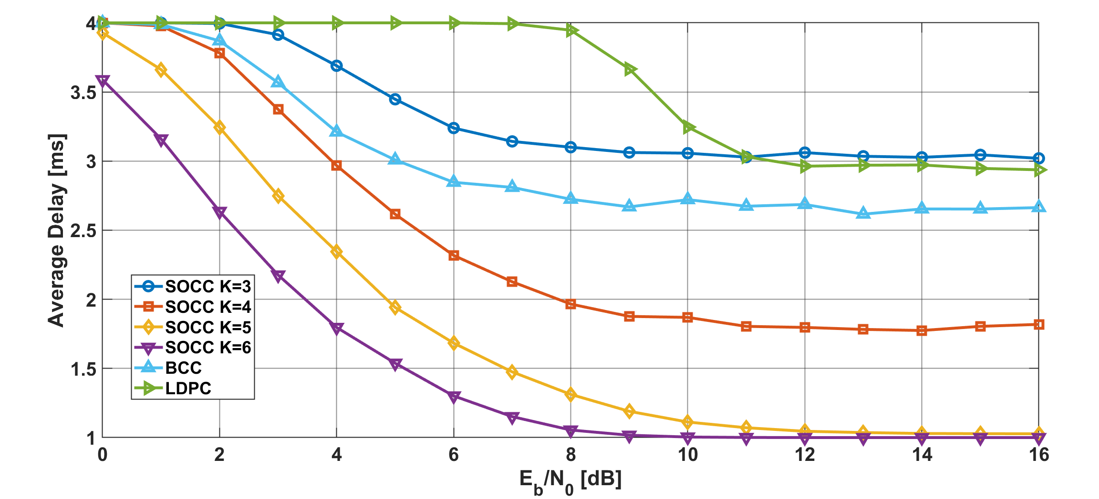
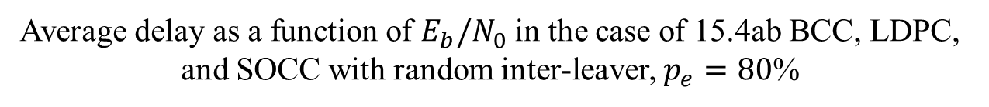
Results
Average delay as a function of $E_{b}/N_{0}$ in the case of 15.4ab BCC, LDPC, and SOCC with random inter-leaver, $p_{e}=80$%
Notes:
Also, in the strong interference case, low delay can be achieved with low-rate SOCCs while satisfying low BER and a certain level of throughput.

Slide 14
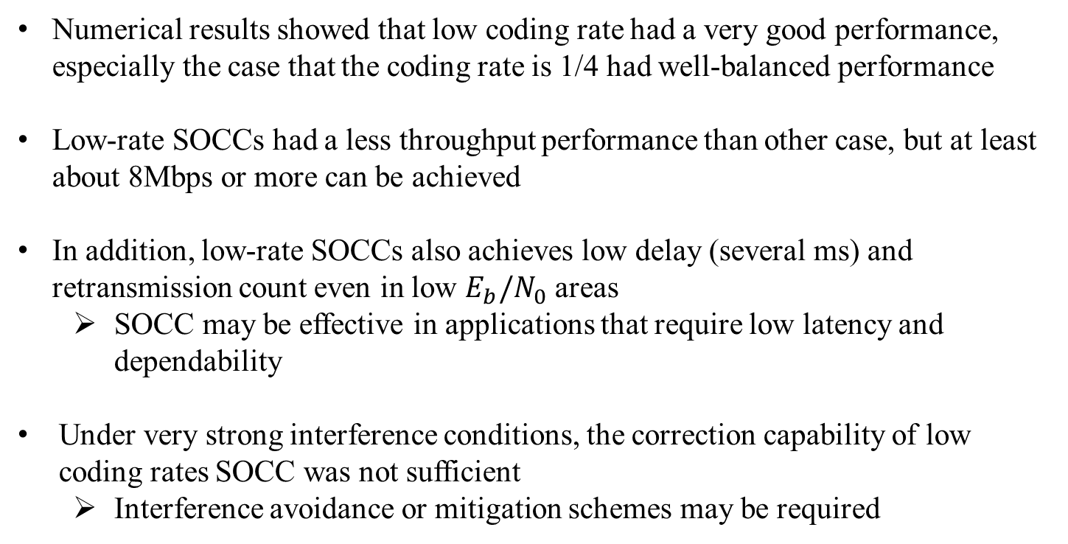
Conclusion
Numerical results showed that low coding rate had a very good performance, especially the case that the coding rate is 1/4 had well-balanced performance
Low-rate SOCCs had a less throughput performance than other case, but at least about 8Mbps or more can be achieved
In addition, low-rate SOCCs also achieves low delay (several ms) and retransmission count even in low $E_{b}/N_{0}$ areas
  SOCC may be effective in applications that require low latency and dependability
Under very strong interference conditions, the correction capability of low coding rates SOCC was not sufficient
  Interference avoidance or mitigation schemes may be required

Slide 15
Reference
Kento Takabayashi, Hirokazu Tanaka, Katsumi Sakakibara, "Evaluation of Wireless Body Area Network Utilizing Super Orthogonal Convolutional Code," in Proceedings of 2019 International Symposium on Intelligent Signal Processing and Communication Systems (ISPACS 2019), Beitou, Taipei, Taiwan, pp.1-2, Dec. 2019.
Kento Takabayashi, Hirokazu Tanaka, Katsumi Sakakibara, "Toward Dependable Internet of Medical Things: IEEE 802.15.6 Ultra-Wideband Physical Layer Utilizing Superorthogonal Convolutional Code," Sensors, 2022, vol. 22, no. 6, 2172, Mar. 2022.

Slide 16
Thank you for your attention ! ! !
* This research was funded by JSPS Grant-in-Aid for Early-Career Scientists Grant Number JP20K14737
16

Slide 17
Results
PSDU throughput as a function of $E_{b}/N_{0}$ in the case of 15.4ab BCC, LDPC, and SOCC with random inter-leaver, $p_{e}=30$%
Notes:
Low-rate SOCCs had a less performance than other case, but at least 7.8Mbps or more can be achieved.

Slide 18
Results
PSDU throughput as a function of $E_{b}/N_{0}$ in the case of 15.4ab BCC, LDPC, and SOCC with random inter-leaver, $p_{e}=80$%
Notes:
Low-rate SOCCs had a less performance than other case, but at least 7.8Mbps or more can be achieved.

Slide 19
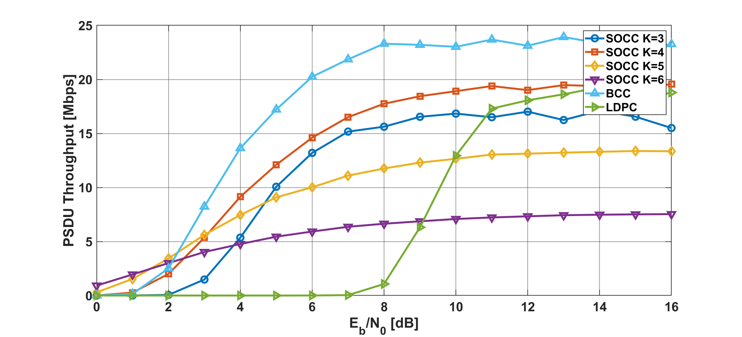

Results
PSDU throughput as a function of $E_{b}/N_{0}$ in the case of 15.4ab BCC, LDPC, and SOCC with random inter-leaver, $p_{e}=95$%
Notes:
Low-rate SOCCs had a less performance than other case, but at least 7.8Mbps or more can be achieved.

Slide 20
Results
Average delay as a function of $E_{b}/N_{0}$ in the case of 15.4ab BCC, LDPC, and SOCC with random inter-leaver, $p_{e}=30$%
Notes:
In addition, low-rate SOCCs also achieves low delay and retransmission count even in low $E_{b}/N_{0}$ areas.
This is an advantage over HARQ with BCC.

Slide 21
Results
Average delay as a function of $E_{b}/N_{0}$ in the case of 15.4ab BCC, LDPC, and SOCC with random inter-leaver, $p_{e}=80$%
Notes:
In addition, low-rate SOCCs also achieves low delay and retransmission count even in low $E_{b}/N_{0}$ areas.
This is an advantage over HARQ with BCC.

Slide 22
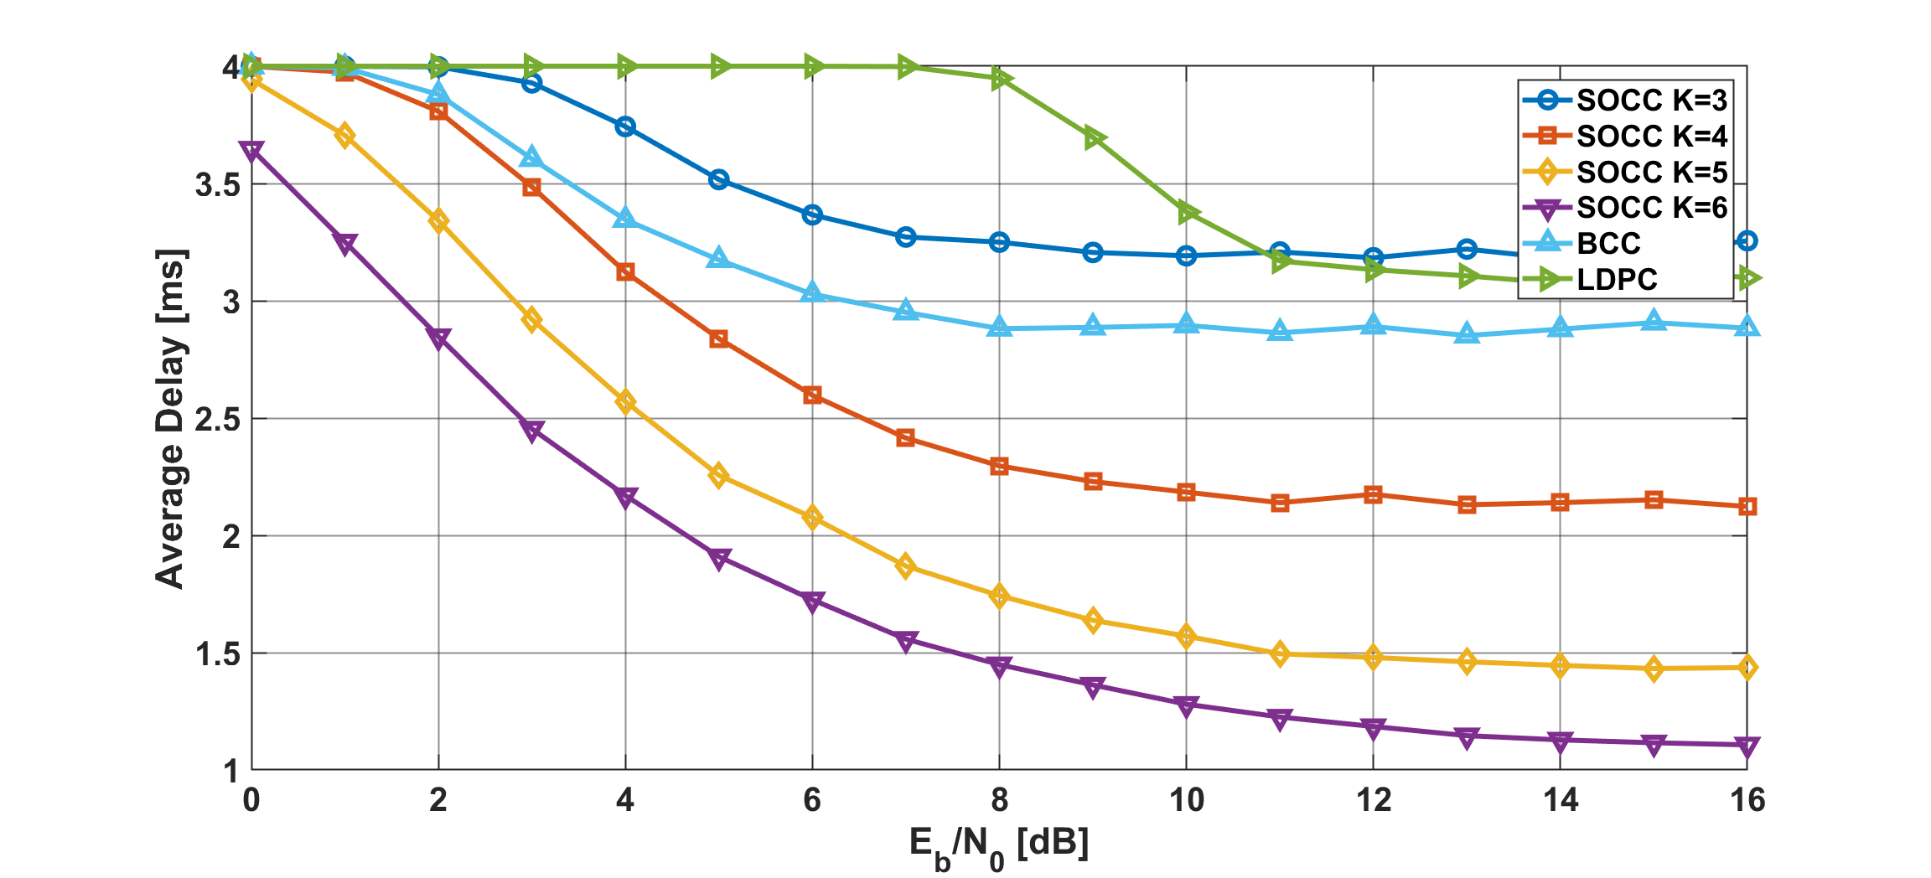
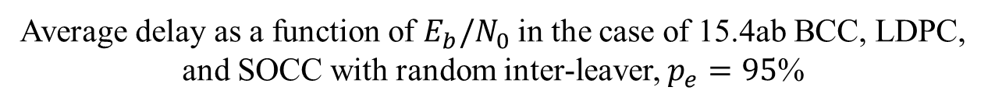
Results
Average delay as a function of $E_{b}/N_{0}$ in the case of 15.4ab BCC, LDPC, and SOCC with random inter-leaver, $p_{e}=95$%
Notes:
In addition, low-rate SOCCs also achieves low delay and retransmission count even in low $E_{b}/N_{0}$ areas.
This is an advantage over HARQ with BCC.

