Slide 1
Project: IEEE P802.15 Working Group for Wireless Personal Area Networks (WPANs)
Submission Title: [Evaluation of IEEE 802.15.6ma Ultra-wideband Physical Layer Utilizing Super Orthogonal Convolutional Code]
Date Submitted: [9 September 2024]
Source: [Kento Takabayashi¹, Ryuji Kohno^{2,3} ] [1;Toyo University, 2;Yokohama National University, 3;YRP International Alliance Institute(YRP-IAI)]
Address [1: 2100 Kujirai, Kawagoe, Saitama, Japan 351-8585, Japan 719-1197,
2; 79-5 Tokiwadai, Hodogaya-ku, Yokohama, Japan 240-8501,
3; YRP1 Blg., 3-4 HikarinoOka, Yokosuka-City, Kanagawa, 239-0847 Japan]
Voice:[1; +81-866-94-2104, 2: +81-90-5408-0611],
Email:[1: takabayashi.kento.xp@gmail.com, 2:kohno@ynu.ac.jp]
Re: []
Abstract: [The performance of an IEEE 802.15.6ma ultra-wideband physical layer utilizing super orthogonal convolutional codes is evaluated. These slides may offer opportunity to discuss on revision for a dependable physical layer technology of a new standard IEEE802.15.6ma.] Purpose: [The discussion will lead definition and requirement of current ongoing research and development on dependable wireless networks.]
Notice: This document has been prepared to assist the IEEE P802.15. It is offered as a basis for discussion and is not binding on the contributing individual(s) or organization(s). The material in this document is subject to change in form and content after further study. The contributor(s) reserve(s) the right to add, amend or withdraw material contained herein. Release: The contributor acknowledges and accepts that this contribution becomes the property of IEEE and may be made publicly available by P802.15.
Notes:
doc.: IEEE 802.15-09-0117-00-0007
<month year>

Slide 2
Evaluation of IEEE 802.15.6ma Ultra-wideband Physical Layer Utilizing Super Orthogonal Convolutional Code
September 2024,
Hybrid Session ,
Hilton - Waikoloa, HI
Kento Takabayashi¹, Ryuji Kohno^{2,3}
1. Toyo University, Japan
2. Yokohama National University, Japan
3. YRP International Alliance Institute, Japan

Slide 3
Motivation and Aim of study
UWB is a promising technology that may satisfy the requirements of IoMT
IEEE 802.15.6 UWB PHY has limited transmission output and requires to ensure dependability
New consideration is given to the application of Super Orthogonal Convolutional Codes (SOCC) as a technique for improving dependability for higher priority case
We perform evaluation when SOCC is applied at the IEEE 802.15.6 UWB PHY, and confirm the effectiveness of these combinations
Notes:
SOCCs have attracted attention as error correction codes for code division multiple access (CDMA) using the spread spectrum
Therefore, SOCCs are considered to be compatible with the UWB, as they use a very wide bandwidth

Slide 4
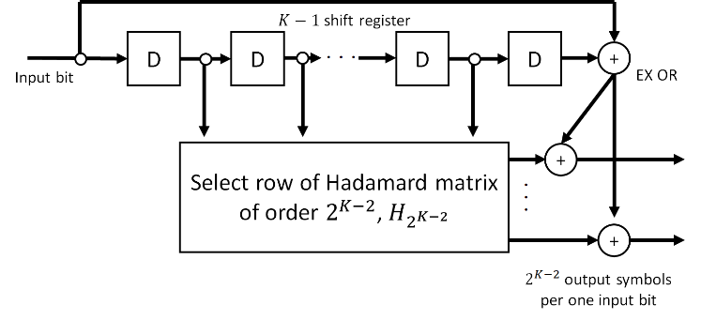
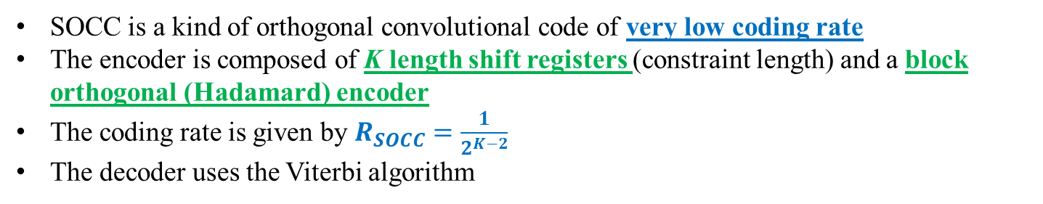
SOCC
Fig. SOCC encoder
SOCC is a kind of orthogonal convolutional code of very low coding rate
The encoder is composed of K length shift registers (constraint length) and a block orthogonal (Hadamard) encoder
The coding rate is given by $R_{SOCC}=\frac{1}{2^{K−2}}$
The decoder uses the Viterbi algorithm
Notes:
The inner (K- 2) bit memories are mapped into one Walsh sequence of length $2^{K−2}$ (two to the power of K-2)
The two outer bits are added to each binary number of the selected Walsh sequence by exclusive OR
One divided by two to the power of K-2
Therefore, SOCCs are considered to be compatible with the UWB, as they use a very wide bandwidth

Slide 5
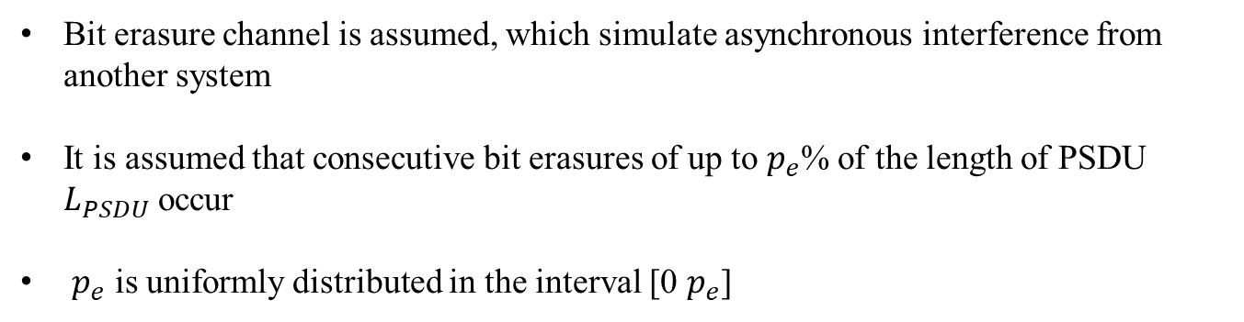
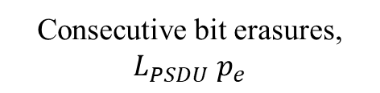
Bit erasure channel
0 1 1 0 0 1 0 0 1・・・0 1 1 1 ✕ ✕ ✕ ✕ ✕ ✕ ・・・0 1 1 0 0 0 1 1
Consecutive bit erasures, $L_{PSDU}$ $p_{e}$
Bit erasure channel is assumed, which simulate asynchronous interference from another system
It is assumed that consecutive bit erasures of up to $p_{e}$% of the length of PSDU $L_{PSDU}$ occur
$p_{e}$ is uniformly distributed in the interval [0 $p_{e}$]

Slide 6
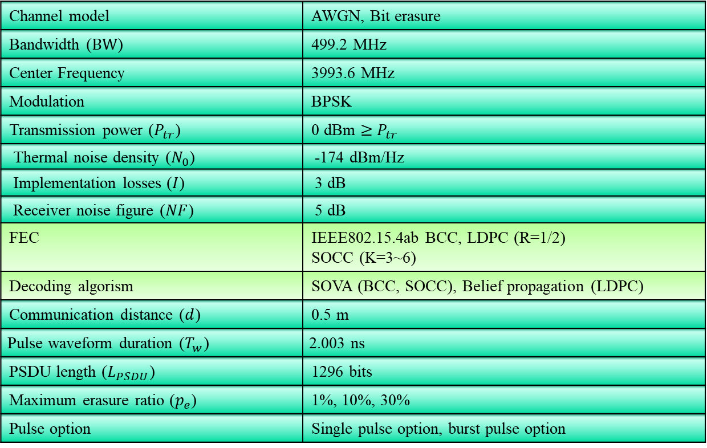
Evaluation
4. Evaluation
Table. Simulation Parameters
Channel model | AWGN, Bit erasure
Bandwidth ($BW$) | 499.2 MHz
Center Frequency | 3993.6 MHz
Modulation | BPSK
Transmission power ($P_{tr}$) | 0 dBm $≥$ $P_{tr}$
Thermal noise density ($N_{0}$) | -174 dBm/Hz
Implementation losses ($I$) | 3 dB
Receiver noise figure ($NF$) | 5 dB
FEC | IEEE802.15.4ab BCC, LDPC (R=1/2) SOCC (K=3~6)
Decoding algorism | SOVA (BCC, SOCC), Belief propagation (LDPC)
Communication distance ($d$) | 0.5 m
Pulse waveform duration ($T_{w}$) | 2.003 ns
PSDU length ($L_{PSDU}$) | 1296 bits
Maximum erasure ratio ($p_{e}$) | 1%, 10%, 30%
Pulse option | Single pulse option, burst pulse option

Slide 7
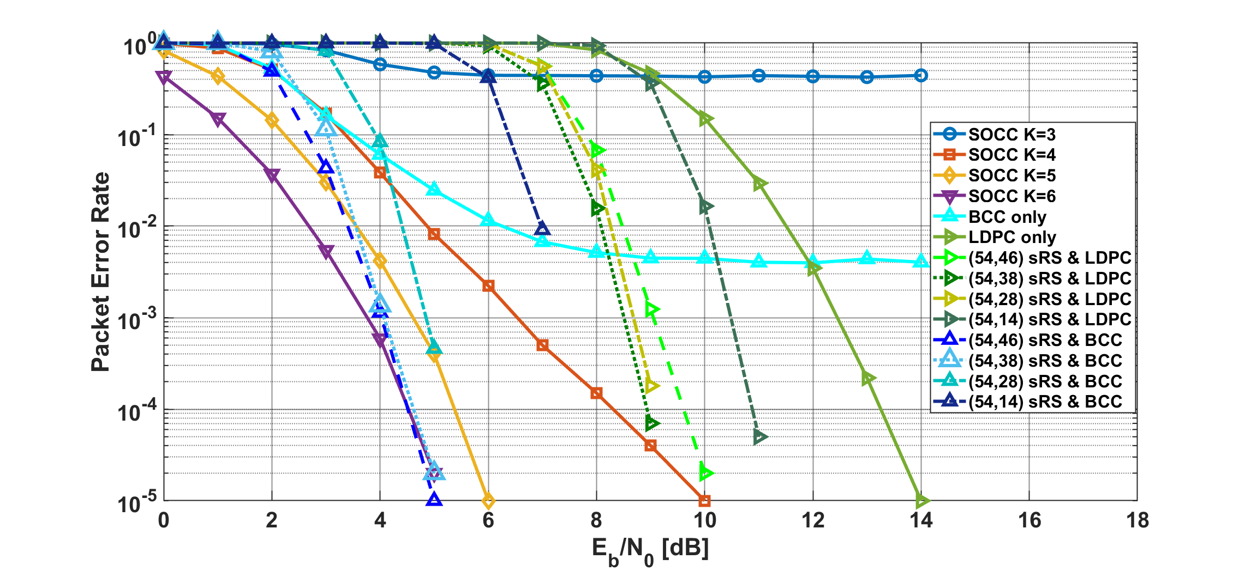
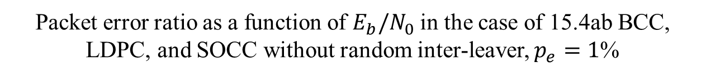
Results
Packet error ratio as a function of $E_{b}/N_{0}$ in the case of 15.4ab BCC, LDPC, and SOCC without random inter-leaver, $p_{e}=1$%
Notes:
In the case of that condition, small bit erasures, SOCC with coding rate 1/16, (54, 46) sRS and BCC, and (54, 38) sRS and BCC had a better performance.
Then, SOCC with coding rate ¼, 1/8, and (54, 28) sRS and BCC had also a good performance.

Slide 8
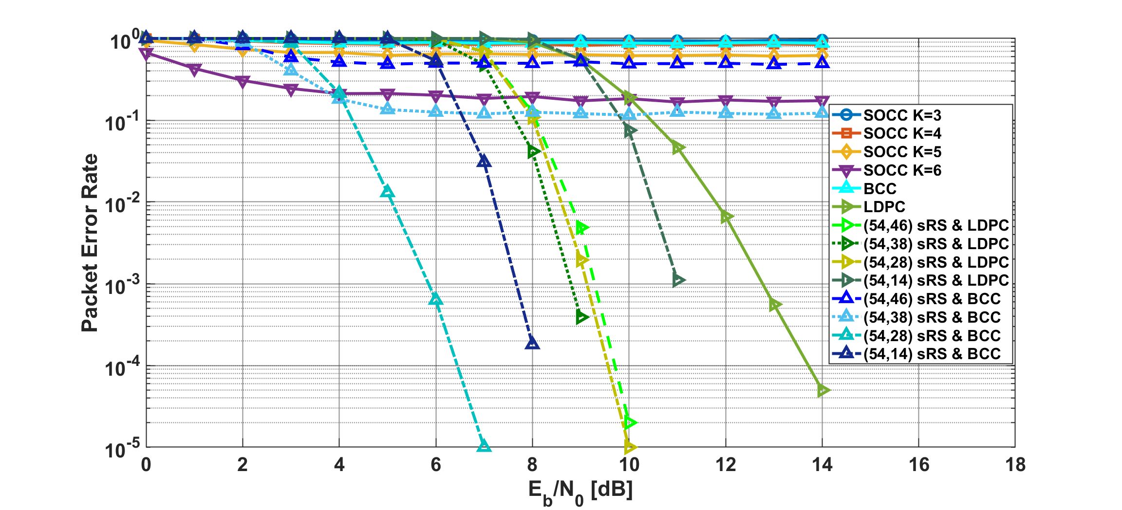
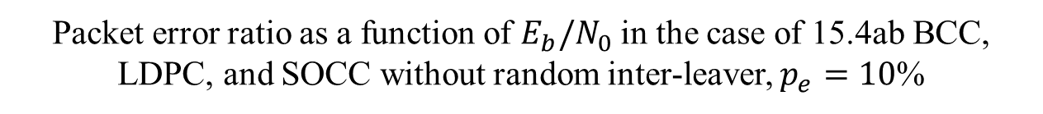
Results
Packet error ratio as a function of $E_{b}/N_{0}$ in the case of 15.4ab BCC, LDPC, and SOCC without random inter-leaver, $p_{e}=10$%
Notes:
In the case of that condition, many bit erasures, (54, 28) sRS and BCC had a better performance
Error floor did not appeared in LDPC cases.
However, SOCC without inter-leaver did not have a good performance due to large burst errors.

Slide 9
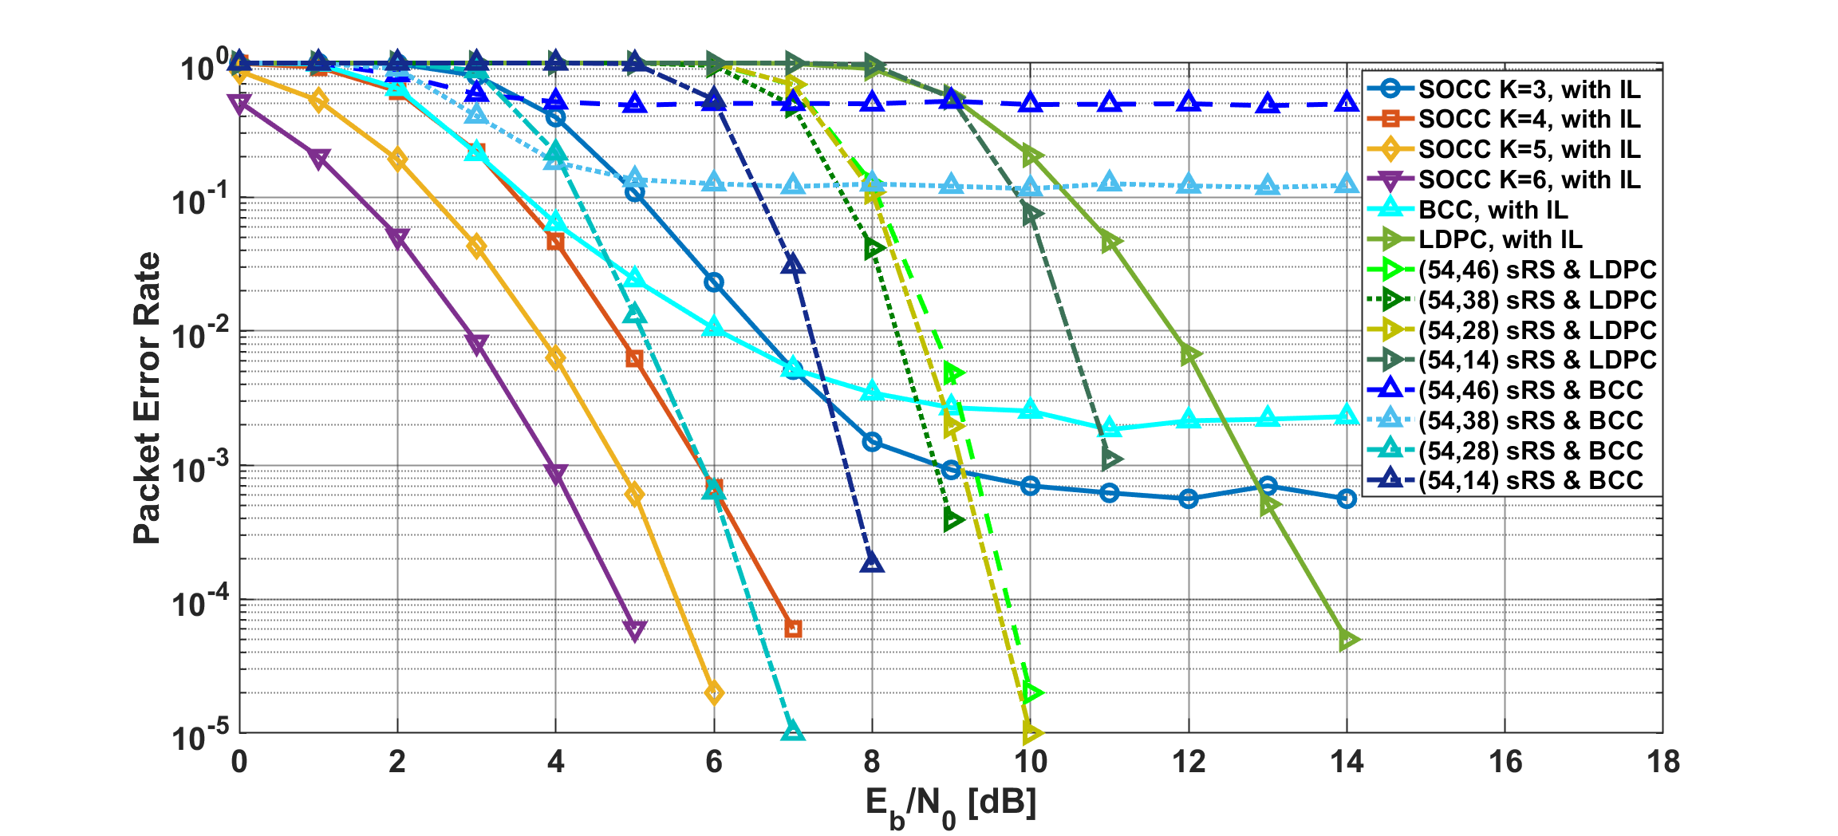
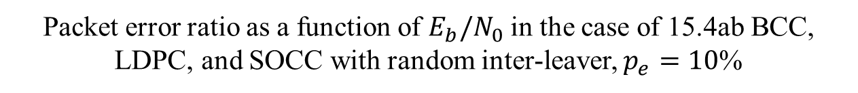
Results
Packet error ratio as a function of $E_{b}/N_{0}$ in the case of 15.4ab BCC, LDPC, and SOCC with random inter-leaver, $p_{e}=10$%
Notes:
SOCC with random inter-leaver had a very good performance.
SOCC with coding rate ¼, has a similar performance to (54, 28) sRS and BCC , those coding rate are almost the same.

Slide 10
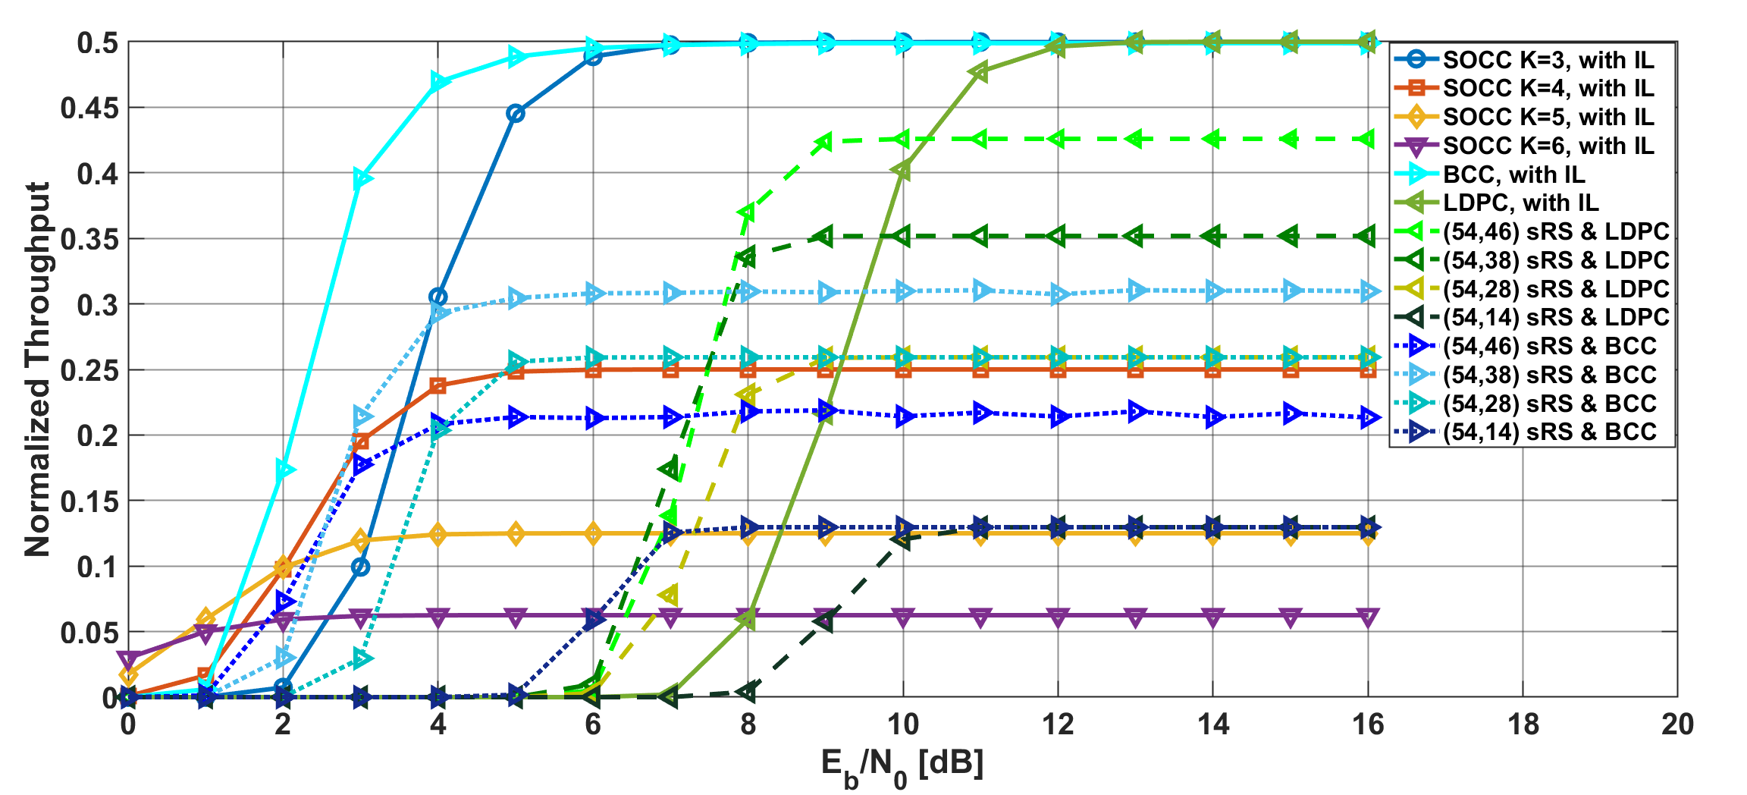

Results
Normalized throughput as a function of $E_{b}/N_{0}$ in the case of 15.4ab BCC, LDPC, and SOCC with random inter-leaver, $p_{e}=10$%
Notes:
SOCC with random inter-leaver also had a good performance in low $E_{b}/N_{0}$ areas.

Slide 11
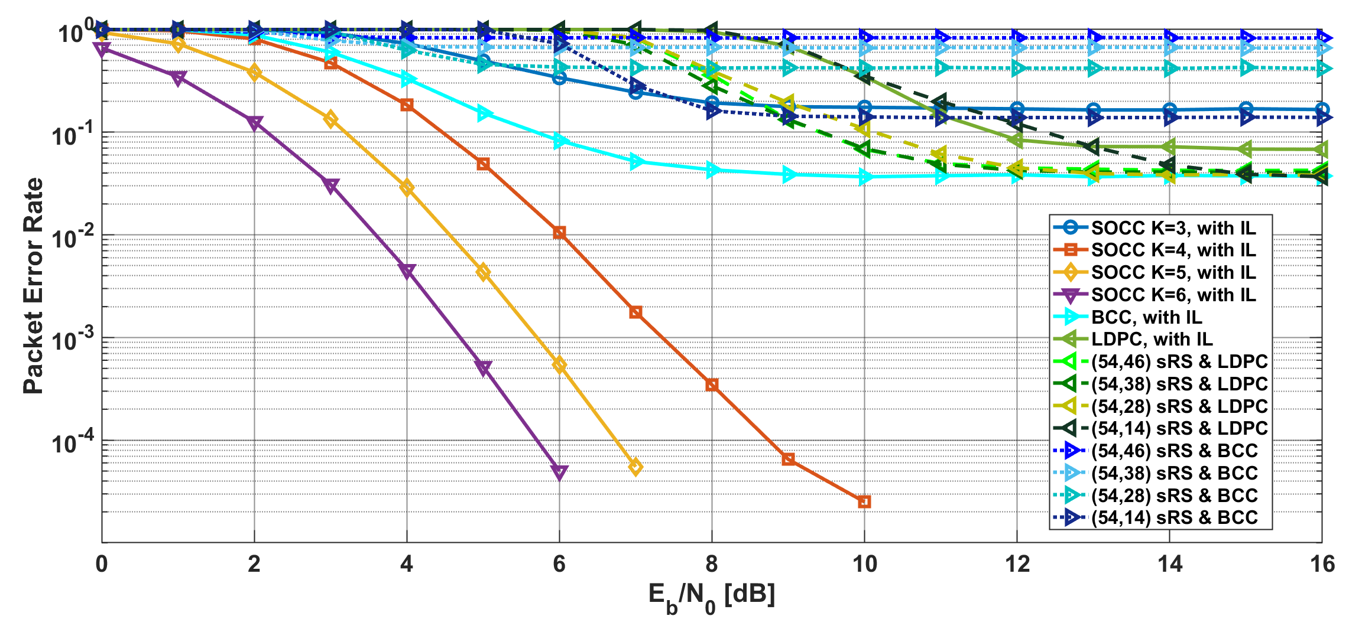
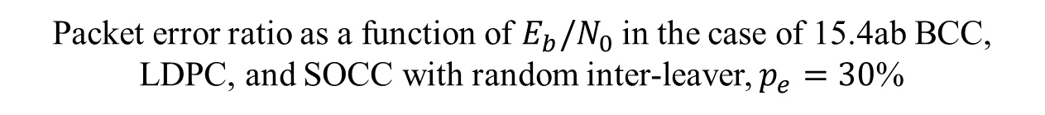
Results
Packet error ratio as a function of $E_{b}/N_{0}$ in the case of 15.4ab BCC, LDPC, and SOCC with random inter-leaver, $p_{e}=30$%
Notes:
SOCC with random inter-leaver had a much better performance than BCC and LDPC.
Low rate SOCC with random inter-leaver could also remove many bit erasures, but BCC and LDPC concatenated with RS could not do them.

Slide 12
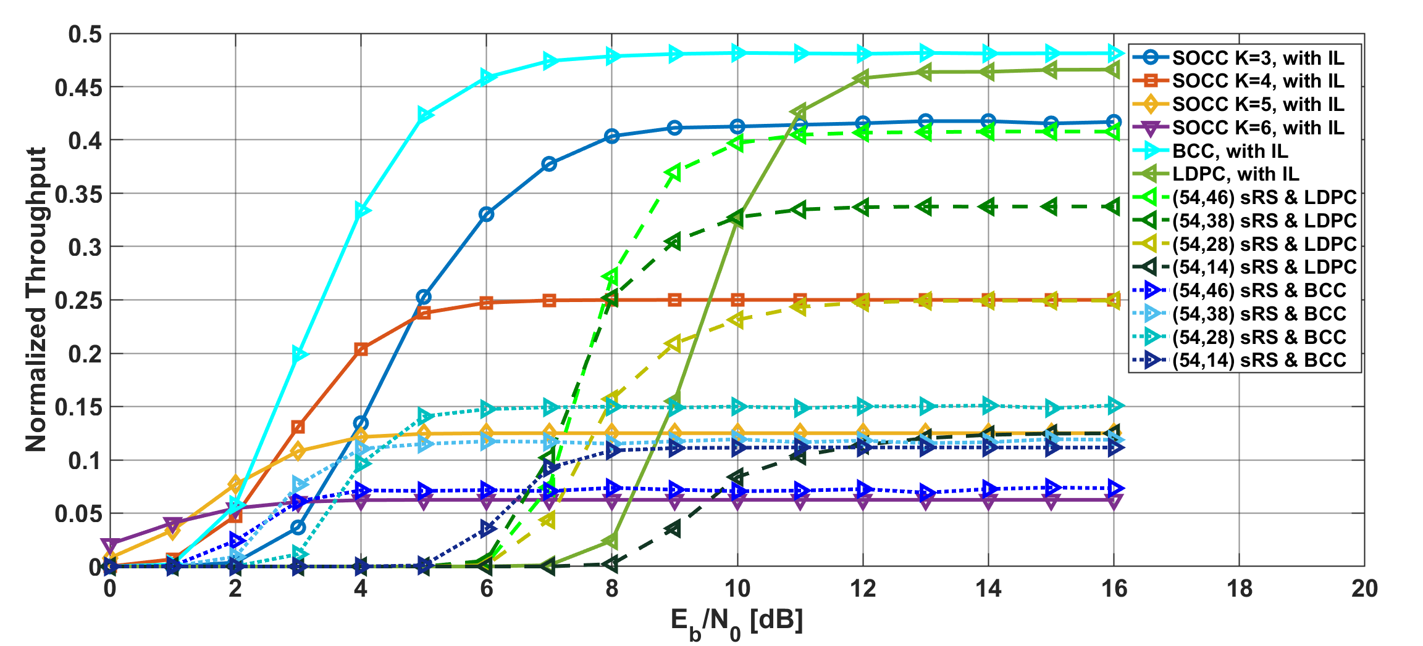

Results
Normalized throughput as a function of $E_{b}/N_{0}$ in the case of 15.4ab BCC, LDPC, and SOCC with random inter-leaver, $p_{e}=30$%
Notes:
Low rate SOCC with random inter-leaver could obtain the same throughput in $p_{e}=30$% as that in $p_{e}=10$%

Slide 13
Conclusion
Numerical results showed that SOCC and concatenated codes with RS and BCC achieved good performance in small bit erasures case
An error floor occurred in the case of concatenated codes with high coding rate RS and BCC and SOCC without inter-leaver in many bit erasures case
Low-rate SOCCs with inter-leaver had a better performance than other combinations
  SOCC can perform well in many situations by combining with inter-leaver.

Slide 14
Reference
Kento Takabayashi, Hirokazu Tanaka, Katsumi Sakakibara, "Evaluation of Wireless Body Area Network Utilizing Super Orthogonal Convolutional Code," in Proceedings of 2019 International Symposium on Intelligent Signal Processing and Communication Systems (ISPACS 2019), Beitou, Taipei, Taiwan, pp.1-2, Dec. 2019.
Kento Takabayashi, Hirokazu Tanaka, Katsumi Sakakibara, "Toward Dependable Internet of Medical Things: IEEE 802.15.6 Ultra-Wideband Physical Layer Utilizing Superorthogonal Convolutional Code," Sensors, 2022, vol. 22, no. 6, 2172, Mar. 2022.

Slide 15
Thank you for your attention ! ! !
* This research was funded by JSPS Grant-in-Aid for Early-Career Scientists Grant Number JP20K14737
15

Slide 16
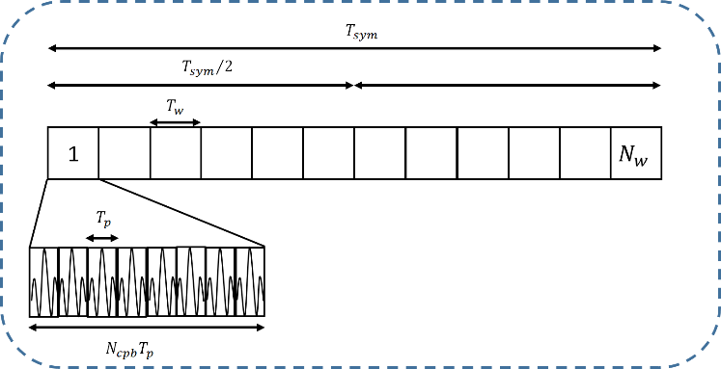
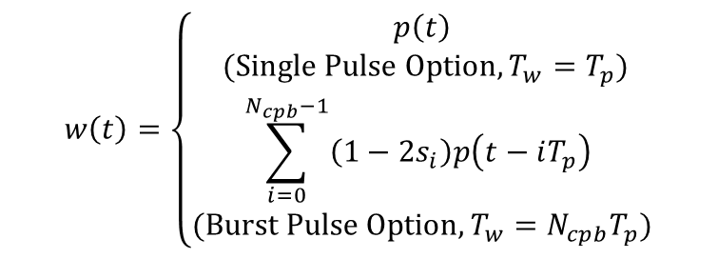
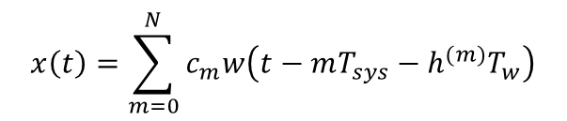
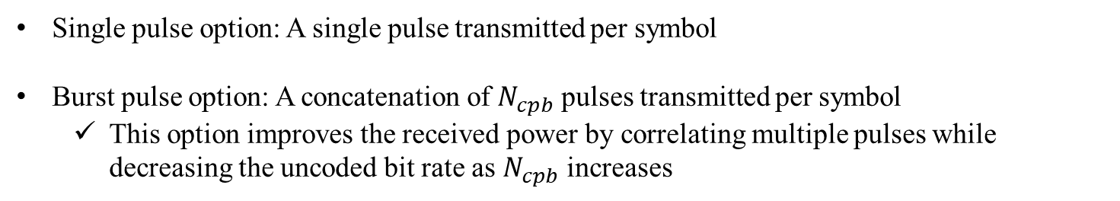
2. IEEE 802.15.6 UWB PHY
Pulse option
Transmitting signal
$$x\left(t\right)=\sum_{m=0}^{N}{c_{m}w\left(t−mT_{sys}−h^{(m)}T_{w}\right)}$$
$$w\left(t\right)=\left\{\begin{aligned}p\left(t\right) \\ (Single Pulse Option, T_{w}=T_{p}) \\ \sum_{i=0}^{N_{cpb}−1}{\left(1−2s_{i}\right)p\left(t−iT_{p}\right) } \\ (Burst Pulse Option, T_{w}=N_{cpb}T_{p})\end{aligned}\right.$$
Fig. Signal transmission example where the burst pulse option is used
Single pulse option: A single pulse transmitted per symbol
Burst pulse option: A concatenation of $N_{cpb}$ pulses transmitted per symbol
  This option improves the received power by correlating multiple pulses while decreasing the uncoded bit rate as $N_{cpb}$ increases

Slide 17

2. IEEE 802.15.6 UWB PHY
Frequency spectrum
Low Band
High Band
・・・
・・・
・・・
0
1
2
3
6
10
frequency $f$
bandwidth 499.2 MHz
3993.6 MHz
7987.2 MHz
The UWB band is divided into two band groups: low band (channel 0-2) and high band (channel 3-10) which are divided into operating frequency channels with 499.2 MHz bandwidth
Orange colors are mandatory channels (Low Band: channel 1，High Band: channel 6)
The power spectral density emission limit is -41.3 dBm/MHz which is very low

Slide 18
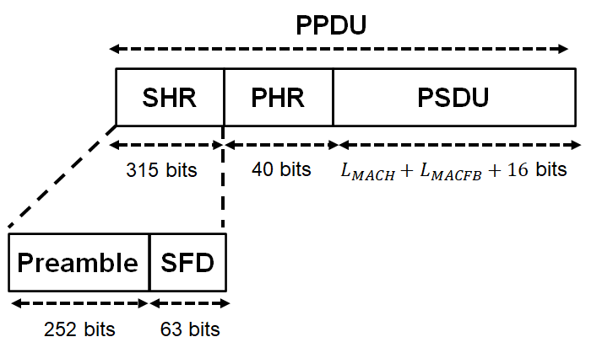
2. IEEE 802.15.6 UWB PHY
Frame format
SHR is divided into two parts: The first part is the preamble, intended for timing synchronization, packet detection, and carrier frequency offset recovery, and The second part is the start-of-frame delimiter (SFD) for frame synchronization
The PHR contains information about the data rate of the PSDU, length of the medium access control (MAC) frame body, pulse shape, burst mode, and so on
The PSDU contains the MAC protocol data unit (MPDU)

Slide 19
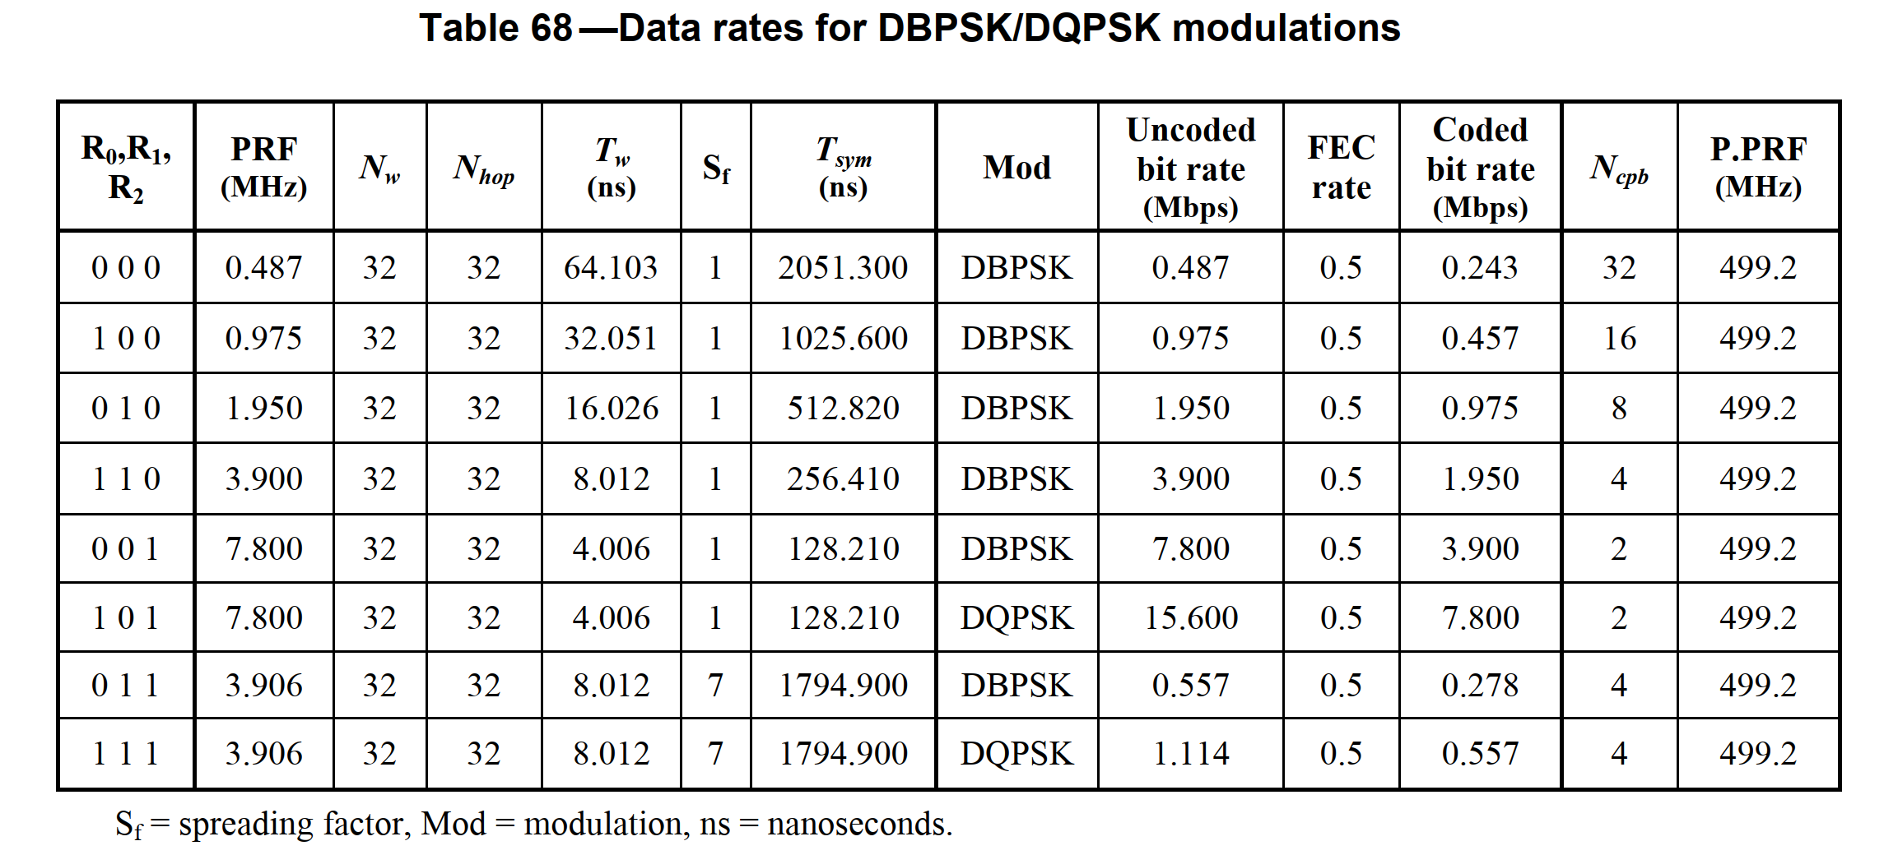
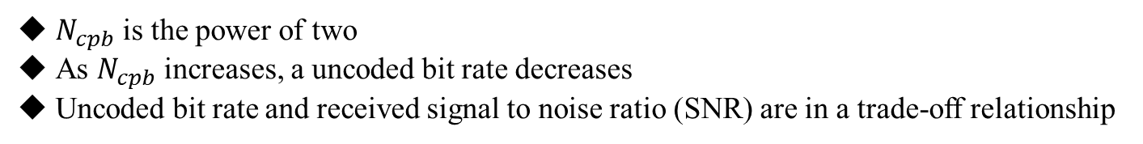
2. IEEE 802.15.6 UWB PHY
$N_{cpb}$ is the power of two
As $N_{cpb}$ increases, a uncoded bit rate decreases
Uncoded bit rate and received signal to noise ratio (SNR) are in a trade-off relationship

Slide 20
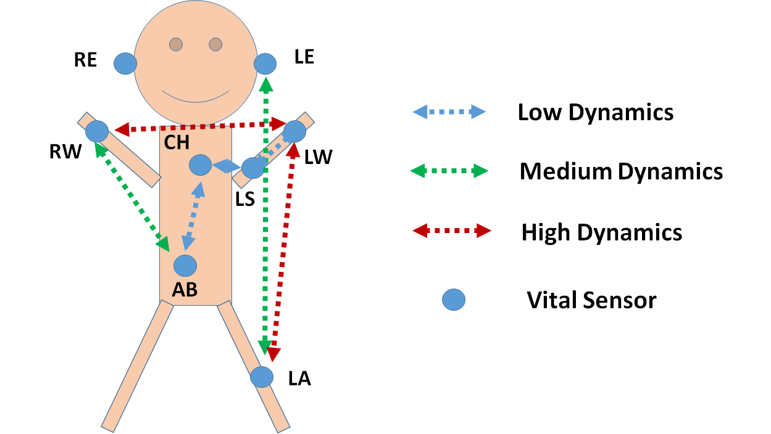
Cross-layer Evaluation
PSDU length and Time slot length is fixed
  The smaller coding rate is, the shorter information bits including PSDU is
The ratio of each link type is as follows: LD:MD:HD = 3:2:1
The ratio of the lengths of MAP and RAP is as follows: MAP:RAP = 4:1
The same number of time slots are assigned to each sensor in MAP
PHY packet errors at each link type refer to previous results

Slide 21
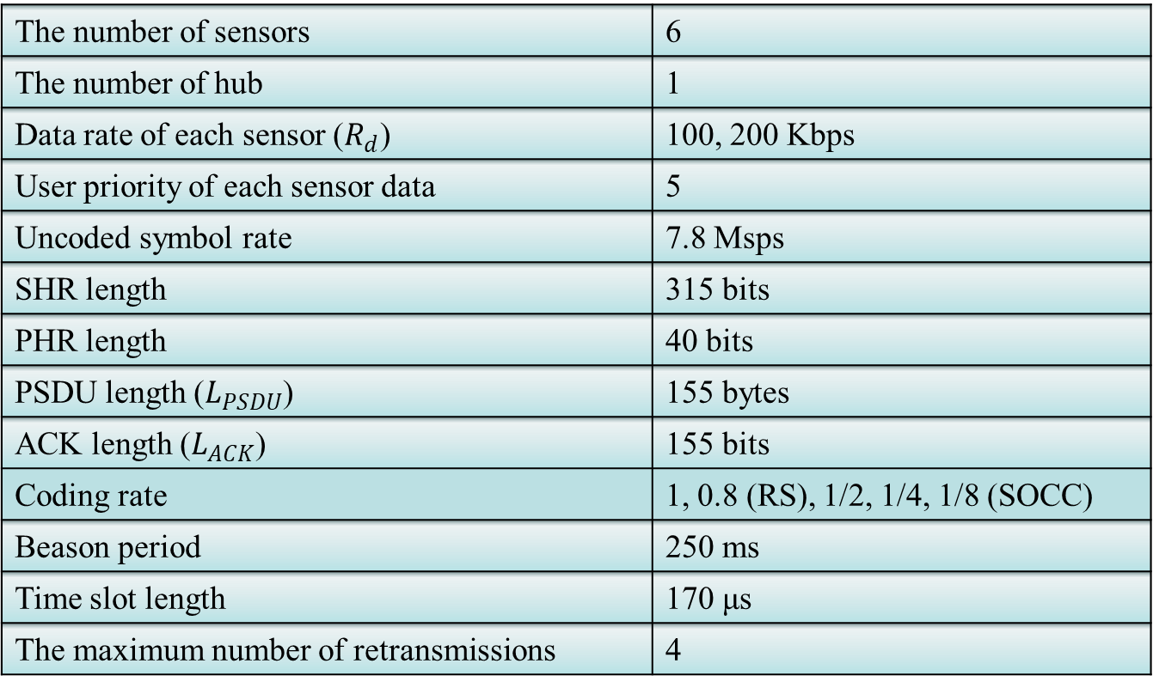
Cross-layer Evaluation
The number of sensors | 6
The number of hub | 1
Data rate of each sensor ($R_{d}$) | 100, 200 Kbps
User priority of each sensor data | 5
Uncoded symbol rate | 7.8 Msps
SHR length | 315 bits
PHR length | 40 bits
PSDU length ($L_{PSDU}$) | 155 bytes
ACK length ($L_{ACK}$) | 155 bits
Coding rate | 1, 0.8 (RS), 1/2, 1/4, 1/8 (SOCC)
Beason period | 250 ms
Time slot length | 170 μs
The maximum number of retransmissions | 4

Slide 22
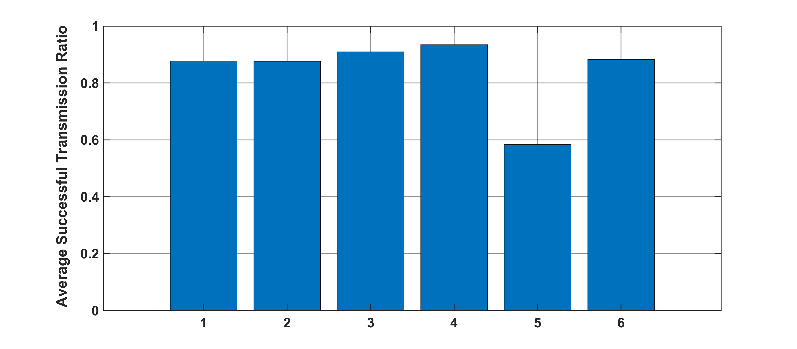
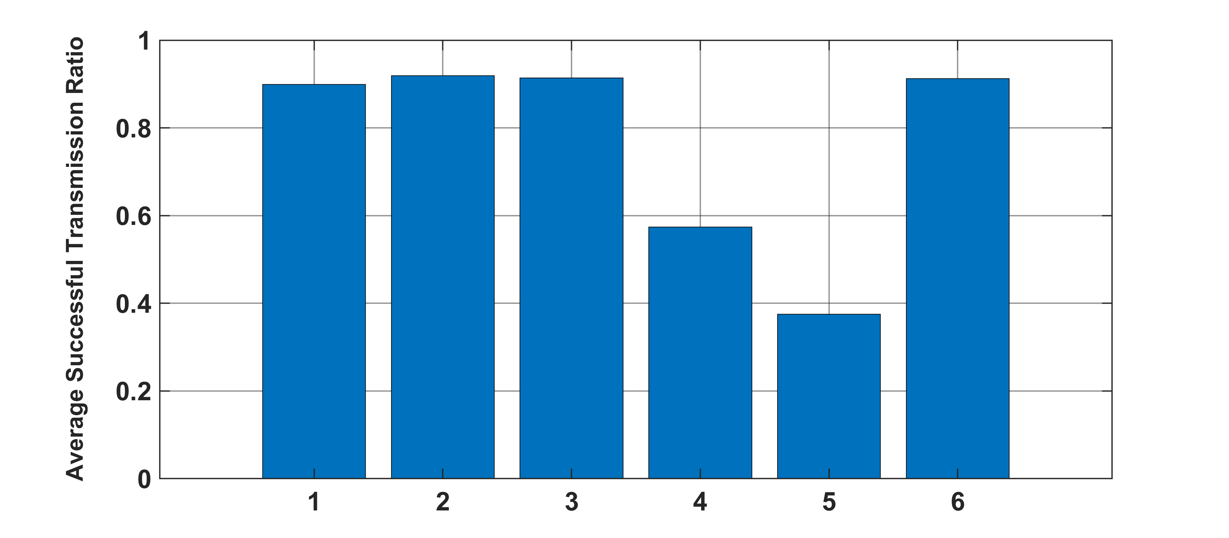
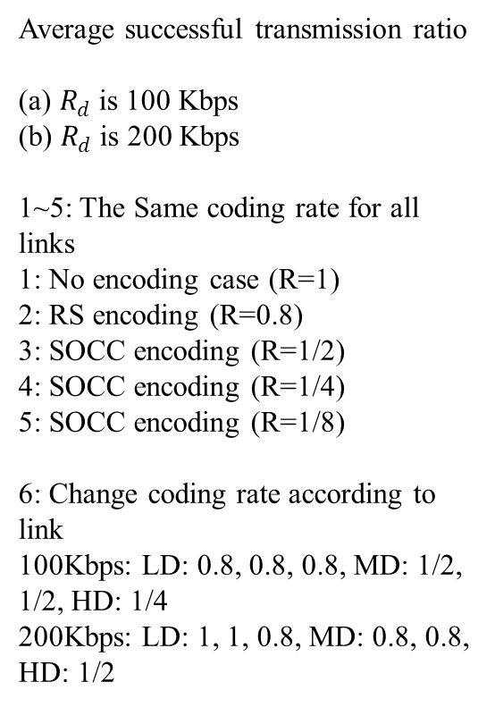
Cross-layer Evaluation
Average successful transmission ratio
(a) $R_{d}$is 100 Kbps
(b) $R_{d}$is 200 Kbps
1~5: The Same coding rate for all links
1: No encoding case (R=1)
2: RS encoding (R=0.8)
3: SOCC encoding (R=1/2)
4: SOCC encoding (R=1/4)
5: SOCC encoding (R=1/8)
6: Change coding rate according to link
100Kbps: LD: 0.8, 0.8, 0.8, MD: 1/2, 1/2, HD: 1/4
200Kbps: LD: 1, 1, 0.8, MD: 0.8, 0.8, HD: 1/2
(a)
(b)

Slide 23
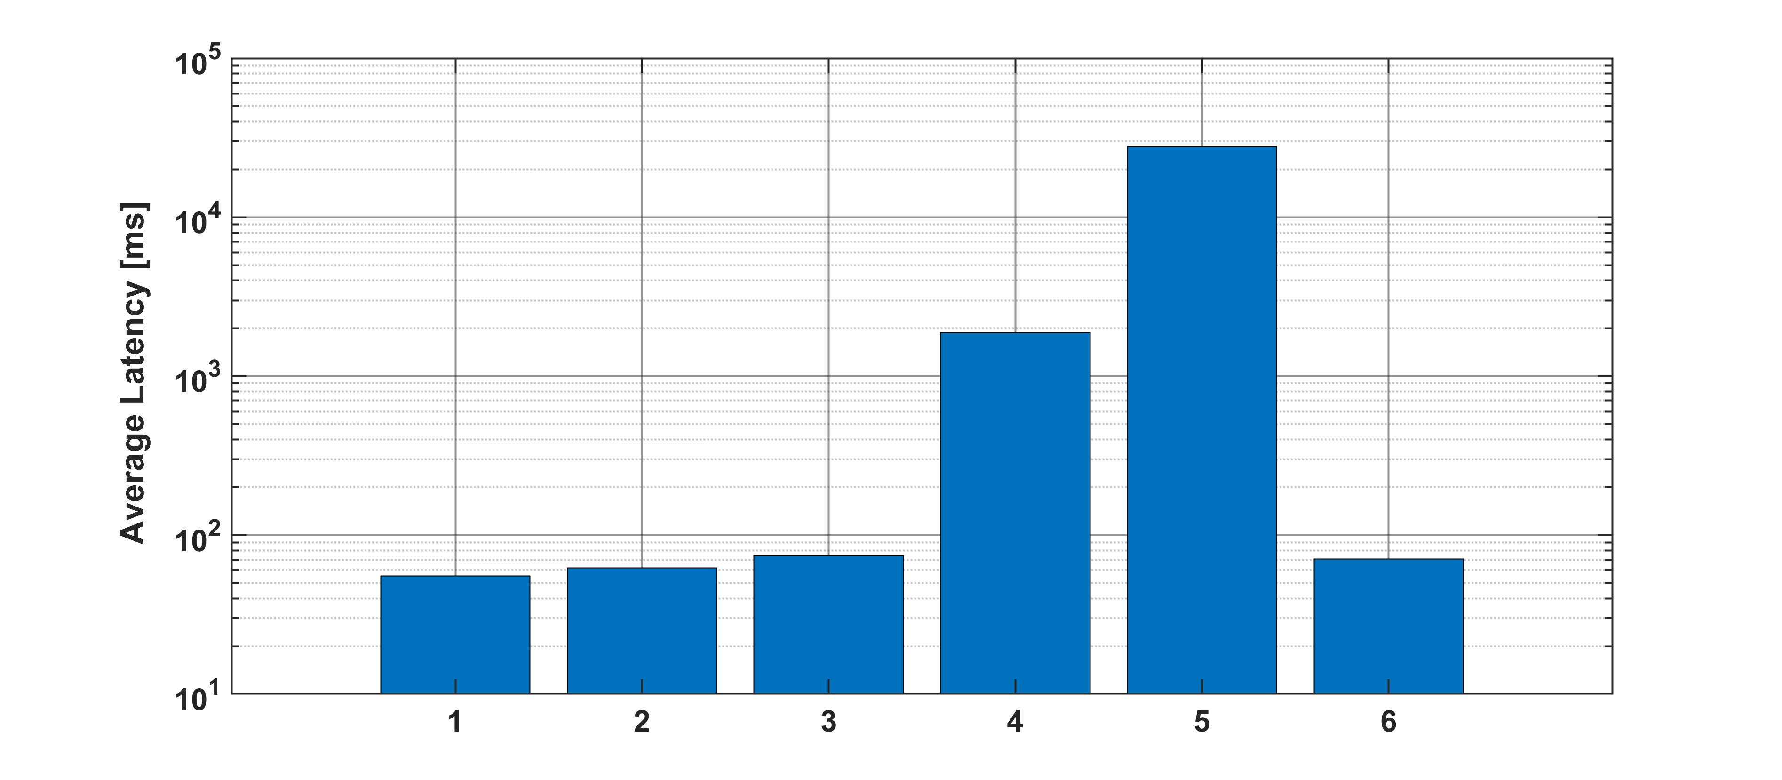
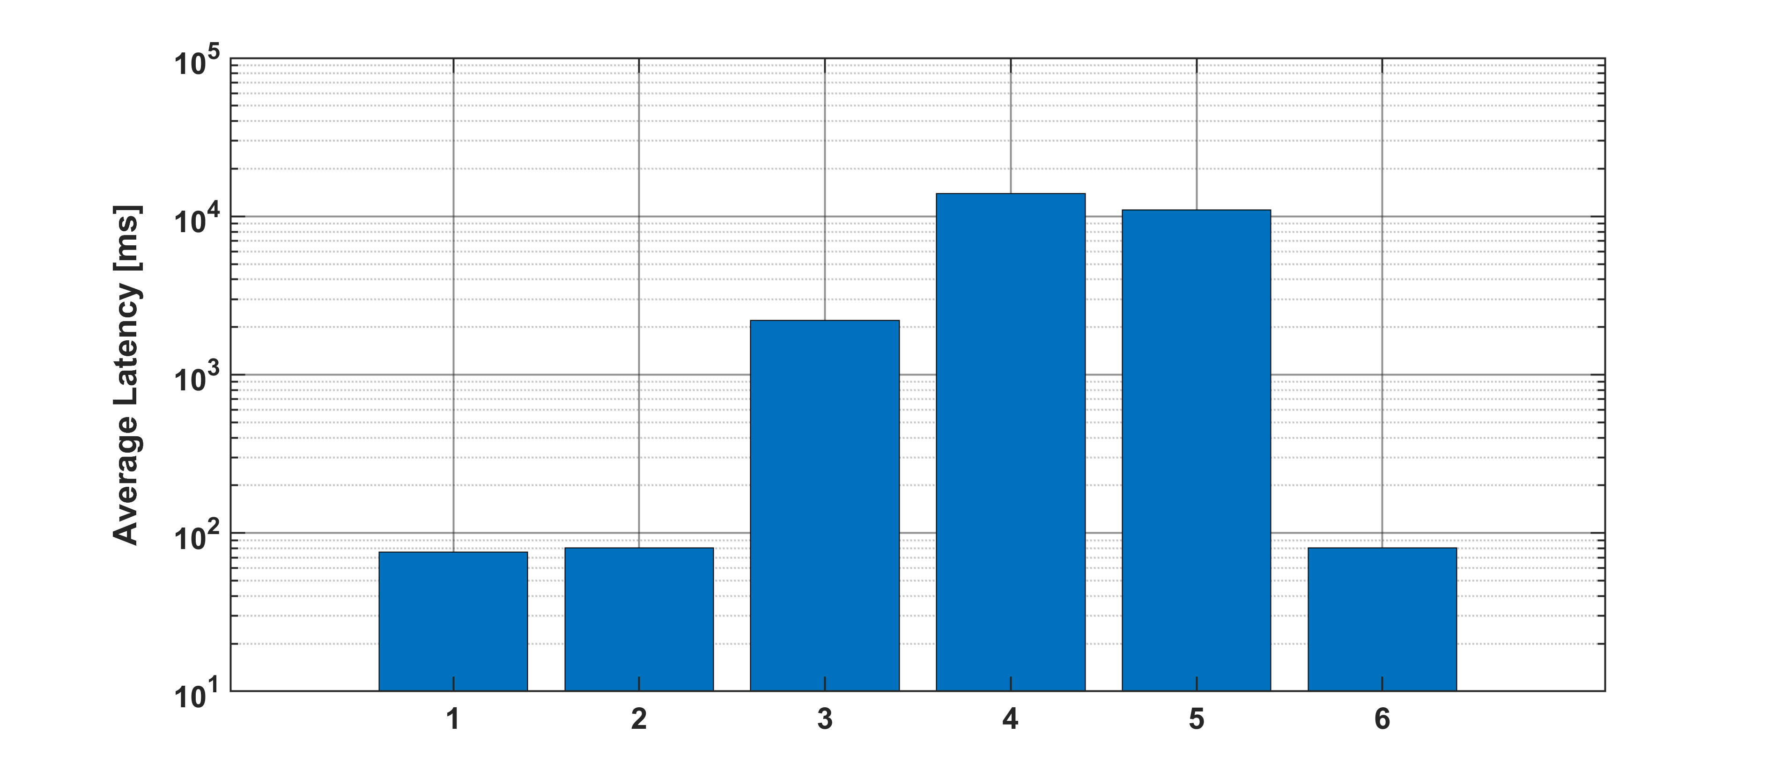
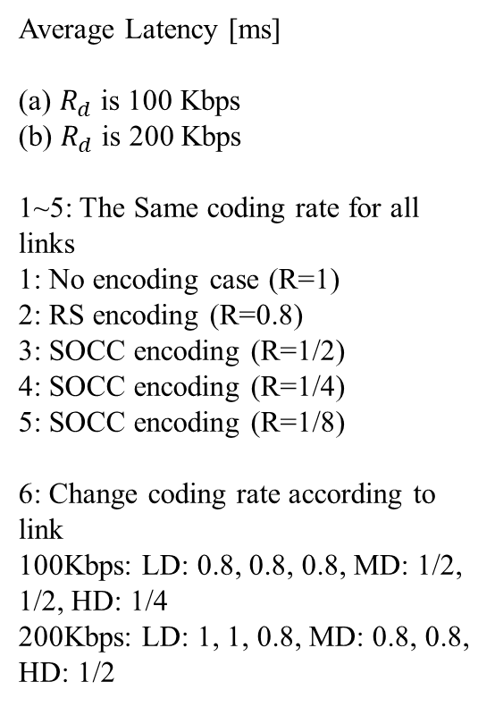
Cross-layer Evaluation
Average Latency [ms]
(a) $R_{d}$is 100 Kbps
(b) $R_{d}$is 200 Kbps
1~5: The Same coding rate for all links
1: No encoding case (R=1)
2: RS encoding (R=0.8)
3: SOCC encoding (R=1/2)
4: SOCC encoding (R=1/4)
5: SOCC encoding (R=1/8)
6: Change coding rate according to link
100Kbps: LD: 0.8, 0.8, 0.8, MD: 1/2, 1/2, HD: 1/4
200Kbps: LD: 1, 1, 0.8, MD: 0.8, 0.8, HD: 1/2
(a)
(b)

Slide 24


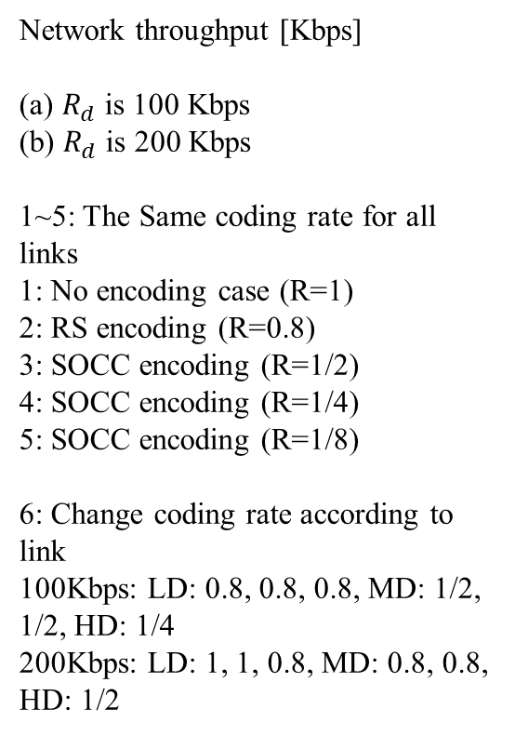
Cross-layer Evaluation
Network throughput [Kbps]
(a) $R_{d}$is 100 Kbps
(b) $R_{d}$is 200 Kbps
1~5: The Same coding rate for all links
1: No encoding case (R=1)
2: RS encoding (R=0.8)
3: SOCC encoding (R=1/2)
4: SOCC encoding (R=1/4)
5: SOCC encoding (R=1/8)
6: Change coding rate according to link
100Kbps: LD: 0.8, 0.8, 0.8, MD: 1/2, 1/2, HD: 1/4
200Kbps: LD: 1, 1, 0.8, MD: 0.8, 0.8, HD: 1/2
(a)
(b)

Slide 25
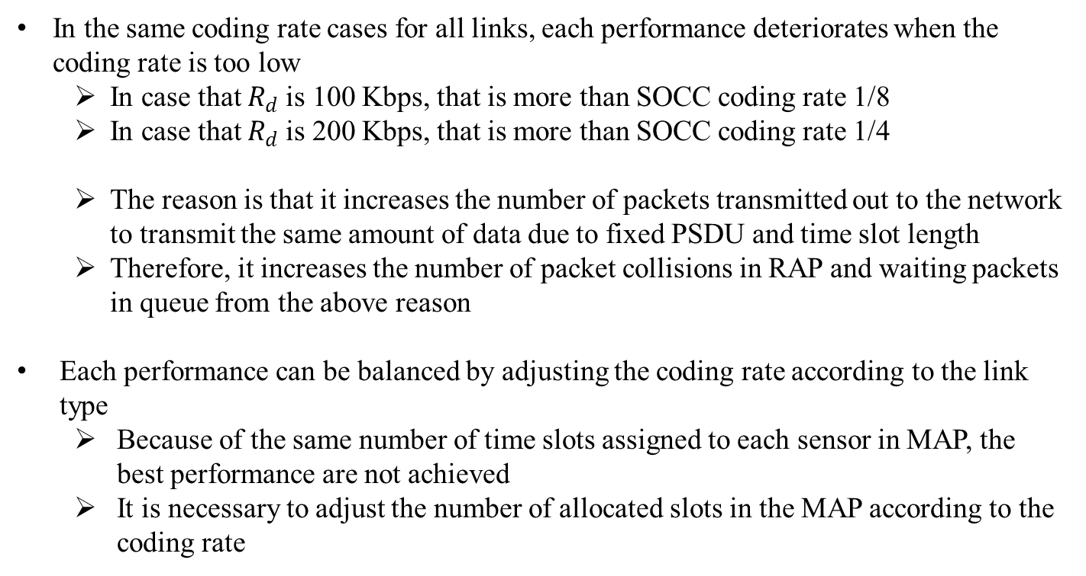
Cross-layer Evaluation - Discussion
In the same coding rate cases for all links, each performance deteriorates when the coding rate is too low
  In case that $R_{d}$is 100 Kbps, that is more than SOCC coding rate 1/8
  In case that $R_{d}$is 200 Kbps, that is more than SOCC coding rate 1/4
  The reason is that it increases the number of packets transmitted out to the network to transmit the same amount of data due to fixed PSDU and time slot length
  Therefore, it increases the number of packet collisions in RAP and waiting packets in queue from the above reason
Each performance can be balanced by adjusting the coding rate according to the link type
  Because of the same number of time slots assigned to each sensor in MAP, the best performance are not achieved
  It is necessary to adjust the number of allocated slots in the MAP according to the coding rate

Slide 26
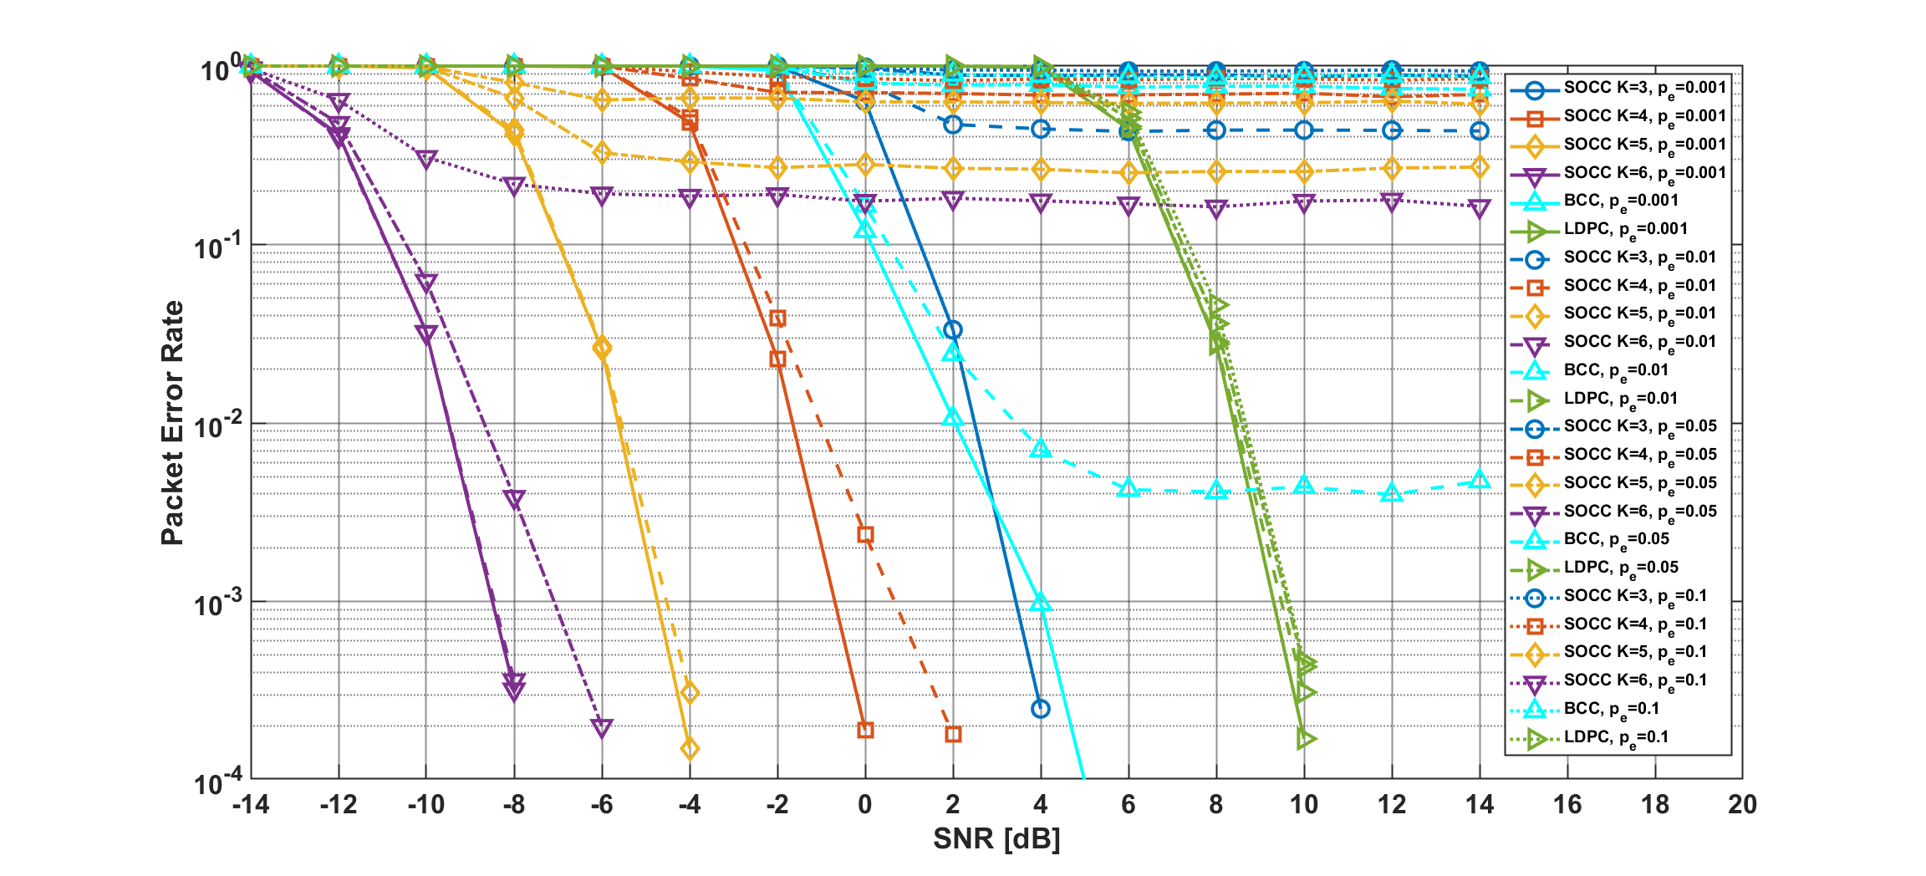
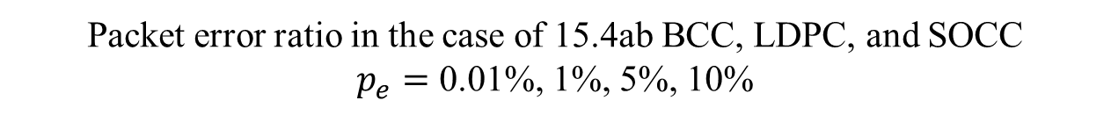
Results
Packet error ratio in the case of 15.4ab BCC, LDPC, and SOCC
$p_{e}=$ 0.01%, 1%, 5%, 10%

Slide 27
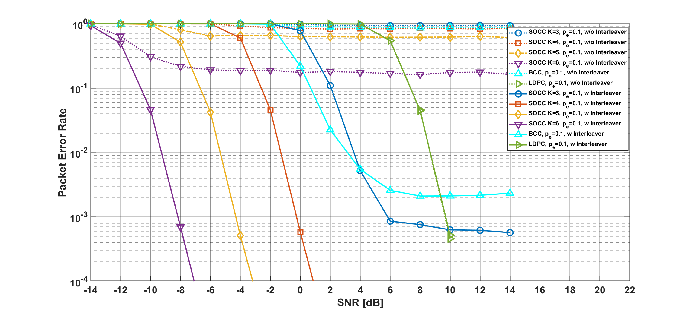
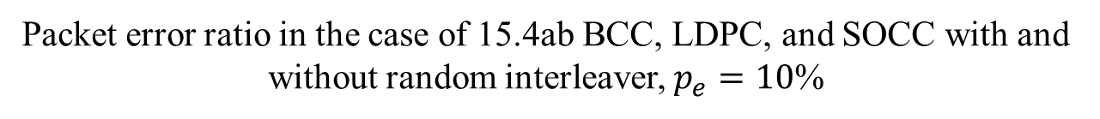
Results
Packet error ratio in the case of 15.4ab BCC, LDPC, and SOCC with and without random interleaver, $p_{e}=10$%

