Slide 1
Project: IEEE P802.15 Working Group for Wireless Personal Area Networks (WPANs)
Submission Title: [Evaluation of IEEE 802.15.6ma Ultra-wideband Physical Layer Utilizing Super Orthogonal Convolutional Code]
Date Submitted: [17 January 2023]
Source: [Kento Takabayashi¹, Ryuji Kohno^{2,3} ] [1;Okayama Prefectural University, 2;Yokohama National University, 3;YRP International Alliance Institute(YRP-IAI)]
Address [1: 111-1 Kuboki, Soja-shi, Okayama, Japan 719-1197,
2; 79-5 Tokiwadai, Hodogaya-ku, Yokohama, Japan 240-8501,
3; YRP1 Blg., 3-4 HikarinoOka, Yokosuka-City, Kanagawa, 239-0847 Japan]
Voice:[1; +81-866-94-2104, 2: +81-90-5408-0611],
Email:[1: takabayashi.kento.xp@gmail.com, 2:kohno@ynu.ac.jp]
Re: []
Abstract: [The performance of an IEEE 802.15.6ma ultra-wideband physical layer utilizing super orthogonal convolutional codes is evaluated. These slides may offer opportunity to discuss on revision for a dependable physical layer technology of a new standard IEEE802.15.6ma.] Purpose: [The discussion will lead definition and requirement of current ongoing research and development on dependable wireless networks.]
Notice: This document has been prepared to assist the IEEE P802.15. It is offered as a basis for discussion and is not binding on the contributing individual(s) or organization(s). The material in this document is subject to change in form and content after further study. The contributor(s) reserve(s) the right to add, amend or withdraw material contained herein. Release: The contributor acknowledges and accepts that this contribution becomes the property of IEEE and may be made publicly available by P802.15.
Notes:
doc.: IEEE 802.15-09-0117-00-0007
<month year>

Slide 2
Evaluation of IEEE 802.15.6ma Ultra-wideband Physical Layer Utilizing Super Orthogonal Convolutional Code
January 2023,
Hybrid Session ,
Baltimore, Maryland
Kento Takabayashi¹, Ryuji Kohno^{2,3}
1. Okayama Prefectural University, Japan
2. Yokohama National University, Japan
3. YRP International Alliance Institute, Japan

Slide 3
Agenda
Introduction
IEEE 802.15.6 UWB PHY
Super Orthogonal Convolutional Code
Evaluation
Conclusion

Slide 4
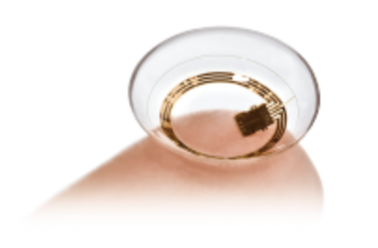

1. Introduction - IoMT
Internet of Medical Things (IoMT):
  IoT in the medical and healthcare field
Scope of IoMT
  Healthcare・Mibyo (未病)
  Home Health Care
  Diagnosis
  Treatment
  Prognostic treatment・Rehabilitation
IoMT requires…
  Reliability and safety of conventional medical devices
  Mass device management, reliable communication, heterogeneity and interoperability of devices more than conventional IoT
Fig. Triggerfish sensor (© SEED Co.,Ltd.)
Fig. Fetal Monitor iCTG (Managed medical device (class II), © Melody International Ltd. )
Notes:
.

Slide 5
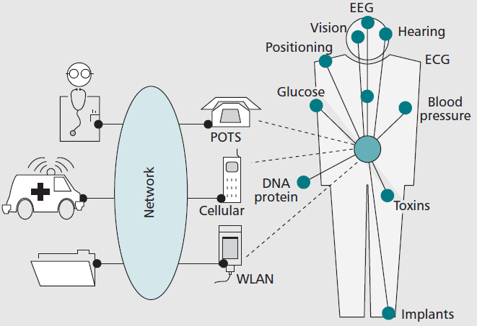
1. Introduction - WBAN
Wearable health system is actively studied (m-Health, IoMT, etc.)
Wireless Body Area Networks （WBAN） have been extensively researched
IEEE 802.15.6, one of the standards of WBAN, was issued
The system specifications of "Smart Body Area Networks (SmartBAN)" by the European Telecommunications Standards Institute (ETSI) were issued
Fig. Example of wireless healthcare system (WBAN)

Slide 6
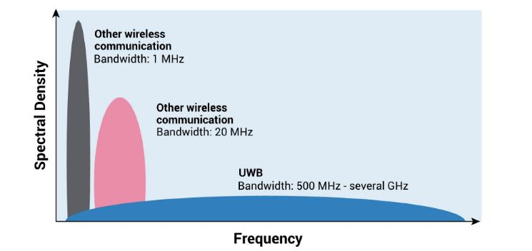
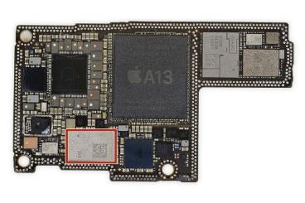
1. Introduction - UWB
IEEE 802.15.6 defines three physical layers
  Narrowband
  Ultra-wideband (UWB)
  Human body communication (HBC)
UWB technology has recently regained attention (introduction to iPhone and AirTag, support for Android 12)
UWB offers…
  high data rate transmission
  Ultra-high-precision positioning
  low energy consumption
  powerful multi-pass resolution
  good coexistence with other wireless communication systems
UWB is a technology that may satisfy the requirements of IoMT
Fig. UWB Frequency Spectol
Fig. U1 in iPhone 11
Notes:
I focus on UWB PHY because…

Slide 7
1. Motivation and Aim of study
UWB is a promising technology that may satisfy the requirements of IoMT
IEEE 802.15.6 UWB PHY has limited transmission output and requires to ensure dependability
New consideration is given to the application of Super Orthogonal Convolutional Codes (SOCC) as a technique for improving dependability
We perform evaluation when SOCC is applied at the IEEE 802.15.6 UWB PHY, and confirm the effectiveness of these combinations
Notes:
SOCCs have attracted attention as error correction codes for code division multiple access (CDMA) using the spread spectrum
Therefore, SOCCs are considered to be compatible with the UWB, as they use a very wide bandwidth

Slide 8
2. IEEE 802.15.6 UWB PHY
Modulation
In the IR-UWB PHY, the bits of the physical layer protocol data unit (PPDU) are modulated by either on–off modulation or differentially encoded binary phase shift keying (DBPSK)/quadrature phase shift keying (DQPSK)
This research assumes DBPSK
Error detection and correction codes
PHR: CRC-4 ITU is applied as the error detection code, and (40, 28) shortened BCH code is applied as the error correction code
PSDU: CRC-16-CCITT is applied as the error detection code, and (63, 51) BCH code or (126, 63) shortened BCH code is applied as the error correction code
In this study, (63, 51) BCH code is applied as the error correction code of PSDU ((126, 63) shortened BCH code is used in combination with Type II Hybrid ARQ)

Slide 9
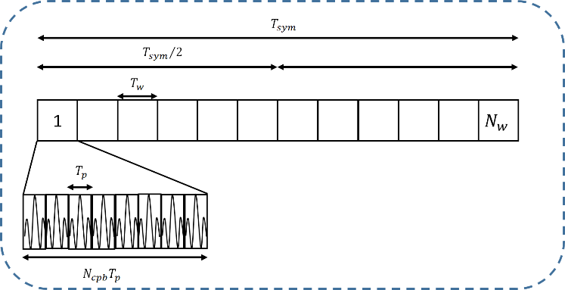
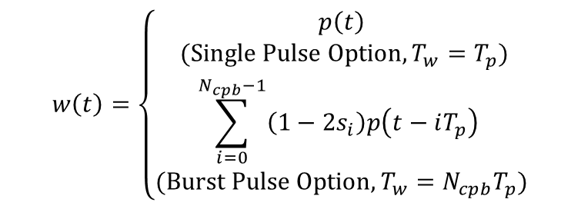
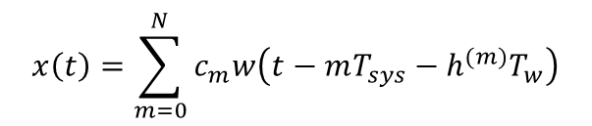
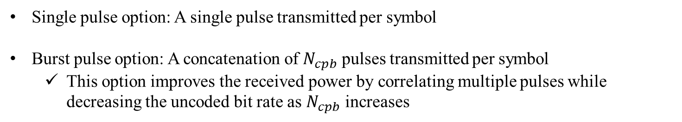
2. IEEE 802.15.6 UWB PHY
Pulse option
Transmitting signal
$$x\left(t\right)=\sum_{m=0}^{N}{c_{m}w\left(t−mT_{sys}−h^{(m)}T_{w}\right)}$$
$$w\left(t\right)=\left\{\begin{aligned}p\left(t\right) \\ (Single Pulse Option, T_{w}=T_{p}) \\ \sum_{i=0}^{N_{cpb}−1}{\left(1−2s_{i}\right)p\left(t−iT_{p}\right) } \\ (Burst Pulse Option, T_{w}=N_{cpb}T_{p})\end{aligned}\right.$$
Fig. Signal transmission example where the burst pulse option is used
Single pulse option: A single pulse transmitted per symbol
Burst pulse option: A concatenation of $N_{cpb}$ pulses transmitted per symbol
  This option improves the received power by correlating multiple pulses while decreasing the uncoded bit rate as $N_{cpb}$ increases

Slide 10
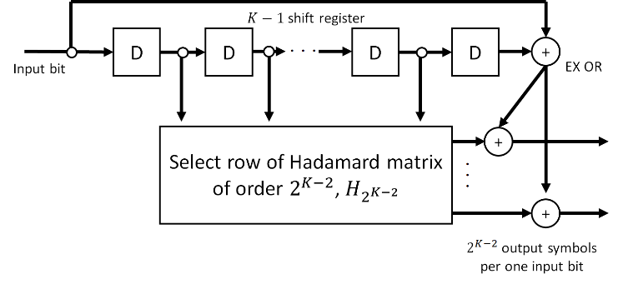
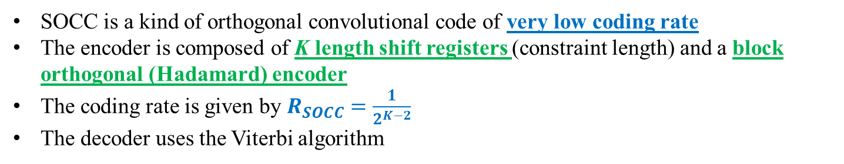
3. SOCC
Fig. SOCC encoder
SOCC is a kind of orthogonal convolutional code of very low coding rate
The encoder is composed of K length shift registers (constraint length) and a block orthogonal (Hadamard) encoder
The coding rate is given by $R_{SOCC}=\frac{1}{2^{K−2}}$
The decoder uses the Viterbi algorithm
Notes:
The inner (K- 2) bit memories are mapped into one Walsh sequence of length $2^{K−2}$ (two to the power of K-2)
The two outer bits are added to each binary number of the selected Walsh sequence by exclusive OR
One divided by two to the power of K-2

Slide 11
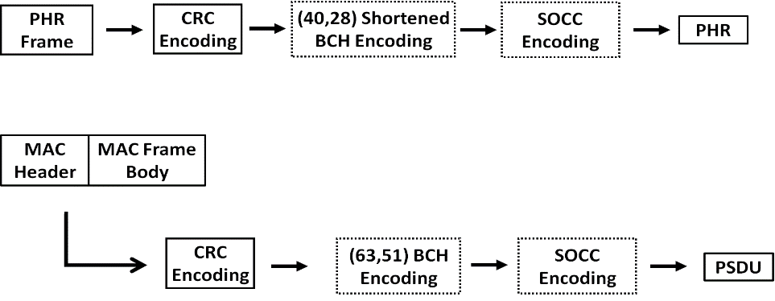
3. Application of SOCCs to IEEE 802.15.6 UWB PHY
Procedure for applying an SOCC
Fig. Block diagrams showing the procedure for applying an SOCC to the IEEE 802.15.6 UWB PHY
For the PHR, after the CRC encoding of the PHR frame, whether to apply the shortened BCH code is determined, and then, whether to apply an SOCC is determined
Similarly, for the PSDU, after the CRC encoding of the MAC header and MAC frame body, whether to apply the BCH code is determined, and then, whether to apply an SOCC is determined
Concatenated encoding using the BCH code as the outer code and an SOCC as the inner code is performed when both the BCH code and SOCC are applied

Slide 12
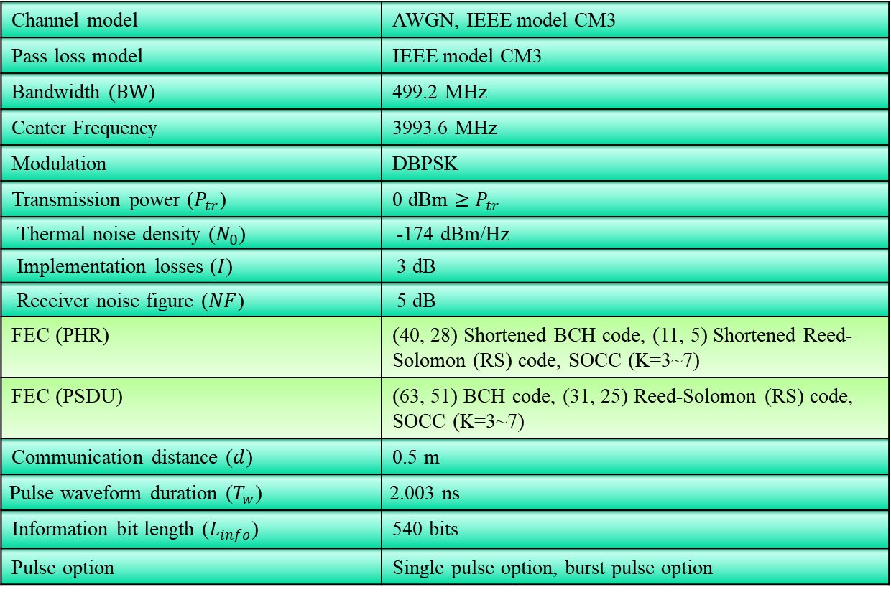
4. Evaluation
4. Evaluation
Table. Simulation Parameters
Channel model | AWGN, IEEE model CM3
Pass loss model | IEEE model CM3
Bandwidth ($BW$) | 499.2 MHz
Center Frequency | 3993.6 MHz
Modulation | DBPSK
Transmission power ($P_{tr}$) | 0 dBm $≥$ $P_{tr}$
Thermal noise density ($N_{0}$) | -174 dBm/Hz
Implementation losses ($I$) | 3 dB
Receiver noise figure ($NF$) | 5 dB
FEC (PHR) | (40, 28) Shortened BCH code, (11, 5) Shortened Reed-Solomon (RS) code, SOCC (K=3~7)
FEC (PSDU) | (63, 51) BCH code, (31, 25) Reed-Solomon (RS) code, SOCC (K=3~7)
Communication distance ($d$) | 0.5 m
Pulse waveform duration ($T_{w}$) | 2.003 ns
Information bit length ($L_{info}$) | 540 bits
Pulse option | Single pulse option, burst pulse option
Notes:
For comparison, the computer simulation also evaluates the case where the (11, 5) shortened Reed–Solomon (RS) code and the (31, 25) RS code are applied to the PHR and PSDU, respectively, as error correction codes with coding rates almost equal to those of the BCH codes used in IEEE 802.15.6

Slide 13
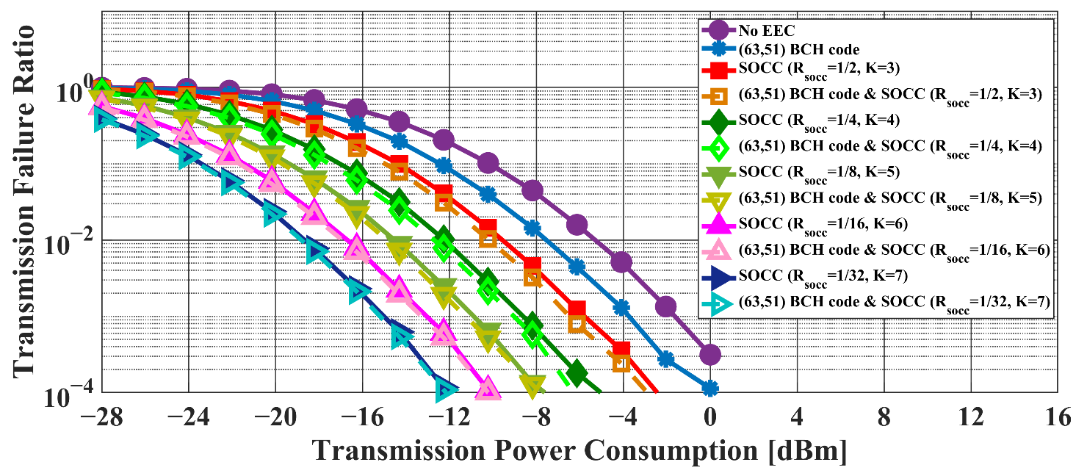
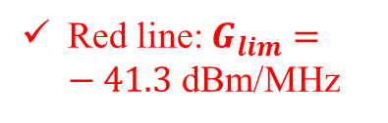
4. Evaluation – Single Pulse Option
Red line: $G_{lim}=−41.3$ dBm/MHz
Fig. Transmission failure ratio as a function of the transmission power (Single pulse option, IEEE model CM3，BCH encoding)

Slide 14
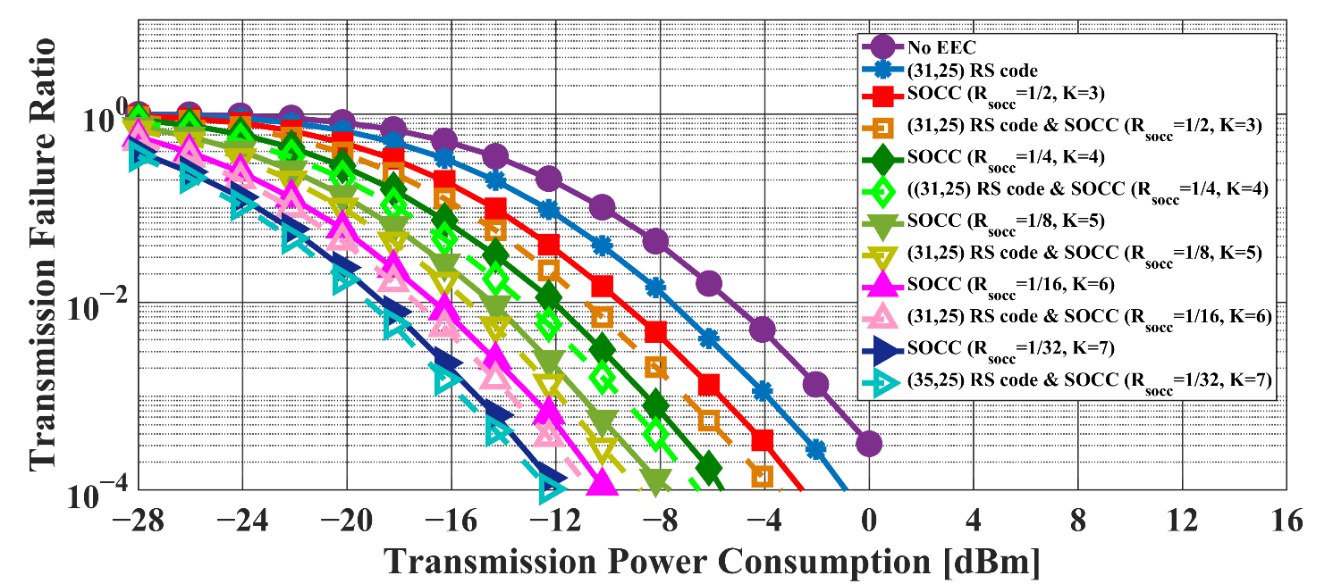
4. Evaluation – Single Pulse Option
Red line: $G_{lim}=−41.3$ dBm/MHz
Fig. Transmission failure ratio as a function of the transmission power (Single pulse option, IEEE model CM3，RS encoding)

Slide 15
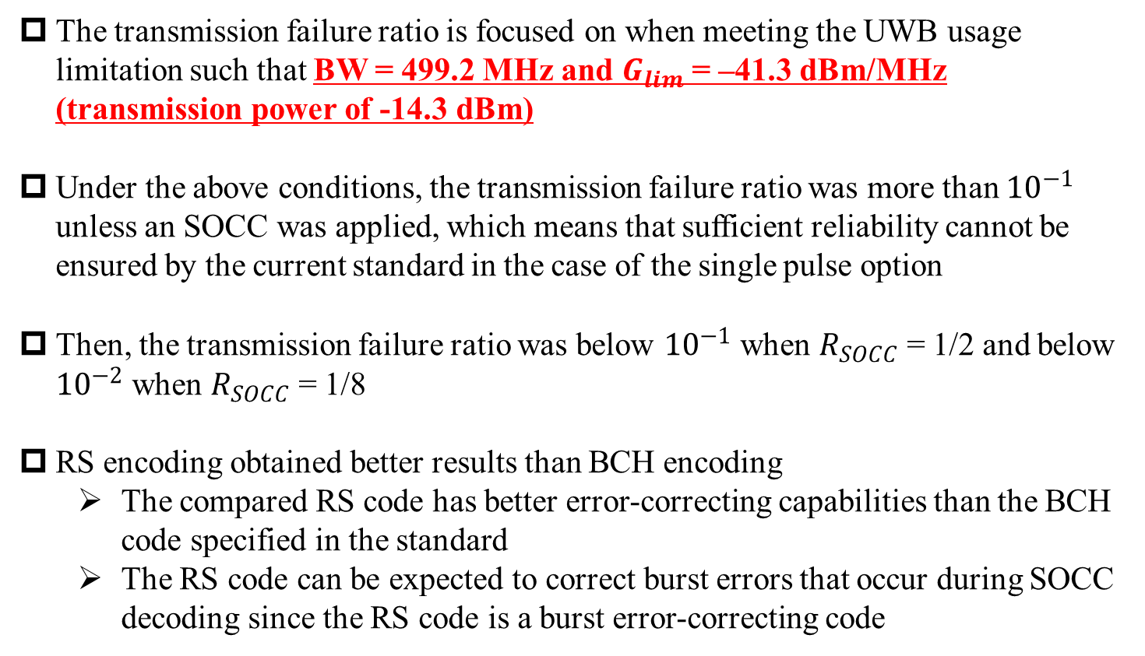
4. Discussion – Single Pulse Option
The transmission failure ratio is focused on when meeting the UWB usage limitation such that BW = 499.2 MHz and $G_{lim}$ = –41.3 dBm/MHz (transmission power of -14.3 dBm)
Under the above conditions, the transmission failure ratio was more than ${10}^{−1}$ unless an SOCC was applied, which means that sufficient reliability cannot be ensured by the current standard in the case of the single pulse option
Then, the transmission failure ratio was below ${10}^{−1}$ when $R_{SOCC}$ = 1/2 and below ${10}^{−2}$ when $R_{SOCC}$ = 1/8
RS encoding obtained better results than BCH encoding
  The compared RS code has better error-correcting capabilities than the BCH code specified in the standard
  The RS code can be expected to correct burst errors that occur during SOCC decoding since the RS code is a burst error-correcting code

Slide 16
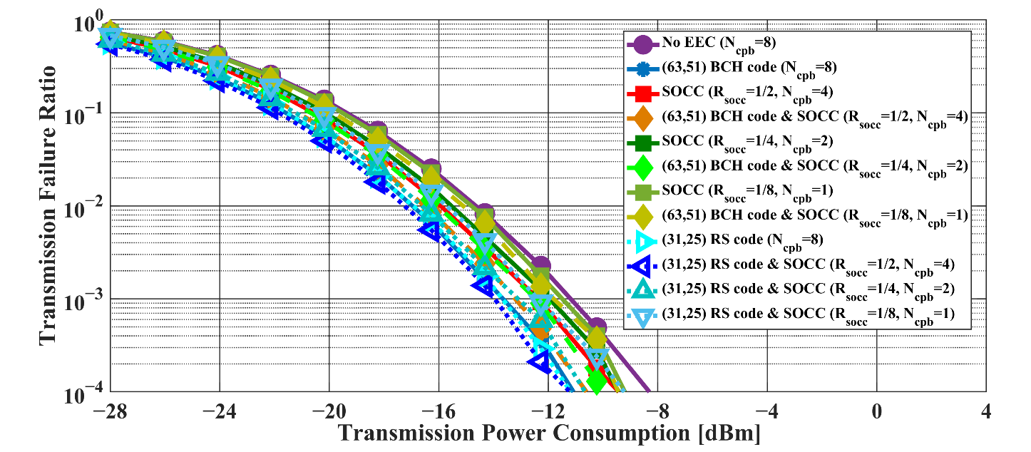
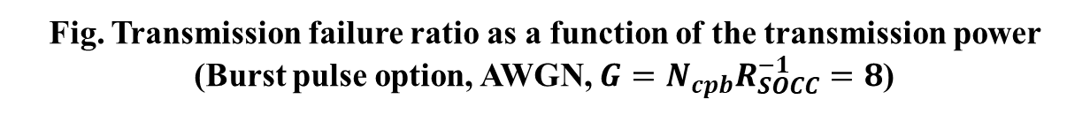
4. Evaluation – Burst Pulse Option
Red line: $G_{lim}=−41.3$ dBm/MHz
Fig. Transmission failure ratio as a function of the transmission power (Burst pulse option, AWGN, $G=N_{cpb}R_{SOCC}^{−1}=8$)

Slide 17
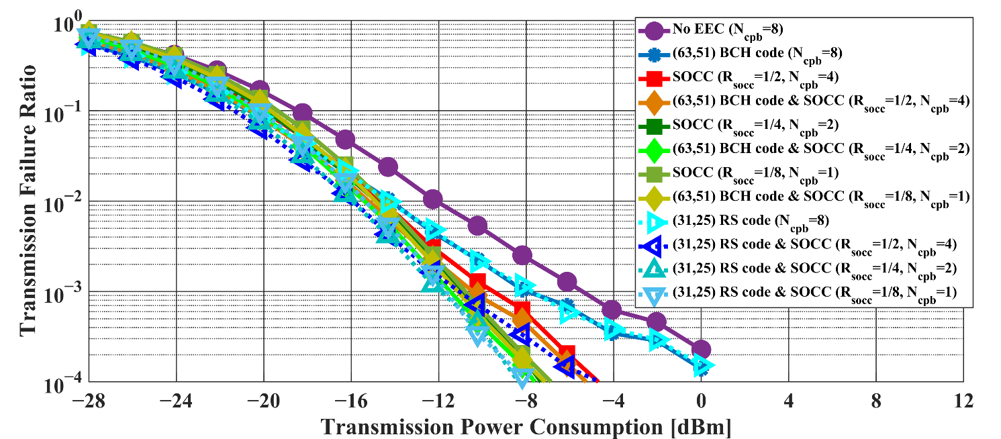
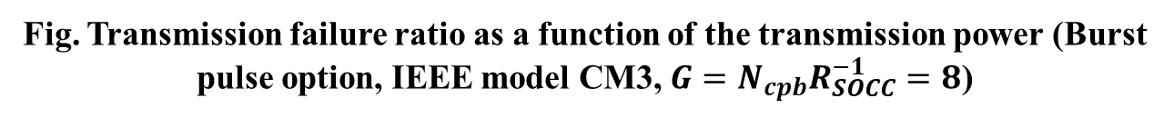
4. Evaluation – Burst Pulse Option
Red line: $G_{lim}=−41.3$ dBm/MHz
Fig. Transmission failure ratio as a function of the transmission power (Burst pulse option, IEEE model CM3, $G=N_{cpb}R_{SOCC}^{−1}=8$)

Slide 18
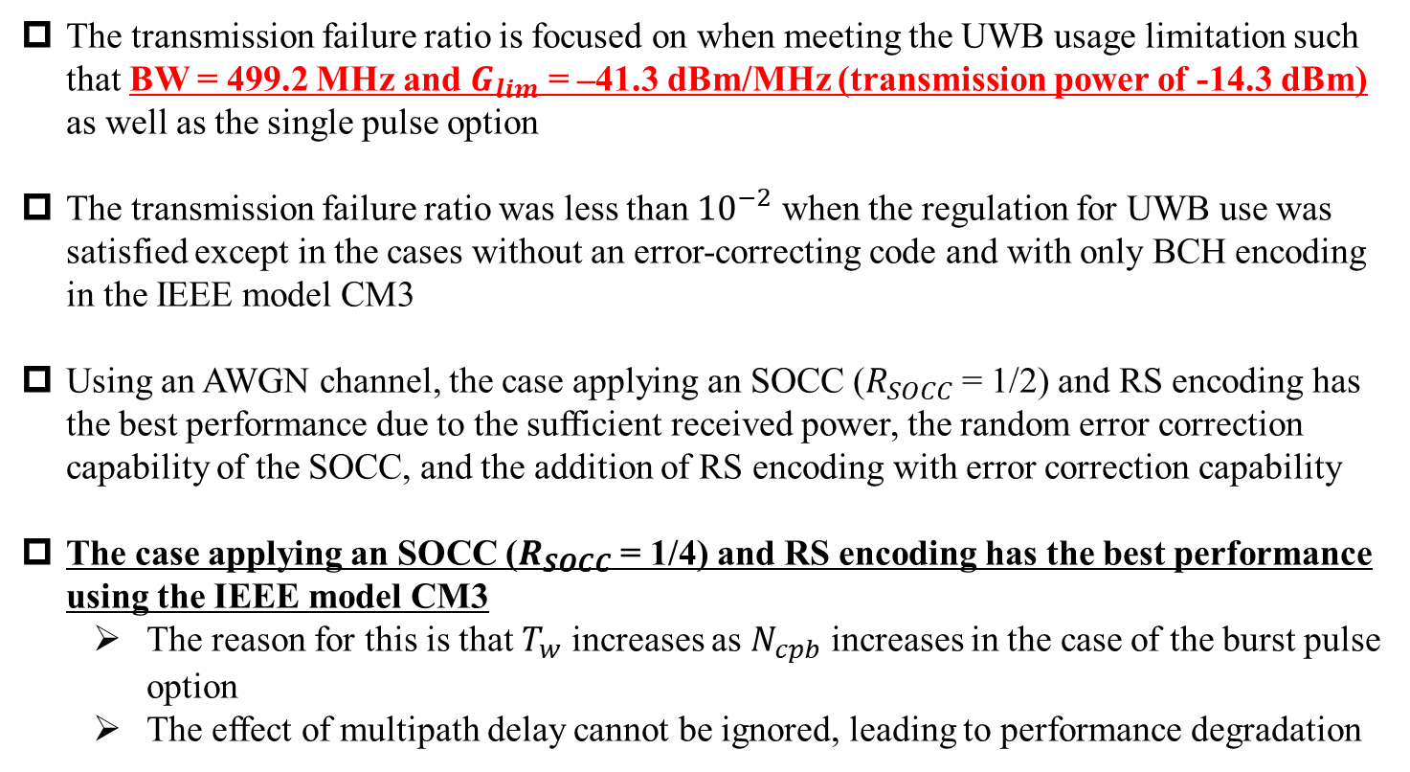
4. Discussion – Burst Pulse Option
The transmission failure ratio is focused on when meeting the UWB usage limitation such that BW = 499.2 MHz and $G_{lim}$ = –41.3 dBm/MHz (transmission power of -14.3 dBm) as well as the single pulse option
The transmission failure ratio was less than ${10}^{−2}$ when the regulation for UWB use was satisfied except in the cases without an error-correcting code and with only BCH encoding in the IEEE model CM3
Using an AWGN channel, the case applying an SOCC ($R_{SOCC}$ = 1/2) and RS encoding has the best performance due to the sufficient received power, the random error correction capability of the SOCC, and the addition of RS encoding with error correction capability
The case applying an SOCC ($R_{SOCC}$ = 1/4) and RS encoding has the best performance using the IEEE model CM3
  The reason for this is that $T_{w}$ increases as $N_{cpb}$ increases in the case of the burst pulse option
  The effect of multipath delay cannot be ignored, leading to performance degradation

Slide 19
5. Conclusion
This research proposed applying an SOCC to the UWB PHY of IEEE 802.15.6 to improve its dependability and evaluated the effect of applying an SOCC by computer simulations
Numerical results showed that sufficient dependability could not be ensured by the error control method defined by IEEE 802.15.6 and that high energy efficiency was obtained while ensuring a sufficient transmission failure ratio by applying an SOCC in the single and the burst pulse options
It was also confirmed that a combination effect could be obtained with an SOCC by applying RS codes with almost the same coding rate as the BCH code specified in IEEE 802.15.6

Slide 20
5. Future Direction
Comparison of SOCC and LDPC
  802.11 standard optionally applies LDPC
  802.15.4ab also considers applying 802.11 standard based LDPC because of ease of implementation
  LDPC has strong error correction capability like SOCC
  However, LDPC requires long code lengths to obtain strong error correction capability
  It is quite possible that the PSDU length will be shortened in WBAN applications
  Therefore, SOCC and short length LDPC will be compared in a WBAN environment

Slide 21
Reference
Kento Takabayashi, Hirokazu Tanaka, Katsumi Sakakibara, "Evaluation of Wireless Body Area Network Utilizing Super Orthogonal Convolutional Code," in Proceedings of 2019 International Symposium on Intelligent Signal Processing and Communication Systems (ISPACS 2019), Beitou, Taipei, Taiwan, pp.1-2, Dec. 2019.
Kento Takabayashi, Hirokazu Tanaka, Katsumi Sakakibara, "Toward Dependable Internet of Medical Things: IEEE 802.15.6 Ultra-Wideband Physical Layer Utilizing Superorthogonal Convolutional Code," Sensors, 2022, vol. 22, no. 6, 2172, Mar. 2022.

Slide 22
Thank you for your attention ! ! !
* This research was funded by JSPS Grant-in-Aid for Early-Career Scientists Grant Number JP20K14737
22

Slide 23
Appendix

Slide 24

2. IEEE 802.15.6 UWB PHY
Frequency spectrum
Low Band
High Band
・・・
・・・
・・・
0
1
2
3
6
10
frequency $f$
bandwidth 499.2 MHz
3993.6 MHz
7987.2 MHz
The UWB band is divided into two band groups: low band (channel 0-2) and high band (channel 3-10) which are divided into operating frequency channels with 499.2 MHz bandwidth
Orange colors are mandatory channels (Low Band: channel 1，High Band: channel 6)
The power spectral density emission limit is -41.3 dBm/MHz which is very low

Slide 25
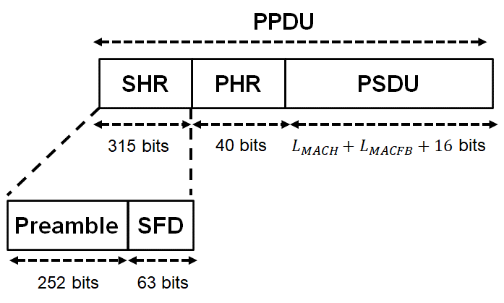
2. IEEE 802.15.6 UWB PHY
Frame format
SHR is divided into two parts: The first part is the preamble, intended for timing synchronization, packet detection, and carrier frequency offset recovery, and The second part is the start-of-frame delimiter (SFD) for frame synchronization
The PHR contains information about the data rate of the PSDU, length of the medium access control (MAC) frame body, pulse shape, burst mode, and so on
The PSDU contains the MAC protocol data unit (MPDU)

Slide 26
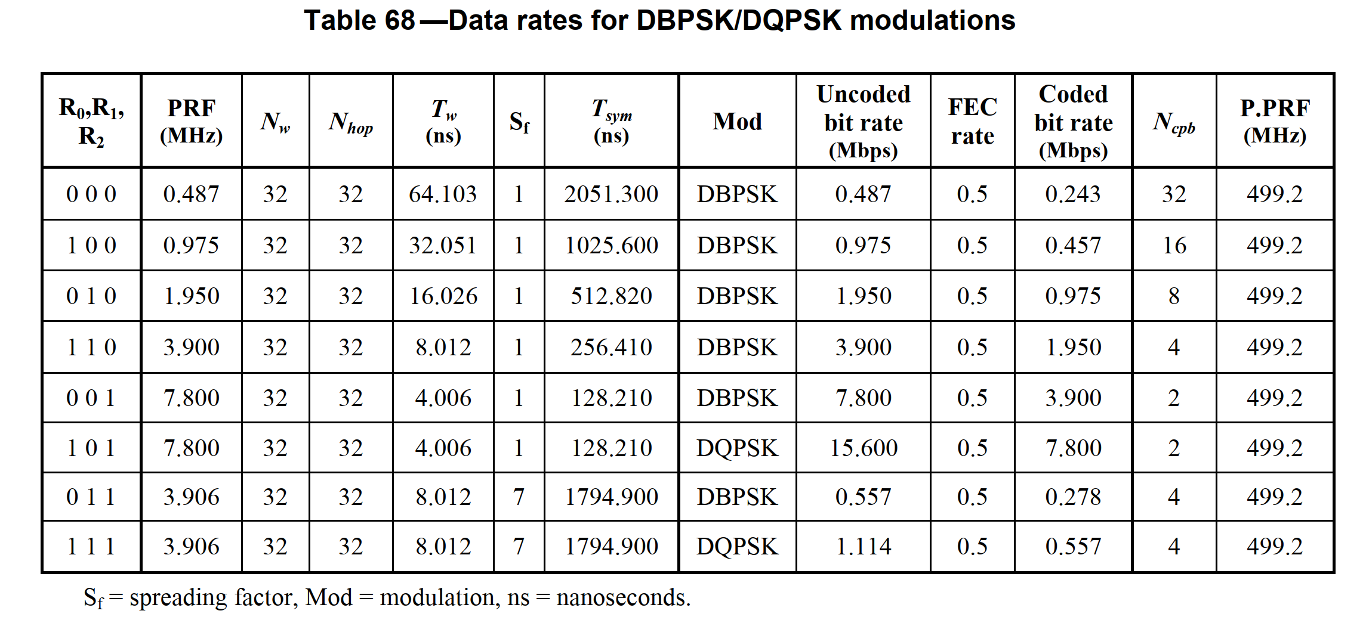
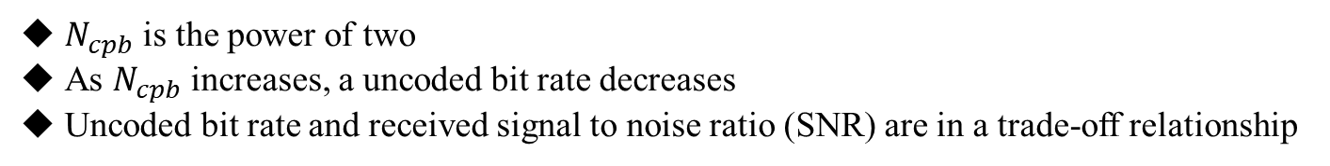
2. IEEE 802.15.6 UWB PHY
$N_{cpb}$ is the power of two
As $N_{cpb}$ increases, a uncoded bit rate decreases
Uncoded bit rate and received signal to noise ratio (SNR) are in a trade-off relationship

Slide 27
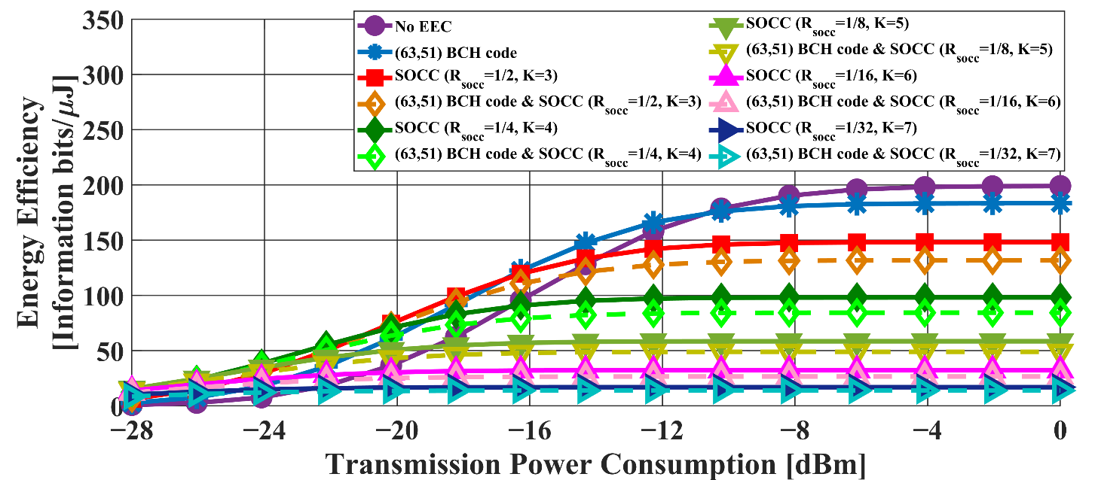
4. Evaluation – Single Pulse Option
Red line: $G_{lim}=−41.3$ dBm/MHz
Fig. Energy efficiency as a function of the transmission power (Single pulse option, IEEE model CM3，BCH encoding)

Slide 28
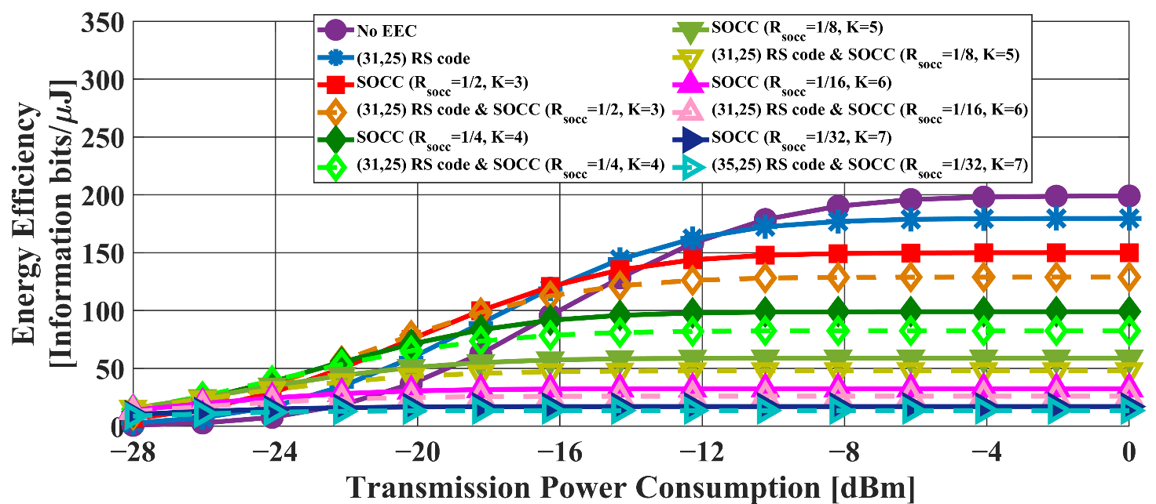
4. Evaluation – Single Pulse Option
Red line: $G_{lim}=−41.3$ dBm/MHz
Fig. Energy efficiency as a function of the transmission power (Single pulse option, IEEE model CM3，RS encoding)

Slide 29
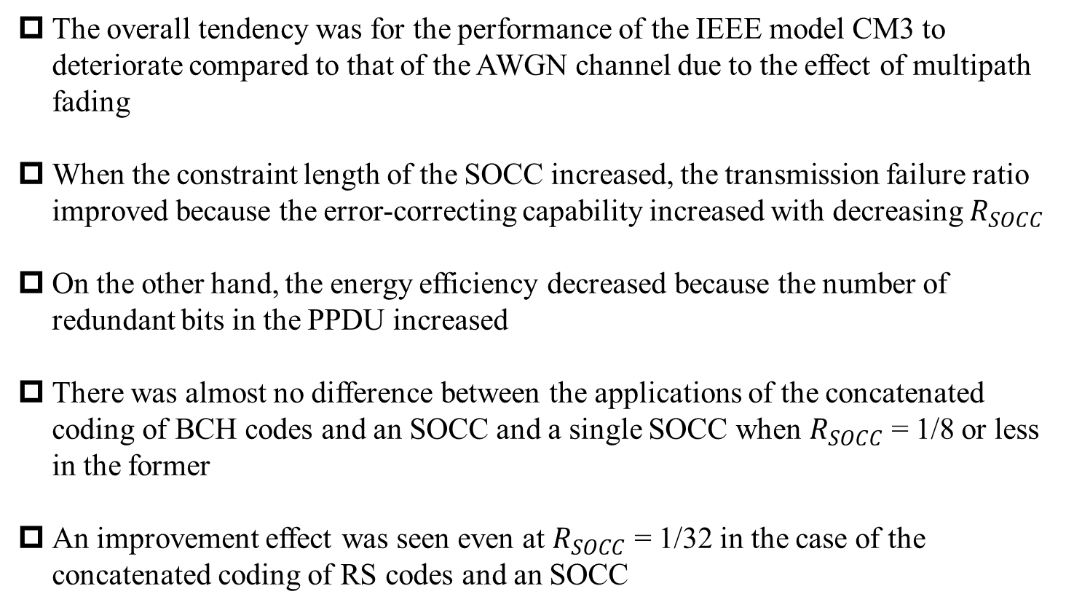
4. Result – Single Pulse Option
The overall tendency was for the performance of the IEEE model CM3 to deteriorate compared to that of the AWGN channel due to the effect of multipath fading
When the constraint length of the SOCC increased, the transmission failure ratio improved because the error-correcting capability increased with decreasing $R_{SOCC}$
On the other hand, the energy efficiency decreased because the number of redundant bits in the PPDU increased
There was almost no difference between the applications of the concatenated coding of BCH codes and an SOCC and a single SOCC when $R_{SOCC}$ = 1/8 or less in the former
An improvement effect was seen even at $R_{SOCC}$ = 1/32 in the case of the concatenated coding of RS codes and an SOCC

Slide 30
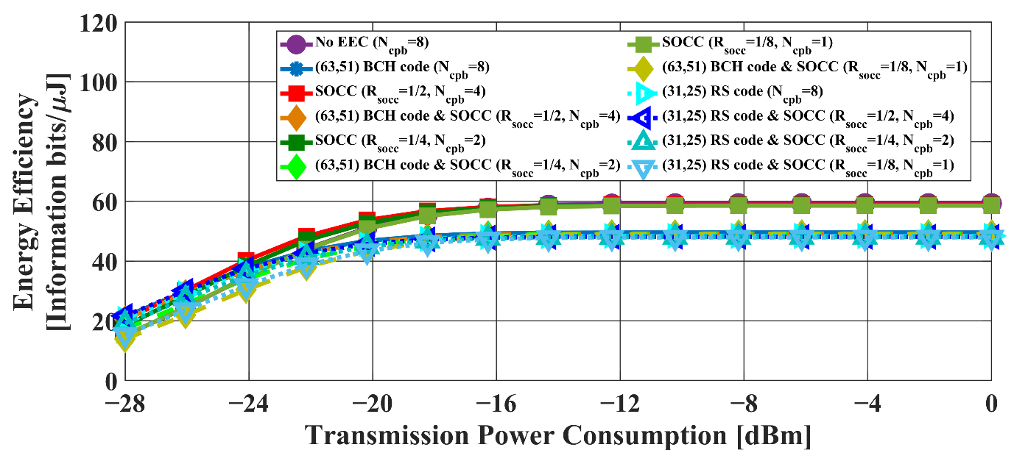
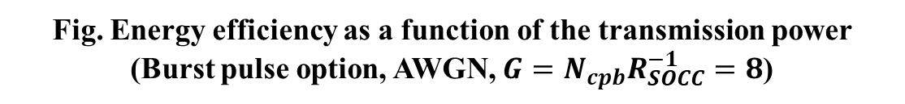
4. Evaluation – Burst Pulse Option
Red line: $G_{lim}=−41.3$ dBm/MHz
Fig. Energy efficiency as a function of the transmission power (Burst pulse option, AWGN, $G=N_{cpb}R_{SOCC}^{−1}=8$)

Slide 31
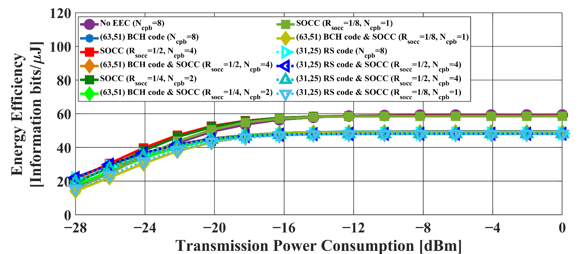
4. Evaluation – Burst Pulse Option
Red line: $G_{lim}=−41.3$ dBm/MHz
Fig. Energy efficiency as a function of the transmission power
(Burst pulse option, IEEE model CM3, $G=N_{cpb}R_{SOCC}^{−1}=8$)

Slide 32
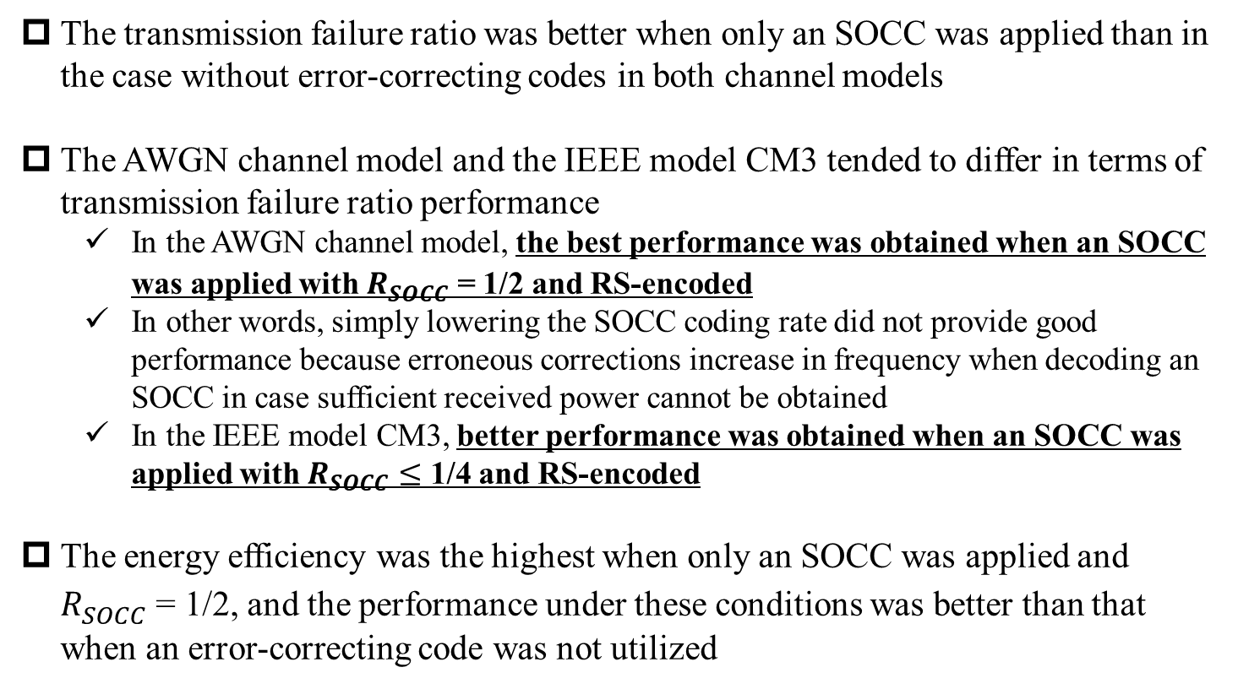
4. Result – Burst Pulse Option
The transmission failure ratio was better when only an SOCC was applied than in the case without error-correcting codes in both channel models
The AWGN channel model and the IEEE model CM3 tended to differ in terms of transmission failure ratio performance
  In the AWGN channel model, the best performance was obtained when an SOCC was applied with $R_{SOCC}$ = 1/2 and RS-encoded
  In other words, simply lowering the SOCC coding rate did not provide good performance because erroneous corrections increase in frequency when decoding an SOCC in case sufficient received power cannot be obtained
  In the IEEE model CM3, better performance was obtained when an SOCC was applied with $R_{SOCC}≤$ 1/4 and RS-encoded
The energy efficiency was the highest when only an SOCC was applied and $R_{SOCC}$ = 1/2, and the performance under these conditions was better than that when an error-correcting code was not utilized

