Slide 1
Project: IEEE P802.15 Working Group for Wireless Specialty Networks
Submission Title: Hybrid ARQ Scheme Utilizing Decomposable Error Correcting Code for Dependable WBAN
Date Submitted: 17 January 2023
Source: Kento Takabayashi¹, Ryuji Kohno^{2,3}
Company: (1) Okayama Prefectural University (2)Yokohama National University (3) YRP International Alliance Institute
Address: (1) 111-1 Kuboki, Soja-shi, Okayama, Japan 719-1197, (2)79-5 Tokiwadai, Hodogaya-ku, Yokohama, 240-8501 Japan,
(3) YRP1 Blg., 3-4 HikarinoOka, Yokosuka-City, Kanagawa, 239-0847 Japan
Voice:[(1) +81-866-94-2104 , (2) +81-90-5408-0611] E-Mail:[takabayashi.kento.xp@gmail.com, kohno@ynu.ac.jp, kohno@yrp-iai.jp]
Re: In response to call for technical contributions
Abstract: The performance evaluation of a hybrid ARQ scheme utilizing a decomposable error correcting code for wireless body area network based on the IEEE 802.15.6 is provided. This hybrid ARQ scheme is also extended to a QoS control scheme.
Purpose: Material for discussion in P802.15.6a TG corresponding to comments in EC Meeting
Notice: This document has been prepared to assist the IEEE P802.15. It is offered as a basis for discussion and is not binding on the contributing individual(s) or organization(s). The material in this document is subject to change in form and content after further study. The contributor(s) reserve(s) the right to add, amend or withdraw material contained herein.
Release: The contributor acknowledges and accepts that this contribution becomes the property of IEEE and may be made publicly available by P802.15.

Slide 2
QoS-aware Hybrid ARQ Scheme Utilizing Decomposable Error Correcting Codes for Wireless Body Area Networks
January 2023,
Hybrid Session ,
Baltimore, Maryland
Kento Takabayashi ⁽¹⁾, Ryuji Kohno^{(2, 3)}
⁽¹⁾Okayama Prefectural University
⁽²⁾Yokohama National University, ⁽³⁾YRP-International Alliance Institute

Slide 3
Agenda
Introduction
Review of error control in IEEE802.15.6
Proposed error control scheme for WBAN
Results
Conclusion

Slide 4
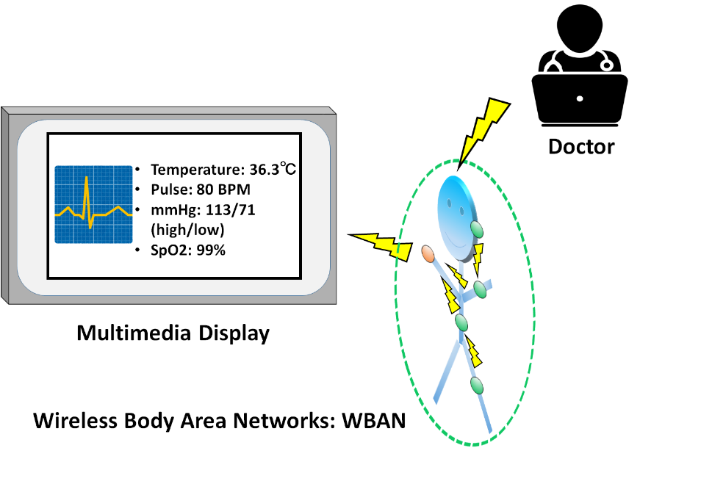
1. Introduction
Wearable healthcare system is actively studied (m-Health, tele-medicine, Internet of Medical Things (IoMT), etc.)
As one of the IoMT system, Wireless Body Area Networks (WBAN) have been extensively researched
WBAN consists of a collection of low-power, miniaturized, invasive or non-invasive lightweight sensors with wireless communication capabilities operating near the human body, and a hub controlling viral sensors
IEEE 802.15.6, one of the standards of WBAN, was issued in 2012

Slide 5
1. Importance of QoS control
In WBAN systems, a wearable vital sign sensor node can include various types of sensors with different data rates, the allowable communication error ratio and delay
Therefore, optimal QoS control for input data is an important feature in sensor data transmission procedures
User priority | Traffic designation | Frame type
0 | Background (BK) | Data
1 | Best effort (BE) | Data
2 | Excellent effort (EE) | Data
3 | Video (VI) | Data
4 | Voice (VO) | Data
5 | Medical data or network control | Data or management
6 | High-priority medical data or network control | Data or management
7 | Emergency or medical implant event report | Data
To address this requirement, an optimal hybrid ARQ scheme employing a decomposable error control coding scheme is proposed
The performance of the proposed system has been compared to an IEEE 802.15.6-based system, and outperformed it

Slide 6
2. Error control in IEEE802.15.6
IEEE802.15.6 shall use a (63, 51) BCH code as an error correcting code in narrowband, UWB and HBC PHY
Only user priority 6 data in UWB-PHY may use a hybrid ARQ with a (126, 63) shortened BCH code
WBAN may deal with 8 levels of user priority data
Those data have a wide range of quality of service (QoS)
The error controlling of the current IEEE Std. 802.15.6 cannot cope with it because of lack of flexibility

Slide 7
3. Proposed hybrid ARQ scheme for WBAN
Proposed QoS control scheme using decomposable error correcting codes and Weldon’s ARQ protocol
It is based on punctured convolutional codes (constraint length $K$ = 3 and coding rates $r_{i}$ of 8/9 to 1/16)
The $r_{i}=8/9$ punctured code patterns (codeword 1 and codeword 1') are generated as shown in the next figure
At the first transmission, codeword 1 is sent
To increment the coding rate of the punctured code, elements of codeword 1' are sent after the first transmission
After sending all elements to reconstruct the original convolutional code, codewords 1 and 1' are transmitted alternately
A receiver reconstructs and decodes low-rate decomposable codes by changing the number of data copies in Weldon's ARQ protocol

Slide 8
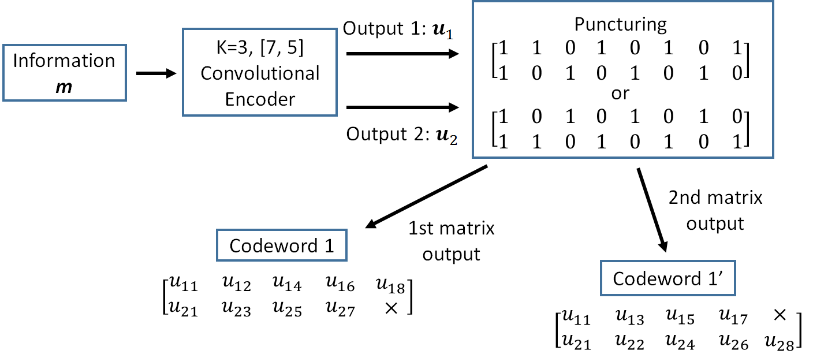
3. Proposed hybrid ARQ scheme for WBAN
Firstly, the information bit sequence $m$ is encoded via the punctured convolutional code, and codeword 1 is transmitted

Slide 9
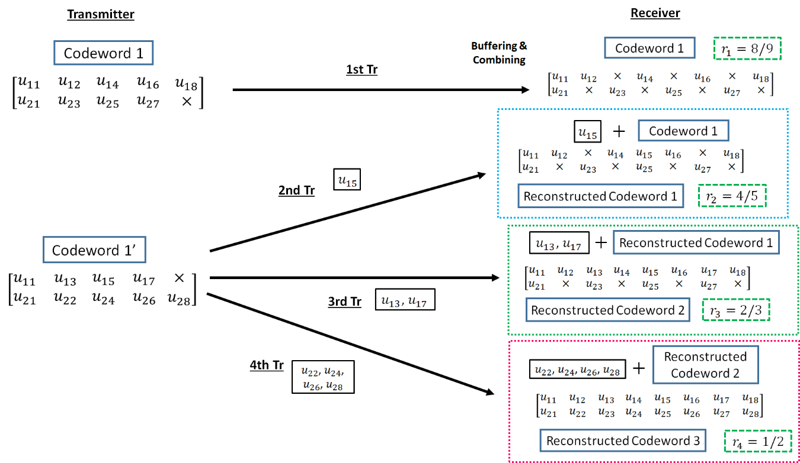
3. Proposed hybrid ARQ scheme for WBAN
If bit errors are detected after decoding codeword 1, the receiver stores the transmitted codeword 1, and the transmitter re-sends the sub-codeword of codeword 1' $n_{i}$ times if $1 ≤i ≤3$. At the receiver, the received sub-codeword and stored codeword are combined, and the reconstructed codeword is decoded

Slide 10
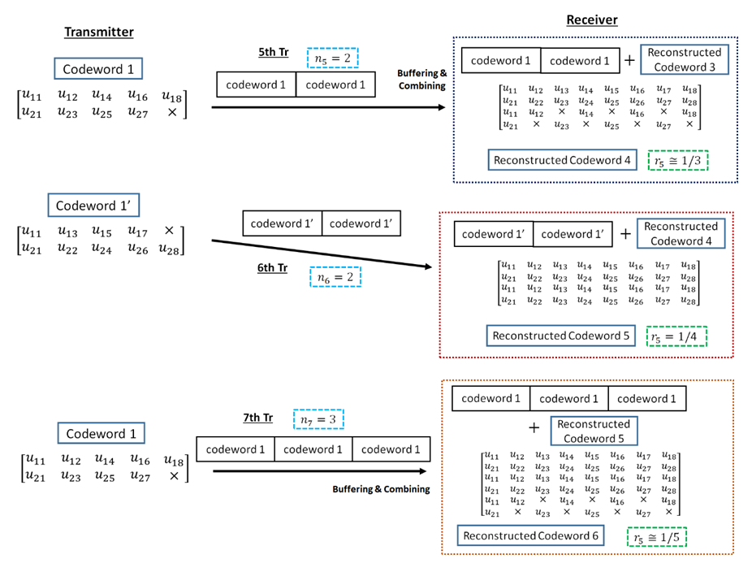
3. Proposed hybrid ARQ scheme for WBAN
After the third retransmission, codeword 1 is sent $n_{4}$ times and combined with a buffered codeword at the receiver. If bit errors are detected after decoding reconstructed codeword, the $n_{4}$codeword 1 is buffered in the receiver, and codeword 1' is transmitted $n_{5}$ times and combined with a stored codeword
After that, codeword 1 and 1' are sent alternately $n_{i}$ times and stored. Then, a receiver reconstructs and decodes low-rate decomposable codes by changing the number of data copies $n_{i}$ in Weldon's ARQ protocol. At this time, a buffered old codeword is updated to a transmitted new codeword

Slide 11
3. Proposed hybrid ARQ scheme for WBAN
Advantages of the proposed hybrid ARQ scheme
The coding rate is very wide
Bit errors are sufficiently eliminated at the coding rate of $r_{c}$ = 8/9 under very good channel conditions
Very low coding rates remove bit errors under bad channel conditions
A coding rate at the first transmission may be changed according to channel conditions
In the case of the small number of retransmissions, it is sufficient to transmit the small number of redundant bits
This characteristic leads to improvement of energy efficiency and reduction of transmission delay at retransmission

Slide 12
4. Simulation parameters
The proposed and standard schemes are evaluated based on SNR and the number of other WBANs by computer simulations
In these computer simulations, the IEEE model CM 3 is applied as a channel model, which is targeted for wearable WBAN and includes multi-path fading
The IEEE model CM 4 is utilized for interference from other WBANs
Parameter | Detail
Channel model | IEEE model CM3, CM4
Bandwidth (BW) | 499.2 MHz
Central frequency ($f_{c}$) | 3993.6 MHz
Pulse shape | Gaussian mono pulse
Pulse duration ($T_{p}$) | 2.003 ns
Modulation | DBPSK
FEC | $r_{c}­=$ 8/9 to 1/16, $K=3$, Convolutional codes
Decoding | Soft decision, Viterbi decoding
ARQ protocol | Weldon's ARQ
Spreading sequence | Gold sequence
Spreading factor ($N_{s}$) | 7
Number of other WBANs | 0 ~10
Max distance from other WBANs | 3 m
Tx RF power consumption ($P_{tx,RF}$) | 37 μW
Tx circ. power consumption ($P_{tx,circ}$) | 2 mW
Rx power consumption ($P_{rx}$) | 20 mW
Synch. header duration ($T_{SHR}$) | 40.32 μs
PHY header durations ($T_{PHR}$) | 82.052 μs
Information bit length ($L_{info}$) | 306 bits
ACK length ($L_{ACK}$) | 7 bytes
Uncoded data rate (R) | 0.557 Mbps

Slide 13
4. Each QoS of Data A and B
QoS requirements of different data types
Data types | Data A | Data B
User priority | 5 | 6
RBER | $$≤ {10}^{−6}$$ | $$≤ {10}^{−2}$$
Energy efficiency | low | high
Preset number of data copies in Weldon‘s ARQ $n_{i}$ (Scheme 1)
$$i$$ | 1 | 2 | 3 | 4 | 5 | 6 | 7 | 8 | 9 | 10 | 11
Data A | 1 | 4 | 4 | 5 | 5 | 6 | 6 | 8 | 8 | 8 | 8
Data B | 1 | 1 | 2 | 3 | 4 | - | - | - | - | - | -
In the simulation, two data (Data A and Data B) with different types of QoS requirements are considered
It is assumed that a low PER is desired for Data A and high energy efficiency is important for Data B
Data A is assumed to be a physiological parameter with a low data rate, for example blood pressure, SpO2, or temperature, and Data B to be a waveform such as an ECG output

Slide 14
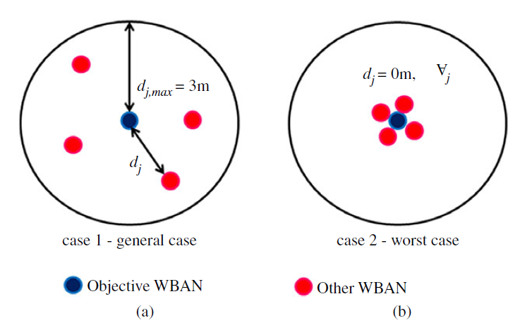
4. Two types of cases
(a) and (b) present Case 1 (general case) and Case 2 (worst case)
Notes:
In Case 1, other WBANs followed a uniform distribution within 3 m of the objective WBAN
In Case 2, the other WBANs were placed more closely to the objective WBAN

Slide 15
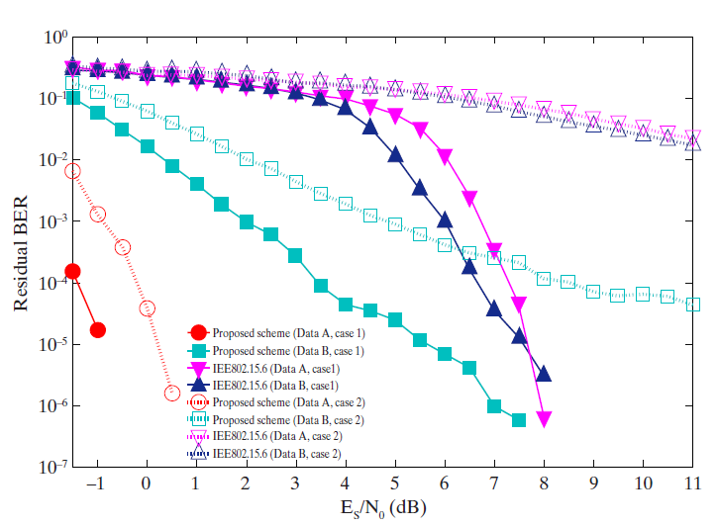
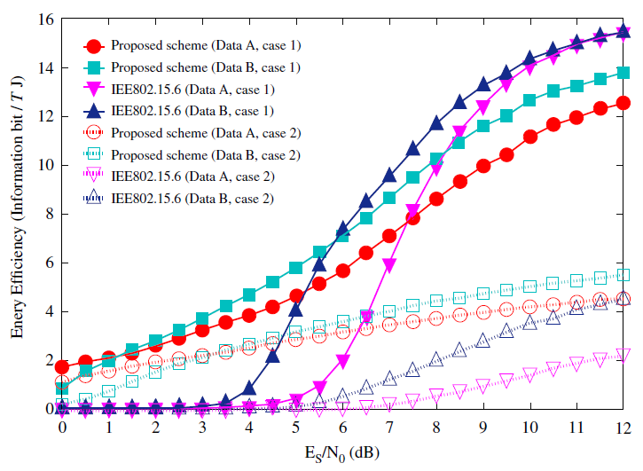
4. Numerical results
RBER and energy efficiency performance as a function of ${E_{s}}/{N_{0}}$. The number of other WBANs is 5.
RBER means the bit error ratio at which the transmission failed beyond the maximum number of retransmissions

Slide 16
4. Results
The proposed scheme satisfies the QoS requirements for data A and, while IEEE Std. 802.15.6 does not
Data B has better performances with respect to both standard schemes
Those standard schemes are not basically designed so that any QoSs can be satisfied
That is one of problems in those standard schemes
The performances in Case 2 were worse than those in Case 1, especially when using the standard method
However, our proposed scheme was able to satisfy the required QoSs in the worst case scenario under lower SNR conditions than the standard scheme
Under high SNR conditions in Case 2, the energy efficiency of our proposed scheme was better by 1.5–2.5 (information bit/μJ) than that of IEEE 802.15.6
For our system, the energy efficiency was better for Data A than for Data B under low SNR conditions in both Cases 1 and 2 due to the error correction scheme

Slide 17
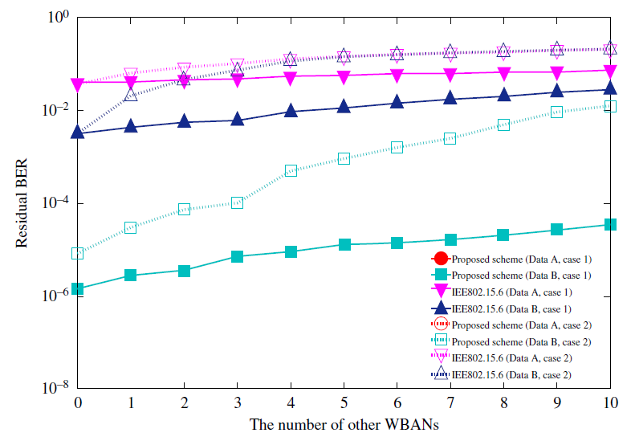
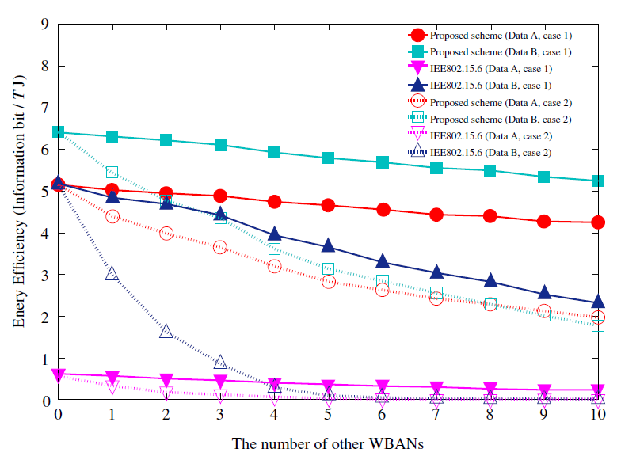
4. Numerical results
RBER and energy efficiency performance as a function of the number of other WBANs. ${E_{s}}/{N_{0}}=5$ dB.
RBER means the bit error ratio at which the transmission failed beyond the maximum number of retransmissions

Slide 18
4. Results
The proposed scheme also satisfies the QoS requirements for Data A and B, while both standard schemes approach do not like the previous figures
The RBER of Data A is not plotted because all errors were removed by the large error correcting capacity
As the number of other WBANs increased, the performance deteriorated
However, the proposed scheme satisfied the QoSs for two datasets
In contrast, the standard performed very poorly, especially in Case 2
This suggested that the standard scheme was not robust against strong interference from other WBANs
In Case 1, the energy efficiency performance of the high QoS mode was inferior to that for Data A of the proposed scheme
The standard scheme had a poor RBER performance under small interference conditions
The RBER performance of our scheme under the same conditions was good

Slide 19
5. Conclusion
The performance of our proposed hybrid ARQ scheme was evaluated in scenarios where other WBANs interfere
Computer simulations were conducted to evaluate the proposed scheme against performance measures such as RBER and energy efficiency and to compare the results with those from an error control scheme defined in IEEE 802.15.6
The numerical results demonstrated that the proposed scheme was able to satisfy the required QoS for each data type and that the QoS control was more flexible than that of the standard in both general and worst case scenarios
The proposed scheme had poorer energy efficiency than IEEE 802.15.6 under high SNR conditions in the general case scenario
However, the IEEE 802.15.6 solution was unable to achieve the required performance under the worst case scenario

Slide 20
5. Future Direction
User priority | Inner code | Outer code | HARQ
0 | - | (31, 25) Reed-Solomon code | -
1 | - | (31, 25) Reed-Solomon code | -
2 | - | (31, 25) Reed-Solomon code | -
3 | - | (31, 25) Reed-Solomon code | -
4 | Proposed decomposable code, R=4/5 | (31, 25) Reed-Solomon code | ◯
5 | Proposed decomposable code, R=2/3 | (31, 25) Reed-Solomon code | ◯
6 | Proposed decomposable code, R=1/2 | (31, 25) Reed-Solomon code | ◯
7 | Proposed decomposable code, R=1/4 | (31, 25) Reed-Solomon code | ◯
Error correcting code and coding rate are mapped to each QoS (the above table is an example, blue color: low QoS, red color: high QoS)
As an outer code, (31, 25) Reed-Solomon code will be selected to correct burst errors due to interference from other WBANs
As an inner code, proposed decomposable codes and hybrid ARQ will be selected, and the coding rates are changed according to each QoS

Slide 21
Reference
Kento Takabayashi, Hirokazu Tanaka, Chika Sugimoto, Ryuji Kohno, "Performance Evaluation of Error Control Scheme in Multihop WBAN Based on IEEE802.15.6," The International Symposium on Information Theory and Its Applications 2016 (ISITA 2016), Monterey, California, US, pp.370-374, Oct. 2016.
Kento Takabayashi, Hirokazu Tanaka, Chika Sugimoto, Ryuji Kohno, "Performance Analysis of Cross-layer Approach About Error Control Scheme for WBANs," Proceedings of the 11th International Symposium on Medical Information and Communication Technology (ISMICT 2017), Lisbon, Portugal, pp.1-5, Feb. 2017.
Kento Takabayashi, Heikki Karvonen, Tuomas Paso, Hirokazu Tanaka, Chika Sugimoto, Ryuji Kohno, "Performance Evaluation of a QoS-aware Error Control Scheme for Multiple-WBAN Environment," IEEJ Transactions on Electrical and Electronic Engineering, vol.12, no.S1, pp.S146-S157, Jun. 2017.
Kento Takabayashi, Hirokazu Tanaka, Chika Sugimoto, Katsumi Sakakibara, Ryuji Kohno, "Cross-layer Design and Performance Analysis of Quality of Service Control Scheme for Wireless Body Area Networks," IEEE Access, vol.5, pp.22462-22470, Nov. 2017.

Slide 22
Apendix

Slide 23
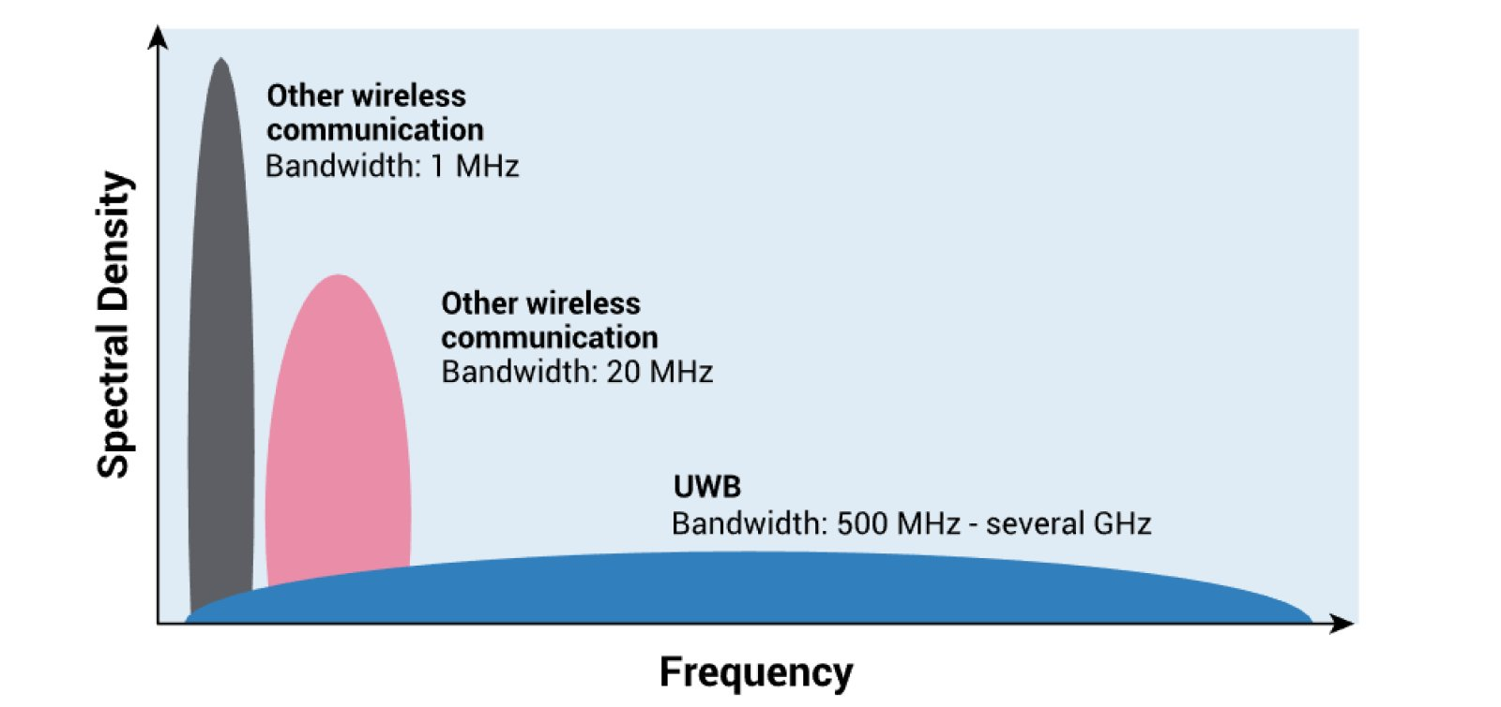
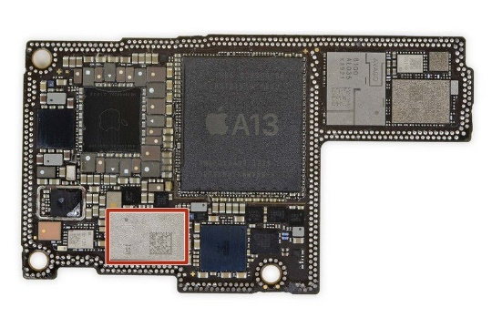
1. Introduction - UWB
IEEE 802.15.6 defines three physical layers
Narrowband
Ultra-wideband (UWB)
Human body communication (HBC)
UWB technology has recently regained attention (introduction to iPhone and AirTag, support for Android 12)
UWB offers…
high data rate transmission
Ultra-high-precision positioning
low energy consumption
powerful multi-pass resolution
good coexistence with other wireless communication systems
UWB is a technology that may satisfy the requirements of IoMT
Fig. UWB Frequency Spectol
Fig. U1 in iPhone 11

