Slide 1
Project: IEEE P802.15 Working Group for Wireless Specialty Networks
Submission Title: Hybrid ARQ Scheme Utilizing Decomposable Error Correcting Code for Dependable WBAN
Date Submitted: 15 November 2022
Source: Kento Takabayashi¹, Ryuji Kohno^{2,3}
Company: (1) Okayama Prefectural University (2)Yokohama National University (3) YRP International Alliance Institute
Address: (1) 111-1 Kuboki, Soja-shi, Okayama, Japan 719-1197, (2)79-5 Tokiwadai, Hodogaya-ku, Yokohama, 240-8501 Japan,
(3) YRP1 Blg., 3-4 HikarinoOka, Yokosuka-City, Kanagawa, 239-0847 Japan
Voice:[(1) +81-866-94-2104 , (2) +81-90-5408-0611] E-Mail:[takabayashi.kento.xp@gmail.com, kohno@ynu.ac.jp, Kohno@yrp-iai.jp]
Re: In response to call for technical contributions
Abstract: The performance evaluation of a hybrid ARQ scheme utilizing a decomposable error correcting code for wireless body area network based on the IEEE 802.15.6 is provided.
Purpose: Material for discussion in P802.15.6a TG corresponding to comments in EC Meeting
Notice: This document has been prepared to assist the IEEE P802.15. It is offered as a basis for discussion and is not binding on the contributing individual(s) or organization(s). The material in this document is subject to change in form and content after further study. The contributor(s) reserve(s) the right to add, amend or withdraw material contained herein.
Release: The contributor acknowledges and accepts that this contribution becomes the property of IEEE and may be made publicly available by P802.15.

Slide 2
QoS-aware Hybrid ARQ Scheme Utilizing Decomposable Error Correcting Codes for Wireless Body Area Networks
Kento Takabayashi ⁽¹⁾, Ryuji Kohno^{(2, 3)}
⁽¹⁾Okayama Prefectural University
⁽²⁾Yokohama National University, ⁽³⁾YRP-International Alliance Institute

Slide 3
Agenda
Introduction
Review of error control in IEEE802.15.6
Proposed error control scheme for WBAN
Operation of proposed scheme
Results
Conclusion

Slide 4
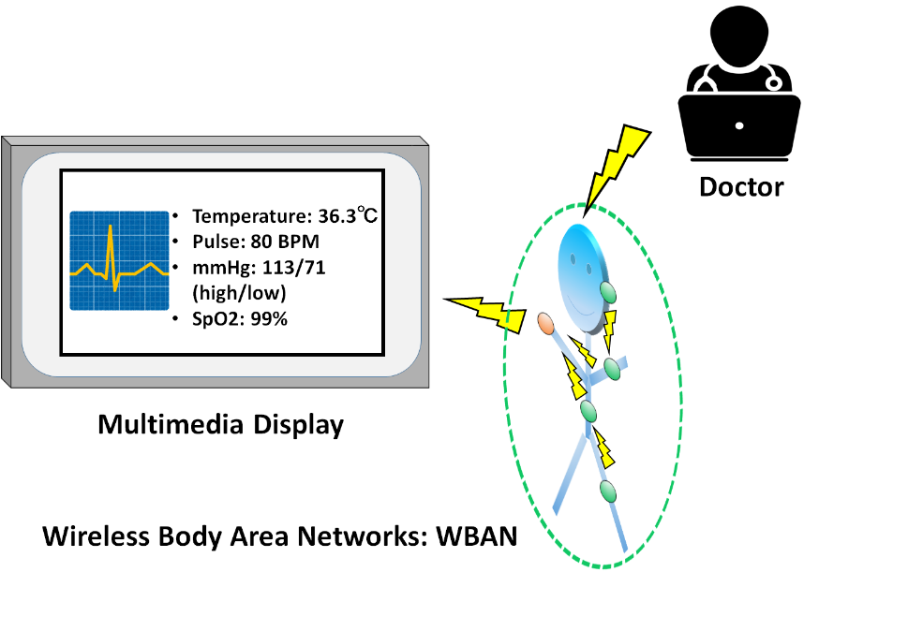
1. Introduction
Wearable healthcare system is actively studied (m-Health, tele-medicine, Internet of Medical Things (IoMT), etc.)
As one of the IoMT system, Wireless Body Area Networks (WBAN) have been extensively researched
WBAN consists of a collection of low-power, miniaturized, invasive or non-invasive lightweight sensors with wireless communication capabilities operating near the human body, and a hub controlling viral sensors
IEEE 802.15.6, one of the standards of WBAN, was issued in 2012

Slide 5
1. Importance of QoS control
In WBAN systems, a wearable vital sign sensor node can include various types of sensors with different data rates, the allowable communication error ratio and delay
Therefore, optimal QoS control for input data is an important feature in sensor data transmission procedures
User priority | Traffic designation | Frame type
0 | Background (BK) | Data
1 | Best effort (BE) | Data
2 | Excellent effort (EE) | Data
3 | Video (VI) | Data
4 | Voice (VO) | Data
5 | Medical data or network control | Data or management
6 | High-priority medical data or network control | Data or management
7 | Emergency or medical implant event report | Data
To address this requirement, an optimal hybrid ARQ scheme employing a decomposable error control coding scheme has been proposed
The performance of the proposed system has been compared to an IEEE 802.15.6-based system, and outperformed it

Slide 6
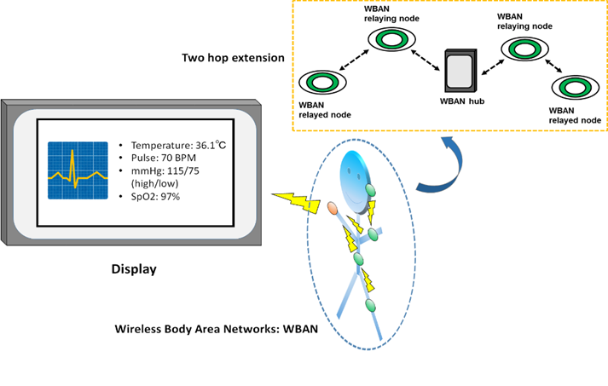
1. Purpose and contribution
Purpose
In the study, the performance of a hybrid ARQ scheme for a WBAN based on IEEE Std. 802.15.6 is evaluated under multi-path fading channel of ultra-wideband (UWB) PHY
Contribution
The performance of our proposed hybrid ARQ scheme (Scheme 1) is improved by appropriately determining the coding rate using channel estimation (Scheme 2)
With this improvement, data packets can be relayed to the hub with a small number of transmissions even when the maximum number of retransmissions is limited by a two-hop extension

Slide 7
2. Error control in IEEE802.15.6
IEEE802.15.6 shall use a (63, 51) BCH code as an error correcting code in narrowband, UWB and HBC PHY
Only user priority 6 data in UWB-PHY may use a hybrid ARQ with a (126, 63) shortened BCH code
WBAN may deal with 8 levels of user priority data
Those data have a wide range of quality of service (QoS)
The error controlling of the current IEEE Std. 802.15.6 cannot cope with it because of lack of flexibility

Slide 8
3. Proposed hybrid ARQ scheme for WBAN
Proposed QoS control scheme using decomposable error correcting codes and Weldon’s ARQ protocol
It is based on punctured convolutional codes (constraint length $K$ = 3 and coding rates $r_{i}$ of 8/9 to 1/16)
The $r_{i}=8/9$ punctured code patterns (codeword 1 and codeword 1') are generated as shown in the next figure
At the first transmission, codeword 1 is sent
To increment the coding rate of the punctured code, elements of codeword 1' are sent after the first transmission
After sending all elements to reconstruct the original convolutional code, codewords 1 and 1' are transmitted alternately
A receiver reconstructs and decodes low-rate decomposable codes by changing the number of data copies in Weldon's ARQ protocol

Slide 9
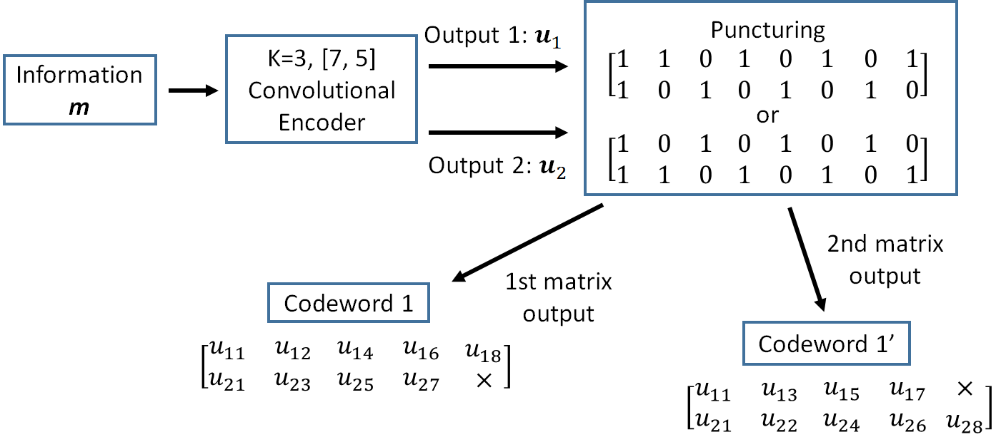
3. Proposed hybrid ARQ scheme for WBAN
Firstly, the information bit sequence $m$ is encoded via the punctured convolutional code, and codeword 1 is transmitted

Slide 10
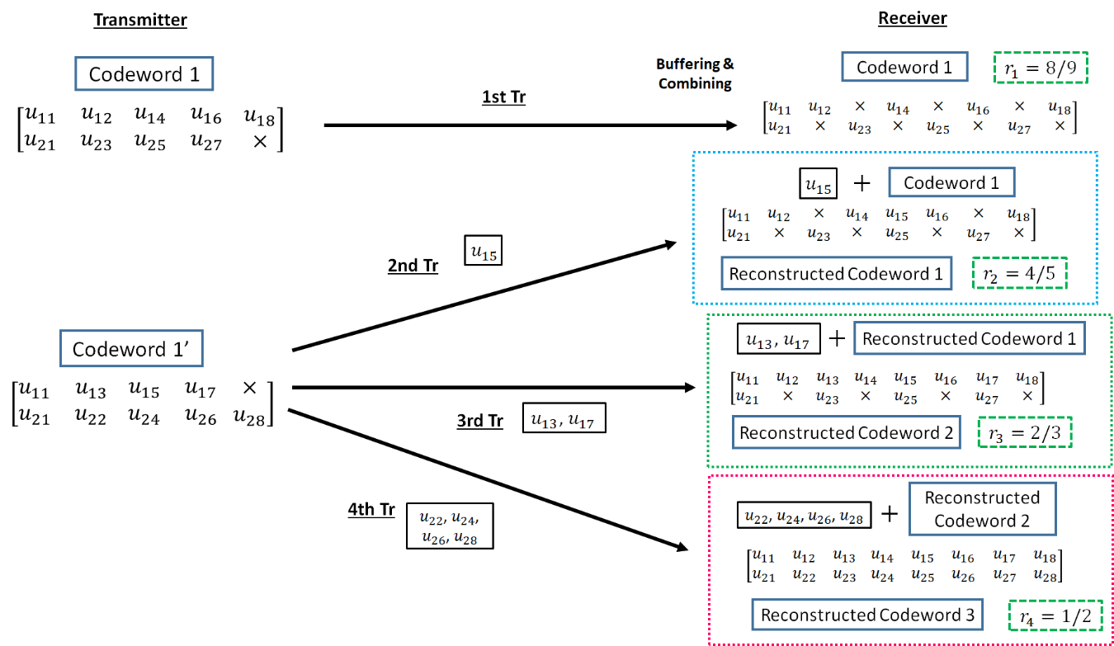
3. Proposed hybrid ARQ scheme for WBAN
If bit errors are detected after decoding codeword 1, the receiver stores the transmitted codeword 1, and the transmitter re-sends the sub-codeword of codeword 1' $n_{i}$ times if $1 ≤i ≤3$. At the receiver, the received sub-codeword and stored codeword are combined, and the reconstructed codeword is decoded

Slide 11
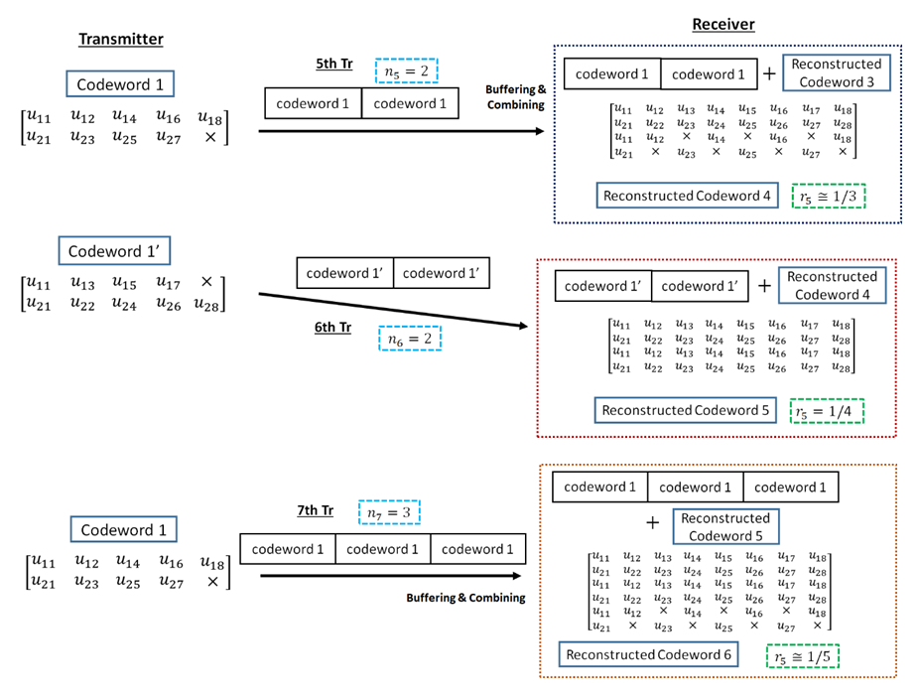
3. Proposed hybrid ARQ scheme for WBAN
After the third retransmission, codeword 1 is sent $n_{4}$ times and combined with a buffered codeword at the receiver. If bit errors are detected after decoding reconstructed codeword, the $n_{4}$codeword 1 is buffered in the receiver, and codeword 1' is transmitted $n_{5}$ times and combined with a stored codeword
After that, codeword 1 and 1' are sent alternately $n_{i}$ times and stored. Then, a receiver reconstructs and decodes low-rate decomposable codes by changing the number of data copies $n_{i}$ in Weldon's ARQ protocol. At this time, a buffered old codeword is updated to a transmitted new codeword

Slide 12
3. Proposed hybrid ARQ scheme for WBAN
Advantages of the proposed hybrid ARQ scheme
The coding rate is very wide
Bit errors are sufficiently eliminated at the coding rate of $r_{c}$ = 8/9 under very good channel conditions
Very low coding rates remove bit errors under bad channel conditions
A coding rate at the first transmission may be changed according to channel conditions
In the case of the small number of retransmissions, it is sufficient to transmit the small number of redundant bits
This characteristic leads to improvement of energy efficiency and reduction of transmission delay at retransmission

Slide 13
4. System model
A sensor node (N1) includes multiple sensors that produce different data types that are transmitted via a relaying node (N2) to the target hub (H)
${tr}_{A→B}$: the number of transmissions from nodes A to B, $q_{A→B}$: the maximum number of transmissions from nodes A to B
If bit errors are detected, the system retransmits until the maximum number of retransmissions is reached
The transmission is considered to have failed if the data from a sensor node do not reach the target hub

Slide 14
4. Proposed scheme
Two proposed schemes are assumed:
Scheme 1
The first scheme (Scheme 1) transmits data depending on preset parameters
Scheme 2
In the second scheme (Scheme 2), coding rates are varied with the SNR estimated using a preamble signal according to each QoS requirement
The operation example is as follows (and a next figure):
The channel SNR is estimated by using the preamble of the beacon or the T-Poll received from the hub or the relaying node
The relayed node or the relaying node determines the coding rate according to the estimated channel SNR and transmits data to the relaying node or the hub
If a bit error is detected, elements of the encoded data (codeword) are transmitted to increase error correcting capability after receiving NACK

Slide 15
5. Simulation parameters
The proposed and standard schemes with two-hop extension are evaluated based on communication distance by computer simulations
In these computer simulations, the IEEE model CM 3 is applied as a channel model, which is targeted for wearable WBAN and includes multi-path fading
A hospital room case in the IEEE model CM3 is utilized as a path loss model
Parameter | Detail
Channel model | IEEE model CM3
Path loss model | IEEE model CM3
Bandwidth (BW) | 499.2 MHz
Central frequency ($f_{c}$) | 3993.6 MHz
Pulse shape | Gaussian mono pulse
Pulse duration ($T_{p}$) | 2.003 ns
Modulation | DBPSK
FEC | $r_{c}­=$ 8/9 to 1/16, $K=3$, Convolutional codes
Decoding | Soft decision, Viterbi decoding
ARQ protocol | Weldon's ARQ
Power spectral density ($P_{sd}$) | −41.3 dBm/MHz
Thermal noise density ($N_{0}$) | −174 dBm/Hz
Implementation losses ($I$) | 3 dB
Receiver noise figure (NF) | 5 dB
Tx RF power consumption ($P_{tx,RF}$) | 37 μW
Tx circ. power consumption ($P_{tx,circ}$) | 2 mW
Rx power consumption ($P_{rx}$) | 20 mW
Number of pulses per bit ($N_{cpb}$) | 2
Uncoded data rate (R) | 7.8 Mbps
Synch. header duration ($T_{SHR}$) | 40.32 μs
PHY header durations ($T_{PHR}$) | 82.052 μs
Information bit length ($L_{info}$) | 306 bits
ACK length ($L_{ACK}$) | 7 bytes
Uncoded data rate (R) | 7.8 Mbps

Slide 16
5. Each QoS of Data A and B
QoS requirements of different data types
Maximum number of transmissions
Data types | Data A | Data B
User priority | 5 | 6
PER | $$≤ {10}^{−2}$$ | $$≤ {10}^{−1}$$
Energy efficiency | low | high
$$q$$ | $$q_{N1→N2}$$ | $$q_{N2→H}$$ | $$q_{max}$$
Data A | 11 | $$11−{tr}_{N1→N2}$$ | 11
Data B | 5 | 5 | 10
Preset number of data copies in Weldon‘s ARQ $n_{i}$ (Scheme 1)
$$i$$ | 1 | 2 | 3 | 4 | 5 | 6 | 7 | 8 | 9 | 10 | 11
Data A | 1 | 4 | 4 | 5 | 5 | 6 | 6 | 7 | 7 | 8 | 8
Data B | 1 | 1 | 2 | 3 | 4 | - | - | - | - | - | -
In the simulation, two data (Data A and Data B) with different types of QoS requirements are considered
It is assumed that a low PER is desired for Data A and high energy efficiency is important for Data B
Data A is assumed to be a physiological parameter with a low data rate, for example blood pressure, SpO2, or temperature, and Data B to be a waveform such as an ECG output

Slide 17
5. Compared scheme
In computer simulations of the compared schemes, Data A was transmitted using the default mode with (63, 51) BCH code in IEEE Std. 802.15.6 and the error control scheme utilizing the (63, 55) Reed-Solomon code in IEEE Std. 802.15.4a with ordinary ARQ
Data B was transmitted using the high QoS mode with (126, 63) shortened BCH code and type-II hybrid ARQ, and then the error control scheme utilizing the concatenated code consisting of the (63, 55) Reed-Solomon code and the convolutional code whose constraint length is three and coding rate is 1/2 in IEEE Std. 802.15.4a with ordinary ARQ
Cases for the proposed scheme of each hop
Each case of the proposed scheme in each hop is summarized as shown in the next table
 | $$N1→N2$$ | $$N2→H$$
Case 1 | Scheme 1 | Scheme 1
Case 2 | Scheme 1 | Scheme 2
Case 3 | Scheme 2 | Scheme 2

Slide 18
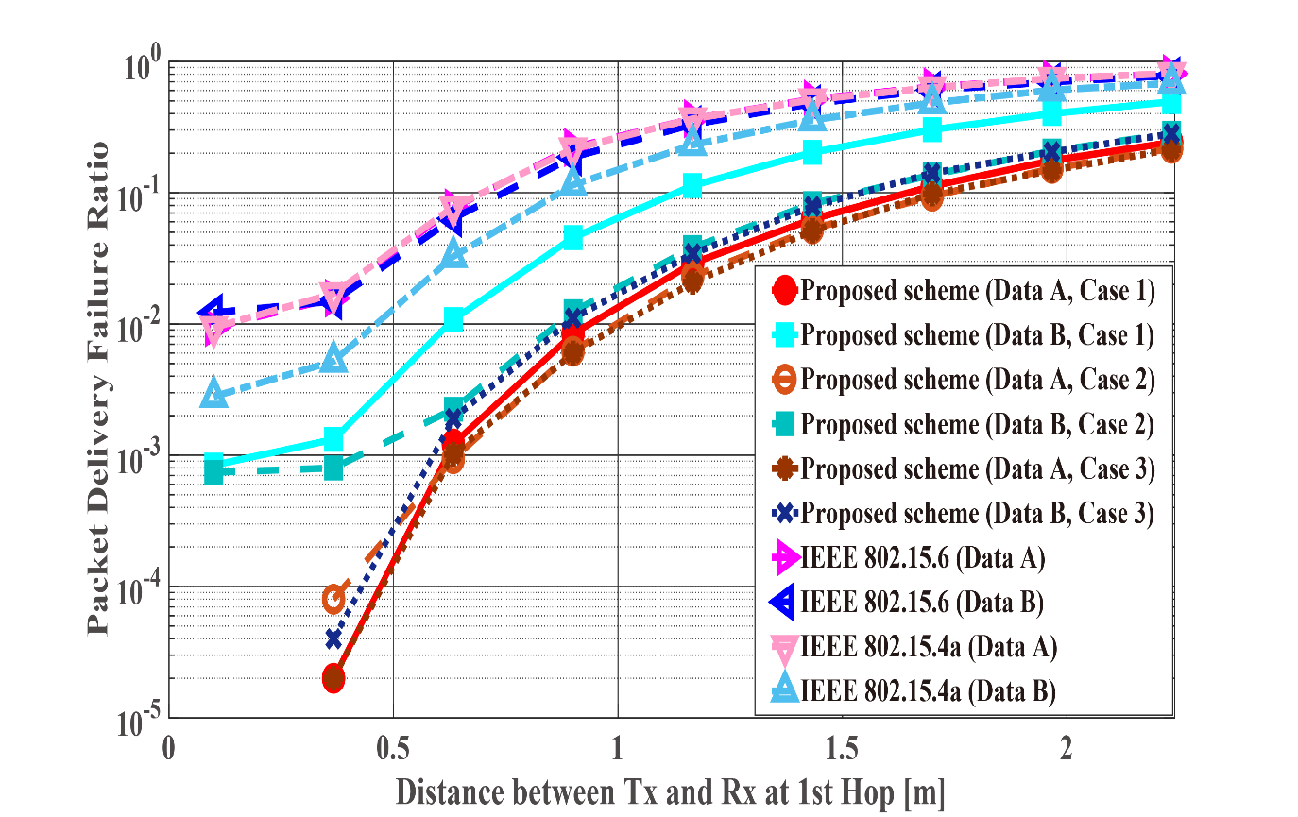
5. Numerical results
Packet delivery failure ratio with constant $d_{2nd}=40 cm$, the distance of the first hop $d_{1st}$ is changed from 10 centimeters (cm) to 2.2 m
PDFR means the ratio at which the two-hop relay failed beyond the maximum number of retransmissions

Slide 19
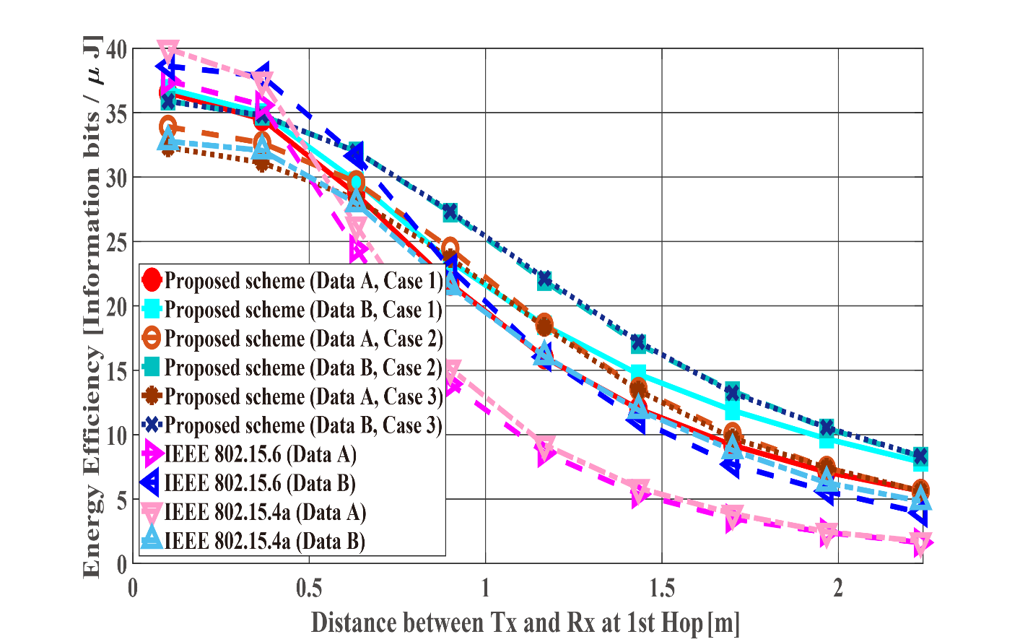
5. Numerical results
Energy efficiency with constant $d_{2nd}=40 cm$, the distance of the first hop $d_{1st}$ is changed from 10 centimeters (cm) to 2.2 m

Slide 20
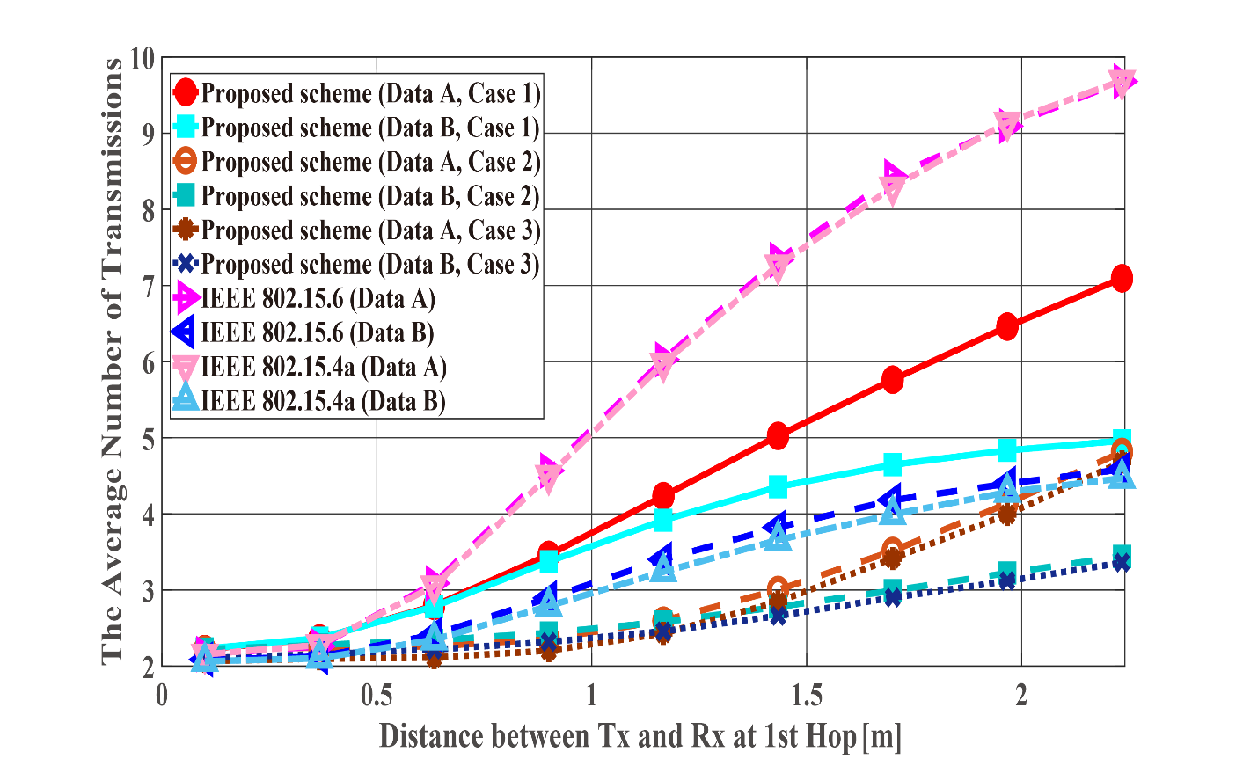
5. Numerical results
Average number of transmissions with constant $d_{2nd}=40 cm$, the distance of the first hop $d_{1st}$ is changed from 10 centimeters (cm) to 2.2 m

Slide 21
5. Discussion (constant $d_{2nd}$ case)
The proposed scheme satisfies the QoS requirements for data A and, while IEEE Std. 802.15.6 and 15.4a do not
Data B has better performances with respect to both standard schemes
Those standard schemes are not basically designed so that any QoSs can be satisfied
That is one of problems in those standard schemes
Cases 2 and 3 show better energy efficiency and average number of transmissions than Case 1
The coding rate of Case 2 and Case 3 is set appropriately for the channel SNR and the number of retransmissions is reduced by utilizing Scheme 2
Case 1 uses only Scheme 1 and it requires a larger number of retransmissions
There is not a large difference between Cases 2 and 3
$d_{2nd}$ is short and the error correcting capability of coding rate $r_{c}$ = 8/9 at the first transmission can reduce bit errors sufficiently

Slide 22
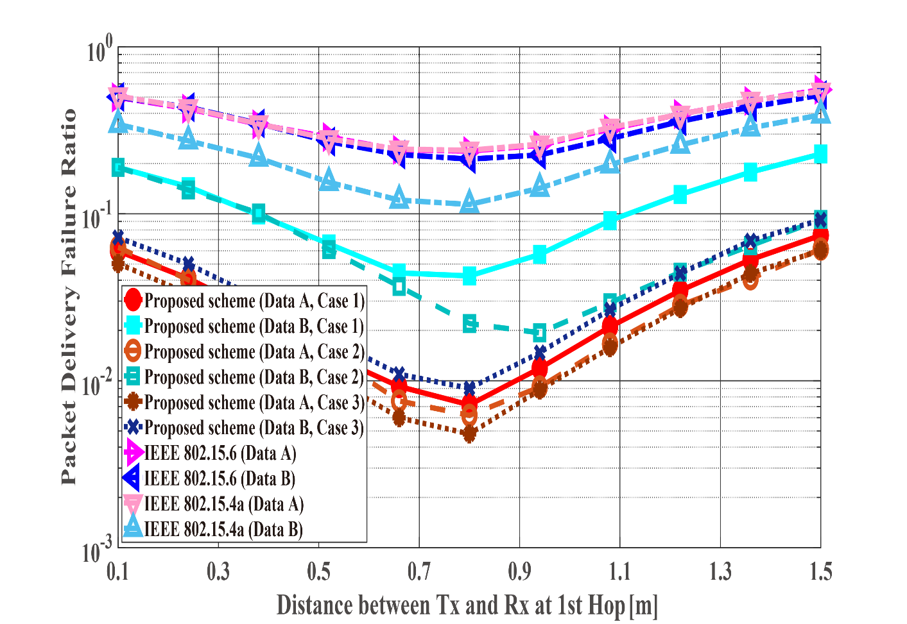
5. Numerical results
Packet delivery failure ratio with constant $d_{2hops}=d_{1st}+d_{2nd}=1.5 m$ varying the $d_{1st}$ and $d_{2nd}$ values. For $d_{1st}$ = 1.5 m, data are transmitted using only a single hop.

Slide 23
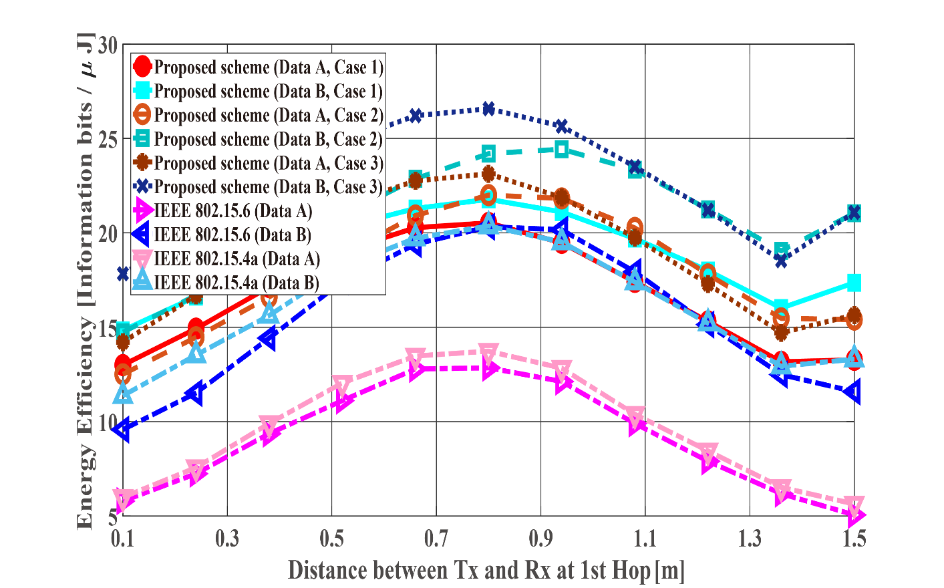
5. Numerical results
Energy efficiency with constant $d_{2hops}=d_{1st}+d_{2nd}=1.5 m$ varying the $d_{1st}$ and $d_{2nd}$ values. For $d_{1st}$ = 1.5 m, data are transmitted using only a single hop.

Slide 24
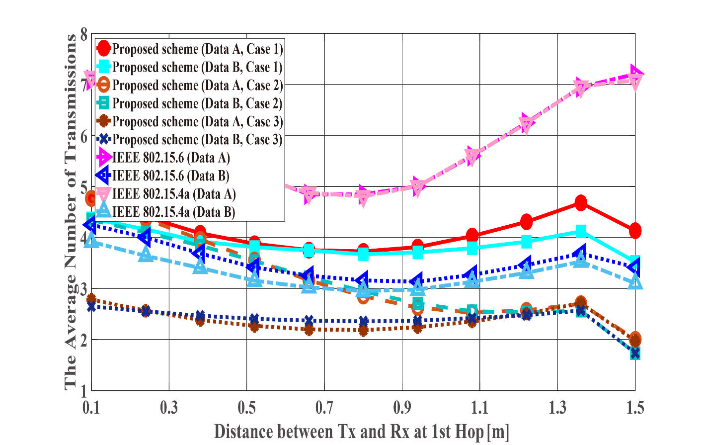
5. Numerical results
Average number of transmissions with constant $d_{2hops}=d_{1st}+d_{2nd}=1.5 m$ varying the $d_{1st}$ and $d_{2nd}$ values. For $d_{1st}$ = 1.5 m, data are transmitted using only a single hop.

Slide 25
5. Discussion (constant $d_{2hops}$ case)
The proposed scheme satisfies the QoS requirements for Data A and B, while both standard schemes approach do not like the first scenario
The performances of both standards are worse than the proposed one
For example, Data A of the proposed scheme satisfies PDFR <${10}^{−2}$, while that of both standards do not satisfy PDFR <${10}^{−1}$
The correcting capability of error correcting codes used in those standards is lower than that of the proposed scheme
Comparing Case 1 and Case 2, Case 2 has better characteristics
Case 2 can select a coding rate suitable for the channel condition by using Scheme 2 at the second hop
Regarding Case 1, since Scheme 1 is used at both hops, it is considered that a hop having a bad channel condition is greatly affected
Case 3 shows the best performance because Scheme 2 is used at both hops
All cases (except Case 2) achieve optimal performance when $d_{1st}=d_{2nd}=\frac{d_{2hop}}{2}$

Slide 26
6. Conclusion
The performance of our proposed hybrid ARQ scheme in the case of two-hop extension was evaluated
The PDFR, number of transmissions, and energy efficiency of our proposed system, IEEE Std. 802.15.6 and 15.4a were evaluated for this case
The numerical results show that the proposed scheme outperforms those standard schemes
Case 3 (i.e., the coding rates change depending on the channel’s condition) showed better performance than the other cases at both hops
When $d_{2hops}$ was fixed, it was shown that performance became optimal when $d_{1st}=d_{2nd}$ (except Case 2) from computer simulations
This result is expected to greatly contribute to the optimization of how nodes and hubs are arranged when designing a WBAN

Slide 27
Reference
Kento Takabayashi, Hirokazu Tanaka, Chika Sugimoto, Ryuji Kohno, "Performance Evaluation of Error Control Scheme in Multihop WBAN Based on IEEE802.15.6," The International Symposium on Information Theory and Its Applications 2016 (ISITA 2016), Monterey, California, US, pp.370-374, Oct. 2016.
Kento Takabayashi, Hirokazu Tanaka, Chika Sugimoto, Ryuji Kohno, "Performance Analysis of Cross-layer Approach About Error Control Scheme for WBANs," Proceedings of the 11th International Symposium on Medical Information and Communication Technology (ISMICT 2017), Lisbon, Portugal, pp.1-5, Feb. 2017.
Kento Takabayashi, Hirokazu Tanaka, Chika Sugimoto, Katsumi Sakakibara, Ryuji Kohno, "Cross-layer Design and Performance Analysis of Quality of Service Control Scheme for Wireless Body Area Networks," IEEE Access, vol.5, pp.22462-22470, Nov. 2017.
Kento Takabayashi, Hirokazu Tanaka, Chika Sugimoto, Katsumi Sakakibara, Ryuji Kohno, "Performance Evaluation of Quality of Service Control Scheme in Multi-hop WBAN Based on IEEE 802.15.6," Sensors, 2018, vol.18, issue.11, 3969, Nov. 2018.

Slide 28
Apendix

Slide 29
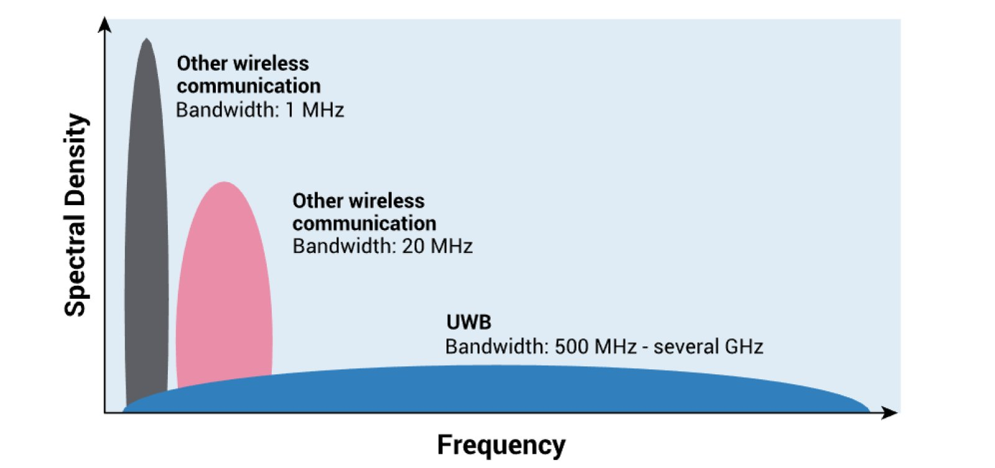
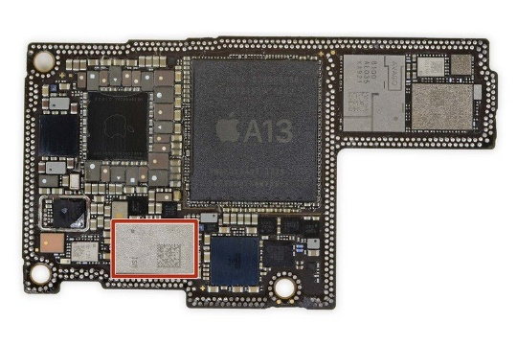
1. Introduction - UWB
IEEE 802.15.6 defines three physical layers
Narrowband
Ultra-wideband (UWB)
Human body communication (HBC)
UWB technology has recently regained attention (introduction to iPhone and AirTag, support for Android 12)
UWB offers…
high data rate transmission
Ultra-high-precision positioning
low energy consumption
powerful multi-pass resolution
good coexistence with other wireless communication systems
UWB is a technology that may satisfy the requirements of IoMT
Fig. UWB Frequency Spectol
Fig. U1 in iPhone 11

Slide 30
2. IEEE 802.15.6 UWB PHY
Frequency spectrum
Low Band
High Band
・・・
・・・
・・・
0
1
2
3
6
10
frequency $f$
bandwidth 499.2 MHz
3993.6 MHz
7987.2 MHz
The UWB band is divided into two band groups: low band (channel 0-2) and high band (channel 3-10) which are divided into operating frequency channels with 499.2 MHz bandwidth
Orange colors are mandatory channels (Low Band: channel 1，High Band: channel 6)
The power spectral density emission limit is -41.3 dBm/MHz which is very low

Slide 31
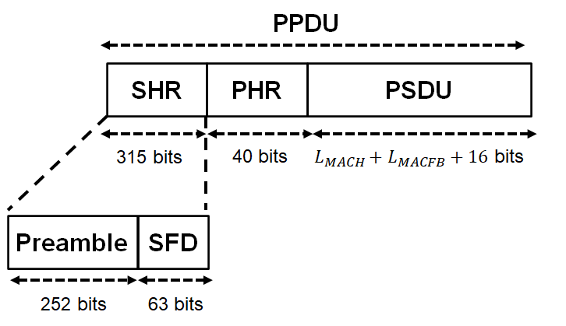
2. IEEE 802.15.6 UWB PHY
Frame format
SHR is divided into two parts: The first part is the preamble, intended for timing synchronization, packet detection, and carrier frequency offset recovery, and The second part is the start-of-frame delimiter (SFD) for frame synchronization
The PHR contains information about the data rate of the PSDU, length of the medium access control (MAC) frame body, pulse shape, burst mode, and so on
The PSDU contains the MAC protocol data unit (MPDU)

Slide 32
2. IEEE 802.15.6 UWB PHY
Modulation
In the IR-UWB PHY, the bits of the physical layer protocol data unit (PPDU) are modulated by either on–off modulation or differentially encoded binary phase shift keying (DBPSK)/quadrature phase shift keying (DQPSK)
This research assumes DBPSK
Error detection and correction codes
PHR: CRC-4 ITU is applied as the error detection code, and (40, 28) shortened BCH code is applied as the error correction code
PSDU: CRC-16-CCITT is applied as the error detection code, and (63, 51) BCH code or (126, 63) shortened BCH code is applied as the error correction code
In this study, (63, 51) BCH code is applied as the error correction code of PSDU ((126, 63) shortened BCH code is used in combination with Type II Hybrid ARQ)

Slide 33
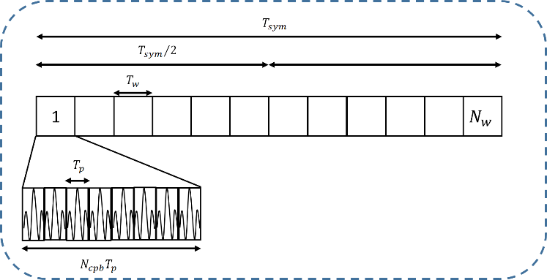
2. IEEE 802.15.6 UWB PHY
Pulse option
Transmitting signal
$$x\left(t\right)=\sum_{m=0}^{N}{c_{m}w\left(t−mT_{sys}−h^{(m)}T_{w}\right)}$$
$$w\left(t\right)=\left\{\begin{aligned}p\left(t\right) \\ (Single Pulse Option, T_{w}=T_{p}) \\ \sum_{i=0}^{N_{cpb}−1}{\left(1−2s_{i}\right)p\left(t−iT_{p}\right) } \\ (Burst Pulse Option, T_{w}=N_{cpb}T_{p})\end{aligned}\right.$$
Fig. Signal transmission example where the burst pulse option is used
Single pulse option: A single pulse transmitted per symbol
Burst pulse option: A concatenation of $N_{cpb}$ pulses transmitted per symbol
This option reduces the data rate while improving the received power by correlating multiple pulses

Slide 34
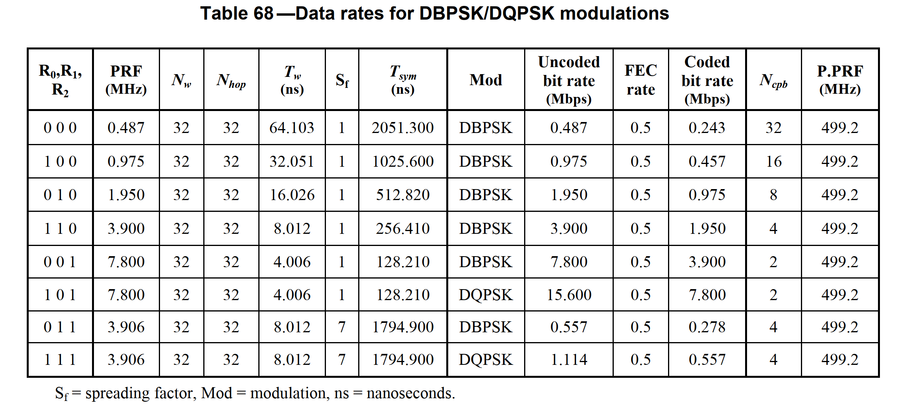
2. IEEE 802.15.6 UWB PHY
$N_{cpb}$ is the power of two
As $N_{cpb}$ increases, a data rate decreases
Data rate and received signal to noise ratio (SNR) are in a trade-off relationship

