Slide 1
Project: IEEE P802.15 Working Group for Wireless Personal Area Networks (WPANs)
Submission Title: SSBD Latency and Performance Analysis
Date Submitted: November 7th, 2022
Source: Benjamin Rolfe (Blind Creek Associates), Dries Neirynck (Ultra-radio)
Address:
E-Mail: ben.rolfe @ ieee.org
Re: Channel access for low latency
Abstract: This presentation is a follow-on to document 15-22-0485, Spectrum Sensing Based Deferral. This provides an analysis of performance relative to unslotted CSMA as defined in 802.15.4.
Purpose: Look at the performance differences between CSMA and SSBD
Notice: This document has been prepared to assist the IEEE P802.15. It is offered as a basis for discussion and is not binding on the contributing individual(s) or organization(s). The material in this document is subject to change in form and content after further study. The contributor(s) reserve(s) the right to add, amend or withdraw material contained herein.
Release: The contributor acknowledges and accepts that this contribution becomes the property of IEEE and may be made publicly available by P802.15.

Slide 2
What is SSBD
Presented document 15-22-0485-01:
Like CSMA but with differences:
  Uses a linear backoff growth
  Includes multiple termination options:
    Fail when CCA returns busy and max number of backoffs exceeded
    Fall back to Aloha
Uses CCA as supported by the PHY

Slide 3
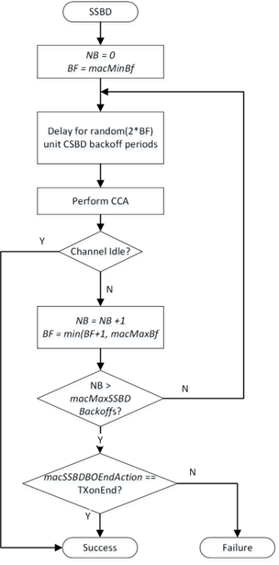
SSBD Algorithm overview
The algorithm terminates with Success when CCA returns idle.
The action when NB exceeds macMaxSSBDBackoffs depends on macSSBDBOEndAction:
  When set to FailOnEnd, end with Failure.
  When set to TXonEnd, end with Success. (fallback to Aloha)

Slide 4
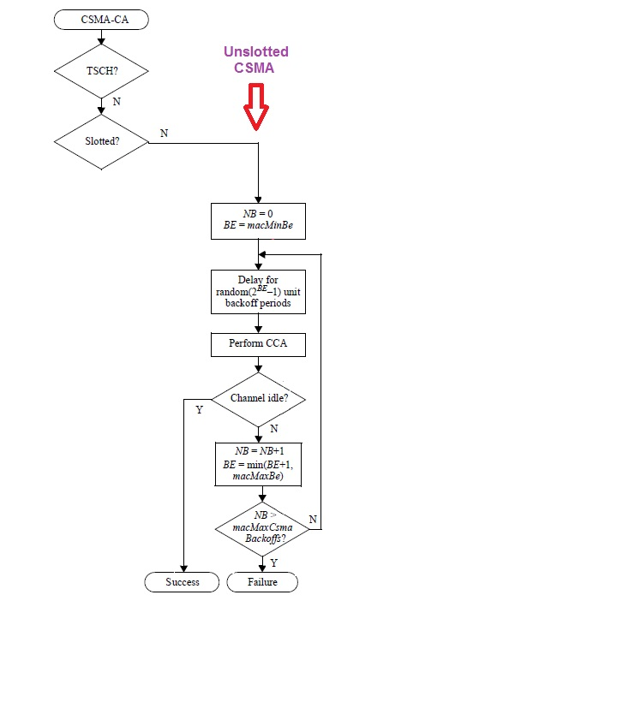
CSMA vs SSBD

Slide 5
Channel Access Demonstration Recap
From document # 15-22-0409 Demonstration
Recap: This demonstration showed use of a listen before talk scheme similar to the proposed Spectrum Sensing Based Deferral proposal which improved reliability in the presence of a multiple UWB devices in a small space.
Highlights:
Multiple (12) UWB data links transporting real time audio
Multiple (12) UWB data links plus a ranging link
The SSBD channel access shows significant improvement in packet delivery within the 10ms latency constraint
The SSBD channel access improved coexistence with the ranging link
Ranging link was using unslotted Aloha

Slide 6
Video - Notes
The use of sensing based channel access allows for the 12 links to coexist and application latency of 10 ms to be maintained.
The performance of a concurrent UWB ranging device is significantly improved when sensing based channel access is enabled on the contending devices.
LBT ON
LBT OFF
1000 ranging events logged at 2.5 meters
(100 seconds at 10 Hz polling rate)
From document # 15-22-0409 Demonstration

Slide 7
Additional Study: With 802.11ax
Following the July presentation, additional experiments were conducted
  802.11ax 6 GHz Access Point
  2 different client devices were tried
  Additional UWB devices added
Results were sanity checked by analysis
High level result: use of SSBD helped both ways

Slide 8
This Analysis
Looks at the channel access latency and success statistics
Simple simulation with a large number of iterations (channel access attempts)
Examines the effect of changing channel access parameters
Simple model of channel condition
  Set “optimism factor” for CCA clear return
    % of time channel is occupied when performing CCA
  This allows setting an arbitrary approximation of channel loading (all sources)

Slide 9
Caveats and Considerations
This analysis does not look at what channel conditions warrant use of a sensing based channel access
  There’s a lot of prior work analyzing when a contention based access schemes
  There’s a lot of variations of CSMA in actual implementations of different wireless standards
Experience and practical experiments show that it can provide a benefit
  We look at channel loading > 18% (the Aloha threshold commonly recognized)
  We look at various levels of loading with 25%, 50% and 75% presented here.
  Channel load may include other than UWB systems in the real world
  Assume channel access is NOT coordinated between contending devices
In unlicensed spectrum, all access is contention based!

Slide 10
So…
Use of a spectrum sensing based channel access can help
  Coexist with other UWB such as ranging
  Coexist with other than UWB
Other times Aloha is going to work better
  Low duty cycle and when aggregate channel load is low
Not one or the other – fit the solution to the need

Slide 11
Methodology
Compares statistically the channel access delay between unslotted CSMA and SSBD.
Using a Monte Carlo analysis based on a given CCA optimism factor
Examine the effect of different parameter settings.
The “optimism” factor: a probability, constant for the simulation run, that CAA will return clear
  e.g. an optimism parameter value of 50% results in CCA returning clear 50% of the CCA attempts.

Slide 12
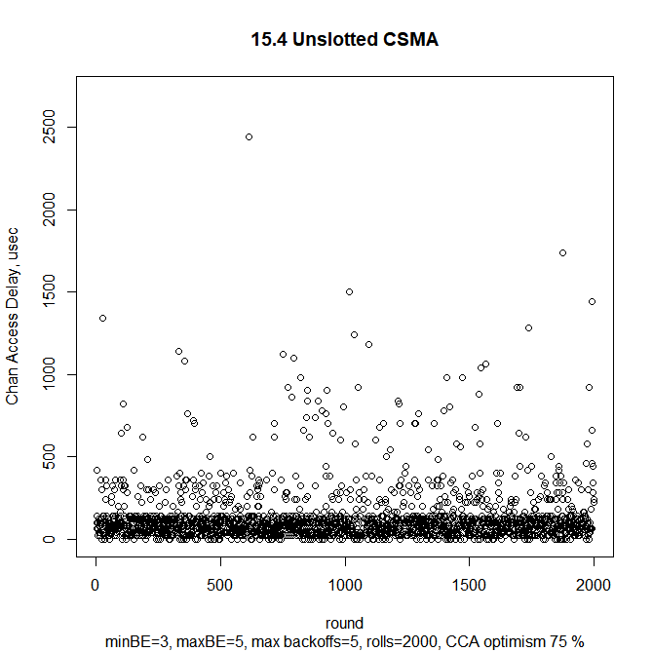
Some Results: CSMA at 75% optimism
Iterations: 2000
Channel access delay, μsec:
  Max: 2440.00
  Min: 0.00
  Median: 80.00
  Mean: 130.42
  Stdev: 174.86

Slide 13
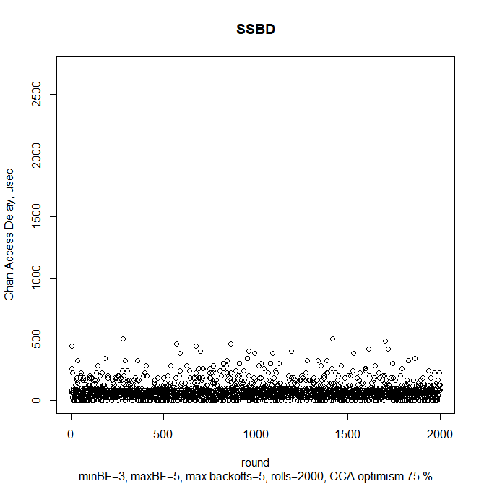
Some Results: SSBD at 75% optimism
Iterations: 2000
Channel access delay, μsec
  Max: 500.00
  Min: 0.00
  Median: 60.00
  Mean: 74.10
  Stdev: 65.81

Slide 14
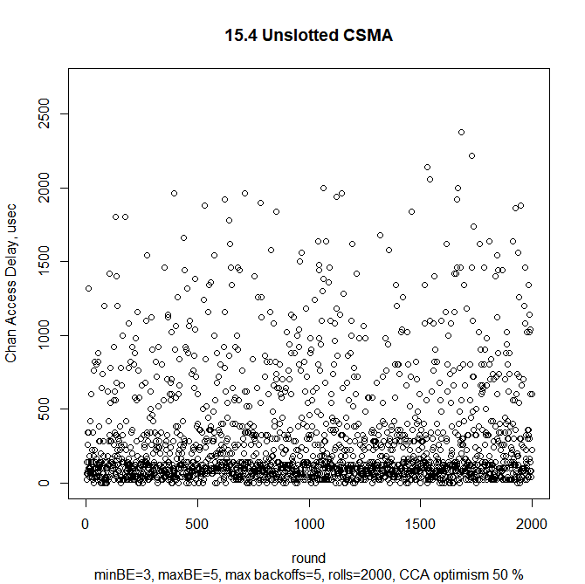
Some Results: CSMA at 50% optimism
Iterations: 2000
Channel access delay, μsec
  Max: 2380.00
  Min: 0.00
  Median: 120.00
  Mean: 290.05
  Stdev: 378.47

Slide 15
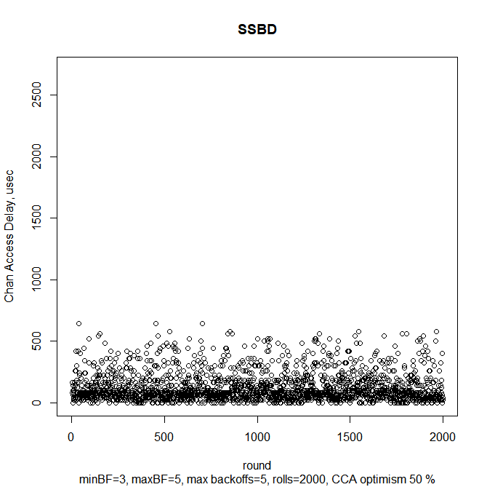
Some Results: SSBD at 50% optimism
Iterations: 2000
Channel access delay, μsec
  Max: 640.00
  Min: 0.00
  Median: 80.00
  Mean: 125.47
  Stdev: 117.40

Slide 16
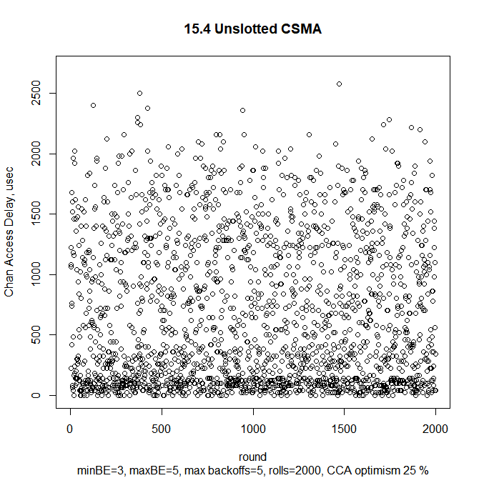
Some Results: CSMA at 25% optimism
Iterations: 2000
Channel access delay, μsec
  Max: 2580.00
  Min: 0.00
  Median: 420.00
  Mean: 659.52
  Stdev: 603.62

Slide 17
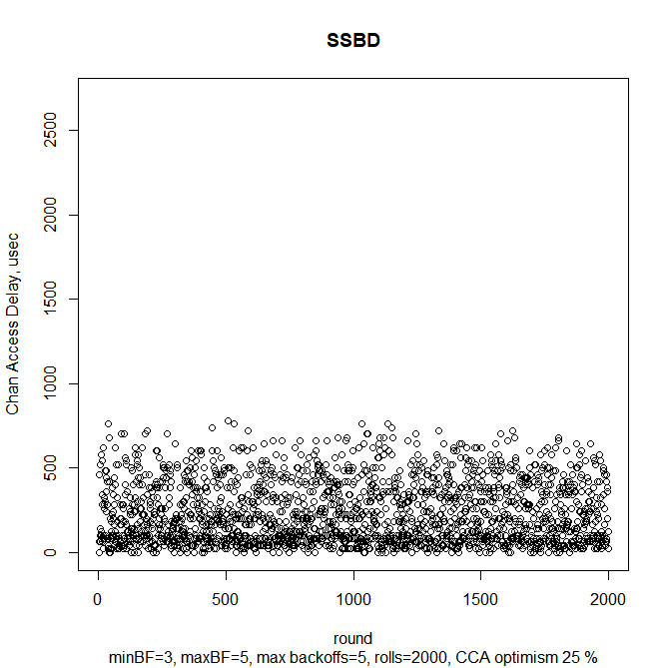
Some Results: SSBD at 25% optimism
Iterations: 2000
Channel access delay, μsec
  Max: 780.00
  Min: 0.00
  Median: 180.00
  Mean: 231.72
  Stdev: 180.74

Slide 18
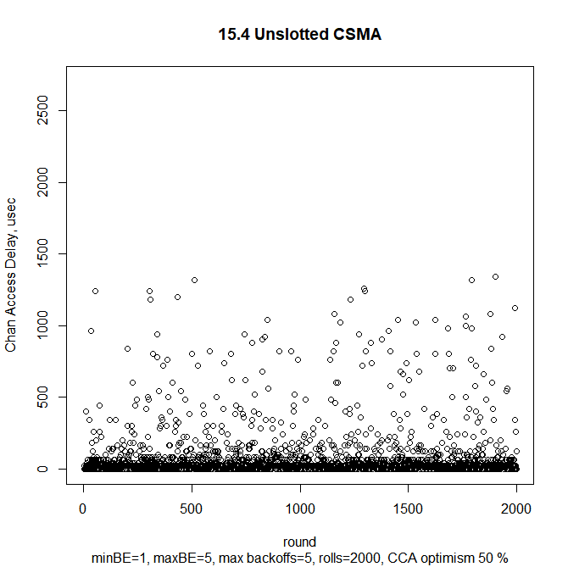
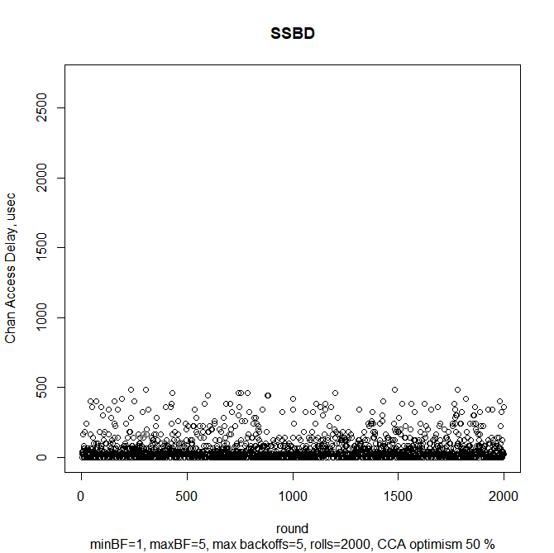
Changing Parameters: macMinBE/BF
Max: 1340.00
Min: 0.00
Mean: 85.90
Stdev: 184.77
Max: 480.00
Min: 0.00
Mean: 56.85
Stdev: 83.17

Slide 19
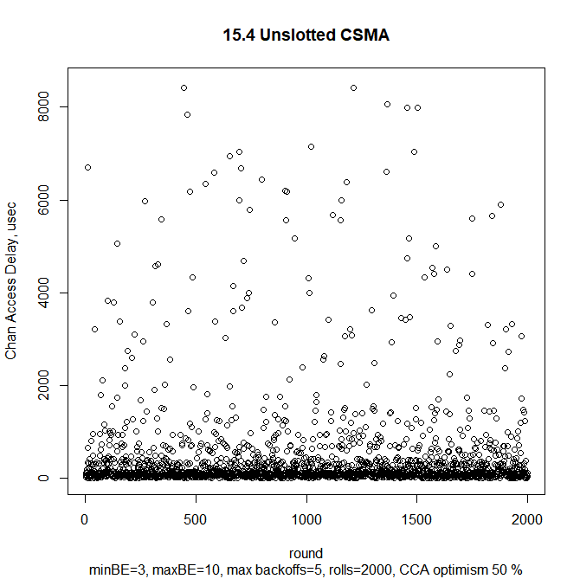
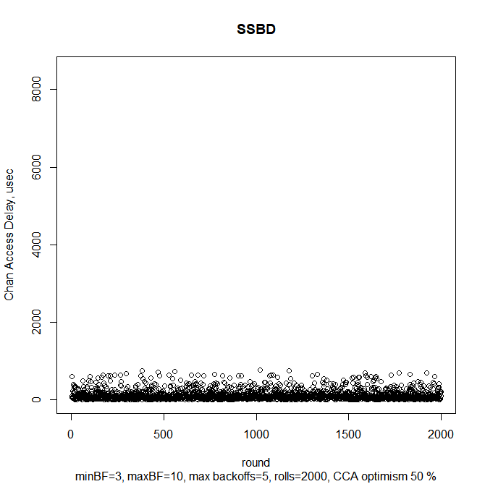
Changing Parameters: macMaxBE/BF
Max: 9000.00
Min: 0.00
Mean: 464.42
Stdev: 1051.51
Max: 780.00
Min: 0.00
Mean: 129.62
Stdev: 132.23

Slide 20
Conclusion:
Comparing CSMA and SSBD
Channel access latency bounded differently
  Bounded to lower latency with SSBD
  Delay range at each CCA attempt bounded by linear growth vs exponential
  Worst-case delay reduced by linear backoff
Fall-back to Aloha
  Increased packet delivery success
  Provides more opportunity for other transmitters and reduces collisions with other active transmissions

Slide 21
Things to explore further
Improved CCA model
Different CSMA/SSBD parameter values
Channel access failure rates w/CSMA
Effect of additional channel access enhancements such as persistence
Network modeling of channel access and coexistence (e.g. as done for 802.19.3)
  Show how CCA success is affected by network conditions, traffic types, and application scenarios

Slide 22
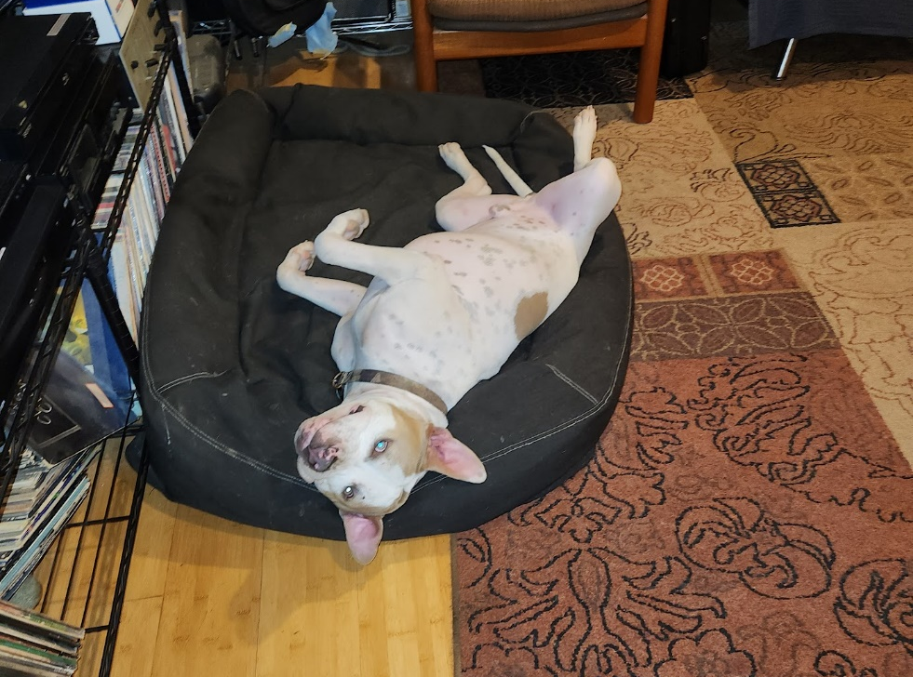
Thanks for your Attention!

