Slide 1
Project: IEEE P802.15 Working Group for Wireless Personal Area Networks (WPANs)
Submission Title: Discussion on the Issues of Draft D2 comment from Intel Corporation
Date Submitted: October 2022
Source: Huy Nguyen, Yeong Min Jang [Kookmin University].
Contact: +82-2-910-5068 E-Mail: yjang@kookmin.ac.kr
Re:
Abstract: Response to the Issues of Draft D2 comment from Intel Corporation
Purpose: Response to the Issues of Draft D2 comment from Intel Corporation
Notice: This document has been prepared to assist the IEEE P802.15. It is offered as a basis for discussion and is not binding on the contributing individual(s) or organization(s). The material in this document is subject to change in form and content after further study. The contributor(s) reserve(s) the right to add, amend or withdraw material contained herein.
Release: The contributor acknowledges and accepts that this contribution becomes the property of IEEE and may be made publicly available by P802.15.

Slide 2
Discussion on the Issues of Draft D2 comment from Intel Corporation

Slide 3
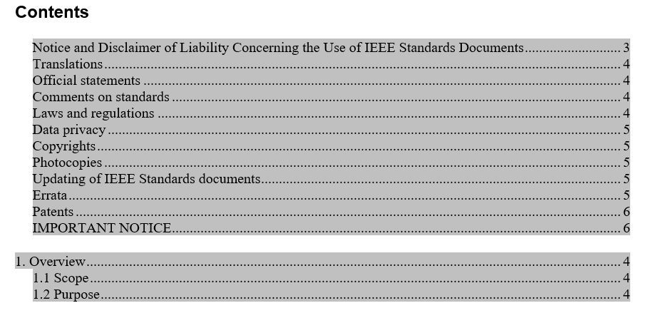
Issue #1: Decorate the Draft version
There is no bookmark for table of content, making it extremely hard to navigate through the document. Intsert table of content using book marking.
➔ We already have Table content in Draft Version D2 document (Pages #1-3)

Slide 4
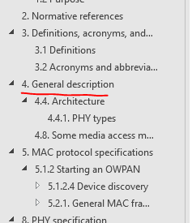
Issue #1: Decorate the Draft version
Clauses 4.4, 4.8, 5.x 8.x apear to be subcluases of clause 3. Adjust the clauses hierarchy

Slide 5
Issue #2: Technical issue in the Draft version
Annex O and Q are not identified as informative which makes it normative, refer to annexes A-N for proper designation
➔ We will update the annex contents with the proper designation

Slide 6
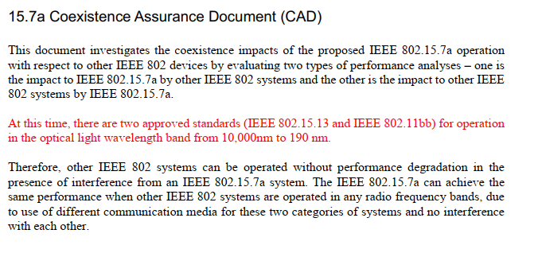
Issue #2: Technical issue in the Draft version
The CAD indicates the technology is the first within 802 to use light in the wavelength of 10,000 - 190nm, however there are two more projects in similar development status that uses partial or full overlap of the band, specifically 802.11bb which uses the 800-1000 nm, and 802.15.13 it is therefore beneficiary to develop coexistence mechanism and provide a reference in the CAD for this.
➔ We will update CAD document as suggestions.

