Slide 1
Project: IEEE P802.15 Interest Group for Wireless Personal Area Networks (WPANs)
Submission Title: Advantages of MIMO C-OOK scheme in Draft D2 document
Date Submitted: October 2022
Source: Huy Nguyen, Yeong Min Jang [Kookmin University].
Contact: +82-2-910-5068 E-Mail: yjang@kookmin.ac.kr
Re:
Abstract: Advantages of MIMO C-OOK scheme in Optical Camera Communication System
Purpose: To introduce the advantages of MIMO C-OOK for Optical Camera Communication
Notice: This document has been prepared to assist the IEEE P802.15. It is offered as a basis for discussion and is not binding on the contributing individual(s) or organization(s). The material in this document is subject to change in form and content after further study. The contributor(s) reserve(s) the right to add, amend or withdraw material contained herein.
Release: The contributor acknowledges and accepts that this contribution becomes the property of IEEE and may be made publicly available by P802.15.

Slide 2
Advantages of MIMO C-OOK scheme in Draft D2 document

Slide 3
Introduction
On-Off keying (OOK) scheme is known as the simplest form of amplitude-shift keying modulation by using two statuses: ON/OFF to transmit data
C-OOK stands for Camera- On Off Keying, a communication mode within the IEEE 802.15.7-2018 Optical Wireless Communication standard. Particularly, C-OOK is within the PHY V mode of IEEE 802.15.7-2018 standard.
MIMO C-OOK scheme, which updated the conventional C-OOK scheme, used MIMO, region of interest, and matched filter techniques.

Slide 4
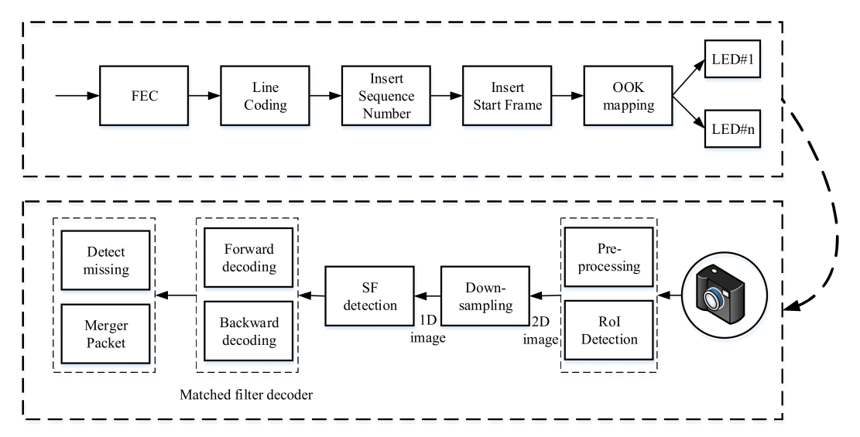
Architecture of MIMO C-OOK scheme
Reference architecture of MIMO C-OOK

Slide 5
Matched filter for MIMO C-OOK scheme
Find the start of frame
With the preamble detection based on matched filter, the received signals and the template of preamble signal will be multiplied by the convolution algorithm (1). The positions of preamble part are the maximum value of the convolution results.
$(f∗g)(t)≜\int_{−∞}^{+∞}{f\left(τ\right)g\left(t−τ\right)dτ}$
An experimental result of COOK within a rolling image. (b) The results of preamble position detection based on matched filter.

Slide 6
Matched filter for MIMO C-OOK scheme
Decoding based on the matched filter
With data decoding, we also multiplied the received signal and the template signal of line coding (Manchester code, 4B6B, 8B10B, etc.). Then, we can define the value of signals (0 or 1).
Manchester code signal patterns and COOK received signal. (a) 0 impulse, (b) 1 impulse, (c) COOK received signal.

Slide 7
Advantages of MIMO C-OOK scheme
Mobility support
Support multi-LED for high data rate.
High data rate (5.76 Mbps with 4 LEDs)

