Slide 1
Project: IEEE P802.15 Working Group for Wireless Personal Area Networks (WPANs)
Submission Title: Advantages of Rolling Shutter OFDM scheme in Draft D2 document
Date Submitted: October 2022
Source: Huy Nguyen, Yeong Min Jang [Kookmin University].
Contact: +82-2-910-5068 E-Mail: yjang@kookmin.ac.kr
Re:
Abstract: Advantages of Rolling Shutter OFDM scheme in Draft D2 document
Purpose: To discuss about the advantages of RS-OFDM scheme for OCC system based on rolling shutter effect.
Notice: This document has been prepared to assist the IEEE P802.15. It is offered as a basis for discussion and is not binding on the contributing individual(s) or organization(s). The material in this document is subject to change in form and content after further study. The contributor(s) reserve(s) the right to add, amend or withdraw material contained herein.
Release: The contributor acknowledges and accepts that this contribution becomes the property of IEEE and may be made publicly available by P802.15.

Slide 2
Advantages of Rolling Shutter OFDM scheme in Draft D2 document

Slide 3
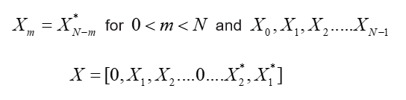
Rolling shutter OFDM scheme
Architecture of Rolling Shutter-OFDM system
Unlike the conventional OFDM in Radio Frequency, instead of feeding the data symbol directly into the IDFT block, each symbol must pass through the Hermitian block.

Slide 4
Data structure of Rolling Shutter OFDM scheme
Proposed data frame structure for Rolling Shutter-OFDM system
To support the compatibility of frame rate variation, every packet can contain many sub-packets, and each sub-packet in the same packet has the same data payload with a Sequence Number (SN).
The SN represents the serial number of packets.

Slide 5
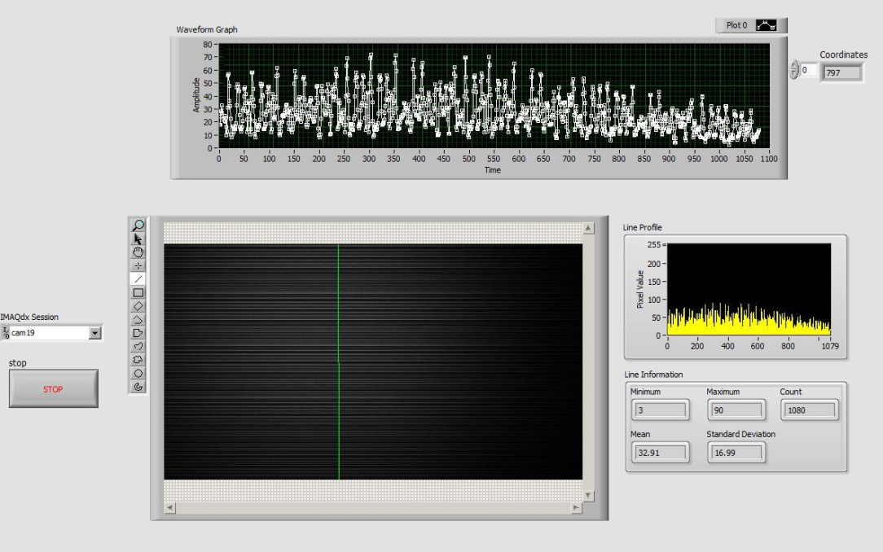
Data structure of Rolling Shutter OFDM scheme

Slide 6
Advantages of Rolling Shutter OFDM scheme
Mobility support
Reduce the Inter-Symbol Interference
High data rate (4.608 Mbps)

Slide 7
References
[1] Huy Nguyen, Thieu Minh Duc, Trang Nguyen, and Yeong Min Jang, “Rolling OFDM for Image Sensor Based Optical Wireless Communication,” IEEE Photonics Journal, Volume 11, Issue 4.

