Slide 1
Project: IEEE P802.15 Working Group for Wireless Personal Area Networks (WPANs)
Submission Title: [Considerations of the STS in 802.15.4z]
Date Submitted: [25 October, 2022]
Source: [Claudio Anliker, Giovanni Camurati, Srdjan Capkun (ETH Zurich)]
Re: [Input to the Working Group]
Abstract: [This document discusses security concerns about the Scrambled Timestamp Sequence (STS).]
Purpose: []
Notice: This document has been prepared to assist the IEEE P802.15. It is offered as a basis for discussion and is not binding on the contributing individual(s) or organization(s). The material in this document is subject to change in form and content after further study. The contributor(s) reserve(s) the right to add, amend or withdraw material contained herein.
Release: The contributor acknowledges and accepts that this contribution becomes the property of IEEE and may be made publicly available by P802.15.

Slide 2
PAR Objective | Proposed Solution (how addressed)
Safeguards so that the high throughput data use cases will not cause significant disruption to low duty-cycle ranging use cases
Interference mitigation techniques to support higher density and higher traffic use cases
Other coexistence improvement
Backward compatibility with enhanced ranging capable devices (ERDEVs)
Improved link budget and/or reduced air-time
Additional channels and operating frequencies
Improvements to accuracy / precision / reliability and interoperability for high-integrity ranging | Consider STS alternatives for 4ab.
Reduced complexity and power consumption
Hybrid operation with narrowband signaling to assist UWB
Enhanced native discovery and connection setup mechanisms
Sensing capabilities to support presence detection and environment mapping
Low-power low-latency streaming
Higher data-rate streaming allowing at least 50 Mbit/s of throughput
Support for peer-to-peer, peer-to-multi-peer, and station-to-infrastructure protocols
Infrastructure synchronization mechanisms

Slide 3
Clarifications on the Ghost Peak paper
Simple Attack on static STS / Super Deterministic Code (SDC):
reduced ToF due to earlier ToA
compute ToF
Initiator
$${STS}_{1}$$
$${STS}_{1}$$
Attacker
can learn STS…
… and retransmit it earlier!
Responder
scheduled response time
The attacker can learn the STS and use it to advance the signal in time → distance reduction.
→ This is not the Ghost Peak attack.

Slide 4
Clarifications on the Ghost Peak paper
Ghost Peak: oblivious to STS content:
shorter ToF due to Ghost Peak
compute ToF
Initiator
$${STS}_{i}$$
$${STS}_{i+1}$$
$${STS}_{i+1}+{STS}_{att}$$
Attacker
not interested in ${STS}_{i}$
transmit a randomly chosen ${STS}_{att}$ instead
Responder
scheduled response time
The Ghost Peak attacker does not bother to learn the STS:
GP is designed to attack the dynamic STS mode, where learning the STS is pointless.
Works against the static STS too, but more effective attacks are available (see previous slide).

Slide 5
Clarifications on the Ghost Peak paper
Major points:
We observed distance reductions with chips of two vendors using DS-TWR, 64/128 block STS (4/8k pulses) and dynamic STS mode.
The success probabilities for the two chips were ~4% and ~0.02%, respectively.
The difference may depend to some degree on fine tuning / calibration of the setup, STS length, and receiver internals.
The maximal distance reductions were ~15-20m (not controllable).

Slide 6
Recap: STS
The STS consists of pseudo-random bits (4096 in standard configuration):
Generated with AES
Every bit is represented by a single pulse.
However, these bits are not decoded / recovered by the receiver.
In HRP, the high Pulse-Repetition Frequency (PRF) makes it difficult to decode individual pulses.
Example: Pulse interval of e.g. 16 ns, channel spread of 100 ns realistic → overlap of several pulses
Result: Received signal is heavily distorted by the channel, BER would be high
Consequence: Perform cross-correlation between received signal and STS to measure «similarity» between them at any given time.

Slide 7
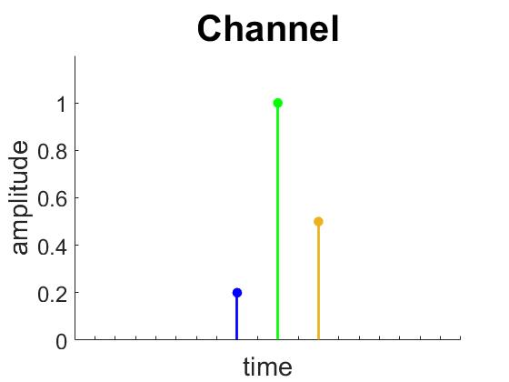
Recap: STS
Result of cross-correlation of a received signal ($s\left[t\right]$) with a known STS ($g_{loc}\left[m\right]$) results in a Channel Impulse Response (CIR) approximation:
A peak indicates that a copy of the STS arrived at that point in time.
Intuition: since the attacker does not know the STS, they cannot create such a peak.
Thus, one can use the first peak in the STS CIR to securely determine the ToA of the ranging message.
TX
RX

Slide 8
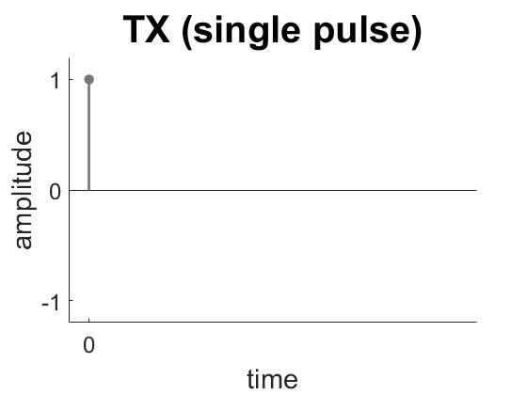
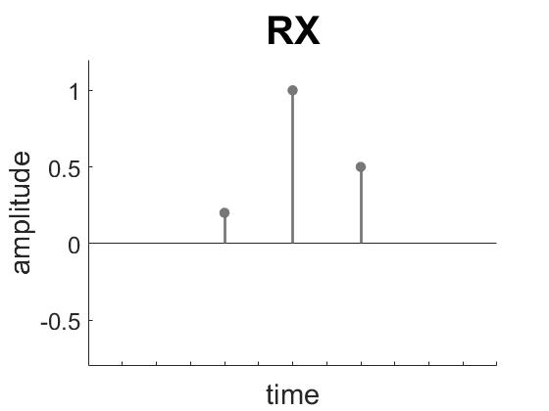
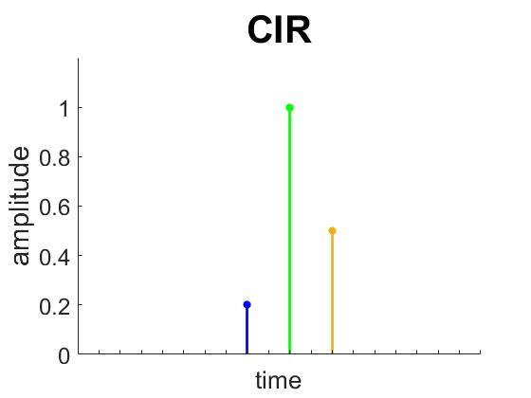
CIR example
=

Slide 9
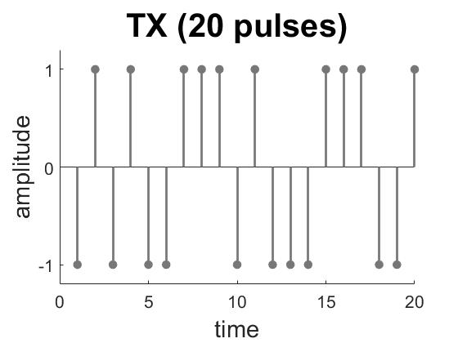
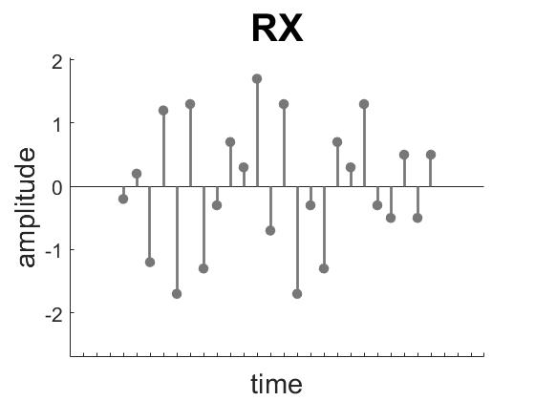
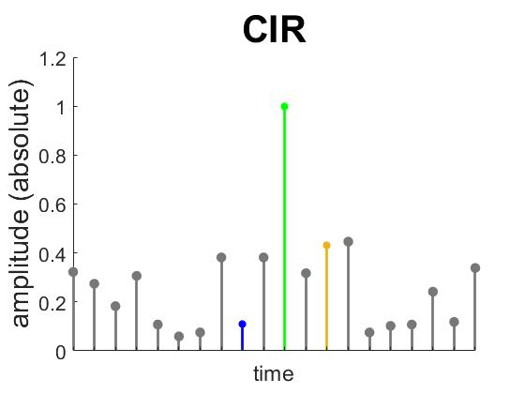
CIR example
similarities → auto-correlation
channel spread → inter-pulse interference

Slide 10
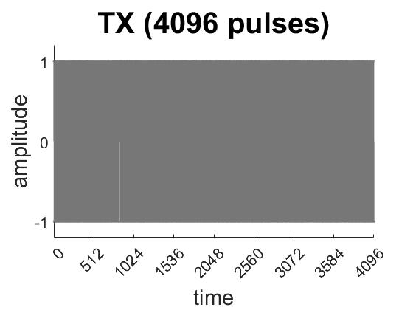
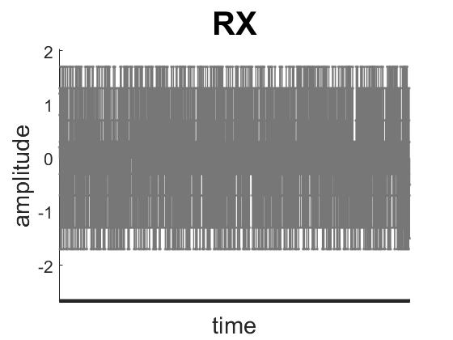
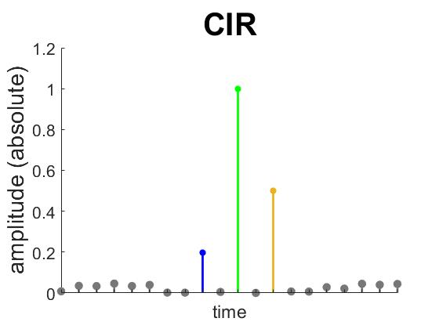
CIR example
CIR improved, but there is still noise.
→ Threshold to identify peaks.

Slide 11
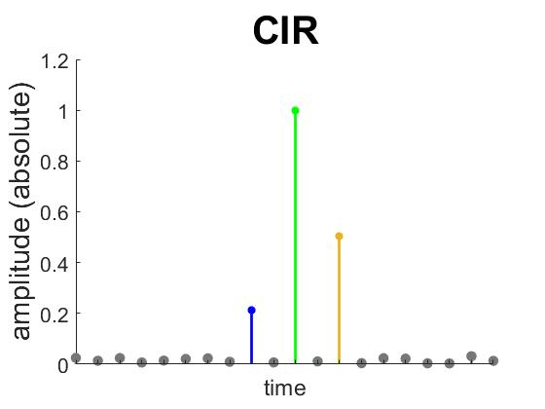
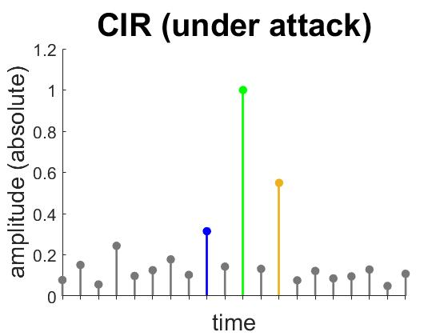
CIR example
What happens if an attacker injects a signal?
Ghost Peak
The injected signal raises the noise floor of the CIR. If a value within the backsearch window exceeds the threshold, the attack is successful.

Slide 12
Summary CIR
There is no bit decoding:
Each CIR value depends on $\left|g_{loc}\right|$ different samples:
The CIR value only shows the overall correlation result, not how it has been obtained.
A single correlation value does not accurately reflect the number of correct bits. Compare:
Largely correct but attenuated copy of STS
Injected signal with a few (slightly more than 50%) correct pulses with high power
However, a strong, incorrect signal injection increases the correlation noise:
→ Thus, the statistical significance of a peak compared to the noise is used.

Slide 13
Open questions / issues
How does the noise floor have to be calculated?
By how much does a correlation value have to be “above” the noise to be regarded as a peak?
Or, in other words: how strong does a genuine path have to be for us to guarantee its security?
Since CIR values depend on the power of individual pulses, a security analysis likely depends on receiver design/parameters, such as
the Automatic Gain Control (AGC),
the resolution of the Analog-to-Digital Converter (ADC), and
clipping of high-power signals,
as they all affect the set of possible inputs for the CIR computation.

Slide 14
Open questions / issues
Consequence: The security properties of the STS
are unclear and probably hard to prove,
depend on the receiver implementation,
and likely require additional hardening measures / defense mechanisms, which are not standardized.
No security guarantees or public analysis, customers and chip integrators have to trust vendors.
Decide whether UWB security should be a matter of standardization or competition.
Alternative security approach preferable for IEEE 802.15.4ab
Decouple security properties from receiver design to encourage open discussion / collaboration
Individual bit decoding (similar to LRP) for the RIF?

Slide 15
Questions?
Takeaways
Ghost Peak successful against static and dynamic STS modes of chips of at least two vendors.
Auto-correlation noise and inter-pulse interference lead to noisy CIR
Receivers use a threshold (or other strategy?) to distinguish CIR noise from legitimate paths
This is not standardized, receiver-specific and, in some cases, demonstrably insecure in practice.

