Slide 1
140th Session of meetings of the IEEE 802.15 Working Group for Wireless Specialty Networks (WSN)
Opening Report
Nov. 14-17, 2022
Held in Bangkok & Hybrid via Webex

Slide 2
802.15 WG Org. Chart

Slide 3
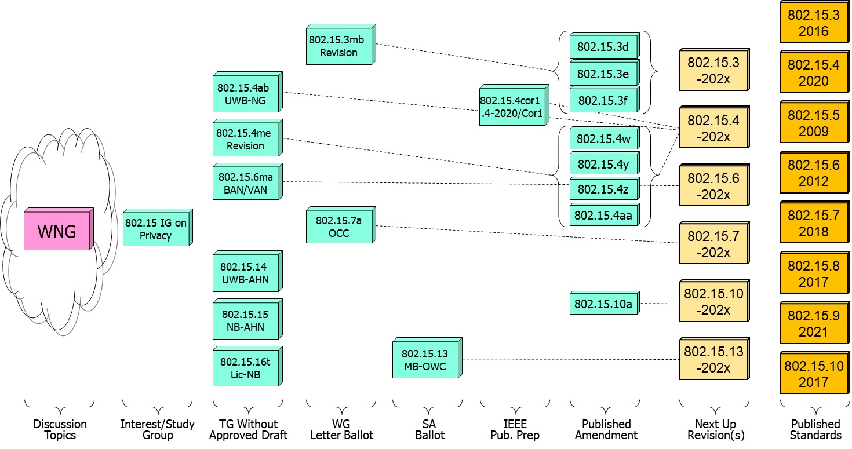
802.15 WG Standards Pipeline

Slide 4
802.15 WG Administrative
Voting members: 138
Nearly voting members: 15
Aspirant voting member: 19
802.15 WG Officer elections held in March 2022
Clint Powell elected WG Chair
Phil Beecher elected WG Vice-Chair
Ann Krieger appt’d. WG Vice-Chair
Still seeking a WG Sec & 1 WG Vice-Chair
*If interested contact WG15 Chair

Slide 5
802.15 WG Subgroups/Objectives
TG 3mb – Revision b, Maintenance (mb)
Objective: revision for 802.15.3, extension of the frequency range to 300 GHz and review the 802.1D references and replace them with 802.1Q as appropriate
TG 4/Cor1 – 802.15.4-2020 Corrigenda
Objective: correction of errors, inconsistencies, and ambiguities
TG 4ab – Next Generation Ultra WideBand (UWB-NG) amendment
Objective: enhancements to 802.15.4 Ultra Wideband (UWB) physical layers (PHYs) media access control (MAC), and associated ranging techniques while retaining backward compatibility with enhanced ranging capable devices (ERDEVs)
TG 4me – Revision e, Maintenance (mb)
Objective: revision to 802.15.4-2020, rolling up amendments 802.15.4w, 802.15.4y, 802.15.4z, and 802.15.4aa and work on errors, omissions, updates, etc.

Slide 6
802.15 WG Subgroups/Objectives
TG 6ma – Revision a, Maintenance (ma)
Objective: enhancements to the BAN Ultra Wideband (UWB) physical layer (PHY) and media access control (MAC) to support enhanced dependability to a human BAN (HBAN) and adds support for vehicle body area networks (VBAN), a coordinator in a vehicle with devices around the vehicular cabin
TG 7a – Optical Camera Communication (OCC)
Objective: high-rate OCC Physical Layer (PHY) using light wavelengths from 10,000 nm to 190 nm delivering data rates up to 100 Mb/s for point-to-point and point-to-multipoint communication

Slide 7
802.15 WG Subgroups/Objectives
TG 13 – Multi-Gigabit/sec Optical Wireless Communication (MG-OWC)
Objective: define OWC specifications to enable high data rate transfer among end points with up to multi-Gigabit throughput and ranges up to 200 m unrestricted line of site targeting support for ceiling-mounted infrastructure serving stationary and mobile devices as well as point-to-point links
TG 14 – Impulse Radio Ultra Wideband Wireless Ad Hoc Networks (UWB-AHN) ---IN HIBERNATION---
Objective: focused on impulse radio (IR) Ultra Wideband (UWB) PHY and MAC providing precision ranging capability that is accurate to the centimeter level by including (via. referencing) the 802.15.4 IR UWB functionality into a simple focused specification
TG 15 – Narrow Band Wireless Ad Hoc Networks (NB-AHN) ---IN HIBERNATION---
Objective: focused on narrow band ad hoc network PHY and MAC by including (via referencing) functionality and features of 802.15.4 into a simple focused specification

Slide 8
802.15 WG Subgroups/Objectives
TG 16t – Licensed Narrowband (Lic-NB)
Objective: specify new PHY in licensed spectrum with channel bandwidths greater than or equal to 5 kHz and less than 100 kHz focusing on spectrum less than 2 GHz.
IG Privacy
Objective: determine interest of topic “privacy of addresses” and if SG should be formed to develop PAR and CSD

Slide 9
802.15 WG Subgroups/Objectives
SC Maintenance/Rules
Objective: review errors noted in published standards providing a response/proposal to the 802.15 WG; review the 802.15 WG operations manual and suggest changes to 802.15 WG; review PARs submitted by other WGs
SC IETF – Internet Engineering Task Force standing committee
Objective: provides an 802.15 liaison to IETF for projects associated with 802.15 standards
SC THz – TeraHertz (THz)
Objective: follow the developments of THz communications, providing input to the regulatory framework for THz comms. in close cooperation IEEE 802.18 TAG; trigger the start of projects to amend existing and develop new standards for THz comms.
SC WNG – Wireless Next Generation (WNG)
Objective: provides an opportunity to individuals to make technical presentations to the 802.15 WG on new technologies and/or proposals for new projects

Slide 10
Meeting Slots for 802.15 WG Sept. Interim

Slide 11
Session Objectives Nov. 14-17, 2022
TG 3mb (Revision) (4 meeting slots)
Comment resolution on initial Letter Ballot
Seek WG approval to start Letter Ballot Recirc
TG 4/Cor1 (0 meeting slots)
In IEEE editing phase
TG 4ab (UWB-NG) (8 meeting slots)
Continue to hear and discuss PHY & MAC presentations
Identify elements to start pulling together baseline draft
TG 4me (Revision) (4 meeting slots)
Hear presentations on errors, omissions, updates, etc.
Hear status update of merged baseline draft
TG 6ma (Revision) (3 meeting slots)
Hear and discuss presentations
Continue harmonization with TG 4ab

Slide 12
Session Objectives Nov. 14-17, 2022
TG 7a (OCC) (3 meeting slots)
Comment resolution on initial Letter Ballot
Seek WG approval to start Letter Ballot Recirc
TG 13 (MG-OWC) (2 meeting slots)
Comment resolution for latest SA Ballot recirc
Discuss timeline of future recircs and submission to RevCom
TG 14 (UWB-AHN) (0 meeting slots)
TG 15 (NB-AHN) (0 meeting slots)
TG 16t (Lic-NB) (3 meeting slots)
Continue draft development
Joint 802.1/802.15 (1 meeting slot)
Presentation on additional elements of 802.15.4 arch. overview
Next steps for moving ahead

Slide 13
Session Objectives Nov. 14-17, 2022
IG PRIVACY (2 meeting slots)
Discuss and formulate objectives w.r.t. address privacy
Seek approval to form SG
SC MAINTENANCE (2 meeting slots)
Review any change requests for the Operations Manual
Work on any templates
Review other WG PAR submissions
SC IETF (1 meeting slot)
Discuss IETF activities
SC THz (0 meeting slots)
SC WNG (1 meeting slot)
Hearing presentations

