Slide 1
Project: IEEE P802.15 Working Group for Wireless Specialty Networks (WSN)
Submission Title: TG 15.4ab Agenda and Meeting Slides
Date Submitted: 27 September 2022
Source: Benjamin A. Rolfe (Blind Creek Associates)
Contact:
Voice: +1 408 395 7207, E-Mail: ben.rolfe @ ieee.org
Re: Task Group 4ab: 802.15.4 UWB Next Generation
Abstract: Teleconference (WebEx) Agenda and Meeting Slides
Purpose: Emulate organization, encourage participation and make further progress
Notice: This document has been prepared to assist the IEEE P802.15. It is offered as a basis for discussion and is not binding on the contributing individual(s) or organization(s). The material in this document is subject to change in form and content after further study. The contributor(s) reserve(s) the right to add, amend or withdraw material contained herein.
Release: The contributor acknowledges and accepts that this contribution becomes the property of IEEE and may be made publicly available by P802.15.
Notes:
Jul 12, 2010
Page 1

Slide 2

Task Group 15.4ab
Next Generation UWB Amendment
Teleconference / Virtual Meeting
September 27th, 2022

Slide 3
Task Group Rules
Discussion: Everyone present is welcome
Straw polls: Everyone present may vote
Formal motions: WG voters
  To make, second and vote
Patent policy for PAR activities applies
All the usual rules of conduct
Please identify yourself on first contact with name and affiliation

Slide 4
IEEE-SA Patent, Copyright, and Participation Policies
See: https://grouper.ieee.org/groups/802/sapolicies.shtml
IEEE-SA Patent Slides for Standards Development Meetings (.pdf)
https://development.standards.ieee.org/myproject/Public/mytools/mob/slideset.pdf
IEEE-SA Standards Board Patent Committee (PatCom) home page
https://standards.ieee.org/content/ieee-standards/en/about/sasb/patcom/index.html
IEEE-SA Participation Policy meeting slide set - individual method (.pdf)
https://standards.ieee.org/content/dam/ieee-standards/standards/web/documents/other/Participant-Behavior-Individual-Method.pdf
Working Group Copyright Materials
https://standards.ieee.org/ipr/copyright-materials.html
https://standards.ieee.org/content/dam/ieee-standards/standards/web/documents/other/ieee-sa-copyright-policy-2019.pdf

Slide 5
Participants have a duty to inform the IEEE
  Participants shall inform the IEEE (or cause the IEEE to be informed) of the identity of each holder of any potential Essential Patent Claims of which they are personally aware if the claims are owned or controlled by the participant or the entity the participant is from, employed by, or otherwise represents
  Participants should inform the IEEE (or cause the IEEE to be informed) of the identity of any other holders of potential Essential Patent Claims
  Early identification of holders of potential Essential Patent Claims is encouraged

Slide 6
Ways to inform IEEE
Cause an LOA to be submitted to the IEEE SA (patcom@ieee.org); or
Provide the chair of this group with the identity of the holder(s) of any and all such claims as soon as possible; or
Speak up now and respond to this Call for Potentially Essential Patents
If anyone in this meeting is personally aware of the holder of any patent claims that are potentially essential to implementation of the proposed standard(s) under consideration by this group and that are not already the subject of an Accepted Letter of Assurance, please respond at this time by providing relevant information to the WG Chair
08 June 2021 – Slide 2

Slide 7
Other Guidelines for IEEE Working Group Meetings
All IEEE SA standards meetings shall be conducted in compliance with all applicable laws, including antitrust and competition laws.
  Don’t discuss the interpretation, validity, or essentiality of patents/patent claims.
  Don’t discuss specific license rates, terms, or conditions.
    Relative costs of different technical approaches that include relative costs of patent licensing terms may be discussed in standards development meetings.
      Technical considerations remain the primary focus.
  Don’t discuss or engage in the fixing of product prices, allocation of customers, or division of sales markets.
  Don’t discuss the status or substance of ongoing or threatened litigation.
  Don’t be silent if inappropriate topics are discussed. Formally object to the discussion immediately.
---------------------------------------------------------------
For more details, see IEEE SA Standards Board Operations Manual, clause 5.3.10 and
Antitrust and Competition Policy: What You Need to Know at http://standards.ieee.org/develop/policies/antitrust.pdf

Slide 8


Slide 9


Slide 10


Slide 11
IEEE 802 Ground Rules
Respect … give it, get it
NO product pitches
NO corporate pitches
NO prices
NO restrictive notices – (no confidentially notices in email)
Presentations must be openly available

Slide 12
Instructions for Chairs of standards development activities
At the beginning of each standards development meeting the chair or a designee is to:
    Show the following slides (or provide them beforehand)
    Advise the standards development group participants that:
    IEEE SA’s copyright policy is described in Clause 7 of the IEEE SA Standards Board Bylaws and Clause 6.1 of the IEEE SA Standards Board Operations Manual;
    Any material submitted during standards development, whether verbal, recorded, or in written form, is a Contribution and shall comply with the IEEE SA Copyright Policy;
    Instruct the Secretary to record in the minutes of the relevant meeting:
    That the foregoing information was provided and that the copyright slides were shown (or provided beforehand).

Slide 13
IEEE SA Copyright Policy
By participating in this activity, you agree to comply with the IEEE Code of Ethics, all applicable laws, and all IEEE policies and procedures including, but not limited to, the IEEE SA Copyright Policy.
    Previously Published material (copyright assertion indicated) shall not be presented/submitted to the Working Group nor incorporated into a Working Group draft unless permission is granted.
    Prior to presentation or submission, you shall notify the Working Group Chair of previously Published material and should assist the Chair in obtaining copyright permission acceptable to IEEE SA.
    For material that is not previously Published, IEEE is automatically granted a license to use any material that is presented or submitted.

Slide 14
IEEE SA Copyright Policy
    The IEEE SA Copyright Policy is described in the IEEE SA Standards Board Bylaws and IEEE SA Standards Board Operations Manual
      IEEE SA Copyright Policy, see
      Clause 7 of the IEEE SA Standards Board Bylaws
      https://standards.ieee.org/about/policies/bylaws/sect6-7.html#7
      Clause 6.1 of the IEEE SA Standards Board Operations Manual
      https://standards.ieee.org/about/policies/opman/sect6.html
    IEEE SA Copyright Permission
      https://standards.ieee.org/content/dam/ieee-standards/standards/web/documents/other/permissionltrs.zip
    IEEE SA Copyright FAQs
      https://standards.ieee.org/faqs/copyrights/
    IEEE SA Best Practices for IEEE Standards Development
    http://standards.ieee.org/content/dam/ieee-standards/standards/web/documents/other/best_practices_for_ieee_standards_development_051215.pdf
    Distribution of Draft Standards (see 6.1.3 of the SASB Operations Manual)
      https://standards.ieee.org/about/policies/opman/sect6.html

Slide 15
Proposed Agenda
Opening and meeting preamble
Recap and Reminders
Technical discussions
  Topics identified for more discussion
  802.15 and 802.18
Next steps
  Review telecon schedule and holidays
Any other Business

Slide 16
Recap

Slide 17
5.2.b Scope of the project (As approved):
This amendment enhances the Ultra Wideband (UWB) physical layers (PHYs) medium access control (MAC), and associated ranging techniques while retaining backward compatibility with enhanced ranging capable devices (ERDEVs).
Areas of enhancement include:
  additional coding, preamble and modulation schemes to additional coding, preamble and modulation schemes to support improved link budget and/or reduced air-time relative to IEEE Std 802.15.4 UWB;
  additional channels and operating frequencies;
  interference mitigation techniques to support greater device density and higher traffic use cases relative to the IEEE Std 802.15.4 UWB;
  improvements to accuracy, precision and reliability and interoperability for high-integrity ranging; schemes to reduce complexity and power consumption;
  definitions for tightly coupled hybrid operation with narrowband signaling to assist UWB;
  enhanced native discovery and connection setup mechanisms;
  sensing capabilities to support presence detection and environment mapping;
  and mechanisms supporting low-power low-latency streaming as well as high data-rate streaming allowing at least 50 Mb/s of throughput.
Support for peer-to-peer, peer-to-multi-peer, and station-to-infrastructure protocols are in scope, as are infrastructure synchronization mechanisms. This amendment includes safeguards so that the high throughput data use cases do not cause significant disruption to low duty-cycle ranging use cases.
https://development.standards.ieee.org/myproject-web/app#viewpar/9081

Slide 18
Project Schedule (working baseline)
Proposed project schedule | Nov-21 | Dec-21 | Jan-22 | Feb-22 | Mar-22 | Apr-22 | May-22 | Jun-22 | Jul-22 | Aug-22 | Sep-22 | Oct-22 | Nov-22 | Dec-22 | Jan-23 | Feb-23 | Mar-23 | Apr-23 | May-23 | Jun-23 | Jul-23 | Aug-23 | Sep-23 | Oct-23 | Nov-23 | Dec-23 | Jan-24 | Feb-24 | Mar-24 | Apr-24 | May-24 | Jun-24 | Jul-24 | Aug-24 | Sep-24 | Oct-24 | Nov-24
Call for proposals
Hear and evaluate proposals
Cut-off for new proposals, PHY
Cut-off for new proposals, MAC
Integrate poposals/contributions into TFD
Develop draft from TFD
Draft 0
TG draft review and revision
Working group pre-ballot review
Pre-ballot review and comment resolution
First letter ballot |  |  |  |  |  |  |  |  |  |  |  |  |  |  |  |  | LB
LB Comment Resolution
WG Recirculatoin |  |  |  |  |  |  |  |  |  |  |  |  |  |  |  |  |  |  |  |  | LB-R
Comment resolution, 1st recirc
Conditional approval for SA ballot
WG Recirculatoin |  |  |  |  |  |  |  |  |  |  |  |  |  |  |  |  |  |  |  |  |  |  | LB-R
Comment resolution, 2nd recirc and final recirc
First SA ballot |  |  |  |  |  |  |  |  |  |  |  |  |  |  |  |  |  |  |  |  |  |  |  |  | SA
Comment resolution, first SA ballot
SA Resirculation |  |  |  |  |  |  |  |  |  |  |  |  |  |  |  |  |  |  |  |  |  |  |  |  |  |  |  | SA-R
Comment resolution, SA recirculation
SA Resirculation |  |  |  |  |  |  |  |  |  |  |  |  |  |  |  |  |  |  |  |  |  |  |  |  |  |  |  |  |  |  | SA-R
Comment resolution, 2nd SA recirc
Conditional or unconditional approval to RevCom |  |  |  |  |  |  |  |  |  |  |  |  |  |  |  |  |  |  |  |  |  |  |  |  |  |  |  |  | ?? |  |  |  | ??
Optional 3rd SA recirc if needed |  |  |  |  |  |  |  |  |  |  |  |  |  |  |  |  |  |  |  |  |  |  |  |  |  |  |  |  |  |  |  |  | SA-R
RevCom meets |  |  |  |  |  |  |  |  |  |  |  |  |  |  |  |  |  |  |  |  |  |  |  |  |  |  |  |  |  |  |  |  |  | ` |  |  |  | `
You are Here >
Notes: SASB/RevCom schdule for 2024 a guess

Slide 19
Schedule Major Milestones
Near Term Working Milestones
Call for proposals | November 2021
Cut-off for new features (high level feature set), PHY | May 2022
Cut-off for new features (high level feature set), MAC | July 2022
Draft 0 | Post-November 2022
TG draft review and revision complete | November-January 2022
Working group pre-ballot review commence | January-Feb 2022 (following Jan meeting)
First letter ballot | March 2023 (following meeting)
…
Progress as of Sept 27th:
As per review in the interim closing, about 1 meeting cycle from our initial schedule goals
Most areas need further technical development
  More time to get it right is better than getting it wrong

Slide 20

Technical Discussion

Slide 21
Topics identified for further discussion
  Channel plan
    Method of drafting
    Provision for gaps/holes (excluded channels)
  Scheduled access
    Several similar approaches (different terms)
    Several raised discussion on advertising/discovery
      Period vs aperiodic/randomized
  Improved PHY header
    CRC vs SECDEd
    Different CRC algorithms – enough better?
  Alternate R-marker mapping
    Some questions require off-line discussion (reflector) to understand the benefit
  ??

Slide 22
802.15 and 802.18 RRTAG
802.18 is the “802 voice” on regulatory input
  Needs to be the “whole 802” viewpoint
  Diversity of views requires diversity of participation
UWB is important
  Growing in importance rapidly
  We have a collection of UWB experts in TG4ab
  Your TG chair is active in RRTAG
    But only one pair of eyes
WG chair is looking for more WSN perspectives
802 can have a very positive impact on how things change
  802 represents the best wireless technologies for many uses
  WSN includes a rich set of those technologies
  We need to protect the present as well as promote the future

Slide 23

Next Steps

Slide 24
Telecon Schedule
Sept '22
S | M | T | W | 14 | F | S
18 | 19 | 20 | 21 | 22 | 23 | 24
25 | 26 | 27 | 28 | 29 | 30
Today
November '22
S | M | T | W | T | F | S
 |  | 1 | 2 | 3 | 4 | 5
6 | 7 | 8 | 9 | 10 | 11 | 12
13 | 14 | 15 | 16 | 17 | 18 | 19
20 | 21 | 22 | 23 | 24 | 25 | 26
27 | 28 | 29 | 30
October '22
S | M | T | W | T | F | S
 |  |  |  |  |  | 1
2 | 3 | 4 | 5 | 6 | 7 | 8
9 | 10 | 11 | 12 | 13 | 14 | 15
16 | 17 | 18 | 19 | 20 | 21 | 22
23 | 24 | 25 | 26 | 27 | 28 | 29
30 | 31
Next Call
Plenary

Slide 25
Telecon Schedule
Sept '22
S | M | T | W | 14 | F | S
18 | 19 | 20 | 21 | 22 | 23 | 24
25 | 26 | 27 | 28 | 29 | 30
Today
November '22
S | M | T | W | T | F | S
 |  | 1 | 2 | 3 | 4 | 5
6 | 7 | 8 | 9 | 10 | 11 | 12
13 | 14 | 15 | 16 | 17 | 18 | 19
20 | 21 | 22 | 23 | 24 | 25 | 26
27 | 28 | 29 | 30
October '22
S | M | T | W | T | F | S
 |  |  |  |  |  | 1
2 | 3 | 4 | 5 | 6 | 7 | 8
9 | 10 | 11 | 12 | 13 | 14 | 15
16 | 17 | 18 | 19 | 20 | 21 | 22
23 | 24 | 25 | 26 | 27 | 28 | 29
30 | 31
Major Holiday in China
Rotation optimized for Asia
Still make sense?
Next Call
Plenary

Slide 26
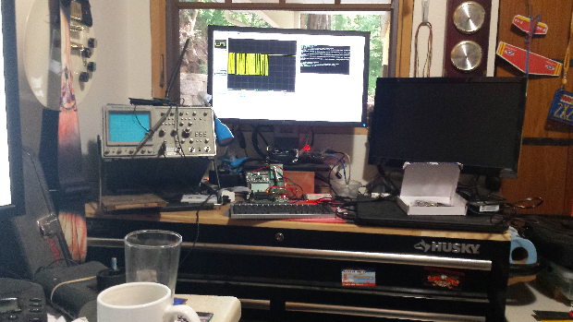
Other Business

Slide 27
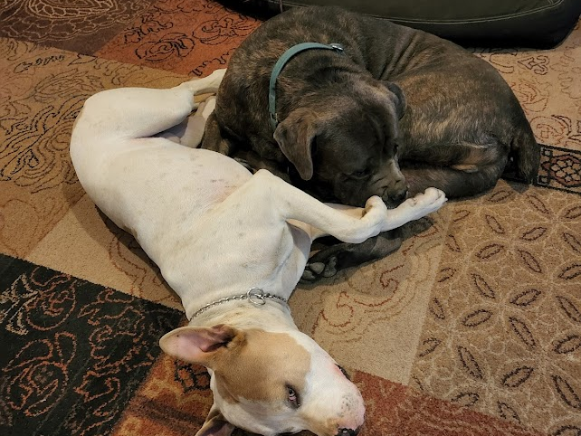
Adjourned
Thanks

