Slide 1
Project: IEEE P802.15 Working Group for Wireless Specialty Networks (WSN)
Submission Title: TG 15.4ab September 2022 Interim Session Closing Report
Date Submitted: 15 September 2022
Source: Benjamin A. Rolfe (Blind Creek Associates)
Contact:
Voice: +1 408 395 7207, E-Mail: ben.rolfe @ ieee.org
Re: Task Group 4ab: 802.15.4 UWB Next Generation
Abstract: Summary of TG4ab meetings during the session
Purpose: Inform and Ammuse
Notice: This document has been prepared to assist the IEEE P802.15. It is offered as a basis for discussion and is not binding on the contributing individual(s) or organization(s). The material in this document is subject to change in form and content after further study. The contributor(s) reserve(s) the right to add, amend or withdraw material contained herein.
Release: The contributor acknowledges and accepts that this contribution becomes the property of IEEE and may be made publicly available by P802.15.
Notes:
Jul 12, 2010
Page 1

Slide 2
Mixed Mode Interim September 2022
Task Group 15.4ab
Next Generation UWB Amendment
Live!
in-person and on-line!
New and Improved!

Slide 3
Task Group 15.4ab Next Generation UWB Amendment
Objective: enhancements to 802.15.4 Ultra Wideband (UWB) physical layers (PHYs) medium access control (MAC) and associated ranging techniques while retaining backward compatibility with enhanced ranging capable devices (ERDEVs).

Slide 4
5.2.b Scope of the project (As approved):
This amendment enhances the Ultra Wideband (UWB) physical layers (PHYs) medium access control (MAC), and associated ranging techniques while retaining backward compatibility with enhanced ranging capable devices (ERDEVs). Areas of enhancement include:
additional coding, preamble and modulation schemes to additional coding, preamble and modulation schemes to support improved link budget and/or reduced air-time relative to IEEE Std 802.15.4 UWB;
additional channels and operating frequencies;
interference mitigation techniques to support greater device density and higher traffic use cases relative to the IEEE Std 802.15.4 UWB;
improvements to accuracy, precision and reliability and interoperability for high-integrity ranging; schemes to reduce complexity and power consumption;
definitions for tightly coupled hybrid operation with narrowband signaling to assist UWB;
enhanced native discovery and connection setup mechanisms;
sensing capabilities to support presence detection and environment mapping;
and mechanisms supporting low-power low-latency streaming as well as high data-rate streaming allowing at least 50 Mb/s of throughput.
Support for peer-to-peer, peer-to-multi-peer, and station-to-infrastructure protocols are in scope, as are infrastructure synchronization mechanisms. This amendment includes safeguards so that the high throughput data use cases do not cause significant disruption to low duty-cycle ranging use cases.
https://development.standards.ieee.org/myproject-web/app#viewpar/9081

Slide 5
Task Group Organization
Chair: Benjamin Rolfe (BCA)¹
Vice Chair: Clint Powell (Meta)
Vice Chair: Clint Chaplin (SRA)
Vice Chair and Recording Secretary: David Xun Yang (Huawei)
Lead Technical Editor: Billy Verso (Qorvo)
Thank you to all the volunteers!
¹ Affiliation Details here: https://mentor.ieee.org/802-ec/dcn/22/ec-22-0061-00-00EC-rolfe-affiliations-by-802-activity.pdf

Slide 6
Task Group Agenda
https://mentor.ieee.org/802.15/dcn/22/15-22-0440-11-04ab-tg4ab-agenda-september-2022.xlsx
 |  |  |  |  |  |  | Sept 2022 Wireless Plenary
 |  |  |  | Mtg. Local Time | SUNDAY |  | MONDAY |  |  |  | TUESDAY |  |  |  | WEDNESDAY |  |  |  | THURSDAY
 |  |  |  | Hawaiian | 11-Sep-2022 |  | 12-Sep-2022 |  |  |  | 13-Sep-2022 |  |  |  | 14-Sep-2022 |  |  |  | 15-Sep-2022
EDT | PDT | UTC | JST |  | Virtual Rm 1 |  | Virtual Rm 1 | Virtual Rm 2 | Virtual Rm 3 | Virtual Rm 4 | Virtual Rm 1 | Virtual Rm 2 | Virtual Rm 3 | Virtual Rm 4 | Virtual Rm 1 | Virtual Rm 2 | Virtual Rm 3 | Virtual Rm 4 | Virtual Rm 1 | Virtual Rm 2 | Virtual Rm 3 | Virtual Rm 4
13:00 | 10:00 | 17:00 | 2:00 | 07:00-07:30 |  |  | CONTINENTAL BREAKFAST |  |  |  | CONTINENTAL BREAKFAST |  |  |  | CONTINENTAL BREAKFAST |  |  |  | CONTINENTAL BREAKFAST
13:30 | 10:30 | 17:30 | 2:30 | 07:30-08:00 |  |  |  |  |  |  |  |  |  |  | 802.15 AC MEETING Rm 3
14:00 | 11:00 | 18:00 | 3:00 | 08:00-08:30 |  |  | JOINT WIRELESS OPENING |  |  |  | TG4ab NG-UWB
14:30 | 11:30 | 18:30 | 3:30 | 08:30-09:00 |  |  |  |  |  |  |  |  |  |  | TG4ab NG-UWB
15:00 | 12:00 | 19:00 | 4:00 | 09:00-09:30 |  |  | 802.15 WG Opening Plenary Rm 1
15:30 | 12:30 | 19:30 | 4:30 | 09:30-10:00
16:00 | 13:00 | 20:00 | 5:00 | 10:00-10:30 |  |  | Break |  |  |  | Break |  |  |  | Break |  |  |  | Break
16:30 | 13:30 | 20:30 | 5:30 | 10:30-11:00 |  |  | TG4 Cor1 |  |  | TG3ma HDR | SC Main_Rules Rm 1 |  |  |  | 802.15 WG Midweek Plenary Rm 1 |  |  |  | TG4ab NG-UWB |  |  | SC IETF
17:00 | 14:00 | 21:00 | 6:00 | 11:00-11:30 |  |  | TG4me
17:30 | 14:30 | 21:30 | 6:30 | 11:30-12:00 |  |  |  |  |  |  | 802.15/802.1 Joint Mtg Rm 1 |  |  |  | SC WNG Rm 1
18:00 | 15:00 | 22:00 | 7:00 | 12:00-12:30
18:30 | 15:30 | 22:30 | 7:30 | 12:30-13:00 |  |  | LUNCH |  |  |  | LUNCH |  |  |  | LUNCH |  |  |  | LUNCH
19:00 | 16:00 | 23:00 | 8:00 | 13:00-13:30
19:30 | 16:30 | 23:30 | 8:30 | 13:30-14:00 |  |  | TG4ab NG-UWB |  |  | TG13 OWC | TG4ab NG-UWB |  | TG16t LicNB | TG13 OWC | TG4ab NG-UWB |  | TG16t LicNB | TG13 OWC | TG4ab NG-UWB | TG7a OCC | TG16t LicNB | TG13 OWC
20:00 | 17:00 | 0:00 | 9:00 | 14:00-14:30
20:30 | 17:30 | 0:30 | 9:30 | 14:30-15:00
21:00 | 18:00 | 1:00 | 10:00 | 15:00-15:30
21:30 | 18:30 | 1:30 | 10:30 | 15:30-16:00 |  |  | Break |  |  |  | Break |  |  |  | Break |  |  |  | Break
22:00 | 19:00 | 2:00 | 11:00 | 16:00-16:30 | WIRELESS CHAIRS MEETING |  | TG4ab NG-UWB |  | TG7a OCC | TG6ma BAN/ VAN | TG4me |  |  | TG6ma BAN/ VAN | TG4me |  | TG7a OCC | TG6ma BAN/ VAN | 802.15 WG Closing Plenary Rm 1
22:30 | 19:30 | 2:30 | 11:30 | 16:30-17:00
23:00 | 20:00 | 3:00 | 12:00 | 17:00-17:30
23:30 | 20:30 | 3:30 | 12:30 | 17:30-18:00 | 802.15 AC MEETING Rm 3
0:00 | 21:00 | 4:00 | 13:00 | 18:00-18:30 |  |  | Break |  |  |  | Break |  |  |  | Break |  |  |  | Break

Slide 7
Session Objectives
Hear technical contributions and develop technical content for the draft
Converge and build consensus
Consider proposed text for draft
Map the path to a technically complete draft

Slide 8
Project Schedule

Slide 9
Project Schedule (working baseline)
Proposed project schedule | Nov-21 | Dec-21 | Jan-22 | Feb-22 | Mar-22 | Apr-22 | May-22 | Jun-22 | Jul-22 | Aug-22 | Sep-22 | Oct-22 | Nov-22 | Dec-22 | Jan-23 | Feb-23 | Mar-23 | Apr-23 | May-23 | Jun-23 | Jul-23 | Aug-23 | Sep-23 | Oct-23 | Nov-23 | Dec-23 | Jan-24 | Feb-24 | Mar-24 | Apr-24 | May-24 | Jun-24 | Jul-24 | Aug-24 | Sep-24 | Oct-24 | Nov-24
Call for proposals
Hear and evaluate proposals
Cut-off for new proposals, PHY
Cut-off for new proposals, MAC
Integrate poposals/contributions into TFD
Develop draft from TFD
Draft 0
TG draft review and revision
Working group pre-ballot review
Pre-ballot review and comment resolution
First letter ballot |  |  |  |  |  |  |  |  |  |  |  |  |  |  |  |  | LB
LB Comment Resolution
WG Recirculatoin |  |  |  |  |  |  |  |  |  |  |  |  |  |  |  |  |  |  |  |  | LB-R
Comment resolution, 1st recirc
Conditional approval for SA ballot
WG Recirculatoin |  |  |  |  |  |  |  |  |  |  |  |  |  |  |  |  |  |  |  |  |  |  | LB-R
Comment resolution, 2nd recirc and final recirc
First SA ballot |  |  |  |  |  |  |  |  |  |  |  |  |  |  |  |  |  |  |  |  |  |  |  |  | SA
Comment resolution, first SA ballot
SA Resirculation |  |  |  |  |  |  |  |  |  |  |  |  |  |  |  |  |  |  |  |  |  |  |  |  |  |  |  | SA-R
Comment resolution, SA recirculation
SA Resirculation |  |  |  |  |  |  |  |  |  |  |  |  |  |  |  |  |  |  |  |  |  |  |  |  |  |  |  |  |  |  | SA-R
Comment resolution, 2nd SA recirc
Conditional or unconditional approval to RevCom |  |  |  |  |  |  |  |  |  |  |  |  |  |  |  |  |  |  |  |  |  |  |  |  |  |  |  |  | ?? |  |  |  | ??
Optional 3rd SA recirc if needed |  |  |  |  |  |  |  |  |  |  |  |  |  |  |  |  |  |  |  |  |  |  |  |  |  |  |  |  |  |  |  |  | SA-R
RevCom meets |  |  |  |  |  |  |  |  |  |  |  |  |  |  |  |  |  |  |  |  |  |  |  |  |  |  |  |  |  |  |  |  |  | ` |  |  |  | `
You are Here >
Notes: SASB/RevCom schdule for 2024 a guess

Slide 10
Schedule Major Milestones
Near Term Working Milestones
Call for proposals | November 2021
Cut-off for new features (high level feature set), PHY | May 2022
Cut-off for new features (high level feature set), MAC | July 2022
Draft 0 | September 2022
TG draft review and revision complete | November 2022
Working group pre-ballot review complete | January 2022 (before meeting)
First letter ballot | March 2023 (following meeting)
…
Plan A
Call for proposals | November 2021
Cut-off for new features (high level feature set), PHY | May 2022
Cut-off for new features (high level feature set), MAC | July 2022
Draft 0 | January 2023
TG draft review and revision complete | March 2022
Working group pre-ballot review/comment collection b | March 2023 – May 2023
Working group pre-ballot review complete | May 2023 (before meeting)
First letter ballot | July 2023 (following meeting)
Revise

Slide 11
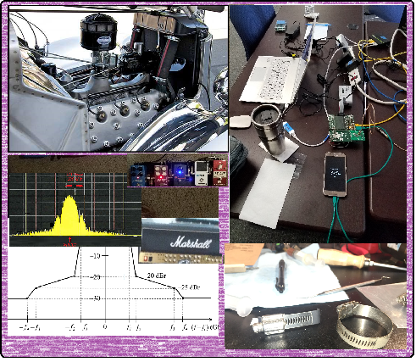
Technical Presentations

Slide 12
Technical Contributions
15-22-0456 | https://mentor.ieee.org/802.15/dcn/22/15-22-0456-00-04ab-uwb-channel-usage-coordination-for-better-uwb-coexistence.pptx
15-22-0473 | https://mentor.ieee.org/802.15/dcn/22/15-22-0473-01-04ab-nb-cca-follow-up.pptx
15-22-0466 | https://mentor.ieee.org/802.15/dcn/22/15-22-0466-00-04ab-more-on-updating-the-number-of-fragments-for-nba-mms-uwb-ranging.pptx
15-22-0479 | https://mentor.ieee.org/802.15/dcn/22/15-22-0479-00-04ab-more-consideration-on-sensing-pulse-shape-in-802-15-4ab.pptx
15-22-0475 | https://mentor.ieee.org/802.15/dcn/22/15-22-0475-00-04ab-phr-content-and-rate.pptx
15-22-0485 | https://mentor.ieee.org/802.15/dcn/22/15-22-0485-01-04ab-ssbd-channel-access.pptx
15-22-0461 | https://mentor.ieee.org/802.15/dcn/22/15-22-0481-01-04ab-short-term-cross-correlation.pptx
15-22-0468 | https://mentor.ieee.org/802.15/dcn/22/15-22-0468-02-04ab-bpsk-modulation-for-high-speed-data-rates-in-impulse-ultra-wideband-radio.pptx
15-22-0467 | https://mentor.ieee.org/802.15/dcn/22/15-22-0467-01-04ab-a-phy-header-proposal.pptx
15-22-0489 | https://mentor.ieee.org/802.15/dcn/22/15-22-0489-00-04ab-uwb-sensing-sequence-selection.pptx
15-22-0465 | https://mentor.ieee.org/802.15/dcn/22/15-22-0465-01-04ab-usecase-for-the-multiple-transmissions-in-a-ranging-slot.ppt
15-22-0494 | https://mentor.ieee.org/802.15/dcn/22/15-22-0494-02-04ab-further-evaluation-of-preamble-sequence-options-for-15-4ab.pptx

Slide 13
Technical Contributions
15-22-0476 | https://mentor.ieee.org/802.15/dcn/22/15-22-0476-01-04ab-more-on-nb-considerations-for-nba-mms-uwb.pptx
15-22-0474 | https://mentor.ieee.org/802.15/dcn/22/15-22-0474-01-04ab-mms-uwb-ranging-integrity-protection-via-time-hopping.pptx
15-22-0493 | https://mentor.ieee.org/802.15/dcn/22/15-22-0493-00-04ab-updates-on-narrowband-channel-allocation-and-access.pptx
15-22-0508 | https://mentor.ieee.org/802.15/dcn/22/15-22-0508-00-04ab-status-on-downlink-tdoa-dl-tdoa-location-service-technical-specifications-in-802-15.pptx
15-22-0471 | https://mentor.ieee.org/802.15/dcn/22/15-22-0471-00-04ab-requirements-for-location-tracking-in-dense-environments.pdf
15-22-0504 | https://mentor.ieee.org/802.15/dcn/22/15-22-0504-01-04ab-uwb-sensing-discussion-for-802-15-4ab.pptx
15-22-0507 | https://mentor.ieee.org/802.15/dcn/22/15-22-0507-00-04ab-simulation-evaluation-of-preamble-sequences-for-4ab.pptx
15-22-0506 | https://mentor.ieee.org/802.15/dcn/22/15-22-0506-01-04ab-new-results-on-possible-ldpc-codes-for-15-4ab.pptx
15-22-0501 | https://mentor.ieee.org/802.15/dcn/22/15-22-0501-00-04ab-new-scheduling-ie-for-4ab-applications.pptx
15-22-0500 | https://mentor.ieee.org/802.15/dcn/22/15-22-0500-00-04ab-new-control-ie-for-4ab-applications.pptx
15-22-0514 | https://mentor.ieee.org/802.15/dcn/22/15-22-0514-00-04ab-non-coherent-phy-layer-proposal-for-15-4ab-tfd.docx
15-22-0499 | https://mentor.ieee.org/802.15/dcn/22/15-22-0499-00-04ab-rmarkers-in-mixed-mms-for-ranging-integrity.pptx

Slide 14
Next Steps

Slide 15
Telecon Schedule
Usual Cadence:
Weekly on Tuesday
Alternating time:
06:00 PT
22:00 PT (10pm)
Skip week after interim
First call: 27th Sept 06:00
[phase decided by coin flip]
Sept '22
S | M | T | W | 14 | F | S
11 | 12 | 13 | 14 | 15 | 16 | 17
18 | 19 | 20 | 21 | 22 | 23 | 24
25 | 26 | 27 | 28 | 29 | 30
First Call

Slide 16
Telecon Schedule
Sept '22
S | M | T | W | 14 | F | S
18 | 19 | 20 | 21 | 22 | 23 | 24
25 | 26 | 27 | 28 | 29 | 30
October '22
S | M | T | W | T | F | S
 |  |  |  |  |  | 1
2 | 3 | 4 | 5 | 6 | 7 | 8
9 | 10 | 11 | 12 | 13 | 14 | 15
16 | 17 | 18 | 19 | 20 | 21 | 22
23 | 24 | 25 | 26 | 27 | 28 | 29
30 | 31
November '22
S | M | T | W | T | F | S
 |  | 1 | 2 | 3 | 4 | 5
6 | 7 | 8 | 9 | 10 | 11 | 12
13 | 14 | 15 | 16 | 17 | 18 | 19
20 | 21 | 22 | 23 | 24 | 25 | 26
27 | 28 | 29 | 30
First Call
Plenary

Slide 17
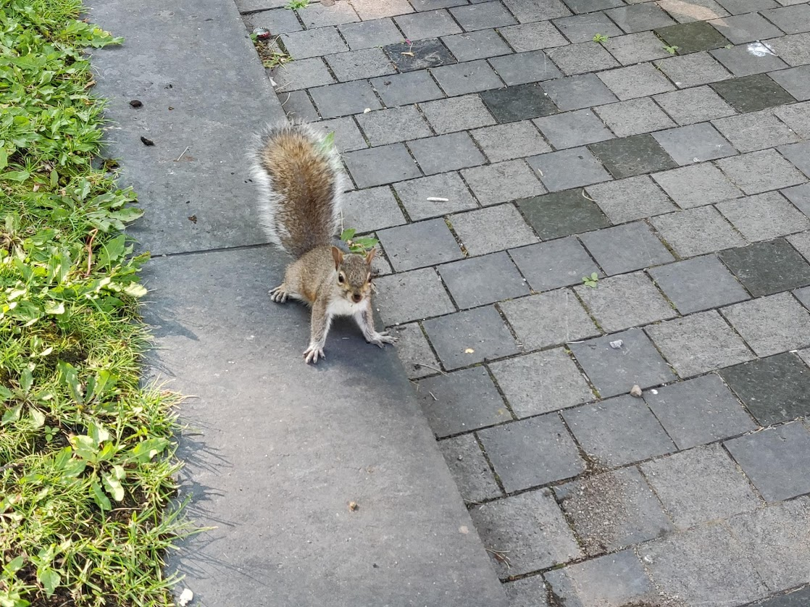
And that was the way it was, September 2022!

