Slide 1
Project: IEEE P802.15 Working Group for Wireless Personal Area Networks (WPANs)
Submission Title: [TG15.6ma Closing Report for September 2022]
Date Submitted: [15th September 2022]
Source: [Ryuji Kohno1,2,] [1;Yokohama National University, 2;YRP International Alliance Institute(YRP-IAI)]
Address [1; 79-5 Tokiwadai, Hodogaya-ku, Yokohama, 240-8501 Japan
2; YRP1 Blg., 3-4 HikarinoOka, Yokosuka-City, Kanagawa, 239-0847 Japan]
Voice:[1; +81-90-5408-0611], FAX: [+81-45-383-5528],
Email:[1: kohno@ynu.ac.jp, 2: kohno@yrp-iai.jp] Re: []
Abstract: [This document contains closing report for TG15.6ma for Revision of P802.15.6-2012 with Enhanced Dependability September 2022.]
Purpose: [information]
Notice: This document has been prepared to assist the IEEE P802.15. It is offered as a basis for discussion and is not binding on the contributing individual(s) or organization(s). The material in this document is subject to change in form and content after further study. The contributor(s) reserve(s) the right to add, amend or withdraw material contained herein.
Release: The contributor acknowledges and accepts that this contribution becomes the property of IEEE and may be made publicly available by P802.15.

Slide 2
IEEE 802.15 TG6ma
(Revision of IEEE802.15.6-2012)
Closing Report
In Personal and Virtual Hybrid Plenary Session
September 15th, 2022
Ryuji Kohno
Yokohama National University(YNU),
YRP International Alliance Institute(YRP-IAI)

Slide 3
Objectives of TG 6ma – Enhanced Dependability Body Area Network (ED-BAN)
Objective: Enhancements to the BAN Ultra Wideband (UWB) physical layer (PHY) and media access control (MAC) to support enhanced dependability to a human BAN (HBAN) and adds support for vehicle body area networks (VBAN), a coordinator in a vehicle with devices around the vehicular cabin.
Action:
Complete Channel Model Document(CMD) for revision
Complete Document on MAC for enhanced dependability
Complete Technical Requirement Document(TRD)
Call for Proposals with Complete all Documentation
Discussion on Feasibility and satisfaction in market of the TRD
Discussion on Feasibility of TSN of 802.1 in MAC and interference mitigation in PHY and MAC
Joint Meeting with other groups for harmonization to resolve common problems
Next Things to Do：
Accept Proposals to Satisfy Technical Requirements

Slide 4
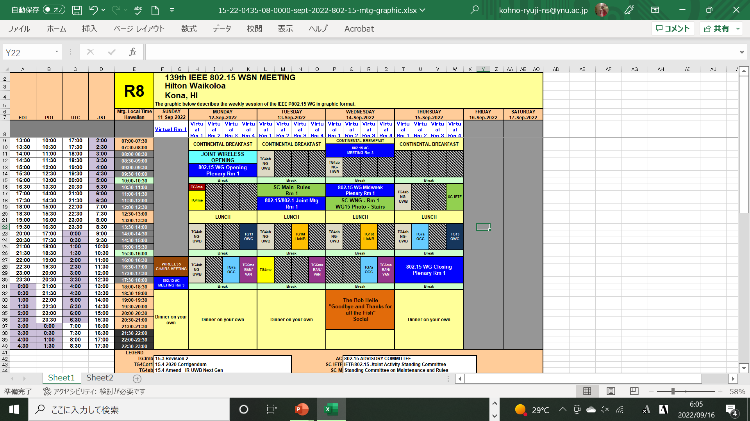
TG15.6ma Interim Session Schedule for 12-17th, September 2022
TG15.6ma has three own sessions and one joint session such as
Session1: PM2 16:00-18:00 Local Hawaii Time, 22:00-24:00 EDT on Sept. 12(MON) 11:00-13:00 JST on Sept. 13(TUE)
Session2: PM2 16:00-18:00 Local Hawaii Time, 22:00-24:00 EDT on Sept. 13(TUE) 11:00-13:00 JST on Sept. 14(WED)
Session3: PM2 16:00-18:00 Local Hawaii Time, 22:00-24:00 EDT on Sept. 14(WED) 11:00-13:00 JST on Sept. 15(THU)

Slide 5
TG15.6ma Interim Session Schedule for 12-17th, September 2022
 | Sept. 12th Monday | Sept. 13th Tuesday | Sept. 14th Wednesday | Sept. 15th Thursday
EDT 3:00PM-05:00PM JST: 4:00AM-6:00PM+1 day | IEEE802.15 Opening Plenary
EDT 4:30PM-6:30PM JST: 5:30AM-7:30AM+1 day |  |  | Mid Plenary & WNG Session
EDT 10:00PM-0:00AM JST: 11:00AM-1:00PM+1 day | PM2 TG15.6ma Session 1 | PM2 TG15.6ma Session 2 | PM2 TG15.6ma Session 3 | IEEE802.15 Closing Plenary
1. TG 15.6ma Session1,2,3, Tue PM2 (Virtual Room #4)
Session1: PM2 16:00-18:00 Local Hawaii Time, 22:00-24:00 EDT on Sept. 12(MON) 11:00-13:00 JST on Sept. 13(TUE)
Session2: PM2 16:00-18:00 Local Hawaii Time, 22:00-24:00 EDT on Sept. 13(TUE) 11:00-13:00 JST on Sept. 14(WED)
Session3: PM2 16:00-18:00 Local Hawaii Time, 22:00-24:00 EDT on Sept. 14(WED) 11:00-13:00 JST on Sept. 15(THU)
https://ieeesa.webex.com/ieeesa/j.php?MTID=med8f9216fb4125e4c5f1785e1066136d
Meeting number: 2333 367 1149
Password: 80215mtgrm4
Opening Plenary Session
https://ieeesa.webex.com/ieeesa/j.php?MTID=me41ba543dee2942d53225c6c762c9e15
Meeting number (access code): 2341 182 9640
Meeting password: 80215mtgrm1
Closing Plenary Session
https://ieeesa.webex.com/ieeesa/j.php?MTID=me41ba543dee2942d53225c6c762c9e15
Meeting number: 2341 182 9640
Password: 80215mtgrm1

Slide 6
Agenda items for the week
TG15.6a meeting call to order doc.#15-22-0452-01-06ma
Call for essential patents and policies & procedures reminder
Approve last meeting minutes: TG 15.6a Meeting Minutes for July 2022 doc.#15-22-0417-00-06ma
Agenda of TG15.6ma September Meeting doc.#15-22-0451-08-06ma
Review and Summary
  IG DEP, SG & TG15.6a Activity for Amendment of IEEE802.15.6 Wireless BAN with Enhanced Dependability
  doc.#15-22-0389-01-06ma
  2. Summary of Channel and Environmental Modeling Activities for BANs on TG15.6a doc.#15-22-0091-04-06ma
  3 Draft TG6ma Channel Model Document for Enhanced Dependability doc.#15-22-0344-02-06ma
  Presentation
  Propagation characteristics of UWB communication applications including medical implants, BCI and Passenger Bus
  doc.#15-22-0469-01-06ma
  2.. Channel Model for Wearable and Implant BAN in use case of BMI and BCI doc.#15-22-0269-04-06ma
  3. Draft TG6ma Channel Model Document for Enhanced Dependability doc.#15-22-0344-03-06ma
  MAC proposal for supporting dependable BAN service classes doc.#15-22-0277--04-06ma
  Harmonization to TSN doc.#15-22-0388-01-06ma
  MAC Harmonization doc.#15-22-0www-00-06ma
  Hybrid ARQ Scheme Utilizing Decomposable Error Correcting Code for Dependable WBAN .#15-22-0375-00-06ma
  MAC Bridging for Time-Sensitive Networking of 802.15.6ma doc.#15-22-0024-00-06a
Discussion
1. TG6ma Channel Model Document for Enhanced Dependability doc.#15-22-0519-00-06ma
2. TG6ma Call for Proposals doc.#15-22-0488-00-06ma
  3. Motion to approve TG6ma Call for Proposals, Technical Requirements Documents, and Channel Model document
  doc.#15-22-0518-01-06ma
4. Timeline for next July and September meetings and later doc.#15-22-0423-02-06ma

Slide 7
TG 6ma Timeline
Tech Req Doc July 2022
Chan Mod Doc. Call Proposals Sept 2022
Harmon Proposals January 2023
Specification Framework Doc January 2023
1st Draft Doc March 2023
WG Letter Ballot May 2023
Comment Resolution Sept 2023
Sponsor Ballot Nov 2023
Comment Resolution Mar 2024
Revcom May 2024
All dates indicate deadlines

Slide 8
Timeline details.
Note: the deadlines are subject to change.

Slide 9
Contributions
・TG15.6ma opening report for September 2022 meeting 15-22-0452-01-06ma
・TG15.6ma Agenda of September Meeting in 2022 15-22-0451-08-06ma
・Overview of IG-DEP, SG6a, TG6a, and TG15.6ma for Revision of IEEE802.15.6-2012 Wireless BAN with Enhanced Dependability 15-22-0389-01-06ma
・Summary of Channel and Environmental Modeling Activities for BANs on TG15.6a 15-22-0091-04-06ma
・Draft TG6ma Channel Model Document for Enhanced Dependability 15-22-0344-02-06ma
・Summary of Channel and Environmental Modeling Activities for BANs on TG15.6a 15-22-0091-04-06ma
・TG6ma Channel Model Document for Enhanced Dependability 15-22-0519-00-06ma
・MAC Proposal for BAN with Enhanced Dependability 15-22-0277-04-06ma
・Hybrid ARQ Scheme Utilizing Decomposable Error Correcting Code for Dependable WBAN .15-22-0375-00
・Propagation characteristics of UWB communication applications including medical implants, BCI and Passenger Bus 15-22-0469-01-06ma
・Channel Model for Wearable and Implant BAN in use case of BMI and BCI 15-22-0269-04-06ma
・Draft TG6ma Channel Model Document for Enhanced Dependability 15-22-0344-03-06ma
・Harmonization to TSN 15-22-0388-01-06ma
・TG6ma Call for Proposals 15-22-0488-00-06ma
・Motion to approve TG6ma Call for Proposals, Technical Requirements Documents, and Channel Model document 15-22-0518-01-06ma
・Timeline for next July and September meetings and later 15-22-0522-00-06ma
・ TG15.6ma Meeting Minutes for September 2022 15-22-0523-00-06ma
・ TG15.6ma Closing Report for September 2022 15-22-0522-00-06ma

Slide 10
Contacts and Conference call
Chair; Ryuji Kohno, YNU/YRP-IAI
kohno@ynu.ac.jp, kohno@yrp-iai.jp
Vice-Chair; Marco Hernandez, YRP-IAI/CWC
Marco.Hernandez@ieee.org
3. Secretary; Takumi Kobayashi, YNU/TCU
kobayashi-takumi-ch@ynu.ac.jp
Technical Editor; Minsoo Kim, YRP-IAI
minsoo@minsookim.com

Slide 11
Thank You !
Any Questions ?

