Slide 1
Project: IEEE P802.15 Working Group for Wireless Personal Area Networks (WPANs)
Submission Title: [New Data Rates and Coding]
Date Submitted: [15 September, 2022]
Source: [Carlos Aldana, Chunyu Hu, Kangjin Yoon, Claudio da Silva, Jack Zou (Meta), Billy Verso, Jarek Niewczas, Carl Murray, Michael McLaughlin (Qorvo), Frank Leong, Riku Pirhonen, Wolfgang Küchler, Abdul Wahid Abdul Kareem, Jianxuan Du (NXP Semiconductors), Bin Qian, Chenchen Liu, Wei Lin, Rani Keren (Huawei), Bin Tian, Koorosh Akhavan, Pooria Pakrooh, Ehsan H (Qualcomm), Xiliang Luo, Vinod Kristem (Apple)]
Re: [Input to the Working Group]
Abstract: [Presentation, UWB in 802.15, new data rates, coding]
Purpose: []
Notice: This document has been prepared to assist the IEEE P802.15. It is offered as a basis for discussion and is not binding on the contributing individual(s) or organization(s). The material in this document is subject to change in form and content after further study. The contributor(s) reserve(s) the right to add, amend or withdraw material contained herein.
Release: The contributor acknowledges and accepts that this contribution becomes the property of IEEE and may be made publicly available by P802.15.

Slide 2
PAR Objective | Proposed Solution (how addressed)
Safeguards so that the high throughput data use cases will not cause significant disruption to low duty-cycle ranging use cases
Interference mitigation techniques to support higher density and higher traffic use cases
Other coexistence improvement
Backward compatibility with enhanced ranging capable devices (ERDEVs) | Re-use of existing PHY elements
Improved link budget and/or reduced air-time | Reduced air-time via high data rates
Additional channels and operating frequencies
Improvements to accuracy / precision / reliability and interoperability for high-integrity ranging
Reduced complexity and power consumption
Hybrid operation with narrowband signaling to assist UWB
Enhanced native discovery and connection setup mechanisms
Sensing capabilities to support presence detection and environment mapping
Low-power low-latency streaming | Low latency via high data rates
Higher data-rate streaming allowing at least 50 Mbit/s of throughput | Data rates higher than 50 Mbit/s
Support for peer-to-peer, peer-to-multi-peer, and station-to-infrastructure protocols
Infrastructure synchronization mechanisms

Slide 3
New Data Rates and Coding

Slide 4
Consensus among Co-authors (I)
We agree that a convincing case can be made in support of inclusion of high data rates in the 15.4ab amendment, beyond the data rates currently available in the 15.4z amendment
We agree to use mean PRF249.6 MHz for the higher data rates
Assuming coding rate of 1/2, we agree on a data rate of 62.4 Mbit/s
Assuming coding rate of 1/2, we agree on a data rate of 124.8 Mbit/s (minor changes in coding rate and correspondingly in data rate may apply) as a non-mandatory mode
We agree to use BPSK modulation as shown in slides 6-7.
We agree that these higher data rates shall be based on considerations in line with those underlying the 15.4z HPRF modulation schemes
We agree to consider a HPRF mode lower data rate to improve link budget. The mean PRF of the lower data rates shall be 124.8 MHz, the same as that of 7.8 Mbps. The lower rate mode for the PSDU (data payload) is 1.95 Mbps with rate 1/2 K=7 BCC as base rate and LDPC as optional mode.

Slide 5
Consensus among Co-authors (II)
We agree that new data rates shall apply to PSDU
Regarding PHR content and its data rate, we agree to converge on the directions set forth in 15-22-475-01 and 15-22-467-01.
We agree to include a single optional advanced coding scheme
The advanced coding scheme shall have nominal coding rate 1/2
Due to the PHR being very short, in this scheme the PHR (assumed similar in length to the 15.4z HPRF PHR) shall be encoded using K=7 convolutional coding, resulting in the desired combination of “stronger PHR than PSDU” due to PHR CC tail bits
Primary candidate is the 802.11n LDPC code with block lengths {648,1296,1944}
This scheme is well-known, field-tested, and supported by available implementations of known implementation loss, complexity, energy consumption, and latency
The use of full parity bits has been shown to provide SNR gains and is the default LDPC behavior.
802.11n based LDPC codes are subject to further study
We agree that a convincing case can be made in support of inclusion of additional preamble schemes in the 15.4ab amendment
We agree that the next step is to consider new preambles.

Slide 6
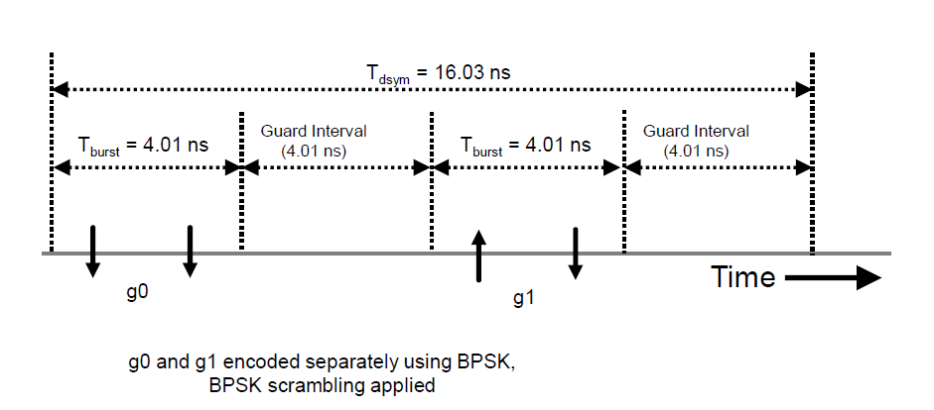
Chosen 62.4 Mbps modulation
2 bursts per symbol, with mean PRF=249.6 MHz

Slide 7
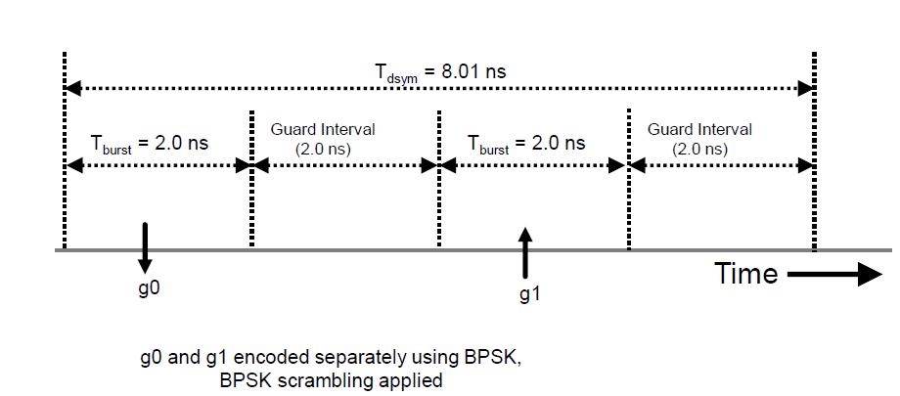
Chosen 124.8 Mbps
2 bursts per symbol, with mean PRF=249.6 MHz

