Slide 1
Project: IEEE P802.15 Working Group for Wireless Specialty Networks (WSN)
Submission Title: [Status on Downlink TDOA (DL-TDOA) Based Location Service Technical Specifications in 802.15]
Date Submitted: [11th September 2022]
Source: [Zhenzhen Ye and Yongsen Ma] Company [Red Point Positioning]
Re: Call for contributions to TG15.4ab
Abstract: Presentation, UWB in 802.15, DL-TDOA
Purpose: Present technical content for consideration by the group
Notice: This document has been prepared to assist the IEEE P802.15. It is offered as a basis for discussion and is not binding on the contributing individual(s) or organization(s). The material in this document is subject to change in form and content after further study. The contributor(s) reserve(s) the right to add, amend or withdraw material contained herein.
Release: The contributor acknowledges and accepts that this contribution becomes the property of IEEE and may be made publicly available by P802.15.

Slide 2
PAR Objective | Proposed Solution (how addressed)
Safeguards so that the high throughput data use cases will not cause significant disruption to low duty-cycle ranging use cases
Interference mitigation techniques to support higher density and higher traffic use cases | The proposed method for DL-TDOA scheduling is used to reduce interference between participating anchors. DL-TDOA supports a high density of tags without increasing interference potential.
Other coexistence improvement
Backward compatibility with enhanced ranging capable devices (ERDEVs) | The proposed MAC enhancements are compatible with legacy ERDEVs; All required information is conveyed using IEs in existing MAC frame formats harmlessly ignored by non-participating legacy devices.
Improved link budget and/or reduced air-time
Additional channels and operating frequencies
Improvements to accuracy / precision / reliability and interoperability for high-integrity ranging | The new feature will provide enhanced reliability in some high density use cases.
Reduced complexity and power consumption
Hybrid operation with narrowband signaling to assist UWB | Option allowed to offload network discovery and device management to NB channels
Enhanced native discovery and connection setup mechanisms
Sensing capabilities to support presence detection and environment mapping
Low-power low-latency streaming
Higher data-rate streaming allowing at least 50 Mbit/s of throughput
Support for peer-to-peer, peer-to-multi-peer, and station-to-infrastructure protocols | The proposed superframe structure, transmission scheme and messages are to support downlink TDOA location service.
Infrastructure synchronization mechanisms | Proposed IE(s) supports synchronization for downlink TDOA network infrastructure

Slide 3
Recap & Status
A few designs for providing DL-TDOA based location service proposed in IEEE 802.15.4ab and an external industrial alliance (FiRa) [2-9]
July’s presentation [1] provided a high-level timing structure to unify different designs
Current focus
Initial changes in technical specification (see doc. IEEE 15-22-0490-00-04ab)
Frames and IEs to support different designs
OOB/IB consideration

Slide 4
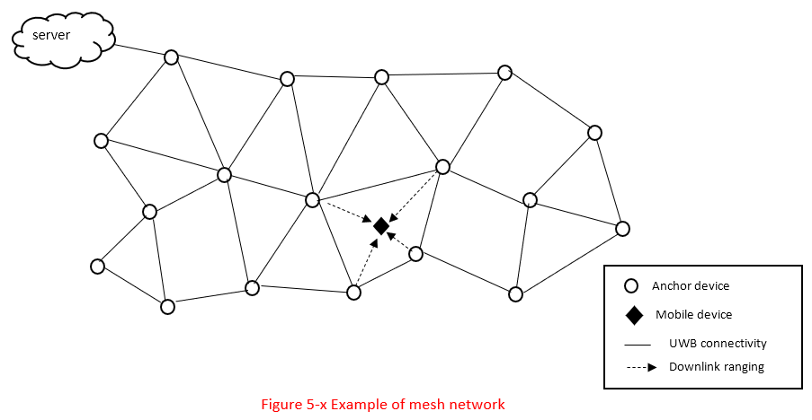
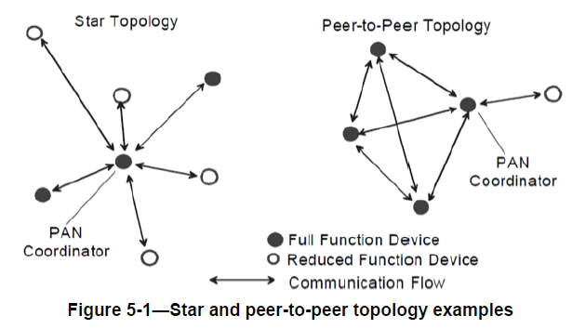
Summary of Changes in Technical Specifications
Section 5.2 Special Application Spaces
Add a new section 5.2.9 to introduce DL-TDOA based location service
Section 5.5 Network Topologies
Add a network topology example in section 5.5.3 (peer-to-peer network formation) to illustrate a network of DL-TDOA based location service
Original in 802.15.4

Slide 5
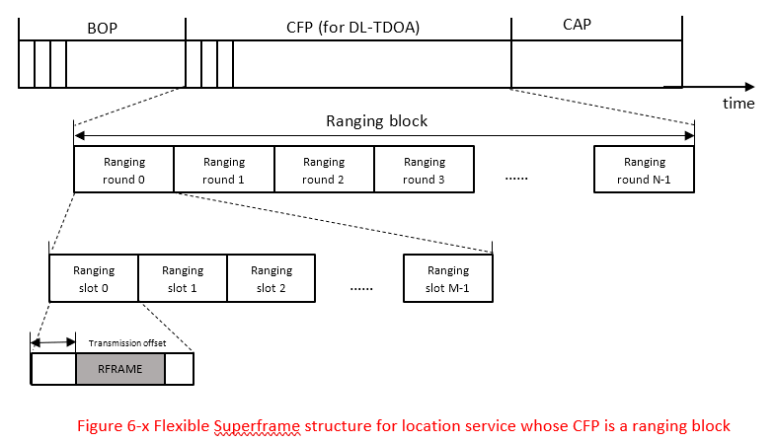
Summary of Changes in Technical Specifications (Cont’d)
Section 5.7.1 Superframe Structure
Add a new section 5.7.1.5 to introduce a flexible superframe structure for location service, based on contribution in July [1]
Section 6.2 Channel Access
Add a new section 6.2.12 to describe details of the superframe structure for location service
Section 6.9 Ranging
Minor modification on the description of TDOA in section 6.9.1.2.5 from 802.15.4z
Add a new section 6.9.12 to describe various ranging block options in the superframe structure, based on [1]

Slide 6
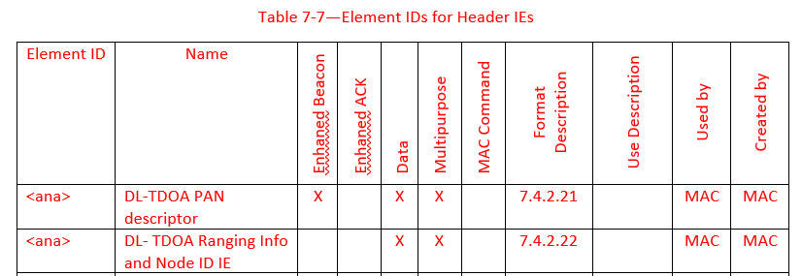
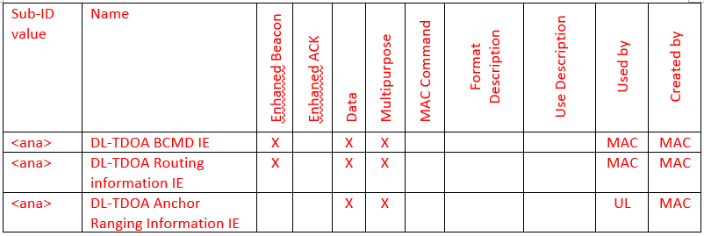
Summary of Changes in Technical Specifications (Cont’d)
Section 6.18 (new, working in progress) – added to describe ideas of in-band device discovery and association for DL-TDOA based location service
Section 7.4 IEs (working in progress)
Add two header IEs (sec. 7.4.2.21 and 7.4.2.22) to support Beacon and DL-TDOA Ranging frames
Add two nested IEs (sec. 7.4.4.56 and 7.4.4.57) for support Beacon frame
Add one nested IE (sec. 7.4.4.58) to support DL-TDOA Ranging frame

Slide 7
Next Steps
Continue to work on frames and IEs to support different designs
Consideration of other ideas in DL-TDOA based location service context, e.g.,
MMS [10-13]
Hyper block-based mode [14]

Slide 8
References
Zhenzhen Ye, Yongsen Ma (Redpoint), Jean-Marie André (ST microelectronics), Sven Zeisberg (HTW), Pablo Corbalán Pelegrín [NXP], Status on Downlink TDOA (DL-TDOA) Location Service Proposals in 802.15, 2022-07-12, IEEE 802.15 TG4ab
Zhenzhen Ye, Yongsen Ma (Redpoint), Jean-Marie André (ST microelectronics), Sven Zeisberg (HTW): Converging Downlink TDOA (DL-TDOA) Location Service Proposals in 802.15, 2022-05-18, IEEE 802.15 TG4ab
Zhenzhen Ye (Redpoint): Reverse TDOA Applications and Technical Characteristics. IEEE 15-21-0223-00-04ab, 2021-04-27, IEEE 802.15 TG4ab
Zhenzhen Ye (Redpoint): Downlink TDOA (DL-TDOA) Location Service in 802.15. IEEE 15-21-0488-00-04ab, 2021-09-15, IEEE 802.15 TG4ab
Yongsen Ma, Zhenzhen Ye (Redpoint): Beacon and Ranging Frames to Support Downlink TDOA (DL-TDOA) Location Service in 802.15. IEEE 15-21-0616-01-04ab, 2021-11-16, IEEE 802.15 TG4ab
Sven Zeisberg, Jean-Marie André: 802.15.4z upgrade requirements for larger industrial scenarios. IEEE 15-21-0066-00-04ab, 2021-01-20, IEEE 802.15 SG4ab
Jean-Marie André, Sven Zeisberg: DL-TDOA positioning TDMA scheme. IEEE 15-21-0530-00-04ab, 2021-10-19, IEEE 802.15 TG4ab
Jean-Marie André (ST microelectronics), Sven Zeisberg (HTW), Vincent van der Locht (SynchronicIT), Frank Stephan (ZIGPOS), Andreas Schumacher (TRUMPF): TDMA scheme enabling industrial DL-TDoA and UL-TDoA scenarios. IEEE 15-22-0077-00-04ab, 2022-01-2, IEEE 802.15 TG4ab
Jean-Marie André (ST microelectronics), Sven Zeisberg (HTW), Vincent van der Locht (SynchronicIT), Frank Stephan (ZIGPOS), Andreas Schumacher (TRUMPF): Information Elements for efficient DL-TDoA. IEEE 15-22-0113-00-04ab, 2022-02, IEEE 802.15 TG4ab
J.S. Hammerschmidt, Ersen Ekrem, Eren Sasoglu, Xiliang Luo (Apple): Narrowband assisted multi-millisecond UWB. IEEE 15-21-0409-00-04ab, 2021-07, IEEE 802.15 TG4ab
Ersen Ekrem, et al., NBA-UWB Technical Framework Proposal. IEEE-15-22-xxxx-00-004ab, 2022-03, IEEE 802.15 TG4ab
Billy Verso, et al. (Qorvo), Multi-millisecond Ranging, IEEE-15-22-0205-00-04ab, 2022-03, IEEE 802.15 TG4ab
Kangjin Yoon (Meta), Mingyu Lee (Samsung), NE Scehduling IE for 4ab applications, IEEE-15-22-501-00-4ab, 2022-09, IEEE 802.15 TG4ab
Youngwan So, Mingyu Lee, Taeyoung Ha, Karthik Srinivasa Gopalan, Aniruddh Rao Kabbinale, Ankur Bansal, Clint Chaplin (Samsung), Hyper Block-based Mode, 2022-09-13, IEEE-15-22-463-00-04ab, IEEE 802.15 TG4ab

