Slide 1
Project: IEEE P802.15 Working Group for Wireless Personal Area Networks (WPANs)
Submission Title: [Simulation evaluation of preamble sequences for 4ab]
Date Submitted: [Sep, 2022]
Source: [Chenchen Liu, Bin Qian, David Xun Yang] Company [Huawei Technologies]
Address [Huawei Bantian Base, Longgang District, Shenzhen, 518129 China]
E-Mail:[liuchenchen1@Huawei.com]
Re: [Task Group 4ab: UWB Next Generation]
Abstract: [Share our evaluation method and simulation results ]
Purpose: [ ]
Notice: This document has been prepared to assist the IEEE P802.15. It is offered as a basis for discussion and is not binding on the contributing individual(s) or organization(s). The material in this document is subject to change in form and content after further study. The contributor(s) reserve(s) the right to add, amend or withdraw material contained herein.
Release: The contributor acknowledges and accepts that this contribution becomes the property of IEEE and may be made publicly available by P802.15.

Slide 2
Technical Guidance
PAR Objective | Proposed Solution (how addressed)
Safeguards so that the high throughput data use cases will not cause significant disruption to low duty-cycle ranging use cases
Interference mitigation techniques to support higher density and higher traffic use cases
Other coexistence improvement
Backward compatibility with enhanced ranging capable devices (ERDEVs)
Improved link budget and/or reduced air-time
Additional channels and operating frequencies
Improvements to accuracy / precision / reliability and interoperability for high-integrity ranging
Reduced complexity and power consumption
Hybrid operation with narrowband signaling to assist UWB
Enhanced native discovery and connection setup mechanisms
Sensing capabilities to support presence detection and environment mapping
Low-power low-latency streaming
Higher data-rate streaming allowing at least 50 Mbit/s of throughput
Support for peer-to-peer, peer-to-multi-peer, and station-to-infrastructure protocols
Infrastructure synchronization mechanisms

Slide 3
Introduction
Several new preamble sequences have been proposed for 15.4ab
One evaluation method has been proposed in DCN 446
The goal of this presentation is to analyze the metrics for the preamble sequence and to reach consensus on the preamble sequence evaluation method

Slide 4
Evaluation Scenarios
Cross-correlation with the existing preamble sequence is a trivial metric because of the following reasons:
  The uncoordinated interference most likely comes from the STS or data segment instead of the preamble
  The mean PRF of length 31 preamble sequences is very small, which can be easily identified
  The cross-correlations between the length 91 preamble sequences are already very large (-9.5dB)
The cross-correlation affects detection false alarm rate, but the number of symbols for packet detection is small in general

Slide 5
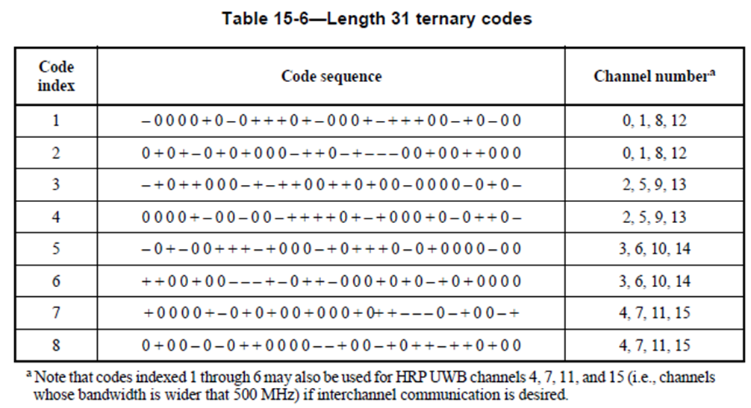
Evaluation Scenarios
We would suggest to define preamble sequences for each group of channel as in 15.4a
Four different sequences for each group of channels
No any two sequences are equivalent under circular shift

Slide 6
Ipatov preamble sequences with length 133
Code index | Code sequence | Channel number
33 | -1 0 -1 -1 1 1 1 1 1 1 1 0 -1 1 1 -1 -1 -1 0 -1 -1 1 -1 -1 -1 1 -1 -1 -1 0 1 -1 -1 -1 1 1 -1 1 -1 1 1 1 -1 -1 1 0 -1 1 1 1 0 0 1 0 -1 1 1 1 1 1 -1 1 -1 -1 1 0 1 1 -1 -1 1 1 1 1 -1 -1 -1 1 -1 1 1 -1 1 -1 1 1 -1 -1 1 1 1 1 -1 -1 -1 1 0 -1 1 1 -1 1 1 -1 1 1 1 -1 1 -1 1 -1 1 -1 1 -1 1 1 1 1 -1 0 -1 -1 1 0 1 1 -1 1 -1 -1 -1 | 0,1,8,12
34 | -1 -1 1 1 -1 -1 0 1 -1 -1 1 -1 -1 1 -1 0 1 0 -1 1 -1 -1 1 -1 1 -1 -1 -1 1 -1 1 -1 0 1 1 1 1 -1 1 1 -1 -1 1 1 -1 -1 1 1 0 1 -1 -1 -1 -1 0 -1 1 -1 1 1 1 0 0 1 1 -1 0 -1 1 -1 1 1 -1 -1 1 -1 1 1 1 1 -1 1 -1 1 1 -1 0 -1 -1 0 1 1 1 1 -1 -1 -1 1 -1 -1 1 1 1 -1 -1 1 1 1 1 1 1 1 1 1 -1 1 1 1 1 1 -1 -1 -1 -1 1 -1 1 -1 1 0 1 1 -1 | 0,1,8,12
35 | -1 -1 1 0 -1 -1 1 1 -1 -1 -1 -1 1 -1 1 -1 -1 -1 1 -1 1 1 1 1 -1 -1 1 1 1 -1 0 1 -1 0 -1 1 1 -1 -1 0 -1 -1 1 -1 -1 1 1 1 1 1 1 -1 -1 -1 -1 -1 -1 1 1 -1 1 1 -1 1 0 1 1 -1 1 1 1 0 -1 -1 -1 1 -1 1 1 0 -1 0 -1 1 -1 -1 -1 1 -1 1 -1 1 0 0 1 1 1 0 1 -1 1 1 1 1 -1 1 1 1 -1 1 -1 -1 1 1 1 1 0 -1 1 1 1 -1 1 1 -1 1 -1 -1 1 1 1 -1 1 | 0,1,8,12
36 | 0 1 -1 1 -1 1 1 -1 1 0 0 1 0 1 1 1 -1 -1 1 1 1 1 1 -1 1 1 0 -1 1 -1 0 1 -1 1 1 -1 -1 1 -1 1 1 -1 1 1 1 -1 -1 -1 1 -1 1 1 1 -1 -1 1 -1 -1 -1 1 1 -1 -1 -1 -1 1 1 0 -1 1 -1 1 -1 1 0 1 1 1 -1 1 -1 1 0 1 1 1 1 -1 -1 -1 1 -1 -1 -1 -1 1 -1 1 1 -1 -1 -1 -1 1 1 -1 -1 1 1 0 -1 1 -1 -1 0 -1 -1 -1 1 1 0 1 1 1 1 1 1 1 -1 -1 -1 1 -1 | 0,1,8,12

Slide 7
Ipatov preamble sequences with length 133
Code index | Code sequence | Channel number
37 | -1 1 1 -1 -1 -1 -1 -1 -1 -1 1 1 1 1 1 -1 1 -1 1 -1 1 1 1 -1 0 -1 1 1 1 1 -1 1 -1 -1 -1 1 0 -1 -1 -1 -1 -1 1 1 -1 1 0 1 1 -1 1 1 -1 1 -1 -1 1 1 1 -1 -1 -1 -1 1 -1 1 -1 -1 1 1 1 0 -1 -1 1 1 -1 -1 -1 0 -1 1 -1 1 1 -1 -1 1 -1 1 -1 1 1 1 1 1 1 -1 1 -1 0 1 1 1 -1 1 1 0 -1 1 1 0 1 0 1 1 0 -1 1 1 -1 1 1 -1 -1 1 1 -1 -1 1 0 0 1 | 2,5,9,13
38 | -1 1 -1 0 -1 1 -1 -1 1 -1 -1 1 1 -1 1 1 0 1 1 1 -1 1 -1 1 0 -1 -1 0 1 1 1 0 1 0 1 1 -1 1 1 1 -1 -1 1 0 -1 1 1 -1 -1 -1 1 1 -1 1 1 1 1 -1 1 1 -1 -1 1 1 1 1 -1 -1 1 -1 1 -1 -1 1 0 0 1 -1 -1 -1 -1 -1 -1 1 1 -1 1 -1 1 -1 1 1 -1 -1 -1 -1 1 0 1 -1 -1 -1 1 -1 -1 1 1 1 1 -1 -1 0 1 1 -1 1 -1 1 -1 1 1 1 1 1 1 1 1 -1 -1 -1 -1 0 1 | 2,5,9,13
39 | 1 1 1 -1 0 1 1 1 -1 1 1 -1 1 -1 -1 1 1 -1 1 1 -1 1 -1 -1 -1 1 -1 1 -1 1 -1 -1 1 0 1 1 1 1 1 1 1 1 1 -1 -1 -1 -1 1 1 -1 -1 1 -1 1 0 1 -1 -1 -1 1 1 1 1 1 -1 1 0 -1 -1 1 1 0 0 1 -1 1 1 1 1 0 1 0 -1 1 -1 -1 1 1 1 -1 1 1 1 -1 -1 -1 1 -1 -1 1 -1 -1 -1 0 1 -1 -1 0 1 1 -1 1 -1 -1 -1 1 -1 -1 1 -1 1 -1 -1 0 -1 1 0 1 1 1 -1 -1 -1 | 2,5,9,13
40 | -1 -1 1 0 -1 1 1 1 -1 1 -1 -1 1 1 1 1 1 1 -1 -1 1 -1 1 1 -1 -1 0 1 1 0 0 1 1 1 1 -1 1 -1 0 -1 -1 1 1 0 -1 0 1 1 1 1 1 -1 1 1 -1 1 1 1 -1 -1 1 1 1 0 1 1 -1 -1 -1 -1 -1 -1 -1 1 0 -1 1 -1 -1 1 -1 1 -1 1 0 1 -1 1 1 -1 -1 -1 -1 -1 1 -1 1 1 -1 -1 1 1 -1 1 -1 1 0 1 -1 1 1 1 0 1 -1 -1 -1 1 1 1 -1 -1 1 1 -1 1 -1 -1 1 -1 1 -1 -1 | 2,5,9,13

Slide 8
Ipatov preamble sequence with length 133
Code index | Code sequence | Channel number
41 | -1 -1 -1 1 -1 1 1 0 1 -1 -1 0 -1 1 1 1 1 -1 1 -1 1 -1 1 -1 1 -1 1 1 1 -1 1 1 -1 1 1 -1 0 1 -1 -1 -1 1 1 1 1 -1 -1 1 1 -1 1 -1 1 1 -1 1 -1 -1 -1 1 1 1 1 -1 -1 1 1 0 1 -1 -1 1 -1 1 1 1 1 1 -1 0 1 0 0 1 1 1 -1 0 1 -1 -1 1 1 1 -1 1 -1 1 1 -1 -1 -1 1 0 -1 -1 -1 1 -1 -1 -1 1 -1 -1 0 -1 -1 -1 1 1 -1 0 1 1 1 1 1 1 1 -1 -1 0 -1 | 3,6,10,14
42 | -1 1 1 0 1 -1 1 -1 1 -1 -1 -1 -1 1 1 1 1 1 -1 1 1 1 1 1 1 1 1 1 -1 -1 1 1 1 -1 -1 1 -1 -1 -1 1 1 1 1 0 -1 -1 0 -1 1 1 -1 1 -1 1 1 1 1 -1 1 -1 -1 1 1 -1 1 -1 0 -1 1 1 0 0 1 1 1 -1 1 -1 0 -1 -1 -1 -1 1 0 1 1 -1 -1 1 1 -1 -1 1 1 -1 1 1 1 1 0 -1 1 -1 1 -1 -1 -1 1 -1 1 -1 -1 1 -1 0 1 0 -1 1 -1 -1 1 -1 -1 1 0 -1 -1 1 1 -1 -1 | 3,6,10,14
43 | 1 -1 1 1 1 -1 -1 1 -1 1 1 -1 1 1 1 -1 0 1 1 1 1 -1 -1 1 -1 1 1 1 -1 1 1 1 1 -1 1 0 1 1 1 0 0 1 -1 1 -1 1 -1 -1 -1 1 -1 0 -1 0 1 1 -1 1 -1 -1 -1 0 1 1 1 -1 1 1 0 1 -1 1 1 -1 1 1 -1 -1 -1 -1 -1 -1 1 1 1 1 1 1 -1 -1 1 -1 -1 0 -1 -1 1 1 -1 0 -1 1 0 -1 1 1 1 -1 -1 1 1 1 1 -1 1 -1 -1 -1 1 -1 1 -1 -1 -1 -1 1 1 -1 -1 0 1 -1 -1 | 3,6,10,14
44 | -1 1 -1 -1 -1 1 1 1 1 1 1 1 0 1 1 -1 -1 -1 0 -1 -1 1 -1 0 1 1 -1 -1 1 1 -1 -1 -1 -1 1 1 -1 1 -1 -1 -1 -1 1 -1 -1 -1 1 1 1 1 0 1 -1 1 -1 1 1 1 0 1 -1 1 -1 1 -1 0 1 1 -1 -1 -1 -1 1 1 -1 -1 -1 1 -1 -1 1 1 1 -1 1 -1 -1 -1 1 1 1 -1 1 1 -1 1 -1 -1 1 1 -1 1 0 -1 1 -1 0 1 1 -1 1 1 1 1 1 -1 -1 1 1 1 0 1 0 0 1 -1 1 1 -1 1 -1 1 0 | 3,6,10,14

Slide 9
ipatov preamble sequence of length 133
Code index | Code sequence | Channel number
41 | 1 0 0 1 -1 -1 1 1 -1 -1 1 1 -1 1 1 -1 0 1 1 0 1 0 1 1 -1 0 1 1 -1 1 1 1 0 -1 1 -1 1 1 1 1 1 1 -1 1 -1 1 -1 -1 1 1 -1 1 -1 0 -1 -1 -1 1 1 -1 -1 0 1 1 1 -1 -1 1 -1 1 -1 -1 -1 -1 1 1 1 -1 -1 1 -1 1 1 -1 1 1 0 1 -1 1 1 -1 -1 -1 -1 -1 0 1 -1 -1 -1 1 -1 1 1 1 1 -1 0 -1 1 1 1 -1 1 -1 1 -1 1 1 1 1 1 -1 -1 -1 -1 -1 -1 -1 1 1 -1 | 4,7,11,15
42 | 1 0 -1 -1 -1 -1 1 1 1 1 1 1 1 1 -1 1 -1 1 -1 1 1 0 -1 -1 1 1 1 1 -1 -1 1 -1 -1 -1 1 0 1 -1 -1 -1 -1 1 1 -1 1 -1 1 -1 1 1 -1 -1 -1 -1 -1 -1 1 0 0 1 -1 -1 1 -1 1 -1 -1 1 1 1 1 -1 -1 1 1 -1 1 1 1 1 -1 1 1 -1 -1 -1 1 1 -1 0 1 -1 -1 1 1 1 -1 1 1 0 1 0 1 1 1 0 -1 -1 0 1 -1 1 -1 1 1 1 0 1 1 -1 1 1 -1 -1 1 -1 -1 1 -1 0 -1 1 -1 | 4,7,11,15
43 | -1 -1 -1 1 1 1 0 1 -1 0 -1 -1 1 -1 1 -1 -1 1 -1 -1 -1 1 -1 1 1 0 -1 -1 1 0 -1 -1 -1 1 -1 -1 1 -1 -1 -1 1 1 1 -1 1 1 1 -1 -1 1 -1 0 1 0 1 1 1 1 -1 1 0 0 1 1 -1 -1 0 1 -1 1 1 1 1 1 -1 -1 -1 1 0 1 -1 1 -1 -1 1 1 -1 -1 -1 -1 1 1 1 1 1 1 1 1 1 0 1 -1 -1 1 -1 1 -1 1 -1 -1 -1 1 -1 1 1 -1 1 1 -1 -1 1 -1 1 1 -1 1 1 1 0 -1 1 1 1 | 4,7,11,15
44 | -1 -1 1 -1 1 -1 -1 1 -1 1 1 -1 -1 1 1 1 -1 -1 -1 1 0 1 1 1 -1 1 0 1 -1 1 -1 1 1 -1 -1 1 1 -1 1 -1 -1 -1 -1 -1 1 1 -1 1 0 1 -1 1 -1 1 -1 -1 1 -1 0 1 -1 -1 -1 -1 -1 -1 -1 1 1 0 1 1 1 -1 -1 1 1 1 -1 1 1 -1 1 1 1 1 1 0 -1 0 1 1 -1 -1 0 -1 1 -1 1 1 1 1 0 0 1 1 0 -1 -1 1 1 -1 1 -1 -1 1 1 1 1 1 1 -1 -1 1 -1 1 1 1 -1 0 1 -1 -1 | 4,7,11,15

Slide 10
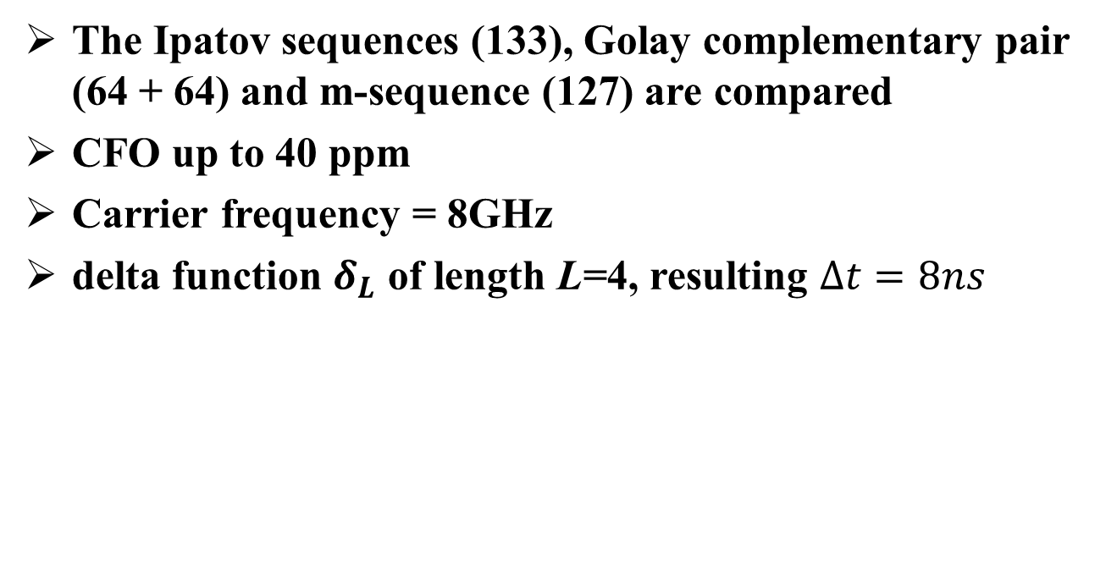
Evaluation Scenarios
The Ipatov sequences (133), Golay complementary pair (64 + 64) and m-sequence (127) are compared
CFO up to 40 ppm
Carrier frequency = 8GHz
delta function $δ_{L}$ of length L=4, resulting $∆t=8ns$

Slide 11
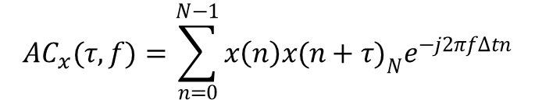
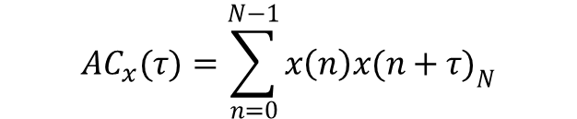

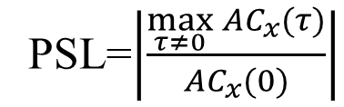
Auto-Correlation
$${AC}_{x}(τ)=\sum_{n=0}^{N−1}{x\left(n\right){x(n+τ)}_{N}}$$
CFO=0
CFO up to 40 ppm
Metric [7]:
$${AC}_{x}(τ,f)=\sum_{n=0}^{N−1}{x\left(n\right){x(n+τ)}_{N}e^{−j2πf∆tn}}$$
$$\max_{\begin{aligned}τ≠0, \\ f∈[0,320k]\end{aligned}}\left|\frac{{AC}_{x}(τ,f)}{{AC}_{x}(0,f)}\right|$$
PSL=$\left|\frac{\max_{τ≠0}{{AC}_{x}(τ)}}{{AC}_{x}(0)}\right|$
or
Sequence Set | Normalized Auto-Correlation (dB)
 | CFO = 0 | CFO up to 40 ppm
Ipatov (133) | -inf | -15.5
M-Sequence (127) | -42.1 | -15.8
Golay Sequence (64, 64) | -11 | -10.6

Slide 12
Cross-Correlation
Cross-Correlation with CFO = 0
Cross-Correlation with CFO up to 40ppm
Metric [7]:
Sequence Set | Normalized Cross-Correlation (dB)
 | CFO = 0 | CFO up to 40 ppm
Ipatov (133) | -14.4 | -12.3
M-Sequence | -16.5 | -13.5
Golay Sequence (64,64) | -12 | -10.4

Slide 13
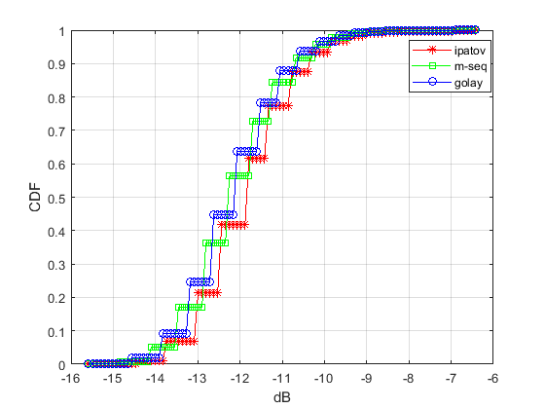
Correlation with Random Sequences
The random sequence r(n), where P(r(n)=-1) = P(r(n)=1) = 0.5
The CDF of maximum correlation with CFO=0ppm

Slide 14
Concluding Remarks
In this contribution, we propose a preamble evaluation method in terms of auto-correlation and normalized cross-correlation performance.
Ipatov sequence and M-sequence have reasonable performance in both auto-correlation and normalized cross-correlation.

Slide 15
References
[1] 15-22-0243-00-04ab-golay-complementary-sequences-preamble-construction-for-uwb-ranging-beyond-4z-ipatov (Xiliang)
[2]15-22-0267-01-04ab-preamble-only-packet-for-uwb (Chenchen Liu)
[3]15-22-0178-00-04ab-a-novel-channel-sounding-sequence (McLaughlin)
[4]15-22-0280-01-04ab-deterministic-sts-for-sensing-applications (Igor Dotlic)
[5] P802.15.4z, Draft Standard for Low-Rate Wireless Networks
[6]15-22-0446-01-04ab-simulation-framework-for-recommending-preambles-for-4ab (Vinod Kristem)
[7] 15-22-0390-00-04ab-discussion-on-preamble-sequence-options-for-detection-and-channel-estimation (Pooria Pakrooh)

Slide 16
Appendix
Golay sequence of number :
{1 10 17 20} and {25 35 42 49} from dcn:0447r1
With CFO=0
With CFO up to 40ppm
-13.2 | -12 | -12 | -12 | -13.2 | -12 | -12 | -12
-12 | -18.1 | -12 | -12 | -12 | -12 | -12 | -12
-12 | -12 | -13.2 | -12 | -12 | -12 | -12 | -13.2
-12 | -12 | -12 | -13.2 | -12 | -12 | -12 | -14.5
-13.2 | -12 | -12 | -12 | -11 | -12 | -12 | -12
-12 | -12 | -12 | -12 | -12 | -13.2 | -12 | -12
-12 | -12 | -12 | -12 | -12 | -12 | -11 | -12
-12 | -12 | -13.2 | -14.5 | -12 | -12 | -12 | -14.5
-11.6 | -10.4 | -10.4 | -10.4 | -11.6 | -10.4 | -9.4 | -10.4
-10.4 | -11.6 | -10.4 | -10.4 | -10.4 | -10.4 | -10.4 | -10.4
-10.4 | -10.4 | -11.6 | -10.4 | -10.4 | -9.9 | -10.4 | -9.4
-10.4 | -10.4 | -10.4 | -11.6 | -10.4 | -9.9 | -10.4 | -11.6
-11.6 | -10.4 | -10.4 | -10.4 | -10.7 | -10.4 | -10.4 | -10.4
-10.4 | -10.4 | -10.4 | -10.4 | -10.4 | -11.6 | -10.4 | -10.4
-9.4 | -10.4 | -10.4 | -10.4 | -10.4 | -10.4 | -10.6 | -10.4
-10.4 | -10.4 | -9.4 | -11.6 | -10.4 | -10.4 | -10.4 | -11.6

Slide 17
Appendix
M sequence of length 127:
Set1=[' 1 1 1 1 1 1 -1 1 1 1 1 1 -1 -1 1 1 1 1 -1 1 -1 1 1 1 -1 -1 -1 -1 1 1 -1 1 1 1 -1 1 -1 -1 1 1 -1 -1 -1 1 -1 1 -1 1 1 -1 -1 -1 -1 -1 1 -1 1 1 1 1 -1 -1 -1 1 1 1 -1 1 1 -1 1 1 -1 -1 1 -1 -1 1 -1 1 -1 -1 1 -1 -1 -1 -1 1 -1 -1 1 1 1 -1 -1 1 -1 1 1 -1 1 -1 -1 -1 1 -1 -1 -1 1 1 -1 -1 1 1 -1 1 -1 1 -1 1 -1 -1 -1 -1 -1 -1 -1‘
' 1 -1 -1 1 -1 1 -1 1 1 1 1 1 1 -1 -1 1 -1 -1 -1 -1 -1 1 1 1 1 1 -1 1 -1 -1 1 1 1 1 -1 1 1 1 1 -1 -1 -1 1 -1 1 1 1 -1 -1 1 1 1 -1 1 1 -1 -1 -1 1 1 -1 1 -1 1 1 -1 -1 1 -1 1 1 -1 1 -1 -1 -1 -1 1 -1 1 -1 -1 -1 1 -1 -1 -1 1 1 1 -1 -1 -1 -1 1 1 -1 -1 1 1 -1 1 1 -1 1 1 1 -1 1 -1 1 -1 1 -1 -1 1 -1 -1 1 1 -1 -1 -1 -1 -1 -1 -1'
'-1 -1 -1 -1 -1 -1 -1 1 -1 1 1 -1 -1 1 1 1 1 -1 -1 1 -1 1 1 1 1 -1 1 -1 1 1 -1 1 -1 -1 1 -1 -1 1 1 -1 1 -1 1 -1 1 -1 -1 1 1 1 -1 1 1 1 1 1 -1 1 1 -1 -1 -1 -1 -1 1 1 -1 -1 -1 1 1 -1 1 1 -1 1 1 1 -1 -1 1 1 -1 -1 1 -1 -1 -1 -1 1 1 1 1 1 1 -1 -1 -1 1 -1 1 -1 1 1 1 -1 1 -1 -1 -1 1 1 1 -1 -1 -1 -1 1 -1 -1 -1 1 -1 -1 1 -1 1'
'-1 -1 -1 -1 -1 -1 -1 1 1 -1 -1 1 -1 -1 1 -1 1 -1 1 -1 1 1 1 -1 1 1 -1 1 1 -1 -1 1 1 -1 -1 -1 -1 1 1 1 -1 -1 -1 1 -1 -1 -1 1 -1 1 -1 -1 -1 -1 1 -1 1 1 -1 1 -1 -1 1 1 -1 1 -1 1 1 -1 -1 -1 1 1 -1 1 1 1 -1 -1 1 1 1 -1 1 -1 -1 -1 1 1 1 1 -1 1 1 1 1 -1 -1 1 -1 1 1 1 1 1 -1 -1 -1 -1 -1 1 -1 -1 1 1 1 1 1 1 -1 1 -1 1 -1 -1 1']
Set2=[' 1 1 1 1 -1 -1 -1 1 -1 -1 -1 -1 1 1 -1 1 -1 -1 1 1 -1 1 1 -1 1 1 1 1 1 1 -1 1 1 1 -1 1 1 -1 -1 1 1 1 -1 1 -1 -1 -1 1 -1 1 -1 -1 1 -1 -1 1 1 1 1 1 -1 -1 1 1 -1 -1 1 -1 1 -1 1 1 -1 -1 -1 1 1 -1 -1 -1 -1 1 -1 -1 1 -1 1 1 1 1 -1 1 -1 1 -1 1 -1 -1 -1 -1 -1 1 -1 1 1 -1 1 -1 1 1 1 -1 -1 1 -1 -1 -1 1 1 1 -1 -1 -1 -1 -1 -1 -1'
' 1 1 1 1 -1 1 -1 1 -1 -1 1 1 1 -1 1 1 -1 -1 -1 -1 1 1 -1 1 -1 1 1 -1 1 1 -1 1 -1 -1 1 -1 1 -1 1 -1 1 1 1 1 1 -1 -1 1 1 -1 1 1 1 1 -1 -1 -1 1 -1 1 -1 -1 -1 1 1 -1 -1 -1 1 1 1 -1 -1 1 -1 -1 1 1 -1 -1 1 1 1 1 1 1 -1 1 1 1 -1 -1 -1 -1 -1 1 -1 1 1 -1 -1 1 -1 1 1 1 -1 1 -1 -1 -1 -1 1 -1 -1 1 -1 -1 -1 1 -1 -1 -1 -1 -1 -1 -1'
' 1 -1 1 1 -1 1 1 -1 1 -1 1 -1 -1 -1 1 -1 1 -1 1 -1 1 1 -1 -1 -1 1 1 1 -1 -1 1 1 -1 1 -1 -1 1 1 -1 -1 1 1 1 -1 1 -1 -1 -1 -1 1 -1 -1 -1 1 1 -1 1 1 1 -1 1 1 1 1 -1 -1 1 -1 1 -1 -1 1 -1 1 1 1 -1 -1 -1 -1 1 1 1 1 1 -1 1 1 -1 -1 1 -1 -1 1 1 1 1 -1 1 -1 1 1 1 1 1 1 -1 -1 -1 1 -1 -1 1 -1 -1 -1 -1 -1 1 1 -1 -1 -1 -1 -1 -1 -1'
'-1 -1 -1 -1 -1 -1 -1 1 -1 -1 1 1 -1 1 -1 -1 1 1 1 -1 -1 1 1 -1 -1 1 -1 -1 1 -1 1 1 1 -1 -1 -1 -1 -1 1 1 1 1 -1 -1 -1 1 1 1 -1 1 -1 1 1 -1 -1 1 1 1 1 1 1 -1 -1 1 -1 1 -1 -1 -1 1 -1 1 1 -1 1 -1 1 -1 1 -1 -1 1 -1 -1 -1 1 1 -1 1 1 1 1 -1 1 1 1 -1 1 1 -1 1 1 -1 -1 -1 -1 1 -1 1 -1 1 1 1 1 1 -1 1 -1 -1 -1 -1 1 1 -1 -1 -1 1']
With CFO=0
With CFO up to 40ppm
-42.1 | -18.6 | -18.6 | -18.6 | -18.6 | -18.6 | -14.8 | -14.8
-18.6 | -42.1 | -18.6 | -16.5 | -14.8 | -14.8 | -14.8 | -14.8
-18.6 | -18.6 | -42.1 | -18.6 | -18.6 | -18.6 | -14.8 | -18.6
-18.6 | -16.5 | -18.6 | -42.1 | -18.6 | -18.6 | -18.6 | -18.6
-18.6 | -14.8 | -18.6 | -18.6 | -42.1 | -18.6 | -18.6 | -18.6
-18.6 | -14.8 | -18.6 | -18.6 | -18.6 | -42.1 | -18.6 | -18.6
-14.8 | -14.8 | -14.8 | -18.6 | -18.6 | -18.6 | -42.1 | -18.6
-14.8 | -14.8 | -18.6 | -18.6 | -18.6 | -18.6 | -18.6 | -42.1
-16.8 | -13.8 | -15.1 | -14.2 | -14.3 | -14 | -8.3 | -8.3
-14.7 | -18.7 | -14.1 | -14.1 | -8.3 | -8.3 | -8.3 | -8.3
-14.5 | -13.9 | -17.9 | -14.2 | -13.9 | -13.6 | -8.3 | -14.8
-14.4 | -14.1 | -13.9 | -18.7 | -14.2 | -14.9 | -14.1 | -14.6
-12.9 | -8.3 | -13.7 | -13.7 | -17.7 | -13.5 | -14.3 | -14
-13.6 | -8.3 | -14.1 | -14.6 | -13.7 | -18.2 | -14.4 | -14
-8.3 | -8.3 | -8.3 | -14.7 | -14 | -14.1 | -15.8 | -14
-8.3 | -8.3 | -14.9 | -14.3 | -13.8 | -14 | -14 | -18.1

Slide 18
Appendix
Ipatov sequence of length 133：
With CFO=0
With CFO up to 40ppm
-Inf | -14.8 | -14.4 | -15.6 | -15.2 | -11.3 | -13 | -13.7
-14.8 | -Inf | -14.1 | -14.4 | -13 | -13.7 | -7.9 | -14.1
-14.4 | -14.1 | -Inf | -14.8 | -6.4 | -11.6 | -11.3 | -13
-15.6 | -14.4 | -14.8 | -Inf | -11.3 | -13 | -13.7 | -11.6
-15.2 | -13 | -6.4 | -11.3 | -Inf | -15.6 | -14.8 | -14.4
-11.3 | -13.7 | -11.6 | -13 | -15.6 | -Inf | -14.4 | -14.8
-13 | -7.9 | -11.3 | -13.7 | -14.8 | -14.4 | -Inf | -15.6
-13.7 | -14.1 | -13 | -11.6 | -14.4 | -14.8 | -15.6 | -Inf
-15.8 | -12.7 | -12.7 | -13.1 | -12 | -9.6 | -11.3 | -11.3
-12.3 | -15.8 | -12.3 | -12.7 | -11.3 | -11.9 | -6.1 | -10.8
-12.6 | -12.3 | -15.5 | -12.7 | -4.6 | -9.8 | -9.5 | -11.2
-13.1 | -12.8 | -12.5 | -16.2 | -9.6 | -11.4 | -12 | -9.9
-12 | -11.3 | -4.7 | -9.6 | -16.3 | -13 | -13.1 | -12.7
-9.6 | -11.5 | -9.9 | -11.3 | -13.1 | -16.2 | -12.7 | -12.8
-11.3 | -6.1 | -9.5 | -11.9 | -12.7 | -12.5 | -16.2 | -13.1
-11.3 | -11.3 | -11.3 | -9.8 | -12.7 | -12.9 | -13 | -15.9

