Slide 1
Project: IEEE P802.15 Working Group for Wireless Personal Area Networks (WPANs)
Submission Title: [New Results on Possible LDPC Codes for 15.4ab]
Date Submitted: [14th Sept. 2022]
Source: [Wei Lin, Xun Yang, Bin Qian, Chenchen Liu, Li Sun, Rani Keren, Shimi Shilo, Lei Huang, Edward Au] Company [Huawei]
Address [Huawei base, Shenzhen, CHINA & Huawei Israel]
E-Mail:[lin.linwei@huawei.com]
Re: [Study Group 4ab: UWB Next Generation]
Abstract: [New Results on Possible LDPC Codes for 15.4ab]
Purpose: []
Notice: This document has been prepared to assist the IEEE P802.15. It is offered as a basis for discussion and is not binding on the contributing individual(s) or organization(s). The material in this document is subject to change in form and content after further study. The contributor(s) reserve(s) the right to add, amend or withdraw material contained herein.
Release: The contributor acknowledges and accepts that this contribution becomes the property of IEEE and may be made publicly available by P802.15.

Slide 2
Technical Guidance
PAR Objective | Proposed Solution (how addressed)
Safeguards so that the high throughput data use cases will not cause significant disruption to low duty-cycle ranging use cases.
Interference mitigation techniques to support higher density and higher traffic use cases
Other coexistence improvement
Backward compatibility with enhanced ranging capable devices (ERDEVs).
Improved link budget and/or reduced air-time | New Channel Coding Schemes can provide improved link budgets and reduced air time
Additional channels and operating frequencies
Improvements to accuracy / precision / reliability and interoperability for high-integrity ranging;
Reduce complexity and power consumption;
Hybrid operation with narrowband signaling to assist UWB;
Enhanced native discovery and connection setup mechanisms;
Sensing capabilities to support presence detection and environment mapping;
Low-power low-latency streaming
higher data-rate streaming allowing at least 50 Mbit/s of throughput. | New Channel Coding Schemes with higher rates can support high data rate
Support for peer-to-peer, peer-to-multi-peer, and station-to-infrastructure protocols;
Infrastructure synchronization mechanisms.

Slide 3
Related Submissions
[1] 15-21-0506-02-04ab-Advanced Coding for Data Communications in 802.15.4ab, Carlos Aldana, et al
[2] 15-21-0592-00-04ab-high-data-rates, C. Murray, et al
[3] 15-22-0181-01-04ab-new-data-rates, C. Murray, et al
[4] 15-22-0050-00-04ab- Channel Coding Considerations for 802.15.4ab, Wei Lin, et al
[5] 15-22-0154-00-04ab-further-considerations-of-advanced-channel-coding-on-15-4ab, Wei Lin, et al
[6] 15-22-0265-01-04ab-discussion-on-advanced-channel-coding-for-15-4ab, Wei Lin, et al
[7] 15-22-0274-00-04ab-high-data-rates-and-coding, Carlos Aldana, et al
[8] 15-22-0296-01-04ab-a-higher-data-rate-proposal-for-uwb, Koorosh Akhavan, et al
[9] 15-21-0506-03-04ab-advanced-coding-for-data-comm, Carlos Aldana, et al
[10] 15-22-0391-01-04ab-preliminary-discussion-on-possible-ldpc-codes-for-15-4ab, Wei Lin, et al

Slide 4
Discussions on Advanced Channel Coding
The consideration of introducing possible new advanced coding schemes were extensively discussed in [1]-[5]
  Some initial discussions on the new advanced coding can be found in [1]-[5], where extensive comparisons of BCC, Turbo, Polar, LDPC codes can be found in terms of performance, complexity, etc.
Most participants agreed to converge to LDPC codes during the May IEEE Meeting [6]-[10]
  In [7], some consensus among some co-authors were achieved, including to converge the selection of new advanced codes for 15.4ab to LDPC codes
  [7] also suggested that ‘Primary candidate is the 802.11n LDPC code’, and some important comparison metrics for possible alternative schemes, such as packet lengths, considered PER, implementation complexity, etc.
  In [6], we also suggested to further converge the candidates to LDPC codes after extensive evaluations, and also LDPC codes have been widely employed in current wireless standards.
  Furthermore, [8] suggested to better balance the performance of PHR and data part, e.g., PHR may need additional protection, e.g., symbol repetition.
  [9] provided further simulation results of short (e.g., 30 bytes) and very short (e.g., 10~5 bytes) payloads with 11n LDPC codes, and showed that 11n LDPC can perform well at lower effective coding rates

Slide 5
The Targets of New UWB LDPC Codes
Compared with existing standards (e.g., 11ax/be), data transmissions in 15.4ab include a large amount of short payloads (e.g., around 20 Bytes)
  The candidate LDPC codes should perform well at short payload lengths with corresponding amount of padding bits
  The performances of short payloads with candidate LDPC codes should be as close as possible to PHR, but not surpass the performance of PHR (BCC & SECDED encoded with one repetition)
Low Power & Low Complexity is very important for UWB applications
  It is beneficial for the candidate LDPC codes to have very low density parity-check matrices, the number of ‘1’s inside the H matrix is relatively small → an additional ‘1’ incurs additional computations inside LDPC decoder
  It is beneficial for the candidate LDPC codes to share a single base matrix, and possible different lifting coefficients for corresponding code lengths → similar to NR LDPC
The WLAN LDPC codes were primarily designed for fixed Rate & Length Combinations
  The 11n LDPC of different lengths (even with the same rate) don‘t share the same base (mother) matrices
  The 11n LDPC wasn’t optimized for short payload transmissions → a relatively large amount of shortening bits

Slide 6
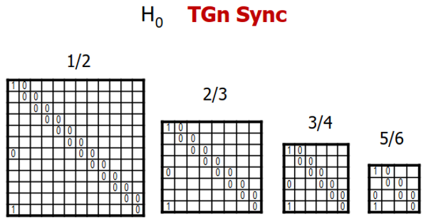
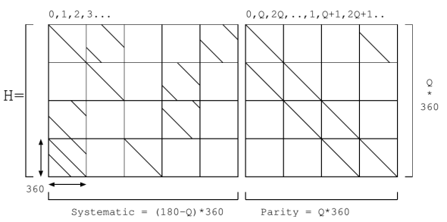
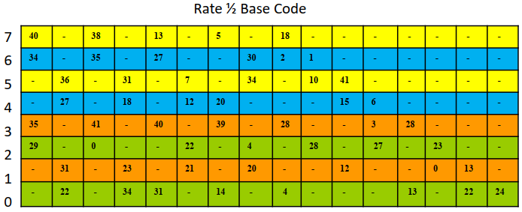
Possible candidate LDPC codes - Classic QC-LDPC
There are currently two major LDPC structures widely employed in industry
  Classic QC-LDPC (11n/11ad/DVB) and Raptor-Like QC-LDPC (5G NR)
Classic QC-LDPC (11n/11ad/DVB) → Repeat Accumulate + Quasi Cyclic
  Classic QC-LDPC codes are widely employed in various standards, they are implementation friendly and good performance for fixed rates/lengths
  Classic QC-LDPC codes are not convenient for rate/length compatible, e.g., require a individually designed H matrix for each rate and length (12 matrices in 11n), and significant performance loss occurs for shortening or puncturing
RA
RA
RA
11ad/ay LDPC Code
Parity-Check Part of WLAN LDPC Codes
DVB-S2 LDPC Code

Slide 7
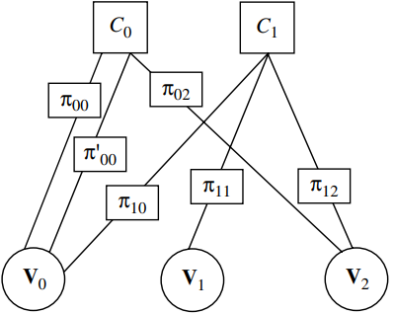
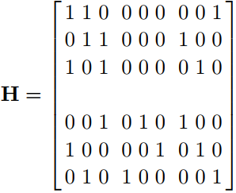
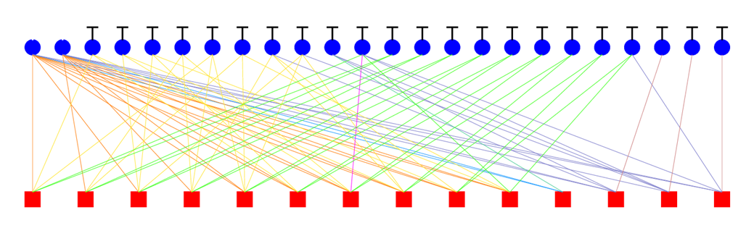
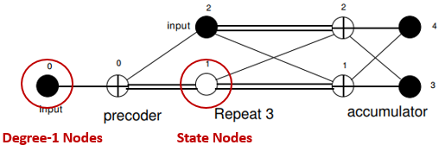
Possible candidate LDPC codes - Raptor-Like QC-LDPC
Raptor-Like QC-LDPC → Protograph + Multi-Edge Type + Accumulate Repeat Accumulate
  Protograph: a Tanner graph with a relatively small number of nodes → Protograph design & Lifting optimization
    P-EXIT chart analysis (Liva2007) → different protographs having same degree distribution may have different thresholds
    The Protograph-based LDPC codes can be extended to long lengths through different lifting sizes with single base matrix → decoding threshold can guarantee the performance
  Multi-Edge Type: edges are better controlled by categorizing into several different types
    Can avoid weak local combinations of nodes → e.g., all connections to a particular CN being made to VNs of smallest degree
  ARA & MET: state nodes in conjunction with degree-1 nodes → improve performance with controlled complexity
  Raptor-Like QC-LDPC codes can accommodate various rates and lengths with a single base matrix, and also can obtain very good performance under shortening and puncturing
State Nodes
Degree-1 Nodes
Protograph
Multi-Edge Type (MET)
Accumulate Repeat Accumulate (ARA)

Slide 8
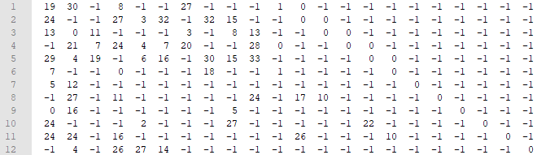
Further Discussion on LDPC Coding → Short Code
For the candidate LDPC codes
  The possible candidate new LDPC codes includes 802.11n LDPC codes, alternative classic QC-LDPC codes, and Raptor-Like QC-LDPC codes
  The possible new LDPC codes shall be extensively compared with 802.11n LDPC in terms of performance, implementation complexity, power consumption, etc.
New Raptor-Like QC-LDPC Code for 15.4ab
  Complexity: 76 CPMS (New RL-QC-LDPC) vs 88 CPMs (WLAN LDPC)
R = 1/2
degree-1 nodes
Capacity (Eb/N0) = 0.1618 dB
Hb_Thr = 0.5571 dB: Decoding Threshold of a Base Matrix (Protograph) → Minimum Eb/N0 to achieve error free transmission, assuming cycle-free with infinite length → Guarantee the performance of medium/long codes
Gap to Capacity = 0.3953 dB
R = 2/3
State/Puncture Nodes
Size: 12x22, Lifting = 34, n = 20 x 34 = 680 bits

Slide 9
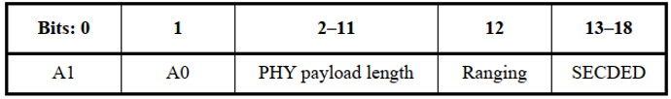
Simulation Assumptions → Short Code
Channel & Modulation: AWGN + BPSK
Coding Configurations
  PHR (19 + 6 (tail zeros) = 25 bits) is encoded with CL7 BCC + SECDED, and 2 Symbols (Rep.)
  LDPC Decoder: Layered Normalized Min-Sum Decoding with 8 Iterations
  Default Rate: R = 1/2
  Default Lengths: 11n LDPC (324, 648), RL LDPC (340, 680)
LDPC Transmitting Schemes
  Mode 1: Shortening without Puncturing → Actual code rate lower than R = 1/2
  Mode 2: Shortening with Puncturing → Actual code rate can be adjusted to R = 1/2
  For short payloads, comparing with CL7 BCC (R=1/2), the actual rates of LDPC with Mode 1 are much lower than 1/2, while LDPC with Mode 2 can be adjusted to the same rate as BCC (R=1/2)

Slide 10
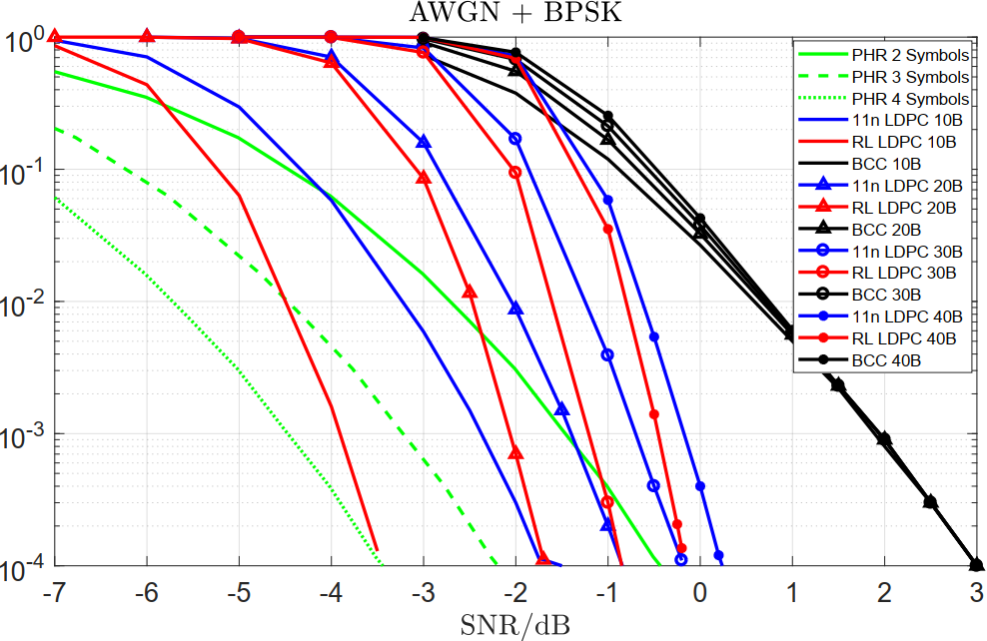
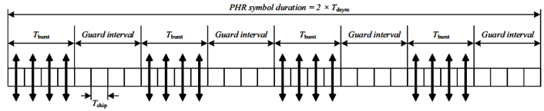
Simulation Results of Transmitting Mode 1 → Short Code
15.4z PHR Scheme
  PHR with 2 Symbols (Current 15.4z)
  PHR (3 Syms / 4 Syms) → 1.7dB / 3dB Improvement
  Actual Code Rates → Under different rates, unfair for BCC
  All BCC Data Transmission: R = 1/2
  10 Bytes LDPC: R ~ 0.20 (RL: 0.1905 / 11n: 0.1980)
  20 Bytes LDPC: R ~ 0.32 (RL: 0.3200 / 11n: 0.3300)
  30 Bytes LDPC: R ~ 0.42 (RL: 0.4138 / 11n: 0.4255)
  40 Bytes LDPC: R ~ 0.49 (RL: 0.4848 / 11n: 0.4969)
  Reliability
  Payload of 10 Bytes: both NR-LDPC (~2dB) and 11n-LDPC (~0.5dB) surpass PHR of 2 Syms at FER = 10⁻²
  Payload of 20 Bytes: NR-LDPC surpasses 11n-LDPC ~0.5dB at FER = 10⁻² and ~0.7dB at FER = 10⁻³
PER
FER
Es/N0 for BPSK

Slide 11
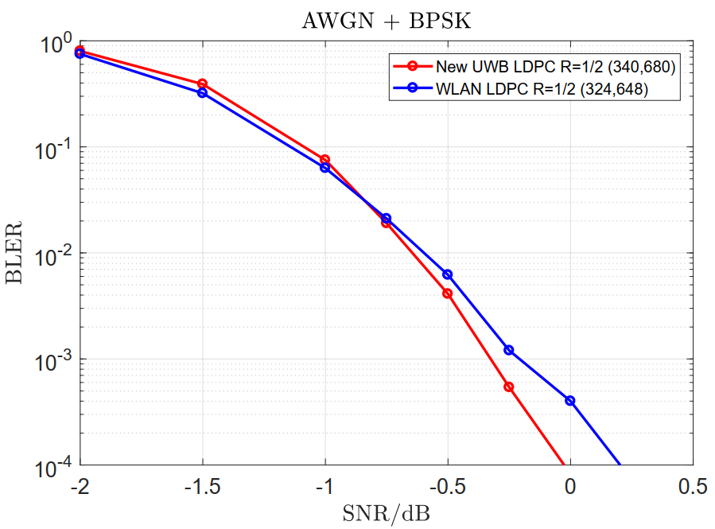
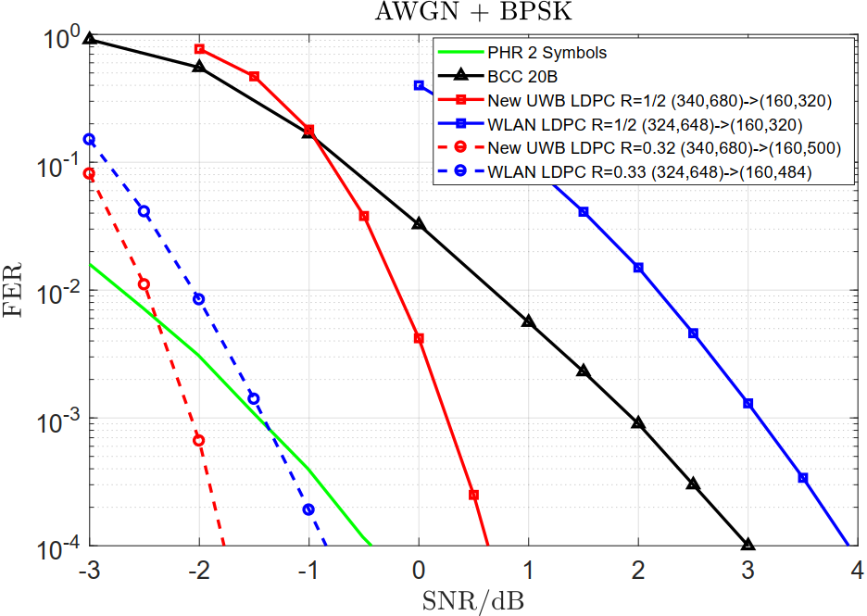
Simulation Results of Transmitting Mode 2 → Short Code
20 Bytes
PER
PER
R=1/2
R~0.32
Es/N0 for BPSK
Es/N0 for BPSK
  New LDPC (340,680) vs. WLAN LDPC (324,648) at R = 1/2 → Under same rates, fair for BCC
  Can obtain around 0.25dB gain at BLER = 10⁻⁴ and Complexity: 76 CPMS (New LDPC) vs 88 CPMs (WLAN LDPC)
  New LDPC (160,320) vs. WLAN LDPC (160,320) at R = ½ → LDPC of same rate of R = 1/2 (Fair)
  New LDPC performs very well at short payload (20 bytes) → over 2dB compared with R = ½ WLAN LDPC (Shorten & Punc)
  New LDPC (160,500) vs. WLAN LDPC (160,484) at R ~= 0.32
  New LDPC performs also very well at short payload (20 bytes) → around 0.45dB compared with shortening WLAN LDPC
  All with a single parity-check matrix

Slide 12
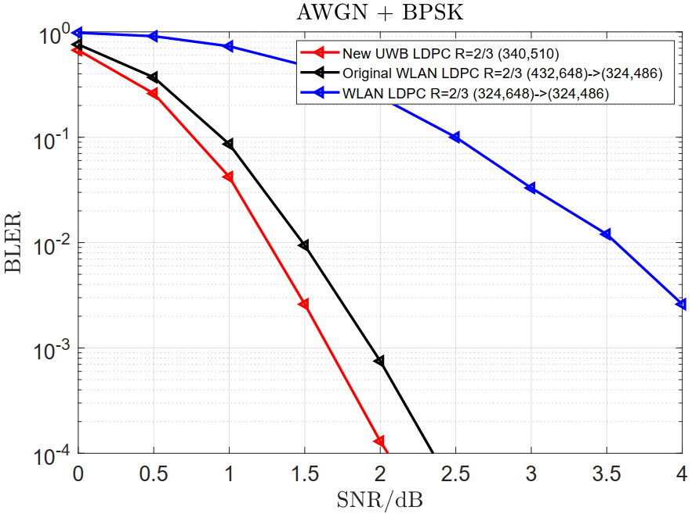
Simulation Results of Transmitting Mode 2 → Short Code
  New LDPC (340,510) vs. two WLAN LDPC (324,486) at R = 2/3
  WLAN LDPC 01: R = 1/2 WLAN LDPC (324,648) → (324,486)
  WLAN LDPC 02: R = 2/3 WLAN LDPC (432,648) → (324,486)
  New LDPC can obtain 0.35dB gain compared with original R = 2/3 WLAN LDPC 02 at similar lengths, and over 2.5 dB compared with R = 1/2 WLAN LDPC 01 punctured to R = 2/3
  Complexity: 50 CPMS (New LDPC) vs 88 CPMs (WLAN LDPC)
PER
R = 2/3
Es/N0 for BPSK
  All with a single parity-check matrix

Slide 13
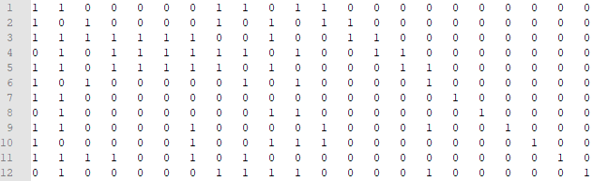
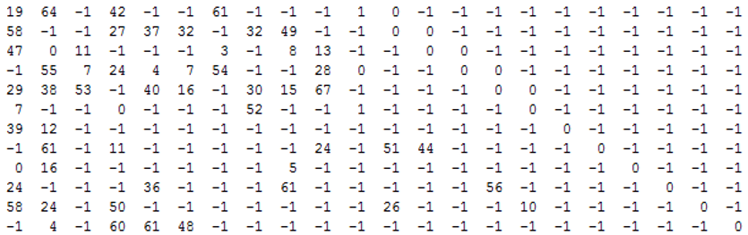
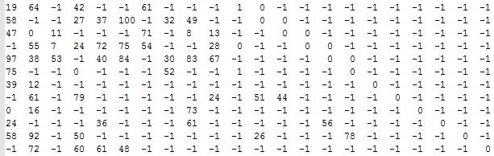
RL-LDPC Codes → Medium & Long Codes
The RL-LDPC codes of three lengths (short / medium / long) can be embedded into a single base matrix with a single set of lifting factors → Similar to 5G LDPC codes
  Only the lifting factors of long code needs to be implemented → lifting factors of medium and short code can be conveniently obtained by modulo operations (widely optimized in 5G LDPC decoders)
Single Base Matrix for all lengths
Size: 12x22, Lifting = 34, n = 20 x 34 = 680 bits
Size: 12x22, Lifting = 34x2 = 68, n = 20 x 68 = 1360 bits
Size: 12x22, Lifting = 34x3 = 102, n = 20 x 102 = 2040 bits

Slide 14
RL-LDPC Codes → Medium & Long Codes
The RL-LDPC codes of three lengths (short / medium / long) can be embedded into a single base matrix with a single set of lifting factors → Similar to 5G LDPC codes
  Only the lifting factors of long code needs to be implemented → lifting factors of medium and short code can be conveniently obtained by modulo operations (widely optimized in 5G LDPC decoders)
Size: 12x22, Lifting = 34, n = 20 x 34 = 680 bits
Size: 12x22, Lifting = 34x2 = 68, n = 20 x 68 = 1360 bits
  Examples for embedded lifting factors:
  Case A: 19 (19 % 34 = 19) ← 19 (19 % 68 = 19) ← 19 (long)
  Case B: 30 (64 % 34 = 30) ← 64 (64 % 68 = 64) ← 64 (long)
  Case C: 29 (29 % 34 = 29) ← 29 (97 % 68 = 29) ← 97 (long)
  All with one base matrix and one group of lifting coefficients
  → Reduces the implementation complexity of 3 lengths
Size: 12x22, Lifting = 34x3 = 102, n = 20 x 102 = 2040 bits

Slide 15
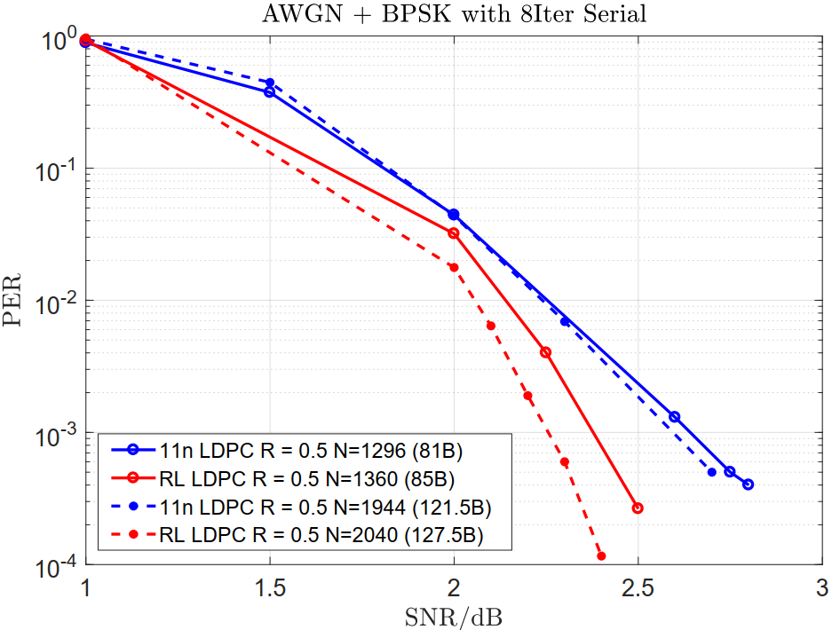
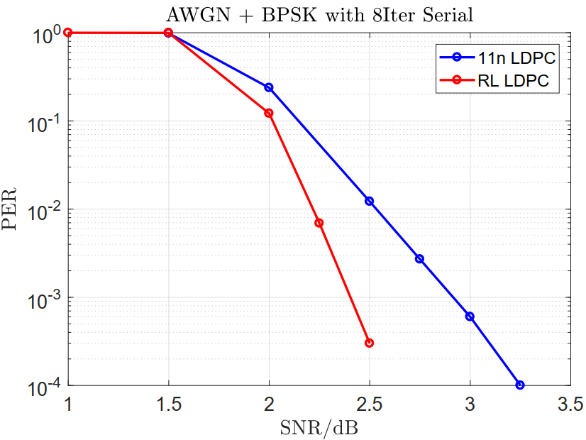
Simulation Results → Medium & Long Codes
  1500 Bytes
  Single Codeword
  Around 13 Codewords with Shortening Bits Evenly Distributed

Slide 16
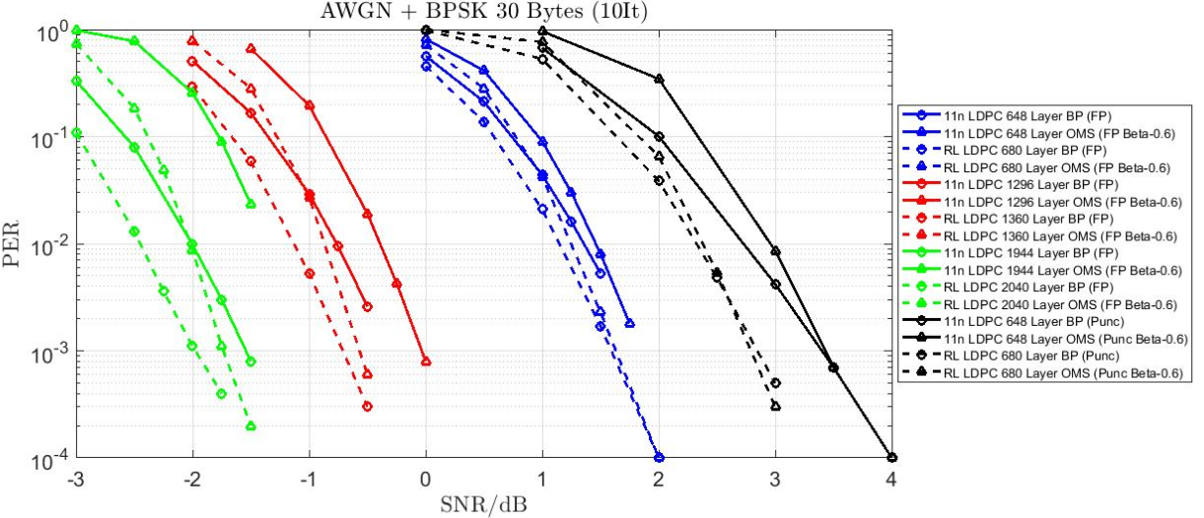
Simulation Results → Medium & Long Codes

Slide 17
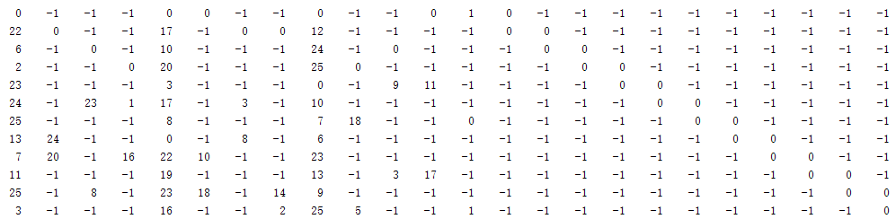
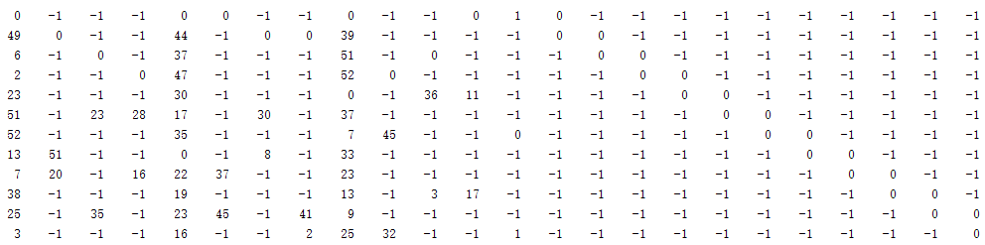
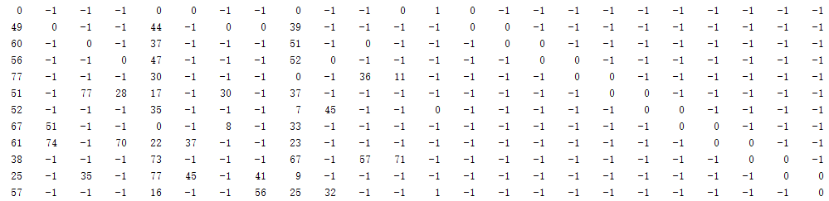
11n-648 Based LDPC Codes → Alternative Solution
If we want to maximum reuse the existing 11n LDPC codes, to facilitate the implementation and save the area on chip, an alternative UWB LDPC solution can be considered
  The 11n LDPC of different lengths don‘t share the same base matrix, neither the same set of lifting factors
  We can consider to fully reuse the rate-1/2, length-648 11n LDPC matrix, and the 1296 and 1944 matrices can be obtained conveniently based on the same base matrix of 11n short LDPC code
  The set of 11n-648 Based LDPC codes of three lengths (short / medium / long) can also be embedded into a single base matrix with a single set of lifting factors
  Lifting factors of different lengths can be conveniently obtained by modulo operations (widely optimized in 5G LDPC decoders) → the short code is exactly the 11n-684 LDPC code of rate-1/2
Single Base Matrix for all lengths
11n-648 LDPC (R = 1/2)
Size: 12x24, Lifting = 27, n = 24 x 27 = 648 bits
Size: 12x24, Lifting = 27x2 = 54, n = 24 x 52 = 1248 bits
Size: 12x24, Lifting = 27x3 = 81, n = 24 x 81 = 1944 bits

Slide 18
11n-648 Based LDPC Codes → Alternative Solution
If we want to maximum reuse the existing 11n LDPC codes, to facilitate the implementation and save the area on chip, an alternative UWB LDPC solution can be considered
  Lifting factors of different lengths can be conveniently obtained by modulo operations (widely optimized in 5G LDPC decoders) → the short code is exactly the 11n-684 LDPC code of rate-1/2
11n-648 LDPC (R = 1/2)
Size: 12x24, Lifting = 27, n = 20 x 27 = 648 bits
Size: 12x24, Lifting = 27x2 = 54, n = 24 x 54 = 1296 bits
  Examples for embedded lifting factors:
  Case A: 0 (0 % 27 = 0) ← 0 (0 % 54 = 0) ← 0 (long)
  Case B: 17 (44 % 27 = 17) ← 44 (44 % 54 = 44) ← 44 (long)
  Case C: 23 (23 % 27 = 23) ← 23 (77 % 54 = 23) ← 77 (long)
  All with one base matrix and one group of lifting coefficients
  → Reduces the implementation complexity of 3 lengths
Size: 12x24, Lifting = 27x3 = 81, n = 24 x 81 = 1944 bits

Slide 19
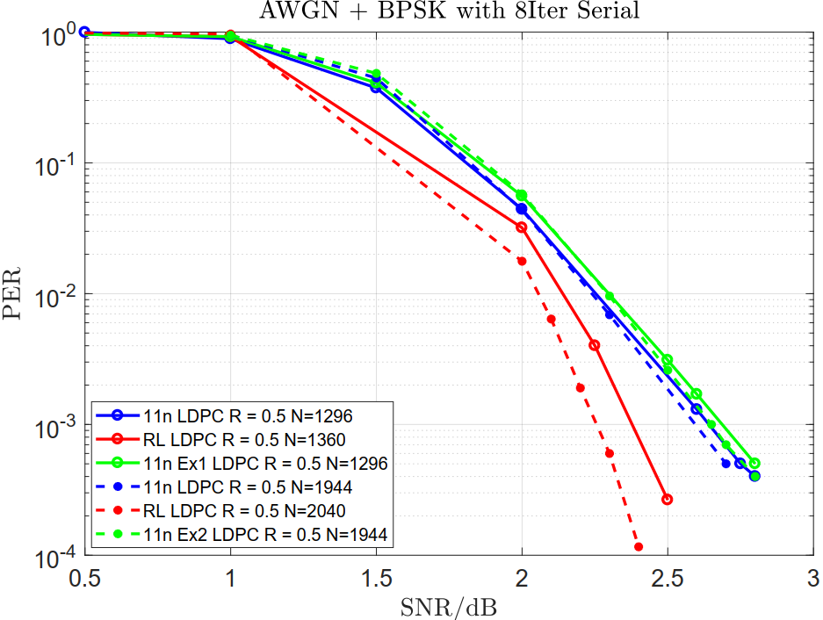
Simulation Results → 11n-648 Based LDPC Codes
  The 1296 and 1944 11n-648 Based LDPC Codes performs very close to the default 11n LDPC codes
  The 648, 1296, 1944 11n-648 Based LDPC Codes share the same base matrix, and the same set of lifting factors
  The decoder can fully reuse the 11n-648 short code decoder with a simple modulo operation at the addressing module if 1296 or 1944 code is enabled
  Decoder area occupation can be significantly reduced

Slide 20
Conclusions
The Raptor-Like LDPC code can achieve better performances compared with 11n LDPC for short, medium, or long payloads (with or without puncturing operations)
  The Raptor-Like LDPC can flexibly adjust the rate through shortening and puncturing to align the performance with that of PHR → keep the performance close but not surpass PHR
Both RL-LDPC and 11n-648 based LDPC codes of three lengths (short / medium / long) can be embedded into a single base matrix with a single set of lifting factors → Similar to 5G LDPC codes
  The 11n-648 based LDPC decoder can fully reuse the 11n-648 short code decoder with a simple modulo operation at the addressing module if 1296 or 1944 code is enabled, and the decoder area occupation can be significantly reduced

Slide 21
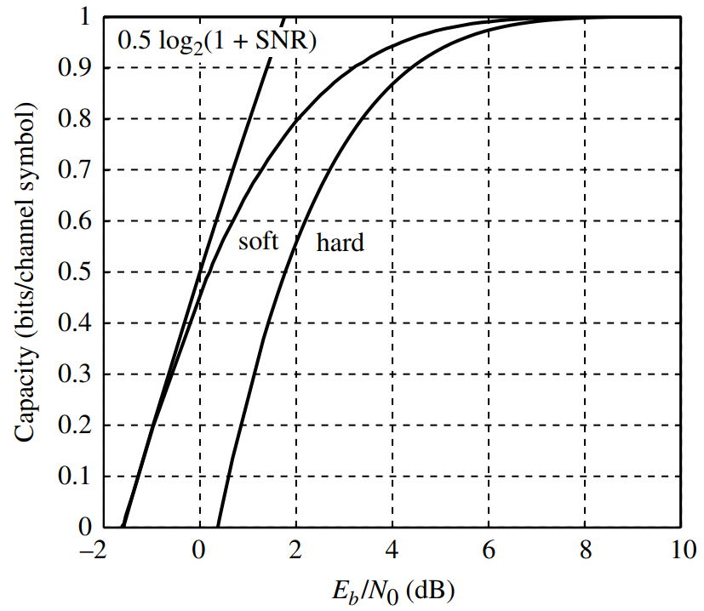
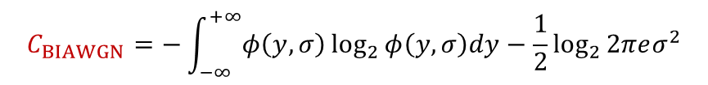
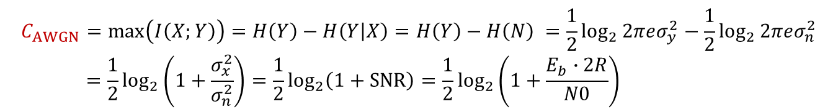



Appendix: Capacity of AWGN & BI-AWGN
For (Unconstrained-Input) AWGN Channel (PAM):
  The capacity can be achieved when inputs are Gaussian distributed:
For Binary Input AWGN (BI-AWGN) Channel (BPSK):
  The capacity can be achieved when inputs are uniform distributed, i.e., P(0) = 0.5
$$C_{AWGN}=\max\left(I\left(X;Y\right)\right)=H\left(Y\right)−H\left(Y | X\right)=H\left(Y\right)−H\left(N\right) =\frac{1}{2}\log_{2}{2πeσ_{y}^{2}}−\frac{1}{2}\log_{2}{2πeσ_{n}^{2}}$$
$$=\frac{1}{2}\log_{2}\left(1+\frac{σ_{x}^{2}}{σ_{n}^{2}}\right)=\frac{1}{2}\log_{2}\left(1+SNR\right)=\frac{1}{2}\log_{2}\left(1+\frac{E_{b}∙2R}{N0}\right)$$
$$bits/symbol$$
$$C_{BIAWGN}=−\int_{−∞}^{+∞}{φ（y,σ）\log_{2}{φ（y,σ）dy}}−\frac{1}{2}\log_{2}{2πeσ^{2}}$$
$$bits/symbol$$
AWGN
BI-AWGN
$$φ（y,σ）=\frac{1}{\sqrt{8πσ^{2}}}\left[e^{−{(y−1)}^{2}/2σ^{2}}+e^{−{(y+1)}^{2}/2σ^{2}}\right]$$
  Capacity for R = 0.5:
  AWGN → Eb/N0 = 0 dB;
  BI-AWGN → Eb/N0 ~ 0.16 dB

Slide 22
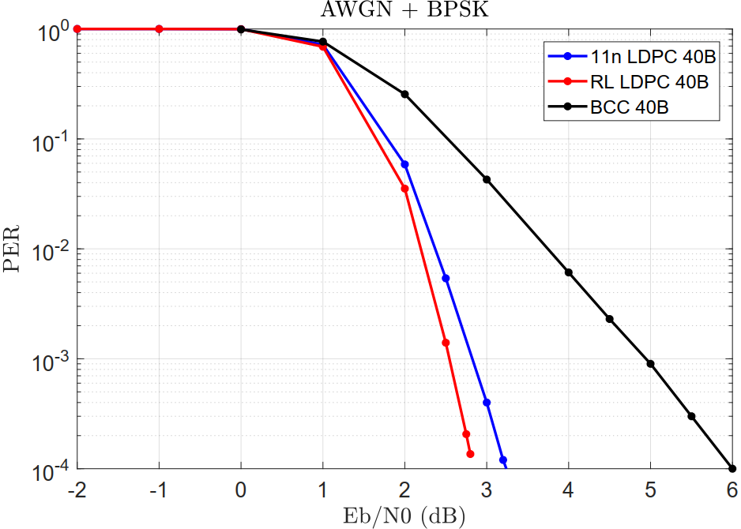

Appendix: Simulation Results with Capacity
Es/N0, Eb/N0 and SNR:
  Es/N0 = (Eb*R)/N0
  Es/N0 and SNR:
  When Tsym = Tsamp,
    For complex signals (QPSK): Es/N0 = SNR
    For real signals (BPSK): Es/N0 = 0.5*SNR
  To in line with the industrial custom, our previous SNR were actually Es/N0 for BPSK, and the real SNR of BPSK shall be 2*Es/N0
  To erase the ambiguity of abscissa, the right figure is illustrated with Eb/N0, then we can compare the performance with capacity in terms of Eb/N0
QPSK & QAM
BPSK
Source: Robert G. Gallager, Principles of Digital Communication Gallager, 2008
Capacity of BI-AWGN in Eb/N0

Slide 23
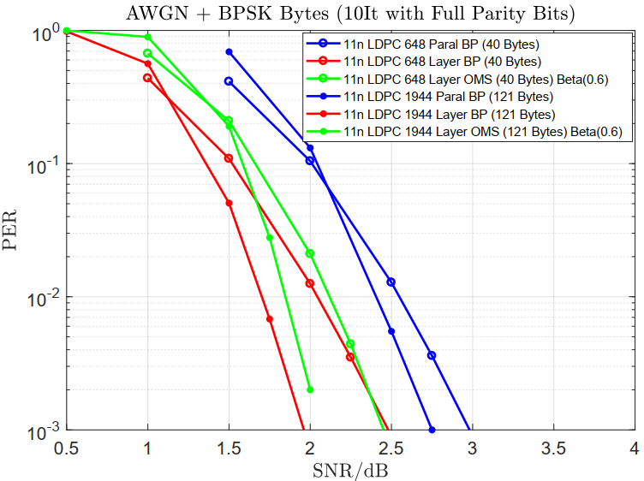
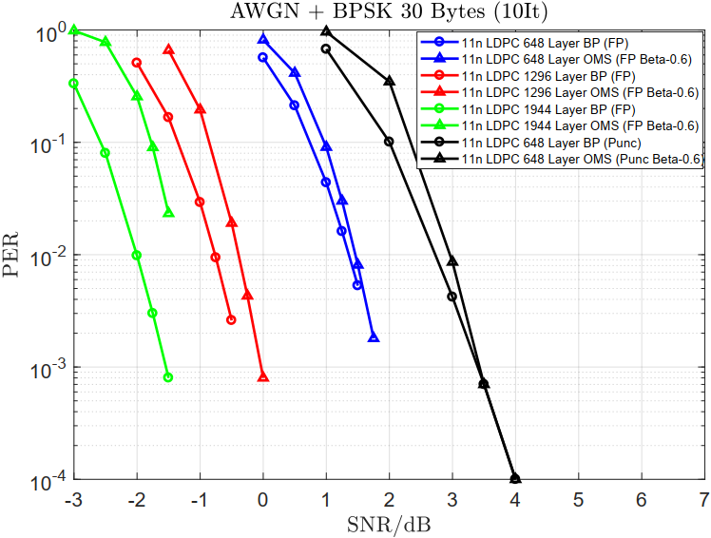
Appendix: Simulation Alignments based on 11n LDPC

Slide 24
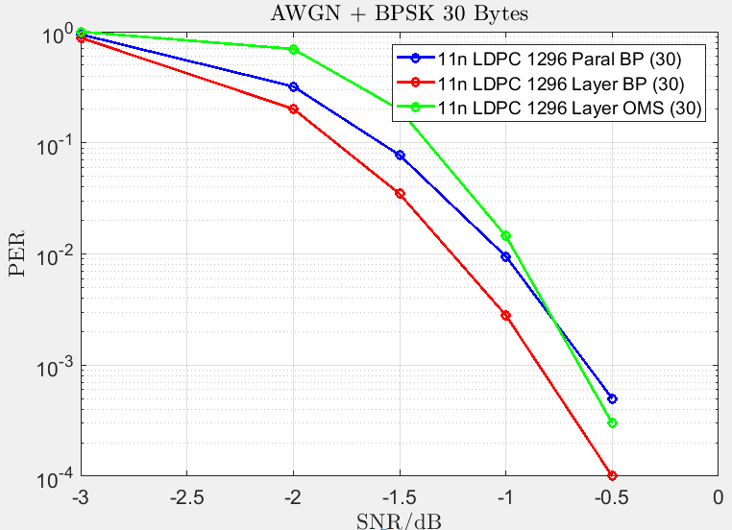
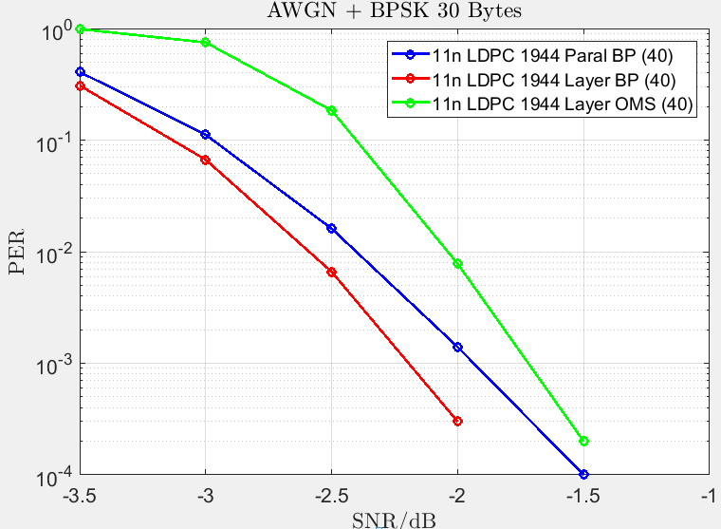
Appendix: Simulation Alignments based on 11n LDPC

Slide 25
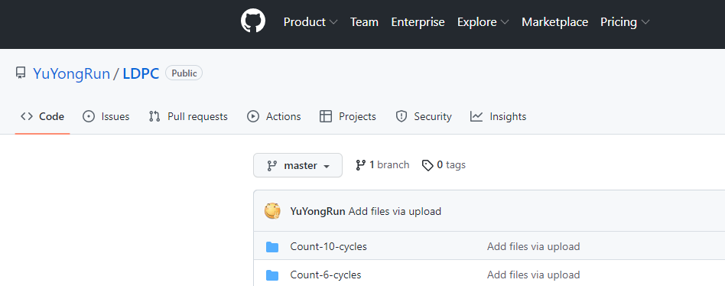
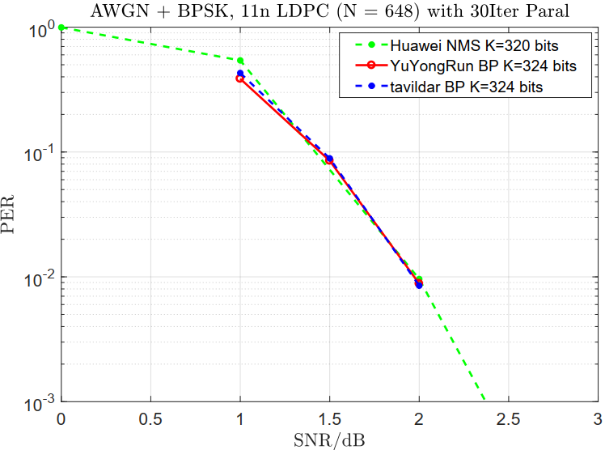
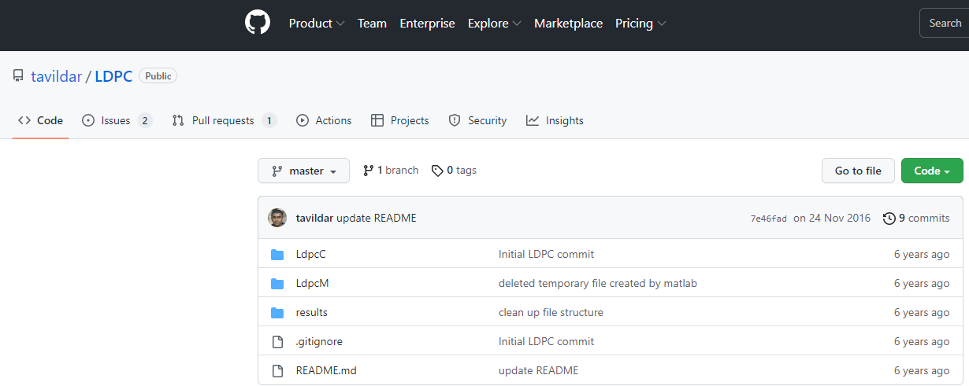
Appendix: Simulation Alignments → Public Sources
  SNR = Eb/N0 for BPSK of rate 1/2

Slide 26
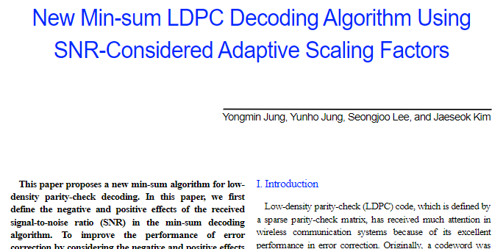
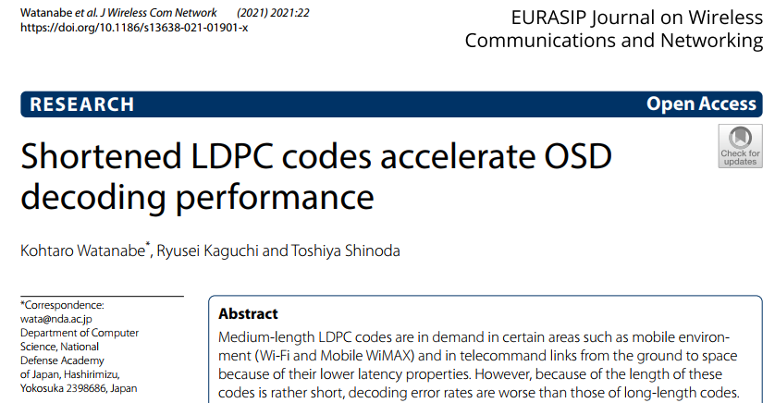
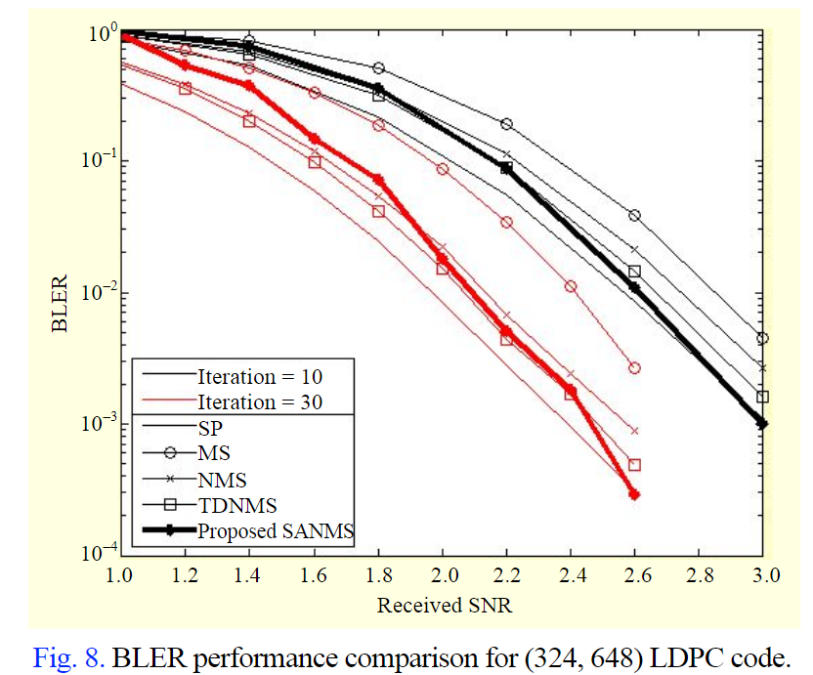
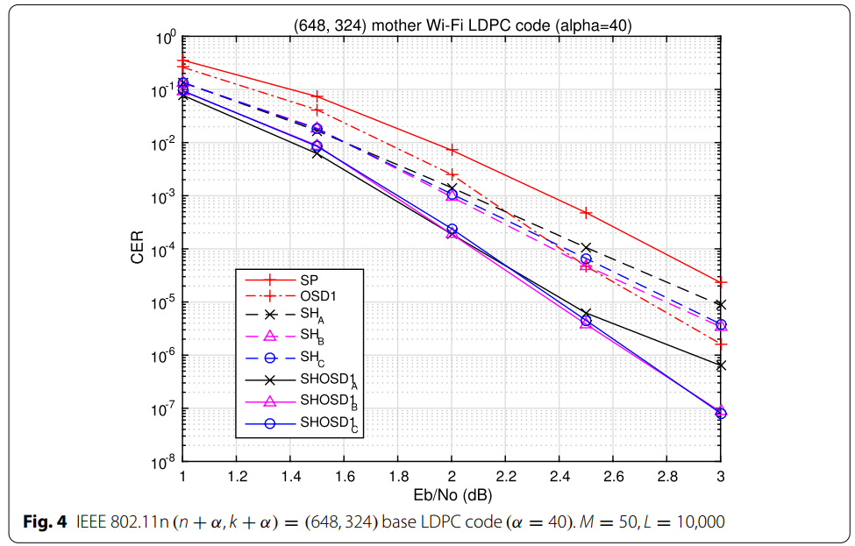
Appendix: Simulation Alignments → Academic Papers
BP with 50 Iter
BP with 30 Iter
  SNR = Eb/N0 for BPSK of rate 1/2

Slide 27
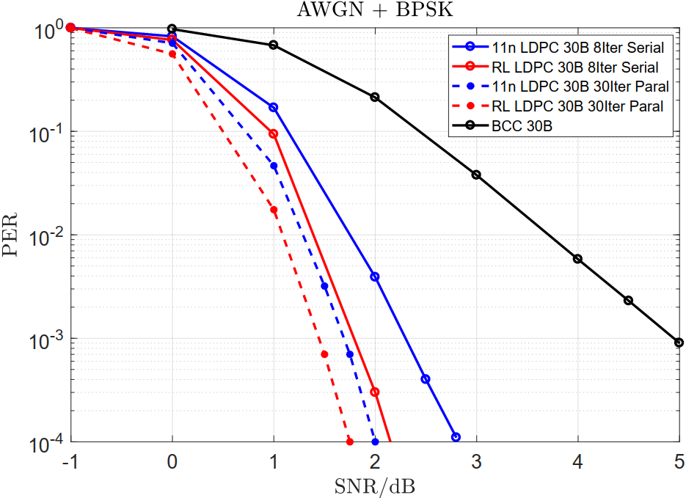
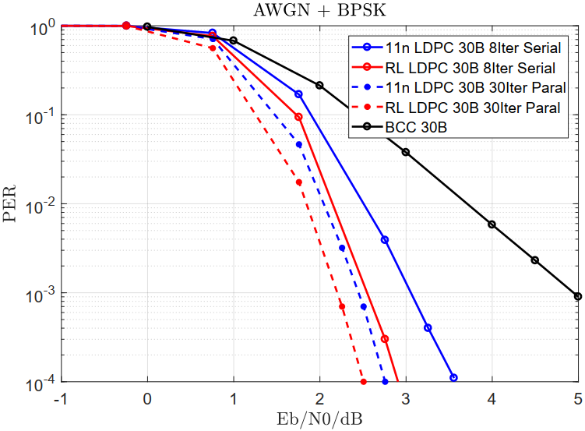
Appendix: More Simulation Results of Short Code
  All BCC Data Transmission: R = 1/2
  30 Bytes LDPC: R ~ 0.42 (RL: 0.4138 / 11n: 0.4255)

Slide 28
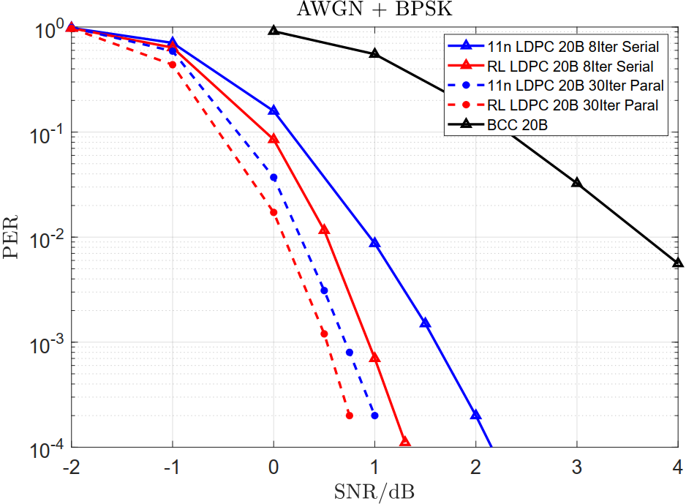
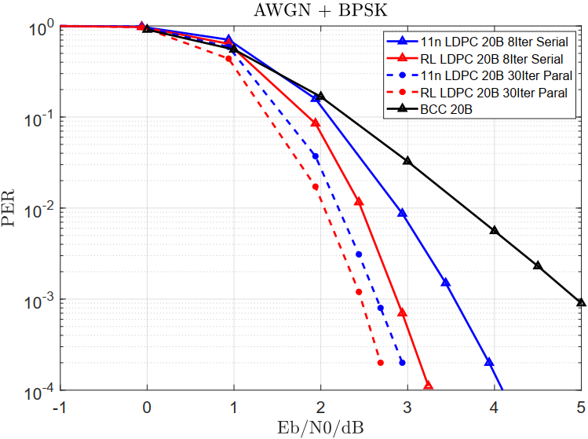
Appendix: More Simulation Results of Short Code
  All BCC Data Transmission: R = 1/2
  20 Bytes LDPC: R ~ 0.32 (RL: 0.3200 / 11n: 0.3300)

Slide 29
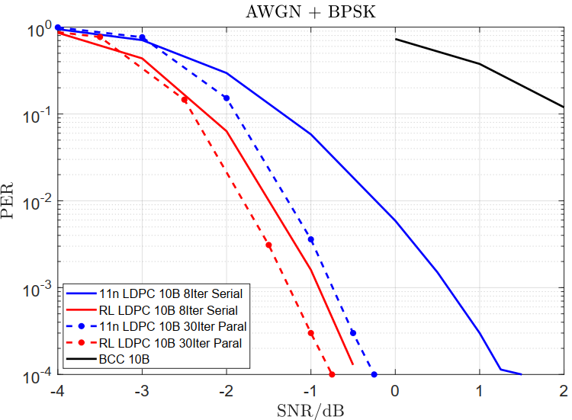
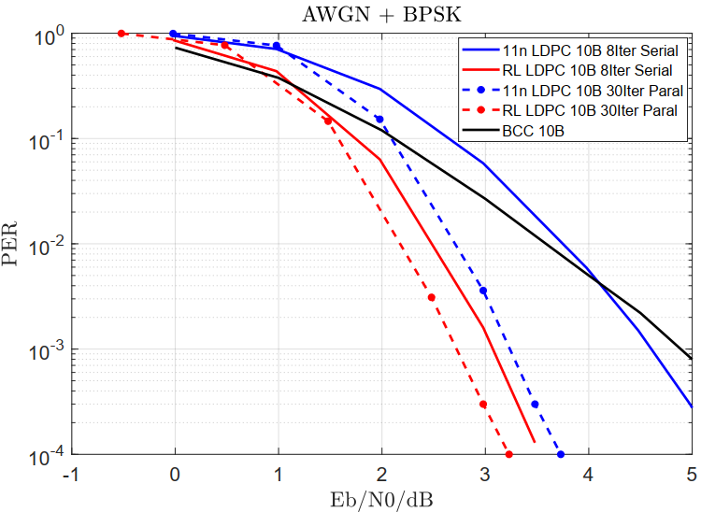
Appendix: More Simulation Results of Short Code
  All BCC Data Transmission: R = 1/2
  10 Bytes LDPC: R ~ 0.20 (RL: 0.1905 / 11n: 0.1980)

Slide 30
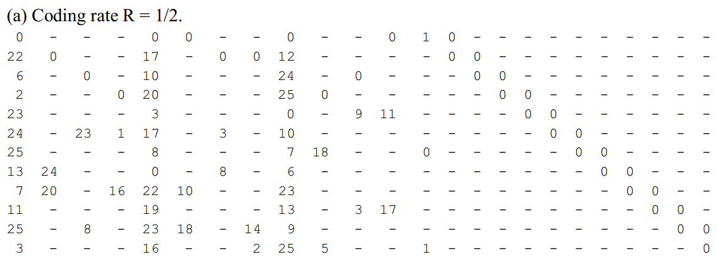
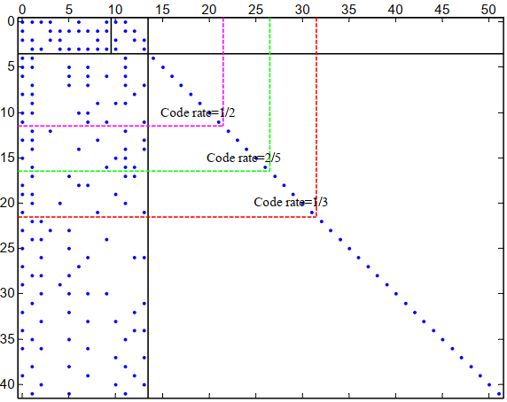
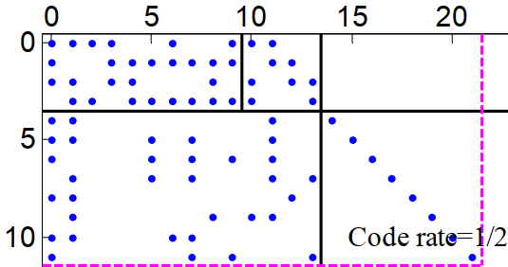
Appendix: Matrices
11n LDPC: Rate-1/2, Base Matrix: 12x24, N = 648, Z = 27
BG2 of NR LDPC: 1/5 ≤ R ≤ 2/3, 6 ≤ Kb ≤ 10
R = 1/2
degree-1 nodes
R = 2/3
State/Puncture Nodes
Size: 12x22, Lifting = 34, n = 20 x 34 = 680 bits

Slide 31
Thank You

