Slide 1
Project: IEEE P802.15 Working Group for Wireless Personal Area Networks (WPANs)
Submission Title: UWB Regulatory Considerations
Date Submitted: 14 September 2022
Source: Dries Neirynck (Ultra Radio Ltd), Jim Lansford (Qualcomm)
E-Mail: dries.neirynck ultra-radio.com, jlansfor qti.qualcomm.com
Re: September WNG meeting
Abstract:
Regulatory considerations for UWB deployment world-wide
Purpose: Provide background information needed for implementations of the standard.
Notice: This document has been prepared to assist the IEEE P802.15. It is offered as a basis for discussion and is not binding on the contributing individual(s) or organization(s). The material in this document is subject to change in form and content after further study. The contributor(s) reserve(s) the right to add, amend or withdraw material contained herein.
Release: The contributor acknowledges and accepts that this contribution becomes the property of IEEE and may be made publicly available by P802.15.

Slide 2
UWB Regulatory Considerations
Dries Neirynck (Ultra Radio Ltd)
Jim Lansford (Qualcomm)

Slide 3
-41.3 dBm/MHz mean, 0 dBm peak in 50 MHz?
No so fast – regulations vary:
Per country
Per application
Per frequency range

Slide 4
-41.3 dBm/MHz mean, 0 dBm peak in 50 MHz?
No so fast – regulations vary:
Per country
Per application
Per frequency range
… and over time:
Success of secure ranging based on 802.15.4z is leading to
many more countries allowing ultra-wideband
worry that aggregation of UWB emissions will cause interference

Slide 5
In general, from a regulatory perspective
UWB is an “underlay technology”
operating on a non-protected, non-interfering basis
Underlay technology: operates in spectrum licensed to other services
Non-interfering: cannot cause harmful interference to those services
Non-protected: must accept harmful interference from others
6 GHz UNII – including from other non-protected, non-interfering applications

Slide 6
FCC – 2002: First to introduce UWB
CFR Title 47, Part 15: Operation without individual license
15.517 – indoor UWB systems
15.519 – handheld UWB systems
-41.3 dBm/MHz mean, 0 dBm peak in 50 MHz in 3.1 – 10.6 GHz
10 dB bandwidth minimum 500 MHz
Fixed outdoor emissions are prohibited
10 second rule for handheld devices
Rules written under assumption that UWB would be used for communications

Slide 7
FCC – 2006: First (and still last) update
47 CFR § 15.250 - Wideband systems within the band 5925-7250 MHz
Only “update” to UWB rules
Minimum 10 dB bandwidth reduced to 50 MHz
Fixed outdoor still prohibited
But 10 second rule dropped
Since 2006, only waivers
Usually for specific devices from specific manufacturers

Slide 8
Meanwhile, in Europe
First UWB rules in 2006
-41.3 dBm/MHz in 6.0 - 8.5 GHz
Minimum 10 dB BW 50 MHz
Same prohibition on fixed outdoor
And lots of updates ever since
Mitigation techniques (low duty cycle, detect and avoid) for 3.1 – 4.8 GHz and 8.5 – 9.0 GHz
Specific applications (e.g. keyless entry for vehicles)

Slide 9
European highlights
ECC Decision (06)04
First approved March 2006, last updated 2019
Voluntary coordination between CEPT member states
Currently being revised
To allow fixed outdoor transmissions
To allow 10 dB extra power indoors
To simplify vehicular use
All between 6.0 – 8.5 GHz
European Commission Decisions
Largely copies of ECC Decisions but mandatory for single market members
Currently Decision (EU) 2019/785
ETSI Harmonised Standards
EN 302 065 series

Slide 10
The rest of the world
Most countries implement either CEPT or FCC framework
CEPT framework mainly in Europe, Africa and Asia
Particularly China, Japan and Korea have own rule sets
FCC framework mainly in North and South America

Slide 11
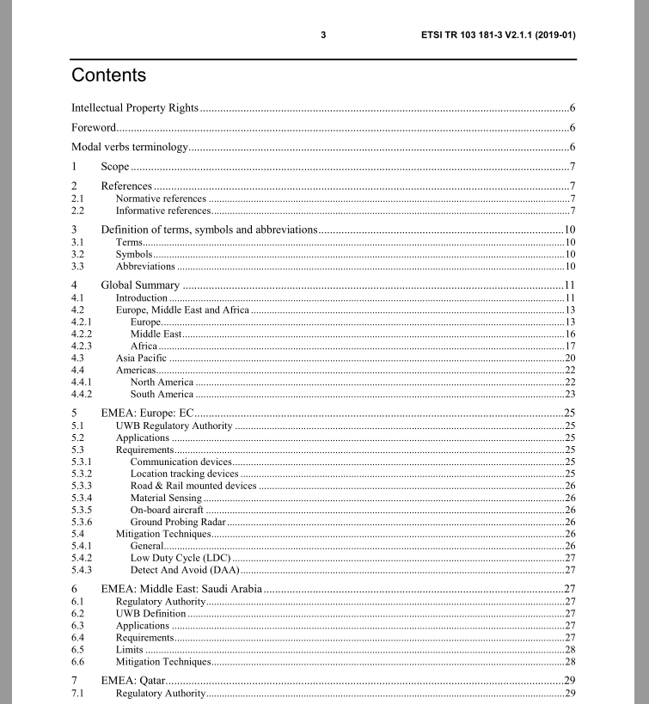

Slide 12
Liaison Statement Extract
ETSI TC ERM TGUWB has previously published ETSI TR 103 181-3 (V2.1.1, 2019-01), an overview of UWB regulations between 3.1 – 10.6 GHz worldwide. Since then, many states have introduced UWB regulations. In this context, ETSI TC ERM TGUWB is now working on a revision of TR 103 181-3 and we would appreciate if any IEEE member could contribute to this revision.
From our side, ETSI TC ERM TGUWB would be happy to provide any information you may require on the applicable CEPT/EC spectrum regulations and the corresponding ETSI standards. We will also inform you once the revision of TR 103 181-3 has been published.
(see 802.18-22/0060r0)

