Slide 1
September 2022
doc.: 15-22-0499-00-04ab
Project: IEEE P802.15 Working Group for Wireless Personal Area Networks (WPANs)
Submission Title: RMARKERs in Mixed MMS for Ranging Integrity
Date Submitted: 13 September, 2022
Source: Xiliang Luo, Vinod Kristem, Moche Cohen (Apple Inc.)
Address: One Apple Park Way, Cupertino, CA 95104, USA
E-Mail: luoxiliang@ieee.org
Abstract: More discussions and recommendations about the ranging markers in mixed MMS format that enable ranging integrity.
Purpose: Define RMARKERs to ensure ranging integrity with mixed MMS format.
Notice: This document has been prepared to assist the IEEE P802.15. It is offered as a basis for discussion and is not binding on the contributing individual(s) or organization(s). The material in this document is subject to change in form and content after further study. The contributor(s) reserve(s) the right to add, amend or withdraw material contained herein.
Release: The contributor acknowledges and accepts that this contribution becomes the property of IEEE and may be made publicly available by P802.15.
Submission
X. Luo, et al

Slide 2
September 2022
doc.: 15-22-0499-00-04ab
PAR Objective | Proposed Solution (how addressed)
Safeguards so that the high throughput data use cases will not cause significant disruption to low duty-cycle ranging use cases
Interference mitigation techniques to support higher density and higher traffic use cases
Other coexistence improvement
Backward compatibility with enhanced ranging capable devices (ERDEVs)
Improved link budget and/or reduced air-time | MMS
Additional channels and operating frequencies
Improvements to accuracy / precision / reliability and interoperability for high-integrity ranging | MMS for high-integrity ranging
Reduced complexity and power consumption
Hybrid operation with narrowband signaling to assist UWB | NBA-MMS
Enhanced native discovery and connection setup mechanisms
Sensing capabilities to support presence detection and environment mapping
Low-power low-latency streaming
Higher data-rate streaming allowing at least 50 Mbit/s of throughput
Support for peer-to-peer, peer-to-multi-peer, and station-to-infrastructure protocols
Infrastructure synchronization mechanisms
Submission
X. Luo, et al

Slide 3
September 2022
doc.: 15-22-0499-00-04ab
Ranging Integrity with MMS
Overall designs
Ranging integrity
baseline: build on 4z schemes
attain performance enhancements by exploiting multiple fragments
X & Y can be flexibly configured as follows
With NB assistance:
X $∈$ {1, 2, 4, 8}, Y $∈$ {1, 2, 4, 8} → incremental gain
Without NB assistance:
X$∈${0, 1, 2, 4, 8} , Y $∈$ {1, 2, 4, 8} → incremental gains
NB
Either
Z = {0, 1}
1ms
1ms
(X-2) ms
(1+Z) ms
1ms
(Y-2) ms
UWB
SYNC
SFD
Preamble
Fragment
1
Preamble
Fragment
2
Preamble
Fragment
X
Ranging Integrity
Fragment
1
Ranging Integrity
Fragment
2
Ranging Integrity
Fragment
Y
Submission
X. Luo, et al

Slide 4
September 2022
doc.: 15-22-0499-00-04ab
Ranging Markers for Ranging Integrity with MMS
Overall designs: RIF-RMARKERs
One RIF-RMARKER is defined as the peak of the first/last UWB pulse in each RIF
RIF-RMARKERs will enable ranging integrity against adversarial slow/fast-clock attacks
One RIF-RMARKER is advanced → Another RIF-RMARKER has to be delayed!
1ms
(Y-2) ms
Preamble
Fragment
X
RIF
1
RIF
2
RIF
Y
RIF-RMARKER 1
RIF-RMARKER 2
RIF-RMARKER Y
Submission
X. Luo, et al

Slide 5
September 2022
doc.: 15-22-0499-00-04ab
Ranging Markers for Ranging Integrity with MMS: Slow-Clock Attack
Ideal/Absolute Clock
1ms
RIF
1
RIF
2
RIF
3
RIF
4
RIF
5
RIF
6
RIF
7
RIF
8
Legit Tx
ClockFreqOffset = 0
Attack-SlowClock
ClockFreqOffset = -40ppm
RIF
1
RIF
2
RIF
3
RIF
4
RIF
5
RIF
6
RIF
7
RIF
8
120ns
160ns
One RIF-RMARKER is advanced → Another RIF-RMARKER has to be delayed!
Submission
X. Luo, et al

Slide 6
September 2022
doc.: 15-22-0499-00-04ab
Ranging Markers for Ranging Integrity with MMS: Fast-Clock Attack
Ideal/Absolute Clock
1ms
RIF
1
RIF
2
RIF
3
RIF
4
RIF
5
RIF
6
RIF
7
RIF
8
Legit Tx
ClockFreqOffset = 0
Attack-SlowClock
ClockFreqOffset = +40ppm
RIF
1
RIF
2
RIF
3
RIF
4
RIF
5
RIF
6
RIF
7
RIF
8
160ns
120ns
One RIF-RMARKER is advanced → Another RIF-RMARKER has to be delayed!
Submission
X. Luo, et al

Slide 7
September 2022
doc.: 15-22-0499-00-04ab
Proposals
In the case of mixed MMS with RIFs, the additional ranging markers, i.e., RIF-RMARKERs, are defined to enable ranging integrity
RIF-RMARKER: defined as the peak of the first/last UWB pulse in each RIF
Timestamps corresponding to all RIF-RMARKERs could be reported to enable ranging integrity
1ms
(Y-2) ms
Preamble
Fragment
X
RIF
1
RIF
2
RIF
Y
RIF-RMARKER 1
RIF-RMARKER 2
RIF-RMARKER Y
Submission
X. Luo, et al

Slide 8
September 2022
doc.: 15-22-0499-00-04ab
Backup Information
Submission
X. Luo, et al

Slide 9
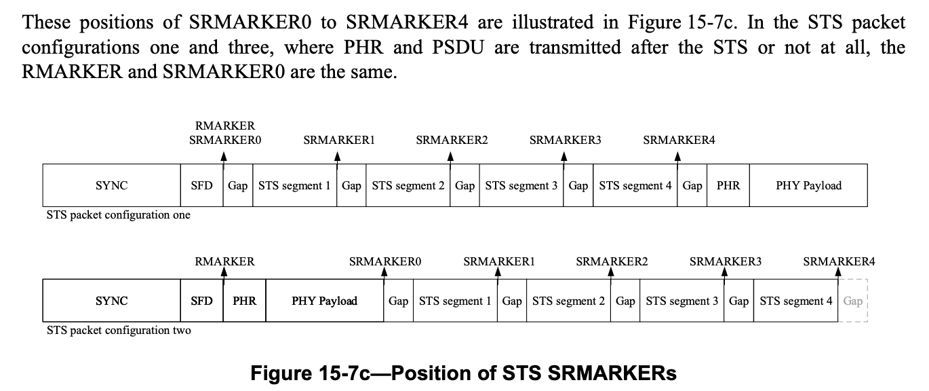
September 2022
doc.: 15-22-0499-00-04ab
4z: 15.2.9.3 Additional STS RMARKERs
Submission
X. Luo, et al

