Slide 1
Project: IEEE P802.15 Working Group for Wireless Personal Area Networks (WPANs)
Submission Title: Further Evaluation of Preamble Sequence Options for 15.4ab
Date Submitted: September 12, 2022
Source: Pooria Pakrooh, Bin Tian, and Koorosh Akhavan (Qualcomm)
E-Mail:{ppakrooh, btian, kakhavan}@qti.qualcomm.com
Abstract: Continued evaluation of preamble proposals for detection and channel estimation
Notice: This document has been prepared to assist the IEEE P802.15. It is offered as a basis for discussion and is not binding on the authoring individual(s) or organization(s). The material in this document is subject to change in form and content after further study. The authors(s) reserve(s) the right to add, amend or withdraw material contained herein.

Slide 2
PAR Objective | Proposed Solution (how addressed)
Safeguards so that the high throughput data use cases will not cause significant disruption to low duty-cycle ranging use cases
Interference mitigation techniques to support higher density and higher traffic use cases | Continued evaluation of preamble proposals for detection and channel estimation
Other coexistence improvement
Backward compatibility with enhanced ranging capable devices (ERDEVs)
Improved link budget and/or reduced air-time
Additional channels and operating frequencies
Improvements to accuracy / precision / reliability and interoperability for high-integrity ranging
Reduced complexity and power consumption
Hybrid operation with narrowband signaling to assist UWB
Enhanced native discovery and connection setup mechanisms
Sensing capabilities to support presence detection and environment mapping
Low-power low-latency streaming
Higher data-rate streaming allowing at least 50 Mbit/s of throughput
Support for peer-to-peer, peer-to-multi-peer, and station-to-infrastructure protocols
Infrastructure synchronization mechanisms

Slide 3
Introduction
In [1], we presented a preliminary set of results for some of the preamble sequences under consideration for 15.4ab: Golay sequence, M-sequence and Ipatov sequence
Two phases were defined for the receiver processing: packet detection and channel estimation.
  Packet detection phase:
    CFO can be large, long coherent combining is not possible.
    Large cross-correlation over short sequence can cause false alarm.
  Channel estimation phase:
    In auto-correlation analysis, CFO of signal is small at the receiver after frequency correction. However, the CFO for the interference may still be larger, since it is from a different transmitter.
    High auto-correlation and cross-correlation can affect the channel estimation.
In [2], a framework has been proposed to conduct Monte-Carlo simulations for various codes, under random interference and frequency error.
In this contribution, we present more results using the framework proposed in [2], for realistic scenarios that we defined in [1].

Slide 4
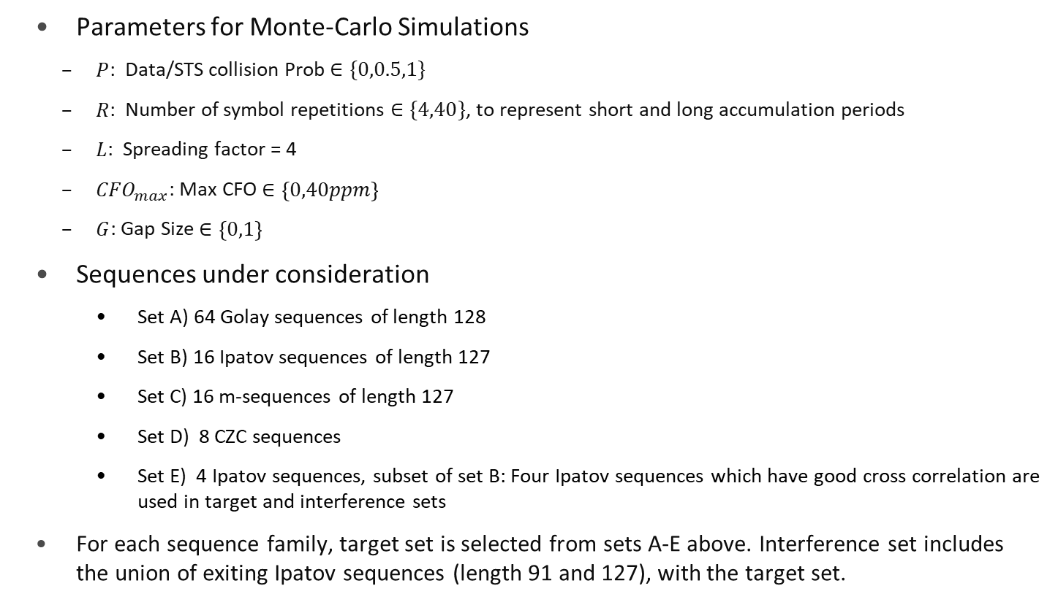
Simulation Settings
Parameters for Monte-Carlo Simulations
  $P$: Data/STS collision Prob $∈\{0,0.5,1\}$
  $R$: Number of symbol repetitions $∈\{4,40\}$, to represent short and long accumulation periods
  $L$: Spreading factor = 4
  ${CFO}_{max}$: Max CFO $∈\left\{0,40ppm\right\}$
  $G$: Gap Size $∈\left\{0,1\right\}$
Sequences under consideration
    Set A) 64 Golay sequences of length 128
    Set B) 16 Ipatov sequences of length 127
    Set C) 16 m-sequences of length 127
    Set D) 8 CZC sequences
    Set E) 4 Ipatov sequences, subset of set B: Four Ipatov sequences which have good cross correlation are used in target and interference sets
For each sequence family, target set is selected from sets A-E above. Interference set includes the union of exiting Ipatov sequences (length 91 and 127), with the target set.

Slide 5
Simulation Observations (CFO=0)
Simulation observations (90th percentile cross-correlation values)
  For packet detection: In mid-high SNR scenarios, cross-correlation for small number of symbols with CFO matters (4 symbols simulated) . MGC ~3dB better than Ipatov.
    No random data/STS: MGC with Gap (-17dB)> Ipatov with Gap (-15.3 dB) > CZC w/o Gap (-12 dB)> Ipatov w/o Gap (-10.1 dB)~ MG w/o Gap (-10.1dB)
    100% random data/STS: Ipatov: -11 dB MGC: -14 dB (Similar with and W/o Gap)
    50% random data/STS: Ipatov: -11 dB (Similar with and w/o Gap) MGC: -11dB (with Gap), -14 dB (W/o Gap)
  For channel estimation: Cross-correlation for large number of symbols with CFO matters (40 symbols simulated) : Gap does not improve the performance in presence of CFO and large number of symbols. MGC ~3dB better than Ipatov.
    No random data/STS: Ipatov and Golay: -10 dB (w/o Gap), -27 dB (with Gap) M: -10 dB (w/o Gap), -31 dB (with Gap), CZC: -12 dB (w/o Gap), -23 dB (with Gap)
    100% random data/STS: Ipatov: -22 dB MGC: -25 dB (Similar with and w/o Gap)
    50% random data/STS: Ipatov: -13 dB (w/o Gap), -22 dB (with Gap) MG: -11 dB (w/o Gap), -25 dB (with Gap), CZC: -24 dB (w/o Gap), -25 dB (with Gap)
  For interference analysis, cross-correlation in the presence of CFO matters. As the interference is coming from an independent transmitter, which is not frequency synchronized to the receiver.
  Without CFO, and in the case of minor random interference, introducing variable gap helps reduce the cross-correlation over large accumulation period.
MGC: M, Golay, CZC sequences

Slide 6
Simulation Observations (Max CFO=40ppm)
Simulation observations (90th percentile cross-correlation values)
  For packet detection: In mid-high SNR scenarios, cross-correlation for small number of symbols with CFO matters (4 symbols simulated) . MGC ~3dB better than Ipatov.
    No random data/STS: MGC with Gap (-18dB)> CZC w/o Gap (-17 dB)> Ipatov with Gap (-16dB) ~ M-sequence w/o Gap (-16 dB)>Ipatov w/o Gap (-14.6dB)> Golay w/o Gap (-12dB)
    100% random data/STS: Ipatov: -13 dB MGC: -15.5 dB (Similar with and W/o Gap)
    50% random data/STS: Ipatov: -13 dB MGC: -15.5 dB (Similar with and W/o Gap)
  For channel estimation: Cross-correlation for large number of symbols with CFO matters (40 symbols simulated) . Gap does not improve the performance in presence of CFO and large number of symbols. MGC ~3dB better than Ipatov.
    No random data/STS: Ipatov: -27 dB MGC: -29 dB
    100% random data/STS: Ipatov: -24 dB MGC: -27 dB
    50% random data/STS: Ipatov: -24 dB MGC: -27 dB
  Over short accumulation duration, in presence of CFO (detection) the cross-correlation is almost similar for MGC codes (~3dB better than Ipatov), similar performance with and w/o gaps in presence of random interference.
  Over long accumulation duration, in presence of CFO (channel estimation) the cross-correlation is almost similar for MGC codes (~3dB better than Ipatov), similar performance with and w/o gaps.
MGC: M, Golay, CZC sequences

Slide 7
Preamble Sequence Considerations: SYNC Field
  For the SYNC part of the UWB packet, we suggest to keep the existing sequences in 4z (Ipatov sequence)
    SYNC is mainly used for packet detection, sometimes over short accumulation period (high SNR regimes).
    Large cross-correlation affects false alarm rate
      Over short packet duration, and in presence of interference from random data/STS, different sequences do not differ much in terms of cross-correlation behavior.
      As shown in the simulations, when CFO and random data are present, different sequences provide -13 to -15dB of interference. There would still be false alarm, regardless of sequence choice.
    False alarm rate can also be partially addressed by enabling early packet drop
      Using more bits in PHR to assign different IDs to different users, to enable early drop of unwanted packets from other users
      Early drop during SFD part of the packet

Slide 8
Preamble Sequence Considerations: Other Fields
  For the other parts of the packet needing accurate CIR estimate (non-secure ranging (legacy/mms), sensing, etc.), there are a few ways to reduce the cross-correlation:
      Introducing variable-length gap
        This helps when frequency error is small, however it adds complexity to the receiver as the receiver has to deal with variable-length sequence
        Moreover, long gap reduces the effective PRF, and it increases the correlation with random data or STS segments
      Use long STS, or M-sequences, to decrease cross-correlation due to averaging
      Even for longer packets, when there is frequency error, gaps are not reducing the cross-correlation considerably

Slide 9
Concluding Remarks
In this contribution, we extended the analysis presented in [1], based on the framework proposed in [2].
When cross-correlation analysis, the effects of interference with random sequence, as well as frequency offset need to be considered.
  In the presence of random interference and CFO, gap does not help in reducing the cross correlation
  M-Sequence, Golay and CZC have similar cross-correlation performance
We propose to keep the existing sequences in 4z (Ipatov sequence) for the SYNC field.
For the other parts of the packet needing accurate CIR estimate, the effect of Gap does not matter much.
  Need to consider M-sequence, Golay sequence and CZC, as they have similar performance, without gap, in the presence of random CFO and random data/STS.

Slide 10
References
[1] 15-22-0418-00-04ab Discussion on preamble sequence options for detection and channel estimation
[2] 15-22-0418-00-04ab Simulation framework for recommending preambles for 4ab

Slide 11
Appendices

Slide 12
Ipatov Set

Slide 13
Ipatov Sequence, R=4, CFO=0

Slide 14
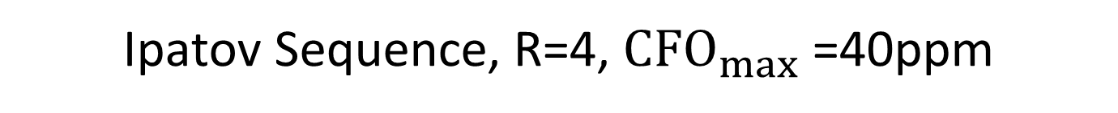
Ipatov Sequence, R=4, $CFO_{max}$ =40ppm

Slide 15
Ipatov Sequence, R=40, CFO=0

Slide 16
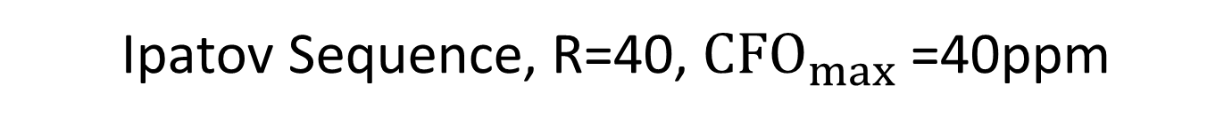
Ipatov Sequence, R=40, $CFO_{max}$ =40ppm

Slide 17
Golay Set

Slide 18
Golay Sequence, R=4, CFO=0

Slide 19
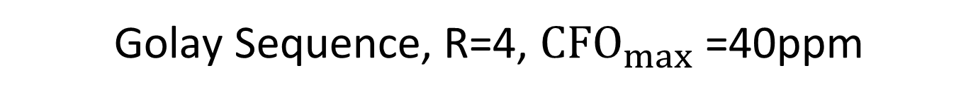
Golay Sequence, R=4, $CFO_{max}$ =40ppm

Slide 20
Golay Sequence, R=40, CFO=0

Slide 21
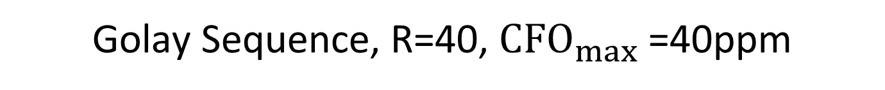
Golay Sequence, R=40, $CFO_{max}$ =40ppm

Slide 22
M-Sequences

Slide 23
M-Sequence, R=4, CFO=0

Slide 24
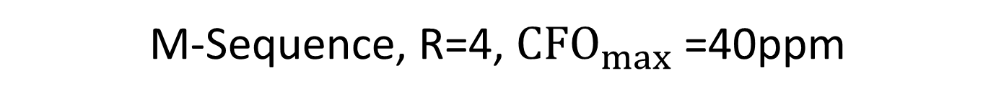
M-Sequence, R=4, $CFO_{max}$ =40ppm

Slide 25
M-Sequence, R=40, CFO=0

Slide 26
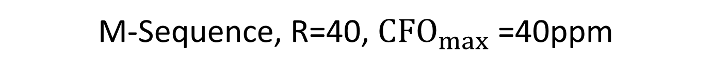
M-Sequence, R=40, $CFO_{max}$ =40ppm

Slide 27
CZC Set

Slide 28
CZC Sequence, R=4, CFO=0

Slide 29
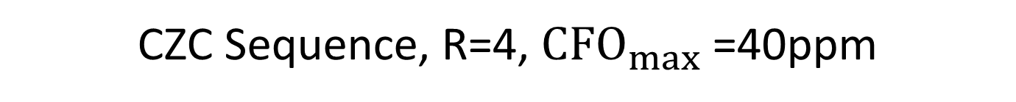
CZC Sequence, R=4, $CFO_{max}$ =40ppm

Slide 30
CZC Sequence, R=40, CFO=0

Slide 31
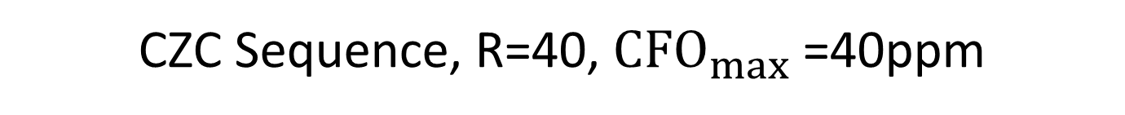
CZC Sequence, R=40, $CFO_{max}$ =40ppm

Slide 32
Ipatov4 Subset

Slide 33
Ipatov4 Sequence, R=4, CFO=0

Slide 34
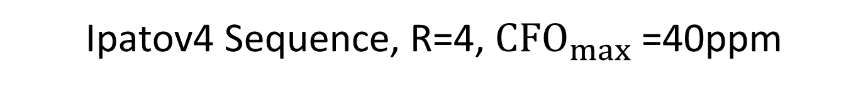
Ipatov4 Sequence, R=4, $CFO_{max}$ =40ppm

Slide 35
Ipatov4 Sequence, R=40, CFO=0

Slide 36
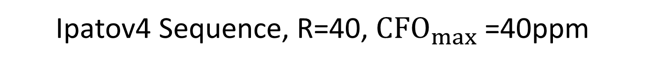
Ipatov4 Sequence, R=40, $CFO_{max}$ =40ppm

