Slide 1
Project: IEEE P802.15 Working Group for Wireless Personal Area Networks (WPANs)
Submission Title: [Updates on Narrowband Channel Allocation and Access]
Date Submitted: [11 July, 2022]
Source: [Alexander Krebs, Yong Liu, Lochan Verma, Jinjing Jiang, SK Yong (Apple)]
E-Mail: krebs@apple.com
Re: [Input to the Working Group]
Abstract: [Summary of discussions and additional simulation results on previously proposed methods for NBA-MMS-UWB channel allocation and access methods.]
Purpose: []
Notice: This document has been prepared to assist the IEEE P802.15. It is offered as a basis for discussion and is not binding on the contributing individual(s) or organization(s). The material in this document is subject to change in form and content after further study. The contributor(s) reserve(s) the right to add, amend or withdraw material contained herein.
Release: The contributor acknowledges and accepts that this contribution becomes the property of IEEE and may be made publicly available by P802.15.

Slide 2
PAR Objective | Proposed Solution (how addressed)
Safeguards so that the high throughput data use cases will not cause significant disruption to low duty-cycle ranging use cases
Interference mitigation techniques to support higher density and higher traffic use cases | Performance of AES vs LFSR PRNGs to randomize NB channel access, performance of biased, Wi-Fi aware channel switching mechanism
Other coexistence improvement
Backward compatibility with enhanced ranging capable devices (ERDEVs)
Improved link budget and/or reduced air-time
Additional channels and operating frequencies
Improvements to accuracy / precision / reliability and interoperability for high-integrity ranging
Reduced complexity and power consumption
Hybrid operation with narrowband signaling to assist UWB | This describes the NB channel switching methods
Enhanced native discovery and connection setup mechanisms
Sensing capabilities to support presence detection and environment mapping
Low-power low-latency streaming
Higher data-rate streaming allowing at least 50 Mbit/s of throughput
Support for peer-to-peer, peer-to-multi-peer, and station-to-infrastructure protocols
Infrastructure synchronization mechanisms

Slide 3
Discussion on Proposals in [1] [2]
Aligned vs unaligned 2.5 MHz narrowband channel map for UNII-3/5
  Consensus among all discussions for preferring 802.11 aligned option
UNII-5 NB CCA/LBT: No retrial within NBA-MMS-UWB sequence
  Clarification: Does not apply to other schemes but NBA-MMS-UWB
NB channel diversity and switching
  AES-128-CTR as baseline PRNG
    Discussion on pro/cons using LFSR based approach instead
  Performance evaluation/discussion requested:
    PRNG biasing for improved coexistence with 802.11 OFDM
    No switching of channels during NBA-MMS-UWB block

Slide 4
Agenda
Performance evaluation AES vs LFSR as PRNG function
Performance evaluation biased vs unbiased PRNG function
Performance evaluation per-block vs per-slot switching

Slide 5
Comparison of AES and LFSR based channel hopping schemes

Slide 6
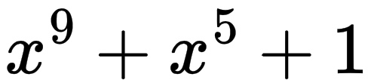
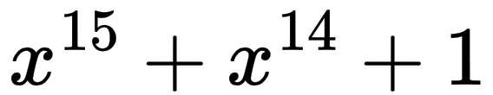
PRNG Candidates
PRNG needed for synchronized pseudo-random access schemes
  In 4ab, NBA-MMS-UWB with potentially 250 new NB channels in UNII-3+5
The following functions have previously been specified for use in 802.15.4
  AES-128
    used in 802.15.4z for STS generation (CTR), PSDU encryption (CCM)
  LFSR9: & SHUFFLE
    9-bit LFSR defined for channel hopping in Chapter 6.2.10
    Non-linear SHUFFLE operation aims to decorrelate output
  LFSR15: x15+x14+1
    15-bit LFSR used in 802.15.4 for PHY symbol spreading
    Could be enhanced by SHUFFLE operation from Ch. 6.2.10
All PRNGs are similarly fast (<10 clock cycles/bit w/o HW accel. [3,4])

Slide 7
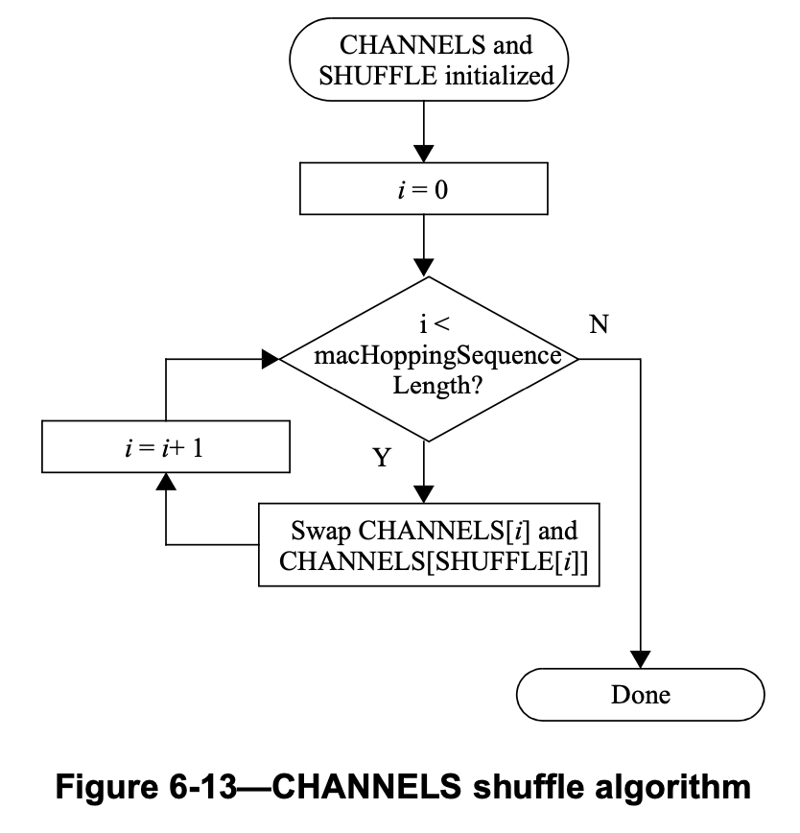
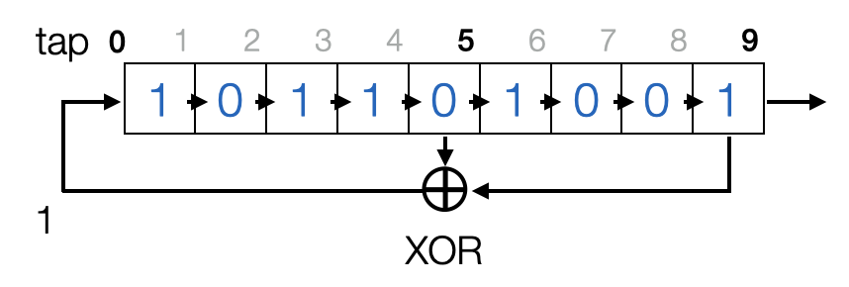
802.15.4 Legacy Channel Hopping
LFSR9 defined in 802.15.4 Ch. 6.2.10
  LFSR output value is used indirectly as index to swap two elements of an m-byte array CHANNELS[] = {1,…,m}
  Non-linear shuffling can effectively improve output statistics, but
    with only one swap per cycle, decorrelation is less effective if m<<v
    state cannot be advanced by more than one step per iteration (seeking problem)
  Cross correlation functions (CCFs) for seed values {1,…,511}, sequence length v=512, and m=250 NB channels show remaining linear dependencies
CCFs 1-511

Slide 8

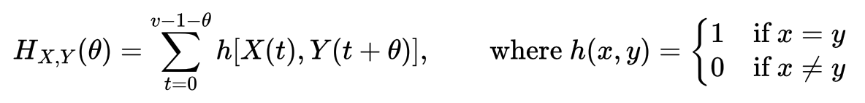
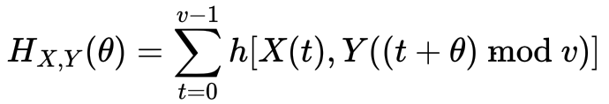

Performance Metric
Aperiodic Hamming Correlation Function:
Counts collisions between length-v sequences X, and Y for given offset
Similar definition for back-to-back periodic sequences
Worst case number of collisions for any 2 out of K users with sequences

Slide 9
Simulation Parameters
Simulation parameters
  m = 250 channels
  K = 12 users
  v = 512 sequence length
Randomly assigned initial seed values
  AES-128-CTR: 0 <= key < 2¹²⁸
  LFSR15: 1 <= seed < 2¹⁵
  LFSR9+SHUFFLE: 1 <= seed < 2⁹
Sequences generated by
  for i=1:v; S_{k}[i] = PRNG[i] % m; end
CDF generated over 5000 trials

Slide 10
Simulation Result
Higher order LFSR improves on 802.15.4 channel hopping scheme
AES outperforms all LFSR based approaches by an average of 2x to 11x
Aperiodic Hamming Correlation

Slide 11
Comparison
 |  | AES-128-CTR | LFSR15 | LFSR9 +SHUFFLE | LFSR15 +SHUFFLE
Performance | Max Hamming correlation (aper.) | Good (mu=8.9) | Worst (mu=205.5) | Poor (mu=99.4) | Fair (mu=20.8)
 | Seed collision | 1:2^128 | 1:2^15-1 | 1:2^9-1 (12% @ K=12) | 1:2^15-1
Complexity | Average clock cycles per bit | <1 (HW [3]) <10 (SW [4]) | <10 | <10 | <10
Complexity | Memory increase over 802.15.4z | 0 | 0 | +250 bytes | +250 bytes
 | Counter ops/seek | 1 | <=32767 | <Inf | <Inf
Effort | Specification subject to change | 15.4z | 802.15.4 (Ch. 15.3.2) | 802.15.4 (Ch. 6.2.10) | n/a (low eff.)
 | Current vendor support | all | all | some | none

Slide 12
Summary
Legacy and alternative LFSR based channel hopping methods have been compared to the newly proposed AES-128 based mechanism in [2]
Critical emerging 4ab use case: m=250 NB channels, shared by possibly 12, or more users
  AES-128 improves performance significantly over existing scheme, without additional HW requirements
  Existing LFSR schemes struggle with increased number of channels, and users
  Number of channels and users are likely to increase further with additional operating bands and emerging use cases
Conclusion
  In order to improve the existing scheme with a LFSR based approach, additional improvements would be needed, e.g., seed randomization, higher order polynomials, additional memory requirements, etc.
  All LFSR tested variants
    are only running up to AES-128 performance, even after ”optimization”
    bear some unfavourable design properties that could headache in the future
    no apparent advantage over AES-128, given that AES-128 is available already

Slide 13
Biased vs Unbiased PRNG

Slide 14
PRNG Biasing Motivation
Long collision burst are unfavorable for ranging/tracking applications
  Tracking of moving objects requires continuous ranging updates
  Example: Sequences A and B with ergodic collision rate p=0.5
Biasing methods 1 & 2 previously proposed in [2] aim to reduce error bursts by avoiding PRNG sequences with recurring WiFi overlap
  Longer off-channel dwell time increases Wi-Fi throughput [5]
Biasing the PRNG output is an offline, precomputable tweak and does not incorporate live information from experienced collisions
  Biasing is not alternative, to but addition to live interference management
tracking outage for extended period of time
  vs. user experience as tracking at ½ rate

Slide 15
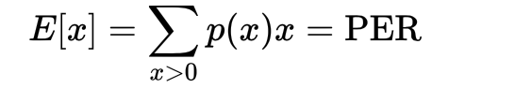
Simulation Parameters
UNII-3 with
  one static WiFi interferer, blocking 40 MHz continuous bandwidth of UNII-3
  50 NB channels (2.5 MHz each), channel switching every ranging block/cycle
Channel switching methods 1 and 2 [2] vs unbiased (AES, uniform random)
Simulation steps (repeat and average for every 802.11 40 MHz WiFi channel in UNII-3):
  For each PRNG candidate, generate -long NB channel number sequence
  Tag each item in the sequence as “collision” if the NB channel overlaps with WiFi channel, tag “no collision” otherwise
  Statistically count occurrences of collision subsequences {0: no collision, 1: single collision, 2: two consecutive collisions, 3: three consecutive collisions, …}
Special properties of collision burst statistics
  X=0: Count of no collisions between NB and WiFi (i.e. 1-PER) where PER=collision rate

Slide 16
Simulation Results
PRNGs unbiased ”uniform random” vs biased methods [2], B={20, 40} MHz)
Same collision rate (40MHz/125MHz = 0.32) for all tested PRNGs
Biasing reduces, or eliminates collision bursts

Slide 17
Summary
Burst error length performance has been evaluated for the two PRNG biasing methods [2] presented in IEEE Montreal 2022
Simulation results
  Both proposed methods demonstrated decreased burst error lengths in the simulated use case of one 40 MHz WiFi interferer
  Biasing also decreases burst error length when bandwidth of interference was falsely guessed
We want to investigate further one more complex WiFi interference scenarios (multiple users/bandwidths)
Our intention is to settle on one biasing method with most favorable properties for standardization
In general, biasing is a nice to have optimization, but not essential for NB operation (optional support)

Slide 18
Channel Diversity per Block/per Slot

Slide 19
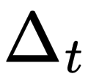
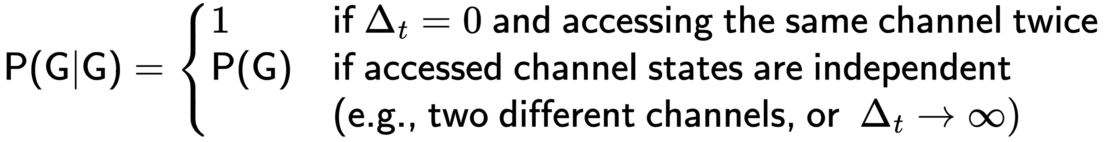
Channel Diversity per block/per slot
NBA-MMS-UWB requires 2, or more NB packets per ranging cycle to successfully transmit
  E.g., if either NB POLL or NB REPORT fails to transmit, ranging result cannot be obtained in the respective ranging cycle
  Ranging outage rate can be defined as 1-P(G)P(G|G)
    where P(G) is the NB packet transmission success probability
    where P(G|G) denotes the probability of two NB packets being successfully transferred at a time offset
We can infer that
Since P(G) <= P(G|G) <= 1 for all monotonical channel models
  therefore 1-P(G)P(G|G) <= 1-P(G) ²
  i.e., ranging outage is same, or better, for sticky NB channel within MMS sequence

Slide 20

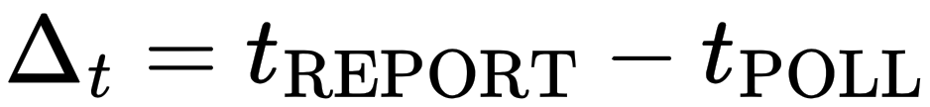
Simulation & Conclusion
Simulation model
  N channels with i.i.d. channel state {GOOD, BAD}
  Channel state switches every X seconds, X ~ exponentially distributed, E[X]=
  NBA-MMS-UWB with
Conclusion
  For one NBA-MMS-UWB sequence, all NB packets need to be transmitted on same channel to minimize outage
  Proposal: “per block” for NBA-MMS-UWB, but configurable for other applications

Slide 21
References
[1] “Narrowband Channel Allocation for NBA-MMS-UWB”, Krebs et al., July 2022, 15-22-0339-01-04ab
[2] “Narrowband Channel Access and Interference Mitigation for NBA-MMS-UWB”, Krebs et al., July 2022, 15-22-0340-01-04ab
[3] STM32U585xx (Cortex M33) datasheet, https://www.st.com/resource/en/data_brief/stm32u585ci.pdf
[4] “Fast, constant-time and masked AES assembly implementations for ARM Cortex-M3 and M4”, https://github.com/Ko-/aes-armcortexm
[5] “Coexistence of Narrowband Frequency Hopping (NB FH) systems and Wi-Fi”, Bailey et al., IEEE 802.11-22/1578r1, September 2022

