Slide 1
Windowing and filtering updates DCN 15-22-0492-00-016t

Slide 2
TX signal SNR MEASUREMENTS FOR SINGLE CARRIER SYSTEM
Sl. No. | Windowing applied or not | Filtering applied or not (257 taps filter) | No: of samples for delay correction of filter | TX SNR (dB)
1. | No | Yes | 128 | 23.5
2. | Yes | Yes | 128 | 32.25
3. | No | Yes | 126 | 34.7
Group delay of filter = (Number of taps-1)/2
= (257-1)/2 = 128
The previous analysis (1 &2 above) was done with group delay 128 where windowing was done before filtering in this case the SNR was higher compared to Sl No 1. Later analysis (Sl No 3) correction in filter group delay gave better CINR proving no need of windowing.

Slide 3
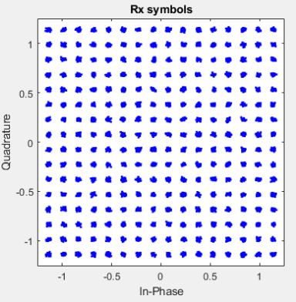
CONSTELLATION PLOT WITH FIR FILTERING (257 taps), 256QAM no noise​​
126 samples delay correction
Tx SNR : 34.7 dB
EVM (dB) : -34.7 dB
EVM (%) : 1.82 %

Slide 4
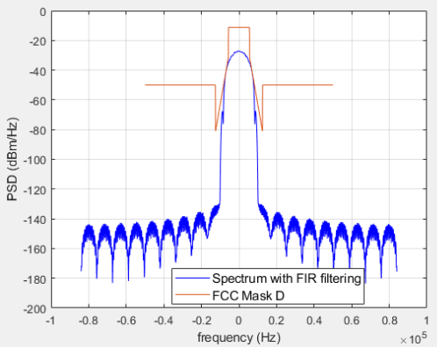
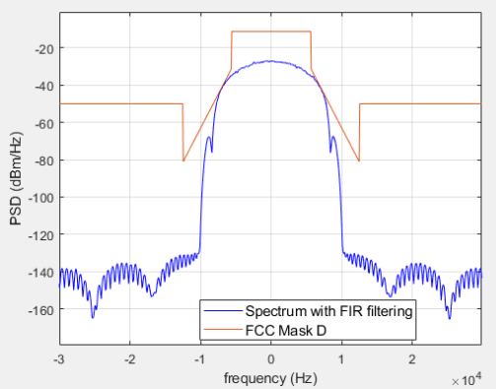
FCC MASK APPLIED ON SPECTRUM WITH FIR FILTERING (257 taps), 256QAM, no noise​
*Zoomed in figure of the plot on left

