Slide 1
Project: IEEE P802.15 Working Group for Wireless Personal Area Networks (WPANs)
Submission Title: [802.15.4 Architecture Overview]
Date Submitted: [3 October 2022]
Source: [Phil Beecher] Company [Wi-SUN Alliance]
Address [Hove, SE England]
Voice:[+44-1273-422275], E-Mail:[pbeecher@wi-sun.org]
Re: [September 2022 Wireless Interim Session]
Abstract: [IEEE Std 802.15.4 Architecture Overview for joint meeting 802.1/802.15]
Purpose: [Contribution for 802]
Notice: This document has been prepared to assist the IEEE P802.15. It is offered as a basis for discussion and is not binding on the contributing individual(s) or organization(s). The material in this document is subject to change in form and content after further study. The contributor(s) reserve(s) the right to add, amend or withdraw material contained herein.
Release: The contributor acknowledges and accepts that this contribution becomes the property of IEEE and may be made publicly available by P802.15.

Slide 2
Abstract
This presentation summarizes IEEE Std 802.15.4™-2020 use of the IEEE Std 802 Overview and Architecture.
Use of the LLC, MAC address formats and MSDU formats are described.
Extracted text is from IEEE Std 802.15.4™-2020

Slide 3
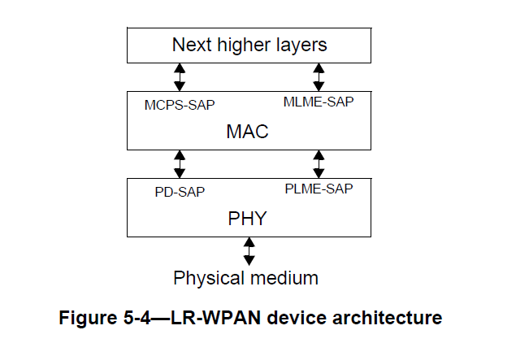
IEEE Std 802.15.4 MAC Services support LLC sublayer entities
The interfaces between the layers serve to define the logical links that are described in this standard.
An LR-WPAN device contains at least one PHY, which contains the radio frequency (RF) transceiver along
with its low-level control mechanism, and a MAC sublayer that provides access to the physical channel for
all types of transfer. Figure 5-4 shows these blocks in a graphical representation.
The next higher layers, shown in Figure 5-4, consist of a network layer, which provides network
configuration, manipulation, and message routing, and an application layer, which provides the intended
function of the device. The definition of these layers is outside the scope of this standard.

Slide 4
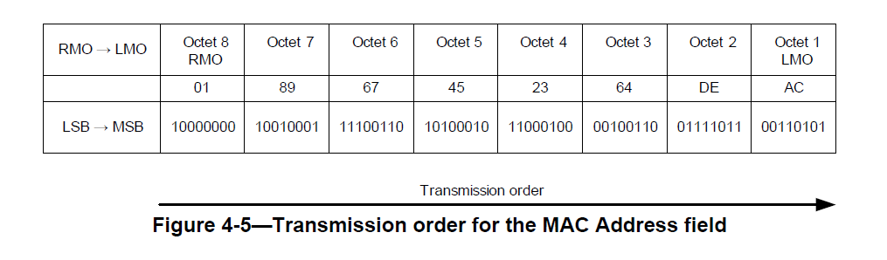
IEEE Std 802.15.4 MAC services and protocols use 64-bit MAC addresses
7.1 Device extended address
A device’s extended address shall be a EUI-64, as defined by IEEE Std 802-2014 and assigned by the IEEE
Registration Authority. The EUI-64 shall be sent in the canonical form defined in 4.5.
4.5 Transmission order
4.5.1 General
For every address field, the bit transmission order shall be performed from the right most octet (RMO) to the
left most octet (LMO) in the field, and inside an octet from the LSB to the MSB.
Figure 4-4 shows the MAC Address field containing a 64-bit MAC address. For this example, the MAC
address value is assumed to be AC-DE-64-23-45-67-89-01.
Broadcast Addresses are supported

Slide 5
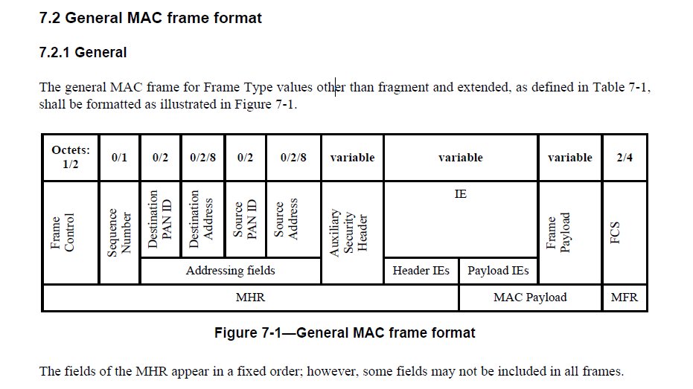
IEEE Std 802.15.4 MAC frame based transmission
Frame based communication using source and destination addressing:

Slide 6
Quality of Service is not supported in IEEE Std 802.15.4

Slide 7
Ethertype Protocol Discrimination (EPD) is supported indirectly using IEEE Std 802.15.9
IEEE Std 802.15.4 does not have direct support for Protocol discrimination
Ethertype Protocol Discrimination is achieved through an IEEE Std 802.15.9 Information Element

Slide 8
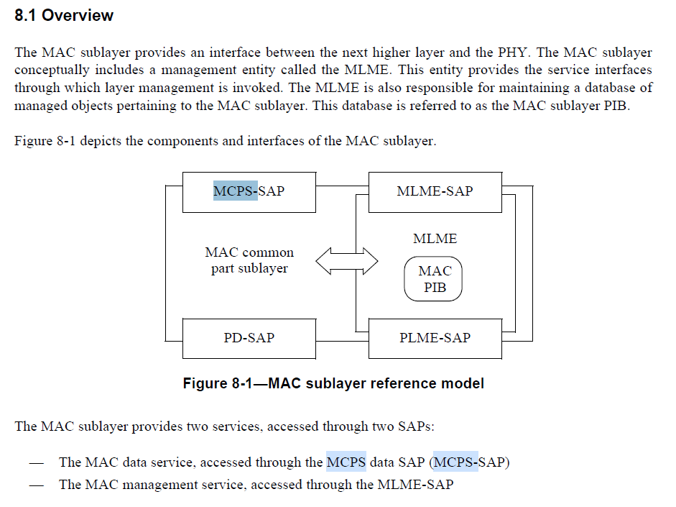
Figure 8-1 shows the MAC sublayer reference model

Slide 9
IIEEE Std 802.15.9
IEEE Std 802.15.9 offers three services:
  Fragmentation
  Protocol multiplexing
  Key Management
Background: Key Management frames are too large for the IEEE Std 802.15.4 minimum frame size; thus IEEE Std 802.15.9 defines a fragmentation mechanism.
IEEE Std 802.15.9 includes a protocol multiplexing layer to allow this fragmentation mechanism to be used by other services than KMP.
IEEE Std 802.15.9 is implemented using IEEE Std 802.15.4 Information Elements (IEs).
Slide 9

Slide 10
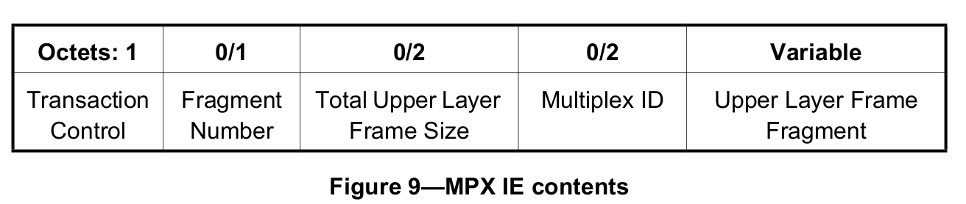
IIEEE Std 802.15.9 Multiplex Information Element (MPX IE)
MPX IE format:
The Multiplex ID can contain EtherType
Slide 10

Slide 11
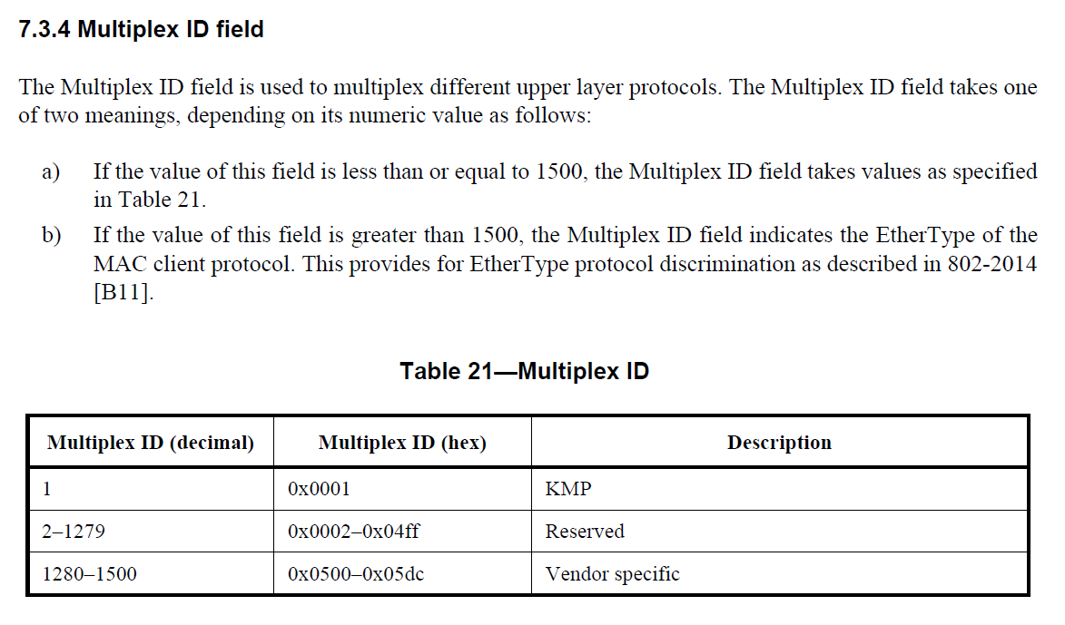
IIEEE Std 802.15.9 Multiplex ID field
Slide 11

Slide 12
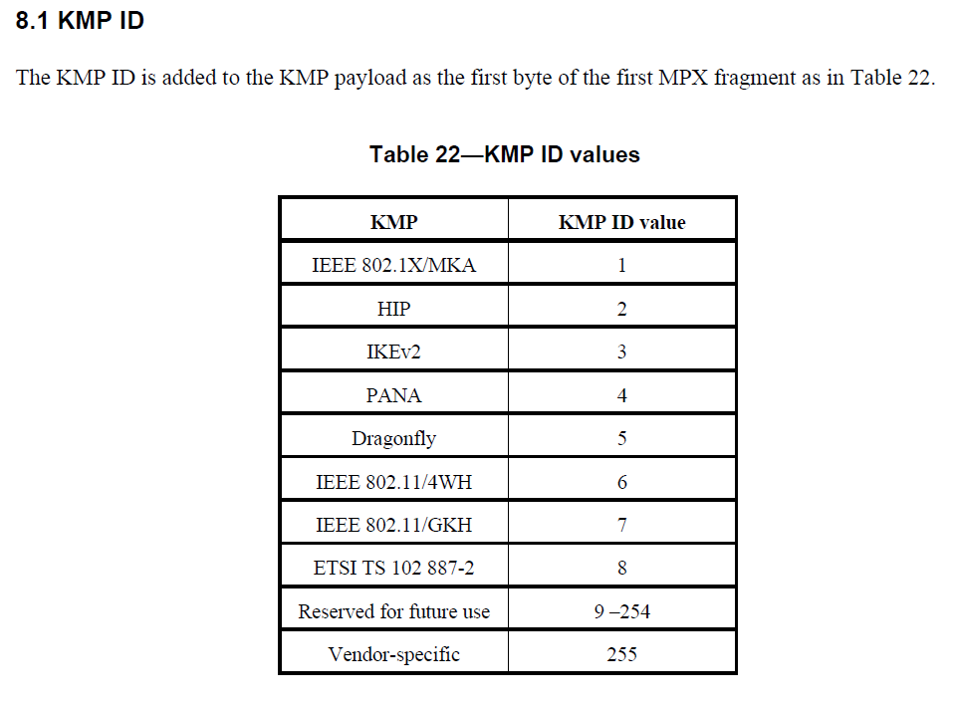
IIEEE Std 802.15.9 KMP Service
Slide 12

Slide 13
Summary: IEEE Std 802.15.4 standard uses several components of 802 architecture
LLC, MAC address formats, MSDU formats, used with IEEE Std 802.15.9, enables implementation of IETF IP based protocols (6lowpan)
IEEE Std 802.15.4 + IEEE Std 802.15.9 enables :
  802.1X security framework,
  IETF EAP protocols,
  and multiple credential types

Slide 14
References
IEEE Std 802.15.4™-2020, see https://ieeexplore.ieee.org/document/9144691
IEEE Std 802.15.9 ™-2021, see https://ieeexplore.ieee.org/document/9690134

