Slide 1
Project: IEEE P802.15 Working Group for Wireless Specialty Networks (WSN)
Submission Title: Spectrum Sensing Based Deferral
Submitted: September 12, 2022
Source: Benjamin Rolfe (Blind Creek Associates), Dries Neirynck (Ultra-radio), Frederic Nabki (Spark),
Contact:
E-Mail: ben.rolfe@ieee.org
Voice: NA
Re: Enhanced channel access for UWB
Abstract: A variation on channel access that includes spectrum sensing and potentially deferring transmission in a time-bounded way to improve performance, reliability and bound latency
Purpose: Consideration for inclusion in the draft amendment
Notice: This document has been prepared to assist the IEEE 802. It is offered as a basis for discussion and is not binding on the contributing individual(s) or organization(s). The material in this document is subject to change in form and content after further study. The contributor(s) reserve(s) the right to add, amend or withdraw material contained herein.
Release: The contributor acknowledges and accepts that this contribution becomes the property of IEEE and may be made publicly available by 802.15.
Notes:
Jul 12, 2010
Page 1

Slide 2
Summary of SSBD proposal
An optional channel access method

Slide 3
Spectrum sensing based deferral
For channel access where bounding latency in the channel access is desired.
Optional in all device types.
For unscheduled random access or with one of the scheduled access schemes.
Employs channel sensing using CCA and bounded deferral using linearly growing random backoff at each deferral.

Slide 4
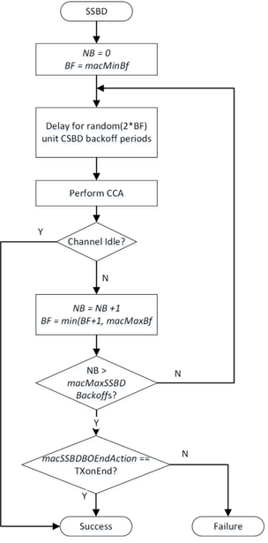
Algorithm overview
NB is the number of times the SSBD algorithm was required to backoff due to channel busy condition.
BF is the backoff factor.
Backoff period defined by aSSBDUnitBackoffPeriod

Slide 5
Algorithm overview
The algorithm shall terminate with Success when CCA returns idle.
The action when NB exceeds macMaxSSBDBackoffs depends on macSSBDBOEndAction:
  when set to TXonEnd, end with Success.
  When set to FailOnEnd, end with Failure.

Slide 6
Parameters
Constant | Description | Value
aSSBDUnitBackoffPeriod | The unit time period use for deferral in the SSBD algorithm, in microseconds. | TBD
Attribute | Type | Range | Description | Default
macMaxBf | Integer | 1 - TBD | The maximum value of the backoff factor (BF) in the SSBD algorithm as described in 6.2.5.x. | 1
macMaxSSBDBackoffs | Integer | 0 – TBD | The maximum number of deferral iterations the SSBD algorithm will attempt before exiting. | TBD
macMinBf | Integer | 1 - macMaxBf | The minimum value of the backoff factor (BF) in the SSBD algorithm as described in 6.2.5.x. | TBD
macSSBDBOEndAction | Enumeration | TxOnEnd, FailOnEnd | Determines the termination result of the SSBD algorithm upon exceeding the maximum back-off count, as described in 6.2.5.x. | TxOnEnd

Slide 7
Spectrum Sensing Based Deferral
Deferral on CCA busy, with random delay and linear back-off to bound channel access latency.
Adjustable to channel conditions and requirements:
  Variable energy detection threshold
  Variable sensing duration
Bounded channel access latency:
  Linear back-off
  Revert to Aloha on failure

