Slide 1
Project: IEEE P802.15 Working Group
Submission Title: [Short term cross-correlation of preamble proposals]
Date Submitted: [13th Sep 2022]
Source: [Michael Mc Laughlin] Affiliation [Qorvo]
Address [ ]
E-Mail:[michael.mclaughlin (at) qorvo.com]
Re: [Short term cross-correlation properties of preamble proposals]
Abstract: [Input to the technical requirements discussion for the 4ab project]
Purpose: []
Notice: This document has been prepared to assist the IEEE P802.15. It is offered as a basis for discussion and is not binding on the contributing individual(s) or organization(s). The material in this document is subject to change in form and content after further study. The contributor(s) reserve(s) the right to add, amend or withdraw material contained herein.
Release: The contributor acknowledges and accepts that this contribution becomes the property of IEEE and may be made publicly available by P802.15.

Slide 2
Technical Guidance [1]
PAR Objective | Proposed Solution (how addressed)
Safeguards so that the high throughput data use cases will not cause significant disruption to low duty-cycle ranging use cases.
Interference mitigation techniques to support higher density and higher traffic use cases | Because both CZC codes and Golay pairs can have pulse gaps inserted, the long term cross correlation of different codes, with different gap lengths, is much lower than codes with fixed symbol lengths
Other coexistence improvement
Backward compatibility with enhanced ranging capable devices (ERDEVs).
Improved link budget and/or reduced air-time
Additional channels and operating frequencies
Improvements to accuracy / precision / reliability and interoperability for high-integrity ranging;
Reduce complexity and power consumption;
Hybrid operation with narrowband signaling to assist UWB;
Enhanced native discovery and connection setup mechanisms;
Sensing capabilities to support presence detection and environment mapping;
Low-power low-latency streaming
higher data-rate streaming allowing at least 50 Mbit/s of throughput.
Support for peer-to-peer, peer-to-multi-peer, and station-to-infrastructure protocols;
Infrastructure synchronization mechanisms.

Slide 3
Short term cross-correlation properties of some preamble sequences
How the periodic max cross correlation properties compare

Slide 4
Cross Correlation of Best 8 codes
Ipatov codes input scaling has been adjusted to make mean power same as denser codes
Ipatov 127 codes (4z BPRF) have 63 zeros
Ipatov 91 codes (4x HPRF) have 10 zeros
CZC codes have the best short term cross correlation (-14.6dB vs -12.9/-12.5/-10.9dB)
Mainly because they were chosen from a superset of >700,000 codes which is itself a fraction of actual number of codes with ZACZ of ≥ 192ns
Work is ongoing to increase the size of this set

Slide 5
Cross Correlation of Best 16 codes
Ipatov codes input scaling has been adjusted to make mean power same as denser codes
Ipatov 127 codes (4z BPRF) have 63 zeros
Ipatov 91 codes (4x HPRF) have 10 zeros
CZC codes have the best short term cross correlation (-13.5dB vs -12.5dB, -10.6dB)
Mainly because they were chosen from a superset of >700,000 codes which is itself a fraction of actual number of codes with ZACZ of ≥ 192ns
Work is ongoing to increase the size of this set

Slide 6
Cross Correlation of Best 64 codes
Again CZC codes have the best short term cross correlation (-12.4dB vs -11.6dB)
Mainly because they were chosen from a superset of >700,000 codes which is itself a fraction of actual number of codes with ZACZ of ≥ 192ns
Work is ongoing to increase the size of this set

Slide 7
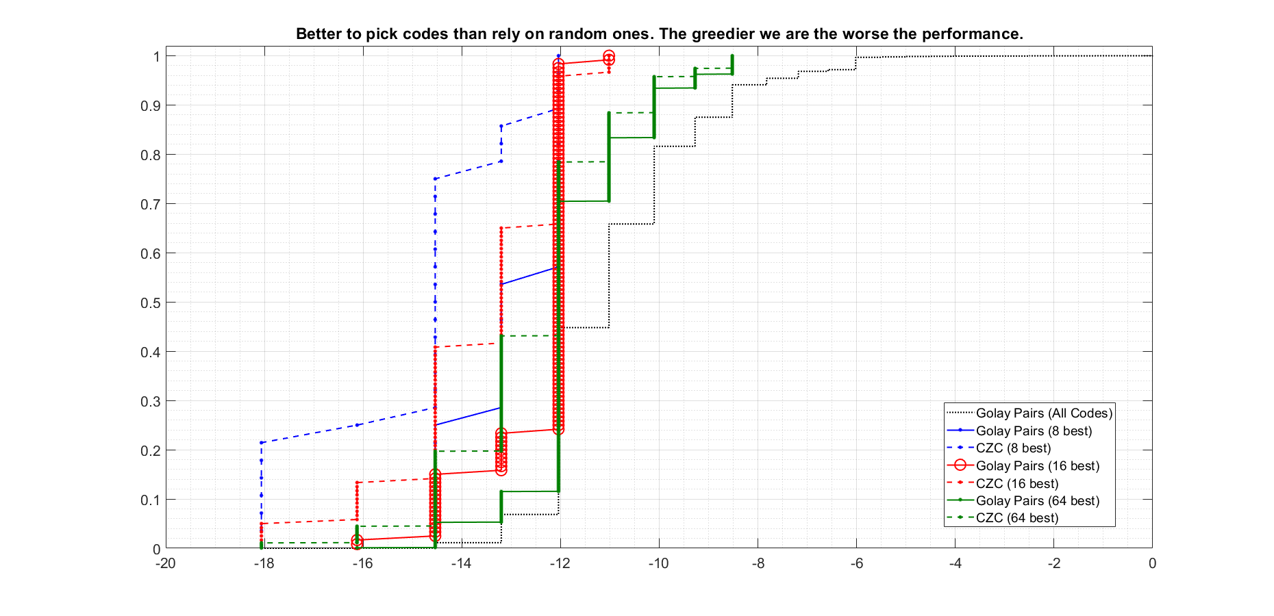

Slide 8
Just an indication of performance with gaps
When either CZC codes or Golay pairs are used for different co-existing networks gaps can be added
A different gap size is used for each network
Cross correlation grows much more slowly for the wrong code than auto-correlation with the correct code
This is not true of fixed length codes like Ipatov sequences
Receiver can reject the packet when it sees this slow down in growth rate
Gaps can be e.g. 0&0, 1&1, 2&2, 3&3 … 15&15
Minimises PRF variation

