Slide 1
Project: IEEE P802.15 Working Group for Wireless Personal Area Networks (WPANs)
Submission Title: [More consideration on sensing pulse shape in 802.15.4ab]
Date Submitted: []
Source: [Xiaohui Peng, Bin Qian, Lei Huang, Kuan Wu, David Xun Yang] Company [Huawei Technologies]
E-Mail: [pengxiaohui5@huawei.com]
Re: [Input to the Working Group]
Abstract: [Sensing, UWB in 802.15.4ab, pulse shape]
Purpose: []
Notice: This document has been prepared to assist the IEEE P802.15. It is offered as a basis for discussion and is not binding on the contributing individual(s) or organization(s). The material in this document is subject to change in form and content after further study. The contributor(s) reserve(s) the right to add, amend or withdraw material contained herein.
Release: The contributor acknowledges and accepts that this contribution becomes the property of IEEE and may be made publicly available by P802.15.

Slide 2
PAR Objective | Proposed Solution (how addressed)
Safeguards so that the high throughput data use cases will not cause significant disruption to low duty-cycle ranging use cases
Interference mitigation techniques to support higher density and higher traffic use cases
Other coexistence improvement
Backward compatibility with enhanced ranging capable devices (ERDEVs) | unified pulse shape for ranging and sensing
Improved link budget and/or reduced air-time
Additional channels and operating frequencies
Improvements to accuracy / precision / reliability and interoperability for high-integrity ranging
Reduced complexity and power consumption
Hybrid operation with narrowband signaling to assist UWB
Enhanced native discovery and connection setup mechanisms
Sensing capabilities to support presence detection and environment mapping | Pulse shape design for sensing
Low-power low-latency streaming
Higher data-rate streaming allowing at least 50 Mbit/s of throughput
Support for peer-to-peer, peer-to-multi-peer, and station-to-infrastructure protocols
Infrastructure synchronization mechanisms

Slide 3
Related Submissions
15-19-0443-01-004z text to address comment id r1-0820 (Michael McLaughin)
15-20-0084-00-004z pulse shaping considerations (Jochen Hammerschmidt)
15-20-0086-00-004z proposed pulse shape text changes for HRP UWB PHY (Michael McLaughin)
15-20-0089-01-004z pulse shape text changes for HRP UWB PHY (Michael McLaughin)
15-22-0040-04-04ab waveform design for UWB sensing (Xiaohui Peng)
15-22-0418-00-04ab sensing pulse shape consideration in 802.15.4ab (Xiaohui Peng)
15-22-0175-00-04ab sensing device (Dag T. Wisland )
15-22-0061-00-04ab sensing – continued (Frank Leong)
15-22-0305-00-04ab a summary of proposals and interests (Billy Verso)

Slide 4
Recap
For sensing application, a pulse shape should be designed to minimize both precursor and postcursor
The pulse shape should be designed to support both ranging and sensing applications in one packet
The specific criteria for sensing pulse shape include range resolution, PSLR (Peak to sidelobe ratio) of the zero-Doppler ambiguity function, spectrum efficiency (or root mean square bandwidth)
A more restrictive time-domain mask should be specified for the sensing pulse shape than ranging

Slide 5
Motivation
Ranging-only application: it should be designed to minimize precursor
Pulse shape | Resolution (ns) | PSLR (dB) | Spectrum efficiency
5th order Butterworth | 1.671 | 16.02 | 73.92%
6th order Butterworth | 1.698 | 15.21 | 73.32%
7th order Butterworth | 1.720 | 14.71 | 72.83%
8th order Butterworth | 1.728 | 14.38 | 72.25%
9th order Butterworth | 1.741 | 14.15 | 71.72%
10th order Butterworth | 1.747 | 14.00 | 71.58%
11th order Butterworth | 1.760 | 13.51 | 63.51%
Unified pulse shape for sensing and ranging: it should be designed to minimize both precursor and postcursor
Gaussian pulse 8.2e-10 | 1.926 | 322.56 | 52.24%
Gaussian pulse 8.5e-10 | 1.998 | 323.07 | 50.29%
Compared with the pulse shape used only for ranging, the spectrum efficiency (or root mean square bandwidth) of a unified pulse shape for sensing and ranging will decrease, which may degrade the ranging performance. Thus, the impact of pulse shape on ranging accuracy is analyzed through theoretical bound.

Slide 6

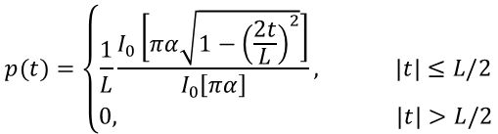

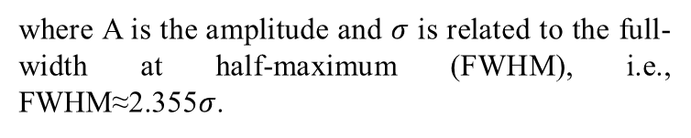
Sensing pulse shapes
Time bounded Gaussian pulse — a Gaussian pulse is shaped as a Gaussian function with no precursor and postcursor. It can be expressed as:
Time bounded Kaiser pulse— a Kaiser pulse is shaped as a Kaiser-Bessel window also with no precursor and postcursor. It can be expressed as:
$$p(t)=\left\{\begin{aligned}Ae^{−\frac{t^{2}}{2σ^{2}}}, \left|t\right|≤L/2 \\ 0, \left|t\right|>L/2\end{aligned}\right.$$
$$FWHM≈2.355σ$$
where A is the amplitude and $σ$ is related to the full-width at half-maximum (FWHM), i.e., FWHM≈2.355$σ$.
$$p(t)=\left\{\begin{aligned}\frac{1}{L}\frac{I_{0}\left[πα\sqrt{1−{\left(\frac{2t}{L}\right)}^{2}}\right]}{I_{0}\left[πα\right]}, \left|t\right|≤L/2 \\ 0, \left|t\right|>L/2\end{aligned}\right.$$
where I₀ is the zeroth-order modified Bessel function of the first kind. L is the window duration, $β=πα$ is a parameter determining the shape of the pulse.

Slide 7
Sensing pulse shapes
The pulse shape is time-bounded with L = 3 chips.
Both the Gaussian pulse shape and the Kaiser-window pulse shape are with no precursor and postcursor.
The spectrum of the Gaussian pulse shape and Kaiser pulse shape are almost the same.

Slide 8
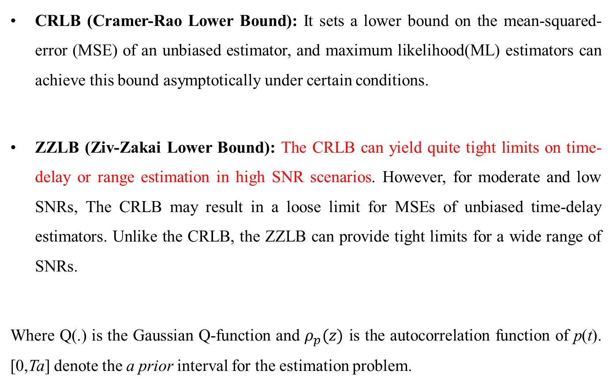
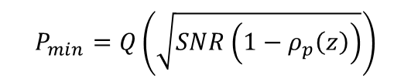
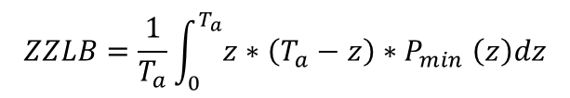
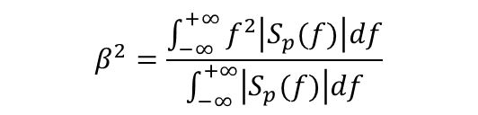

Pulse shape impact on ranging accuracy
CRLB (Cramer-Rao Lower Bound): It sets a lower bound on the mean-squared-error (MSE) of an unbiased estimator, and maximum likelihood(ML) estimators can achieve this bound asymptotically under certain conditions.
ZZLB (Ziv-Zakai Lower Bound): The CRLB can yield quite tight limits on time-delay or range estimation in high SNR scenarios. However, for moderate and low SNRs, The CRLB may result in a loose limit for MSEs of unbiased time-delay estimators. Unlike the CRLB, the ZZLB can provide tight limits for a wide range of SNRs.
Where Q(.) is the Gaussian Q-function and $ρ_{p}(z)$ is the autocorrelation function of p(t). [0,Ta] denote the a prior interval for the estimation problem.
$$CRLB=\frac{1}{8π^{2}β^{2}SNR}$$
$$β^{2}=\frac{\int_{−∞}^{+∞}{f^{2}\left|S_{p}(f)\right|df}}{\int_{−∞}^{+∞}{\left|S_{p}(f)\right|df}}$$
$$ZZLB=\frac{1}{T_{a}}\int_{0}^{T_{a}}{z∗\left(T_{a}−z\right){∗P}_{min}\left(z\right)dz}$$
$$P_{min}=Q\left(\sqrt{SNR\left(1−ρ_{p}\left(z\right)\right)}\right)$$

Slide 9
Pulse shape impact on ranging accuracy
For high SNR condition, the time-delay RMSE (root mean square error) of the sensing pulse shape is about 28% larger than the 5th order Butterworth pulse shape in term of CRLB.
For low SNR condition, the time-delay RMSE (root mean square error) of the sensing pulse shape and the 5th order Butterworth pulse shape are almost the same in term of ZZLB.
The time-delay RMSE (root mean square error) of the Gaussian pulse shape and the Kaiser pulse shape are almost the same either in terms of CRLB or ZZLB.

Slide 10
Summary
For high SNR condition, using a unified pulse shape for sensing and ranging will sacrifice the ranging performance in terms of CRLB.
For low SNR condition, using a unified pulse shape for sensing and ranging has no impact on the ranging performance in terms of ZZLB.
The Gaussian pulse shape and the Kaiser pulse shape have the same performance either in terms of CRLB or ZZLB.
We recommend to define a more restricted time-domain mask with bounded sidelobe level in 15.4ab, which can cover the existing two time-bounded pulse shapes (the Gaussian pulse shape and the Kaiser pulse shape).

Slide 11
References
Amendment1: Enhanced ultra wideband (UWB) physical layers (PHYs) and associated ranging techniques
IEEE standard for low-rate wireless networks
UWB spectral mask and FFC part 15 limits
15-19-0443-01-004z text to address comment id r1-0820 (Michael McLaughin)
15-20-0084-00-004z pulse shaping considerations (Jochen Hammerschmidt)
15-20-0086-00-004z proposed pulse shape text changes for HRP UWB PHY (Michael McLaughin)
15-20-0089-01-004z pulse shape text changes for HRP UWB PHY (Michael McLaughin)
15-22-0040-04-04ab waveform design for UWB sensing (Xiaohui Peng)
15-22-0175-00-04ab sensing device (Dag T. Wisland )
15-22-0061-00-04ab sensing – continued (Frank Leong)
15-22-0305-00-04ab a summary of proposals and interests (Billy Verso)
Chazan, Dan, Moshe Zakai, and Jacob Ziv. "Improved lower bounds on signal parameter estimation." IEEE transactions on Information Theory 21.1 (1975): 90-93.

