Slide 1
Project: IEEE P802.15 Working Group for Wireless Specialty Networks (WSN)
Submission Title: More on NB considerations for NBA-MMS UWB
Source: Bin Qian, Chenchen Liu, David Xun Yang (Huawei Technologies)
Address : [Huawei Bantian Base, Longgang District, Shenzhen, 518129 China]
E-Mail: [qianbin14@huawei.com]
Re: Task Group 4ab: UWB Next Generation for 802.15.4
Abstract: [NB, UWB]
Purpose:
Notice: This document has been prepared to assist the IEEE P802.15. It is offered as a basis for discussion and is not binding on the contributing individual(s) or organization(s). The material in this document is subject to change in form and content after further study. The contributor(s) reserve(s) the right to add, amend or withdraw material contained herein.
Release: The contributor acknowledges and accepts that this contribution becomes the property of IEEE and may be made publicly available by P802.15.
Notes:
Jul 12, 2010
Page 1

Slide 2
PAR Objective | Proposed Solution (how addressed)
Safeguards so that the high throughput data use cases will not cause significant disruption to low duty-cycle ranging use cases
Interference mitigation techniques to support higher density and higher traffic use cases
Other coexistence improvement
Backward compatibility with enhanced ranging capable devices (ERDEVs)
Improved link budget and/or reduced air-time
Additional channels and operating frequencies
Improvements to accuracy / precision / reliability and interoperability for high-integrity ranging
Reduced complexity and power consumption
Hybrid operation with narrowband signaling to assist UWB | Improved symbol-to-chip mapping to assist the CFO estimation and achieve better error performance NB configuration indication
Enhanced native discovery and connection setup mechanisms
Sensing capabilities to support presence detection and environment mapping
Low-power low-latency streaming
Higher data-rate streaming allowing at least 50 Mbit/s of throughput
Support for peer-to-peer, peer-to-multi-peer, and station-to-infrastructure protocols
Infrastructure synchronization mechanisms

Slide 3
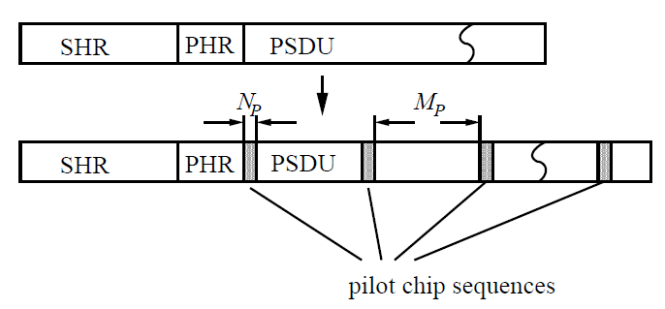
NB Background
The tight clock synchronization between NB and UWB could be used by NB to provide initial CFO to UWB
In [1], the PPDU formats in Clause 12 of IEEE 802.15.4-2020 are recommended as the NB candidate
Clause 21 in IEEE 802.15.4-2020 introduces a pilot insertion method
  Periodic insertion of known chip sequences (pilots) into the stream of PSDU chips shall be used to assist the CFO estimation or phase tracking during receive, taking the finite coherence time of the radio channel into account

Slide 4
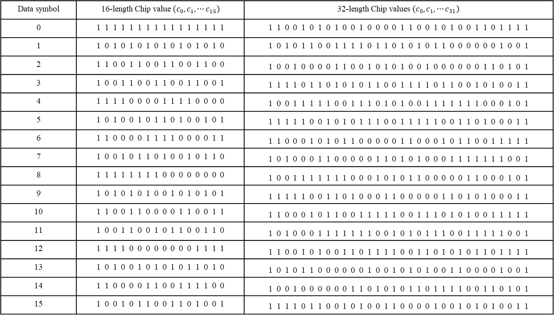
Symbol-to-chip Mapping
Data symbol | 16-length Chip value $\left(c_{0},c_{1},⋯c_{15}\right)$ | 32-length Chip values $\left(c_{0},c_{1},⋯c_{31}\right)$
0 | 1 1 1 1 1 1 1 1 1 1 1 1 1 1 1 1 | 1 1 0 0 1 0 1 0 1 0 0 1 0 0 0 0 1 1 0 0 1 0 1 0 0 1 1 0 1 1 1 1
1 | 1 0 1 0 1 0 1 0 1 0 1 0 1 0 1 0 | 1 0 1 0 1 1 0 0 1 1 1 1 0 1 1 0 1 0 1 0 1 1 0 0 0 0 0 0 1 0 0 1
2 | 1 1 0 0 1 1 0 0 1 1 0 0 1 1 0 0 | 1 0 0 1 0 0 0 0 1 1 0 0 1 0 1 0 1 0 0 1 0 0 0 0 0 0 1 1 0 1 0 1
3 | 1 0 0 1 1 0 0 1 1 0 0 1 1 0 0 1 | 1 1 1 1 0 1 1 0 1 0 1 0 1 1 0 0 1 1 1 1 0 1 1 0 0 1 0 1 0 0 1 1
4 | 1 1 1 1 0 0 0 0 1 1 1 1 0 0 0 0 | 1 0 0 1 1 1 1 1 0 0 1 1 1 0 1 0 1 0 0 1 1 1 1 1 1 1 0 0 0 1 0 1
5 | 1 0 1 0 0 1 0 1 1 0 1 0 0 1 0 1 | 1 1 1 1 1 0 0 1 0 1 0 1 1 1 0 0 1 1 1 1 1 0 0 1 1 0 1 0 0 0 1 1
6 | 1 1 0 0 0 0 1 1 1 1 0 0 0 0 1 1 | 1 1 0 0 0 1 0 1 0 1 1 0 0 0 0 0 1 1 0 0 0 1 0 1 1 0 0 1 1 1 1 1
7 | 1 0 0 1 0 1 1 0 1 0 0 1 0 1 1 0 | 1 0 1 0 0 0 1 1 0 0 0 0 0 1 1 0 1 0 1 0 0 0 1 1 1 1 1 1 1 0 0 1
8 | 1 1 1 1 1 1 1 1 0 0 0 0 0 0 0 0 | 1 0 0 1 1 1 1 1 1 1 0 0 0 1 0 1 0 1 1 0 0 0 0 0 1 1 0 0 0 1 0 1
9 | 1 0 1 0 1 0 1 0 0 1 0 1 0 1 0 1 | 1 1 1 1 1 0 0 1 1 0 1 0 0 0 1 1 0 0 0 0 0 1 1 0 1 0 1 0 0 0 1 1
10 | 1 1 0 0 1 1 0 0 0 0 1 1 0 0 1 1 | 1 1 0 0 0 1 0 1 1 0 0 1 1 1 1 1 0 0 1 1 1 0 1 0 1 0 0 1 1 1 1 1
11 | 1 0 0 1 1 0 0 1 0 1 1 0 0 1 1 0 | 1 0 1 0 0 0 1 1 1 1 1 1 1 0 0 1 0 1 0 1 1 1 0 0 1 1 1 1 1 0 0 1
12 | 1 1 1 1 0 0 0 0 0 0 0 0 1 1 1 1 | 1 1 0 0 1 0 1 0 0 1 1 0 1 1 1 1 0 0 1 1 0 1 0 1 0 1 1 0 1 1 1 1
13 | 1 0 1 0 0 1 0 1 0 1 0 1 1 0 1 0 | 1 0 1 0 1 1 0 0 0 0 0 0 1 0 0 1 0 1 0 1 0 0 1 1 0 0 0 0 1 0 0 1
14 | 1 1 0 0 0 0 1 1 0 0 1 1 1 1 0 0 | 1 0 0 1 0 0 0 0 0 0 1 1 0 1 0 1 0 1 1 0 1 1 1 1 0 0 1 1 0 1 0 1
15 | 1 0 0 1 0 1 1 0 0 1 1 0 1 0 0 1 | 1 1 1 1 0 1 1 0 0 1 0 1 0 0 1 1 0 0 0 0 1 0 0 1 0 1 0 1 0 0 1 1

Slide 5
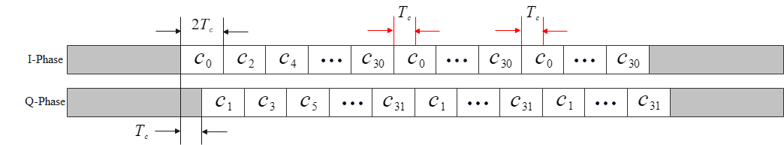
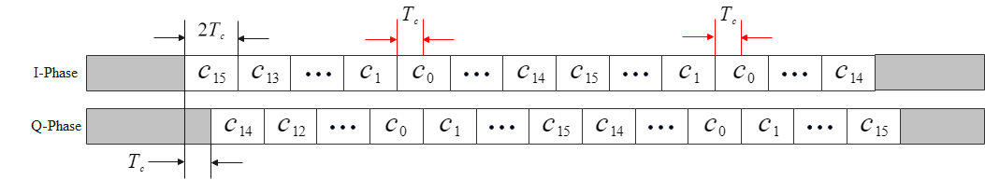
CFO Estimation
Current symbol-to-chip mapping: only preamble symbols could be used to estimate CFO
Proposed symbol-to-chip mapping: both preamble symbols and samples at some specific locations could be used to estimate CFO
  32-length symbol-to-chip mapping: the first chip value and last chip value of all symbols are the same such that all samples within the area marked by the red arrow could be treated as pilots
  16-length symbol-to-chip mapping of payload: the first chip value of all symbols are the same and odd symbols use normal chip sequence while even symbols use reversed chip sequence

Slide 6
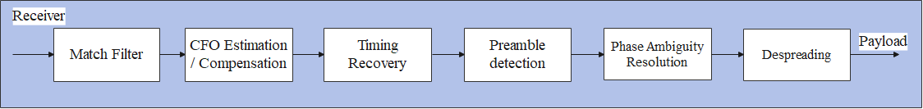
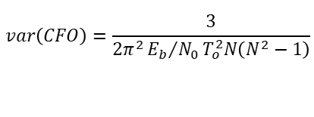
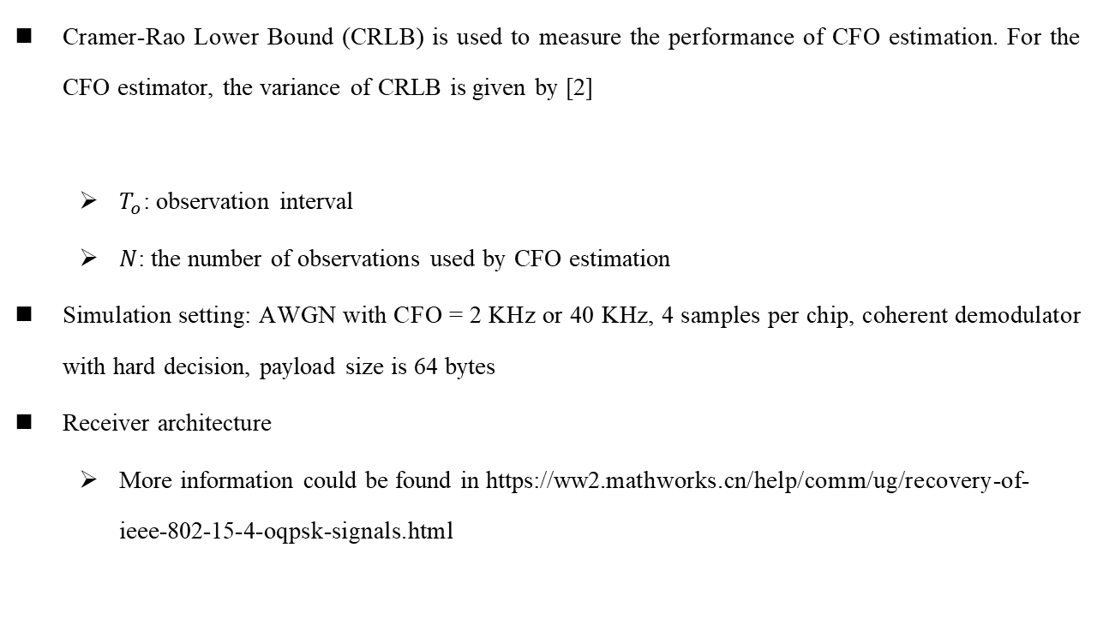
CFO Estimation
Cramer-Rao Lower Bound (CRLB) is used to measure the performance of CFO estimation. For the CFO estimator, the variance of CRLB is given by [2]
  $T_{o}$: observation interval
  $N$: the number of observations used by CFO estimation
Simulation setting: AWGN with CFO = 2 KHz or 40 KHz, 4 samples per chip, coherent demodulator with hard decision, payload size is 64 bytes
Receiver architecture
  More information could be found in https://ww2.mathworks.cn/help/comm/ug/recovery-of-ieee-802-15-4-oqpsk-signals.html
$$var\left(CFO\right)=\frac{3}{2π^{2}{E_{b}}/{N_{0}}T_{o}^{2}N\left(N^{2}−1\right)}$$
[2] David C. Rife, et.al , “Single-tone Parameter Estimation from Discrete-time Observations”, IEEE Trans. Inform. Theory, vol 20, no. 5, 1974, https://ieeexplore.ieee.org/stamp/stamp.jsp?tp=&arnumber=1055282

Slide 7
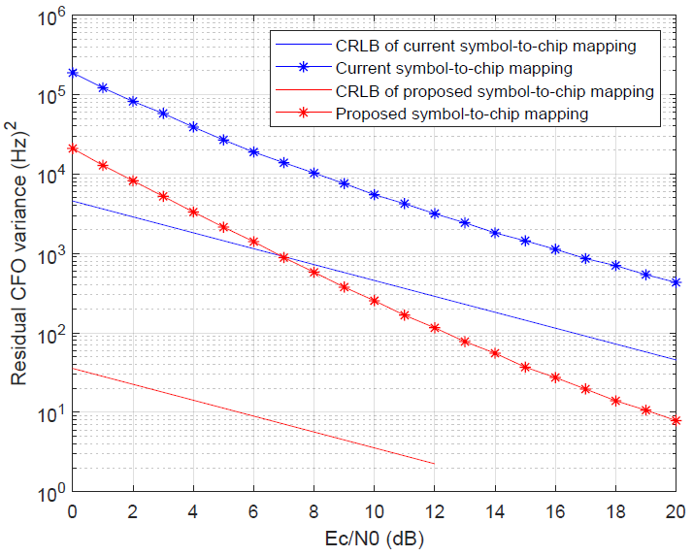
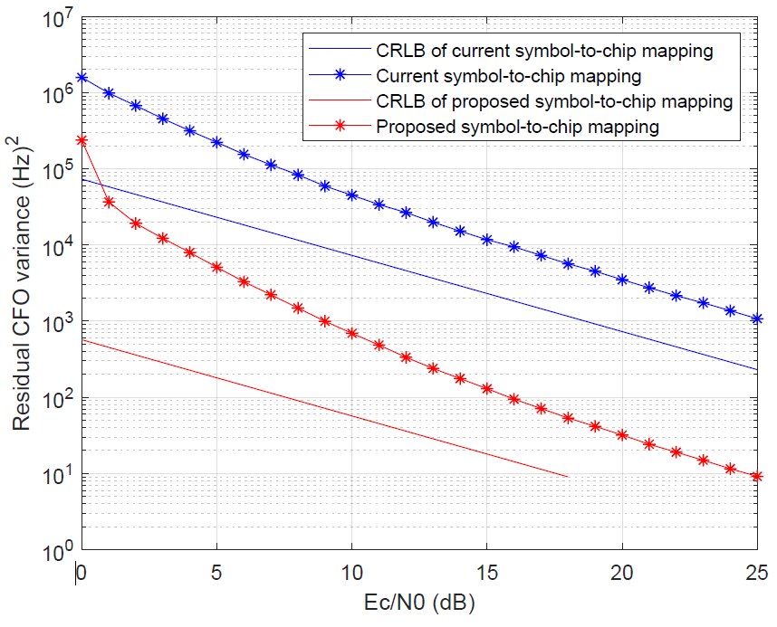
CFO Estimation Simulation Results
Length-32 symbol-to-chip mapping
Length-16 symbol-to-chip mapping
Proposed symbol-to-chip mapping can assist CFO estimation such that NB can provide more accurate CFO to UWB
The CFO estimation method can be found in [3]
[3] Shengchen Dai, et.al , “A Robust Demodulator for OQPSK-DSSS System”, 2014. [Online] https://link.springer.com/content/pdf/10.1007/s00034-014-9844-z.pdf

Slide 8
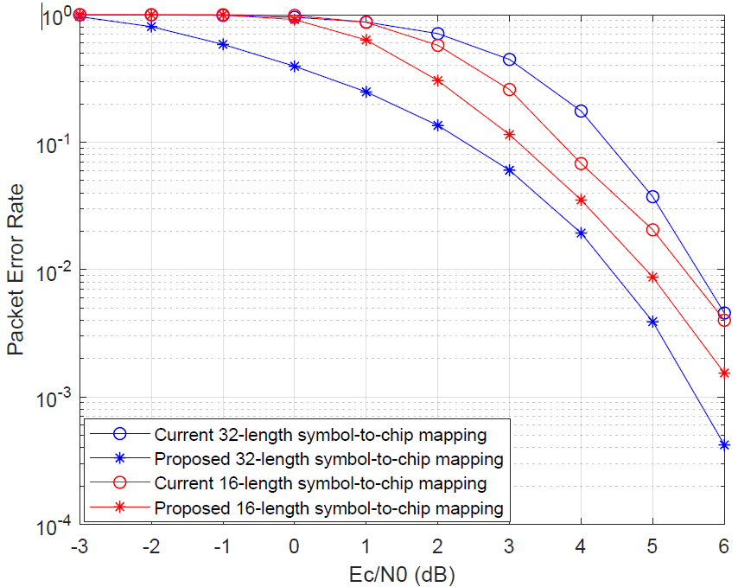
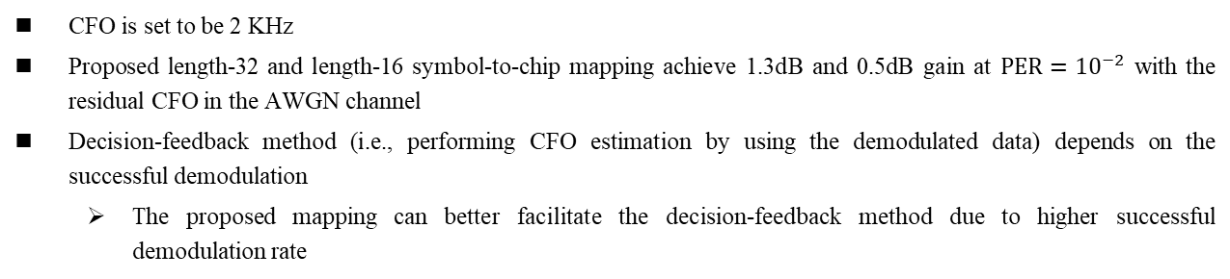
Residual CFO Affects PER
CFO is set to be 2 KHz
Proposed length-32 and length-16 symbol-to-chip mapping achieve 1.3dB and 0.5dB gain at $PER={10}^{−2}$ with the residual CFO in the AWGN channel
Decision-feedback method (i.e., performing CFO estimation by using the demodulated data) depends on the successful demodulation
  The proposed mapping can better facilitate the decision-feedback method due to higher successful demodulation rate

Slide 9
Hamming Distance of Current 32-length Symbol-to-chip Mapping
Symbol-to-chip Mapping sequence | 1 | 2 | 3 | 4 | 5 | 6 | 7 | 8 | 9 | 10 | 11 | 12 | 13 | 14 | 15 | 16
1 | 0 | 16 | 18 | 20 | 20 | 20 | 18 | 16 | 16 | 12 | 14 | 20 | 20 | 20 | 14 | 12
2 | 16 | 0 | 16 | 18 | 20 | 20 | 20 | 18 | 12 | 16 | 12 | 14 | 20 | 20 | 20 | 14
3 | 18 | 16 | 0 | 16 | 18 | 20 | 20 | 20 | 14 | 12 | 16 | 12 | 14 | 20 | 20 | 20
4 | 20 | 18 | 16 | 0 | 16 | 18 | 20 | 20 | 20 | 14 | 12 | 16 | 12 | 14 | 20 | 20
5 | 20 | 20 | 18 | 16 | 0 | 16 | 18 | 20 | 20 | 20 | 12 | 12 | 16 | 12 | 14 | 20
6 | 20 | 20 | 20 | 18 | 16 | 0 | 16 | 18 | 20 | 20 | 20 | 14 | 12 | 16 | 12 | 14
7 | 18 | 20 | 20 | 20 | 18 | 16 | 0 | 16 | 14 | 20 | 20 | 20 | 14 | 12 | 16 | 12
8 | 16 | 18 | 20 | 20 | 20 | 18 | 16 | 0 | 12 | 14 | 20 | 20 | 20 | 14 | 12 | 16
9 | 16 | 12 | 14 | 20 | 20 | 20 | 14 | 12 | 0 | 16 | 18 | 20 | 20 | 20 | 18 | 16
10 | 12 | 16 | 12 | 14 | 20 | 20 | 20 | 14 | 16 | 0 | 16 | 18 | 20 | 20 | 20 | 18
11 | 14 | 12 | 16 | 12 | 14 | 20 | 20 | 20 | 18 | 16 | 0 | 16 | 18 | 20 | 20 | 20
12 | 20 | 14 | 12 | 16 | 12 | 14 | 20 | 20 | 20 | 18 | 16 | 0 | 16 | 18 | 20 | 20
13 | 20 | 20 | 14 | 12 | 16 | 12 | 14 | 20 | 20 | 20 | 18 | 16 | 0 | 16 | 18 | 20
14 | 20 | 20 | 20 | 14 | 12 | 16 | 12 | 14 | 20 | 20 | 20 | 18 | 16 | 0 | 16 | 18
15 | 14 | 20 | 20 | 20 | 14 | 12 | 16 | 12 | 18 | 20 | 20 | 20 | 18 | 16 | 0 | 16
16 | 12 | 14 | 20 | 20 | 20 | 14 | 12 | 16 | 16 | 18 | 20 | 20 | 20 | 18 | 16 | 0
The minimum Hamming distance 12 is far from the theoretical limit

Slide 10
Hamming Distance of Proposed 32-length Symbol-to-chip Mapping
Symbol-to-chip Mapping sequence | 1 | 2 | 3 | 4 | 5 | 6 | 7 | 8 | 9 | 10 | 11 | 12 | 13 | 14 | 15 | 16
1 | 0 | 16 | 16 | 16 | 16 | 16 | 16 | 16 | 16 | 16 | 16 | 16 | 16 | 16 | 16 | 16
2 | 16 | 0 | 16 | 16 | 16 | 16 | 16 | 16 | 16 | 16 | 16 | 16 | 16 | 16 | 16 | 16
3 | 16 | 16 | 0 | 16 | 16 | 16 | 16 | 16 | 16 | 16 | 16 | 16 | 16 | 16 | 16 | 16
4 | 16 | 16 | 16 | 0 | 16 | 16 | 16 | 16 | 16 | 16 | 16 | 16 | 16 | 16 | 16 | 16
5 | 16 | 16 | 16 | 16 | 0 | 16 | 16 | 16 | 16 | 16 | 16 | 16 | 16 | 16 | 16 | 16
6 | 16 | 16 | 16 | 16 | 16 | 0 | 16 | 16 | 16 | 16 | 16 | 16 | 16 | 16 | 16 | 16
7 | 16 | 16 | 16 | 16 | 16 | 16 | 0 | 16 | 16 | 16 | 16 | 16 | 16 | 16 | 16 | 16
8 | 16 | 16 | 16 | 16 | 16 | 16 | 16 | 0 | 16 | 16 | 16 | 16 | 16 | 16 | 16 | 16
9 | 16 | 16 | 16 | 16 | 16 | 16 | 16 | 16 | 0 | 16 | 16 | 16 | 16 | 16 | 16 | 16
10 | 16 | 16 | 16 | 16 | 16 | 16 | 16 | 16 | 16 | 0 | 16 | 16 | 16 | 16 | 16 | 16
11 | 16 | 16 | 16 | 16 | 16 | 16 | 16 | 16 | 16 | 16 | 0 | 16 | 16 | 16 | 16 | 16
12 | 16 | 16 | 16 | 16 | 16 | 16 | 16 | 16 | 16 | 16 | 16 | 0 | 16 | 16 | 16 | 16
13 | 16 | 16 | 16 | 16 | 16 | 16 | 16 | 16 | 16 | 16 | 16 | 16 | 0 | 16 | 16 | 16
14 | 16 | 16 | 16 | 16 | 16 | 16 | 16 | 16 | 16 | 16 | 16 | 16 | 16 | 0 | 16 | 16
15 | 16 | 16 | 16 | 16 | 16 | 16 | 16 | 16 | 16 | 16 | 16 | 16 | 16 | 16 | 0 | 16
16 | 16 | 16 | 16 | 16 | 16 | 16 | 16 | 16 | 16 | 16 | 16 | 16 | 16 | 16 | 16 | 0
The minimum Hamming distance of proposed 32-length symbol-to-chip mapping is 16, which achieves the theoretical limit

Slide 11
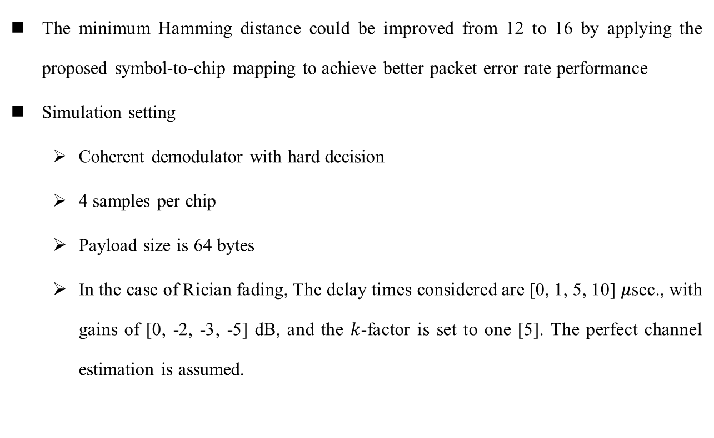
Hamming Distance Improvement
The minimum Hamming distance could be improved from 12 to 16 by applying the proposed symbol-to-chip mapping to achieve better packet error rate performance
Simulation setting
  Coherent demodulator with hard decision
  4 samples per chip
  Payload size is 64 bytes
  In the case of Rician fading, The delay times considered are [0, 1, 5, 10] $μ$sec., with gains of [0, -2, -3, -5] dB, and the $k$-factor is set to one [5]. The perfect channel estimation is assumed.
[5] Asmas M. Romia, et.al , “Optimization of Recursive Least Square-based Adaptive Linear Equalizer for ZigBee Transceiver”, Wireless Personal Communications, 2018, https://link.springer.com/article/10.1007/s11277-018-5961-5

Slide 12
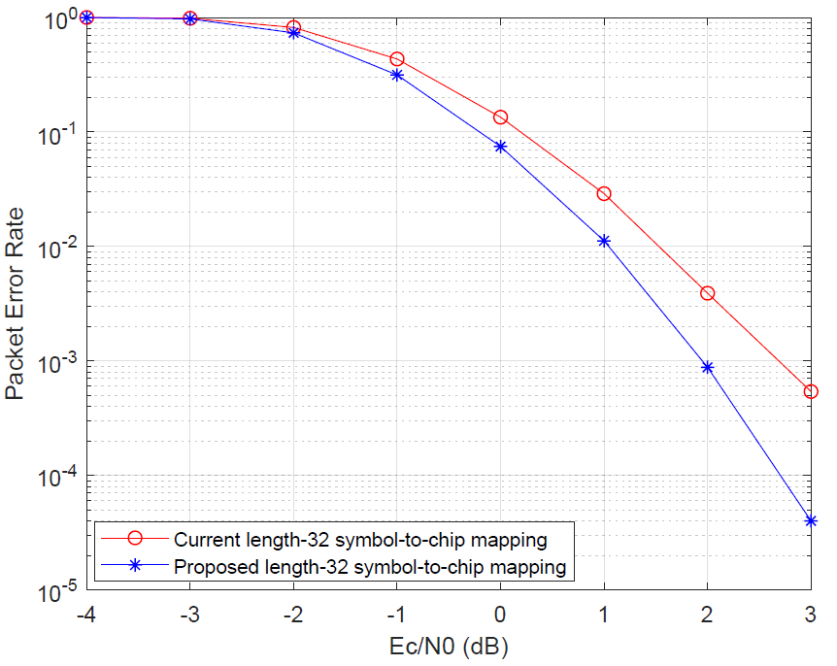
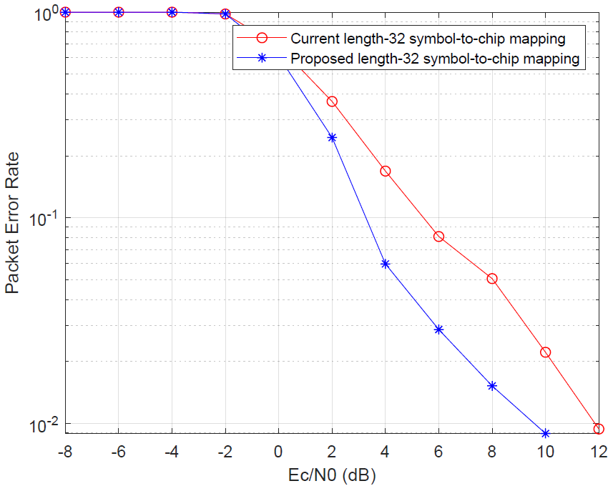
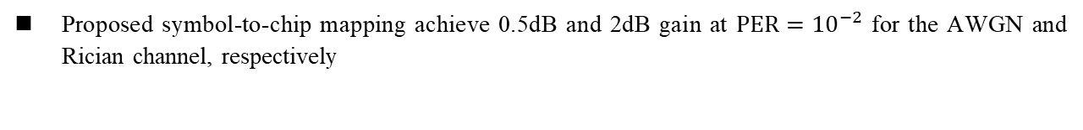
Hamming Distance Improvement
AWGN
Rician
Proposed symbol-to-chip mapping achieve 0.5dB and 2dB gain at $PER={10}^{−2}$ for the AWGN and Rician channel, respectively

Slide 13
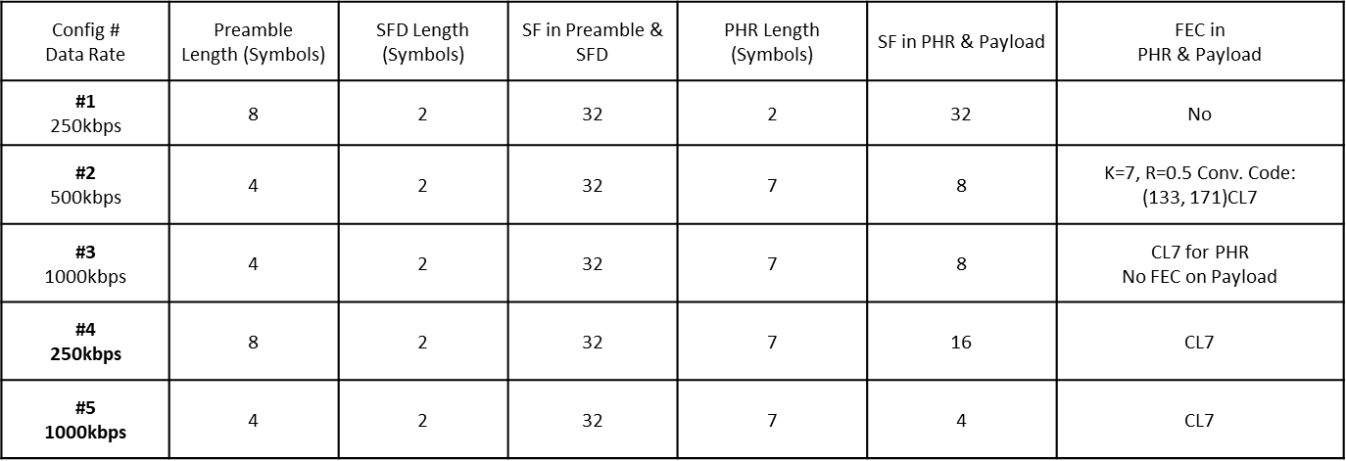
NB Configuration Indication
There are five possible configurations for NB
However, there is no clear indication of different configurations for NB

Slide 14
NB Configuration Indication
The current PHR can not be used to indicate the configurations
  The spreading factor of PHR is variable
  The length of PHR is limited and the content of PHR is used to express the payload size
The configurations indication by other means (e.g., specific IE in the NB payload) will degrade the flexibility
Two options to indicate NB configurations
  Option 1: Select different SFD to indicate different NB configurations
    Reuse [1 1 1 0 0 1 0 1] to indicate Configuration 1 for the compatibility purpose
  Option 2: Fix the spreading factor of PHR and extend the information bits of PHR to indicate NB configurations

Slide 15
References
[1] 15-22-0064-04ab Potentials of narrowband assisted UWB
[2] David C. Rife, et.al , “Single-tone Parameter Estimation from Discrete-time Observations”, IEEE Trans. Inform. Theory, vol 20, no. 5, 1974, https://ieeexplore.ieee.org/stamp/stamp.jsp?tp=&arnumber=1055282
[3] Shengchen Dai, et.al , “A Robust Demodulator for OQPSK-DSSS System”, 2014. [Online] https://link.springer.com/content/pdf/10.1007/s00034-014-9844-z.pdf
[4] 15-22-0420-04ab NB considerations for NBA-MMS UWB
[5] Asmas M. Romia, et.al , “Optimization of Recursive Least Square-based Adaptive Linear Equalizer for ZigBee Transceiver”, Wireless Personal Communications, 2018, https://link.springer.com/article/10.1007/s11277-018-5961-5

