Slide 1
Project: IEEE P802.15 Working Group for Wireless Personal Area Networks (WPANs)
Submission Title: PHR Content and rate
Source: Carlos Aldana (Meta), Jack Zou (Meta), Kangjin Yoon (Meta), Claudio da Silva (Meta), Abhishek Agrawal (Meta), Chunyu Hu (Meta), Bin Tian (Qualcomm), Pooria Pakrooh (Qualcomm), Bin Qian (Huawei), Chenchen Liu (Huawei), Wei Lin (Huawei), David Xun Yang (Huawei)
Address : [1 Hacker Way, Menlo Park, CA 94025]
E-Mail: [caldana (at) fb.com]
Re: Study Group 4ab: UWB Next Generation
Abstract: [PHR content and rate for 802.15.4ab]
Purpose:
Notice: This document has been prepared to assist the IEEE P802.15. It is offered as a basis for discussion and is not binding on the contributing individual(s) or organization(s). The material in this document is subject to change in form and content after further study. The contributor(s) reserve(s) the right to add, amend or withdraw material contained herein.
Release: The contributor acknowledges and accepts that this contribution becomes the property of IEEE and may be made publicly available by P802.15.
Notes:
Jul 12, 2010
Page 1

Slide 2
Technical Guidance
PAR Objective | Proposed Solution (how addressed)
Safeguards so that the high throughput data use cases will not cause significant disruption to low duty-cycle ranging use cases.
Interference mitigation techniques to support higher density and higher traffic use cases
Other coexistence improvement
Backward compatibility with enhanced ranging capable devices (ERDEVs).
Improved link budget and/or reduced air-time | PHR rate optimized to reduce air-time associated with new < 7.8 Mbps data rate
Additional channels and operating frequencies
Improvements to accuracy / precision / reliability and interoperability for high-integrity ranging;
Reduce complexity and power consumption;
Hybrid operation with narrowband signaling to assist UWB;
Enhanced native discovery and connection setup mechanisms;
Sensing capabilities to support presence detection and environment mapping; | PHR content is developed to address this use case
Low-power low-latency streaming
higher data-rate streaming allowing at least 50 Mbit/s of throughput. | PHR content is developed to address this use case
Support for peer-to-peer, peer-to-multi-peer, and station-to-infrastructure protocols;
Infrastructure synchronization mechanisms.

Slide 3
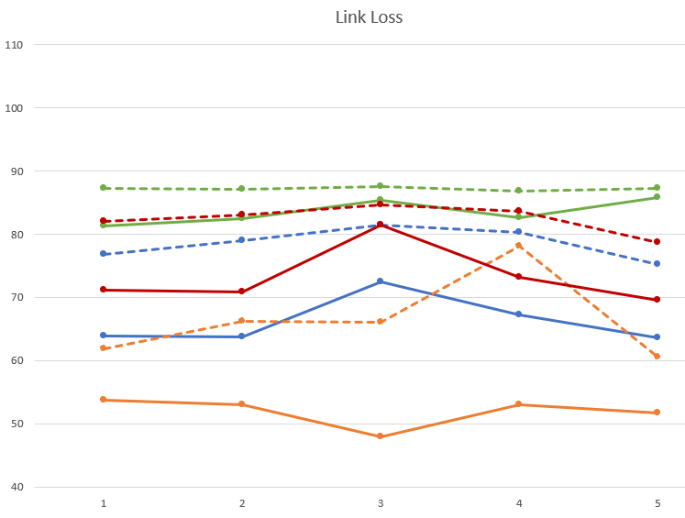
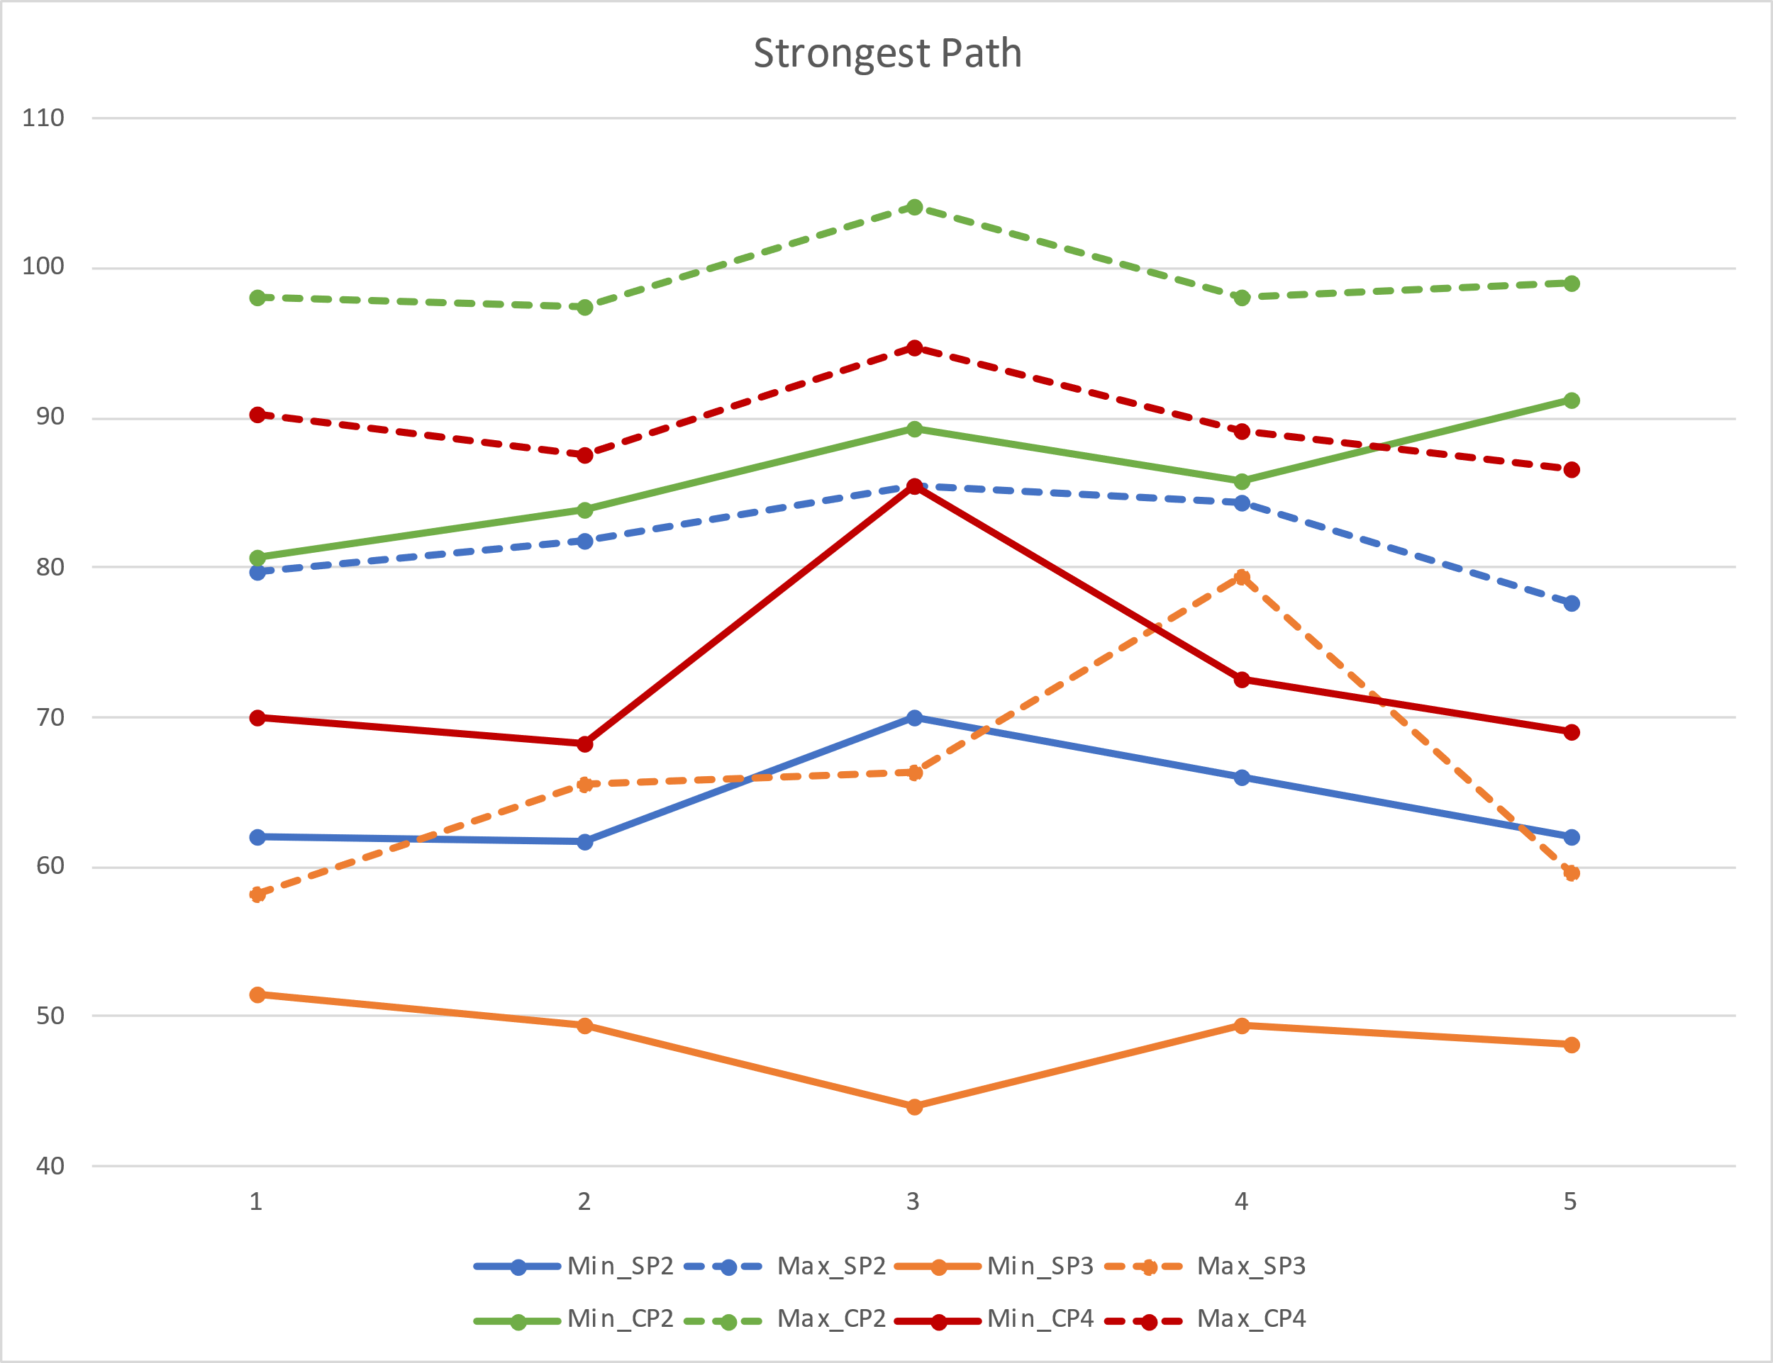
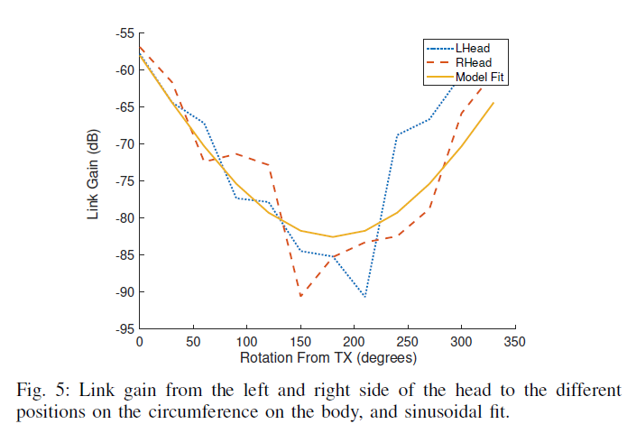
Motivation
Body Area Network measurements have shown a large variability in Received Signal Strength over a short time duration
In a span of ~250ms, there can be a 50/40 dB variation in strongest path/link loss
    In fact, a sudden 20-25 dB drop is possible as soon as antenna is placed behind body (ICC ‘22)
ICC 2022

Slide 4
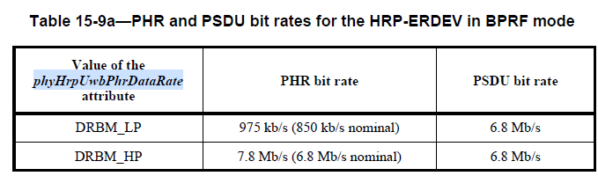
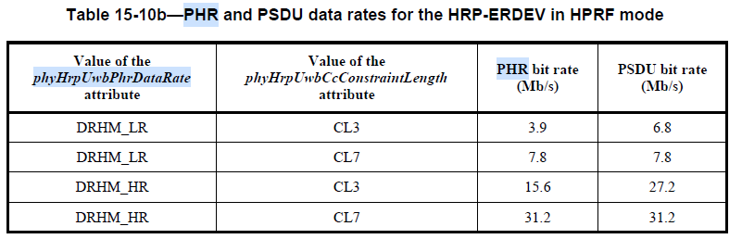
Background
Current 802.15.4z relies on phyHrpUwbPhrDataRate and phyHrpUwbCcConstraintLength to determine the PSDU Data rate.
The 850 kb/s mode is commonly used in the field today

Slide 5
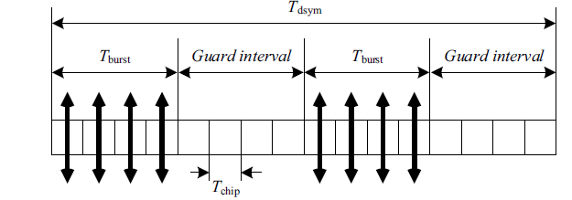
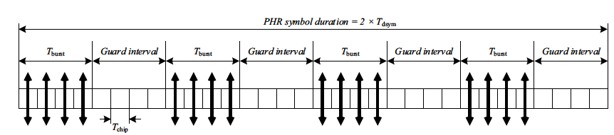
Background
How is PHR code rate reduction achieved in 802.15.4z? By repeating the symbol.
Example of one non – repeated symbol with 249.6 MHz PRF (31.2 Mbps):
Example of repeated PHR symbol with 249.6 MHz PRF. In this case, PHR rate goes from 31.2 Mbps to 15.6 Mbps.

Slide 6
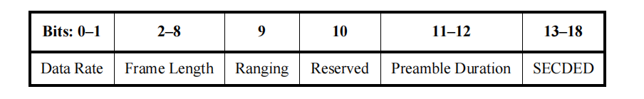
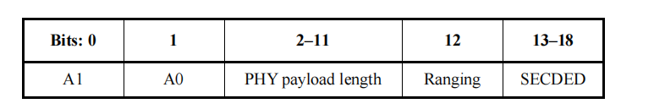
Existing PHR Contents
Current PHR contains the following fields:
SECDED has Hamming distance of 4, so it can be configured to correct a single bit error and detect 2 bit errors or detect 3 bit errors
Legacy, BPRF
HPRF

Slide 7
Proposed PHR Content
0-1
2-13
14
15
16
17-19
20-25
Reserved + Version
PHY payload length
Ranging
Sensing
LDPC
MCS
CRC
Reserved + Version allocated reserved bits and Version, where Version = 0 [current version]
The Ranging field shall be set to one if the current frame is an RFRAME and shall be set to zero otherwise
The Sensing field shall be set to one if the current frame is to be used for sensing and shall be set to zero otherwise
LDPC on: 0 - LDPC is off; 1 - LDPC is on
MCS denoted by Table, where phyHrpUwbCcConstraintLength
determines CL3 or CL7
6 bit CRC (e.g. z^6+z^4+z^3+1) replaces SECDED
This is equivalent to 0x2C in Koopman notation (see Appendix)
MCS | PSDU bit rates (Mb/s)
0 | Reserved
1 | 1.95
2 | 7.8 or 6.8
3 | 31.2 or 27.2
4 | 62.4
5 | 124.8
6-7 (Reserved)

Slide 8
Additional Considerations
8 bit CRC could be added to reduce false alarm prob
Special ID to signal address of TX or RX to allow for the packet to be dropped early

Slide 9
PHR Repetition
Transmitting each PHR symbol multiple times improves the PHR performance by 3dB or more. This is what is currently done for PHR with PSDU transmissions with CL3 in 802.15.4z
This is what could be done in 802.15.4ab in 2x repetition case
13 bits
SECDED
Add trailing bits
Convolutional Code
Modulation
Repetition
50 symbols
19 bits
25 bits
50 bits
25 symbols
20 bits
CRC
Add trailing bits
Convolutional Code
Modulation
2x Repetition
64 symbols
26 bits
32 bits
64 bits
32 symbols

Slide 10
How to configure the new PHR rate
The PHR data rate can be configured via the same variables used in 802.15.4z
phyHrpUwbPhrDataRate | phyHrpUwbCcConstraintLength | PHR Mb/s | NOTE
DRHM_VLRL (NEW) | LDPC | 0.975 | LDPC enabled devices. Supports all PSDU rates.
DRHM_VLR (NEW) | CL7 | 1.95 | Devices that do not have LDPC enabled. Supports all PSDU rates.
DRHM_LRA (NEW) | LDPC or CL7 | 7.8 | Mode in which 1.95 Mbps PSDU rate will not be used. Effective PSDU data rate > = 7.8 Mbps
DRHM_LR | CL3 | 3.9
DRHM_LR | CL7 | 7.8
DRHM_HR | CL3 | 15.6
DRHM_HR | CL7 | 31.2
More efficient than 850 kbps BPRF mode
32 bits of PHR at 7.8 Mbps (“LOS mode”) spans ~4.1us
32 bits of PHR at 0.975 Mbps (“NLOS mode”) spans ~32.8us

Slide 11
Conclusions
Keep existing 802.15.4z OOB methods and add 3 new OOB modes to Table 15-10b
PHR data rate can be selected depending on use case
Reduced overhead
  For longer range or “NLOS mode”, the PHR overhead is reasonable, ~33us
  For short range or “LOS mode”, PHR overhead is negligible, <5us

Slide 12
Appendix

Slide 13
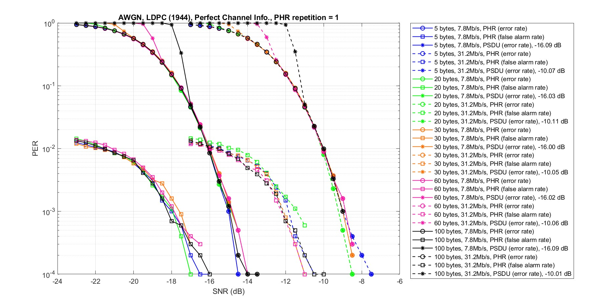
Simulation Results for Option 1 1944 802.11n LDPC
AWGN Channel
Perfect channel Information
PHR has 23 bits (17 information bits + 6 CRC bits)
PHR repetition = 1

Slide 14
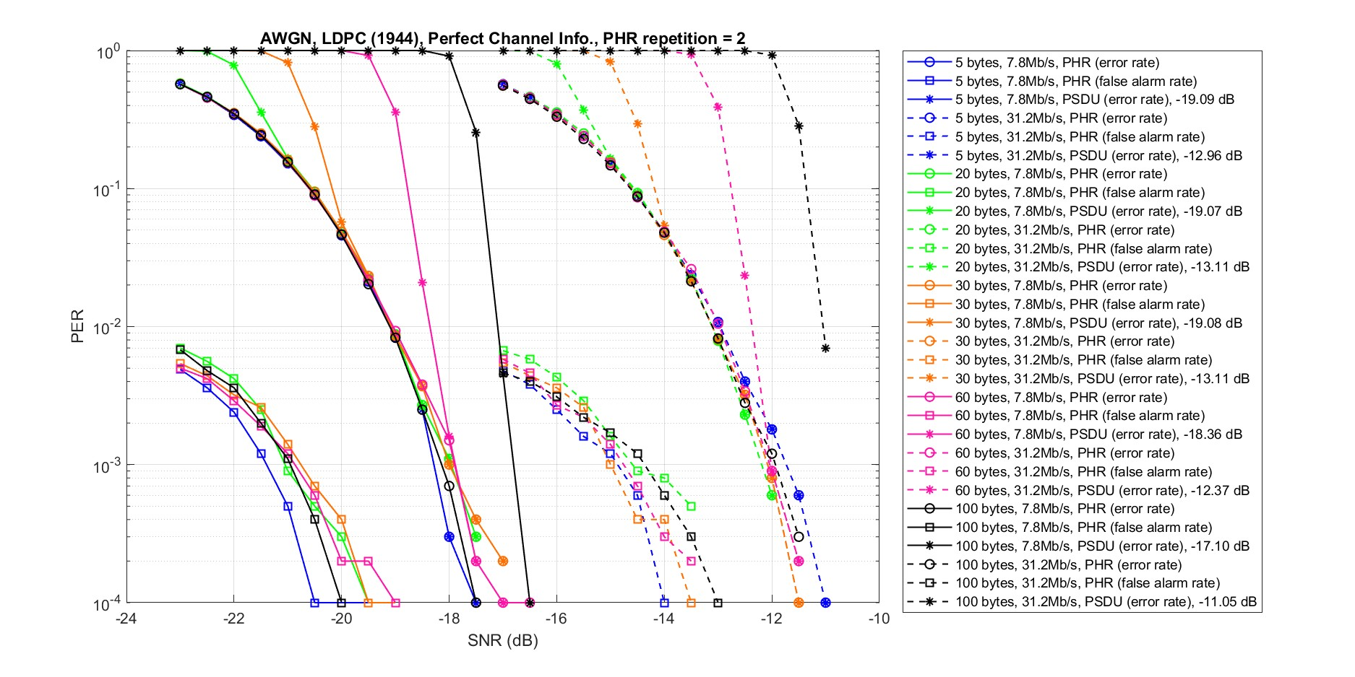
Simulation Results for Option 1 1944 802.11n LDPC
AWGN Channel
Perfect channel Information
PHR has 23 bits (17 information bits + 6 CRC bits)
PHR repetition = 2

Slide 15
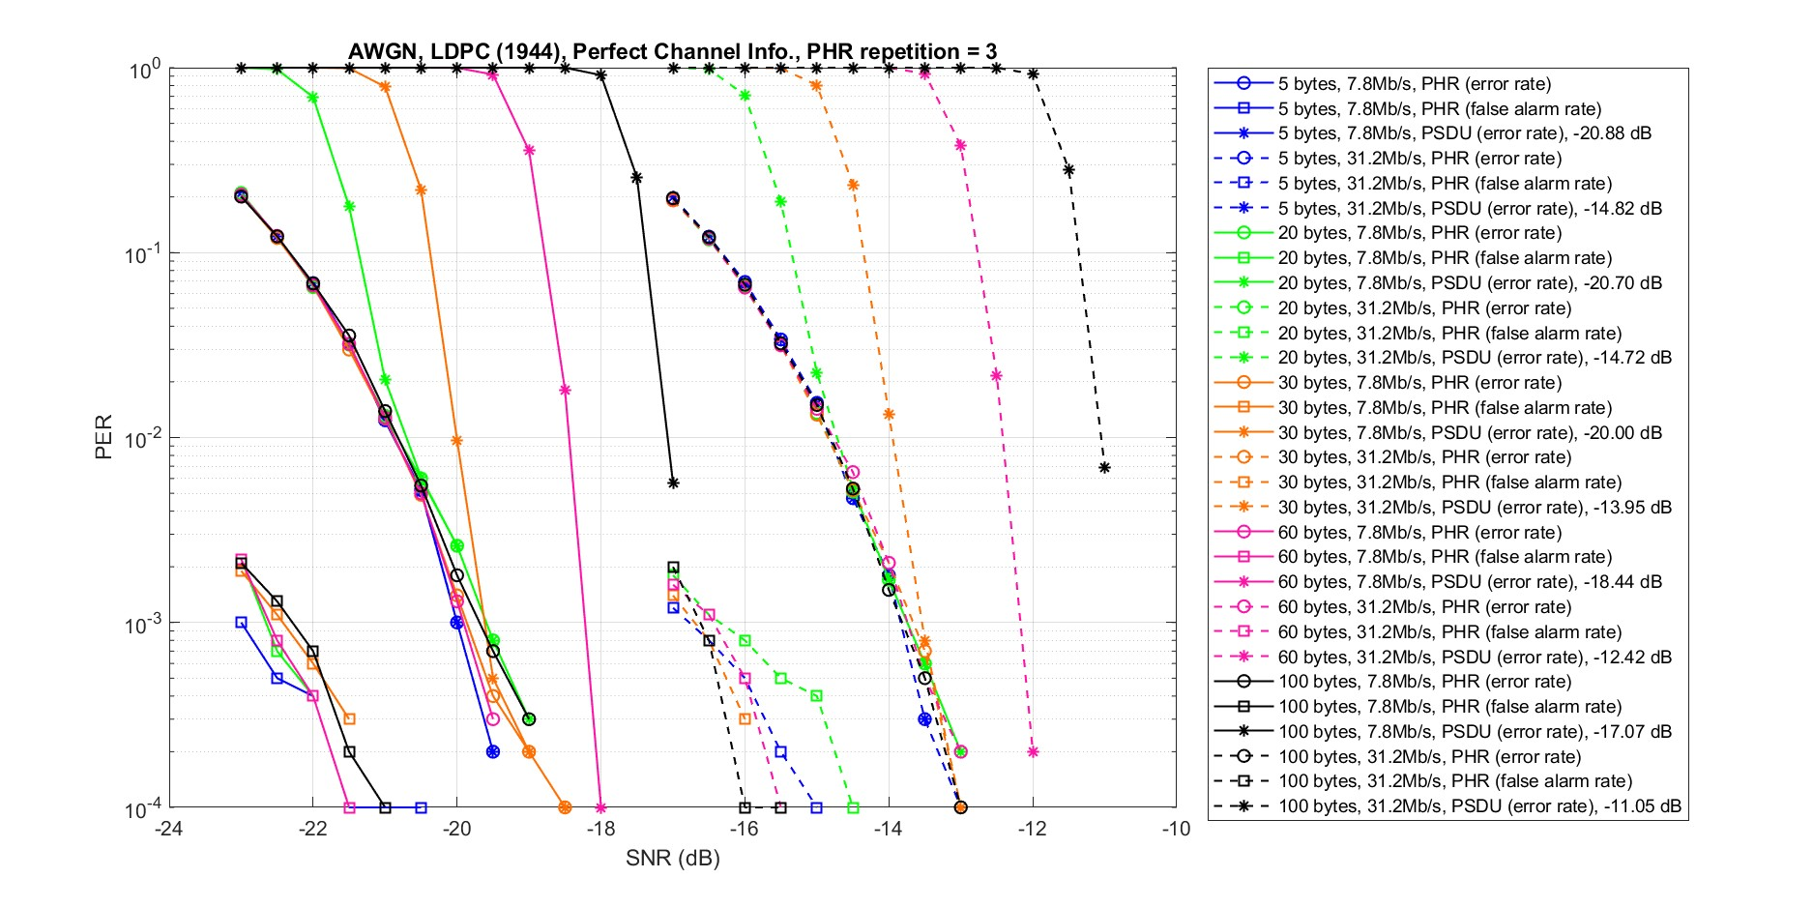
Simulation Results for Option 1 1944 802.11n LDPC
AWGN Channel
Perfect channel Information
PHR has 23 bits (17 information bits + 6 CRC bits)
PHR repetition = 3

Slide 16
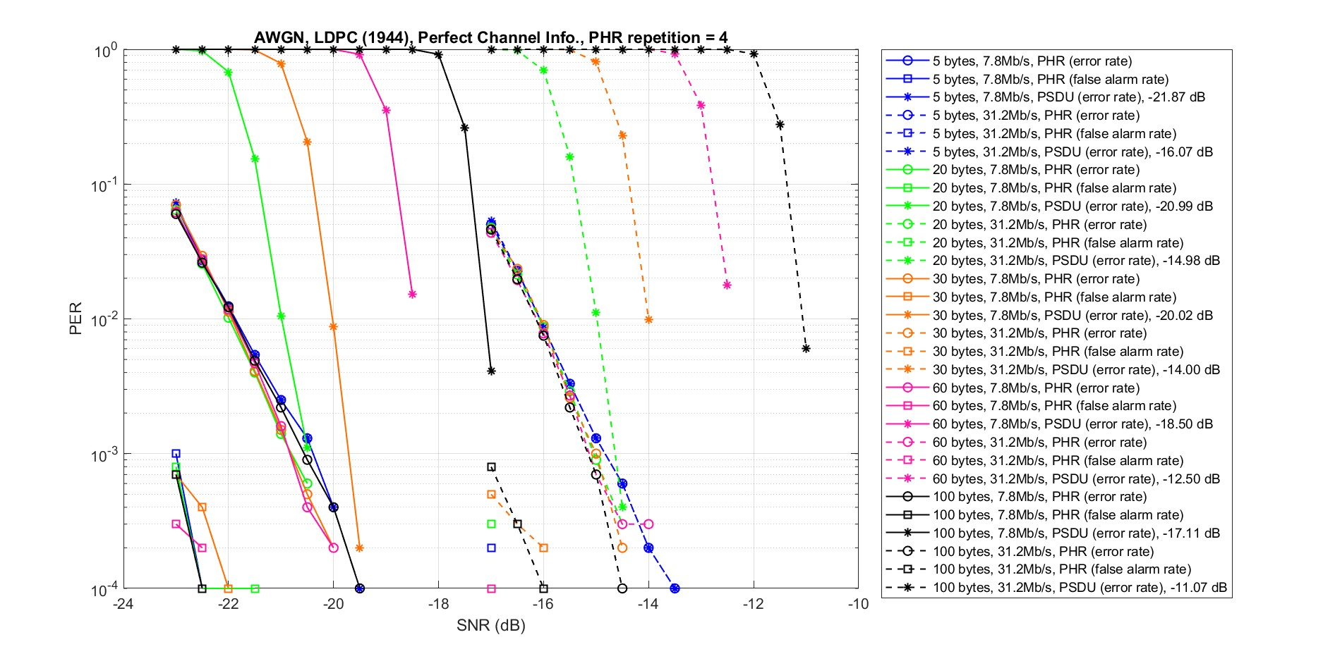
Simulation Results for Option 1 1944 802.11n LDPC
AWGN Channel
Perfect channel Information
PHR has 23 bits (17 information bits + 6 CRC bits)
PHR repetition = 4

Slide 17
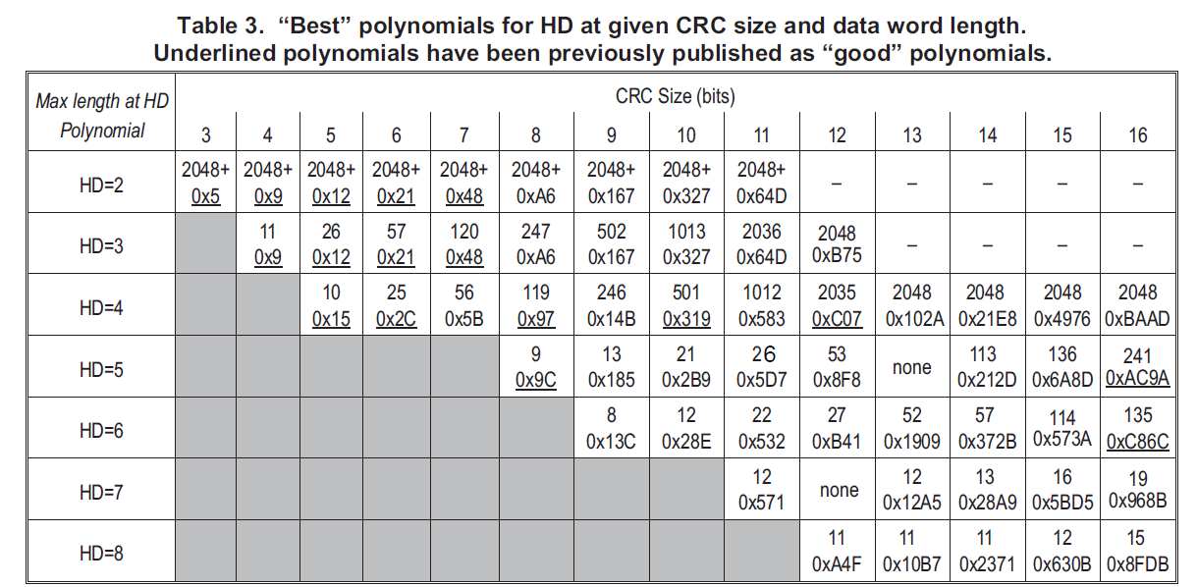
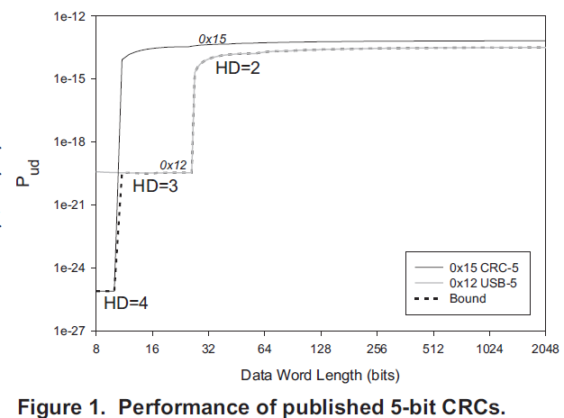
CRC Polynomials
Ref : Koopman, Chakravarty “CRC Polynomial Selection for Embedded Networks”

