Slide 1
Project: IEEE P802.15 Working Group for Wireless Specialty Networks (WSN)
Submission Title: MMS-UWB ranging integrity protection via time hopping
Source: Li Sun, Peng Liu, Bin Qian, David Xun Yang, Lei Huang
Address : [Huawei Bantian Base, Longgang District, Shenzhen, 518129 China]
E-Mail: [sunli50@huawei.com]
Re: Task Group 4ab: UWB Next Generation for 802.15.4
Abstract: [Ranging, integrity, time hopping, MMS-UWB]
Purpose:
Notice: This document has been prepared to assist the IEEE P802.15. It is offered as a basis for discussion and is not binding on the contributing individual(s) or organization(s). The material in this document is subject to change in form and content after further study. The contributor(s) reserve(s) the right to add, amend or withdraw material contained herein.
Release: The contributor acknowledges and accepts that this contribution becomes the property of IEEE and may be made publicly available by P802.15.
Notes:
Jul 12, 2010
Page 1

Slide 2
PAR Objective | Proposed Solution (how addressed)
Safeguards so that the high throughput data use cases will not cause significant disruption to low duty-cycle ranging use cases
Interference mitigation techniques to support higher density and higher traffic use cases
Other coexistence improvement
Backward compatibility with enhanced ranging capable devices (ERDEVs)
Improved link budget and/or reduced air-time
Additional channels and operating frequencies
Improvements to accuracy / precision / reliability and interoperability for high-integrity ranging | The proposed solution can be used to provide an integrity protection for MMS-UWB ranging, thus improving ranging performance.
Reduced complexity and power consumption
Hybrid operation with narrowband signaling to assist UWB
Enhanced native discovery and connection setup mechanisms
Sensing capabilities to support presence detection and environment mapping
Low-power low-latency streaming
Higher data-rate streaming allowing at least 50 Mbit/s of throughput
Support for peer-to-peer, peer-to-multi-peer, and station-to-infrastructure protocols
Infrastructure synchronization mechanisms

Slide 3
Related Contributions
Integrity protection to support secure ranging in IR-UWB <15-22-0072-00-04ab>, Jan. 2022, Li Sun, et. al.
Narrowband assisted multi-millisecond UWB <15-21-0409-00-04ab>, Jul. 2021, J. S. Hammerschmidt, et. al.
More on mixed MMS for ranging integrity <15-22-0392-00-04ab>, Jul. 2022, Xiliang Luo, et. al.
Performance analysis of ranging integrity fragment (RIF) with distance commitment <15-22-0413-00-04ab>, Jul. 2022, David Barras, et al.
Time hopping for fragmented UWB transmission in MMS-UWB systems <15-22-0289-00-04ab>, Ziyang Guo, et. al.

Slide 4
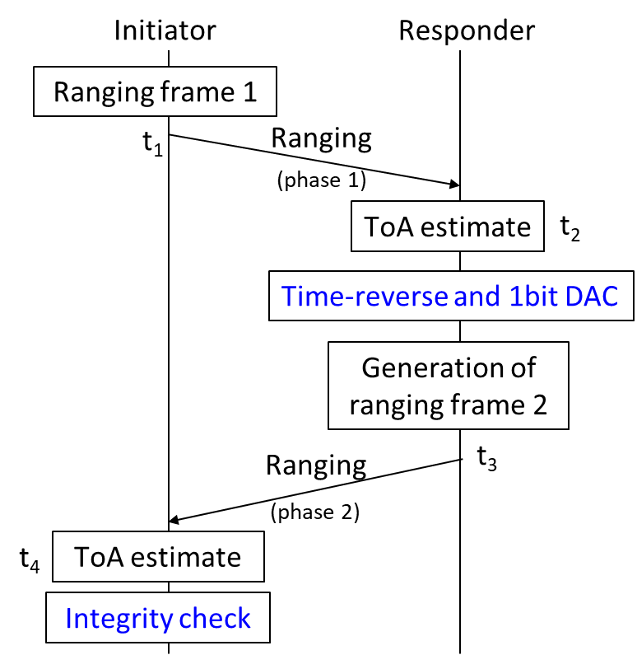
Background and Motivations (1)
Integrity protection, which can be used to detect whether or not the ToA measurement is manipulated, is desired to improve ranging security and accuracy
In [1], the concept of ranging integrity protection was proposed, and a time-reversal based high-integrity ranging protocol was developed
[1] Integrity protection to support secure ranging in IR-UWB <15-22-0072-00-04ab>, Jan. 2022, Li Sun, et. al.

Slide 5
Background and Motivations (2)
Multiple-millisecond UWB (MMS-UWB) is a promising technique to improve link budget and ToF measurement accuracy.
In [2], a mixed multi-millisecond packet format was proposed to provide ranging integrity, where ranging integrity fragments (e.g., STS) follow preamble fragments for integrity validation.
Despite the effectiveness of the aforementioned method, ranging integrity fragments have to be included, which incurs additional transmit power
[2] More on mixed MMS for ranging integrity <15-22-0392-00-04ab>, Jul. 2022, Xiliang Luo, et. al.

Slide 6
Proposed Method (1)
Basic idea: Time hopping, which was proposed in [3] to avoid non-coordinated multi-user interference, can be in combined use with the MMS-UWB ranging to provide ranging integrity.
Expand the 1ms spacing to (1+X) ms
Divide X ms into M slots, and the preamble fragment hops within M slots
LFSR or AES based approach is adopted to generate a pseudo-random sequence, which is used to determine the occupied slot index within each X ms (these slot indices are termed as hopping pattern hereafter)
The hopping pattern is only available at the legitimate ranging pairs
[3] Time hopping for fragmented UWB transmission in MMS-UWB systems <15-22-0289-00-04ab>, Ziyang Guo, et. al.

Slide 7
Proposed Method (2)
Xms
1ms
Xms
1ms
Poll
Frag 1
Frag 2
Frag 3
Frag N
Res
1
2
3
N
Slot 2
Slot M
Slot 3
Slot 1
Time and Freq Sync
Ranging measurement and integrity verification:
Estimate “global” ToA by exploiting the entire set of preamble fragments (correlation-based approach and back-search algorithm can be adopted)
Infer the start time of each fragment (i.e., per-fragment ToAs) based on the global ToA and the known time hopping pattern
Given the per-fragment ToAs obtained above, the receiver extracts all received fragments, and correlates them with the local template (preamble) one by one. The ranging integrity verification passes only if the sum of all correlator’s outputs is above a predetermined threshold

Slide 8
Enhanced Version (1)
In the basic version presented above, the probability of guessing the time-hopping pattern correctly by the attacker is:
$$M^{N}$$
Assume X=1ms, fragment duration=64us, then the maximum value for M is 15; N is typically equal to or smaller than 8 according to [2]
M=15, N=8
$$M^{N}={15}^{8}≈2^{31}$$
Security level not high enough
Enhanced version 1: Use overlapped time hopping instead of orthogonal time hopping.
Xms
Xms
Slot 1
Slot 2
Slot 3
…
Slot M
…
…
1
2
3
M
d
The fragment can be located within any slot between 1 and M
There is no slot. Two possible starting positions of the fragment are apart by d ns
The probability of guessing the time-hopping pattern correctly:
$${\left(\frac{X}{d}\right)}^{N}$$
${\left(\frac{X}{d}\right)}^{N}$=${31250}^{8}≈2^{119}$
e.g., X=1ms, d=32ns, N=8, then

Slide 9
Enhanced Version (2)
Enhanced version 2: Security level can be further improved by using D-decimation preamble fragments to replace standard preamble fragments
D-decimation sequence [4]:
A sequence can be circularly sampled with sampling interval D to produce a new sequence, which is called the D-decimation version of the original sequence
Assume a sequence with length L is an lpatov sequence or an m-sequence. Then, as long as D and L are mutually prime, the D-decimation sequence has the same auto-correlation property as the original sequence
The aforementioned property implies that all the obtained D-decimation sequences can also be used as the preamble fragment, without sacrificing ranging performance
For example, assume L=127, then D can be any integer between 2 and 126. So, the Ipatov preamble fragment with length 127 has 126 different D-decimation versions (including itself)
The probability of guessing the time-hopping pattern correctly:
Orthogonal time hopping + D-decimation preamble:
$${\left((L−1)M\right)}^{N}≈2^{86}$$
(M=15, N=8, L=127)
$${\left(\left(L−1\right)\left(\frac{X}{d}\right)\right)}^{N}≈2^{175}$$
Overlapped time hopping + D-decimation preamble:
(X=1ms, d=32ns, N=8, L=127)
[4] A. Canteaut, et. Al., “Binary m-sequences with three-valued crosscorrelation: A proof of Welch’s conjecture,” IEEE TIT, 2000.

Slide 10
Summary
A time-hopping based method is proposed to enable high-integrity ranging for MMS-UWB.
Integrity validation scheme is also developed, which enjoys a low implementation complexity.
Compared with the mixed MMS method, the proposed approach transmits fewer pulses within a given ranging round. This does not only save transmit power but also decreases interference to other devices.
Time-hopping is a useful tool for MMS-UWB, which brings benefits to both interference mitigation and ranging integrity protection.

