Slide 1
Project: IEEE P802.15 Working Group for Wireless Personal Area Networks (WPANs)
Submission Title: Propagation Characteristics of UWB Communication Applications Including Medical Implants, BCI and Passengers Bus
Date Submitted: September 12th, 2022
Source: Daisuke Anzai, Nagoya Institute of Technology
Address Gokiso-cho, Showa-ku, Nagoya, 466-8555, Japan
Voice: +81-52-735-5389, FAX: +81-52-735-5389, E-Mail: anzai@nitech.ac.jp
Re: In response to call for technical contributions
Abstract: This provides of path loss characteristics of UWB communication applications including medical implants, BCI, and passengers bus.
Purpose: Material for discussion in P802.15.6a TG corresponding to comments in EC Meeting
Notice: This document has been prepared to assist the IEEE P802.15. It is offered as a basis for discussion and is not binding on the contributing individual(s) or organization(s). The material in this document is subject to change in form and content after further study. The contributor(s) reserve(s) the right to add, amend or withdraw material contained herein.
Release: The contributor acknowledges and accepts that this contribution becomes the property of IEEE and may be made publicly available by P802.15.

Slide 2
Propagation Characteristics of UWB Communication Applications Including Medical Implants, BCI and Passengers Bus
Daisuke Anzai
Nagoya Institute of Technology

Slide 3
Background of implant communications

Slide 4
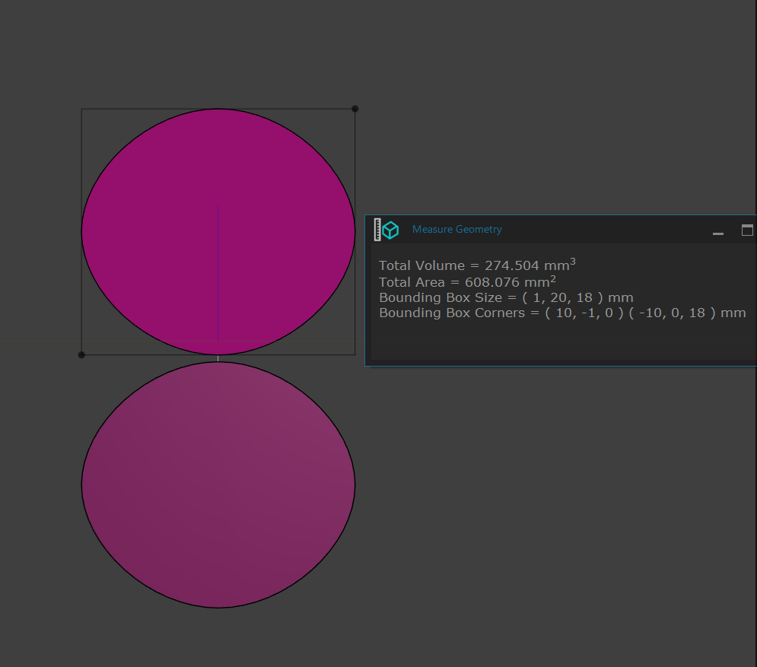
UWB antenna at 3.1 - 10.6 GHz band

Slide 5
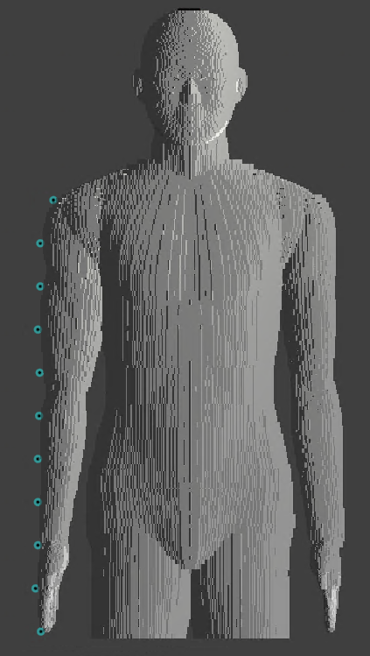



Simulation model
Transmit antenna
Measurement
point
#1
#2
…
Transmitted signal waveform
…
$$z$$
#10
#11
$$x$$
$$y$$

Slide 6
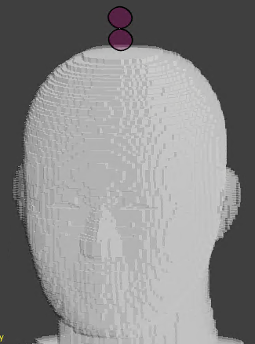
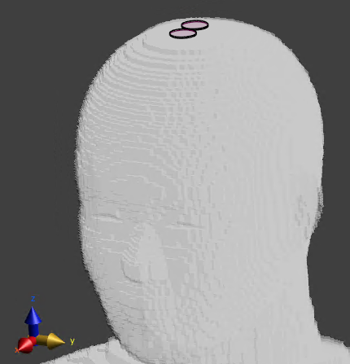
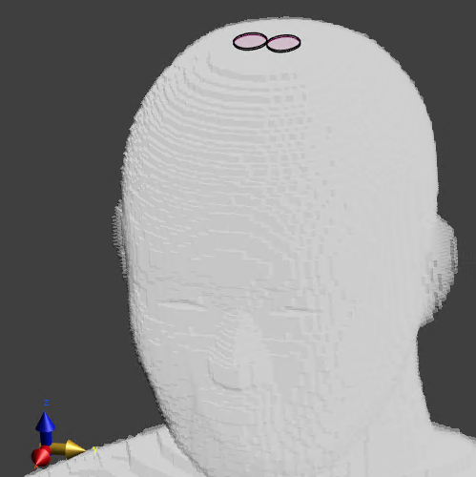
Antenna direction
Antenna direction: x-axis
Antenna direction: y-axis
Antenna direction: z-axis

Slide 7
Dielectric constants of human model
Relative permittivity
Conductivity

Slide 8
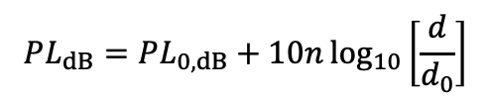
Path loss analysis results
$$PL_{dB}=PL_{0,dB}+10n\log_{10}\left[\frac{d}{d_{0}}\right]$$
Transmitting antenna | Received components | PL₀ [dB] | n
x | x y z | 109.8 100.8 118.5 | 2.22 3.12 1.23
y | x y z | 103.9 85.3 101.4 | 0.85 3.02 2.16
z | x y z | 87.2 68.2 84.7 | 0.91 3.27 2.23

Slide 9
Path loss analysis results

Slide 10
Frequency dependency of path loss characteristics

Slide 11
Frequency dependency of path loss characteristics

Slide 12
Simulation model for passengers bus
Setting A

Slide 13
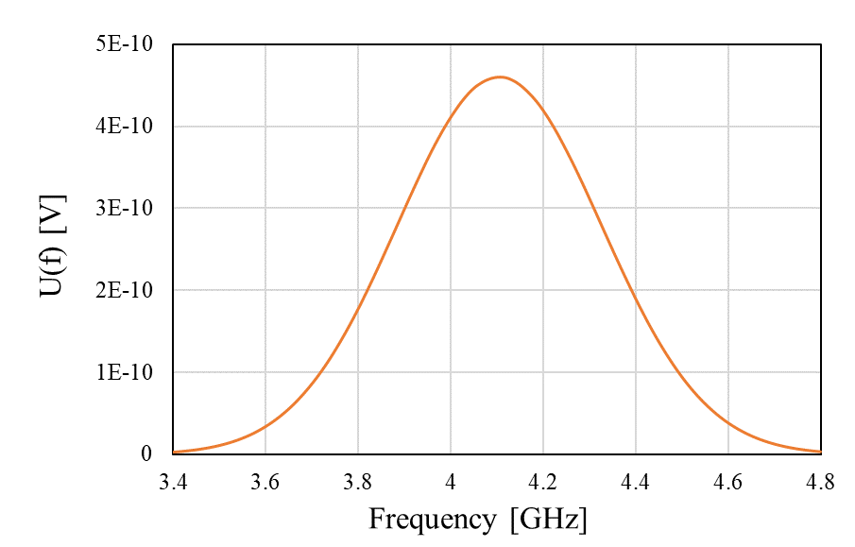
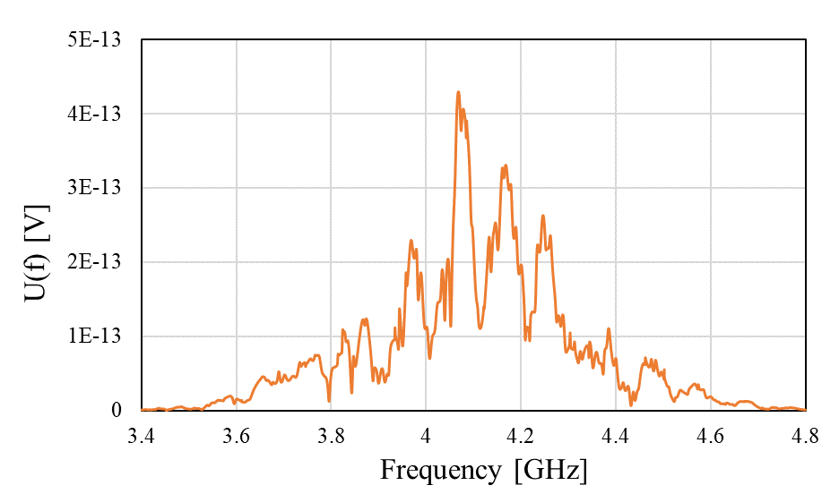
Frequency spectrum

Slide 14
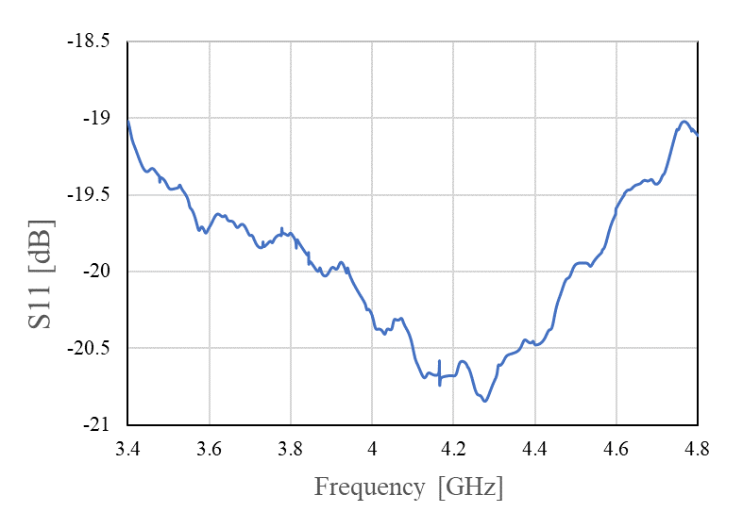
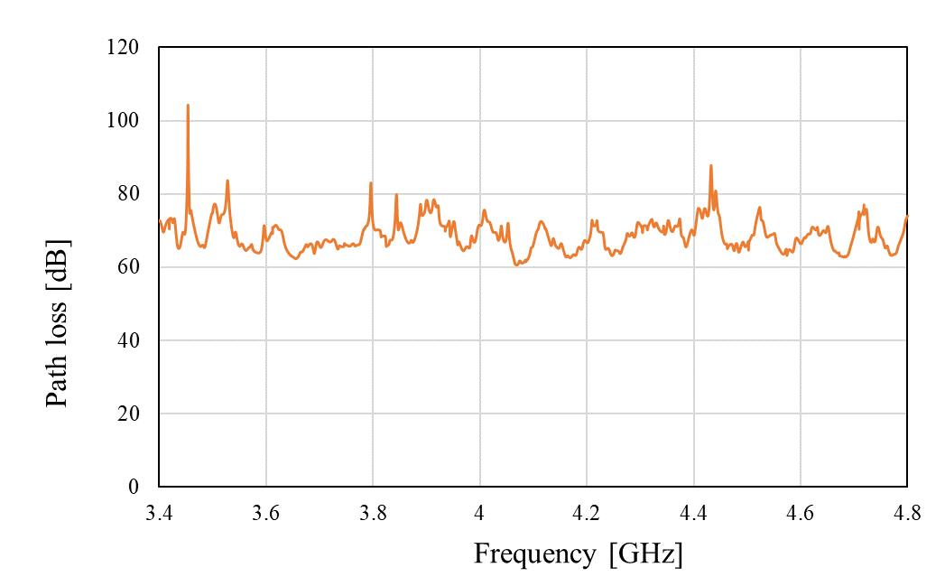
Path loss characteristics
Setting A

Slide 15
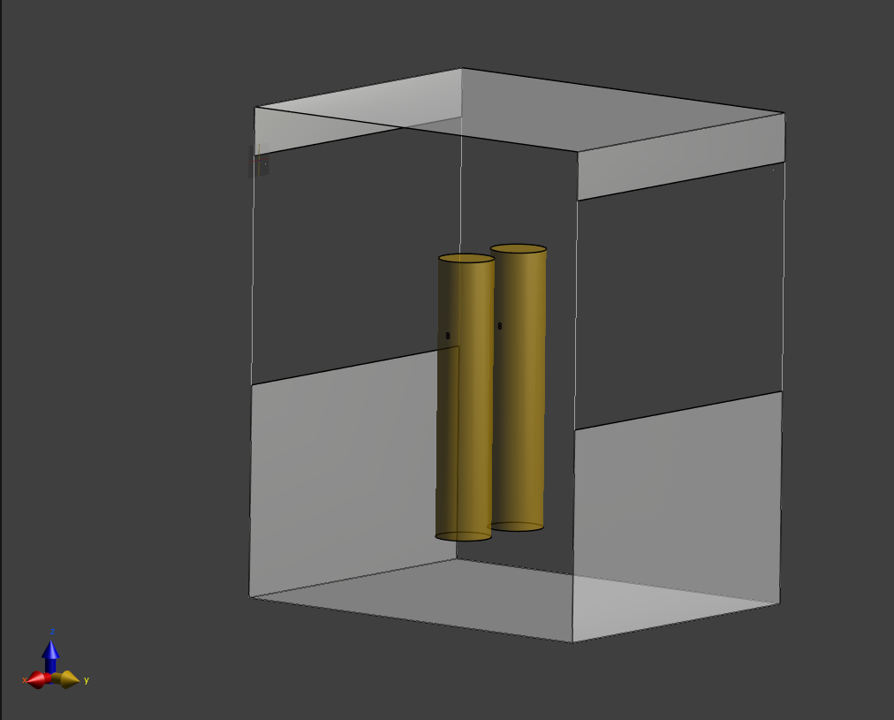
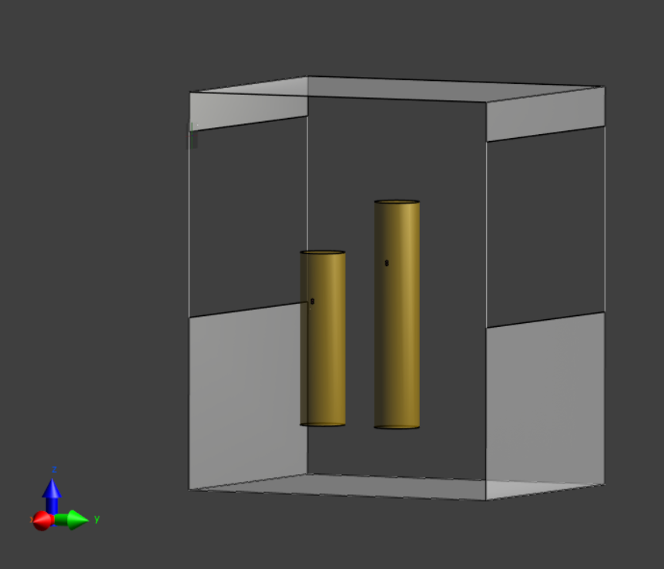
Another situation in bus model
Setting B
Setting C

Slide 16
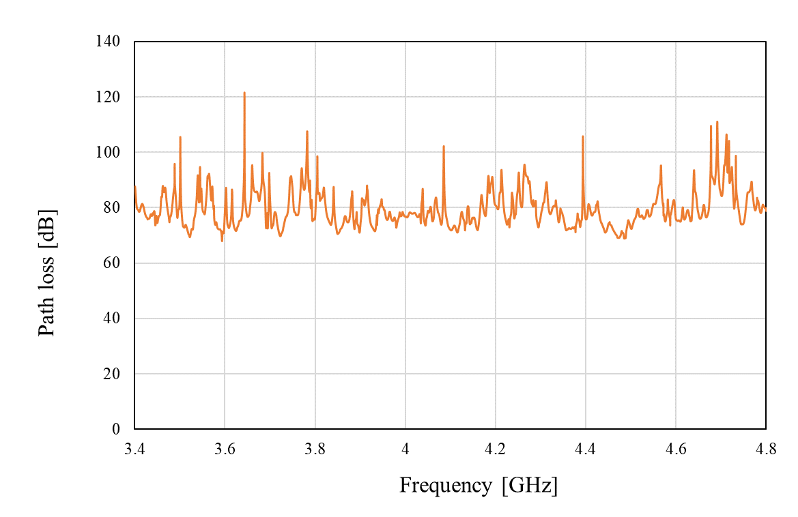
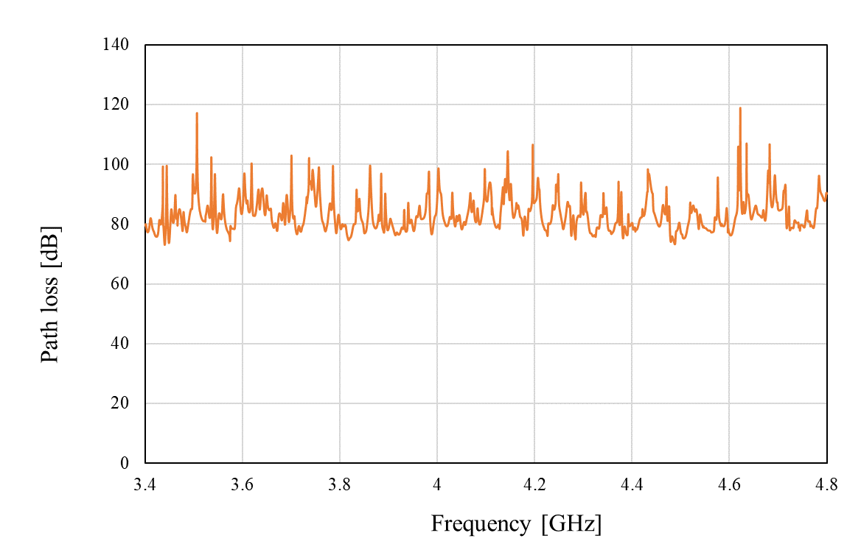
Path loss analysis results
Setting B
Setting C

Slide 17
Path loss analysis for HBAN to VBAN link
VBAN #1
VBAN #2
VBAN

Slide 18
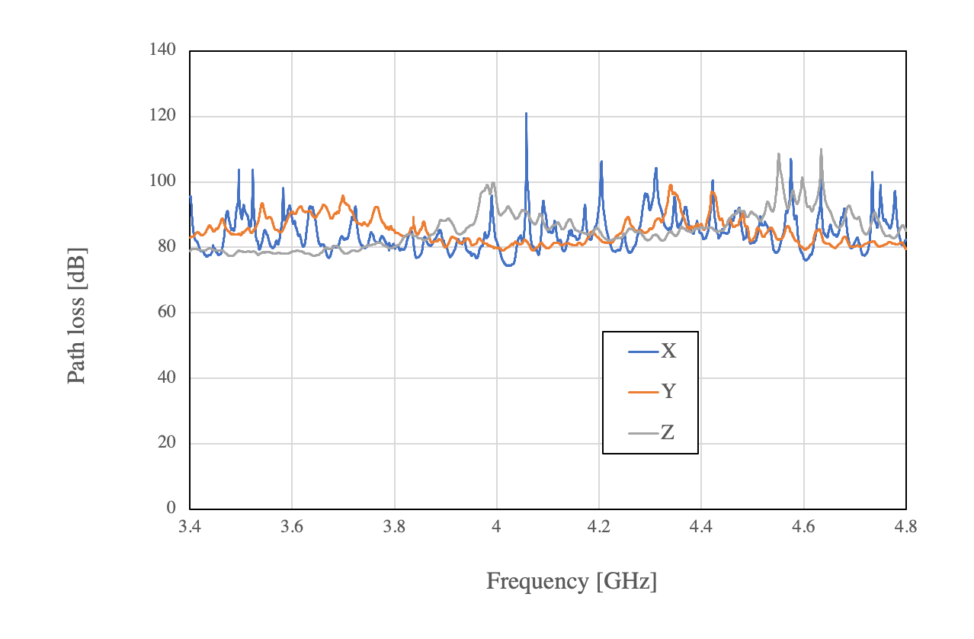
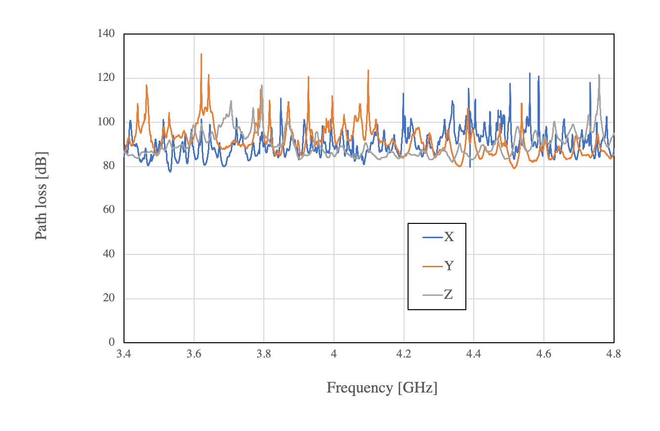
Path loss of a link from HBAN to VBAN
VBAN #1
VBAN #2

Slide 19
References
Y. Shimizu, D. Anzai, R. C-Santiago, P. A. Floor, I. Balasingham, and J. Wang, “Performance evaluation of an ultra-wideband transmit diversity in a living animal experiment” IEEE Trans. Microw. Theory Tech., vol. 65, no. 7, pp. 2596-2606, July 2017.
D. Anzai, K. Katsu, R. Chavez-Santiago, Q. Wang, D. Plettemeier, J. Wang, and I. Balasingham, “Experimental evaluation of implant UWB-IR transmission with living animal for body area networks,” IEEE Trans. Microw. Theory Tech., vol. 62, no. 1, pp. 183-192, Jan. 2014.
J. Shi, D. Anzai, and J. Wang, “Channel modeling and performance analysis of diversity reception for implant UWB wireless link,” IEICE Trans. Commun., no. E95-B, vol. 10, pp. 3197-3205, Oct. 2012.

