Slide 1
Project: IEEE P802.15 Working Group for Wireless Personal Area Networks (WPANs)
Submission Title: [BPSK modulation for high-speed data-rates in impulse ultra-wideband radio]
Date Submitted: [13th September 2022]
Source: [Jarek Niewczas, Billy Verso, Carl Murray, Michael McLaughlin, Igor Dotlic] Company [Qorvo, Inc.]
Address [ ]
E-Mail:[billy.verso (at) qorvo.com]
Re: []
Abstract: [BPSK performance on a TWO-PATH and IEEE-CM1 UWB channels]
Purpose: [Propose efficient way to improve BPSK performance in challenging conditions]
Notice: This document has been prepared to assist the IEEE P802.15. It is offered as a basis for discussion and is not binding on the contributing individual(s) or organization(s). The material in this document is subject to change in form and content after further study. The contributor(s) reserve(s) the right to add, amend or withdraw material contained herein.
Release: The contributor acknowledges and accepts that this contribution becomes the property of IEEE and may be made publicly available by P802.15.

Slide 2
PAR Objective | Proposed Solution (how addressed)
Safeguards so that the high throughput data use cases will not cause significant disruption to low duty-cycle ranging use cases | High-speed data-rates reduce the packet length thus reduce the interference. Pulse hopping additionally reduces the probability of high pulse collision rates between different users.
Interference mitigation techniques to support higher density and higher traffic use cases | ... same as above
Other coexistence improvement | ... same as above
Backward compatibility with enhanced ranging capable devices (ERDEVs)
Improved link budget and/or reduced air-time | ... same as above
Additional channels and operating frequencies
Improvements to accuracy / precision / reliability and interoperability for high-integrity ranging
Reduced complexity and power consumption | ... same as above
Hybrid operation with narrowband signaling to assist UWB
Enhanced native discovery and connection setup mechanisms
Sensing capabilities to support presence detection and environment mapping
Low-power low-latency streaming | ... same as above
Higher data-rate streaming allowing at least 50 Mbit/s of throughput | ... same as above
Support for peer-to-peer, peer-to-multi-peer, and station-to-infrastructure protocols
Infrastructure synchronization mechanisms

Slide 3
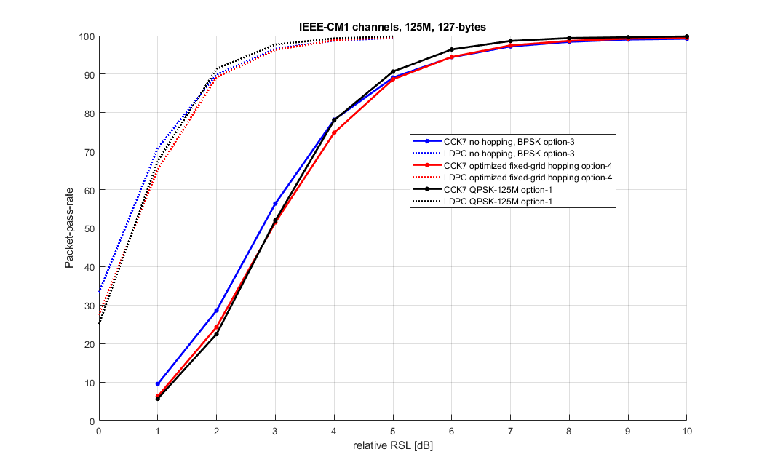
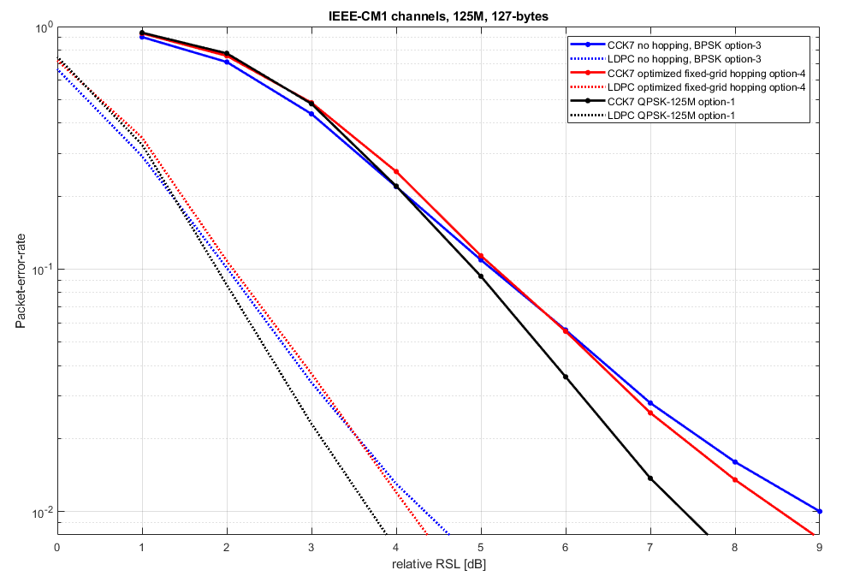
QPSK vs BPSK on IEEE-CM1 channels (CMF, 125Mbps)
On IEEE-CM1 channels (the set consists of 1000 DIFFERENT channels), QPSK vs BPSK performances are close with the CMF receiver. BPSK is better (BLUE line) for easier CM1 channels (the ones which pass at lower RSL levels), while QPSK appears better for the hardest 10% CM1 channels. With LDPC decoder the differences are smaller.

Slide 4
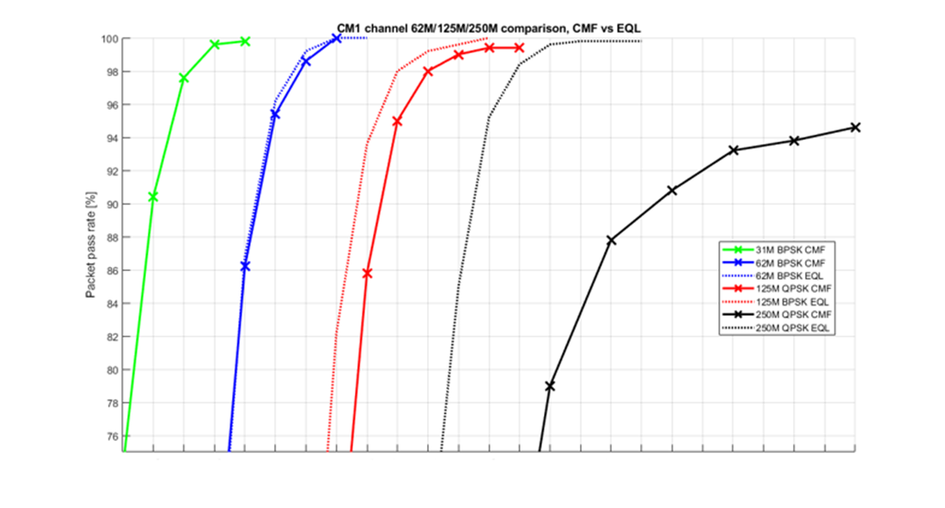
BPSK with equaliser (125Mbps)
On IEEE-CM1 channels, equaliser makes almost no difference at 62 Mbps. There is 1-2dB difference at 125 Mbps, on the rich multipath channels (depending on the channel).
However, with the TWO-PATH channel the performance with an equaliser will not be much better than a CMF.
The hopping scheme with a CMF gives better performance on the TWO-PATH channel.

Slide 5
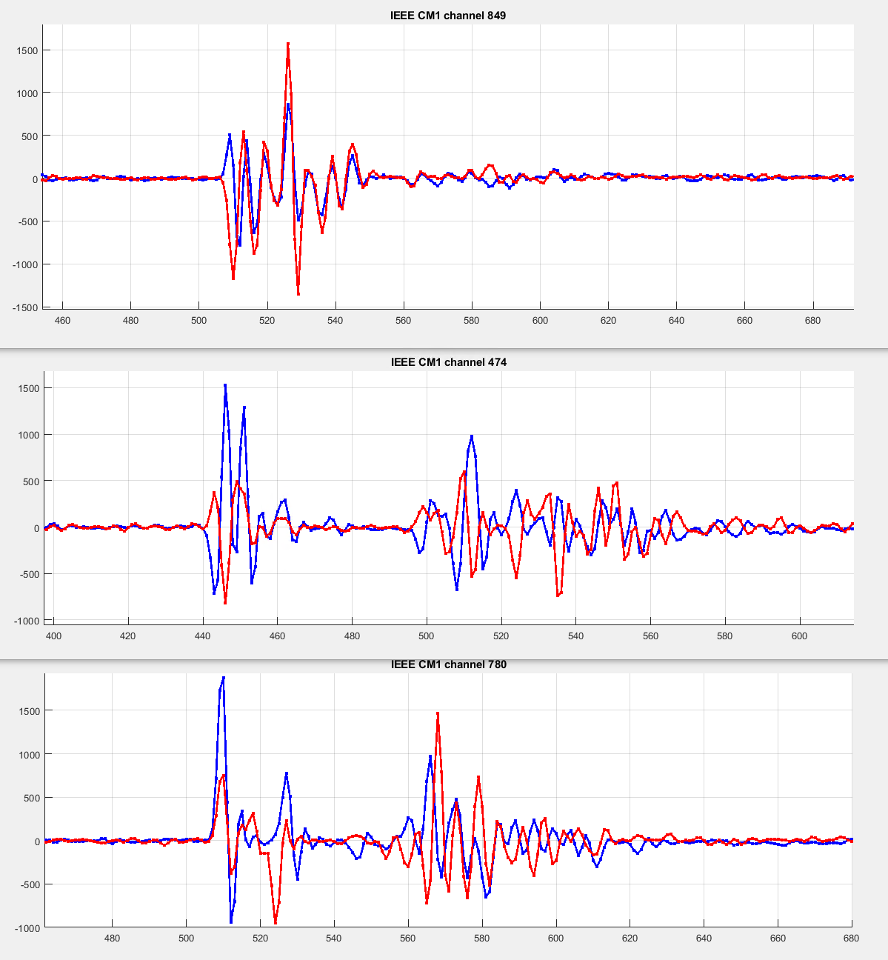
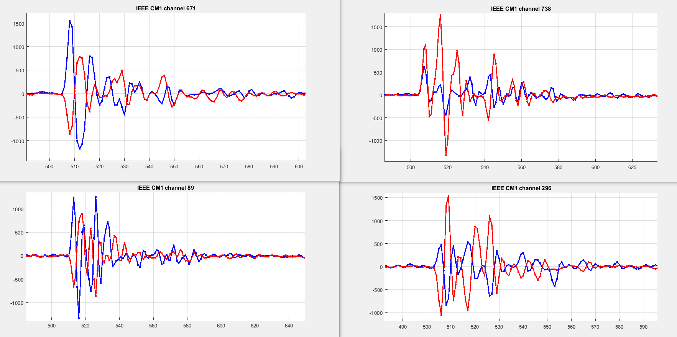
QPSK vs BPSK on IEEE-CM1 channels (125Mbps)
At 125 Mbps, ISI becomes a dominant impairment for certain multipath-rich channels. Some of the problematic channels are shown below. It should be noted that the number of of such channels is only a small percentage of the overall CM1 set and even those channels do not cause the complete failure (like some TWO-PATH channels do), but only a small performance degradation.

Slide 6
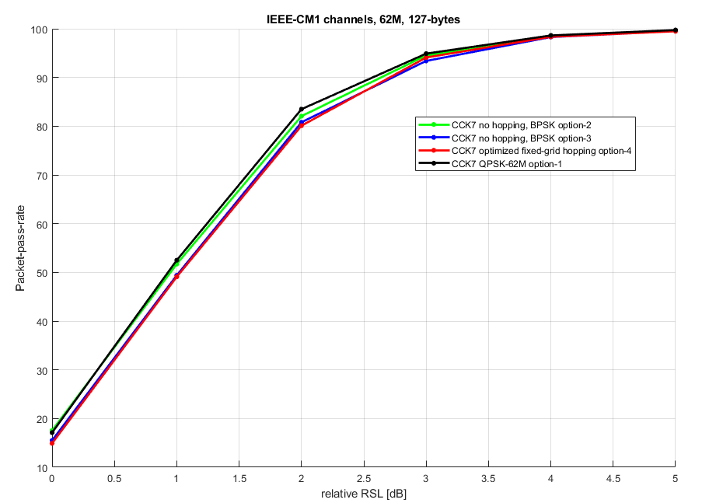
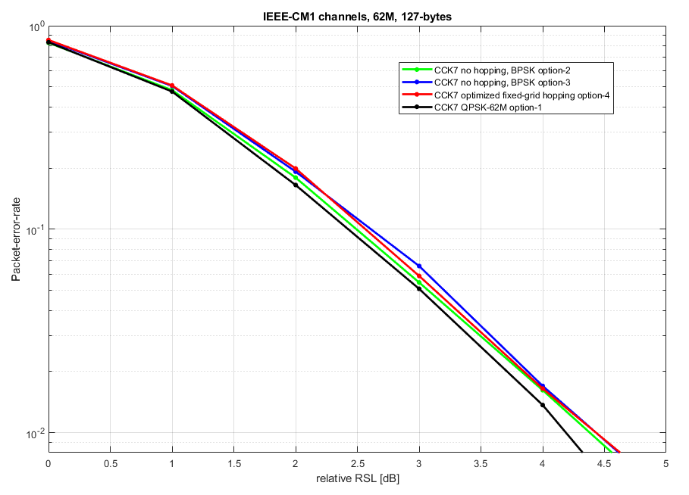
QPSK vs BPSK on IEEE-CM1 channels (CMF, 62Mbps)
At 62 Mbps, QPSK vs BPSK performances are even closer. BPSK option-3 is very close to option-2.

Slide 7
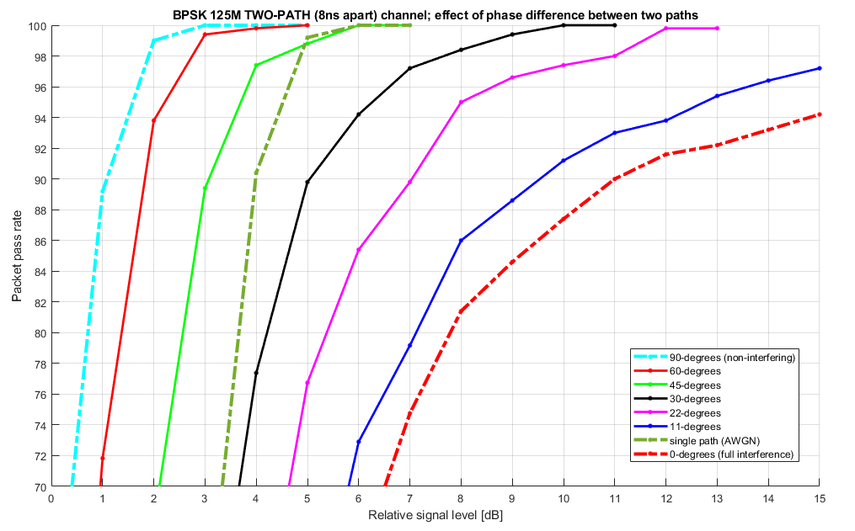
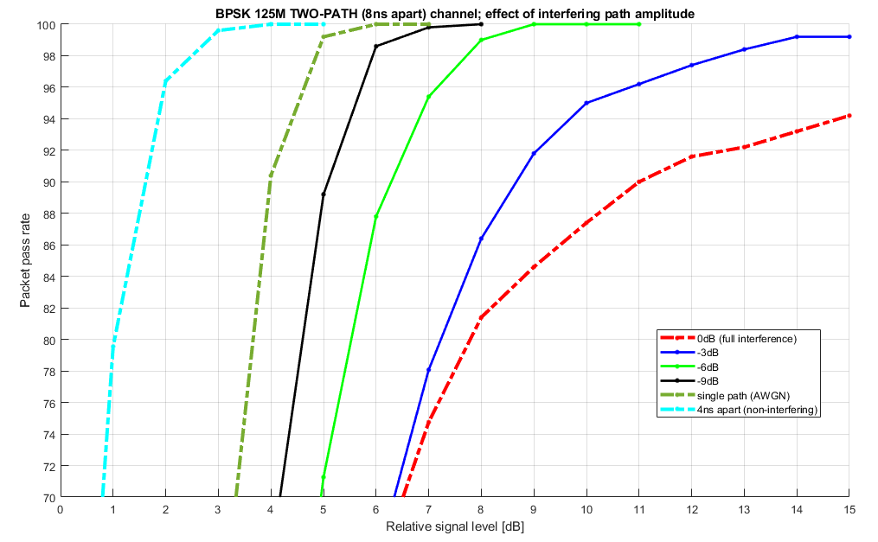
TWO-PATH channel collisions
On a TWO-PATH channel, the worst case scenario is when the two colliding paths have the same power and phase difference is either 0 or 180-degrees. The results presented below show that degradation is significant if the power difference is 0-6dB and the phase difference is up to +/- 45 degrees (from the critical 0 or 180 degrees). BPSK uses grid option-3 (g0 and g1 pulses together followed by 4ns silence gap).

Slide 8
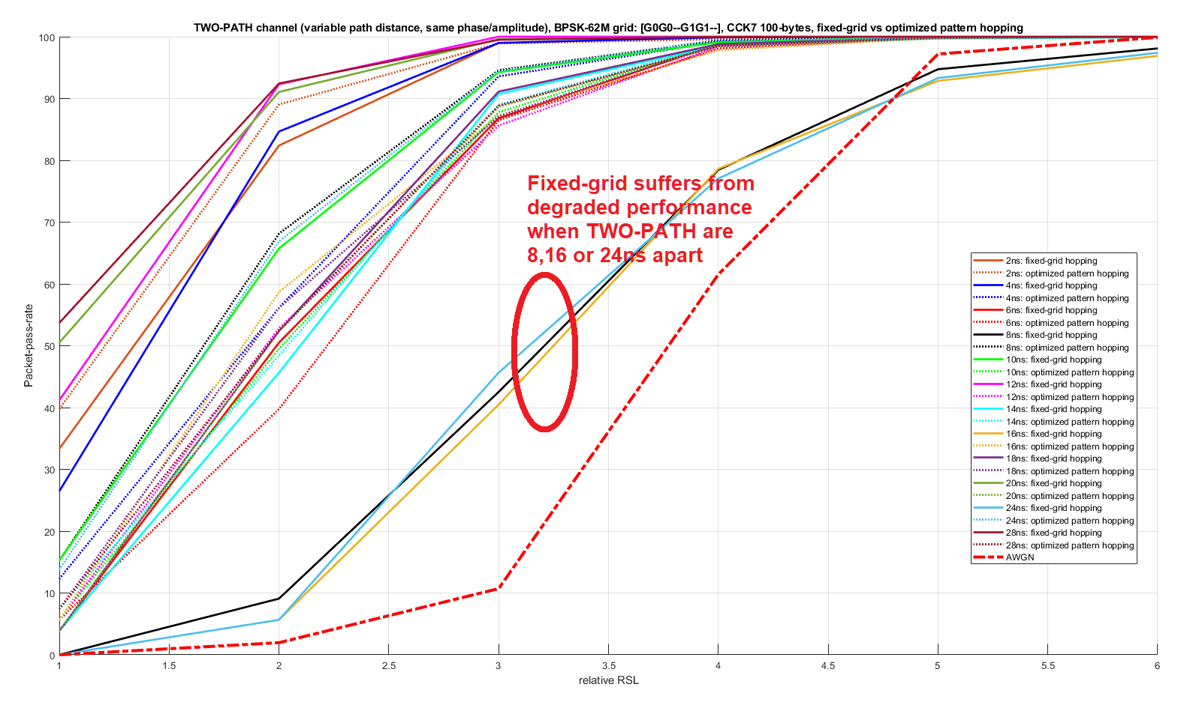
Recap: Fixed-grid BPSK and TWO-PATH channel
The 62 Mbps grid option-2 would suffer with TWO-PATHs 8,16,24ns apart.
The 62 Mbps grid option-3 would only be impacted with TWO-PATHs 16ns apart. Optimized fixed hopping scheme resolves collisions at all delays.

