Slide 1
Project: IEEE P802.15 Working Group for Wireless Personal Area Networks (WPANs)
Submission Title: More on updating the number of fragments for NBA-MMS UWB ranging
Date Submitted: September, 2022
Source: Kuan Wu, Rani Keren, Yunbo Li, Bin Qian, David Xun Yang, Lei Huang (Huawei Technologies)
Email: wukuan2@huawei.com
Abstract: Discussing approach for managing the number of fragments selection in NBA-MMS-UWB ranging
Purpose: To mitigate the reliance of NB channel availability during NBA-MMS-UWB ranging for simple message feedback
Notice: This document has been prepared to assist the IEEE P802.15. It is offered as a basis for discussion and is not binding on the contributing individual(s) or organization(s). The material in this document is subject to change in form and content after further study. The contributor(s) reserve(s) the right to add, amend or withdraw material contained herein.
Release: The contributor acknowledges and accepts that this contribution becomes the property of IEEE and may be made publicly available by P802.15.

Slide 2
PAR Objective | Proposed Solution (how addressed)
Safeguards so that the high throughput data use cases will not cause significant disruption to low duty-cycle ranging use cases
Interference mitigation techniques to support higher density and higher traffic use cases
Other coexistence improvement
Backward compatibility with enhanced ranging capable devices (ERDEVs)
Improved link budget and/or reduced air-time | Discussion on the number of fragments for NBA-MMS UWB
Additional channels and operating frequencies
Improvements to accuracy / precision / reliability and interoperability for high-integrity ranging
Reduced complexity and power consumption
Hybrid operation with narrowband signaling to assist UWB | Discussion on alleviating the reliance on NB channel availability for conveying simple messages
Enhanced native discovery and connection setup mechanisms
Sensing capabilities to support presence detection and environment mapping
Low-power low-latency streaming
Higher data-rate streaming allowing at least 50 Mbit/s of throughput
Support for peer-to-peer, peer-to-multi-peer, and station-to-infrastructure protocols
Infrastructure synchronization mechanisms

Slide 3
Related Contributions
[1] 15-22-0381-00-04ab-nba-uwb-ranging-text-proposal-for-15-4ab-tfd (July, 2022) , Yong Liu et al
[2] 15-22-0378-00-04ab-on-the-selection-of-number-of-fragments-in-mms-uwb (July, 2022) , Rani Keren, Kuan Wu et al

Slide 4
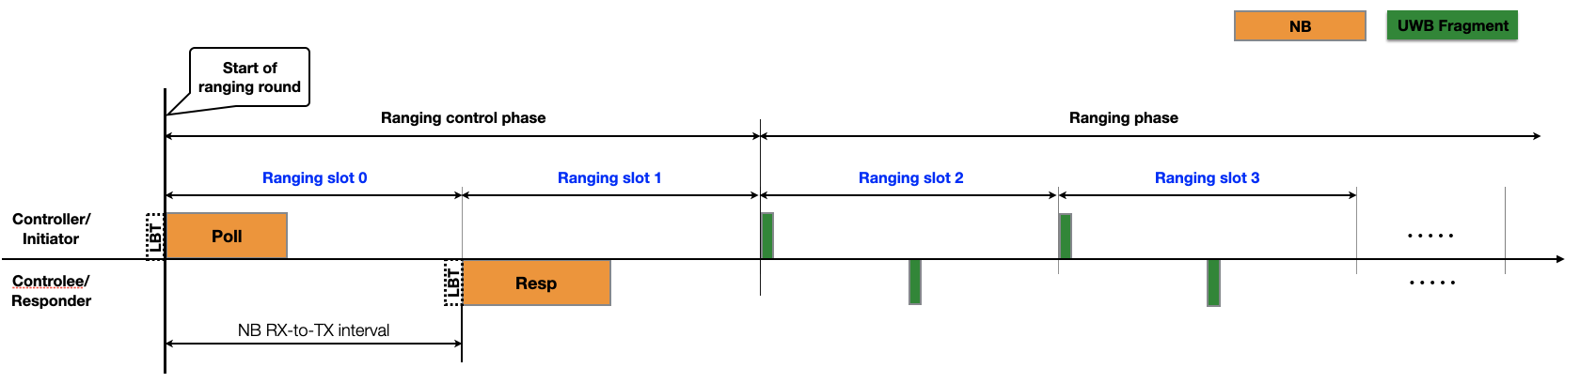
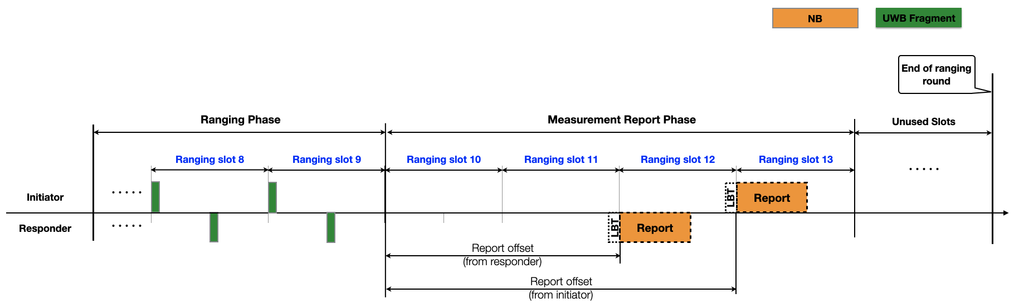
Introduction
If Listen-before-Talk (LBT) is required before a narrowband (NB) transmission in the corresponding operating band, a transmitter shall perform LBT in advance of the start of the expected transmission [1].
Observation: The implementation of narrowband-assisted multi-millisecond (NBA-MMS) ranging is subject to the availability of NB channels →Low robustness

Slide 5
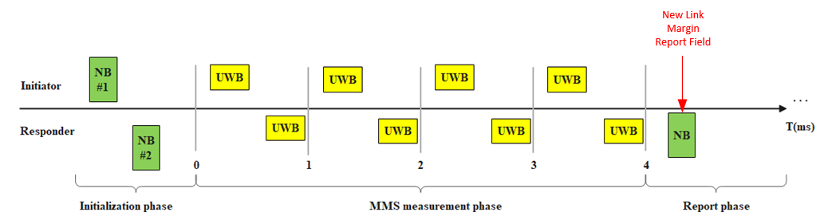
Introduction (cont.)
On the selection of number of fragments in an MMS-UWB [2]
Option 1: Dynamic update of the # of fragments.
e.g., Dynamic update of the # of fragments at the report phase
Option 2: Fixed selection preconfigured to the largest number of fragments.
Observations:
Updating the number of fragments within the MMS measurement phase has not yet been discussed [2].
The updating message by NB feedback at any phases suffers the aforementioned robustness problem.

Slide 6
Motivation & Proposals
During transmission of MMS fragments, enable the receiving side to request an early termination of the MMS procedure in case the number of fragments it has already received is sufficient for a reliable ranging measurement. →This approach may result in a faster and more fluent adaptation to changing channel conditions:
  Transmission of redundant fragments is not required in case channel conditions improve and require less fragments than the pre-configured number of fragments.
  By setting the pre-configured number of fragments to be higher than required by current channel conditions, a sufficient number of fragments may immediately apply once channel conditions are degraded. This avoids failed MMS procedures with insufficient number of fragments during the response to the degrading conditions.
To mitigate the reliance of NB channel availability during MMS ranging for simple message feedback
  Indicating the change of the number of fragments by non-NB method. → Also extended to serve other simple messages
  Maintaining preamble-only structure → non-data packets to convey the feedback message

Slide 7
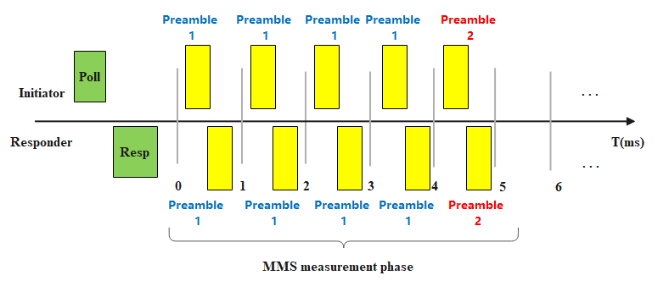
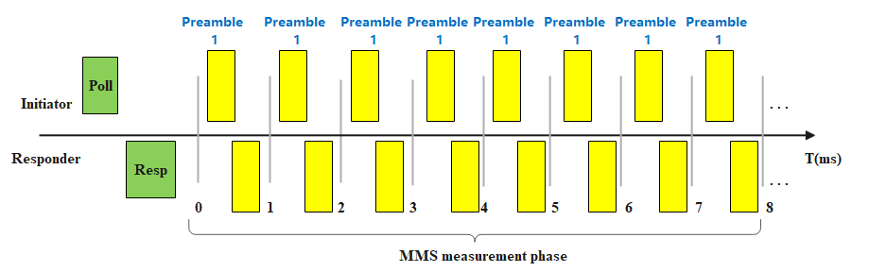
The feedback is conveyed by the change of preambles (Symmetric case)
Instead of using NB signals, maintaining preamble-only packet structure to indicate the change of the number of fragments within the same round.
(a) Originally with 8 fragments for the channel sounding
(b) Feedback that received fragments are sufficient for processing
The change from Preamble 1 to Preamble 2 indicates that the number of fragments is sufficient for aggregation processing, further fragments are no longer needed.
The change operation is jointly determined by both sides (initiator/responder)
  Two-way manner can serve as an ack mechanism for confirming to the other side that the change message has been successfully interpreted.
In case the responding side misses/mis-detects the packet with preamble 2
  The initiator repeats the transmission of preamble 2 until the responding side detects it or until the transmitted number of fragments reaches the max allowed number.
  The responder repeats the transmission of preamble 1 until it successfully detects preamble 2 or until the transmitted number of fragments reaches the max allowed number.

Slide 8
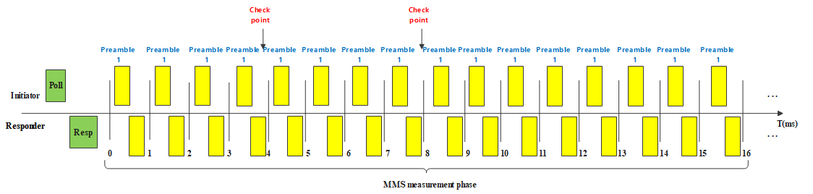
The feedback is conveyed by the change of preambles
(Symmetric case) (cont.)
For the ease of the receiving side, the responder may optionally detect whether there is any change of preamble only at some specific timing check points (Optional).
  Avoiding frequent detections with multiple correlations for different preambles at the responder side to reduce false detection probability of preamble types at the receiver side.
Specifying check-points to detect the preamble changes, for example at slot 4 and 8

Slide 9
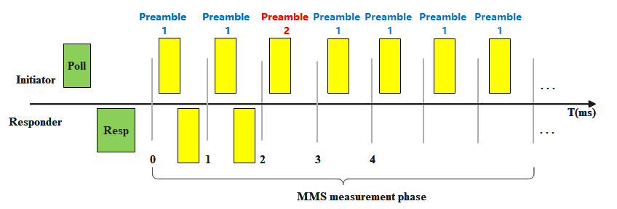
The feedback is conveyed by the change of preambles
(Asymmetric case)
The change operation is implemented by each side (initiator/responder) separately→ In case the noise levels between initiator and responder differ greatly

Slide 10
Summary
  Implicit method to indicate number of fragments without explicit NB indication to alleviate the reliance on NB channel availability
    The use of UWB preamble-only packets/non-data packets method
    A candidate method to provide simple message feedbacks when NB channels are unavailable
  Indicating the change of the number of fragments by changing the preamble
    Specifying time check points for the ease of the receiving side
    The change operation can be operated symmetrically or asymmetrically

