Slide 1
Project: IEEE P802.15 Working Group for Wireless Personal Area Networks (WPANs)
Submission Title: [Supercomplementary Zero-sum Cross-correlation (SZC) Code Blocks Generation]
Date Submitted: [10 July 2022]
Source: [Igor Dotlic and Michael McLaughlin] Company [Qorvo]
Address [Adelaide Chambers, Peter Street, Dublin 8, Ireland]
E-Mail:[igor(dot)dotlic(at)qorvo(dot)com]
Re: [Study Group 4ab: UWB Next Generation.]
Abstract: [The document describes SZC code blocks generation.]
Purpose: [To promote usage of SZC code blocks in IEEE 802.15.4ab standard.]
Notice: This document has been prepared to assist the IEEE P802.15. It is offered as a basis for discussion and is not binding on the contributing individual(s) or organization(s). The material in this document is subject to change in form and content after further study. The contributor(s) reserve(s) the right to add, amend or withdraw material contained herein.
Release: The contributor acknowledges and accepts that this contribution becomes the property of IEEE and may be made publicly available by P802.15.
Notes:
Jul 12, 2010
Page 1

Slide 2
Supercomplementary Zero-sum Cross-correlation (SZC) Code Blocks Generation and Selection Criteria.

Slide 3
Recap on SZC Code Blocks
SZC Code Blocks are deterministic and aperiodic.
They are designed to be used when timing and CFO are synchronized to make CIR estimation with maximum integrity.
Resilient to arbitrary Rx signal deformations consistent across the symbols, e.g., CFO if not removed before the correlation.
Especially useful in sensing.
  In contrast, usage of 4z CSPRNG STS inevitably produces random sidelobes.
  After differential filtering by the Moving Target Indicator (MTI) these sidelobes appear as targets, considerably degrading the sensing performance.

Slide 4
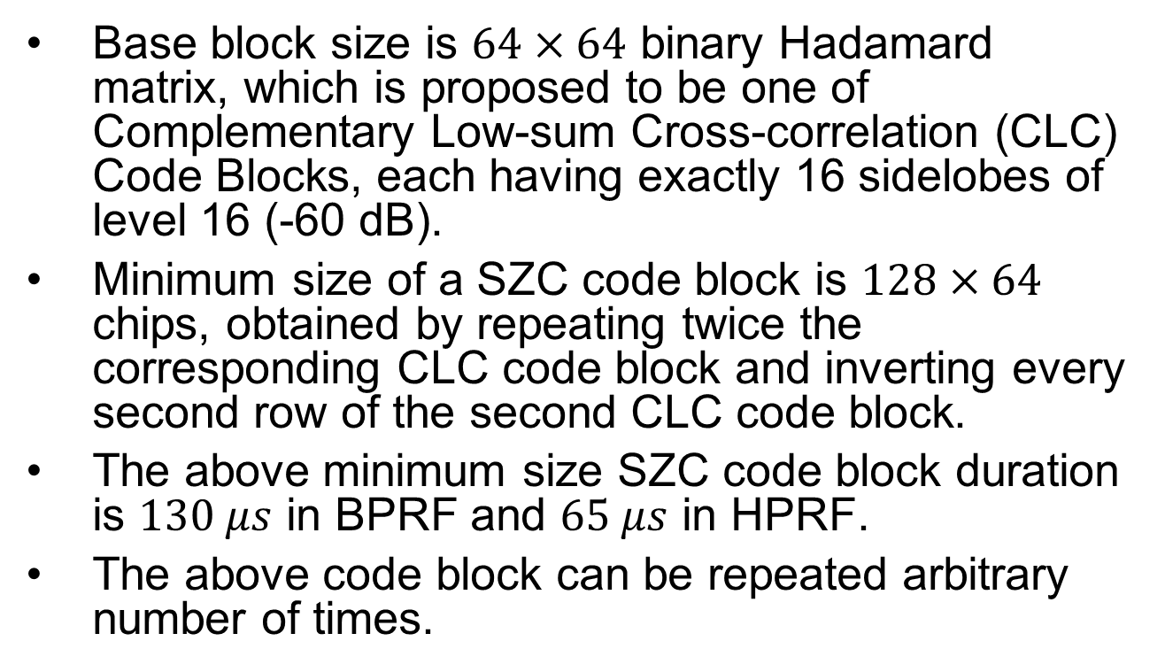
Proposed SZC Code Blocks Structure
Base block size is $64×64$ binary Hadamard matrix, which is proposed to be one of Complementary Low-sum Cross-correlation (CLC) Code Blocks, each having exactly 16 sidelobes of level 16 (-60 dB).
Minimum size of a SZC code block is $128×64$ chips, obtained by repeating twice the corresponding CLC code block and inverting every second row of the second CLC code block.
The above minimum size SZC code block duration is $130 μs$ in BPRF and $65 μs$ in HPRF.
The above code block can be repeated arbitrary number of times.

Slide 5
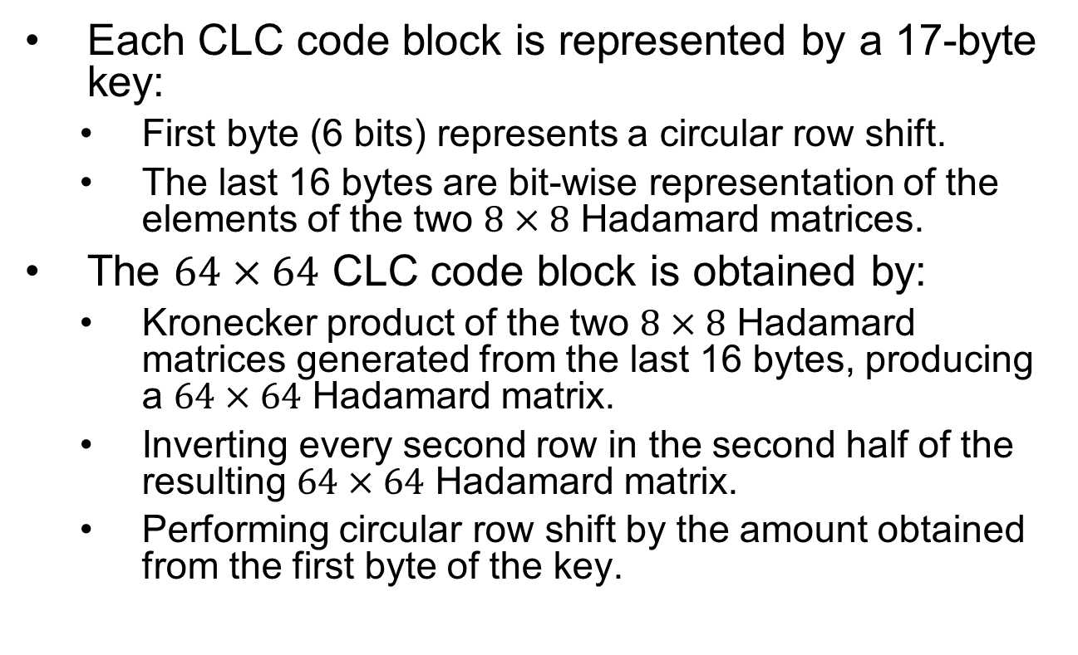
Base CLC Code Blocks Generation
Each CLC code block is represented by a 17-byte key:
  First byte (6 bits) represents a circular row shift.
  The last 16 bytes are bit-wise representation of the elements of the two $8×8$ Hadamard matrices.
The $64×64$ CLC code block is obtained by:
  Kronecker product of the two $8×8$ Hadamard matrices generated from the last 16 bytes, producing a $64×64$ Hadamard matrix.
  Inverting every second row in the second half of the resulting $64×64$ Hadamard matrix.
  Performing circular row shift by the amount obtained from the first byte of the key.

Slide 6
Possible Criteria for SZC Code Blocks Selection
When CFO estimate is perfect SZC Code Block correlation sidelobes fully complement regardless of the CFO removal location – before or after correlation.
Selection criteria can be:
  Sidelobes regrowth under non-ideal CFO estimation conditions.
  Cross-correlation performance.
  Sidelobes regrowth due to other system non-idealities such as ADC quantization noise and phase noise.

Slide 7
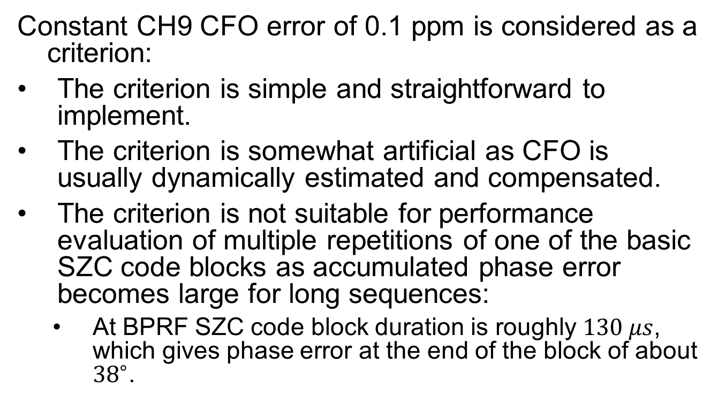
Sidelobes Regrowth under Non-ideal CFO Estimation Conditions
Constant CH9 CFO error of 0.1 ppm is considered as a criterion:
The criterion is simple and straightforward to implement.
The criterion is somewhat artificial as CFO is usually dynamically estimated and compensated.
The criterion is not suitable for performance evaluation of multiple repetitions of one of the basic SZC code blocks as accumulated phase error becomes large for long sequences:
  At BPRF SZC code block duration is roughly $130 μs$, which gives phase error at the end of the block of about ${38}^{∘}$.

Slide 8
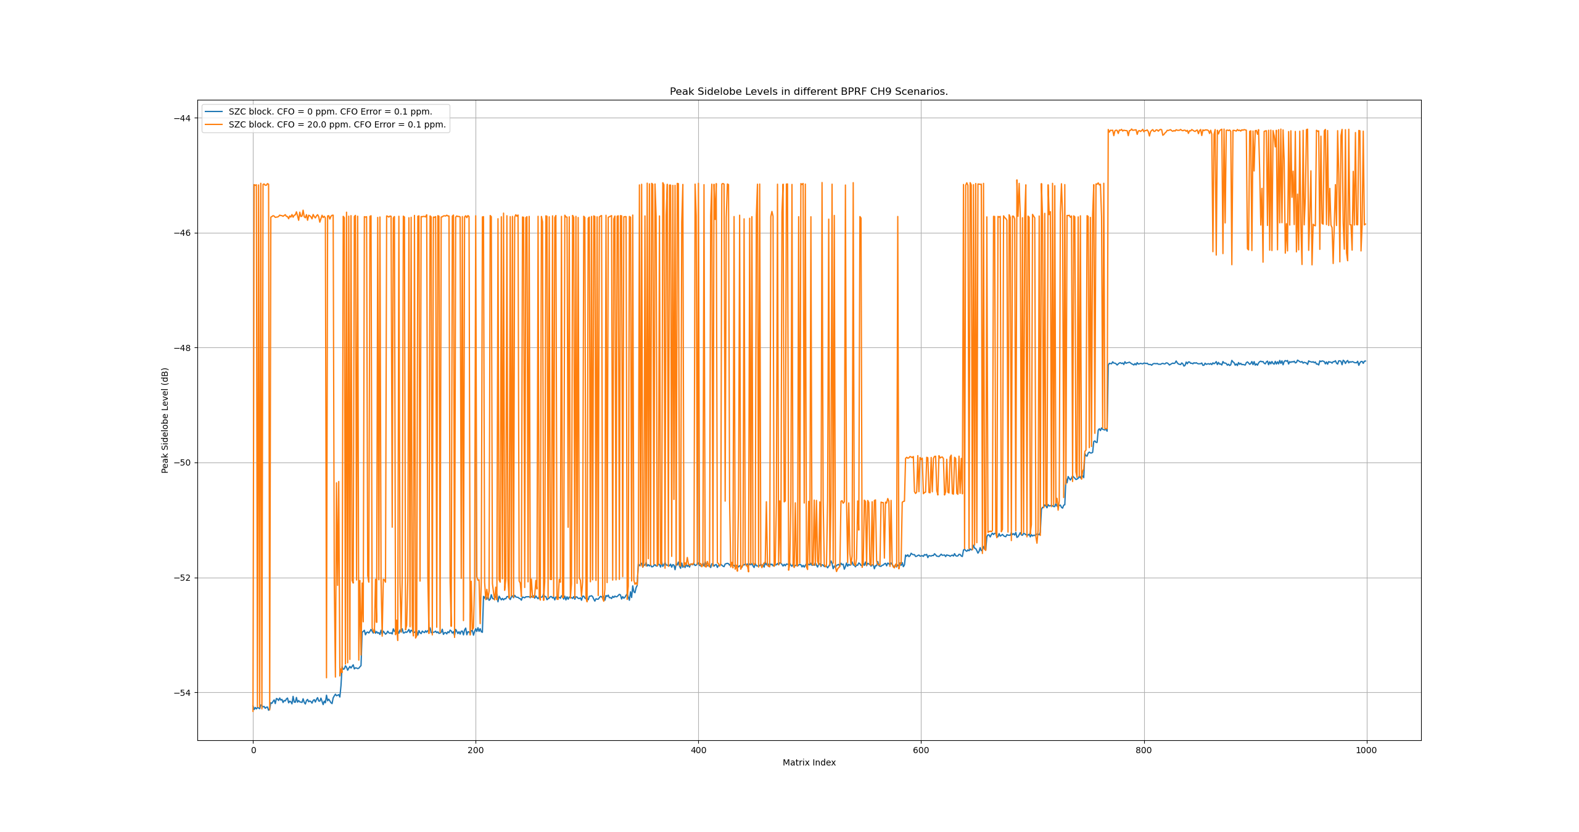
Sidelobes Regrowth for CH9 CFO Error of 0.1 ppm and CH9 CFO of 0 ppm and 20 ppm

Slide 9
Python Code for CLC / SZC Code Blocks Generation and CIR Estimation
CLC code blocks:
  The hex generation keys are given in ‘had_codes_rls_srt.txt’ file.
  They are generated by ‘load_hex_had64’ function of ‘had_utils.py’ module.
SZC codes are generated and used for CIR estimation in ‘szc_matrices_optimization.py’ script, producing the figure on the previous slide.
The Python code is available in Rev 0 of this document. Removed due to a request.

Slide 10
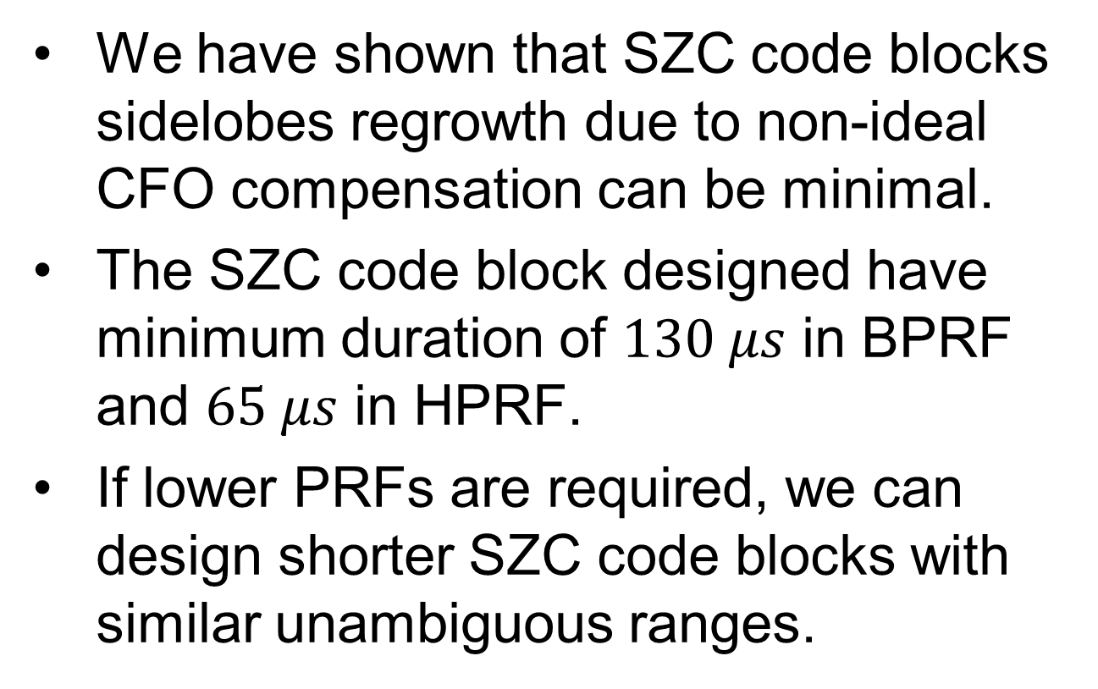
Conclusion
We have shown that SZC code blocks sidelobes regrowth due to non-ideal CFO compensation can be minimal.
The SZC code block designed have minimum duration of $130 μs$ in BPRF and $65 μs$ in HPRF.
If lower PRFs are required, we can design shorter SZC code blocks with similar unambiguous ranges.

