Slide 1
Project: IEEE P802.15 Working Group for Wireless Personal Area Networks (WPANs)
Submission Title: [4ab Channelization Discussion - Continuation]
Source: [Claudio da Silva, Carlos Aldana, Kangjin Yoon, and Chunyu Hu]
Address : []
E-Mail: [{claudiodasilva,caldana,kyoon,chunyuhu}@fb.com]
Re: [Input to TG4ab]
Abstract: [Definition of additional channels to support potential UWB band extension.]
Purpose: [Discuss potential channel plans that take advantage of a potential extension of the UWB band beyond 10.6 GHz in certain regulatory domains.]
Notice: This document has been prepared to assist the IEEE P802.15. It is offered as a basis for discussion and is not binding on the contributing individual(s) or organization(s). The material in this document is subject to change in form and content after further study. The contributor(s) reserve(s) the right to add, amend or withdraw material contained herein.
Release: The contributor acknowledges and accepts that this contribution becomes the property of IEEE and may be made publicly available by P802.15.
Notes:
Jul 12, 2010
Page 1

Slide 2
Technical Guidance
PAR Objective | Proposed Solution (how addressed)
Safeguards so that the HDR use cases will not cause disruption to low duty-cycle ranging use cases.
Interference mitigation techniques to support higher density and higher traffic use cases
Other coexistence improvement
Backward compatibility with enhanced ranging capable devices (ERDEVs).
Improved link budget and/or reduced air-time
Additional channels and operating frequencies | Channelization to support potential UWB band extension
Improvements to accuracy / precision / reliability and interoperability for high-integrity ranging;
Reduce complexity and power consumption;
Hybrid operation with narrowband signaling to assist UWB;
Enhanced native discovery and connection setup mechanisms;
Sensing capabilities to support presence detection and environment mapping;
Low-power low-latency streaming
higher data-rate streaming allowing at least 50 Mbit/s of throughput.
Support for peer-to-peer, peer-to-multi-peer, and station-to-infrastructure protocols;
Infrastructure synchronization mechanisms.

Slide 3
Background
In our previous contribution [1], we discussed the fact that a potential extension of the UWB band beyond 10.6 GHz has been discussed in various organizations.
  For example, ETSI is currently working on an SRDoc (TR 103 750) that considers “(t)echnical characteristics for UWB operation in the frequency band between 8.5 GHz to 10.6 GHz and 10.7 GHz to 12.4 GHz” for various use cases.
For this reason, we suggested in [1] defining “additional channels and operating frequencies” in the 4ab amendment so that 4ab devices may be able to use frequencies above 10.6 GHz.
Notes:
  Implementations of the standard are limited by applicable regulatory requirements.
  Support to most channels defined for HRP/LRP UWB PHYs is optional.
Slide 3

Slide 4
Notes
Based on feedback received, the channel plans discussed in this contribution are for 499.2 MHz channels.
Some interest in possibly also defining overlapping channels and potentially wider channels.
  In this contribution, our main goal is to discuss “baseline” 499.2 MHz channels.
  Overlapping channels are also considered.
The end frequency of the potential band extension is unclear. Different values, such as 12.4, 12.7 and 13.2 GHz, are considered.
  We consider channelization up to 13.2 GHz, but recognize that it may be appropriate to consider a lower end frequency in the draft amendment.
Slide 4

Slide 5
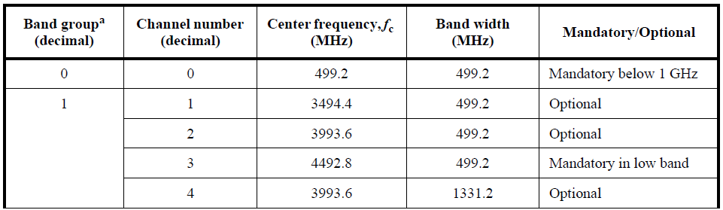
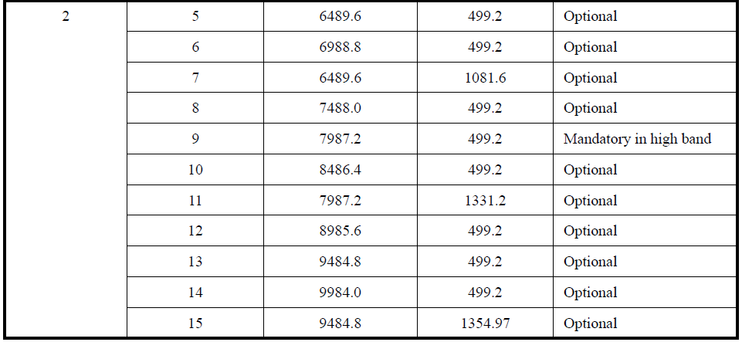
Technical Background 1/2
Center frequencies of all channels are integer multiples of 499.2 MHz
Slide 5

Slide 6
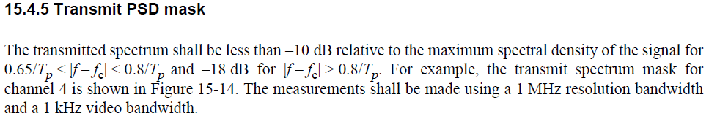
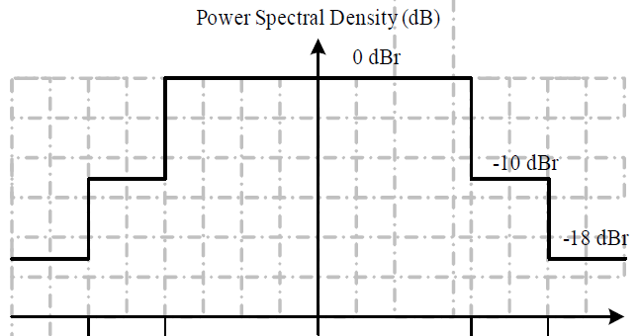
Technical Background 2/2
325 MHz < |f - fc| < 400 MHz
(for 499.2 MHz)
|f - fc| > 400 MHz
(for 499.2 MHz)
fc
fc + 325 MHz
fc + 400 MHz
Slide 6

Slide 7
Band Allocation – Option 1
Channel number | Centre frequency (MHz) | Channel start frequency (MHz) | Channel end frequency (MHz) | Notes
… |  |  |  | Channels currently defined in the IEEE 802.15 standard
13 | 9,484.8 | 9,235.2 | 9,734.4
14 | 9,984.0 | 9,734.4 | 10,233.6
N1 | 10,483.2 | 10,233.6 | 10,732.8 | Option 1: 499.2 MHz channels. Advantage: Ease of implementation. Problem: Transmission in the passive sensing band (10.6-10.7 GHz) will be prohibited in most, if not all, regulatory domains. Solution: Channel N1 would have to be skipped. Even if this is the case, the start frequency of N2 would be too close to 10,700 GHz, resulting in stringent implementation requirements.
N2 | 10,982.4 | 10,732.8 | 11,232.0
N3 | 11,481.6 | 11,232.0 | 11,731.2
N4 | 11,980.8 | 11,731.2 | 12,230.4
N5 | 12,480.0 | 12,230.4 | 12,729.6
Slide 7

Slide 8
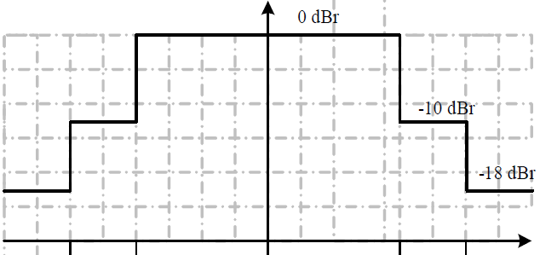
Band Allocation – Option 1
10,657.4
10,982.4
10,582.4
Considerations
  Channel N1 overlaps passive band
  Channel N2 may be too close to the passive band (0 dBr region in the transmit PSD mask partially overlaps the passive band). In practice, channel N2 may not be usable.
If the band is extended to 12.4 GHz or 12.7 GHz, only 2 499.2 MHz channels could be considered to be usable (channels N3 and N4). For 13.2 GHz, 3 channels could be useful.
Slide 8

Slide 9
Band Allocation – Option 2
Breaking from “multiple of 499.2 MHz” center frequency allocation may lead to better spectrum utilization.
Infinite number of solutions exist. Below is an example of what could be achieved if a gap of 1.25x499.2 MHz is introduced to protect passive band.
Channel number | Centre frequency (MHz) | Channel start frequency (MHz) | Channel end frequency (MHz) | Notes
… |  |  |  | Channels currently defined in the IEEE 802.15 standard
14 | 9,984.0 | 9,734.4 | 10,233.6
N1 | 11,107.2 | 10,857.6 | 11,356.8 | Option 2: 1.25x499.2 MHz gap is introduced to protect passive band Problem: Breaking from “multiple of 499.2 MHz” center frequencies increases implementation complexity Advantages: Protection passive band 3 499.2 MHz channels below 12.4/12.7 GHz
N2 | 11,606.4 | 11,356.8 | 11,856.0
N3 | 12,105.6 | 11,856.0 | 12,355.2
N4 | 12,604.8 | 12,355.2 | 12,854.4
Slide 9

Slide 10
Band Allocation – Option 2
10,782.2
11,107.2
10,707.2
Center frequency of new channels are not integer multiples of 499.2 MHz; frequency separation between N1 and 14 is not 499.2 MHz (instead, is “one and a quarter” 499.2 MHz)
If the band is extended to 12.4 GHz or 12.7 GHz, 3 499.2 MHz channels would be usable (channels N1, N2, and N3). For 13.2 GHz, 4 channels would be usable.
Slide 10

Slide 11
Overlapping Channels
The definition/use of overlapping channels was discussed in [2]:
  “Overlap somewhere between 25-75% may be desirable
  Carrier grid spacing of 124.8 MHz allows to choose between 124.8 MHz (N+1, i.e., ~75% overlap), 249.6 MHz (N+2, i.e., ~50% overlap), and 374.4 MHz (N+3, i.e., ~25% overlap) configurations”
The definition of overlapping channels would, by definition, lead to center frequencies that are not multiple of 499.2 MHz.
Either of the two options previously considered can be extended to include overlapping channels.
  Note: Option 1 and option 2 are shifted by 124.8 MHz. Defining overlapped channels (with 124.8 MHz spacing) would “unify” both options.
Slide 11

Slide 12
Overlapping Channels
Example:
Channel number | Centre frequency (MHz) | Channel start frequency (MHz) | Channel end frequency (MHz)
5 | 11,606.4 | 11,356.8 | 11,856.0
6 | 11,731.2 | 11,481.6 | 11,980.8
7 | 11,856.0 | 11,606.4 | 12,105.6
8 | 11,980.8 | 11,731.2 | 12,230.4
9 | 12,105.6 | 11,856.0 | 12,355.2
Channel number | Centre frequency (MHz) | Channel start frequency (MHz) | Channel end frequency (MHz)
1 | 11,107.2 | 10,857.6 | 11,356.8
2 | 11,232.0 | 10,982.4 | 11,481.6
3 | 11,356.8 | 11,107.2 | 11,606.4
4 | 11,481.6 | 11,232.0 | 11,731.2
Slide 12

Slide 13
Conclusion
In this contribution, we discussed factors that impact the definition of a channel plan for frequencies beyond 10.6 GHz. Two channel plan examples were offered.
Feedback is welcome.
Slide 13

Slide 14
References
[1] 22/0330r0, 4ab Channelization Discussion, July 2022.
[2] 22/0175r0, Sensing Device, March 2022.
Slide 14

