Slide 1
Project: IEEE P802.15 Working Group for Wireless Specialty Networks (WSN)
Submission Title: TG 15.4ab Agenda and Meeting Slides
Date Submitted: Aug 22, 2022
Source: Benjamin A. Rolfe (Blind Creek Associates)
Contact:
Voice: +1 408 395 7207, E-Mail: ben.rolfe @ ieee.org
Re: Task Group 4ab: 802.15.4 UWB Next Generation
Abstract: Teleconference (WebEx) Agenda and Meeting Slides
Purpose: Emulate organization, encourage participation and make further progress
Notice: This document has been prepared to assist the IEEE P802.15. It is offered as a basis for discussion and is not binding on the contributing individual(s) or organization(s). The material in this document is subject to change in form and content after further study. The contributor(s) reserve(s) the right to add, amend or withdraw material contained herein.
Release: The contributor acknowledges and accepts that this contribution becomes the property of IEEE and may be made publicly available by P802.15.
Notes:
Jul 12, 2010
Page 1

Slide 2

Task Group 15.4ab
Next Generation UWB Amendment
Teleconference / Virtual Meeting
August 23rd, 2022

Slide 3
Task Group Rules
Discussion: Everyone present is welcome
Straw polls: Everyone present may vote
Formal motions: WG voters
  To make, second and vote
Patent policy for PAR activities applies
All the usual rules of conduct
Please identify yourself on first contact with name and affiliation

Slide 4
IEEE-SA Patent, Copyright, and Participation Policies
See: https://grouper.ieee.org/groups/802/sapolicies.shtml
IEEE-SA Patent Slides for Standards Development Meetings (.pdf)
https://development.standards.ieee.org/myproject/Public/mytools/mob/slideset.pdf
IEEE-SA Standards Board Patent Committee (PatCom) home page
https://standards.ieee.org/content/ieee-standards/en/about/sasb/patcom/index.html
IEEE-SA Participation Policy meeting slide set - individual method (.pdf)
https://standards.ieee.org/content/dam/ieee-standards/standards/web/documents/other/Participant-Behavior-Individual-Method.pdf
Working Group Copyright Materials
https://standards.ieee.org/ipr/copyright-materials.html
https://standards.ieee.org/content/dam/ieee-standards/standards/web/documents/other/ieee-sa-copyright-policy-2019.pdf

Slide 5
IEEE 802 Ground Rules
Respect … give it, get it
NO product pitches
NO corporate pitches
NO prices
NO restrictive notices – (no confidentially notices in email)
Presentations must be openly available

Slide 6
Proposed Agenda
Opening and meeting preamble
Recap and Reminders
Technical discussions
  Preamble evaluation framework
Progressing to drafting
  Status for convergence
  Review September plan
Next steps
Any other Business

Slide 7
Recap

Slide 8
5.2.b Scope of the project (As approved):
This amendment enhances the Ultra Wideband (UWB) physical layers (PHYs) medium access control (MAC), and associated ranging techniques while retaining backward compatibility with enhanced ranging capable devices (ERDEVs).
Areas of enhancement include:
  additional coding, preamble and modulation schemes to additional coding, preamble and modulation schemes to support improved link budget and/or reduced air-time relative to IEEE Std 802.15.4 UWB;
  additional channels and operating frequencies;
  interference mitigation techniques to support greater device density and higher traffic use cases relative to the IEEE Std 802.15.4 UWB;
  improvements to accuracy, precision and reliability and interoperability for high-integrity ranging; schemes to reduce complexity and power consumption;
  definitions for tightly coupled hybrid operation with narrowband signaling to assist UWB;
  enhanced native discovery and connection setup mechanisms;
  sensing capabilities to support presence detection and environment mapping;
  and mechanisms supporting low-power low-latency streaming as well as high data-rate streaming allowing at least 50 Mb/s of throughput.
Support for peer-to-peer, peer-to-multi-peer, and station-to-infrastructure protocols are in scope, as are infrastructure synchronization mechanisms. This amendment includes safeguards so that the high throughput data use cases do not cause significant disruption to low duty-cycle ranging use cases.
https://development.standards.ieee.org/myproject-web/app#viewpar/9081

Slide 9
Project Schedule (working baseline)
Proposed project schedule | Nov-21 | Dec-21 | Jan-22 | Feb-22 | Mar-22 | Apr-22 | May-22 | Jun-22 | Jul-22 | Aug-22 | Sep-22 | Oct-22 | Nov-22 | Dec-22 | Jan-23 | Feb-23 | Mar-23 | Apr-23 | May-23 | Jun-23 | Jul-23 | Aug-23 | Sep-23 | Oct-23 | Nov-23 | Dec-23 | Jan-24 | Feb-24 | Mar-24 | Apr-24 | May-24 | Jun-24 | Jul-24 | Aug-24 | Sep-24 | Oct-24 | Nov-24
Call for proposals
Hear and evaluate proposals
Cut-off for new proposals, PHY
Cut-off for new proposals, MAC
Integrate poposals/contributions into TFD
Develop draft from TFD
Draft 0
TG draft review and revision
Working group pre-ballot review
Pre-ballot review and comment resolution
First letter ballot |  |  |  |  |  |  |  |  |  |  |  |  |  |  |  |  | LB
LB Comment Resolution
WG Recirculatoin |  |  |  |  |  |  |  |  |  |  |  |  |  |  |  |  |  |  |  |  | LB-R
Comment resolution, 1st recirc
Conditional approval for SA ballot
WG Recirculatoin |  |  |  |  |  |  |  |  |  |  |  |  |  |  |  |  |  |  |  |  |  |  | LB-R
Comment resolution, 2nd recirc and final recirc
First SA ballot |  |  |  |  |  |  |  |  |  |  |  |  |  |  |  |  |  |  |  |  |  |  |  |  | SA
Comment resolution, first SA ballot
SA Resirculation |  |  |  |  |  |  |  |  |  |  |  |  |  |  |  |  |  |  |  |  |  |  |  |  |  |  |  | SA-R
Comment resolution, SA recirculation
SA Resirculation |  |  |  |  |  |  |  |  |  |  |  |  |  |  |  |  |  |  |  |  |  |  |  |  |  |  |  |  |  |  | SA-R
Comment resolution, 2nd SA recirc
Conditional or unconditional approval to RevCom |  |  |  |  |  |  |  |  |  |  |  |  |  |  |  |  |  |  |  |  |  |  |  |  |  |  |  |  | ?? |  |  |  | ??
Optional 3rd SA recirc if needed |  |  |  |  |  |  |  |  |  |  |  |  |  |  |  |  |  |  |  |  |  |  |  |  |  |  |  |  |  |  |  |  | SA-R
RevCom meets |  |  |  |  |  |  |  |  |  |  |  |  |  |  |  |  |  |  |  |  |  |  |  |  |  |  |  |  |  |  |  |  |  | ` |  |  |  | `
You are Here >
Notes: SASB/RevCom schdule for 2024 a guess

Slide 10
Schedule Major Milestones
Near Term Working Milestones
Call for proposals | November 2021
Cut-off for new features (high level feature set), PHY | May 2022
Cut-off for new features (high level feature set), MAC | July 2022
Draft 0 | September 2022
TG draft review and revision complete | November 2022
Working group pre-ballot review complete | January 2022 (before meeting)
First letter ballot | March 2023 (following meeting)
…
Progress as of Aug 23:
We have most of the PHY features identified
Multiple proposals in some areas, with collaborative convergence underway
Identified gaps being worked (probably more to be found)
Two more telecons before September Interim (after today)

Slide 11
Goals for Draft 0
Integration of TFD contributions
Support task group review:
  Identify gaps and work towards a technically complete draft 1
  Identify remaining areas for convergence
  Support convergence through collaboration or formal selection
Result becomes Draft 1, technically complete draft ready for WG review

Slide 12
Draft Steps: Pre-ballot
TG Review:
  Complete the draft
  Result: technically complete Draft 1
Informal WG comment collections
  Submit for review by full WG
  Collect and resolve comments
  Finds additional gaps and potential issues
  No votes
  Result: Draft ready for WG Letter Ballot

Slide 13
Draft Steps: Ballots
WG Letter Ballot (LB)
  WG voters (broader than the TG)
  Draft available to all 802 WGs and each WG chair can cast a vote and submit comments
  Collect and resolve comments, Revise and recirculate draft
  Result: Draft ready for SA Ballot
  Requires: < 75% approval and no new disapprove votes with technical comments
Sponsor Association (SA) ballot
  Open to any SA member that joins
  Broader than 802 participation
  Collect and resolve comments, revise and recirculate draft
  Same general threshold for “done”: >75%, no new disapprove, no outstanding technical comments

Slide 14

Technical Discussion

Slide 15

Next Steps

Slide 16
A map of the P802.15.4ab enhancements

Slide 17
Volunteer List
So Far (more expected):
Narrow band assist and improved ranging:
Xiliang Luo, Jonathan Segev, David B., Boris
Sensing
Xiaohui Peng, Pooria Pakrooh
MAC scheduling
Kangin Yoon, Kuan Wu
DL-TDoA:
Zhenzhen Ye, Jean-Marie
Channel access MAC and PHY:
Alex Krebs, Frederic Nabki
Data com improvements
Bin Qian, Frederic Nabki, Carlos Aldana

Slide 18

Planning for September

Slide 19
 |  |  |  |  |  |  | Sept 2022 Wireless Plenary
 |  |  |  | Mtg. Local Time | SUNDAY |  | MONDAY |  |  |  | TUESDAY |  |  |  | WEDNESDAY |  |  |  | THURSDAY
 |  |  |  | Hawaiian | 11-Sep-2022 |  | 12-Sep-2022 |  |  |  | 13-Sep-2022 |  |  |  | 14-Sep-2022 |  |  |  | 15-Sep-2022
EDT | PDT | UTC | JST |  | Virtual Rm 1 |  | Virtual Rm 1 | Virtual Rm 2 | Virtual Rm 3 | Virtual Rm 4 | Virtual Rm 1 | Virtual Rm 2 | Virtual Rm 3 | Virtual Rm 4 | Virtual Rm 1 | Virtual Rm 2 | Virtual Rm 3 | Virtual Rm 4 | Virtual Rm 1 | Virtual Rm 2 | Virtual Rm 3 | Virtual Rm 4
13:00 | 10:00 | 17:00 | 2:00 | 07:00-07:30 |  |  | CONTINENTAL BREAKFAST |  |  |  | CONTINENTAL BREAKFAST |  |  |  | CONTINENTAL BREAKFAST |  |  |  | CONTINENTAL BREAKFAST
13:30 | 10:30 | 17:30 | 2:30 | 07:30-08:00 |  |  |  |  |  |  |  |  |  |  | 802.15 AC MEETING Rm 3
14:00 | 11:00 | 18:00 | 3:00 | 08:00-08:30 |  |  | JOINT WIRELESS OPENING |  |  |  | TG4ab NG-UWB
14:30 | 11:30 | 18:30 | 3:30 | 08:30-09:00 |  |  |  |  |  |  |  |  |  |  | TG4ab NG-UWB
15:00 | 12:00 | 19:00 | 4:00 | 09:00-09:30 |  |  | 802.15 WG Opening Plenary Rm 1
15:30 | 12:30 | 19:30 | 4:30 | 09:30-10:00
16:00 | 13:00 | 20:00 | 5:00 | 10:00-10:30 |  |  | Break |  |  |  | Break |  |  |  | Break |  |  |  | Break
16:30 | 13:30 | 20:30 | 5:30 | 10:30-11:00 |  |  | TG4 Cor1 |  |  | TG3ma HDR | SC Main_Rules Rm 1 |  |  |  | 802.15 WG Midweek Plenary Rm 1 |  |  |  | TG4ab NG-UWB |  |  | SC IETF
17:00 | 14:00 | 21:00 | 6:00 | 11:00-11:30 |  |  | TG4me
17:30 | 14:30 | 21:30 | 6:30 | 11:30-12:00 |  |  |  |  |  |  | 802.15/802.1 Joint Mtg Rm 1 |  |  |  | SC WNG Rm 1
18:00 | 15:00 | 22:00 | 7:00 | 12:00-12:30
18:30 | 15:30 | 22:30 | 7:30 | 12:30-13:00 |  |  | LUNCH |  |  |  | LUNCH |  |  |  | LUNCH |  |  |  | LUNCH
19:00 | 16:00 | 23:00 | 8:00 | 13:00-13:30
19:30 | 16:30 | 23:30 | 8:30 | 13:30-14:00 |  |  | TG4ab NG-UWB |  |  | TG13 OWC | TG4ab NG-UWB |  | TG16t LicNB | TG13 OWC | TG4ab NG-UWB |  | TG16t LicNB | TG13 OWC | TG4ab NG-UWB | TG7a OCC | TG16t LicNB | TG13 OWC
20:00 | 17:00 | 0:00 | 9:00 | 14:00-14:30
20:30 | 17:30 | 0:30 | 9:30 | 14:30-15:00
21:00 | 18:00 | 1:00 | 10:00 | 15:00-15:30
21:30 | 18:30 | 1:30 | 10:30 | 15:30-16:00 |  |  | Break |  |  |  | Break |  |  |  | Break |  |  |  | Break
22:00 | 19:00 | 2:00 | 11:00 | 16:00-16:30 | WIRELESS CHAIRS MEETING |  | TG4ab NG-UWB |  | TG7a OCC | TG6ma BAN/ VAN | TG4me |  |  | TG6ma BAN/ VAN | TG4me |  | TG7a OCC | TG6ma BAN/ VAN | 802.15 WG Closing Plenary Rm 1
22:30 | 19:30 | 2:30 | 11:30 | 16:30-17:00
23:00 | 20:00 | 3:00 | 12:00 | 17:00-17:30
23:30 | 20:30 | 3:30 | 12:30 | 17:30-18:00 | 802.15 AC MEETING Rm 3
0:00 | 21:00 | 4:00 | 13:00 | 18:00-18:30 |  |  | Break |  |  |  | Break |  |  |  | Break |  |  |  | Break

Slide 20
Telecon Schedule
August '22
S | M | T | W | T | F | S
 | 1 | 2 | 3 | 4 | 5 | 6
7 | 8 | 9 | 10 | 11 | 12 | 13
14 | 15 | 16 | 17 | 18 | 19 | 20
21 | 22 | 23 | 24 | 25 | 26 | 27
28 | 29 | 30 | 31
Sept '22
S | M | T | W | T | F | S
 |  |  |  | 1 | 2 | 3
4 | 5 | 6 | 7 | 8 | 9 | 10
11 | 12 | 13 | 14 | 15 | 16 | 17
18 | 19 | 20 | 21 | 22 | 23 | 24
25 | 26 | 27 | 28 | 29 | 30

Slide 21
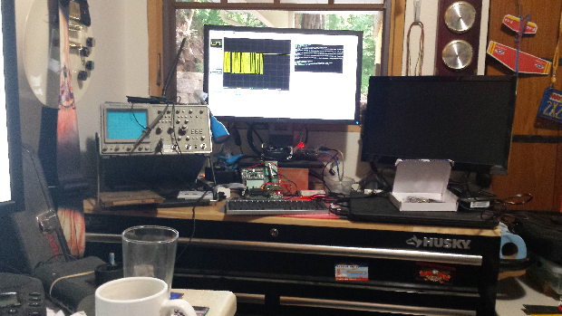
Other Business

Slide 22
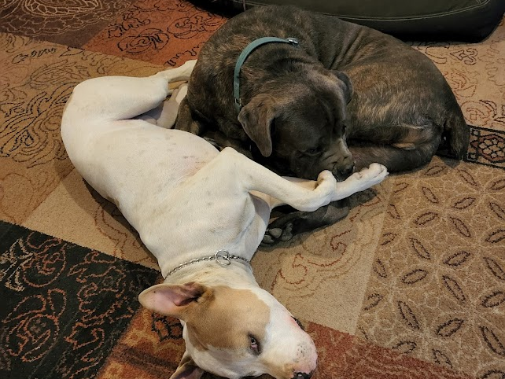
Adjourned
Thanks

