Slide 1
Project: IEEE P802.15 Working Group for Wireless Speciality Networks (WSN)
Submission Title: AWGN Simulation Results for new MCS
Date Submitted: 22 July 2022
Source: Christoph Herold, TU Braunschweig
Address Schleinitzstr. 22, D-38092 Braunschweig, Germany
Voice:+495313912410, FAX: +495313915192, E-Mail: herold@ifn.ing.tu-bs.de
Re: n/a
Abstract: This document describes a simulation study on the performance of the new proposed MCS in an AWGN channel.
Purpose: Input to TG3ma
Notice: This document has been prepared to assist the IEEE P802.15. It is offered as a basis for discussion and is not binding on the contributing individual(s) or organization(s). The material in this document is subject to change in form and content after further study. The contributor(s) reserve(s) the right to add, amend or withdraw material contained herein.
Release: The contributor acknowledges and accepts that this contribution becomes the property of IEEE and may be made publicly available by P802.15.

Slide 2
AWGN Simulation Results for New Modulation and Coding Schemes
Christoph Herold
TU Braunschweig

Slide 3
Outline
Scenario Overview
MCS Performance
Implication to Link Budget

Slide 4
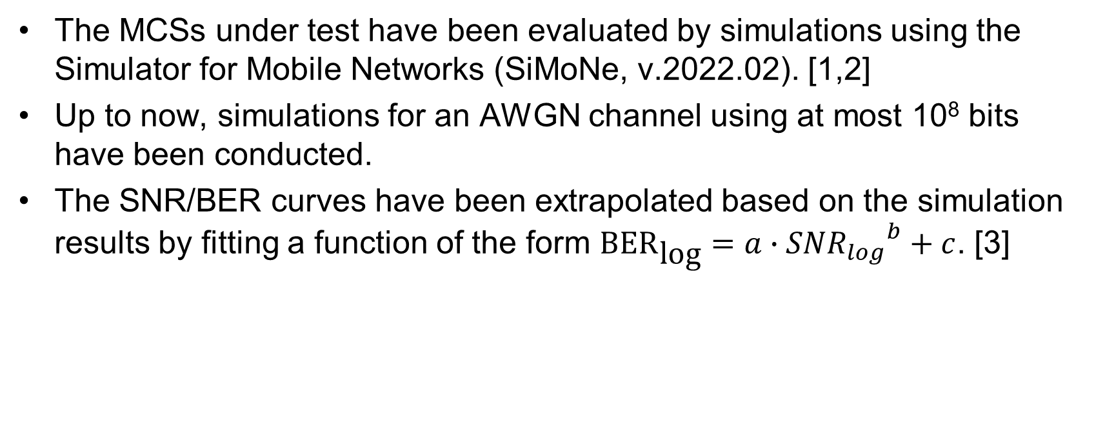
Scenario Overview
The MCSs under test have been evaluated by simulations using the Simulator for Mobile Networks (SiMoNe, v.2022.02). [1,2]
Up to now, simulations for an AWGN channel using at most 10⁸ bits have been conducted.
The SNR/BER curves have been extrapolated based on the simulation results by fitting a function of the form ${\text{BER}}_{\text{log}}=a∙{{SNR}_{log}}^{b}+c$. [3]

Slide 5
Scenario Overview
The following modulation schemes have been simulated:
  On/Off-Keying
  BPSK
  QPSK
  8-PSK
  8-APSK
  16-QAM
  64-QAM
  Two Ring – 16 APSK [4]
  Two Ring – 32 APSK [4]
  Three Ring – 32 APSK [4]
The following forward error correction types have been simulated:
  Rate 11/15 LDPC(1440,1056)
  Rate 14/15 LDPC(1440,1344)

Slide 6
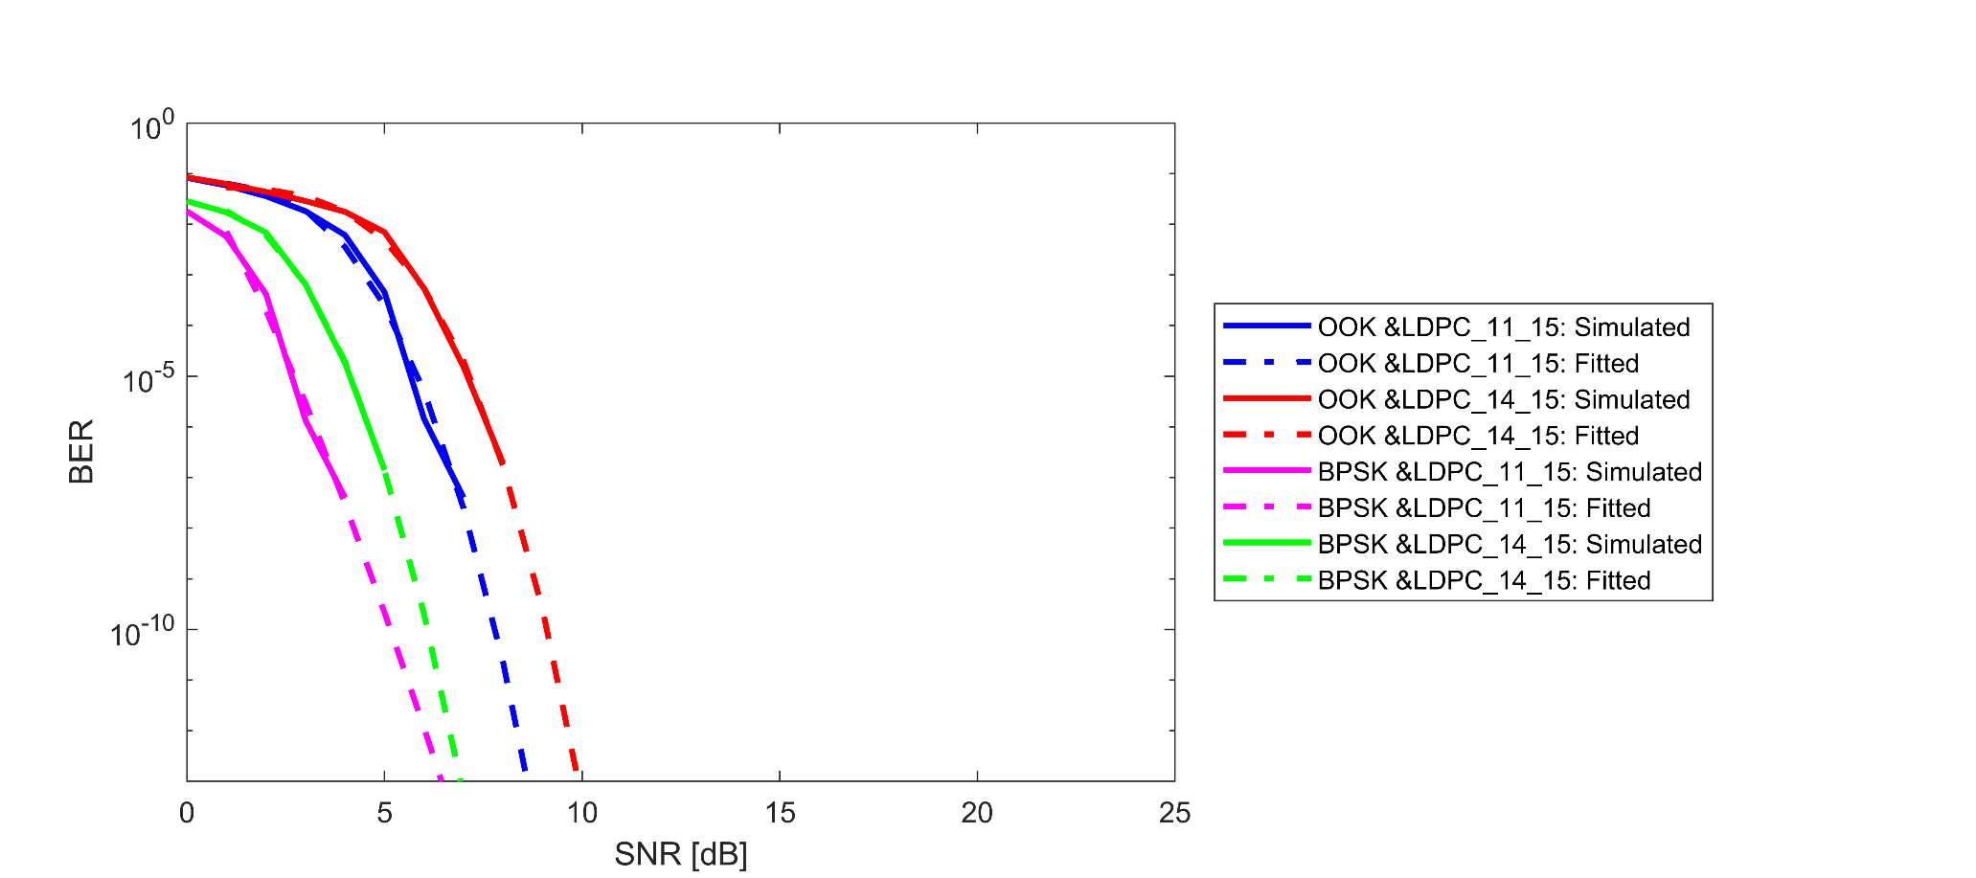
Simulation Results – OOK & BPSK

Slide 7
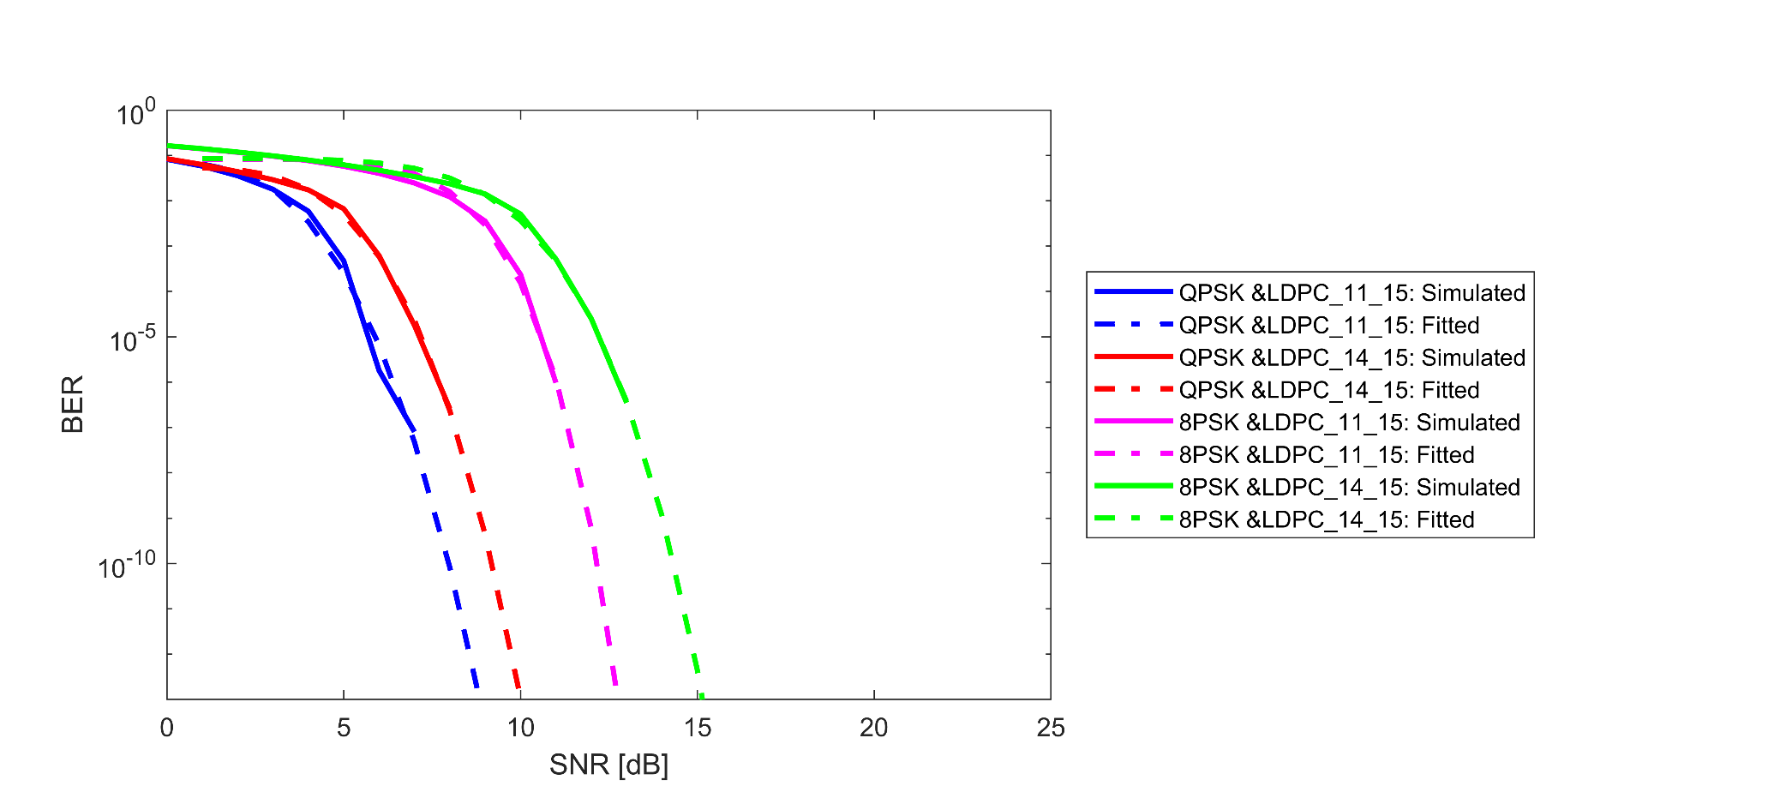
Simulation Results – QPSK & 8PSK

Slide 8
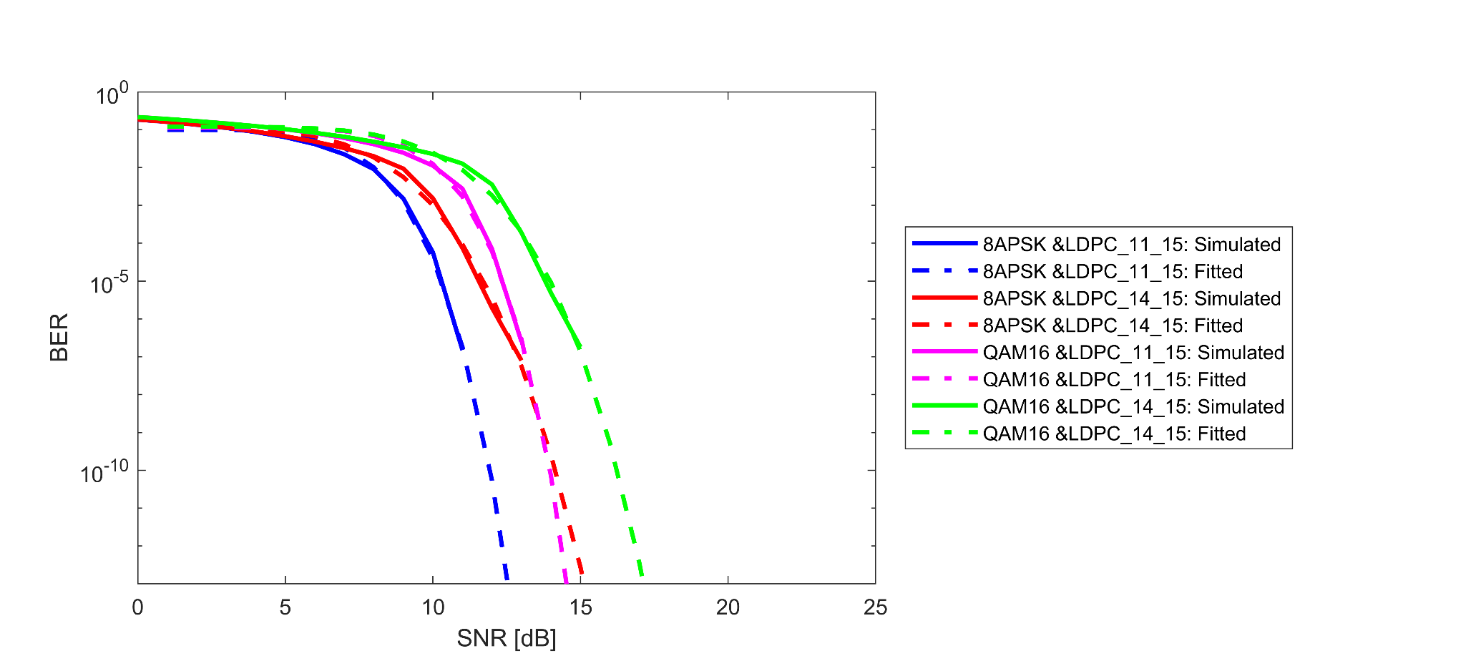
Simulation Results – 8APSK & QAM16

Slide 9
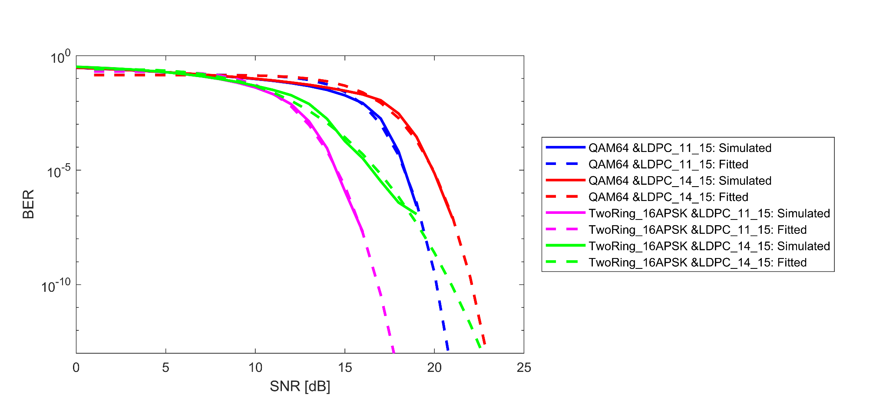
Simulation Results – QAM64 & Two Ring – 16 APSK

Slide 10
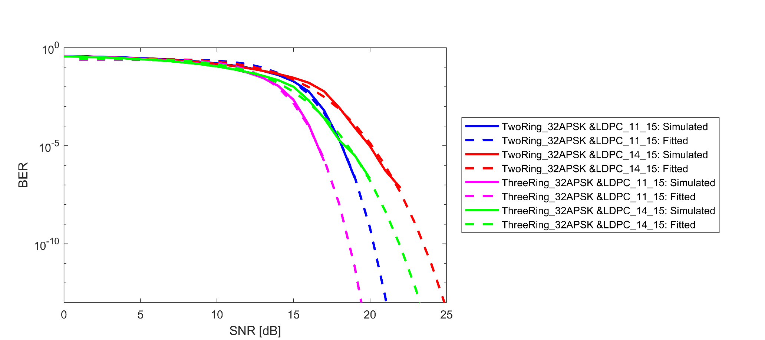
Simulation Results – Two Ring 32 APSK & Three Ring 32 APSK

Slide 11
Implication to Link Budget
Modulation | Codec | Required SNR for BER of 10^-12 (SiMoNe, AWGN) | Required SNR for BER of 10^-12 (Previous, AWGN) [3]
OOK | 11/15 LDPC | 8.38 dB | 5.95 dB
OOK | 14/15 LDPC | 9.67 dB | 9.51 dB
BPSK | 11/15 LDPC | 6.02 dB | 3.10 dB
BPSK | 14/15 LDPC | 6.67 dB | 6.42 dB
QPSK | 11/15 LDPC | 8.58 dB | 6.07 dB
QPSK | 14/15 LDPC | 9.76 dB | 9.48 dB
8PSK | 11/15 LDPC | 12.60 dB | 10.98 dB
8PSK | 14/15 LDPC | 14.91 dB | 14.46 dB
8APSK | 11/15 LDPC | 12.38 dB | 10.98 dB
8APSK | 14/15 LDPC | 14.82 dB | 14.44 dB

Slide 12
Implication to Link Budget
Modulation | Codec | Required SNR for BER of 10^-12 (SiMoNe, AWGN) | Required SNR for BER of 10^-12 (Previous, AWGN) [3]
16QAM | 11/15 LDPC | 14.39 dB | 13.00 dB
16QAM | 14/15 LDPC | 16.87 dB | 16.43 dB
64QAM | 11/15 LDPC | 20.61 dB | 18.11 dB
64QAM | 14/15 LDPC | 22.67 dB | 22.37 dB
Two Ring – 16 APSK | 11/15 LDPC | 17.48 dB | -
Two Ring – 16 APSK | 14/15 LDPC | 22.15 dB | -
Two Ring – 32 APSK | 11/15 LDPC | 20.82 dB | -
Two Ring – 32 APSK | 14/15 LDPC | 24.49 dB | -
Three Ring – 32 APSK | 11/15 LDPC | 19.22 dB | -
Three Ring – 32 APSK | 14/15 LDPC | 22.86 dB | -

Slide 13
Conclusions from Simulation Results
A deviation between past and present simulation results for required SNR_{log} values can be observed.
  Especially the LDPC 11/15 forward error correction schemes perform up to 3 dB worse which might be caused by algorithmic differences

Slide 14
References
[1] Simulator for Mobile Networks. https://www.tu-braunschweig.de/ifn/forschung/neueste-forschung-der-abteilung-mobilfunksysteme/simulator-for-mobile-networks-simone
[2] Eckhardt, J. M., Herold, C., Jung, B. K., Dreyer, N., & Kürner, T. (2022). Modular link level simulator for the physical layer of beyond 5G wireless communication systems. Radio Science, 57, e2021RS007395. https://doi.org/10.1029/2021RS007395
[3] Fricke A., Peng, B., Kürner, T. Preliminary Performacne of FEC Schemes in TG3d Channels. https://mentor.ieee.org/802.15/dcn/16/15-16-0746-07-003d-preliminary-performance-of-fec-schemes-in-tg3d-channels.pdf
[4] Bodet, D., & Jornet J.. Higher Order APSK Constellations Implementation - Required Edits. https://mentor.ieee.org/802.15/dcn/22/15-22-0227-00-03ma-higher-order-apsk-constellations-implementation-required-edits.pdf

