Slide 1
Project: IEEE P802.15 Working Group for Wireless Specialty Networks (WSN)
Submission Title: TG4ab July 2022 Closing Report
Date Submitted: July 14, 2022
Source: Benjamin A. Rolfe (Blind Creek Associates)
Contact:
Voice: +1 408 395 7207, E-Mail: ben.rolfe @ ieee.org
Re: Task Group 4ab: UWB Next Generation for 802.15.4
Abstract: Plenary Session Slides
Purpose: Continue to progress the project
Notice: This document has been prepared to assist the IEEE P802.15. It is offered as a basis for discussion and is not binding on the contributing individual(s) or organization(s). The material in this document is subject to change in form and content after further study. The contributor(s) reserve(s) the right to add, amend or withdraw material contained herein.
Release: The contributor acknowledges and accepts that this contribution becomes the property of IEEE and may be made publicly available by P802.15.
Notes:
Jul 12, 2010
Page 1

Slide 2

Mixed Mode Plenary
July 2022
Task Group 15.4ab
Next Generation UWB Amendment
First Time for an 802 Plenary!
Live and on-line!

Slide 3
5.2.b Scope of the project (As approved):
This amendment enhances the Ultra Wideband (UWB) physical layers (PHYs) medium access control (MAC), and associated ranging techniques while retaining backward compatibility with enhanced ranging capable devices (ERDEVs).
Areas of enhancement include:
  additional coding, preamble and modulation schemes to additional coding, preamble and modulation schemes to support improved link budget and/or reduced air-time relative to IEEE Std 802.15.4 UWB;
  additional channels and operating frequencies;
  interference mitigation techniques to support greater device density and higher traffic use cases relative to the IEEE Std 802.15.4 UWB;
  improvements to accuracy, precision and reliability and interoperability for high-integrity ranging; schemes to reduce complexity and power consumption;
  definitions for tightly coupled hybrid operation with narrowband signaling to assist UWB;
  enhanced native discovery and connection setup mechanisms;
  sensing capabilities to support presence detection and environment mapping;
  and mechanisms supporting low-power low-latency streaming as well as high data-rate streaming allowing at least 50 Mb/s of throughput.
Support for peer-to-peer, peer-to-multi-peer, and station-to-infrastructure protocols are in scope, as are infrastructure synchronization mechanisms. This amendment includes safeguards so that the high throughput data use cases do not cause significant disruption to low duty-cycle ranging use cases.
https://development.standards.ieee.org/myproject-web/app#viewpar/9081

Slide 4
Task Group Organization
Chair: Benjamin Rolfe (BCA)¹
Vice Chair: Clint Powell (Meta)
Vice Chair: Clint Chaplin (SRA)
Vice Chair and Recording Secretary: David Xun Yang (Huawei)
Lead Technical Editor: Billy Verso (Qorvo)
  Thank you to all the volunteers!
¹ Affiliation Details here: https://mentor.ieee.org/802-ec/dcn/22/ec-22-0061-00-00EC-rolfe-affiliations-by-802-activity.pdf

Slide 5
July Agenda
https://mentor.ieee.org/802.15/documents?is_dcn=328&is_group=04ab
15.4ab
 | TG4ab Meeting slots
Joint
 | Joint meetings with TG4ab

Slide 6
Session Objectives
Hear technical contributions (31) develop technical content
Converge PHY proposals
Be ready to commence text submissions
Remember how to talk while in the same room!

Slide 7
Project Schedule (working baseline)
Proposed project schedule | Nov-21 | Dec-21 | Jan-22 | Feb-22 | Mar-22 | Apr-22 | May-22 | Jun-22 | Jul-22 | Aug-22 | Sep-22 | Oct-22 | Nov-22 | Dec-22 | Jan-23 | Feb-23 | Mar-23 | Apr-23 | May-23 | Jun-23 | Jul-23 | Aug-23 | Sep-23 | Oct-23 | Nov-23 | Dec-23 | Jan-24 | Feb-24 | Mar-24 | Apr-24 | May-24 | Jun-24 | Jul-24 | Aug-24 | Sep-24 | Oct-24 | Nov-24
Call for proposals
Hear and evaluate proposals
Cut-off for new proposals, PHY
Cut-off for new proposals, MAC
Integrate poposals/contributions into TFD
Develop draft from TFD
Draft 0
TG draft review and revision
Working group pre-ballot review
Pre-ballot review and comment resolution
First letter ballot |  |  |  |  |  |  |  |  |  |  |  |  |  |  |  |  | LB
LB Comment Resolution
WG Recirculatoin |  |  |  |  |  |  |  |  |  |  |  |  |  |  |  |  |  |  |  |  | LB-R
Comment resolution, 1st recirc
Conditional approval for SA ballot
WG Recirculatoin |  |  |  |  |  |  |  |  |  |  |  |  |  |  |  |  |  |  |  |  |  |  | LB-R
Comment resolution, 2nd recirc and final recirc
First SA ballot |  |  |  |  |  |  |  |  |  |  |  |  |  |  |  |  |  |  |  |  |  |  |  |  | SA
Comment resolution, first SA ballot
SA Resirculation |  |  |  |  |  |  |  |  |  |  |  |  |  |  |  |  |  |  |  |  |  |  |  |  |  |  |  | SA-R
Comment resolution, SA recirculation
SA Resirculation |  |  |  |  |  |  |  |  |  |  |  |  |  |  |  |  |  |  |  |  |  |  |  |  |  |  |  |  |  |  | SA-R
Comment resolution, 2nd SA recirc
Conditional or unconditional approval to RevCom |  |  |  |  |  |  |  |  |  |  |  |  |  |  |  |  |  |  |  |  |  |  |  |  |  |  |  |  | ?? |  |  |  | ??
Optional 3rd SA recirc if needed |  |  |  |  |  |  |  |  |  |  |  |  |  |  |  |  |  |  |  |  |  |  |  |  |  |  |  |  |  |  |  |  | SA-R
RevCom meets |  |  |  |  |  |  |  |  |  |  |  |  |  |  |  |  |  |  |  |  |  |  |  |  |  |  |  |  |  |  |  |  |  | ` |  |  |  | `
You are Here >
Notes: SASB/RevCom schdule for 2024 a guess

Slide 8
Schedule Major Milestones
Near Term Working Milestones
Call for proposals | November 2021
Cut-off for new features (high level feature set), PHY | May 2022
Cut-off for new features (high level feature set), MAC | July 2022
Draft 0 | September 2022
TG draft review and revision complete | November 2022
Working group pre-ballot review complete | January 2022 (before meeting)
First letter ballot | March 2023 (following meeting)
…

Slide 9

Next Steps

Slide 10
Interim TCs
Call frequency and phase:
Weekly on Tuesday
09:00 ET (06:00 PT)
Commencing July 26th
Objectives:
Continue technical convergence
Develop technical framework text

Slide 11

31 Technical Contributions

Slide 12
Technical Presentations This Week
Req Order | Requester | Preferences | Assigned | Topic/Title
1 | Libra | 14-July AM1 | Thursday AM1 | A Wake Up Radio Scheme for UWB.
2 | Huan-Bang | Any AM | Tuesday AM1 | To be announced
3 | Fred and Moh | Any | Monday PM2 | Non-coherent reception
4 | Fred and Moh | Any | Monday PM2 | Channel access demo
5 | Zhenzhen, et al | Any | Tuesday AM1 | DL-TDoA
6 | Jarek Niewczas | Any | Monday PM1 | To be announced
7 | Boris, David | Any | Thursday AM1 | Follow up on secure ranging
8 | Carlos | Tuesday | Tuesday AM1 | LDPC
9 | Shang-Te Yang | PT friendly and before the 802.11 WNG | Tuesday PM2 | UWB Interference Considerations
10 | Xiliang Luo et al | Any | Wednesday PM2 | Preamble sequence convergence
11 | Xiliang Luo | Any | Thursday AM2 | More details on MMS
12 | Xiliang Luo | Later in the week | Thursday AM2 | update on the NB-UWB technical framework
13 | Claudio Anliker | In person so any | Thursday AM1 | Secuirty aspects, analysis of distance boudning proposals
14 | Alexander Krebs |  | Monday PM2 | Narrowband spectrum and channel allocation
15 | Alexander Krebs |  | Monday PM2 | Narrowband channel access and interference mitigation
16 | Alexander Krebs |  | Thursday AM2 | Narrowband advertising and session discovery
17 | Mingyu LEE | Monday PM2 (30 min) | Monday PM1 | Channelization of NB Mirroring Channel
18 | YoungWans So, Mingyu LEE | Tuesday PM2 (30 min) | Tuesday PM2 | Enhancement of Ranging Block Structure
19 | Taeyoung Ha | Tuesday PM2 (30 min) | Tuesday PM2 | Text Proposal for NB Mirroring Channel
20 | YoungWans So, Mingyu LEE | Tuesday PM2 (30 min) | Tuesday PM2 | Text Proposal for Multiple Transmissions in A Ranging Slot
21 | Vinod Kristem | Might be able to sqeeze int o Xiliang's slot; PT friendly | Monday PM2 | Higher data rate and symbol structure
22 | Kangjin Yoon |  | Monday PM1 | HRP PHY Inter frame spacing
23 | Claudio da Silva |  | Monday PM2 | channelization (>10.5 GHz)
24 | Porria Pakrooh, Bin Tian | Tuesday PM2 | Tuesday PM2 | Preamble Sequence Study
25 | Porria Pakrooh, Bin Tian |  | Deferred to later | Updates on sensing TFD
26 | Rani Keren | 15 to 20 minutes | Thursday AM1 | Selecting number of fragments in MMS
27 | Chenchen Liu | 30 min | Wednesday PM2 | Considerations on sequences in 4ab
28 | Bin Qian | 15-20 minutes | Thursday PM1 | NB considerations for NBA-MMS
29 | Wei Lin | 15 minutes | Thursday PM1 | Preliminary Discussion on Possible LDPC Codes for 15.4ab
30 | Xiaohui Peng | 15 minutes | Thursday PM1 | UWB sensing pulse shape
31 | Aniruddh Rao Kabbinale |  | Thursday AM2 | co-scheduling ranging and sensing

Slide 13
Technical Presentations This Week
Doc # | Link1
359 | https://mentor.ieee.org/802.15/dcn/22/15-22-0359-01-04ab-july-2022-meeting-slides.pptx
328 | https://mentor.ieee.org/802.15/dcn/22/15-22-0328-10-04ab-july-2022-tg4ab-agenda.xlsx
368 | https://mentor.ieee.org/802.15/dcn/22/15-22-0368-00-04ab-tg4ab-conf-call-mins-may-to-jul-2022.docx
326 | https://mentor.ieee.org/802.15/dcn/22/15-22-0326-00-04ab-tg4ab-may-interim-mins.docx
369 | https://mentor.ieee.org/802.15/dcn/22/15-22-0369-00-04ab-inter-frame-spacing-for-hrp-uwb-phy.pptx
373 | https://mentor.ieee.org/802.15/dcn/22/15-22-0373-00-04ab-high-speed-data-rates-for-impulse-ultra-wideband-radio.pptx
380 | https://mentor.ieee.org/802.15/dcn/22/15-22-0380-00-04ab-more-on-supercomplementary-zero-sum-cross-correlation-szc-code-blocks.pptx
372 | https://mentor.ieee.org/802.15/dcn/22/15-22-0372-00-04ab-uwb-interference-considerations.pptx
330 | https://mentor.ieee.org/802.15/dcn/22/15-22-0330-00-04ab-4ab-channelization-discussion.pptx
358 | https://mentor.ieee.org/802.15/dcn/22/15-22-0358-00-04ab-coexistence-with-wi-fi-by-using-narrowband-mirroring-channel.pptx
339 | https://mentor.ieee.org/802.15/dcn/22/15-22-0339-00-04ab-narrowband-channel-allocation-for-nba-mms-uwb.pptx
340 | https://mentor.ieee.org/802.15/dcn/22/15-22-0340-01-04ab-narrowband-channel-access-and-interference-mitigation-for-nba-mms-uwb.pptx
383 | https://mentor.ieee.org/802.15/dcn/22/15-22-0383-00-04ab-nb-assisted-uwb-channel-access-follow-up.pptx
378 | https://mentor.ieee.org/802.15/dcn/22/15-22-0378-00-04ab-on-the-selection-of-number-of-fragments-in-mms-uwb.pptx
385 | https://mentor.ieee.org/802.15/dcn/22/15-22-0385-00-04ab-status-on-downlink-tdoa-dl-tdoa-location-service-proposals-in-802-15.pptx
391 | https://mentor.ieee.org/802.15/dcn/22/15-22-0391-01-04ab-preliminary-discussion-on-possible-ldpc-codes-for-15-4ab.pptx
357 | https://mentor.ieee.org/802.15/dcn/22/15-22-0357-01-04ab-flexible-block-structure.ppt
356 | https://mentor.ieee.org/802.15/dcn/22/15-22-0356-00-04ab-multiple-transmissions-in-a-ranging-slot.docx
386 | https://mentor.ieee.org/802.15/dcn/22/15-22-0386-00-04ab-narrow-band-mirroring-channels.docx
390 | https://mentor.ieee.org/802.15/dcn/22/15-22-0390-00-04ab-discussion-on-preamble-sequence-options-for-detection-and-channel-estimation.pptx
400 | https://mentor.ieee.org/802.15/dcn/22/15-22-0400-00-04ab-considerations-on-sequences-in-4ab.pptx
405 | https://mentor.ieee.org/802.15/dcn/22/15-22-0405-02-04ab-way-forward-on-preamble-sequences-beyond-4z-ipatov.pptx
409 | https://mentor.ieee.org/802.15/dcn/22/15-22-0409-01-04ab-non-coherent-hrp-option-for-data-communication-channel-plan-and-experiment.pptx
362 | https://mentor.ieee.org/802.15/dcn/22/15-22-0362-00-04ab-new-data-rates-and-coding.pptx
421 | https://mentor.ieee.org/802.15/dcn/22/15-22-0421-00-04ab-a-wake-up-radio-scheme-for-uwb.pptx
413 | https://mentor.ieee.org/802.15/dcn/22/15-22-0413-00-04ab-performance-analysis-of-ranging-integrity-fragment-rif-with-distance-commitment.pptx
404 | https://mentor.ieee.org/802.15/dcn/22/15-22-0404-01-04ab-co-scheduling-ranging-and-sensing.ppt
381 | https://mentor.ieee.org/802.15/dcn/22/15-22-0381-00-04ab-nba-uwb-ranging-text-proposal-for-15-4ab-tfd.docx
392 | https://mentor.ieee.org/802.15/dcn/22/15-22-0392-00-04ab-more-on-mixed-mms-for-ranging-integrity.pptx
341 | https://mentor.ieee.org/802.15/dcn/22/15-22-0341-01-04ab-nba-uwb-technical-framework-proposal-2022-july.docx
410 | https://mentor.ieee.org/802.15/dcn/22/15-22-0410-00-04ab-nba-mms-uwb-security-considerations.pptx
422 | https://mentor.ieee.org/802.15/dcn/22/15-22-0422-00-04ab-uwb-sensing-scheduling.pptx
418 | https://mentor.ieee.org/802.15/dcn/22/15-22-0418-00-04ab-sensing-pulse-shape-consideration-in-802-15-4ab.pptx
420 | https://mentor.ieee.org/802.15/dcn/22/15-22-0420-00-04ab-nb-considerations-for-nba-mms-uwb.pptx

Slide 14
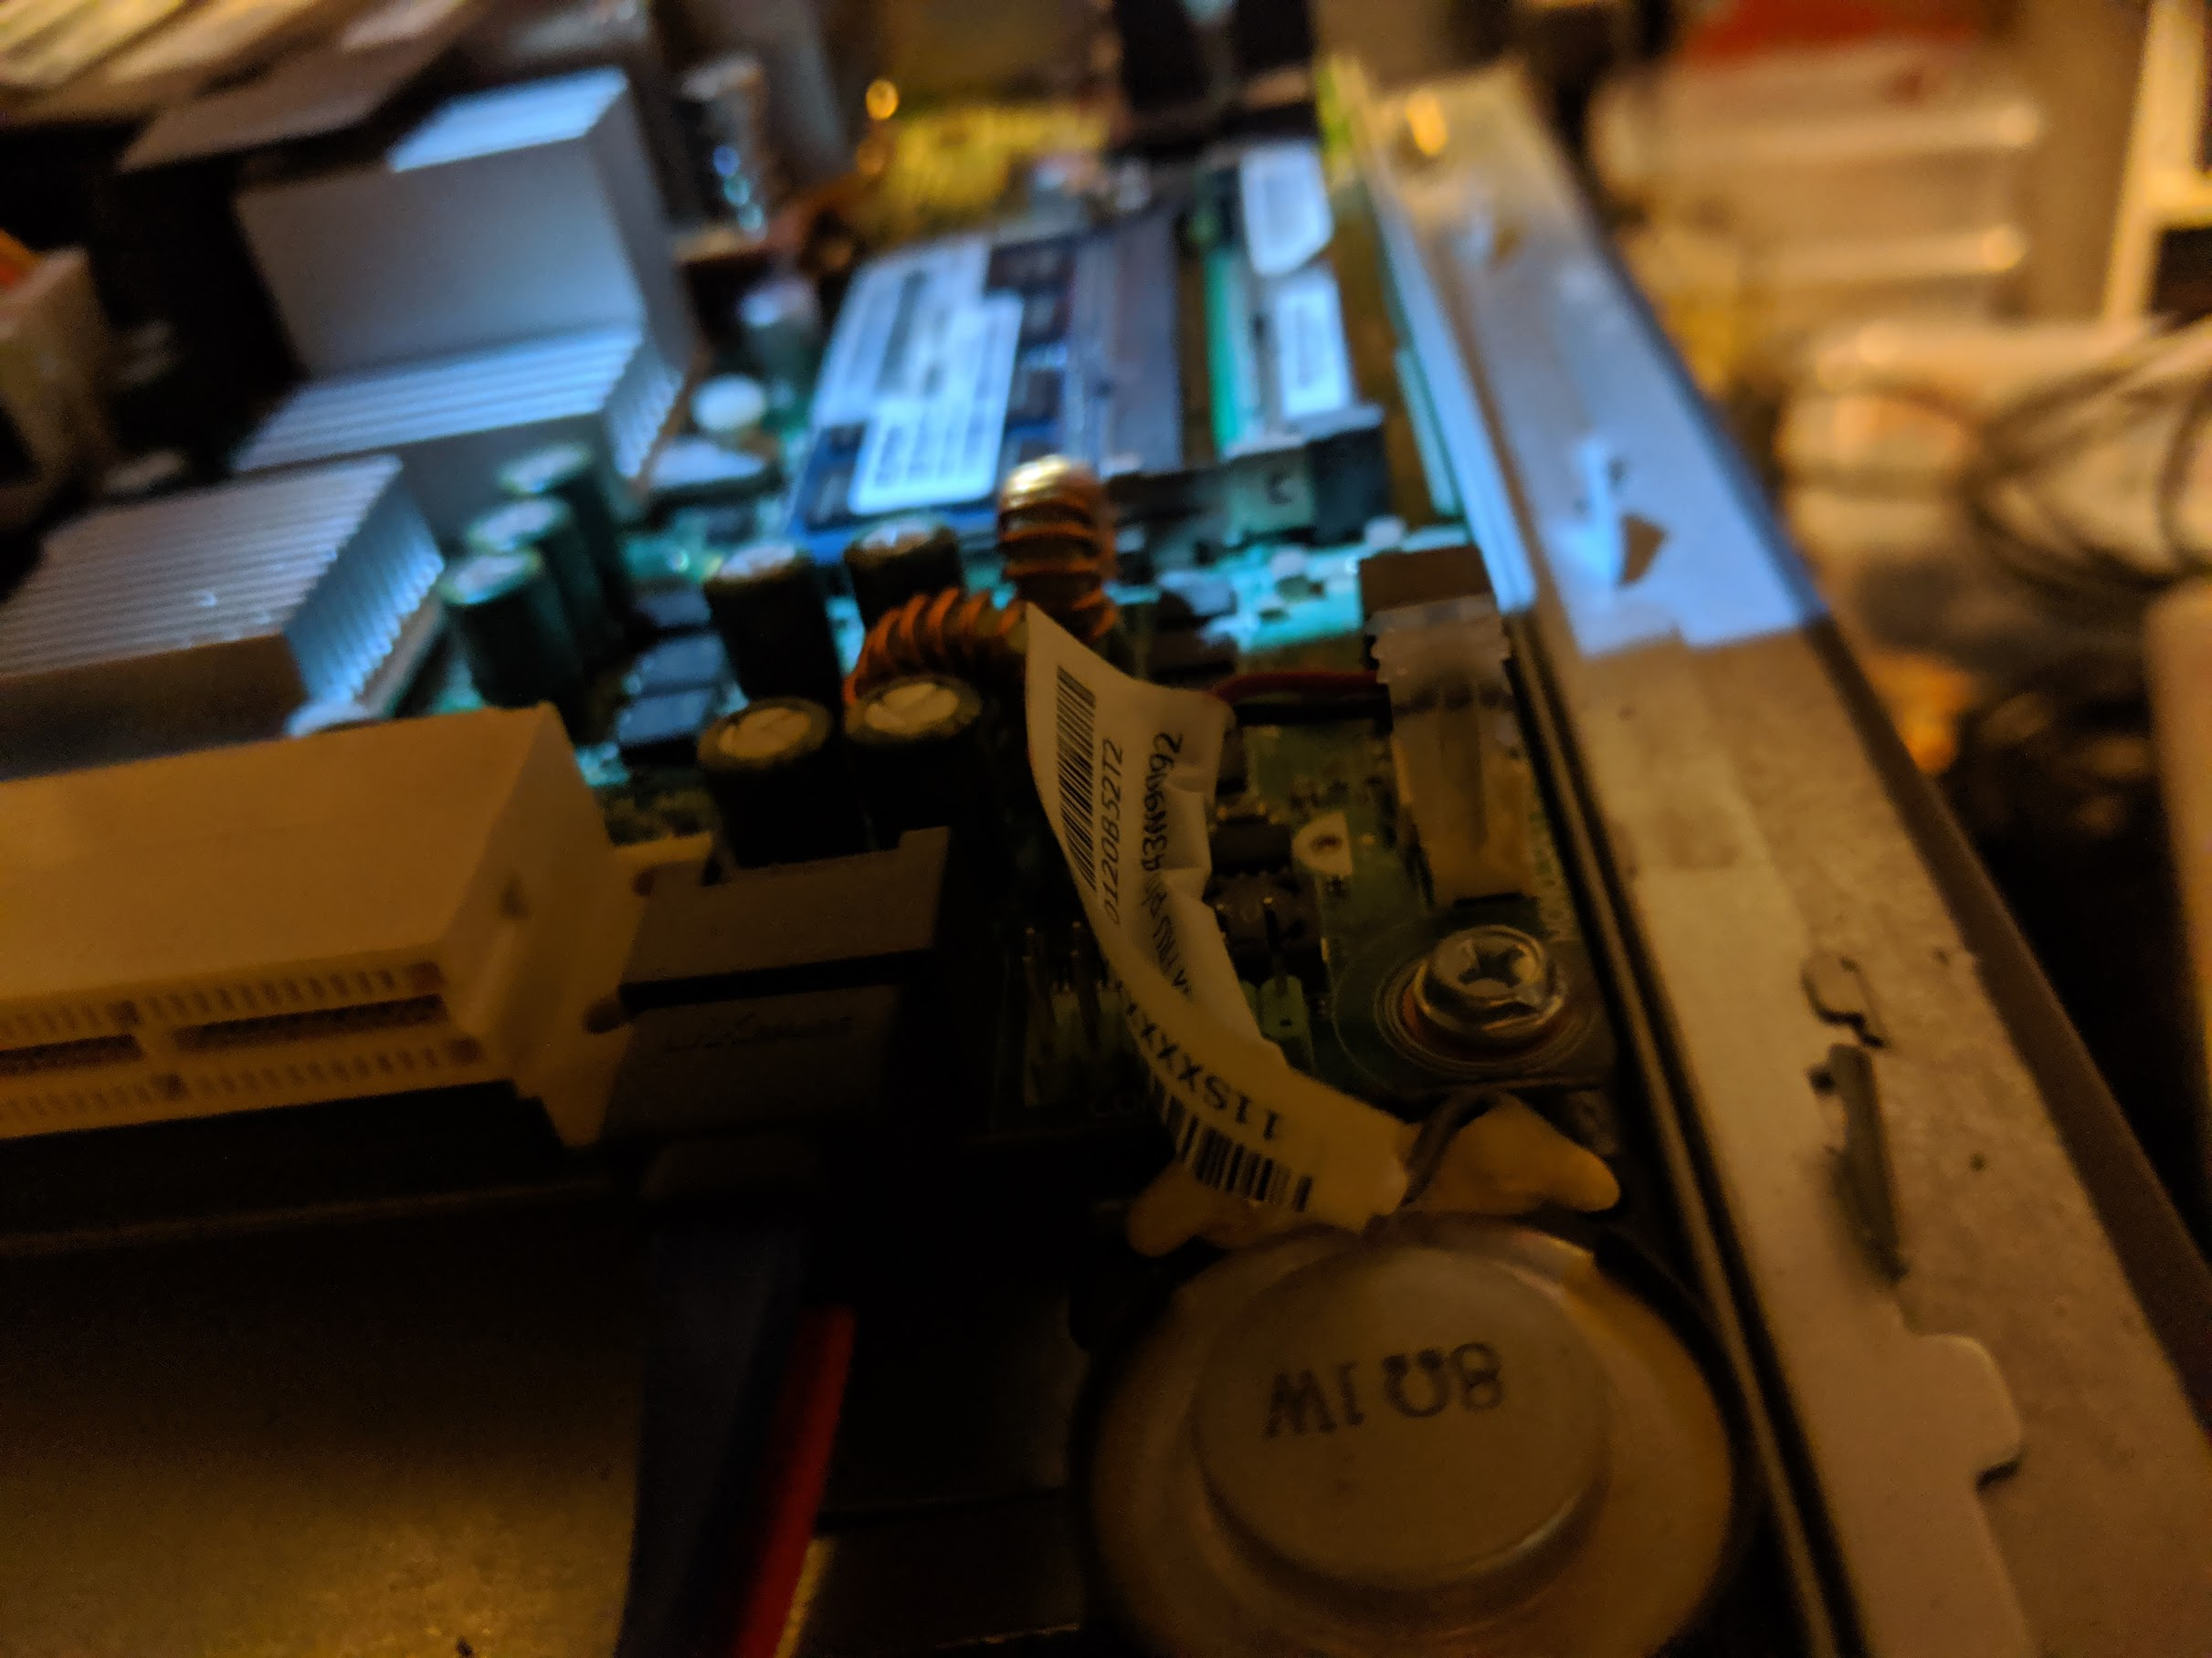
First hybrid (mixed mode) plenary session

Slide 15
In a nutshell
We got it done!
Generally positive for TG4ab
We had dedicated volunteer to run Webex and presentations (2 computers)
Asked people in the room NOT join the Webex (no audio loops)
Two-que multiplexed
Very few problems with remote speakers and Webex interface
Only a few disruptions – we learned and adapted!
Engagement in the room was stellar
Remote attendees were able to join discussion within meeting boundaries, not benefitting from the mingling
In person is better!

Slide 16
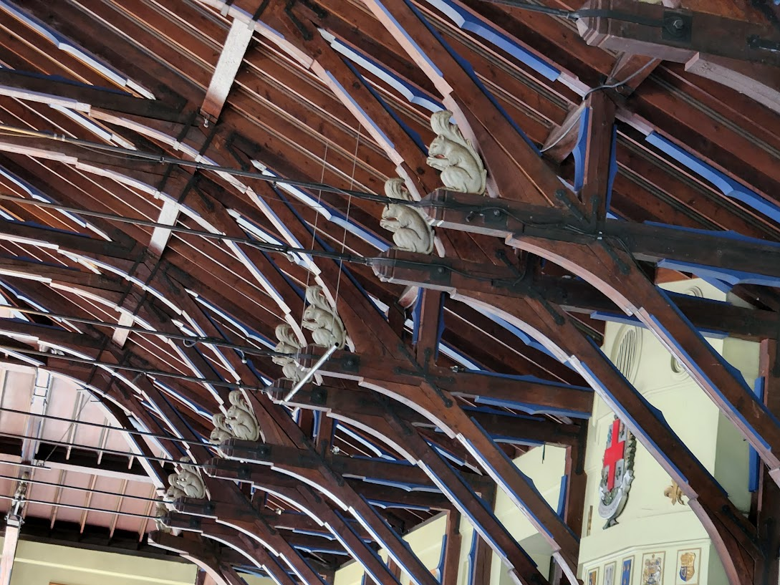
See you in September!

