Slide 1
Project: IEEE P802.15 Working Group for Wireless Personal Area Networks (WPANs)
Submission Title: A Wake Up Radio Scheme for UWB
Date Submitted: 14th July 2022
Source: Weidong Tang, Nansong Li, Libra Xiao (NewRadio Technologies)
Address: 1408, Building 4, Phase 1, Tianan Yungu, Bantian Street, Longgang District, Shenzhen, Guangdong, China
E-Mail: tangweidong@newradiotech.com, linansong@newradiotech.com, xiaojiaxing@newradiotech.com
Re: Call for contributions to IEEE 802.15 TG4ab
Abstract: A wake up radio scheme for NG-UWB
Purpose: Discussion of how to improve the radio technology of the NG-UWB
Notice: This is a basis for discussion and is not binding on the contributing individual(s) or document prepared to assist the IEEE P802.15. The material in this document is subject to change in form and content after further study. The contributor(s) reserve(s) the right to add, amend or withdraw material contained herein.
Release: The contributor acknowledges and accepts that this contribution becomes the property of IEEE and may be made publicly available by P802.15.
submission
Slide1

Slide 2
PAR Objective | The Proposed Solution (how addressed)
Safeguards so that the high throughput data will not cause significant disruption to low duty-cycle ranging use cases
Interference mitigation techniques to support higher density and higher traffic use cases
Other coexistence improvements
Backward compatibility with enhanced ranging capable devices (ERDEVs)
Improved link budget and/or reduced air-time | Improvement of wake up radio link budget
Additional channels and operating frequencies
Improvements to accuracy / precision / reliability and interoperability for high-integrity ranging
Reduced complexity and power consumption | A wake up radio to reduce power consumption of UWB device in sleep mode.
Hybrid operation with narrowband signaling to assist UWB
Enhanced native discovery and connection setup mechanisms
Sensing capabilities to support presence detection and environment mapping
Low-power low-latency streaming | Low power scheme for wake up radio
Higher data-rate streaming allowing at least 50 Mbit/s of throughput
Support for peer-to-peer, peer-to-multi-peer, and station-to-infrastructure protocols
Infrastructure synchronization mechanisms
submission
Slide2

Slide 3
Previous submissions
UWB Wakeup Signaling
<15-21-0557-01-04ab>, Nov 2021, Michael McLaughlin, Ryan Bunch Marcus Granger-Jones. (Qorvo Inc.)
Link budget analysis UWB vs NB
<15-22-0094-01-04ab>, Jan 2022, Michael McLaughlin (Qorvo Inc.)
The Advantages of UWB Wakeup
<15-22-0282-01-04ab>, Jan 2022, Chitao Goe, Michael McLaughlin, Billy Verso, Carl Murray (Qorvo Inc.)
submission
Slide3

Slide 4
Previous proposals
The ubiquitous BLE and 802.11 networks adopt LP-WUR to initiate communication to battery-powered devices but make trade-offs between low power consumption, latency, and anti-interference ability.
Proposal 15-21-0557-00-04ab not only avoids the duty-cycle trap but also achieves very low power consumption without compromising interference resilience, sensitivity, and latency.
The proposed wake up radio system employs synchronized clock at receiver.
submission
Slide4

Slide 5
Basic requirements for a wake up radio
Minimum hardware addition to main UWB transceiver
Low power consumption with years battery life
Better link margin to match UWB regular operation
Sub 10 ms latency for 32-bit device ID
submission
Slide5

Slide 6
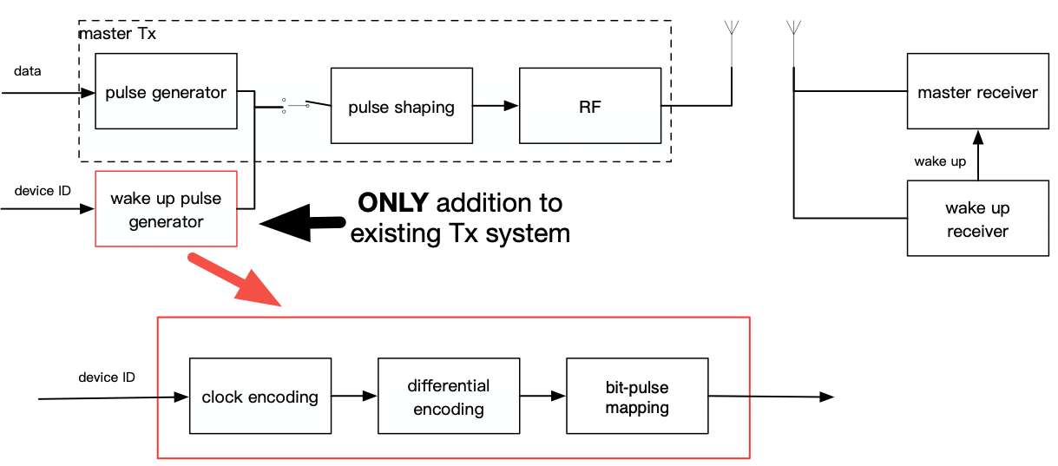
System Overview
submission
Slide6

Slide 7
Receiver of wake up radio
submission
Slide7

Slide 8
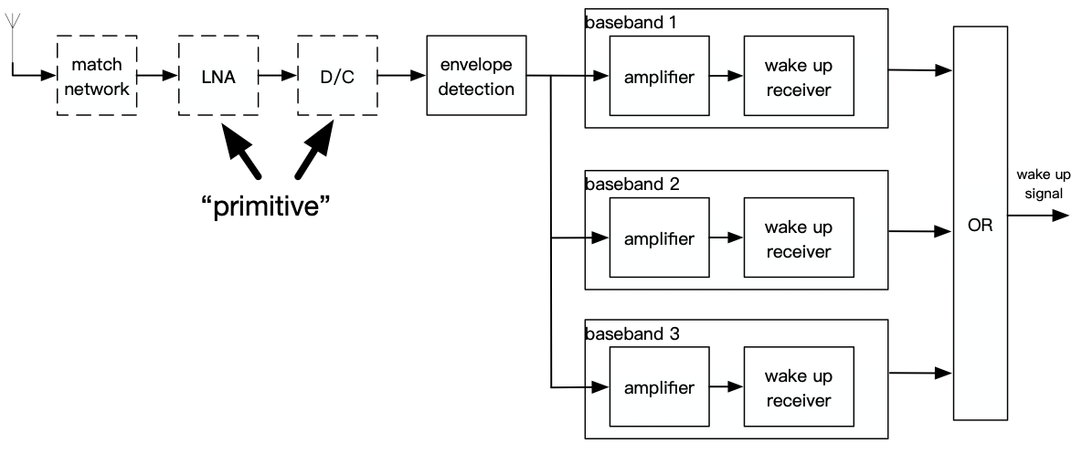
An Example of wake up receiver
submission
Slide8

Slide 9
Link budget
 | BLE 4.0 2.4GHz | 802.15.4 BPRF 5.9GHz | 802.15.4ab 8GHz (0557 Qorvo) | 802.15.4ab 8GHz (WUR)
Power Spectral Density(PSD, dBm/MHz) | - | -41.3 | -41.3 | -41.3
Minimum E_{b}/N₀(0.1% BER, dB) | 8.5 | 6.8 | 6.8 | 12
Bandwith(MHz) | 1 | 2 | 500 | 500
Frequency Center (MHz) | 2450 | 5900 | 7987.2 (CH9) | 7987.2 (CH9)
Bit Rate (Mbps) | 1 | 6.81 | 0.001 | 0.025
Antenna Gain (dB) | 1 | 1 | 1 | 1
Noise Figure (dB) | 6.0 | 6.0 | 6.0 | 6.0
Tx Power backoff (dB) | 1 | 1 | 1 | 1
Tx Time Gain / Max Pulse Gating gain | 0 | 8 | 0 | 0
Tx Power (dBm) | 5 | -7.3 | -15.3 | -15.3
Rx Noise Power (dBm) | -108 | -81.0 | -81.0 | -81.0
Minimum E_{b} (mJ in dB) | -159.5 | -161.2 | -161.2 | -156.0
Minimum Rx Power (dBm) | -99.5 | -92.9 | -131.2 | -112.0
LOS Distance | 71 | 76.7 | 1860.3 | 204.5
Link Margin (dB) | 77 | 85.6 | 115.9 | 96.7
Power Consumption | 2~6 mA | 30~70 mA | ~10 μA (5% Duty Cycle) | ~25 μA (5% Duty Cycle)
submission
Slide9

Slide 10
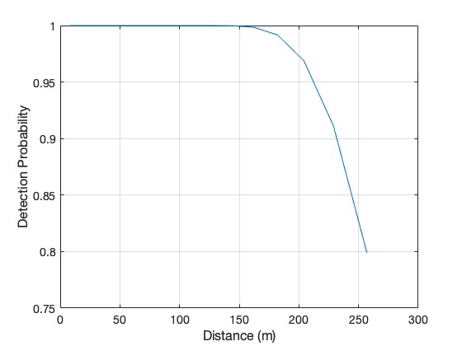
Detection Probability vs. Distance
submission
Slide10

Slide 11
Summary
A dedicated wake up companion
Noncoherent structure requires no synchronization
Flexible configuration leads to further simple circuit
The simplicity of the receiver ensures lower power consumption and longer operation period
No sacrificing of link budget
2-year battery with 5% duty cycle
submission
Slide11

Slide 12
Thank You
submission
Slide12

