Slide 1
Project: IEEE P802.15 Working Group for Wireless Specialty Networks (WSN)
Submission Title: NB considerations for NBA-MMS UWB
Source: Bin Qian, Chenchen Liu, Ziyang Guo, David Xun Yang (Huawei Technologies)
Address : [Huawei Bantian Base, Longgang District, Shenzhen, 518129 China]
E-Mail: [qianbin14@huawei.com]
Re: Task Group 4ab: UWB Next Generation for 802.15.4
Abstract: [NB, UWB]
Purpose:
Notice: This document has been prepared to assist the IEEE P802.15. It is offered as a basis for discussion and is not binding on the contributing individual(s) or organization(s). The material in this document is subject to change in form and content after further study. The contributor(s) reserve(s) the right to add, amend or withdraw material contained herein.
Release: The contributor acknowledges and accepts that this contribution becomes the property of IEEE and may be made publicly available by P802.15.
Notes:
Jul 12, 2010
Page 1

Slide 2
PAR Objective | Proposed Solution (how addressed)
Safeguards so that the high throughput data use cases will not cause significant disruption to low duty-cycle ranging use cases
Interference mitigation techniques to support higher density and higher traffic use cases
Other coexistence improvement
Backward compatibility with enhanced ranging capable devices (ERDEVs)
Improved link budget and/or reduced air-time
Additional channels and operating frequencies
Improvements to accuracy / precision / reliability and interoperability for high-integrity ranging
Reduced complexity and power consumption
Hybrid operation with narrowband signaling to assist UWB | Improved symbol-to-chip mapping to achieve better error performance and assist the CFO estimation NB frequency hopping method
Enhanced native discovery and connection setup mechanisms
Sensing capabilities to support presence detection and environment mapping
Low-power low-latency streaming
Higher data-rate streaming allowing at least 50 Mbit/s of throughput
Support for peer-to-peer, peer-to-multi-peer, and station-to-infrastructure protocols
Infrastructure synchronization mechanisms

Slide 3
NB Symbol-to-chip Mapping

Slide 4
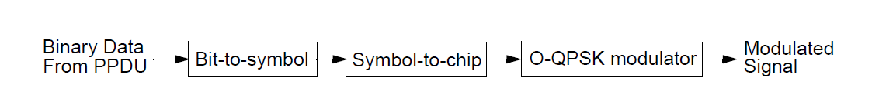
Recap of NB
NB assisted UWB has been discussed in [1-4] to improve link budget
NB provides initial CFO to UWB
In [5], the PPDU formats in Clause 12 of IEEE 802.15.4-2020 are recommended as the NB candidate
The functional block diagram of O-QPSK is as follows
According to the possible data rate, two symbol-to-chip mappings are required
  (32, 4) symbol-to-chip mapping
  (8, 4) symbol-to-chip mapping

Slide 5
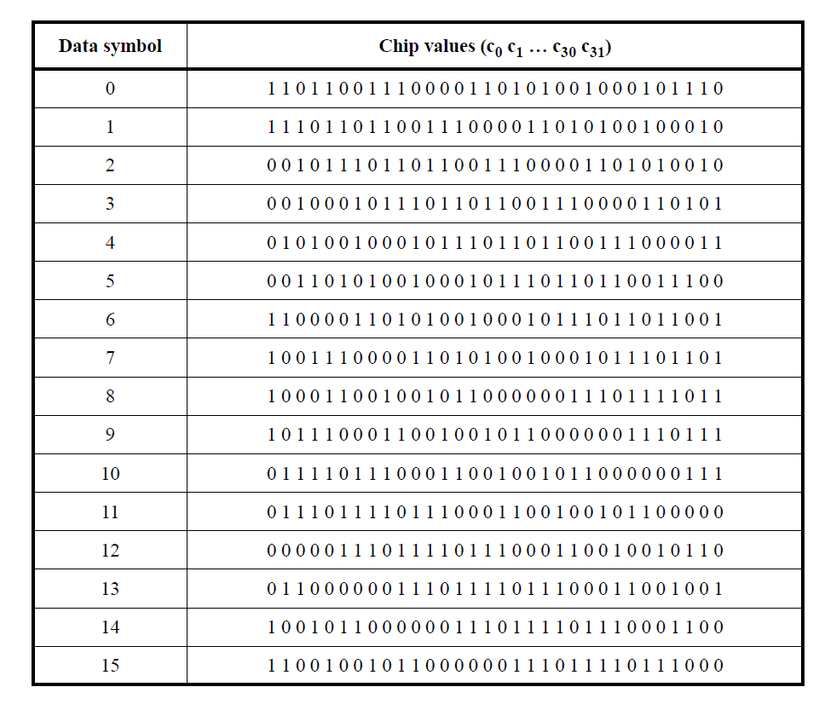
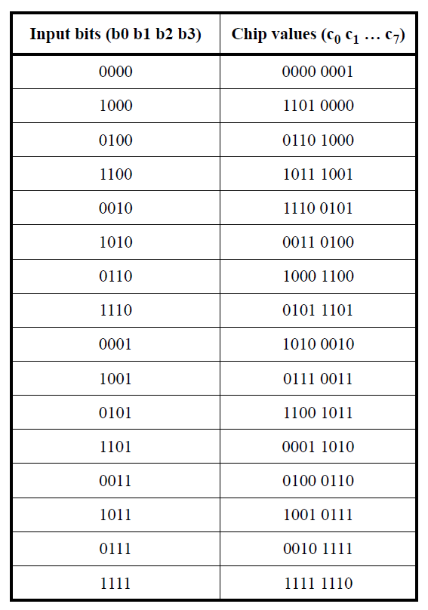
Symbol-to-chip Mapping
  (32, 4) symbol-to-chip mapping
  (8, 4) symbol-to-chip mapping

Slide 6
Autocorrelation Characteristics of Current Mapping
O-QPSK modulation; 4x over-sampling (complex domain)

Slide 7
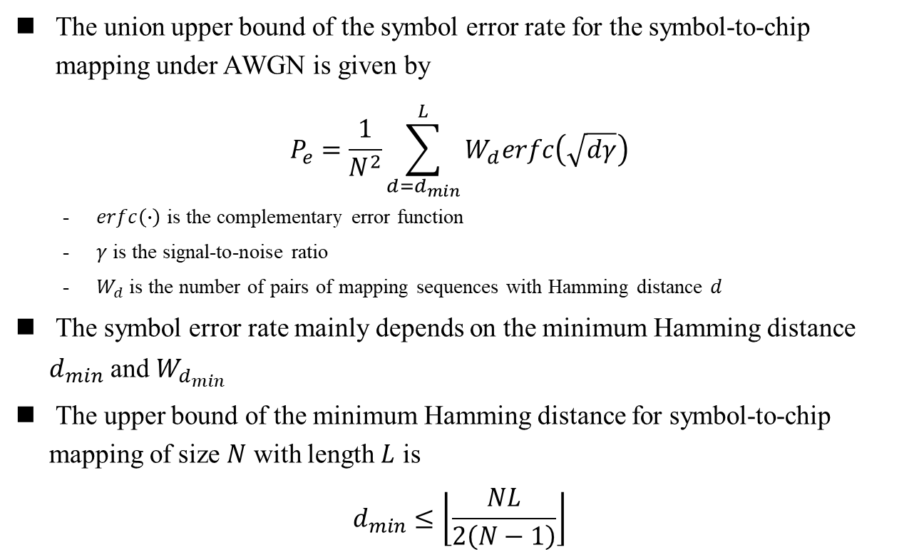
Union Bound
The union upper bound of the symbol error rate for the symbol-to-chip mapping under AWGN is given by
$$P_{e}=\frac{1}{N^{2}}\sum_{d=d_{min}}^{L}{W_{d}erfc\left(\sqrt{dγ}\right)}$$
  $erfc\left(∙\right)$ is the complementary error function
  $γ$ is the signal-to-noise ratio
  $W_{d}$ is the number of pairs of mapping sequences with Hamming distance $d$
The symbol error rate mainly depends on the minimum Hamming distance $d_{min}$ and $W_{d_{min}}$
The upper bound of the minimum Hamming distance for symbol-to-chip mapping of size $N$ with length $L$ is
$$d_{min}≤\left\lfloor \frac{NL}{2\left(N−1\right)}\right\rfloor$$

Slide 8
Hamming Distance
Symbol-to-chip Mapping sequence | 1 | 2 | 3 | 4 | 5 | 6 | 7 | 8 | 9 | 10 | 11 | 12 | 13 | 14 | 15 | 16
1 | 0 | 16 | 18 | 20 | 20 | 20 | 18 | 16 | 16 | 12 | 14 | 20 | 20 | 20 | 14 | 12
2 | 16 | 0 | 16 | 18 | 20 | 20 | 20 | 18 | 12 | 16 | 12 | 14 | 20 | 20 | 20 | 14
3 | 18 | 16 | 0 | 16 | 18 | 20 | 20 | 20 | 14 | 12 | 16 | 12 | 14 | 20 | 20 | 20
4 | 20 | 18 | 16 | 0 | 16 | 18 | 20 | 20 | 20 | 14 | 12 | 16 | 12 | 14 | 20 | 20
5 | 20 | 20 | 18 | 16 | 0 | 16 | 18 | 20 | 20 | 20 | 12 | 12 | 16 | 12 | 14 | 20
6 | 20 | 20 | 20 | 18 | 16 | 0 | 16 | 18 | 20 | 20 | 20 | 14 | 12 | 16 | 12 | 14
7 | 18 | 20 | 20 | 20 | 18 | 16 | 0 | 16 | 14 | 20 | 20 | 20 | 14 | 12 | 16 | 12
8 | 16 | 18 | 20 | 20 | 20 | 18 | 16 | 0 | 12 | 14 | 20 | 20 | 20 | 14 | 12 | 16
9 | 16 | 12 | 14 | 20 | 20 | 20 | 14 | 12 | 0 | 16 | 18 | 20 | 20 | 20 | 18 | 16
10 | 12 | 16 | 12 | 14 | 20 | 20 | 20 | 14 | 16 | 0 | 16 | 18 | 20 | 20 | 20 | 18
11 | 14 | 12 | 16 | 12 | 14 | 20 | 20 | 20 | 18 | 16 | 0 | 16 | 18 | 20 | 20 | 20
12 | 20 | 14 | 12 | 16 | 12 | 14 | 20 | 20 | 20 | 18 | 16 | 0 | 16 | 18 | 20 | 20
13 | 20 | 20 | 14 | 12 | 16 | 12 | 14 | 20 | 20 | 20 | 18 | 16 | 0 | 16 | 18 | 20
14 | 20 | 20 | 20 | 14 | 12 | 16 | 12 | 14 | 20 | 20 | 20 | 18 | 16 | 0 | 16 | 18
15 | 14 | 20 | 20 | 20 | 14 | 12 | 16 | 12 | 18 | 20 | 20 | 20 | 18 | 16 | 0 | 16
16 | 12 | 14 | 20 | 20 | 20 | 14 | 12 | 16 | 16 | 18 | 20 | 20 | 20 | 18 | 16 | 0
The minimum Hamming distance 12 is far from the theoretical upper bound

Slide 9
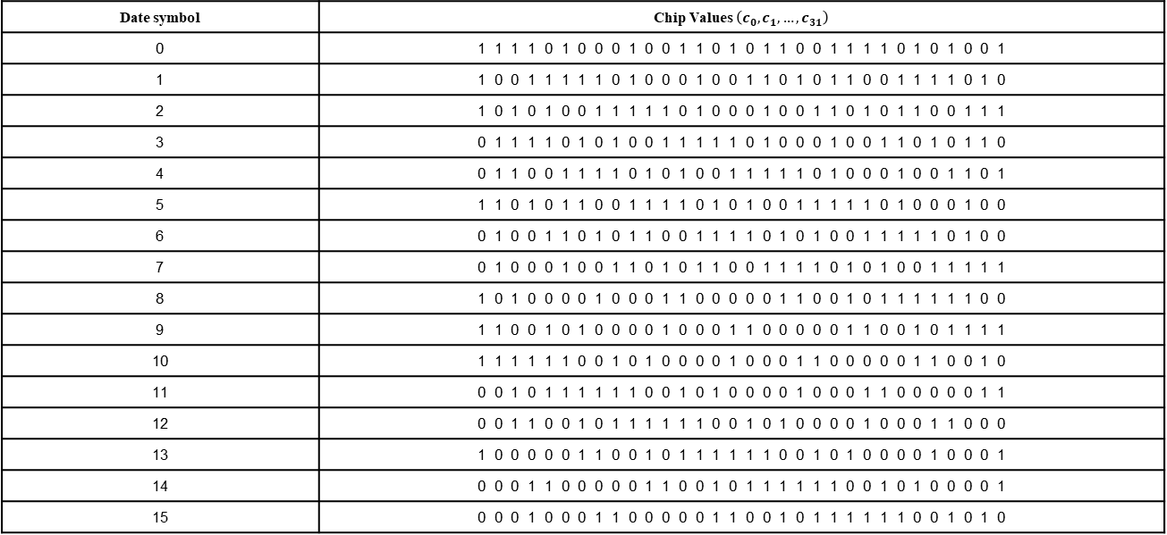
Symbol-to-chip Option 1
Date symbol | Chip Values $\left(c_{0}, c_{1},…, c_{31}\right)$
0 | 1 1 1 1 0 1 0 0 0 1 0 0 1 1 0 1 0 1 1 0 0 1 1 1 1 0 1 0 1 0 0 1
1 | 1 0 0 1 1 1 1 1 0 1 0 0 0 1 0 0 1 1 0 1 0 1 1 0 0 1 1 1 1 0 1 0
2 | 1 0 1 0 1 0 0 1 1 1 1 1 0 1 0 0 0 1 0 0 1 1 0 1 0 1 1 0 0 1 1 1
3 | 0 1 1 1 1 0 1 0 1 0 0 1 1 1 1 1 0 1 0 0 0 1 0 0 1 1 0 1 0 1 1 0
4 | 0 1 1 0 0 1 1 1 1 0 1 0 1 0 0 1 1 1 1 1 0 1 0 0 0 1 0 0 1 1 0 1
5 | 1 1 0 1 0 1 1 0 0 1 1 1 1 0 1 0 1 0 0 1 1 1 1 1 0 1 0 0 0 1 0 0
6 | 0 1 0 0 1 1 0 1 0 1 1 0 0 1 1 1 1 0 1 0 1 0 0 1 1 1 1 1 0 1 0 0
7 | 0 1 0 0 0 1 0 0 1 1 0 1 0 1 1 0 0 1 1 1 1 0 1 0 1 0 0 1 1 1 1 1
8 | 1 0 1 0 0 0 0 1 0 0 0 1 1 0 0 0 0 0 1 1 0 0 1 0 1 1 1 1 1 1 0 0
9 | 1 1 0 0 1 0 1 0 0 0 0 1 0 0 0 1 1 0 0 0 0 0 1 1 0 0 1 0 1 1 1 1
10 | 1 1 1 1 1 1 0 0 1 0 1 0 0 0 0 1 0 0 0 1 1 0 0 0 0 0 1 1 0 0 1 0
11 | 0 0 1 0 1 1 1 1 1 1 0 0 1 0 1 0 0 0 0 1 0 0 0 1 1 0 0 0 0 0 1 1
12 | 0 0 1 1 0 0 1 0 1 1 1 1 1 1 0 0 1 0 1 0 0 0 0 1 0 0 0 1 1 0 0 0
13 | 1 0 0 0 0 0 1 1 0 0 1 0 1 1 1 1 1 1 0 0 1 0 1 0 0 0 0 1 0 0 0 1
14 | 0 0 0 1 1 0 0 0 0 0 1 1 0 0 1 0 1 1 1 1 1 1 0 0 1 0 1 0 0 0 0 1
15 | 0 0 0 1 0 0 0 1 1 0 0 0 0 0 1 1 0 0 1 0 1 1 1 1 1 1 0 0 1 0 1 0
Advantages
  The Hamming distance of any two 32-chip sequences is either 16 or 18 to improve the symbol error performance
  The cyclic shift and element-wise XOR properties are same as the current symbol-to-chip mapping to reduce the complexity of the symbol-to-chip transformation

Slide 10
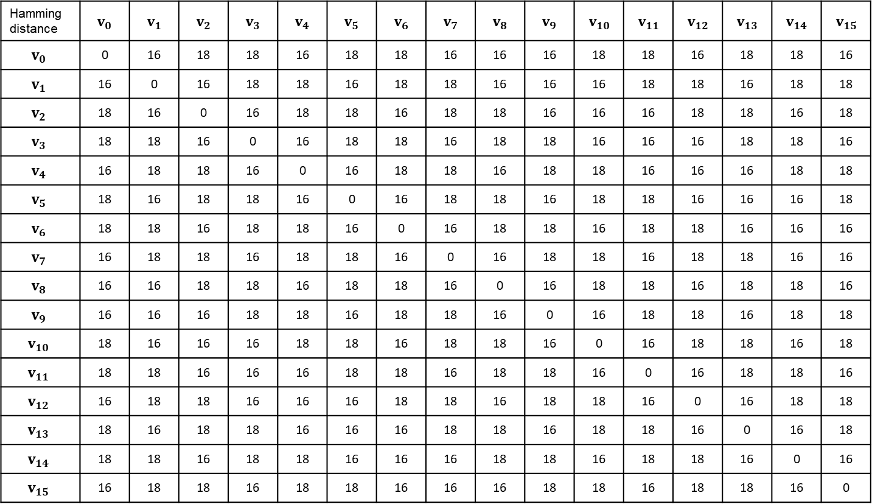
Symbol-to-chip Option 1 Hamming Distance
Hamming distance | $$v_{0}$$ | $$v_{1}$$ | $$v_{2}$$ | $$v_{3}$$ | $$v_{4}$$ | $$v_{5}$$ | $$v_{6}$$ | $$v_{7}$$ | $$v_{8}$$ | $$v_{9}$$ | $$v_{10}$$ | $$v_{11}$$ | $$v_{12}$$ | $$v_{13}$$ | $$v_{14}$$ | $$v_{15}$$
$$v_{0}$$ | 0 | 16 | 18 | 18 | 16 | 18 | 18 | 16 | 16 | 16 | 18 | 18 | 16 | 18 | 18 | 16
$$v_{1}$$ | 16 | 0 | 16 | 18 | 18 | 16 | 18 | 18 | 16 | 16 | 16 | 18 | 18 | 16 | 18 | 18
$$v_{2}$$ | 18 | 16 | 0 | 16 | 18 | 18 | 16 | 18 | 18 | 16 | 16 | 16 | 18 | 18 | 16 | 18
$$v_{3}$$ | 18 | 18 | 16 | 0 | 16 | 18 | 18 | 16 | 18 | 18 | 16 | 16 | 16 | 18 | 18 | 16
$$v_{4}$$ | 16 | 18 | 18 | 16 | 0 | 16 | 18 | 18 | 16 | 18 | 18 | 16 | 16 | 16 | 18 | 18
$$v_{5}$$ | 18 | 16 | 18 | 18 | 16 | 0 | 16 | 18 | 18 | 16 | 18 | 18 | 16 | 16 | 16 | 18
$$v_{6}$$ | 18 | 18 | 16 | 18 | 18 | 16 | 0 | 16 | 18 | 18 | 16 | 18 | 18 | 16 | 16 | 16
$$v_{7}$$ | 16 | 18 | 18 | 16 | 18 | 18 | 16 | 0 | 16 | 18 | 18 | 16 | 18 | 18 | 16 | 16
$$v_{8}$$ | 16 | 16 | 18 | 18 | 16 | 18 | 18 | 16 | 0 | 16 | 18 | 18 | 16 | 18 | 18 | 16
$$v_{9}$$ | 16 | 16 | 16 | 18 | 18 | 16 | 18 | 18 | 16 | 0 | 16 | 18 | 18 | 16 | 18 | 18
$$v_{10}$$ | 18 | 16 | 16 | 16 | 18 | 18 | 16 | 18 | 18 | 16 | 0 | 16 | 18 | 18 | 16 | 18
$$v_{11}$$ | 18 | 18 | 16 | 16 | 16 | 18 | 18 | 16 | 18 | 18 | 16 | 0 | 16 | 18 | 18 | 16
$$v_{12}$$ | 16 | 18 | 18 | 16 | 16 | 16 | 18 | 18 | 16 | 18 | 18 | 16 | 0 | 16 | 18 | 18
$$v_{13}$$ | 18 | 16 | 18 | 18 | 16 | 16 | 16 | 18 | 18 | 16 | 18 | 18 | 16 | 0 | 16 | 18
$$v_{14}$$ | 18 | 18 | 16 | 18 | 18 | 16 | 16 | 16 | 18 | 18 | 16 | 18 | 18 | 16 | 0 | 16
$$v_{15}$$ | 16 | 18 | 18 | 16 | 18 | 18 | 16 | 16 | 16 | 18 | 18 | 16 | 18 | 18 | 16 | 0

Slide 11
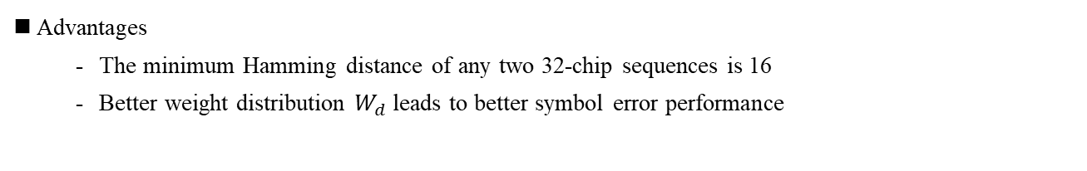
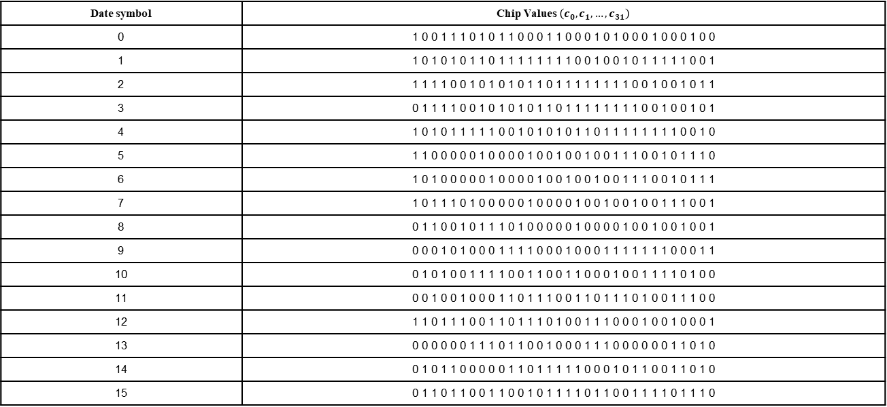
Symbol-to-chip Option 2
Date symbol | Chip Values $\left(c_{0}, c_{1},…, c_{31}\right)$
0 | 1 0 0 1 1 1 0 1 0 1 1 0 0 0 1 1 0 0 0 1 0 1 0 0 0 1 0 0 0 1 0 0
1 | 1 0 1 0 1 0 1 1 0 1 1 1 1 1 1 1 1 0 0 1 0 0 1 0 1 1 1 1 1 0 0 1
2 | 1 1 1 1 0 0 1 0 1 0 1 0 1 1 0 1 1 1 1 1 1 1 1 0 0 1 0 0 1 0 1 1
3 | 0 1 1 1 1 0 0 1 0 1 0 1 0 1 1 0 1 1 1 1 1 1 1 1 0 0 1 0 0 1 0 1
4 | 1 0 1 0 1 1 1 1 1 0 0 1 0 1 0 1 0 1 1 0 1 1 1 1 1 1 1 1 0 0 1 0
5 | 1 1 0 0 0 0 0 1 0 0 0 0 1 0 0 1 0 0 1 0 0 1 1 1 0 0 1 0 1 1 1 0
6 | 1 0 1 0 0 0 0 0 1 0 0 0 0 1 0 0 1 0 0 1 0 0 1 1 1 0 0 1 0 1 1 1
7 | 1 0 1 1 1 0 1 0 0 0 0 0 1 0 0 0 0 1 0 0 1 0 0 1 0 0 1 1 1 0 0 1
8 | 0 1 1 0 0 1 0 1 1 1 0 1 0 0 0 0 0 1 0 0 0 0 1 0 0 1 0 0 1 0 0 1
9 | 0 0 0 1 0 1 0 0 0 1 1 1 1 0 0 0 1 0 0 0 1 1 1 1 1 1 1 0 0 0 1 1
10 | 0 1 0 1 0 0 1 1 1 1 0 0 1 1 0 0 1 1 0 0 0 1 0 0 1 1 1 1 0 1 0 0
11 | 0 0 1 0 0 1 0 0 0 1 1 0 1 1 1 0 0 1 1 0 1 1 1 0 1 0 0 1 1 1 0 0
12 | 1 1 0 1 1 1 0 0 1 1 0 1 1 1 0 1 0 0 1 1 1 0 0 0 1 0 0 1 0 0 0 1
13 | 0 0 0 0 0 0 1 1 1 0 1 1 0 0 1 0 0 0 1 1 1 0 0 0 0 0 0 1 1 0 1 0
14 | 0 1 0 1 1 0 0 0 0 0 1 1 0 1 1 1 1 1 0 0 0 1 0 1 1 0 0 1 1 0 1 0
15 | 0 1 1 0 1 1 0 0 1 1 0 0 1 0 1 1 1 1 0 1 1 0 0 1 1 1 1 0 1 1 1 0
Advantages
  The minimum Hamming distance of any two 32-chip sequences is 16
  Better weight distribution $W_{d}$ leads to better symbol error performance

Slide 12
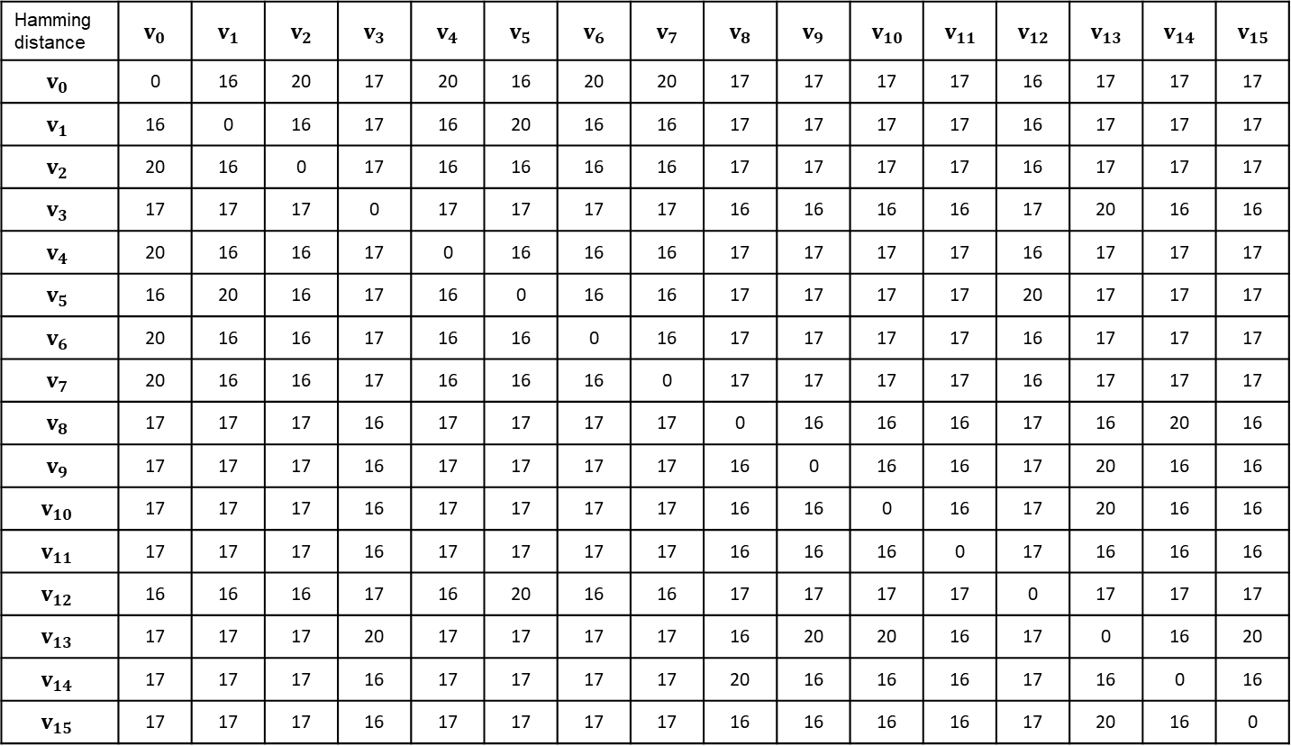
Symbol-to-chip Option 2 Hamming Distance
Hamming distance | $$v_{0}$$ | $$v_{1}$$ | $$v_{2}$$ | $$v_{3}$$ | $$v_{4}$$ | $$v_{5}$$ | $$v_{6}$$ | $$v_{7}$$ | $$v_{8}$$ | $$v_{9}$$ | $$v_{10}$$ | $$v_{11}$$ | $$v_{12}$$ | $$v_{13}$$ | $$v_{14}$$ | $$v_{15}$$
$$v_{0}$$ | 0 | 16 | 20 | 17 | 20 | 16 | 20 | 20 | 17 | 17 | 17 | 17 | 16 | 17 | 17 | 17
$$v_{1}$$ | 16 | 0 | 16 | 17 | 16 | 20 | 16 | 16 | 17 | 17 | 17 | 17 | 16 | 17 | 17 | 17
$$v_{2}$$ | 20 | 16 | 0 | 17 | 16 | 16 | 16 | 16 | 17 | 17 | 17 | 17 | 16 | 17 | 17 | 17
$$v_{3}$$ | 17 | 17 | 17 | 0 | 17 | 17 | 17 | 17 | 16 | 16 | 16 | 16 | 17 | 20 | 16 | 16
$$v_{4}$$ | 20 | 16 | 16 | 17 | 0 | 16 | 16 | 16 | 17 | 17 | 17 | 17 | 16 | 17 | 17 | 17
$$v_{5}$$ | 16 | 20 | 16 | 17 | 16 | 0 | 16 | 16 | 17 | 17 | 17 | 17 | 20 | 17 | 17 | 17
$$v_{6}$$ | 20 | 16 | 16 | 17 | 16 | 16 | 0 | 16 | 17 | 17 | 17 | 17 | 16 | 17 | 17 | 17
$$v_{7}$$ | 20 | 16 | 16 | 17 | 16 | 16 | 16 | 0 | 17 | 17 | 17 | 17 | 16 | 17 | 17 | 17
$$v_{8}$$ | 17 | 17 | 17 | 16 | 17 | 17 | 17 | 17 | 0 | 16 | 16 | 16 | 17 | 16 | 20 | 16
$$v_{9}$$ | 17 | 17 | 17 | 16 | 17 | 17 | 17 | 17 | 16 | 0 | 16 | 16 | 17 | 20 | 16 | 16
$$v_{10}$$ | 17 | 17 | 17 | 16 | 17 | 17 | 17 | 17 | 16 | 16 | 0 | 16 | 17 | 20 | 16 | 16
$$v_{11}$$ | 17 | 17 | 17 | 16 | 17 | 17 | 17 | 17 | 16 | 16 | 16 | 0 | 17 | 16 | 16 | 16
$$v_{12}$$ | 16 | 16 | 16 | 17 | 16 | 20 | 16 | 16 | 17 | 17 | 17 | 17 | 0 | 17 | 17 | 17
$$v_{13}$$ | 17 | 17 | 17 | 20 | 17 | 17 | 17 | 17 | 16 | 20 | 20 | 16 | 17 | 0 | 16 | 20
$$v_{14}$$ | 17 | 17 | 17 | 16 | 17 | 17 | 17 | 17 | 20 | 16 | 16 | 16 | 17 | 16 | 0 | 16
$$v_{15}$$ | 17 | 17 | 17 | 16 | 17 | 17 | 17 | 17 | 16 | 16 | 16 | 16 | 17 | 20 | 16 | 0

Slide 13
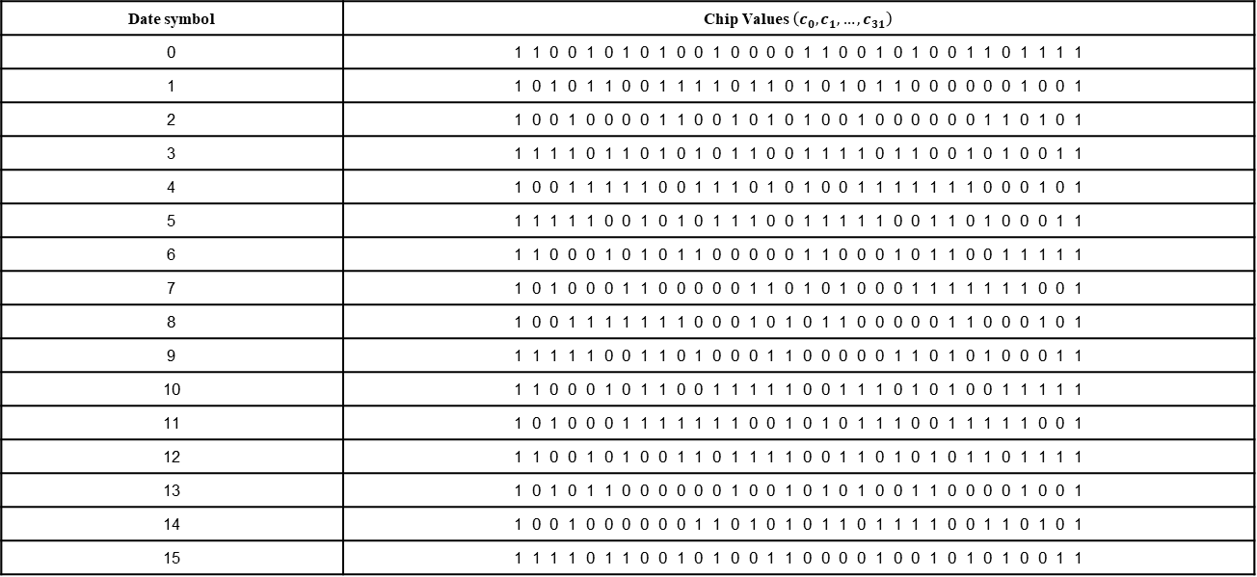
Symbol-to-chip Option 3
Date symbol | Chip Values $\left(c_{0}, c_{1},…, c_{31}\right)$
0 | 1 1 0 0 1 0 1 0 1 0 0 1 0 0 0 0 1 1 0 0 1 0 1 0 0 1 1 0 1 1 1 1
1 | 1 0 1 0 1 1 0 0 1 1 1 1 0 1 1 0 1 0 1 0 1 1 0 0 0 0 0 0 1 0 0 1
2 | 1 0 0 1 0 0 0 0 1 1 0 0 1 0 1 0 1 0 0 1 0 0 0 0 0 0 1 1 0 1 0 1
3 | 1 1 1 1 0 1 1 0 1 0 1 0 1 1 0 0 1 1 1 1 0 1 1 0 0 1 0 1 0 0 1 1
4 | 1 0 0 1 1 1 1 1 0 0 1 1 1 0 1 0 1 0 0 1 1 1 1 1 1 1 0 0 0 1 0 1
5 | 1 1 1 1 1 0 0 1 0 1 0 1 1 1 0 0 1 1 1 1 1 0 0 1 1 0 1 0 0 0 1 1
6 | 1 1 0 0 0 1 0 1 0 1 1 0 0 0 0 0 1 1 0 0 0 1 0 1 1 0 0 1 1 1 1 1
7 | 1 0 1 0 0 0 1 1 0 0 0 0 0 1 1 0 1 0 1 0 0 0 1 1 1 1 1 1 1 0 0 1
8 | 1 0 0 1 1 1 1 1 1 1 0 0 0 1 0 1 0 1 1 0 0 0 0 0 1 1 0 0 0 1 0 1
9 | 1 1 1 1 1 0 0 1 1 0 1 0 0 0 1 1 0 0 0 0 0 1 1 0 1 0 1 0 0 0 1 1
10 | 1 1 0 0 0 1 0 1 1 0 0 1 1 1 1 1 0 0 1 1 1 0 1 0 1 0 0 1 1 1 1 1
11 | 1 0 1 0 0 0 1 1 1 1 1 1 1 0 0 1 0 1 0 1 1 1 0 0 1 1 1 1 1 0 0 1
12 | 1 1 0 0 1 0 1 0 0 1 1 0 1 1 1 1 0 0 1 1 0 1 0 1 0 1 1 0 1 1 1 1
13 | 1 0 1 0 1 1 0 0 0 0 0 0 1 0 0 1 0 1 0 1 0 0 1 1 0 0 0 0 1 0 0 1
14 | 1 0 0 1 0 0 0 0 0 0 1 1 0 1 0 1 0 1 1 0 1 1 1 1 0 0 1 1 0 1 0 1
15 | 1 1 1 1 0 1 1 0 0 1 0 1 0 0 1 1 0 0 0 0 1 0 0 1 0 1 0 1 0 0 1 1
Recommend Option 3
  The Hamming distance of any two 32-chip sequences is 16 to improve the symbol error rate
  There are two chips with the fixed value at the particular positions, which could be used to assist the CFO estimation and compensation
  O-QPSK modulated symbols are orthogonal to support non-coherent demodulator
  O-QPSK modulated symbols have low PAPR in the frequency domain

Slide 14
Autocorrelation Characteristics of Option 3
O-QPSK modulation; 4x over-sampling (all in real numbers)

Slide 15
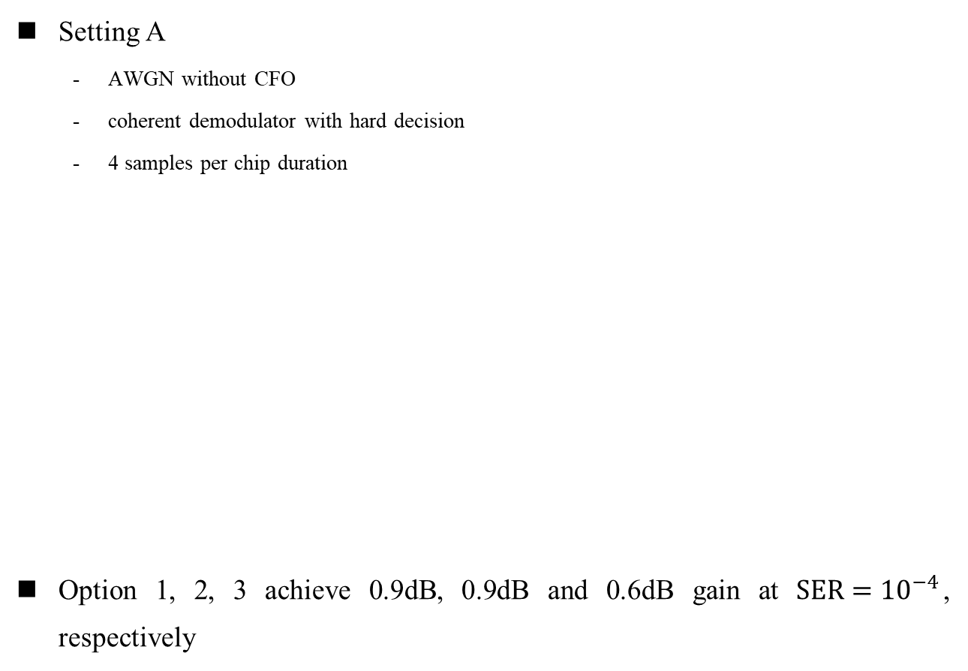
Simulation Results
Setting A
  AWGN without CFO
  coherent demodulator with hard decision
  4 samples per chip duration
Option 1, 2, 3 achieve 0.9dB, 0.9dB and 0.6dB gain at $SER={10}^{−4}$, respectively

Slide 16
Simulation Results
Setting B
  AWGN with CFO = 40 KHz
  coherent demodulator with hard decision, SKD estimator [1] is applied by preamble
  4 samples per chip duration
Option 3 can assist CFO estimation such that NB can provide more accuracy CFO to UWB, while option 1 and 2 have same CFO estimation performance as current PN symbol-to-chip mapping
[1] Shengchen Dai, et.al , “A Robust Demodulator for OQPSK-DSSS System”, 2014. [Online] https://link.springer.com/content/pdf/10.1007/s00034-014-9844-z.pdf

Slide 17
NB Frequency Hopping

Slide 18
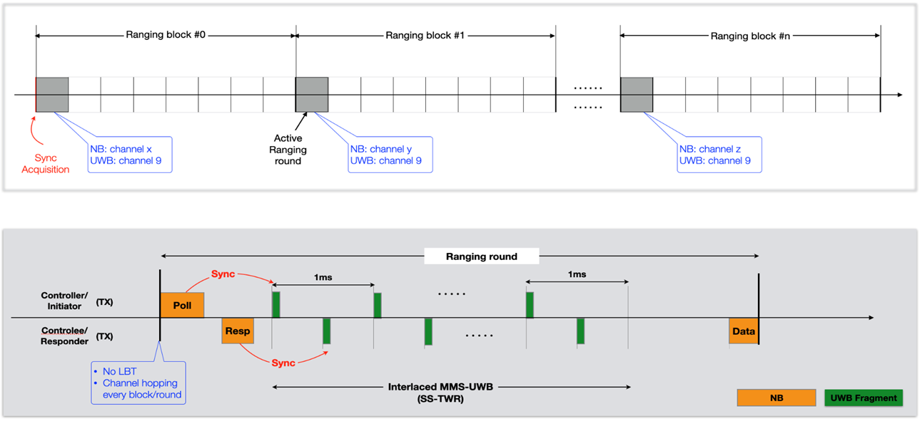
Recap of NB Frequency Hopping
  Frequency hopping is recommended for NB transmission to avoid deep fade and interference from other coexisting systems [6]
  Hop every ranging round/block

Slide 19
Slot Based NB Frequency Hopping
  MMS ranging phase may last for tens of milliseconds, up to 32ms [3]
  Hop every ranging round/block may not be a good choice
    Channel condition and interference may have changed a lot
    NB channel may be occupied when ranging report is sent back
  Slot based frequency hopping: hop every slot (similar to Bluetooth)
    No impact to receiver since hopping timing is known
    The duration of one slot could be pre-set, e.g., 1ms
Ranging Round
MMS ranging phase
Use different frequency

Slide 20

Hopping Function
  Use LFSR to generate pseudo random channel index
    [6] proposes reuse AES-128 to generate pseudo random channel index
    Compared with AES-128 based channel switching, LFSR based channel switching is more structured, which makes it much easier to analyze the auto/cross-correlation performance in theory
  Channel_index = hop_function(initial seed, slot index, block list)
    Initial seed is the starting point of LFSR, which could be determined by the MAC address of the initiator. Initial seed could be transferred by BLE
    Slot index is monotonically increasing with time
    Block list is the channel set being interfered, which could be updated to adapt to the environment change
$\left\lceil \log_{2}{M}\right\rceil$ binary
Channel index in [0, M-1]
Convert to decimal number and mod M
No
Initial seed
LFSR
in block list?
Channel index
Yes

Slide 21
Summary
  3 different O-QPSK (32, 4) symbol-to-chip mappings are introduced. Option 3 is recommended
    The Hamming distance of any two 32-chip sequences is improved from 12 to 16
    It could assist the CFO estimation and compensation
  Slot based NB frequency hopping is introduced
    Hop every ranging round/block may not be a good choice
    A hopping function is proposed

Slide 22
References
[1] 15-22-0064-04ab Potentials of narrowband assisted UWB
[2] 15-22-0074-04ab Link budget analysis for NBA-MMS
[3] 15-21-0593-04ab More on NBA-MMS
[4] 15-21-0409-04ab Narrowband assisted multi-millisecond UWB
[5] 15-22-0262-04ab NBA-UWB technical framework proposal
[6] 15-22-0340-04ab Narrowband channel access and interference mitigation for NBA-MMS-UWB

