Slide 1
Project: IEEE P802.15 Working Group for Wireless Personal Area Networks (WPANs)
Submission Title: [Sensing pulse shape consideration in 802.15.4ab]
Date Submitted: []
Source: [Xiaohui Peng, Bin Qian, Kuan Wu, David Xun Yang] Company [Huawei Technologies]
E-Mail: [pengxiaohui5@huawei.com]
Re: [Input to the Working Group]
Abstract: [Sensing, UWB in 802.15.4ab, pulse shape]
Purpose: []
Notice: This document has been prepared to assist the IEEE P802.15. It is offered as a basis for discussion and is not binding on the contributing individual(s) or organization(s). The material in this document is subject to change in form and content after further study. The contributor(s) reserve(s) the right to add, amend or withdraw material contained herein.
Release: The contributor acknowledges and accepts that this contribution becomes the property of IEEE and may be made publicly available by P802.15.

Slide 2
PAR Objective | Proposed Solution (how addressed)
Safeguards so that the high throughput data use cases will not cause significant disruption to low duty-cycle ranging use cases
Interference mitigation techniques to support higher density and higher traffic use cases
Other coexistence improvement
Backward compatibility with enhanced ranging capable devices (ERDEVs)
Improved link budget and/or reduced air-time
Additional channels and operating frequencies
Improvements to accuracy / precision / reliability and interoperability for high-integrity ranging
Reduced complexity and power consumption
Hybrid operation with narrowband signaling to assist UWB
Enhanced native discovery and connection setup mechanisms
Sensing capabilities to support presence detection and environment mapping | Pulse shape design for sensing
Low-power low-latency streaming
Higher data-rate streaming allowing at least 50 Mbit/s of throughput
Support for peer-to-peer, peer-to-multi-peer, and station-to-infrastructure protocols
Infrastructure synchronization mechanisms

Slide 3
Related Submissions
15-19-0443-01-004z text to address comment id r1-0820 (Michael McLaughin)
15-20-0084-00-004z pulse shaping considerations (Jochen Hammerschmidt)
15-20-0086-00-004z proposed pulse shape text changes for HRP UWB PHY (Michael McLaughin)
15-20-0089-01-004z pulse shape text changes for HRP UWB PHY (Michael McLaughin)
15-22-0040-04-04ab waveform design for UWB sensing (Xiaohui Peng)
15-22-0175-00-04ab sensing device (Dag T. Wisland )
15-22-0061-00-04ab sensing – continued (Frank Leong)
15-22-0305-00-04ab a summary of proposals and interests (Billy Verso)

Slide 4
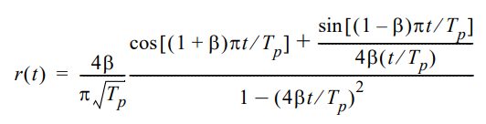
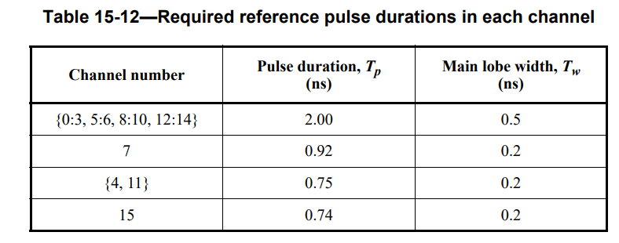
Background—RRC pulse
The IEEE 802.15.4a/z HRP standard specifies a compliance check for HRP pulse.
The cross-correlation between the used pulse and a root raised cosine (RRC) pulse with a rolloff factor of 0.5, must be higher than 0.8 for a duration of at least Tw in the main lobe, and all other side lobes must have cross-correlation lower than 0.3
Section 15.4.4 in IEEE Std 802.15.4-2020
RRC pulse shape
PSD of RRC pulse shape

Slide 5
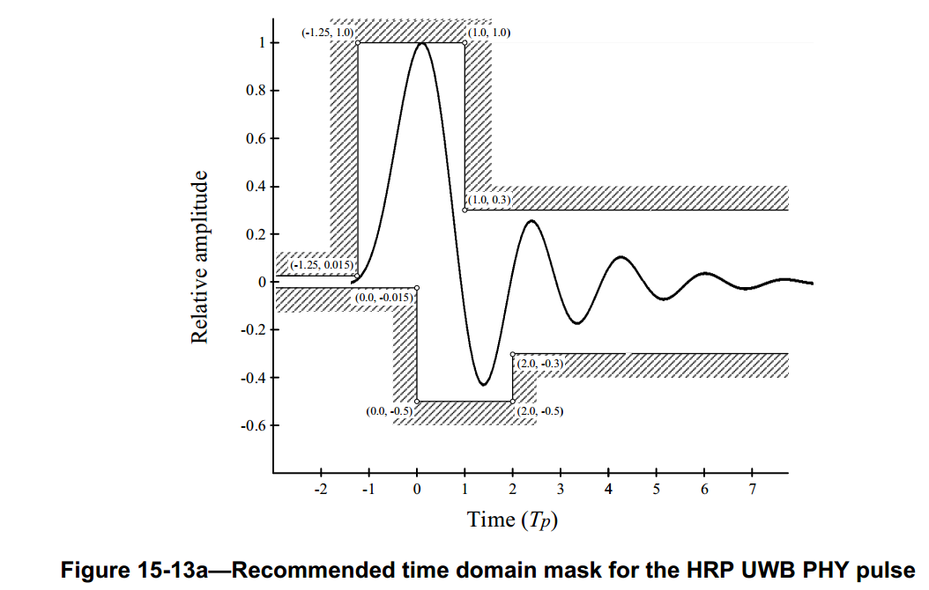
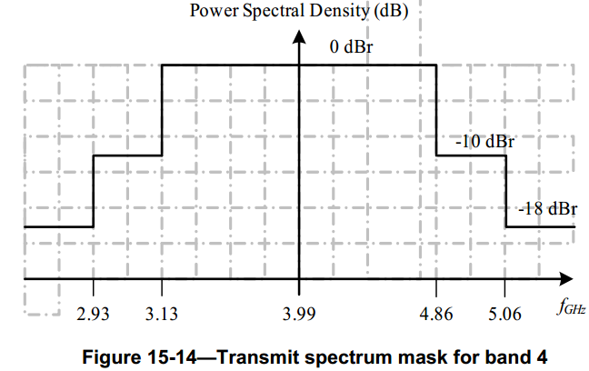
Background—minimum-precursor pulse
Time domain mask: in order to improve the ranging performance, a precursor-free pulse is recommended in IEEE 802.15.4z amendment that should conform to the time-domain mask shown in Fig.15-13a.
PSD mask: the transmitted spectrum shall be less than -10dB relative to the maximum spectral density of the signal for 0.65/T_{p}<|f-f_{c}|<0.8/T_{p} and -18dB for |f-f_{c}|>0.8/T_{p}. For example, the transmit spectrum mask for channel 4 is shown as below.
Pulse example: 8th order Butterworth pulse is a example of minimum-precursor pulse
Recommended time domain mask for the HRP UWB PHY pulse
Transmit spectrum mask for band 4

Slide 6
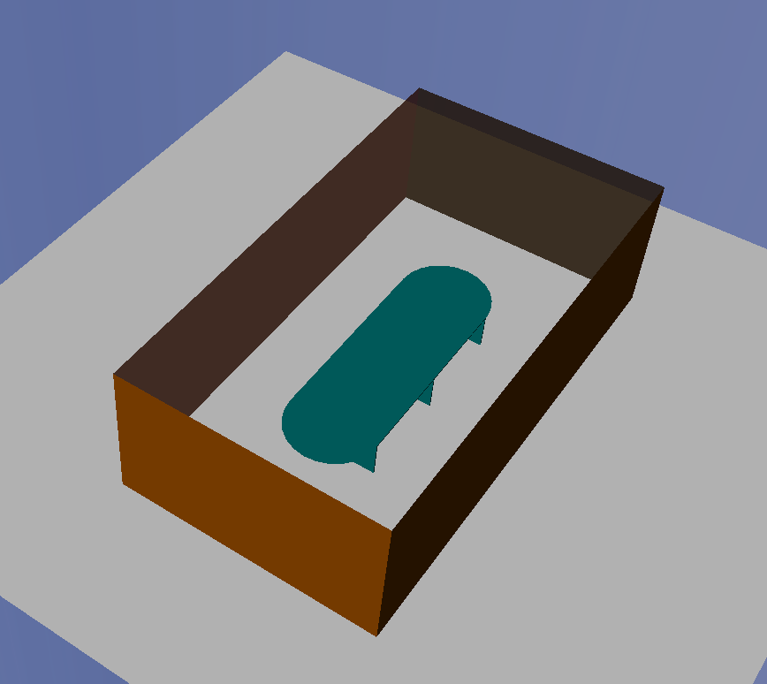

Motivation of existing pulse shape for ranging
For ranging application, it focuses on how to accurately measure the timestamp of the earliest path. The reflected path is considered as interference in this case.
In order to minimize the impact of the reflected path on the earliest path, the precursor on the left side of the mainlobe tends to zero. As shown in the following figure, the peak position of the earliest path is not changed after superposition with the reflected path.
The earliest path
Reflected path
Node B
Node A
The earliest path and the reflected path
Superposition of the earliest path and the reflected path
Ranging application

Slide 7
Limitation of existing pulse shape for sensing
For sensing application, it focuses on how to accurately measure the parameters of the reflected path. The earliest path is considered as interference in this case.
If the same pulse shape is used as in the ranging application, the postcursor of the earliest path will affect the amplitude of the reflected path. As shown in the following figure, the peak position of the reflected path is changed by the postcurser of the earliest path, which will lead to a wrong estimation of the reflection point.
The earliest path
Node B
Reflected path
Node A
Reflection point1
Sensing application
The earliest path and the reflected path
Superposition of the earliest path and the reflected path

Slide 8
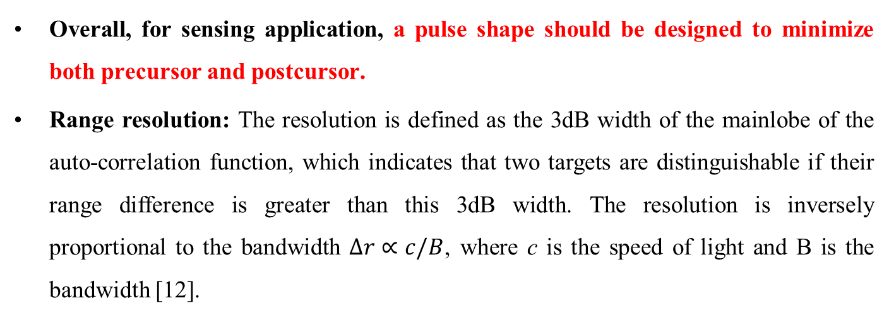

Requirements of pulse shape for sensing
Overall, for sensing application, a pulse shape should be designed to minimize both precursor and postcursor.
Range resolution: The resolution is defined as the 3dB width of the mainlobe of the auto-correlation function, which indicates that two targets are distinguishable if their range difference is greater than this 3dB width. The resolution is inversely proportional to the bandwidth $Δr∝c/B$, where c is the speed of light and B is the bandwidth [12].
3dB width
$$AF\left(τ\right)=\int_{−∞}^{+∞}{s\left(t\right)s^{∗}\left(t−τ\right)dt}$$
Auto-correlation function

Slide 9



Requirements of pulse shape for sensing
PSLR (peak sidelobe level ratio): The main source of ringing artifacts is due to a signal being band-limited. The ratio, usually expressed in decibels (dB), of the amplitude at the peak of the mainlobe to the amplitude at the peak of the sidelobe [12].
Spectrum efficiency: The sensing pulse shape should have a spectrum that complies with the PSD mask defined by 802.15.4z. The spectrum efficiency is defined as:
PSLR
$$AF\left(τ\right)=\int_{−∞}^{+∞}{s\left(t\right)s^{∗}\left(t−τ\right)dt}$$
$$η=\frac{\int{S_{p}\left(f\right)df}}{\int{S_{mask}\left(f\right)df}}$$
$S_{p}(f)$ and $S_{mask}(f)$ are the power density spectrum of the transmitted signal and the PSD mask, respectively.

Slide 10



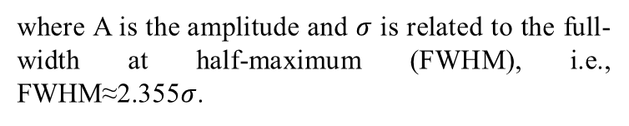
Pulse shape design methods
Method 1: Gaussian pulse — a Gaussian pulse is shaped as a Gaussian function with no precursor and postcursor. It can be expressed as:
Method2: Basic pulse + Gaussian window — in order to reduce the ringing of the pulse, a Gaussian window is applied to the basic pulse (Butterworth pulse) and a new pulse with reduced sidelobe level is obtained. The new pulse also complies with the PSD mask with the following expression:
$$p(t)=Ae^{−\frac{t^{2}}{2σ^{2}}}$$
$$FWHM≈2.355σ$$
where A is the amplitude and $σ$ is related to the full-width at half-maximum (FWHM), i.e., FWHM≈2.355$σ$.
$$p_{w}\left(t\right)=p\left(t\right)w(t)$$
where p(t) is the transmitted signal and w(t) is a Gaussian window.

Slide 11
Basic pulse shape
Cutoff point 2
Cutoff point 3
Cutoff point 1
Cutoff point 4
Pulse shape | Resolution (ns) | PSLR (dB) | Spectrum efficiency
5th order Butterworth | 1.671 | 16.02 | 73.92%
6th order Butterworth | 1.698 | 15.21 | 73.32%
7th order Butterworth | 1.720 | 14.71 | 72.83%
8th order Butterworth | 1.728 | 14.38 | 72.25%
9th order Butterworth | 1.741 | 14.15 | 71.72%
10th order Butterworth | 1.747 | 14.00 | 71.58%
11th order Butterworth | 1.760 | 13.51 | 63.51%

Slide 12
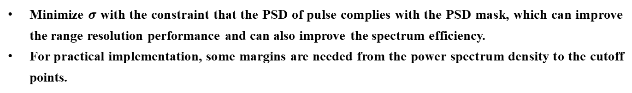
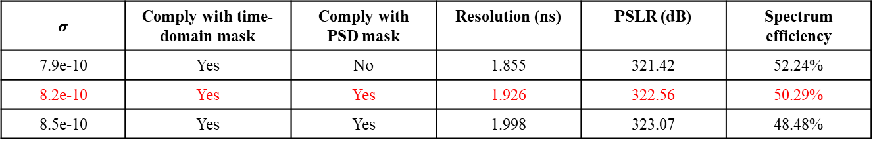
Gaussian pulse shape
Cutoff point 2
Cutoff point 3
Cutoff point 1
Cutoff point 4
$$σ$$ | Comply with time-domain mask | Comply with PSD mask | Resolution (ns) | PSLR (dB) | Spectrum efficiency
7.9e-10 | Yes | No | 1.855 | 321.42 | 52.24%
8.2e-10 | Yes | Yes | 1.926 | 322.56 | 50.29%
8.5e-10 | Yes | Yes | 1.998 | 323.07 | 48.48%
Minimize $σ$ with the constraint that the PSD of pulse complies with the PSD mask, which can improve the range resolution performance and can also improve the spectrum efficiency.
For practical implementation, some margins are needed from the power spectrum density to the cutoff points.

Slide 13
Windowed basic pulse shape
Cutoff point 2
Cutoff point 3
Cutoff point 1
Cutoff point 4
Basic pulse shape + Guassian window | Resolution (ns) | PSLR (dB) | Spectrum efficiency
5th order Butterworth+3.6e-9 | 1.677 | 18.40 | 70.40%
6th order Butterworth+2.2e-9 | 1.711 | 21.53 | 66.45%
7th order Butterworth+1.8e-9 | 1.731 | 23.85 | 64.31%
8th order Butterworth+1.65e-9 | 1.752 | 25.38 | 62.74%
9th order Butterworth+1.55e-9 | 1.765 | 26.73 | 61.39%
10th order Butterworth+1.45e-9 | 1.777 | 28.50 | 60.36%
11th order Butterworth+1.40e-9 | 1.784 | 28.86 | 59.94%

Slide 14
Performance comparison
Pulse shape | Resolution (ns) | PSLR (dB) | Spectrum efficiency
5th order Butterworth | 1.671 | 16.02 | 73.92%
6th order Butterworth | 1.698 | 15.21 | 73.32%
7th order Butterworth | 1.720 | 14.71 | 72.83%
8th order Butterworth | 1.728 | 14.38 | 72.25%
9th order Butterworth | 1.741 | 14.15 | 71.72%
10th order Butterworth | 1.747 | 14.00 | 71.58%
11th order Butterworth | 1.760 | 13.51 | 63.51%
Gaussian pulse 8.2e-10 | 1.926 | 322.56 | 50.29%
Gaussian pulse 8.5e-10 | 1.998 | 323.07 | 48.48%
5th order Butterworth+3.6e-9 | 1.677 | 18.40 | 70.40%
6th order Butterworth+2.2e-9 | 1.711 | 21.53 | 66.45%
7th order Butterworth+1.8e-9 | 1.731 | 23.85 | 64.31%
8th order Butterworth+1.65e-9 | 1.752 | 25.38 | 62.74%
9th order Butterworth+1.55e-9 | 1.765 | 26.73 | 61.39%
10th order Butterworth+1.45e-9 | 1.777 | 28.50 | 60.36%
11th order Butterworth+1.40e-9 | 1.784 | 28.86 | 59.94%
Resolution: the 5th order Butterworth pulse is the best one.
PSLR: the Gaussian pulse is the best one.
Spectrum efficiency: the 5th order Butterworth pulse is the best one.

Slide 15
Performance comparison
Resolution: the 5th order Butterworth pulse is the best one.
PSLR: the Gaussian pulse is the best one.
Spectrum efficiency: the 5th order Butterworth pulse is the best one.

Slide 16
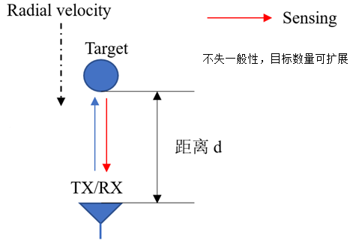
End to end simulation
Channel model: Based on current 802.15.4a channel model, we set a ‘stable’ channel, in which there are some dynamic paths (red line in Fig.1) relating to the targets.
Simulation scenario: According to the position of TX/RX, we set the radial range and velocity. The delay and amplitude of dynamic paths will change overt time, while other multipaths keep unchanged.
Parameters | Value
BW | 499.2MHz
PRF | 62.4MHz
CPI | 100ms
fc | 7987.2MHz
Range resolution | 0.3m
Dynamic path
Channel model
Scenario
Simulation configuration

Slide 17
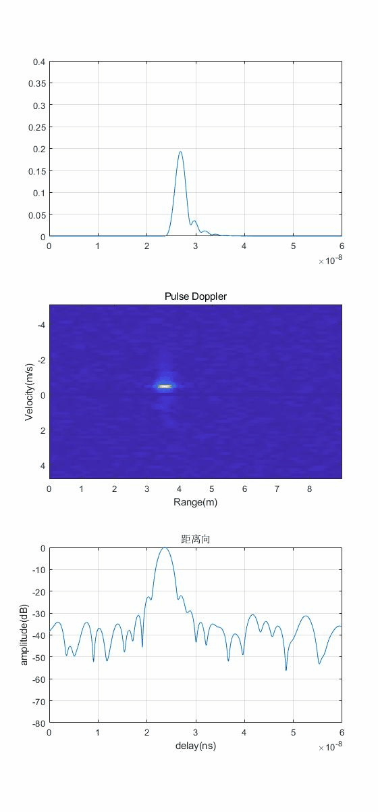
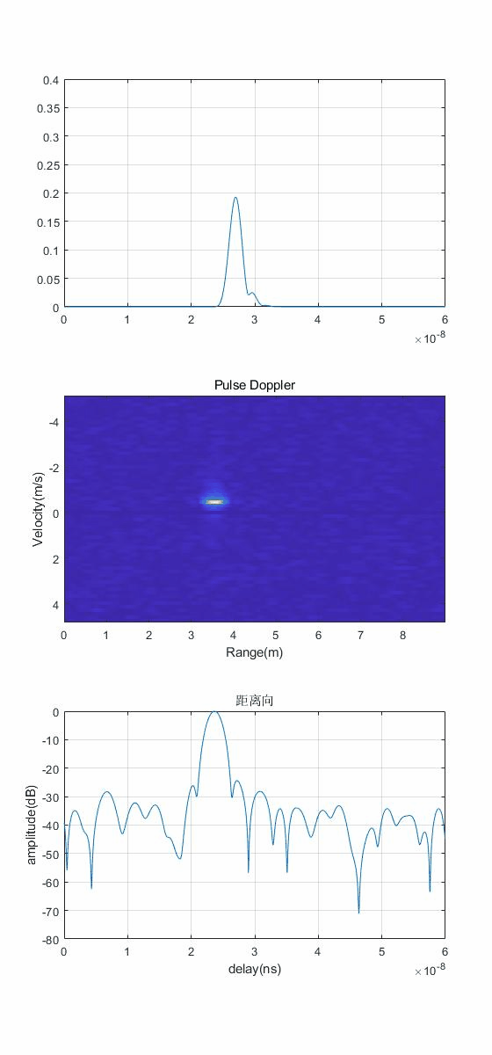
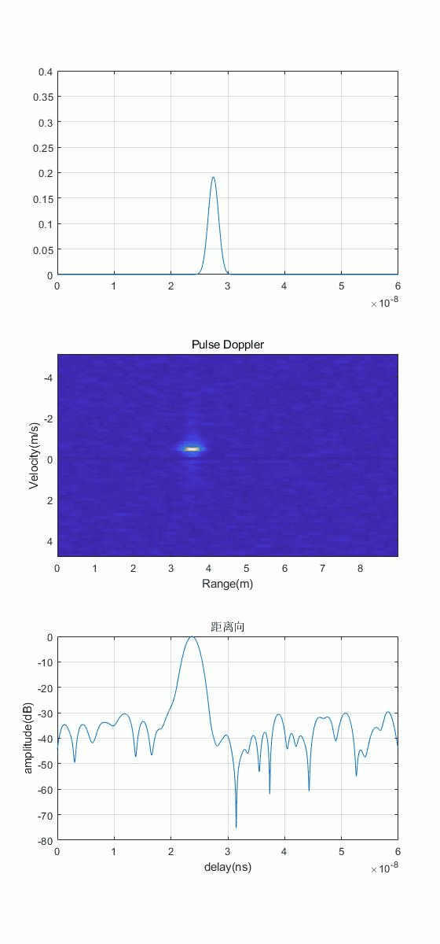




End to end simulation
5th Butterworth pulse shape
5th Butterworth+Gaussian pulse shape
Gaussian pulse shape
v2 = -0.5m/s
v2 = -0.5m/s
v2 = -0.5m/s
v1 = -0.5m/s
v1 = -0.5m/s
v1 = -0.5m/s
$$Δd=d2−d1$$
$$Δd=d2−d1$$
$$Δd=d2−d1$$
d1
d1
….
d1
Radial velocity
TX/RX
Radial velocity
TX/RX
Radial velocity
TX/RX
Snapshot#1
$$d1=3.5m$$
$$Δd=0.05m$$
$$d1=3.5m$$
$$Δd=0.1m$$
Snapshot#10
$$d1=3.5m$$
$$Δd=N∗0.05m$$
Snapshot#2

Slide 18
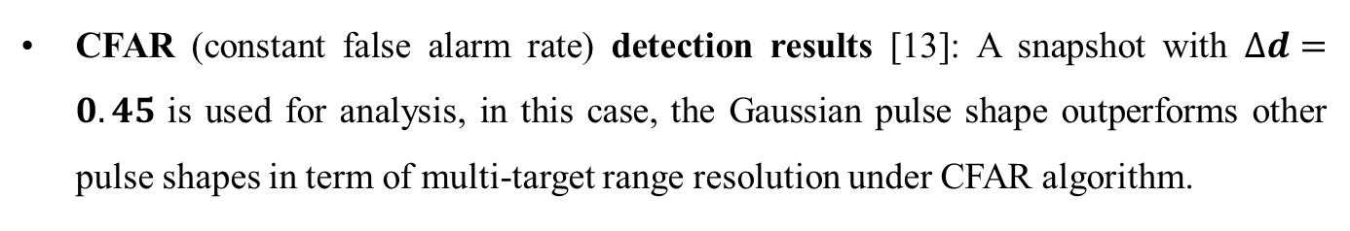
End to end simulation
CFAR (constant false alarm rate) detection results [13]: A snapshot with $∆d=0.45$ is used for analysis, in this case, the Gaussian pulse shape outperforms other pulse shapes in term of multi-target range resolution under CFAR algorithm.
5th Butterworth pulse shape
5th Butterworth+Gaussian pulse shape
Gaussian pulse shape

Slide 19
Pulse Shape – Proposal Outline
  For sensing application, a pulse shape should be designed to minimize both precursor and postcursor.
  It is recommended to use some upper layer message or dedicated IE to indicate the pulse shape.
The Gaussian pulse is a good candidate pulse shape for sensing, but it has 1.6dB spectrum efficiency loss compared with 8th order Butterworth pulse shape.
Although the spectrum efficiency of the Butterworth pulse shape is higher than the Gaussian pulse shape, a portion of the energy is leaked out through the side lobe, which is harmful for the sensing performance.
A more restricted time-domain mask with bounded sidelobe level should be defined in sensing scenario.
A pulse shape designed to minimize both precursor and postcursor can be used for sensing and ranging simultaneously.

Slide 20
References
Amendment1: Enhanced ultra wideband (UWB) physical layers (PHYs) and associated ranging techniques
IEEE standard for low-rate wireless networks
UWB spectral mask and FFC part 15 limits
15-19-0443-01-004z text to address comment id r1-0820 (Michael McLaughin)
15-20-0084-00-004z pulse shaping considerations (Jochen Hammerschmidt)
15-20-0086-00-004z proposed pulse shape text changes for HRP UWB PHY (Michael McLaughin)
15-20-0089-01-004z pulse shape text changes for HRP UWB PHY (Michael McLaughin)
15-22-0040-04-04ab waveform design for UWB sensing (Xiaohui Peng)
15-22-0175-00-04ab sensing device (Dag T. Wisland )
15-22-0061-00-04ab sensing – continued (Frank Leong)
15-22-0305-00-04ab a summary of proposals and interests (Billy Verso)
Derham, T., et al. "Ambiguity functions for spatially coherent and incoherent multistatic radar." IEEE Transactions on Aerospace and Electronic Systems 46.1 (2010): 230-245.
C. Xu, Y. Li, C. Ji, Y. Huang, H. Wang and Y. Xia, "An improved CFAR algorithm for target detection," 2017 International Symposium on Intelligent Signal Processing and Communication Systems (ISPACS), 2017, pp. 883-888.

