Slide 1
Project: IEEE P802.15 Working Group for Wireless Personal Area Networks (WPANs)
Submission Title: [TG15.6ma Closing Report for July 2022]
Date Submitted: [14th July 2022]
Source: [Ryuji Kohno1,2,] [1;Yokohama National University, 2;YRP International Alliance Institute(YRP-IAI)]
Address [1; 79-5 Tokiwadai, Hodogaya-ku, Yokohama, 240-8501 Japan
2; YRP1 Blg., 3-4 HikarinoOka, Yokosuka-City, Kanagawa, 239-0847 Japan]
Voice:[1; +81-90-5408-0611], FAX: [+81-45-383-5528],
Email:[1: kohno@ynu.ac.jp, 2: kohno@yrp-iai.jp] Re: []
Abstract: [This document contains closing report for TG15.6ma for Revision of P802.15.6-2012 with Enhanced Dependability July 2022.]
Purpose: [information]
Notice: This document has been prepared to assist the IEEE P802.15. It is offered as a basis for discussion and is not binding on the contributing individual(s) or organization(s). The material in this document is subject to change in form and content after further study. The contributor(s) reserve(s) the right to add, amend or withdraw material contained herein.
Release: The contributor acknowledges and accepts that this contribution becomes the property of IEEE and may be made publicly available by P802.15.

Slide 2
IEEE 802.15 TG6ma
(Revision of IEEE802.15.6-2012)
Closing Report
In Personal and Virtual Hybrid Plenary Session
July 14th, 2022
Ryuji Kohno
Yokohama National University(YNU),
YRP International Alliance Institute(YRP-IAI)

Slide 3
Objectives of TG 6ma – Enhanced Dependability Body Area Network (ED-BAN)
Objective: Enhancements to the BAN Ultra Wideband (UWB) physical layer (PHY) and media access control (MAC) to support enhanced dependability to a human BAN (HBAN) and adds support for vehicle body area networks (VBAN), a coordinator in a vehicle with devices around the vehicular cabin.
Action:
Complete Channel Model Document(CMD) for revision
Discussion on MAC for enhanced dependability
Complete Technical Requirement Document(TRD)
Feasibility and satisfaction in market of the TRD
Feasibility of TSN of 802.1 in MAC and interference mitigation in PHY and MAC
Joint Meeting with other groups for harmonization to resolve common problems
Next Things to Do：
Complete all documents for call for proposals

Slide 4
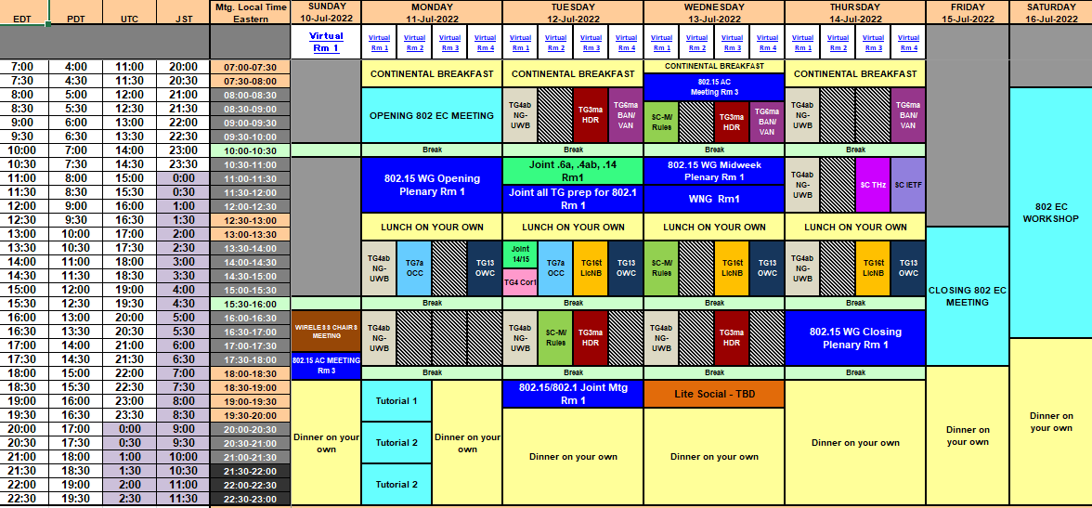
TG15.6ma Plenary Session Schedule for 10-18th, July 2022
TG15.6ma has three own sessions and one joint session such as
Session1: AM1 8:00-10:00 EDT, July 12(TUE), 21:00-23:00 JST
Joint Session TG6a,TG4ab,TG14:AM2 10:30-11:30 July 12(TUE) EDT, 23:30-24:30 JST
Session2 AM1 8:30-10:00 EDT, July 13(WED), 21:30-23:00 JST
Session3: AM1 9:00-11:00 EDT, July 14(THU), 21:00-23:00 JST

Slide 5
TG15.6ma Plenary Session Schedule for 10-18th July 2022
 | July 11th Monday | July 12th Tuesday | July 13th Wednesday | July 14th Thursday
EDT 8:00AM-10:00AM JST: 9:00-11:00PM |  | AM1 TG15.6ma Session 1 | 8:30-10:00AM1 TG15.6ma Session 2 | AM1 TG15.6ma Session 3
EDT 11:30AM-12:30AM JST:+1day 0:30-1:30AM | IEEE802.15 Opening Plenary | AM2 Joint Session TG15.6a, 4ab, &TG14
EDT 4:30PM-15:30PM JST:+1day 5:00-6:00AM |  |  |  | IEEE802.15 Closing Plenary
1. TG 15.6ma Session1,2,3, Tue AM1 (Virtual Room #4)
8:00 AM - 10:00 AM Tue. July 12th,14th 2022 (UTC-04:00) Eastern Time,
8:30 AM - 10:00 AM Tue. July 13th 2022 (UTC-04:00) Eastern Time,
9:00 PM - 11:00PM Tue July 12th,14th 2022 (UTC+9:00) Japan & Korean Time
9:30 PM - 11:00PM Tue July 13th 2022 (UTC+9:00) Japan & Korean Time
https://ieeesa.webex.com/ieeesa/j.php?MTID=m7fadbeaa09b94a2eddcb2fa6535f638d
Meeting number: 2337 002 2352
Password: 80215mtgrm4
Opening and Closing Plenary sessions
Session TG15.6a, 4ab, &TG14 (Virtual Room #1)
EDT 11:30AM-12:30AM July 12th Wednesday
JST:+1day 0:30-1:30AM July 13th Thursday
https://ieeesa.webex.com/ieeesa/j.php?MTID=m6f062ff14eb2736e35dafaf57512b515
Meeting number: 2336 930 3122
Password: 80215mtgrm1

Slide 6
Agenda items for the week
TG15.6a meeting call to order
Call for essential patents and policies & procedures reminder
Approve last meeting minutes: TG 15.6a Meeting Minutes for May 2022 doc.#15-22-0301-00-06a
Agenda of TG15.6ma July Meeting doc.#15-22-0338-02-06ma
Review
  Overview of IG-DEP, SG6a, TG6a, and TG15.6ma for Revision of IEEE802.15.6-2012 Wireless BAN with Enhanced Dependability doc.#15-22-0389-00-06ma
  2. Revision PAR and CSD for IEEE802.15.6ma doc.#15-22-0168-02-06a doc.#15-22-0167-03-06a
  3. Summary of Channel and Environment Model doc.#15-22-0091-03-06a
  Considerations for MAC protocol in IEEE 802.15.6 BAN with Enhanced Dependability doc.#15-22-0186-01-06a
  Interference modeling in the Technical Requirements Document doc.#15-22-0052-00-06a
  Coordinator-to-coordinator communication for Body Area Networks doc.#15-21-0582-02-06a
  Presentation
  Draft TG6ma Channel Model Document for Enhanced Dependability doc.#15-22-0344-00-06ma
  MAC proposal for supporting dependable BAN service classes doc.#15-22-0354-01-06ma
  MAC Proposal on Interference Avoidance in Coexisting Dependable BAN doc.#15-22-0355-01-06ma
  MAC Proposal for BAN with Enhanced Dependability doc.#15-22-0277-01-06ma
  Hybrid ARQ Scheme Utilizing Decomposable Error Correcting Code for Dependable WBAN .#15-22-0375-00-06ma
  MAC Bridging for Time-Sensitive Networking of 802.15.6ma doc.#15-22-0024-00-06a
  Introduction of ESTI Smart BAN and collaboration possibility between IEEE 802.15.6 and ESTI SmartBAN 415-00
  Propagation characteristics of UWB communication applications including medical implants #15-22-0399-00-06ma
  Statistical Pathloss Model for UWB Wireless Capsule Endoscopy doc.#15-22-0401-01-06ma
  Channel Model for Wearable and Implant BAN in use case of BMI and BCI doc.#15-22-0269-02-06a
  Discussion of Numerical Human Body Voxel Model doc.#15-22-0403-00-06ma
  UWB Channel Models Document doc.#15-22-0344-00-06ma
Discussion
1. Common Channel Model for Harmonization with TG 15.6a, 4ab, 5.14, and ETSI Smart BAN
:2. Complete Channel Model Document(CMD)
3. Complete TRD of Enhanced Dependable BAN for Revision of IEEE802.15.6-2012
4. Feasible Technologies for Satisfying the Technical Requirement
5. Timeline for next July and September meetings and later doc.#15-22-0419-00-06ma

Slide 7
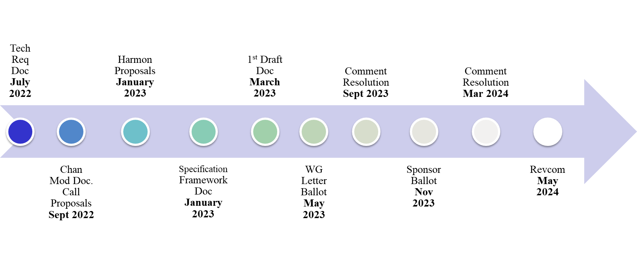
TG15.6ma Timeline
July 2022
All dates indicate deadlines

Slide 8
July 2022
TG15.6ma Timeline Details.
Topic | Deadline | Notes
Technical Requirements Document | July 2022 | Technical requirements baseline for evaluation of proposals.
Channel Model Document (CMD). Call for Proposals. | Sept. 2022 | Finalize CMD. Announcement of call for proposals.
Harmonization of Proposals | January 2023 | Discussions to harmonize all proposals.
Specification Framework Document | January 2023 | Summary of approved proposals.
1st Draft Specification Document | March 2023 | TG approval of 1st Draft Specification.
802.15 WG Letter Ballot | May 2023 | WG letter ballot submission.
Comment, Resolution for LB | Sept 2023 | Resolutions to letter ballot comments.
IEEE SA Sponsor Ballot | November 2023 | WG approval to Sponsor Ballot.
Comment, Resolution for SB | March 2024 | Resolutions to sponsor ballot comments.
RevCom submission | May 2024 | RevCom submission.
Note: the deadlines are subject to change.

Slide 9
Contributions
・TG15.6ma opening report for July 2022 meeting 15-22-0336-01-06ma
・TG15.6ma Agenda of July Meeting in 2022 15-22-0338-07-06ma
・Overview of IG-DEP, SG6a, TG6a, and TG15.6ma for Revision of IEEE802.15.6-2012 Wireless BAN with Enhanced Dependability 15-22-0389-00-06ma
・Draft TG6ma Channel Model Document for Enhanced Dependability 15-22-0344-00-06ma
・MAC proposal for supporting dependable BAN service classes 15-22-0354-01-06ma
・MAC Proposal on Interference Avoidance in Coexisting Dependable BAN 15-22-0355-01-06ma
・MAC Proposal for BAN with Enhanced Dependability 15-22-0277-01-06ma
・Hybrid ARQ Scheme Utilizing Decomposable Error Correcting Code for Dependable WBAN .15-22-0375-00-06ma
・MAC Bridging for Time-Sensitive Networking of 802.15.6ma 15-22-0024-00-06a
・Introduction of ESTI Smart BAN and collaboration possibility between IEEE 802.15.6 and ESTI SmartBAN
15-22-0415-00-06ma
・Propagation characteristics of UWB communication applications including medical implants 399-00-06ma
・Statistical Pathloss Model for UWB Wireless Capsule Endoscopy 15-22-0401-01-06ma
・Channel Model for Wearable and Implant BAN in use case of BMI and BCI 15-22-0269-02-06a
・Discussion of Numerical Human Body Voxel Model 15-22-0403-00-06ma
・UWB Channel Models Document 15-22-0344-00-06ma
・TG15.6ma Timeline 15-22-0419-00-06ma
・TG15.6ma Meeting Minutes for July 2022 15-22-0417-00-06ma
・TG15.6ma Closing Report for July 2022 15-22-0416-00-06ma

Slide 10
Contacts and Conference call
Chair; Ryuji Kohno, YNU/YRP-IAI
kohno@ynu.ac.jp, kohno@yrp-iai.jp
Vice-Chair; Marco Hernandez, YRP-IAI/CWC
Marco.Hernandez@ieee.org
3. Secretary; Takumi Kobayashi, YNU/TCU
kobayashi-takumi-ch@ynu.ac.jp
Technical Editor; Minsoo Kim, YRP-IAI
minsoo@minsookim.com

Slide 11
Thank You !
Any Questions ?

