Slide 1
        doc.: 15-22-0413-00-04ab
Project: IEEE P802.15 Working Group for Wireless Personal Area Networks (WPANs)
Submission Title: Performance analysis of ranging integrity fragment (RIF) with distance commitment
Date Submitted: 14 July 2022
Source: David Barras, Boris Danev (3db)
Address: 3db Access AG, Lavaterstrasse 76, Zurich, Switzerland
E-Mail: david.barras@3db-access.com, boris.danev@3db-access.com
Abstract: Evaluation of the wireless performance of the ranging integrity fragment (RIF)
Purpose: Introducing the concept of distance commitment for ranging integrity checks
Notice: This document has been prepared to assist the IEEE P802.15. It is offered as a basis for discussion and is not binding on the contributing individual(s) or organization(s). The material in this document is subject to change in form and content after further study. The contributor(s) reserve(s) the right to add, amend or withdraw material contained herein.
Release: The contributor acknowledges and accepts that this contribution becomes the property of IEEE and may be made publicly available by P802.15.

Slide 2
Performance analysis of
Ranging Integrity Fragments (RIF)
        doc.: 15-22-0413-00-04ab
Notes:
affiliation

Slide 3
        doc.: 15-22-0413-00-04ab
PAR Objective | Proposed Solution (how addressed)
Safeguards so that the high throughput data use cases will not cause significant disruption to low duty-cycle ranging use cases
Interference mitigation techniques to support higher density and higher traffic use cases
Other coexistence improvement
Backward compatibility with enhanced ranging capable devices (ERDEVs)
Improved link budget and/or reduced air-time | NBA-MMS to improve link budget and provide secure ranging by means of Ranging Integrity Fragments (RIF)
Additional channels and operating frequencies
Improvements to accuracy / precision / reliability and interoperability for high-integrity ranging | Quantifiable integrity levels that are not channel-dependent to allow interoperability
Reduced complexity and power consumption | distance commitment approach on challenge/response messages, real time and reduced post-processing
Hybrid operation with narrowband signaling to assist UWB | Exploit tightly coupled concurrent operation of NB for secure ranging
Enhanced native discovery and connection setup mechanisms
Sensing capabilities to support presence detection and environment mapping
Low-power low-latency streaming
Higher data-rate streaming allowing at least 50 Mbit/s of throughput
Support for peer-to-peer, peer-to-multi-peer, and station-to-infrastructure protocols
Infrastructure synchronization mechanisms

Slide 4
References
        doc.: 15-22-0413-00-04ab
[0262] 15-22-0262-01-04ab-nba-uwb-technical-framework-proposal
[0074] 15-22-0074-00-04ab-link-budget-analysis-for-nba-mms
[0076] 15-22-0076-00-04ab-extending-nbuwb-for-secure-ranging
[0392] 15-22-0392-00-04ab-more-on-mixed-mms-for-ranging-integrity
[4z-2020] IEEE Std 802.15.4z‐2020
[CM4a] Ieee802 15 4a Channel Model Matlab Code Ver 9, TG4a, DCN 114

Slide 5
Introduction (1/2)
        doc.: 15-22-0413-00-04ab
Motivation is to propose a scheme …
  … that provides a PHY for ranging integrity with high link budget (≈100 dB)
  … whose integrity level can be quantified (for device interoperability)
  … that can be processed real-time with the lowest possible power consumption
  … based on the NBA-MMS foundations proposed in [0262]
Proposal for ranging integrity for “4ab” was presented in [0076]
  From [0392] renamed “UWB SEC” into
RIF = “Ranging Integrity Fragment”
1ms
(X-2) ms
(1+Z) ms
1ms
(Y-2) ms
Narrow
band
Preamble
Fragment
1
Preamble
Fragment
2
Preamble
Fragment
X
Ranging Integrity
Fragment
1
Ranging Integrity
Fragment
2
Ranging Integrity
Fragment
Y
NB ← → UWB
Source: More on Mixed MMS for Ranging Integrity (X. Luo et al) – TG4ab DCN 0392

Slide 6
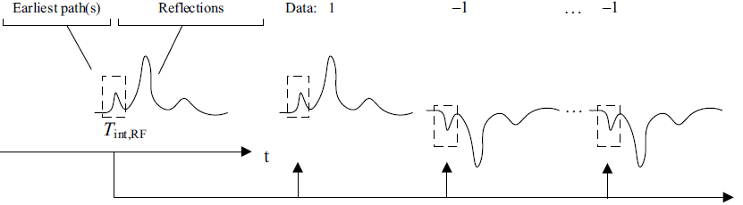
Introduction (2/2)
        doc.: 15-22-0413-00-04ab
Proposal for RIF
  The scheme is based on exchange
  of challenge/response messages
  with distance commitment
  § 10.3.2 in [4z-2020]
  It consists in checking the
  challenges/responses RIF messages
  by applying a bit error tolerance
  according to the security level
  § 6.9.8.2.2 in [4z-2020]
  The challenges/responses RIF messages consists of bursts of UWB pulses carrying a bit of information: a burst may consist in 1 pulse (as 4z STS) or many pulses (similar to legacy HRP payload)

Slide 7
Security Guarantees from Distance Commitment
        doc.: 15-22-0413-00-04ab
Distance Commitment is quantifying the integrity level by two parameters:
  Security level in bits (hardness assumption)
    Fixing the probability of guessing the random challenge/response message
  Time aperture in [nano]seconds
    Defining the maximum distance decrease in case of a correct guess of the random challenge/response message (T_{int,RF})

Slide 8
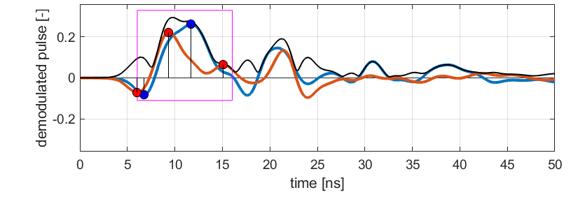
More on the Distance Commitment Principle
        doc.: 15-22-0413-00-04ab
Distance Commitment consists in
  measuring the time-of-arrival (ToA) during UWB PRE fragment by retrieving channel information using optimized sequences (such as Ipatov or other)
  verify the incoming data of a challenge/response message
    distance commitment requires that the message is checked at the 1st path’s ToA
    a time aperture T_{int,RF} after the 1st path is allowed for collecting more energy/paths
    T_{int,RF} is trading off max. theoretical distance reduction against communication performances
first path (ToA)
time aperture for late paths
(here T_{int,RF}=10ns, starting from 1st path)
paths found during UWB PRE fragment

Slide 9
Security Guarantees from Distance Commitment
        doc.: 15-22-0413-00-04ab
From equation SecLev(L,k) the security level is quantifiable :
the maximum number of errors (markers) is given as a function of the challenge size in number of bits (x-axis) for different security levels (20, 32, 64, 128 and 256 bits)
this requirement corresponds to an equivalent maximum BER in the RIF message
markers : for an increase of the security level by a factor 2 (32 to 64 bits), with same number of bits, the sensitivity reduction is 3.3 dB (more Eb/No) → Link budget reduces by 3.3 dB

Slide 10
Security Guarantees from Distance Commitment
        doc.: 15-22-0413-00-04ab
markers : sending twice the number of bits over 2 fragments results in 3.1 dB incremental link budget
(1+Z) ms
(1+Z) ms
1ms
Preamble
Fragment
X
Ranging Integrity
Fragment
1
Preamble
Fragment
X
Ranging Integrity
Fragment
1
Ranging Integrity
Fragment
2
2048 bits / <882 errors
4096 bits / <1848 errors

Slide 11
Sensitivity of Ranging Integrity Fragment
        doc.: 15-22-0413-00-04ab
Sensitivity performances of a single RIF message using distance commitment
  Fixed security level of 32 bits
  Pulses are grouped in bursts of 1 or 4 pulses
  → burst repetition frequency: BRF = PRF/[1 or 4]
  Same mean PRF = 62.4 MHz
  Same number of pulses used for each RIF format
  Clock offset (that introduces CFO/SFO) is also known (has been extracted from NB fragment) and fixed to 0 ppm in the following performance simulations

Slide 12
Results in AWGN
        doc.: 15-22-0413-00-04ab
Comparison of sensitivity between UWB PRE fragment and RIF in AWGN
32-bit equivalent security level (e. g. 2048 bits / <882 errors)
PRE has a 6 dB better sensitivity:
P_{RX,1RIF} - P_{RX,1PRE} = ΔP_{RX} = 6 dB
→ to balance PRE and RIF in AWGN
a 1:4 ratio is needed for #PRE:#RIF
(RIF is the “bottleneck” due to security
hardness requirement and the unique path)
→ Link budget for 32-bit secure ranging
reaches 100 dB (assuming 12 dB
implementation losses and P_{TX} = -7.5 dBm)
ΔP_{RX|AWGN}=6dB

Slide 13
Results in CM
        doc.: 15-22-0413-00-04ab
Comparison between PRE fragment and RIF under NLOS channels
Channel assumptions
  NLOS channels from ref. [CM4a]
  Channel State Information (CSI) is obtained from the UWB preamble fragment of the NBA-MMS message and is considered perfect
Receiver model
  Criteria for a successful PRE in NLOS CM:
  PRE shall give a valid position of
  the early path (compared to the
  early path in noiseless conditions)
  The window aperture duration T_{int,RF} is set
  according to the burst duration, i.e. 4ns,16ns
  → same total window duration for all cases
  (fair comparison from the point of view
  of communication performances)
  Matched filter over window aperture T_{int,RF}
T_{int,RF} = 4ns
T_{int,RF} = 16ns

Slide 14
Results in CM
        doc.: 15-22-0413-00-04ab
Comparison between PRE fragment and RIF under NLOS channels
Median PRE and RIF sensitivity values are similar; however, PRE has a wider spread and may becomes the bottleneck of the MMS frame
Bursts of 4 pulses exhibits:
- better median sensitivity, but max. mean PSD almost cancel this advantage
- significantly smaller spread → improvement of worst cases by > 10 dB!
CM2 (residential NLOS) CM4 (office NLOS)

Slide 15
Summary & Conclusions
        doc.: 15-22-0413-00-04ab
The analysis of the sensitivity performance of the RIF under challenge/response distance commitment has been performed
We considered the RIF with a burst of 1 and 4 pulses, while showing same median sensitivity, a 4 pulses per burst significantly improve the worst cases performance under NLOS by > 10 dB
MMS scheme allows to optimally balance the receiver performances for the PRE and the RIF fragment for any targeted security level
Outlook
  perform analysis on other CM (body TG6) and other RIF burst formats and BRF

