Slide 1
Project: IEEE P802.15 Working Group for Wireless Personal Area Networks (WPANs)
Submission Title: [NBA-MMS UWB - Security Considerations]
Date Submitted: [14 July, 2022]
Source: [Claudio Anliker, Patrick Leu, Giovanni Camurati, Srdjan Capkun (ETH Zurich)]
Re: [Input to the Working Group]
Abstract: [This document discusses security implications of the NBA-MMS UWB proposal.]
Purpose: []
Notice: This document has been prepared to assist the IEEE P802.15. It is offered as a basis for discussion and is not binding on the contributing individual(s) or organization(s). The material in this document is subject to change in form and content after further study. The contributor(s) reserve(s) the right to add, amend or withdraw material contained herein.
Release: The contributor acknowledges and accepts that this contribution becomes the property of IEEE and may be made publicly available by P802.15.

Slide 2
PAR Objective | Proposed Solution (how addressed)
Safeguards so that the high throughput data use cases will not cause significant disruption to low duty-cycle ranging use cases
Interference mitigation techniques to support higher density and higher traffic use cases
Other coexistence improvement
Backward compatibility with enhanced ranging capable devices (ERDEVs)
Improved link budget and/or reduced air-time
Additional channels and operating frequencies
Improvements to accuracy / precision / reliability and interoperability for high-integrity ranging | Describes challenges related to clock frequency offsets in combination with multi-millisecond frames.
Reduced complexity and power consumption
Hybrid operation with narrowband signaling to assist UWB | Describes risks of an NB-based offset estimation.
Enhanced native discovery and connection setup mechanisms
Sensing capabilities to support presence detection and environment mapping
Low-power low-latency streaming
Higher data-rate streaming allowing at least 50 Mbit/s of throughput
Support for peer-to-peer, peer-to-multi-peer, and station-to-infrastructure protocols
Infrastructure synchronization mechanisms

Slide 3
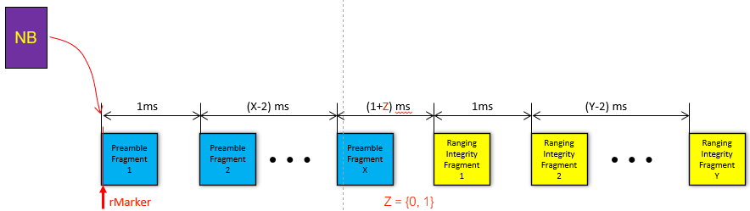
Key points of NBA-MMS UWB
from doc. 15-22-0392-00-04ab
Topic of this presentation: How do the clock frequency offset estimation and the length of the ranging message affect security?

Slide 4
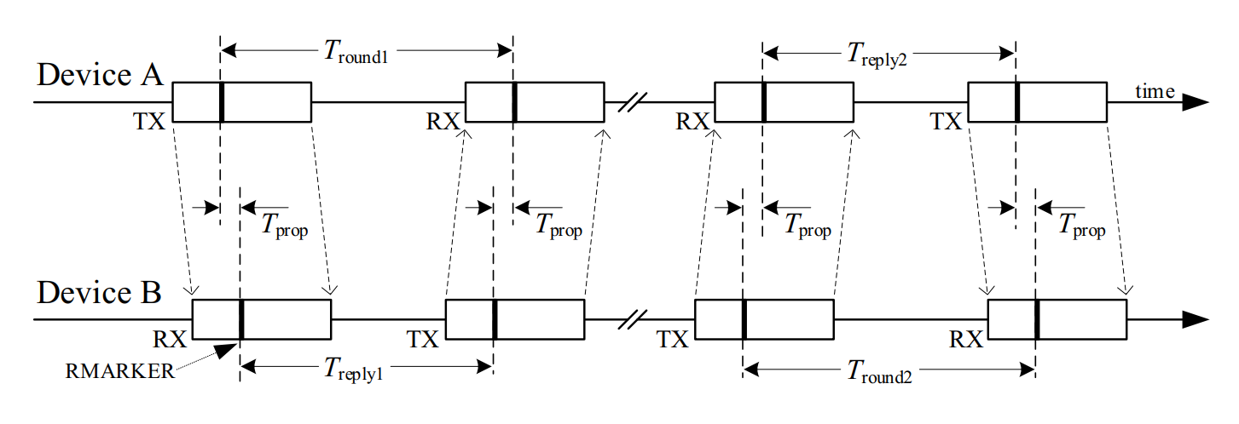

Double-Sided Two-Way Ranging (DS-TWR)
(taken from 802.15.4z)
$${\hat{T}}_{prop}=\frac{\left(T_{round1}×T_{round2}−T_{reply1}×T_{reply2}\right)}{\left(T_{round1}+T_{round2}+T_{reply1}+T_{reply2}\right)}$$
Key points:
The formula compensates for possible clock frequency offsets between device A and device B.
Advancing the RMARKER of an RX packet (i.e. moving it to the left) results in a distance reduction.

Slide 5
Ranging message
Global view of message
global time
Global view of message
without CFO:
NB
PRE1
…
PREn
RIF
…
RMARKER

Slide 6
Ranging message stretched due to clock frequency offset
Global view of message
global time
without CFO:
NB
PRE1
…
PREn
RIF
with CFO:
(transmitter slower)
NB
PRE1
…
PREn
RIF
RMARKER
Despite the clock frequency offset, acquisition and security checks work:
Estimate offset through NB packet
Compensate offset (either by adjusting local clock or by signal processing) to acquire all PREs
Measure ToA of RMARKER
Verify ToA using RIF
Compute ToF using the compensation formula (minimize deviation due to different clock speeds)

Slide 7
Why is this a problem?
Observation: The clock frequency offset estimate from the NB packet dictates when the verification has to happen.
Global view of message without CFO:
…
PREn
RIF
ToA
verification
…
Global view of message with CFO:
(device A slower)
PREn
RIF
ToA
verification
global time
The clock frequency offset could have been manipulated.

Slide 8
Threat Model / Adversary’s Capabilities
There are no limitations on what the adversary can do.
In particular: The adversary can
  detect and replay a signal with an artificial clock frequency offset with negligible delay,
  learn all the required details of the ranging protocol, such as implementation-specific response times or the content of the and , and
  position themselves as required to interact with the devices (physical vicinity).
Exception:
  The adversary does not know any secrets shared between genuine transceivers, meaning it cannot predict the .
  The attacker cannot meddle with or reconfigure the ranging devices.
NB
PREi
RIF

Slide 9
Attack Scenario
Idea: Even though the adversary may not know when the exchanges start, they might be able to attack all four ranging messages, trying to advance the corresponding RMARKERs.

Slide 10
Example: Attacking the second message (Device B → Device A)
global time
RMARKER
Received message at device A
(w/o “artificial” CFO)
NB
PRE1
…
PREn
RIF
and with adversary-induced CFO
NB
PRE1
…
PREn
RIF
results in a distance reduction
Procedure: The adversary overshadows the message with their own copy, which is
slowed down by the maximally tolerated clock frequency offset.
advanced (sent earlier) such that the start of the adversary’s RIF coincides with the start of the actual RIF transmitted by device B. This is possible if NB / PRE are deterministic.
At this point, the adversary can learn and replay the RIF to finalize a valid ranging message.

Slide 11
Why can the adversary attack all messages?
RMARKER shift
Original packet:
NB
PRE1
PRE2
PRE3
RIF
Basic attack:
NB
PRE1
PRE2
PRE3
RIF
With "delayed" NB:
NB
PRE1
PRE2
PRE3
RIF
The uncertainty on the ToA of the NB segment is higher - the adversary could delay its NB copy by dozens of nanoseconds.
This delay might be sufficient for the adversary to transmit the NB reactively once they observe the start of the benign NB segment.
→ Result: Every message can be attacked, which doubles the maximal distance reduction.

Slide 12
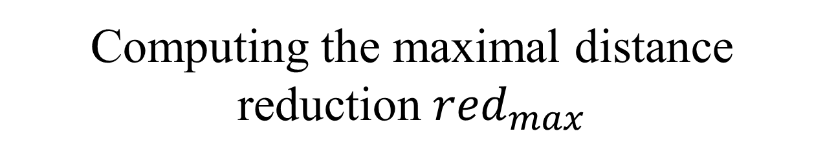
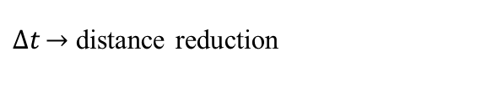

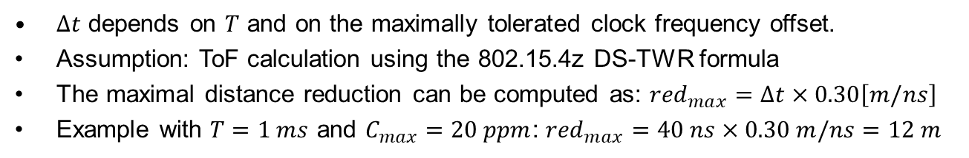
Computing the maximal distance reduction ${red}_{max}$
$$T$$
PREn
RIF
PREn
RIF
$∆t\underset{→}{}$ distance reduction
$∆t$ depends on $T$ and on the maximally tolerated clock frequency offset.
Assumption: ToF calculation using the 802.15.4z DS-TWR formula
The maximal distance reduction can be computed as: ${red}_{max}=∆t×0.30\left[m/ns\right]$
Example with $T=1 ms$ and $C_{max}=20 ppm$: ${red}_{max}=40 ns×0.30 m/ns=12 m$

Slide 13
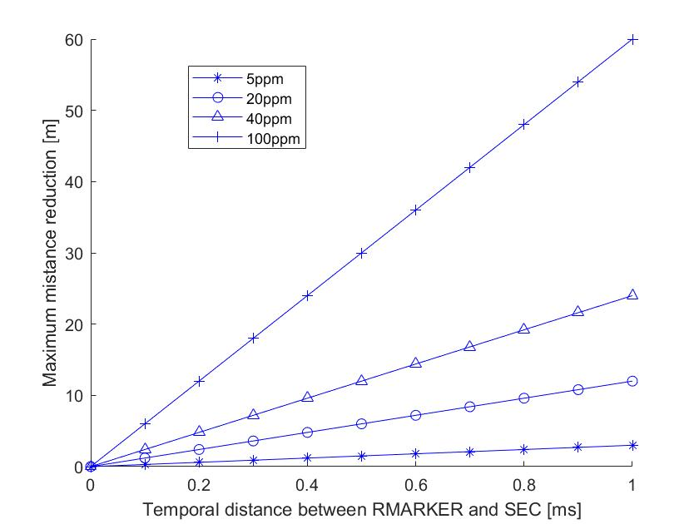
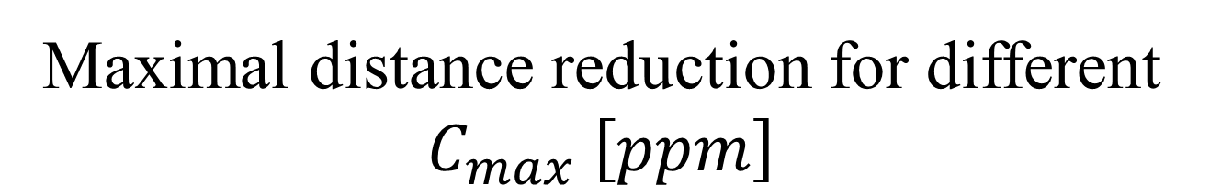


Maximal distance reduction for different $C_{max} \left[ppm\right]$
$$≈60m$$
$$≈3m$$

Slide 14


Could the maximal distance reduction be increased?
In the case that not all RIF bits/pulses have to be correct, the adversary can afford to start transmission earlier and take wrong guesses:
PREn
RIF
PREn
RIF
Repeat known pulses ($BER ≈0.0$)
PREn
RIF
RMARKER shift
Take random guesses ($BER ≈0.5$)

Slide 15
Counter Measures
The risk is a result of the combination of
the delay between the ToA (RMARKER) and the start of the RIF segment.
the maximally tolerated clock frequency offset between the ranging devices.
Thus, intuitive counter measures could be:
Mandating highly accurate clocks
Reduce the delay by moving the RIF closer to the RMARKER (link budget implications)
Recommendation: Communicate the clock frequency offset estimations between the devices and check for consistency (i.e., if both devices measure a negative offset, they might be under attack).

Slide 16
Conclusion
We have shown that the clock frequency offset estimation based on a narrow-band signal could open a new attack window.
This attack might be difficult to implement practically, but it should not be ignored.
Resolving this issue not yet guarantee security of NBA-MMS UWB: The RIF segment is yet to be defined and needs to be subject to a thorough security analysis.

