Slide 1
        doc.: 15-22-0405-02-04ab
Project: IEEE P802.15 Working Group for Wireless Personal Area Networks (WPANs)
Submission Title: Way Forward on Preamble Sequences beyond 4z Ipatov
Date Submitted: 12 July, 2022
Source: Xiliang Luo, Vinod Kristem, Moche Cohen (Apple Inc.), Michael McLaughlin, Billy Verso, Igor Dotlic, Carl Murray, Jarek Niewczas (Qorvo)
Address: One Apple Park Way, Cupertino, CA 95104, USA
E-Mail: luoxiliang@ieee.org
Abstract: We propose a way forward on preamble sequences beyond 4z Ipatov.
Purpose: Recommend a preamble sequence construction scheme for ranging beyond 4z.
Notice: This document has been prepared to assist the IEEE P802.15. It is offered as a basis for discussion and is not binding on the contributing individual(s) or organization(s). The material in this document is subject to change in form and content after further study. The contributor(s) reserve(s) the right to add, amend or withdraw material contained herein.
Release: The contributor acknowledges and accepts that this contribution becomes the property of IEEE and may be made publicly available by P802.15.

Slide 2
        doc.: 15-22-0405-02-04ab
PAR Objective | Proposed Solution (how addressed)
Safeguards so that the high throughput data use cases will not cause significant disruption to low duty-cycle ranging use cases
Interference mitigation techniques to support higher density and higher traffic use cases | Proposed sequences offer flexible multi-user interference mitigation
Other coexistence improvement
Backward compatibility with enhanced ranging capable devices (ERDEVs)
Improved link budget and/or reduced air-time
Additional channels and operating frequencies
Improvements to accuracy / precision / reliability and interoperability for high-integrity ranging
Reduced complexity and power consumption | Proposed sequences allows efficient construction
Hybrid operation with narrowband signaling to assist UWB
Enhanced native discovery and connection setup mechanisms
Sensing capabilities to support presence detection and environment mapping
Low-power low-latency streaming
Higher data-rate streaming allowing at least 50 Mbit/s of throughput
Support for peer-to-peer, peer-to-multi-peer, and station-to-infrastructure protocols
Infrastructure synchronization mechanisms

Slide 3
Way forward on 4ab preambles
(1)
        doc.: 15-22-0405-02-04ab
Expand the set of Ipatov-based preambles in 4z with preamble sequences constructed from complementary sets
  Gaps can be introduced to increase the zero-autocorrelation zone
  Sequences in the complementary set: {S1, S2, …, SD}
    One preamble symbol without gap
      [S1, S2, …, SD]
    One preamble symbol with gap G
      [S1, G, S2, G, …, SD, G], or
      [S1, S2, …, SD/2, G, SD/2+1, …, SD, G]
    Golay pair is one complementary set with size of D=2
Multi-user interference is mitigated by assigning different sequences, sequence periods, gap sizes to different users

Slide 4
Way forward on 4ab preambles
(2)
        doc.: 15-22-0405-02-04ab
The set of preamble sequences are to be selected according to the following criteria
  Simple construction from a seed/index is desirable
    not practical to print all the sequences due to the potential large number of sequences
  Size of zero-autocorrelation zone in the absence of gaps
  Multi-user interference mitigation performance
    long-term cross-correlation and short-term cross-correlation
    also needs to consider CFOs during evaluations
  Spectrum flatness

Slide 5
Way forward on 4ab preambles
(3)
        doc.: 15-22-0405-02-04ab
PRFs:
  Specify mean PRFs up to 124.8MHz
  Specify spread factor: L=4
  Mean PRFs will change accordingly as gaps are introduced and should be lower bounded
    details to be finalized
Length of one preamble symbol after spreading should be within a limited set
  details to be finalized

Slide 6
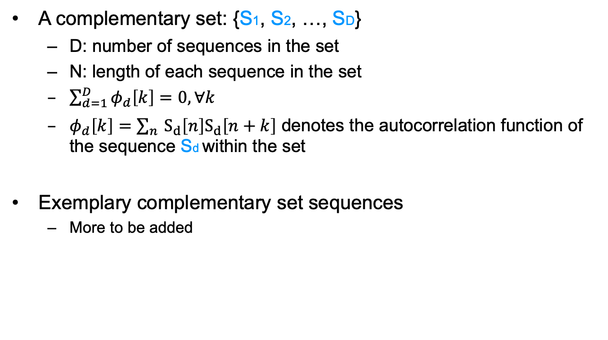
Appendix
        doc.: 15-22-0405-02-04ab
A complementary set: {S1, S2, …, SD}
  D: number of sequences in the set
  N: length of each sequence in the set
  $\sum_{d=1}^{D}{φ_{d}\left[k\right]=0, ∀k}$
  $φ_{d}\left[k\right]=\sum_{n}{S_{d}\left[n\right]S_{d}\left[n+k\right]}$ denotes the autocorrelation function of the sequence Sd within the set
Exemplary complementary set sequences
  More to be added

Slide 7








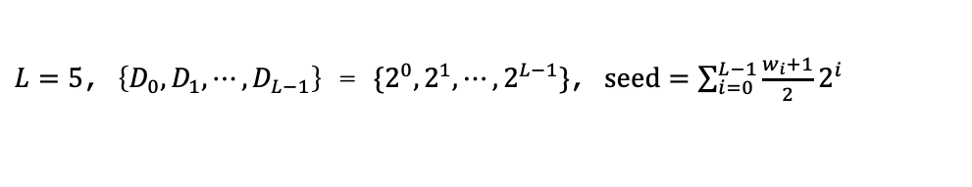




D=2, N=32
        doc.: 15-22-0405-02-04ab
Set-1.
  seed_1 = 0; seed_2 = [6, 15, 22, 31];
Set-2.
  seed_1 = 1; seed_2 = [7, 14, 23, 30];
Set-3.
  seed_1 = 2; seed_2 = [4, 13, 20, 29];
Set-4.
  seed_1 = 3; seed_2 = [5, 12, 21, 28];
+
+
$$⋯$$
+
$$a_{k}^{[L]}$$
Golay pair of length $2^{L}$
$$δ_{k}$$
+
+
+
$$b_{k}^{[L]}$$
$$D_{0}$$
X
-
+
$$D_{1}$$
X
-
+
$$⋯$$
$$D_{L−1}$$
X
-
+
$$w_{0}$$
$$w_{1}$$
$$w_{L−1}$$
$L=5$, $\left\{D_{0},D_{1},⋯,D_{L−1}\right\}$ = $\{2^{0},2^{1},⋯,2^{L−1}\}$, $seed=\sum_{i=0}^{L−1}{\frac{w_{i}+1}{2}2^{i}}$

Slide 8
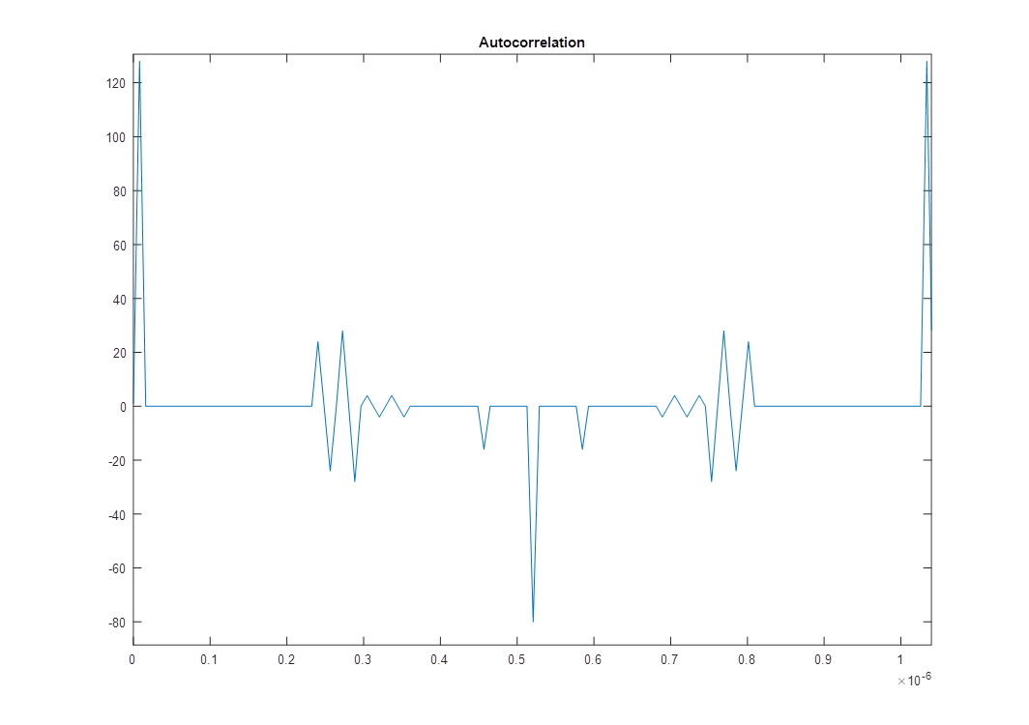
D=64, N=2
        doc.: 15-22-0405-02-04ab
‘+----++++----+++-+---+++-+++-++++-+++----+--+-+++-++-+---+---++++-+++-++-++++-++-+--+-+++---+
-++-+++-++++-++-+++-+---+---+++-+--’
‘+---+-+++-++-++++-++-++++-+++-++-+---+--+-+++---+-+++---+----++++-+++----+--+----+--+----+++-
++++---+-++-+---+++-+---+++-+++-+--’
‘++-+++-+---+--+----+++-+---++++---+---+-++-++++---+----+--+----+--+-++-+---++++---+-++-+++-+-
--+++-+++-+--+----+--+---+----+---+’
‘++-++++-+++-+++---+-++-++++-+++-++-+--+---+-+++----++++----+++-+--+----+++-+++-+---++++-+++--
-+----+--+-++-+---+---+--+---+---+-’
‘+---+-++-++++----+--+-++-+--+-+++----+---+++-+++-+++-++++-+++-++-+++-+--+----++++----+++-+--+
-+++----+---+++-+++-+---+---+---+--’
‘+-+++----++++---+-+++-++-+--+----++++-+++-++-++++-++-+++-+--+-+++---+----++++-+++-+++-++-+--+
-+++-+++-+++---+-++-+---+---+---+++’
‘+++-+++---+-++-+---++++---+---+-+++----+--+---+-++-+++-+++-+---+++-+++-++++-+++-++-+---++++--
--+---++++-++-+--+----+--+----+--+-’
‘+++-+++-++-+++-+---+---+---+++-++++----+--+-+++-++-+--+-+++----+++-+--+-+++---+----+++-+--+--
-+-+++---+---+----+--+----+--+----+’
Each code has a Zero Periodic-Autocorrelation Zone of length 2x224ns assuming 124.8 MHz PRF.

