Slide 1
Project: IEEE P802.15 Working Group for Wireless Personal Area Networks (WPANs)
Submission Title: [Considerations on sequences in 4ab]
Date Submitted: [July, 2022]
Source: [Chenchen Liu, Bin Qian, Ziyang Guo, Peng Liu, David Xun Yang] Company [Huawei Technologies]
Address [Huawei Bantian Base, Longgang District, Shenzhen, 518129 China]
E-Mail:[liuchenchen1@Huawei.com]
Re: [Task Group 4ab: UWB Next Generation]
Abstract: [Share our considerations on the sequences for 4ab standard]
Purpose: [ ]
Notice: This document has been prepared to assist the IEEE P802.15. It is offered as a basis for discussion and is not binding on the contributing individual(s) or organization(s). The material in this document is subject to change in form and content after further study. The contributor(s) reserve(s) the right to add, amend or withdraw material contained herein.
Release: The contributor acknowledges and accepts that this contribution becomes the property of IEEE and may be made publicly available by P802.15.

Slide 2
Technical Guidance
PAR Objective | Proposed Solution (how addressed)
Safeguards so that the high throughput data use cases will not cause significant disruption to low duty-cycle ranging use cases
Interference mitigation techniques to support higher density and higher traffic use cases
Other coexistence improvement
Backward compatibility with enhanced ranging capable devices (ERDEVs)
Improved link budget and/or reduced air-time | Symbol mapping
Additional channels and operating frequencies
Improvements to accuracy / precision / reliability and interoperability for high-integrity ranging | Improved STS，preamble sequence
Reduced complexity and power consumption
Hybrid operation with narrowband signaling to assist UWB
Enhanced native discovery and connection setup mechanisms
Sensing capabilities to support presence detection and environment mapping
Low-power low-latency streaming
Higher data-rate streaming allowing at least 50 Mbit/s of throughput | symbol mapping
Support for peer-to-peer, peer-to-multi-peer, and station-to-infrastructure protocols
Infrastructure synchronization mechanisms

Slide 3
Related Submissions
15-22-0243-00-04ab-golay-complementary-sequences-preamble-construction-for-uwb-ranging-beyond-4z-ipatov (Xiliang)
15-22-0267-01-04ab-preamble-only-packet-for-uwb (Chenchen Liu)
15-22-0178-00-04ab-a-novel-channel-sounding-sequence (McLaughlin)
15-22-0280-01-04ab-deterministic-sts-for-sensing-applications (Igor Dotlic)

Slide 4
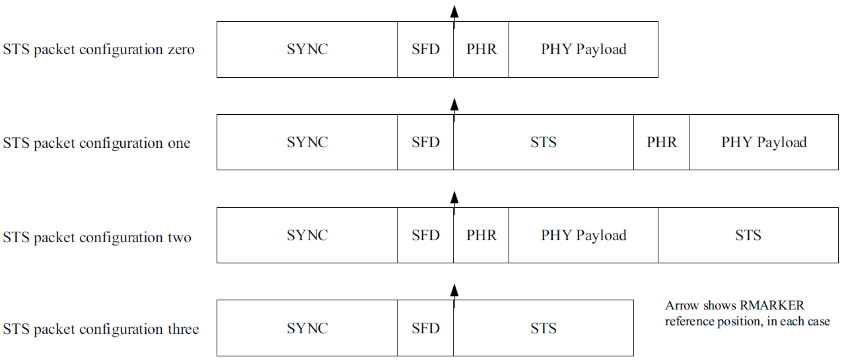
Background
Preamble sequence(both SYNC and preamble only)
STS sequence
Spreading sequence in the payload

Slide 5
Preamble Sequences
Several different preamble sequences are proposed, such as an Ipatov sequence, m-sequence, golay complementary pair sequence and CZC sequence
Sequence | Auto-correlation | Cross-correlation
Ipatov | Perfect auto-correlation globally | Fair cross-correlation globally
M-sequence | Small constant out of phase auto-correlation | Fair cross-correlation globally
Golay pair | Perfect sum of auto-correlation in certain zone | No guaranteed cross-correlation and requires many repetitions to suppress the cross-correlation by averaging
CZC | Perfect sum of auto-correlation in certain zone | No guaranteed cross-correlation

Slide 6
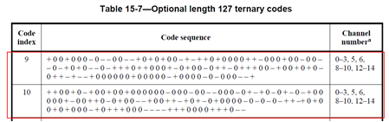
Preamble Sequences Evaluation
Golay pair, #1
1 -1 -1 -1 -1 1 -1 -1 -1 1 1 1 -1 1 -1 -1 -1 1 1 1 1 -1 1 1 -1 1 1 1 1 -1 1 -1 -1 0 0 0 0 0 0 0 0 0 0 0 0 0 0 0 0 0 0 0 0 0 0 0 0 0 0 0 0 0 0 0 0 1 -1 -1 -1 -1 1 -1 -1 -1 1 1 1 -1 1 -1 -1 1 -1 -1 -1 -1 1 -1 -1 1 -1 -1 -1 1 -1 1 1 0 0 0 0 0 0 0 0 0 0 0 0 0 0 0 0 0 0 0 0 0 0 0 0 0 0 0 0 0 0 0 0
Golay pair, #2
1 -1 -1 -1 -1 1 -1 -1 -1 1 1 1 -1 1 -1 -1 -1 1 1 1 1 -1 1 1 -1 1 1 1 -1 1 -1 -1 0 0 0 0 0 0 0 0 0 0 0 0 0 0 0 0 0 0 0 0 0 0 0 0 0 0 0 0 0 0 0 0 0 1 -1 -1 -1 -1 1 -1 -1 -1 1 1 1 -1 1 -1 -1 1 -1 -1 -1 -1 1 -1 -1 1 -1 -1 -1 1 -1 1 1 0 0 0 0 0 0 0 0 0 0 0 0 0 0 0 0 0 0 0 0 0 0 0 0 0 0 0 0 0 0 0 0 0
VS
Ipatov pair, #1
1 0 0 1 0 0 0 -1 0 -1 -1 0 0 -1 -1 1 0 1 0 1 0 0 -1 1 -1 1 1 0 1 0 0 0 0 1 1 -1 0 0 0 1 0 0 -1 0 0 -1 -1 0 -1 1 0 1 0 -1 -1 0 -1 1 1 1 0 1 1 0 0 0 1 -1 0 1 0 0 -1 0 1 1 -1 0 1 1 1 0 0 -1 1 0 0 1 0 1 0 -1 0 1 1 -1 1 -1 -1 1 0 0 0 0 0 0 1 0 0 0 0 0 -1 1 0 0 0 0 -1 0 -1 0 0 0 -1 -1 1
Ipatov pair, #2
-1 0 1 0 0 1 1 -1 -1 0 1 1 1 0 0 0 0 1 1 1 -1 -1 -1 -1 0 0 0 1 1 1 0 1 -1 0 0 0 1 0 1 0 0 1 0 1 -1 1 1 -1 0 -1 0 -1 0 -1 0 0 0 0 1 0 -1 1 0 1 -1 1 1 0 0 1 -1 -1 0 0 1 0 -1 0 1 1 0 0 -1 1 0 0 0 0 0 1 -1 0 -1 1 0 -1 0 1 -1 1 0 -1 0 0 0 -1 -1 0 0 -1 0 0 0 -1 0 0 0 0 0 0 1 0 0 1 0 0 1

Slide 7
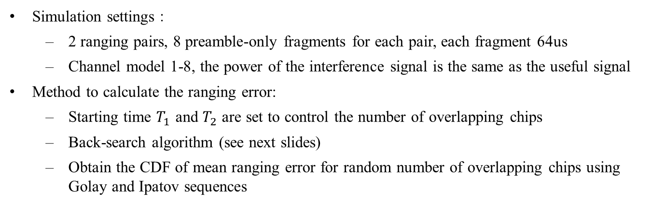
Preamble Sequences Evaluation
Simulation settings：
  2 ranging pairs, 8 preamble-only fragments for each pair, each fragment 64us
  Channel model 1-8, the power of the interference signal is the same as the useful signal
Method to calculate the ranging error:
  Starting time $T_{1}$ and $T_{2}$ are set to control the number of overlapping chips
  Back-search algorithm (see next slides)
  Obtain the CDF of mean ranging error for random number of overlapping chips using Golay and Ipatov sequences
T₁
1ms
1ms
1ms
…
Ranging pair 1
t(ms)
T₂
1ms
1ms
1ms
…
Ranging pair 2
t(ms)
Interfere with each other

Slide 8
Preamble Sequences Evaluation
ToA Estimation Method
20 samples
Peak
Correlation with local template
Average the periodical correlated results, suggested by [1]
Locate the Peak
Locate the first path via back search
First path ToA estimation
15dB
Simulation Settings | Descriptions
Fragment Duration | ~64us
PRF | 31.25MHz
Preamble sequence repetition | 16
Channel model | CM1-CM8
Back search threshold | 15dB

Slide 9
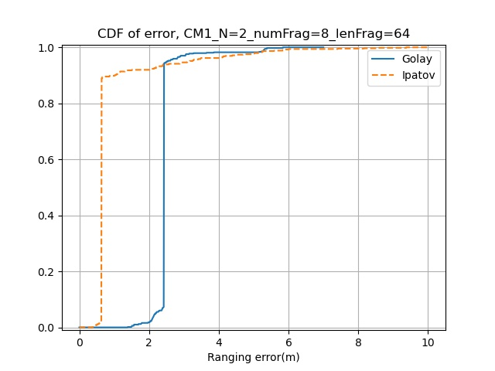
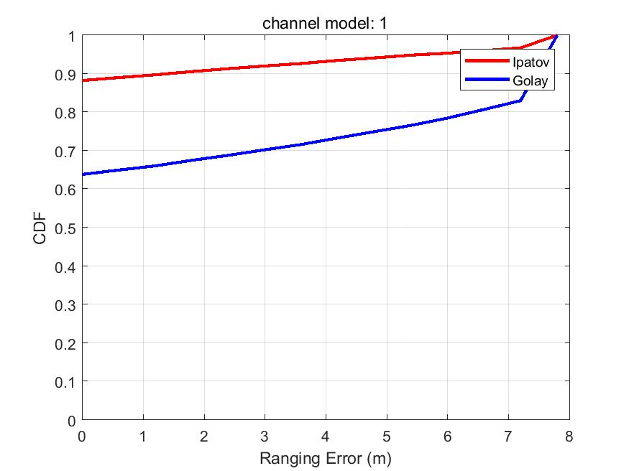
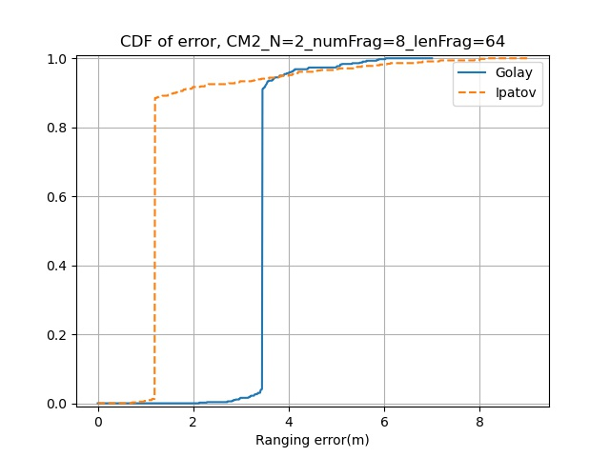
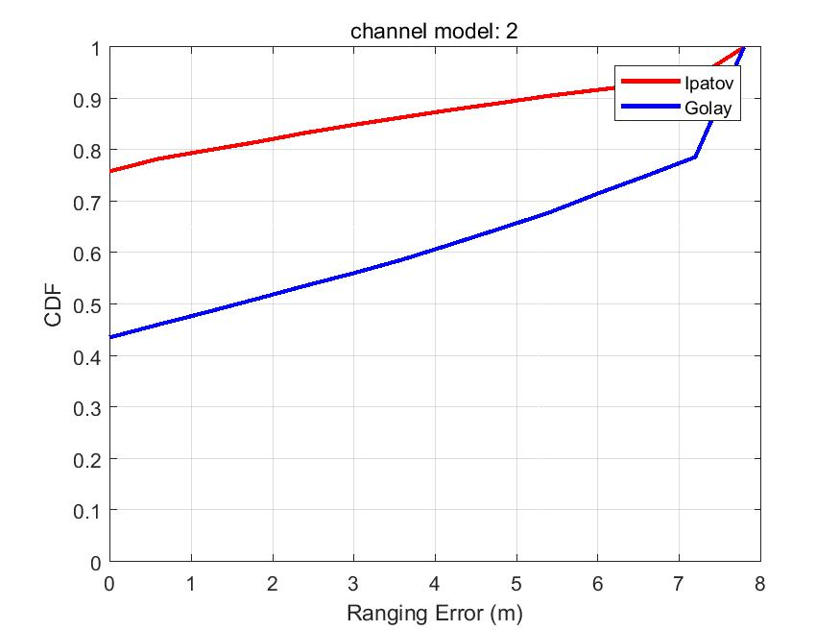
Random Interference
No interference
Random Interference
No interference

Slide 10
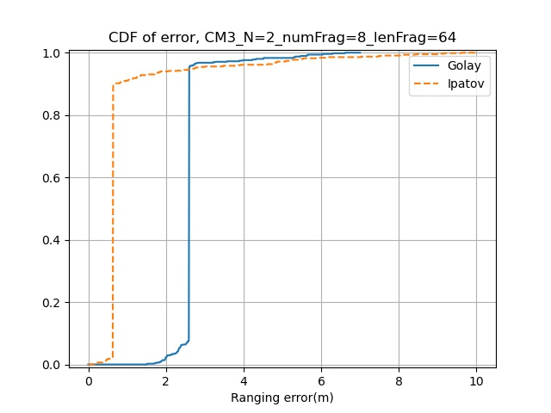
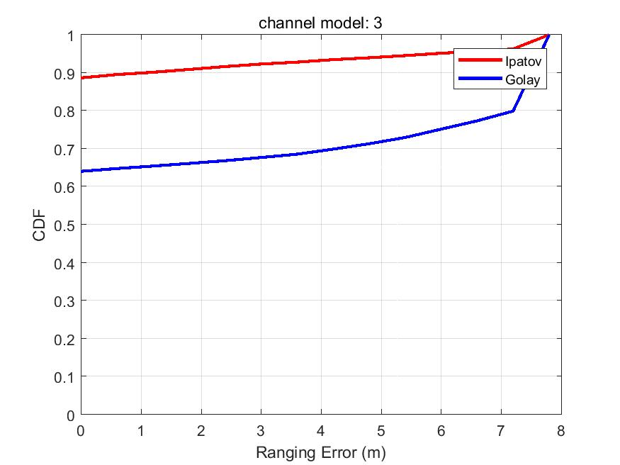
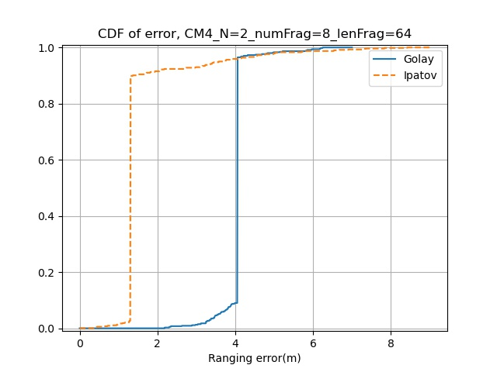
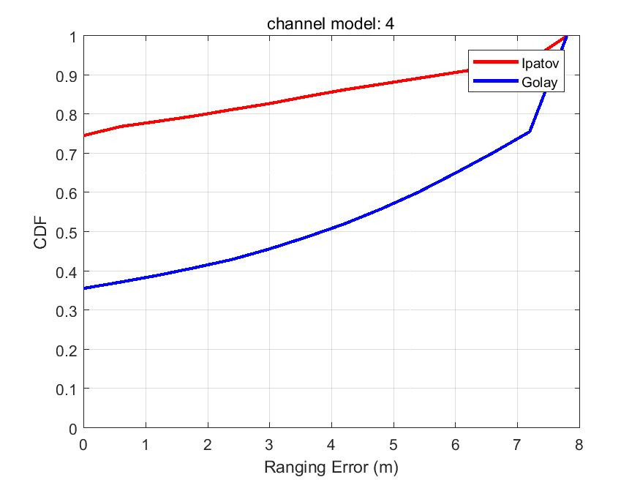
Random Interference
No interference
Random Interference
No interference

Slide 11

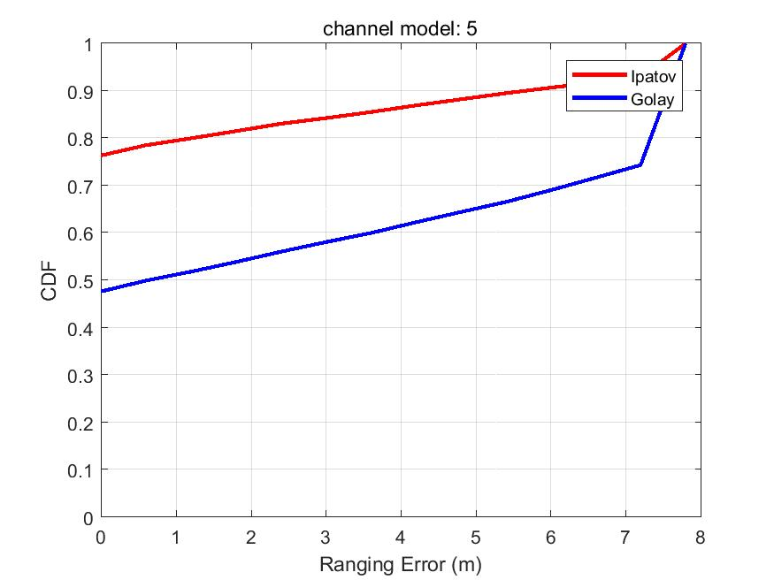
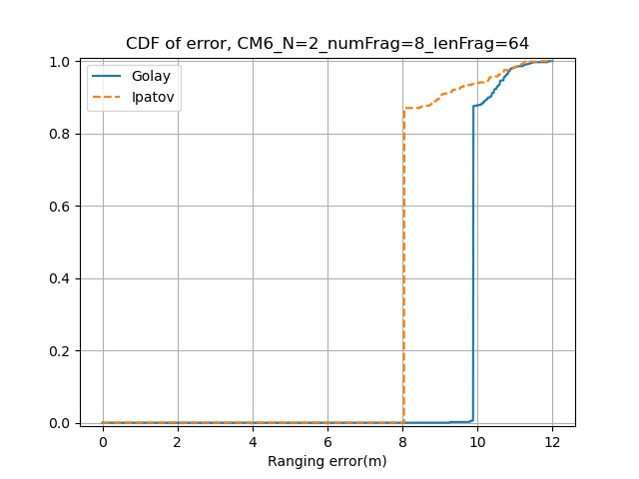
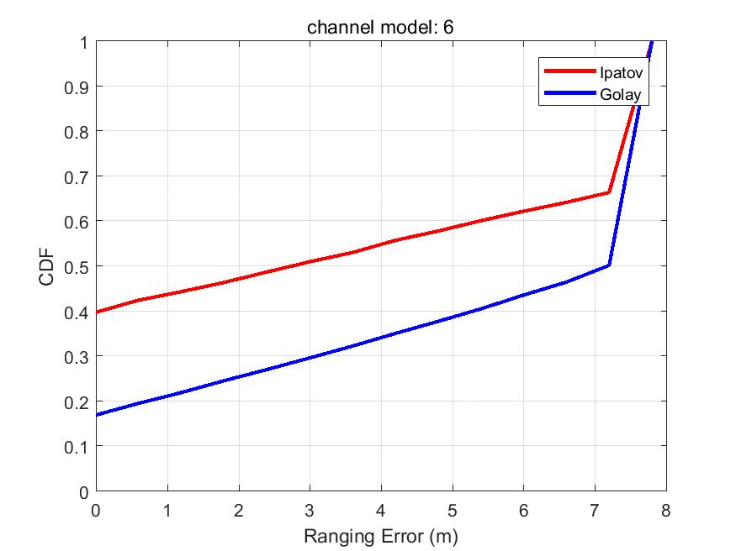
Random Interference
No interference
Random Interference
No interference

Slide 12
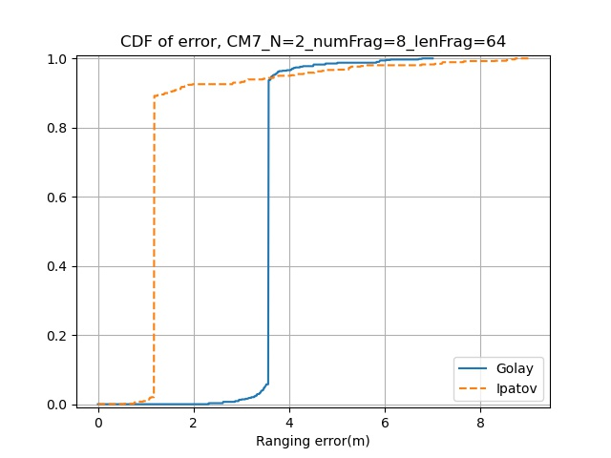
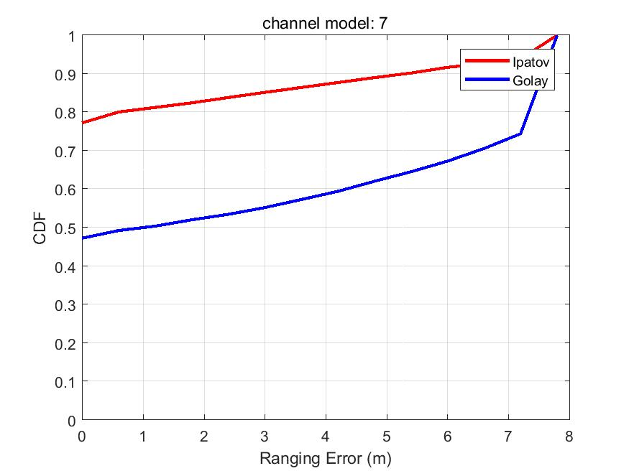
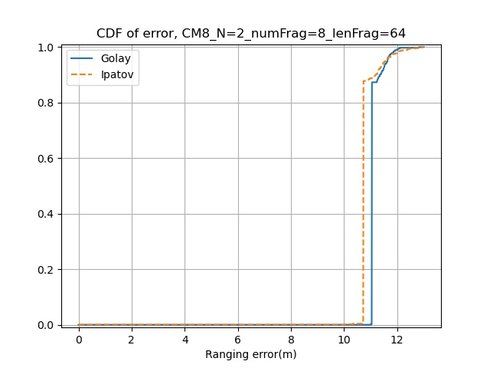
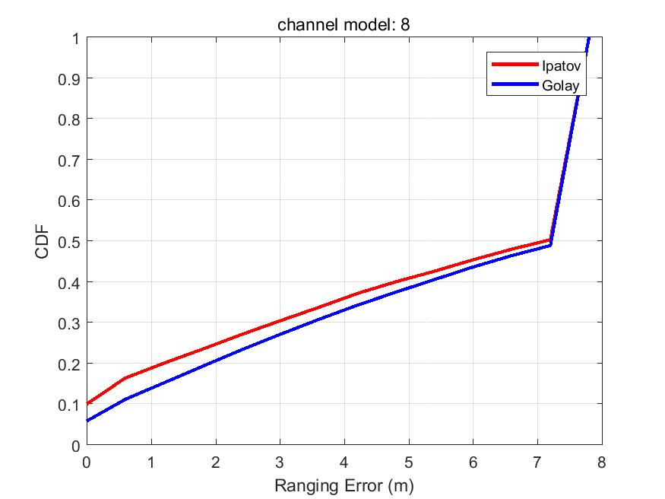
Random Interference
No interference
Random Interference
No interference

Slide 13
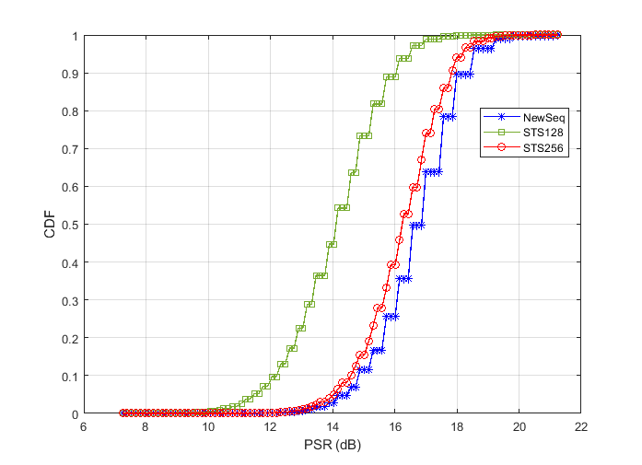
STS Sequence
The STS consists of a sequence of pseudo randomized pulses, generated using DRBG based on AES-128 in counter mode
The deterministic-sts solution[4] is proposed to suppress sidelobes, but it sacrifices security
We suggest to insert 128 additional empty pulses to the STS 128-pulse sequence to form a pulse sequence of length 256, with the following position being an empty pulse, before spreading by the delta function to form the STS
[20 24 26 28 30 31 32 35 36 40 42 43 44 45 48 50 51 54 56 57 58 59 62 65 66 67 68 70 74 75 77 80 81 83 84 86 88 89 91 92 93 94 95 96 97 98 102 103 104 105 106 107 109 113 114 115 117 118 119 121 122 123 126 128 129 130 133 134 135 138 139 140 141 143 144 145 146 149 150 151 152 154 155 157 163 164 167 169 170 171 172 173 174 176 178 180 181 182 184 185 186 187 189 191 193 194 195 196 198 199 200 201 203 206 213 215 216 218 219 220 221 222 224 228 230 234 239 240]

Slide 14
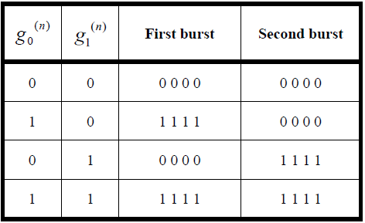
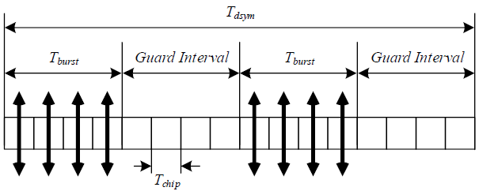

Spreading sequence in the payload
In the 4z standard, the two coded bits $g_{0}$ and $g_{1}$are total independent, two errors in any burst will lead to symbol error
The two coded bits $g_{0}$ and $g_{1}$in one symbol can in fact be coupled to reduce the symbol error rate

Slide 15
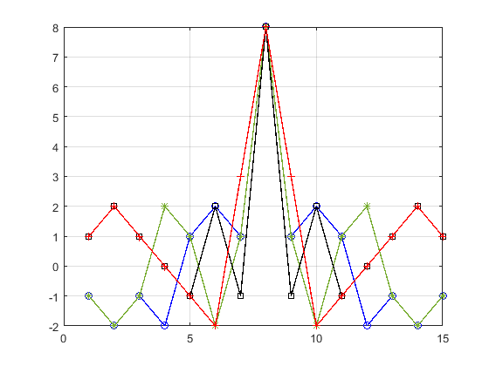
Spreading sequence in the payload
With the following symbol mapping, the minimum hamming distance can be increased to 5, reducing the symbol error rate
The spreading sequence has a good auto-correlation property as well
Data symbol | Coded bits |  | Chip values( )
 | g0 | g1 | First burst | Second burst
0 | 0 | 0 | 0 0 1 0 | 1 1 1 1
1 | 1 | 0 | 1 1 0 0 | 1 0 0 0
2 | 0 | 1 | 0 0 0 1 | 0 1 0 0
3 | 1 | 1 | 1 1 1 1 | 0 0 1 1

Slide 16
Spreading sequence in the payload
For 62.4Mbps, it is better to keep the same symbol structure and double the number of data symbols, e.g.
Data symbol | Coded bits |  |  |  | Chip values( )
 | g0 | g1 | g3 | g4 | First burst | Second burst
0 | 0 | 0 | 0 | 0 | 0 0 0 1 | 1 0 1 1
1 | 0 | 0 | 0 | 1 | 0 1 0 0 | 0 0 0 1
2 | 0 | 0 | 1 | 0 | 0 1 1 1 | 1 1 0 1
3 | 0 | 0 | 1 | 1 | 0 0 1 0 | 0 1 1 1
4 | 0 | 1 | 0 | 0 | 0 1 1 1 | 0 0 1 0
5 | 0 | 1 | 0 | 1 | 0 0 1 0 | 1 0 0 0
6 | 0 | 1 | 1 | 0 | 0 0 0 1 | 0 1 0 0
7 | 0 | 1 | 1 | 1 | 0 1 0 0 | 1 1 1 0
8 | 1 | 0 | 0 | 0 | 1 1 1 0 | 0 1 0 0
9 | 1 | 0 | 0 | 1 | 1 0 1 1 | 1 1 1 0
10 | 1 | 0 | 1 | 0 | 1 0 0 0 | 0 0 1 0
11 | 1 | 0 | 1 | 1 | 1 1 0 1 | 1 0 0 0
12 | 1 | 1 | 0 | 0 | 1 0 0 0 | 1 1 0 1
13 | 1 | 1 | 0 | 1 | 1 1 0 1 | 0 1 1 1
14 | 1 | 1 | 1 | 0 | 1 1 1 0 | 1 0 1 1
15 | 1 | 1 | 1 | 1 | 1 0 1 1 | 0 0 0 1

Slide 17
Spreading sequence in the payload
For a mean PRF=128M, a robust low data rate can be achieve by repeating the symbols created according to the following mappings, so that the hamming distance between the different data symbols can be maximized to increase robustness
Data symbol | Coded bits |  | Chip values( )
 | g0 | g1 | First burst | Second burst
0 | 0 | 0 | 0 1 0 1 1 1 0 0 | 0 0 1 1 0 1 1 1 1
1 | 1 | 0 | 1 0 1 0 0 0 0 0 | 0 1 1 0 0 0 1 0 0
2 | 0 | 1 | 0 1 0 1 1 0 1 1 | 1 0 0 0 1 0 0 0 0
3 | 1 | 1 | 1 0 1 0 0 1 1 1 | 1 1 0 1 1 1 0 1 1
Data symbol | Coded bits |  | Chip values( )
 | g0 | g1 | First burst | Second burst | Third burst
0 | 0 | 0 | 0 0 0 0 0 0 0 0 | 0 0 0 0 0 0 0 0 | 0 0 0 0 0 0 0 0
1 | 1 | 0 | 1 1 1 1 1 1 1 1 | 0 0 0 0 0 0 0 0 | 1 1 1 1 1 1 1 1
2 | 0 | 1 | 0 0 0 0 0 0 0 0 | 1 1 1 1 1 1 1 1 | 1 1 1 1 1 1 1 1
3 | 1 | 1 | 1 1 1 1 1 1 1 1 | 1 1 1 1 1 1 1 1 | 0 0 0 0 0 0 0 0

Slide 18
Summary
Different preamble sequence schemes are compared. Longer Ipatov is preferred for 4ab
Methods to suppress the sidelobes of the STS are discussed. A solution without compromising the security is preferred
Spreading sequence in the payload for different data rates and mean PRFs are proposed as in slide 11-13 .

Slide 19
References
[1] 15-22-0243-00-04ab-golay-complementary-sequences-preamble-construction-for-uwb-ranging-beyond-4z-ipatov (Xiliang)
[2]15-22-0267-01-04ab-preamble-only-packet-for-uwb (Chenchen Liu)
[3]15-22-0178-00-04ab-a-novel-channel-sounding-sequence (McLaughlin)
[4]15-22-0280-01-04ab-deterministic-sts-for-sensing-applications (Igor Dotlic)
[5] P802.15.4z, Draft Standard for Low-Rate Wireless Networks

