Slide 1
Project: IEEE P802.15 Working Group for Wireless Personal Area Networks (WPANs)
Submission Title: Propagation Characteristics of UWB Communication Applications Including Medical Implants
Date Submitted: July 12th, 2022
Source: Daisuke Anzai, Nagoya Institute of Technology
Address Gokiso-cho, Showa-ku, Nagoya, 466-8555, Japan
Voice: +81-52-735-5389, FAX: +81-52-735-5389, E-Mail: anzai@nitech.ac.jp
Re: In response to call for technical contributions
Abstract: This provides introduction of propagation characteristics of UWB communications for medical implant devices including measurement results of implant UWB propagation in FDTD electromagnetic analyses and experiments.
Purpose: Material for discussion in P802.15.6a TG corresponding to comments in EC Meeting
Notice: This document has been prepared to assist the IEEE P802.15. It is offered as a basis for discussion and is not binding on the contributing individual(s) or organization(s). The material in this document is subject to change in form and content after further study. The contributor(s) reserve(s) the right to add, amend or withdraw material contained herein.
Release: The contributor acknowledges and accepts that this contribution becomes the property of IEEE and may be made publicly available by P802.15.

Slide 2
Propagation Characteristics of UWB Communication Applications Including Medical Implants
Daisuke Anzai
Nagoya Institute of Technology

Slide 3
Background of implant communications

Slide 4
Problems on 400MHz MICS-band implant communications

Slide 5
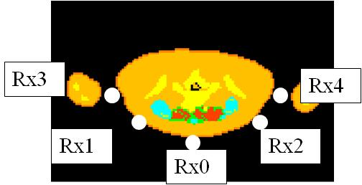
Problems on 400MHz MICS-band implant communications
Required transmit power at BER≦10⁻³
Model A: Average 45mW
Model B: Average 40mW
MICS regulation of 25uW cannot establish reliable implant communications

Slide 6
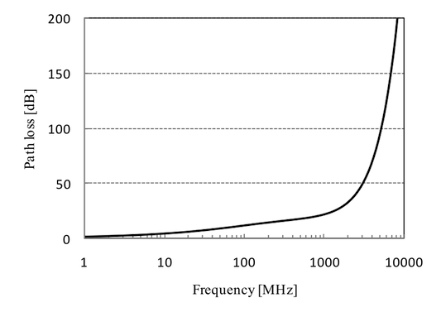
Frequency band for implant communications
muscle，depth d=0.1m
HBC: Human Body Communication
MICS：Medical Implant Communication Service
UWB：Ultra WideBand
HBC, MICS and UWB are
candidates for implant communications
400MHｚ MICS band
are often used for current capsule endoscope system
10-50 MHz
（HBC）
400 MHz
（MICS）
3.4-4.8 GHz
（UWB）
It is difficult to improve the data rate due to the bandwidth regulation of 300 kHz
Channel model to represent path loss
for reliable UWB implant communications

Slide 7
FDTD simulation model
UWB low-band (3.4-4.8 GHz) was employed.

Slide 8
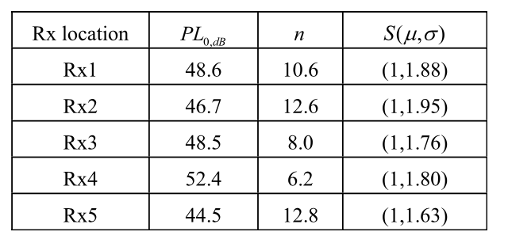
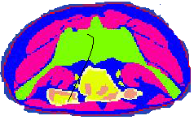
FDTD simulation results
Rx4
Rx5
Rx2
Rx1
Rx3

Slide 9
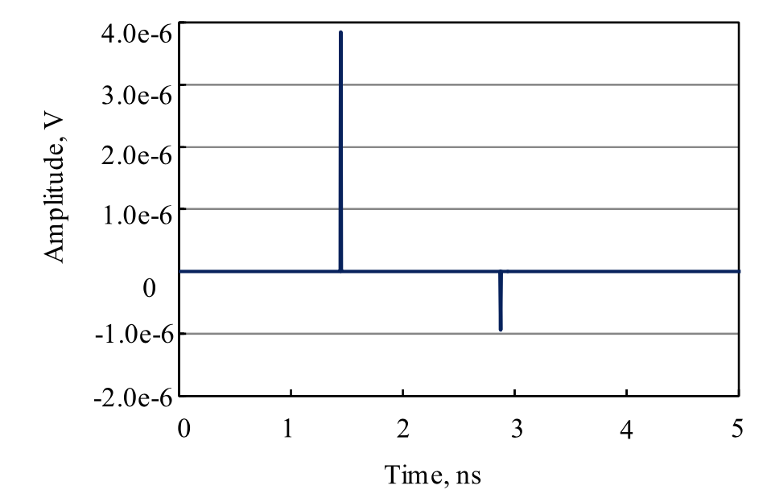
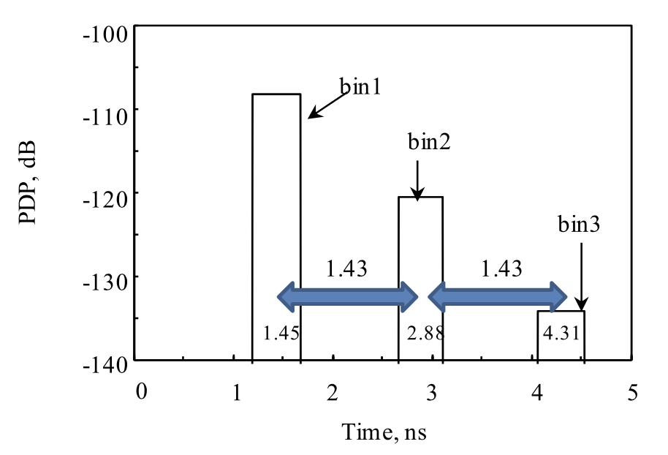
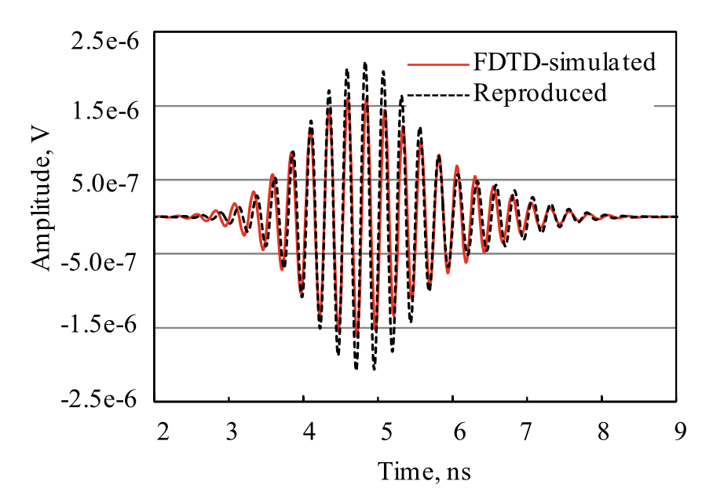
Power delay profile
Approximated two-path model
Rx1, z polarization
Distance from Rx 1: 10.6 cm

Slide 10
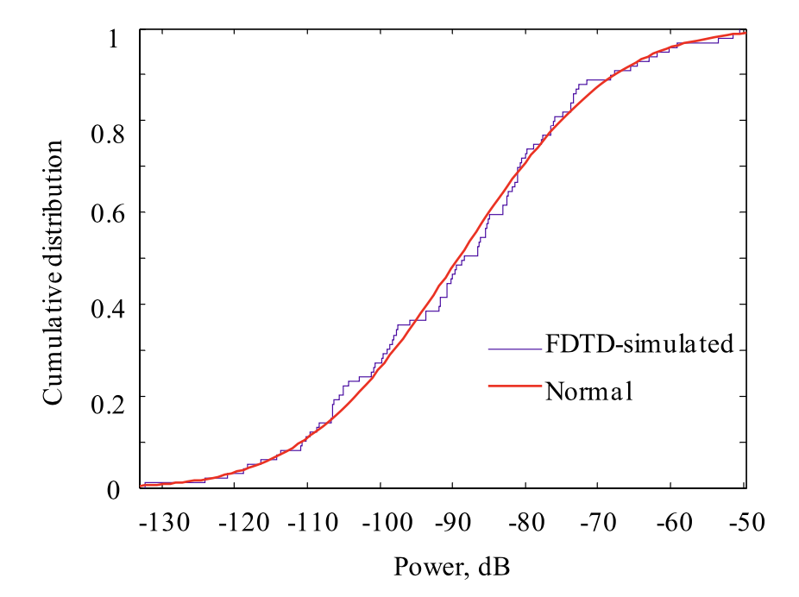
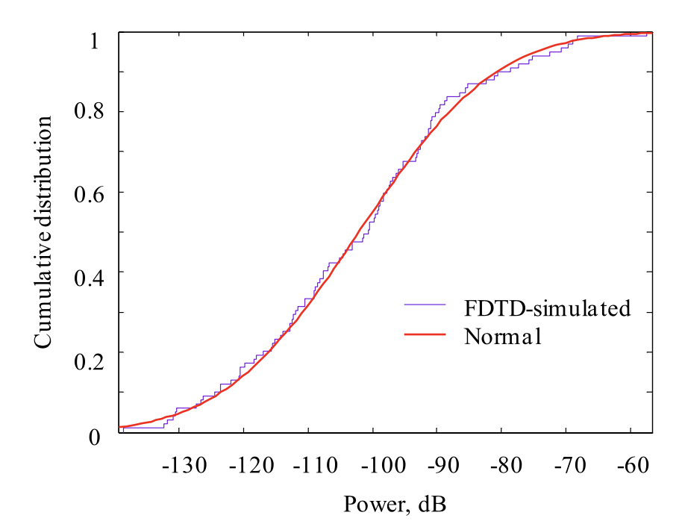
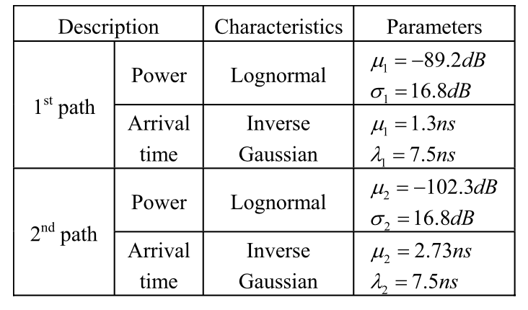
UWB impulse response channel model
1st path power
2nd path power

Slide 11
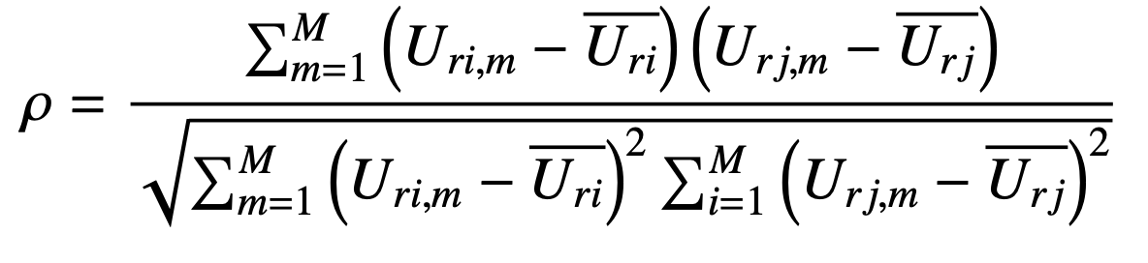
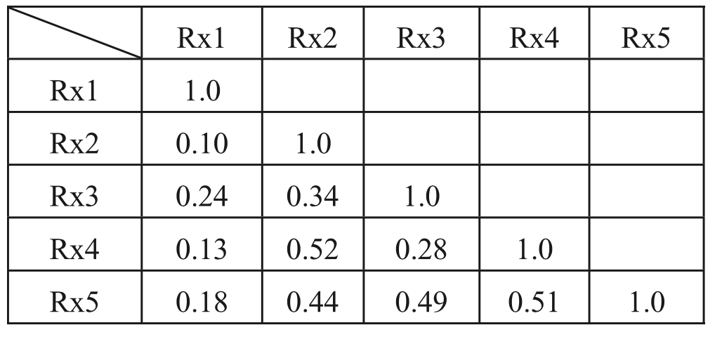
Correlation coefficients between Rx antennas
Rx4
Rx5
Rx2
Rx1
Rx3

Slide 12
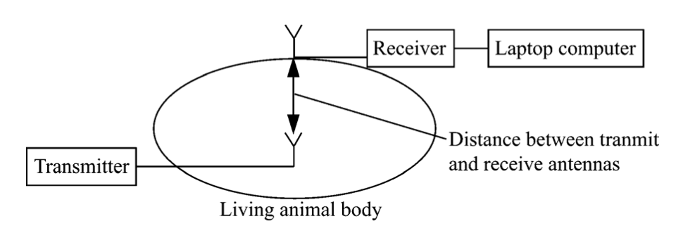
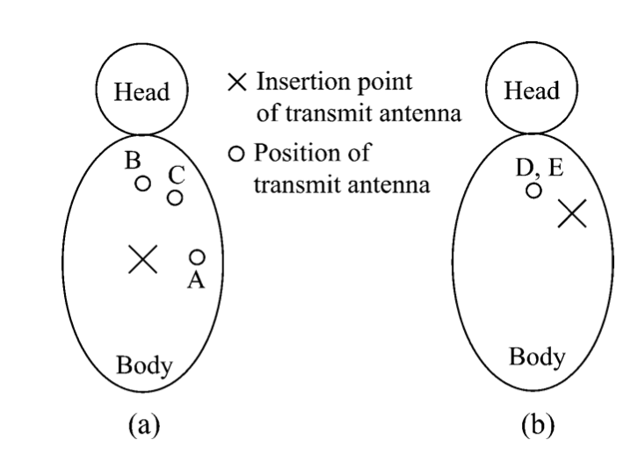
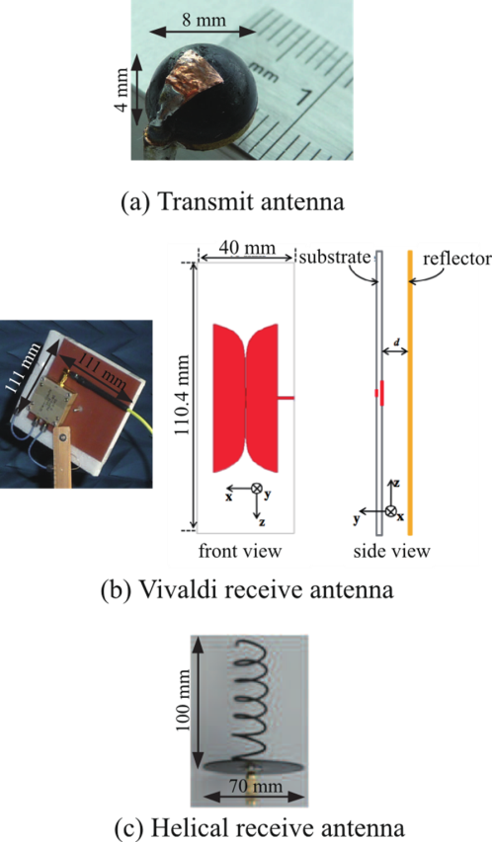
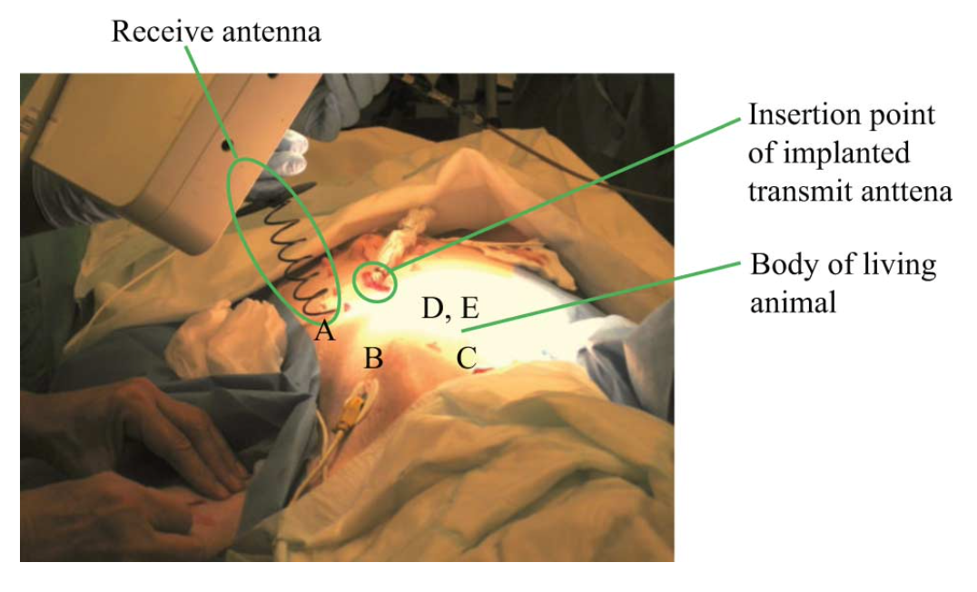
Experimental setup with living animal

Slide 13
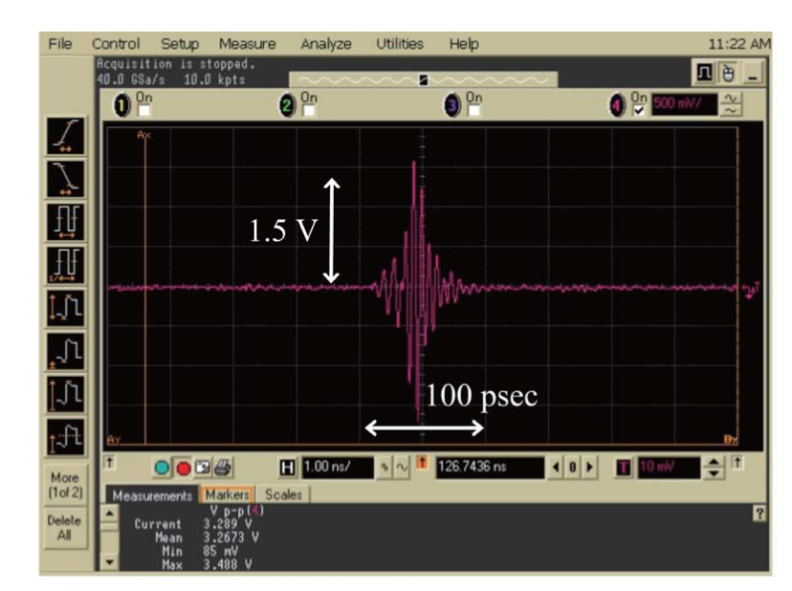
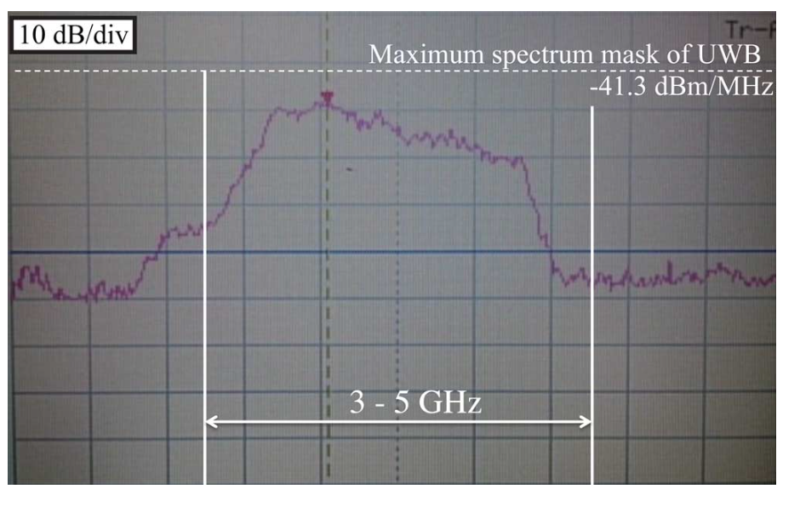
Characteristics of UWB signals
Time waveform of UWB signals
Frequency spectrum

Slide 14
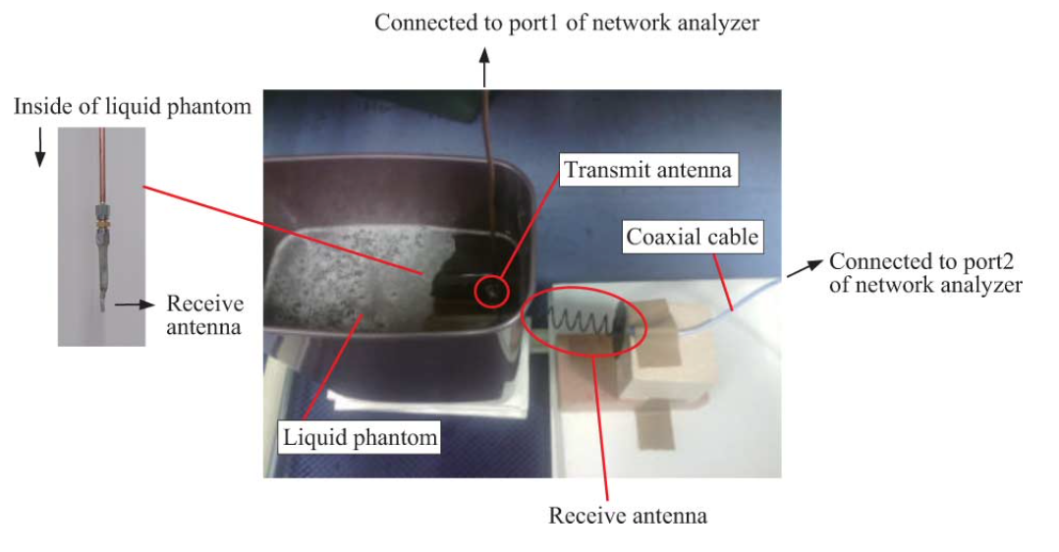
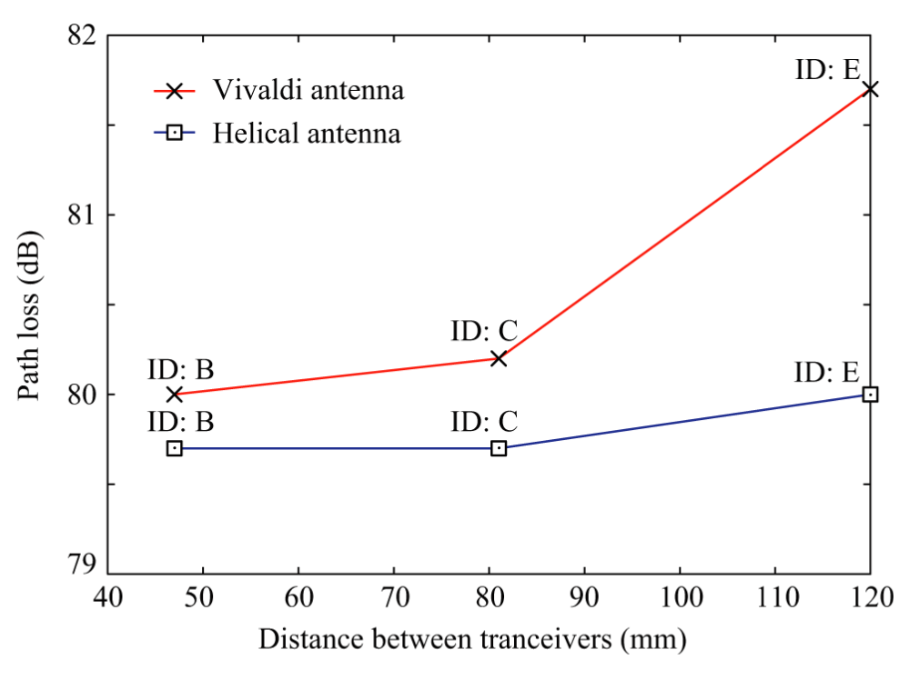
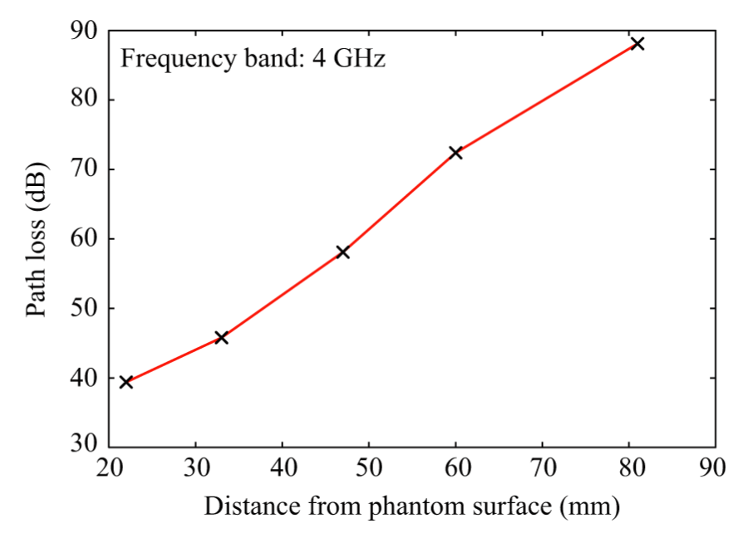
Path loth measurement results
Phantom experiment
Living animal experiment

Slide 15
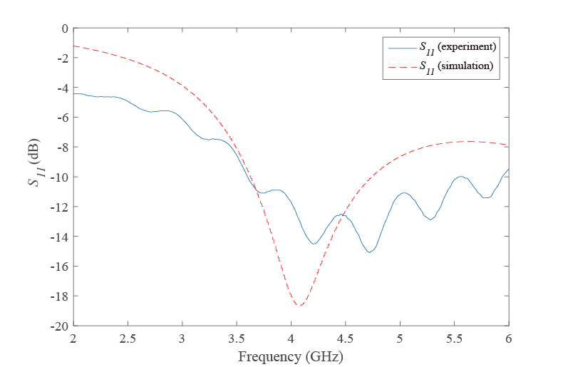
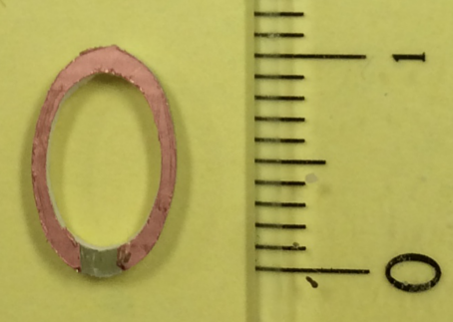
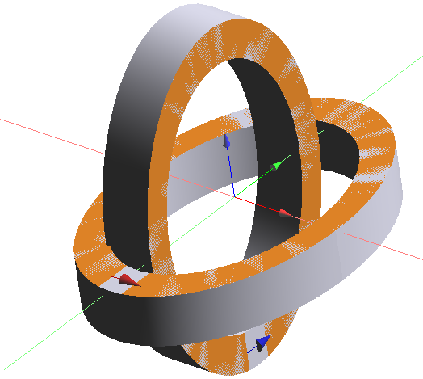
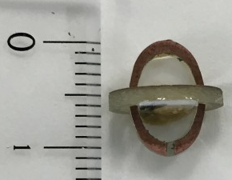
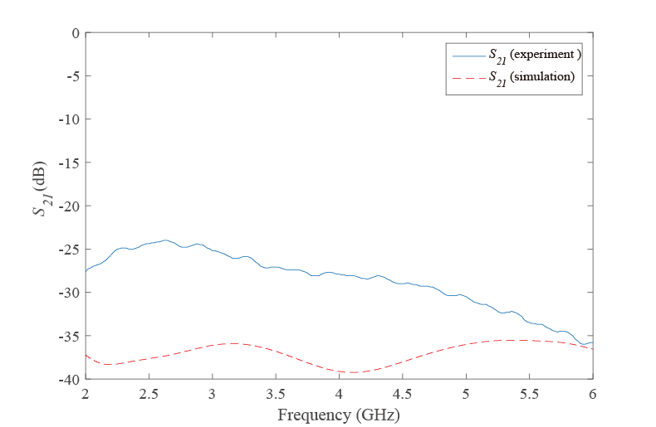
Multiple implant transmit antennas
Planar loop antenna
Realization example of multiple implant antennas
-10 dB
Phantom experiment
Polarization diversity antenna
Phantom experiment
Feeding Point 2
Feeding Point 1
-20 dB

Slide 16
Path loss characteristics of multiple implant antennas in a living animal experiment
Phantom experiment
Living animal experiment
Correlation coefficients between two implant antennas
 | 3.4-4.8 GHz | 3.4-3.6 GHz | 3.4-4.1 GHz
Living animal experiment | 0.84 | 0.51 | 0.76
FDTD analysis | 0.30 | 0.08 | 0.18
Phantom experiment | 0.47 | 0.04 | 0.31

Slide 17
References
Y. Shimizu, D. Anzai, R. C-Santiago, P. A. Floor, I. Balasingham, and J. Wang, “Performance evaluation of an ultra-wideband transmit diversity in a living animal experiment” IEEE Trans. Microw. Theory Tech., vol. 65, no. 7, pp. 2596-2606, July 2017.
D. Anzai, K. Katsu, R. Chavez-Santiago, Q. Wang, D. Plettemeier, J. Wang, and I. Balasingham, “Experimental evaluation of implant UWB-IR transmission with living animal for body area networks,” IEEE Trans. Microw. Theory Tech., vol. 62, no. 1, pp. 183-192, Jan. 2014.
J. Shi, D. Anzai, and J. Wang, “Channel modeling and performance analysis of diversity reception for implant UWB wireless link,” IEICE Trans. Commun., no. E95-B, vol. 10, pp. 3197-3205, Oct. 2012.

