Slide 1
        doc.: 15-22-0392-01-04ab
Project: IEEE P802.15 Working Group for Wireless Personal Area Networks (WPANs)
Submission Title: More on Mixed MMS for Ranging Integrity
Date Submitted: 11 July, 2022
Source: Xiliang Luo, Vinod Kristem, Moche Cohen (Apple Inc.), Frank Leong, Wolfgang Kuchler, Riku Pirhonen (NXP), David Barras, Boris Danev (3db)
Address: One Apple Park Way, Cupertino, CA 95104, USA
E-Mail: luoxiliang@ieee.org
Abstract: We provide more details regarding the mixed MMS format for secure ranging.
Purpose: Recommend a preamble sequence construction scheme for ranging beyond 4z.
Notice: This document has been prepared to assist the IEEE P802.15. It is offered as a basis for discussion and is not binding on the contributing individual(s) or organization(s). The material in this document is subject to change in form and content after further study. The contributor(s) reserve(s) the right to add, amend or withdraw material contained herein.
Release: The contributor acknowledges and accepts that this contribution becomes the property of IEEE and may be made publicly available by P802.15.

Slide 2
        doc.: 15-22-0392-01-04ab
PAR Objective | Proposed Solution (how addressed)
Safeguards so that the high throughput data use cases will not cause significant disruption to low duty-cycle ranging use cases
Interference mitigation techniques to support higher density and higher traffic use cases
Other coexistence improvement
Backward compatibility with enhanced ranging capable devices (ERDEVs)
Improved link budget and/or reduced air-time | MMS
Additional channels and operating frequencies
Improvements to accuracy / precision / reliability and interoperability for high-integrity ranging | MMS for high-integrity ranging
Reduced complexity and power consumption
Hybrid operation with narrowband signaling to assist UWB | NBA-MMS
Enhanced native discovery and connection setup mechanisms
Sensing capabilities to support presence detection and environment mapping
Low-power low-latency streaming
Higher data-rate streaming allowing at least 50 Mbit/s of throughput
Support for peer-to-peer, peer-to-multi-peer, and station-to-infrastructure protocols
Infrastructure synchronization mechanisms

Slide 3
More on Mixed Multi-Milli-Second for
Ranging Integrity
        doc.: 15-22-0392-01-04ab

Slide 4
From the NBA-UWB TFD
        doc.: 15-22-0392-01-04ab
A mixed multi-millisecond packet format
  each millisecond consists of either preamble-only fragments or fragments containing randomly modulated pulses, aimed at providing ranging integrity.
  The fragments of randomly modulated pulses may follow preamble-only fragments.
  The number of fragments of each type will be defined.
  Pulse randomization could be based on AES-128, as in the IEEE 802.15.4z-2020 amendment.

Slide 5
Outline
        doc.: 15-22-0392-01-04ab
Overall design principle
  Numerology
  Ranging integrity
Packet format with NBA for timing/frequency sync
Packet format without NBA for timing/frequency sync

Slide 6
Ranging Integrity with MMS
        doc.: 15-22-0392-01-04ab
Overall designs
  Start from the segmented STS format in 15.4z
    SYNC + SFD as in legacy 15.4z if present
  Increase the gap length such that the time spacing between the start of each fragment is equal to 1ms
    1ms refers to the start-to-start spacing of different fragments, 1ms = 499200 chips
    The gap size: default 499200 chips
      +/-20ppm chip clock accuracy → max 4ns overlapping
      negligible power margin from max allowed
  Increase the max number of segments for ranging integrity to 8
    Recommendation:
      # segments for ranging integrity = {1, 2, 4, 8} → provide incremental SNR boosts

Slide 7

Ranging Integrity with MMS
        doc.: 15-22-0392-01-04ab
Overall designs
  Ranging integrity
    baseline: build on 4z schemes
    attain performance enhancements by exploiting multiple fragments
    specific performance metrics
  Allow additional 1ms gap between preamble fragments and ranging integrity fragments
    heavy signal processing to combine all the preamble fragments to achieve maximum performance in identifying weak paths
    Z=1 → additional time budget to process all the preambles before starting processing the ranging integrity fragments for integrity validation
NB
Either
1ms
1ms
(X-2) ms
(1+Z) ms
1ms
(Y-2) ms
UWB
SYNC
SFD
Preamble
Fragment
1
Preamble
Fragment
2
Preamble
Fragment
X
Ranging Integrity
Fragment
1
Ranging Integrity
Fragment
2
Ranging Integrity
Fragment
Y
Z = {0, 1}

Slide 8
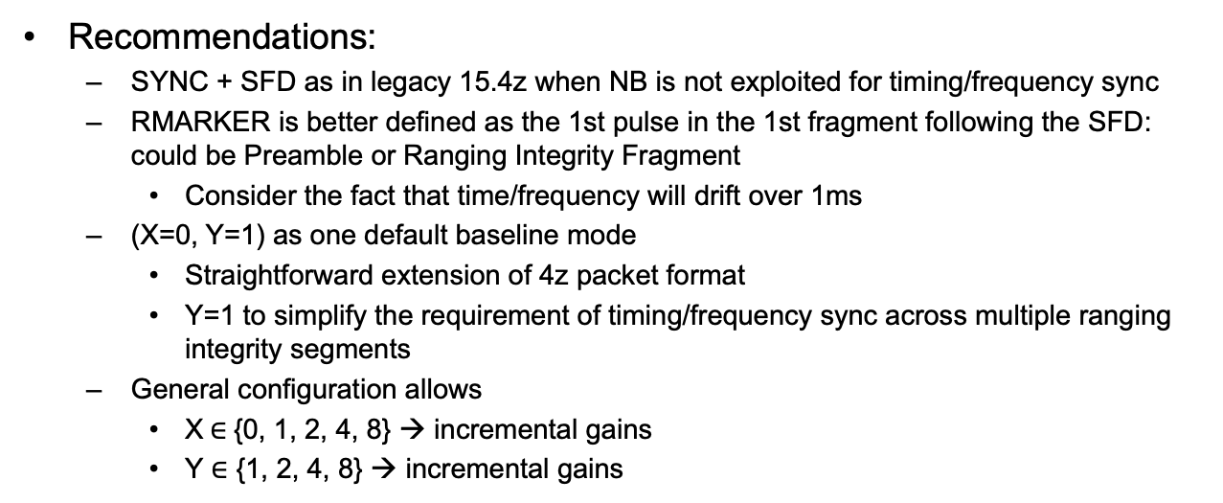
MMS without NB Assistance for Ranging Integrity
        doc.: 15-22-0392-01-04ab
Recommendations:
  SYNC + SFD as in legacy 15.4z when NB is not exploited for timing/frequency sync
  RMARKER is better defined as the 1st pulse in the 1st fragment following the SFD: could be Preamble or Ranging Integrity Fragment
    Consider the fact that time/frequency will drift over 1ms
  (X=0, Y=1) as one default baseline mode
    Straightforward extension of 4z packet format
    Y=1 to simplify the requirement of timing/frequency sync across multiple ranging integrity segments
  General configuration allows
    X$∈${0, 1, 2, 4, 8} → incremental gains
    Y $∈$ {1, 2, 4, 8} → incremental gains
1ms
1ms
(X-2) ms
(1+Z) ms
1ms
(Y-2) ms
UWB
SYNC
SFD
Preamble
Fragment
1
Preamble
Fragment
2
Preamble
Fragment
X
Ranging Integrity
Fragment
1
Ranging Integrity
Fragment
2
Ranging Integrity
Fragment
Y
rMarker
Z = {0, 1}

Slide 9
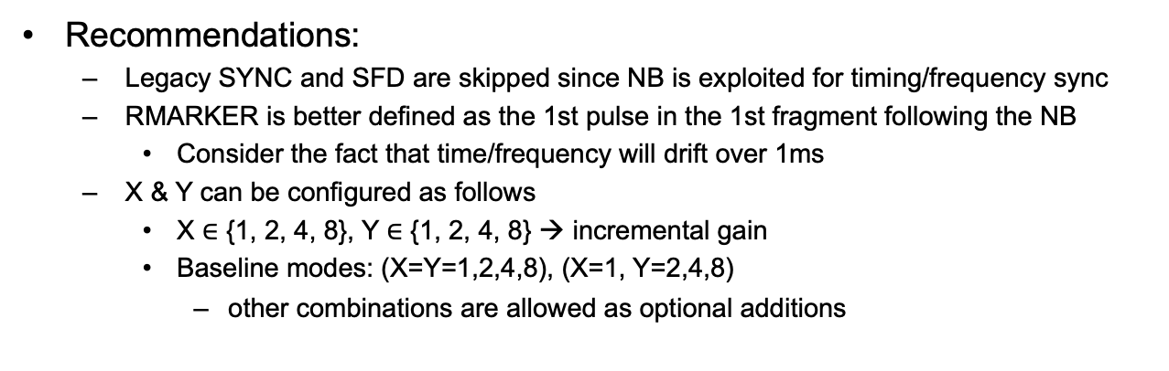
MMS with NB Assistance for Ranging Integrity
        doc.: 15-22-0392-01-04ab
Recommendations:
  Legacy SYNC and SFD are skipped since NB is exploited for timing/frequency sync
  RMARKER is better defined as the 1st pulse in the 1st fragment following the NB
    Consider the fact that time/frequency will drift over 1ms
  X & Y can be configured as follows
    X $∈$ {1, 2, 4, 8}, Y $∈$ {1, 2, 4, 8} → incremental gain
    Baseline modes: (X=Y=1,2,4,8), (X=1, Y=2,4,8)
      other combinations are allowed as optional additions
NB
1ms
(X-2) ms
(1+Z) ms
1ms
(Y-2) ms
UWB
Preamble
Fragment
1
Preamble
Fragment
2
Preamble
Fragment
X
Ranging Integrity
Fragment
1
Ranging Integrity
Fragment
2
Ranging Integrity
Fragment
Y
rMarker
Z = {0, 1}

