Slide 1
Project: IEEE P802.15 Working Group for Wireless Personal Area Networks (WPANs)
Submission Title: [Preliminary Discussion on Possible LDPC Codes for 15.4ab]
Date Submitted: [8th July 2022]
Source: [Wei Lin, Xun Yang, Bin Qian, Chenchen Liu, Rani Keren, Shimi Shilo] Company [Huawei]
Address [Huawei base, Shenzhen, CHINA & Huawei Israel]
E-Mail:[lin.linwei@huawei.com]
Re: [Study Group 4ab: UWB Next Generation]
Abstract: [Preliminary Discussion on Possible LDPC Codes for 15.4ab]
Purpose: []
Notice: This document has been prepared to assist the IEEE P802.15. It is offered as a basis for discussion and is not binding on the contributing individual(s) or organization(s). The material in this document is subject to change in form and content after further study. The contributor(s) reserve(s) the right to add, amend or withdraw material contained herein.
Release: The contributor acknowledges and accepts that this contribution becomes the property of IEEE and may be made publicly available by P802.15.

Slide 2
Technical Guidance
PAR Objective | Proposed Solution (how addressed)
Safeguards so that the high throughput data use cases will not cause significant disruption to low duty-cycle ranging use cases.
Interference mitigation techniques to support higher density and higher traffic use cases
Other coexistence improvement
Backward compatibility with enhanced ranging capable devices (ERDEVs).
Improved link budget and/or reduced air-time | New Channel Coding Schemes can provide improved link budgets and reduced air time
Additional channels and operating frequencies
Improvements to accuracy / precision / reliability and interoperability for high-integrity ranging;
Reduce complexity and power consumption;
Hybrid operation with narrowband signaling to assist UWB;
Enhanced native discovery and connection setup mechanisms;
Sensing capabilities to support presence detection and environment mapping;
Low-power low-latency streaming
higher data-rate streaming allowing at least 50 Mbit/s of throughput. | New Channel Coding Schemes with higher rates can support high data rate
Support for peer-to-peer, peer-to-multi-peer, and station-to-infrastructure protocols;
Infrastructure synchronization mechanisms.

Slide 3
Related Submissions
[1] 15-21-0506-02-04ab-Advanced Coding for Data Communications in 802.15.4ab, Aldana
[2] 15-21-0592-00-04ab-high-data-rates, C. Murray, et al
[3] 15-22-0181-01-04ab-new-data-rates, C. Murray, et al
[4] 15-22-0050-00-04ab- Channel Coding Considerations for 802.15.4ab, Wei Lin, et al
[5] 15-22-0154-00-04ab-further-considerations-of-advanced-channel-coding-on-15-4ab, Wei Lin, et al
[6] 15-22-0265-01-04ab-discussion-on-advanced-channel-coding-for-15-4ab
[7] 15-22-0274-00-04ab-high-data-rates-and-coding
[8] 15-22-0296-01-04ab-a-higher-data-rate-proposal-for-uwb
[9] 15-21-0506-03-04ab-advanced-coding-for-data-comm

Slide 4
Discussions on Advanced Channel Coding
The consideration of introducing possible new advanced coding schemes were extensively discussed in [1]-[5]
Some initial discussions on the new advanced coding can be found in [1]-[5], where extensive comparisons of BCC, Turbo, Polar, LDPC codes can be found in terms of performance, complexity, etc.
Most participants agreed to converge to LDPC codes during the May IEEE Meeting [6]-[8]
In [7], some consensus among some co-authors were achieved, including to converge the selection of new advanced codes for 15.4ab to LDPC codes
[7] also suggested that ‘Primary candidate is the 802.11n LDPC code’, and some important comparison metrics for possible alternative schemes, such as packet lengths, considered PER, implementation complexity, etc.
In [6], we also suggested to further converge the candidates to LDPC codes after extensive evaluations, and also LDPC codes have been widely employed in current wireless standards.
Furthermore, [8] suggested to better balance the performance of PHR and data part, e.g., PHR may need additional protection, e.g., symbol repetition.
[9] provided further simulation results of short (e.g., 30 bytes) and very short (e.g., 10~5 bytes) payloads with 11n LDPC codes, and showed that 11n LDPC can perform well at lower effective coding rates

Slide 5
The Targets of New UWB LDPC Codes
Compared with existing standards (e.g., 11ax/be), data transmissions in 15.4ab include a large amount of short payloads (e.g., around 20 Bytes)
The candidate LDPC codes should perform well at short payload lengths with corresponding amount of padding bits
The performances of short payloads with candidate LDPC codes should be as close as possible to PHR, but not surpass the performance of PHR (BCC & SECDED encoded with one repetition)
Low Power & Low Complexity is very important for UWB applications
It is beneficial for the candidate LDPC codes to have very low density parity-check matrices, the number of ‘1’s inside the H matrix is relatively small → an additional ‘1’ incurs additional computations inside LDPC decoder
It is beneficial for the candidate LDPC codes to share a single base matrix, and possible different lifting coefficients for corresponding code lengths → similar to NR LDPC
The WLAN LDPC codes were primarily designed for fixed Rate & Length Combinations
The 11n LDPC of different lengths (even with the same rate) don‘t share the same base (mother) matrices
The 11n LDPC wasn’t optimized for short payload transmissions → a relatively large amount of shortening bits

Slide 6
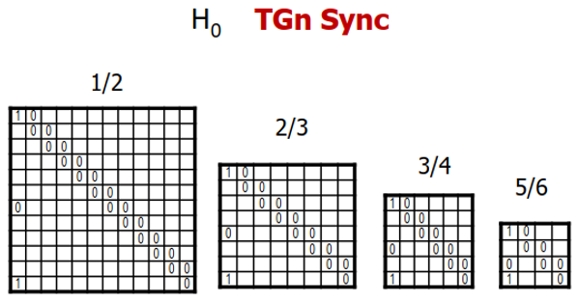
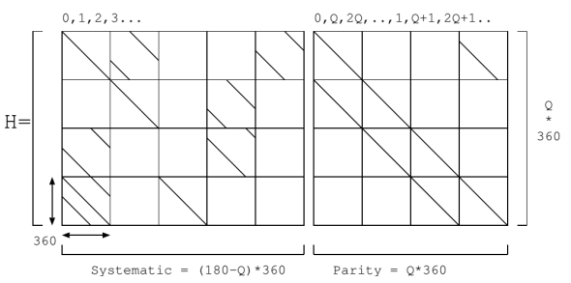
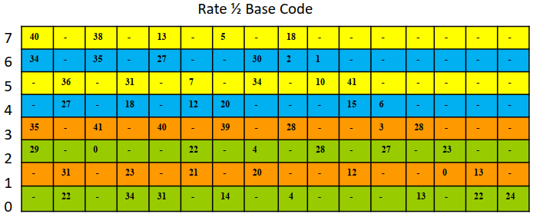
Possible candidate LDPC codes - Classic QC-LDPC
There are currently two major LDPC structures widely employed in industry
Classic QC-LDPC (11n/11ad/DVB) and Raptor-Like QC-LDPC (5G NR)
Classic QC-LDPC (11n/11ad/DVB) → Repeat Accumulate + Quasi Cyclic
Classic QC-LDPC codes are widely employed in various standards, they are implementation friendly and good performance for fixed rates/lengths
Classic QC-LDPC codes are not convenient for rate/length compatible, e.g., require a individually designed H matrix for each rate and length (12 matrices in 11n), and significant performance loss occurs for shortening or puncturing
RA
RA
RA
11ad/ay LDPC Code
Parity-Check Part of WLAN LDPC Codes
DVB-S2 LDPC Code

Slide 7
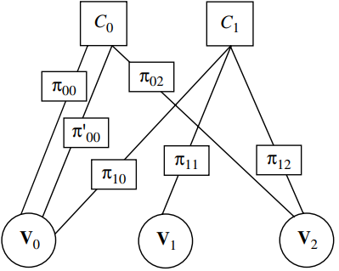
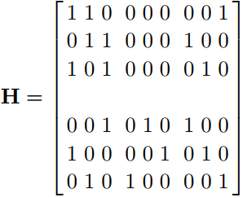
Possible candidate LDPC codes - Raptor-Like QC-LDPC
Raptor-Like QC-LDPC → Protograph + Multi-Edge Type + Accumulate Repeat Accumulate
Protograph: a Tanner graph with a relatively small number of nodes → Protograph design & Lifting optimization
P-EXIT chart analysis (Liva2007) → different protographs having same degree distribution may have different thresholds
The Protograph-based LDPC codes can be extended to long lengths through different lifting sizes with single base matrix → decoding threshold can guarantee the performance
Multi-Edge Type: edges are better controlled by categorizing into several different types
Can avoid weak local combinations of nodes → e.g., all connections to a particular CN being made to VNs of smallest degree
ARA & MET: state nodes in conjunction with degree-1 nodes → improve performance with controlled complexity
Raptor-Like QC-LDPC codes can accommodate various rates and lengths with a single base matrix, and also can obtain very good performance under shortening and puncturing
State Nodes
Degree-1 Nodes
Protograph
Multi-Edge Type (MET)
Accumulate Repeat Accumulate (ARA)

Slide 8
Further Discussion on LDPC Coding
For the candidate LDPC codes
The possible candidate new LDPC codes includes 802.11n LDPC codes, alternative classic QC-LDPC codes, and Raptor-Like QC-LDPC codes
The possible new LDPC codes shall be extensively compared with 802.11n LDPC in terms of performance, implementation complexity, power consumption, etc.
New Raptor-Like QC-LDPC Code for 15.4ab
Complexity: 76 CPMS (New RL-QC-LDPC) vs 88 CPMs (WLAN LDPC)
R = 1/2
degree-1 nodes
Capacity (Eb/N0) = 0.1618 dB
Hb_Thr = 0.5571 dB: Decoding Threshold of a Base Matrix (Protograph) → Minimum Eb/N0 to achieve error free transmission, assuming cycle-free with infinite length → Guarantee the performance of medium/long codes
Gap to Capacity = 0.3953 dB
R = 2/3
State/Puncture Nodes
Size: 12x22, Lifting = 34, n = 20 x 34 = 680 bits

Slide 9
Simulation Assumptions
Channel & Modulation: AWGN + BPSK
Coding Configurations
PHR (19 + 6 (tail zeros) = 25 bits) is encoded with CL7 BCC + SECDED, and 2 Symbols (Rep.)
LDPC Decoder: Layered Normalized Min-Sum Decoding with 8 Iterations
Default Rate: R = 1/2
Default Lengths: 11n LDPC (324, 648), RL LDPC (340, 680)
LDPC Transmitting Schemes
Mode 1: Shortening without Puncturing → Actual code rate lower than R = 1/2
Mode 2: Shortening with Puncturing → Actual code rate can be adjusted to R = 1/2
For short payloads, comparing with CL7 BCC (R=1/2), the actual rates of LDPC with Mode 1 are much lower than 1/2, while LDPC with Mode 2 can be adjusted to the same rate as BCC (R=1/2)

Slide 10
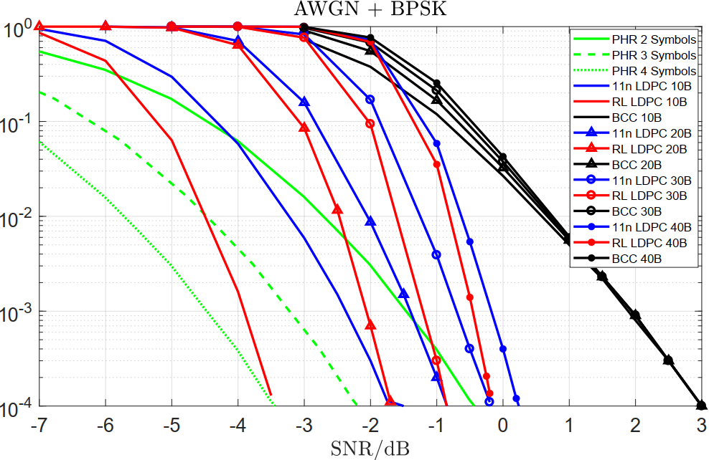
Simulation Results of Transmitting Mode 1
15.4z PHR Scheme
PHR with 2 Symbols (Current 15.4z)
PHR (3 Syms / 4 Syms) → 1.7dB / 3dB Improvement
Actual Code Rates → Under different rates, unfair for BCC
All BCC Data Transmission: R = 1/2
10 Bytes LDPC: R ~ 0.20 (RL: 0.1905 / 11n: 0.1980)
20 Bytes LDPC: R ~ 0.32 (RL: 0.3200 / 11n: 0.3300)
30 Bytes LDPC: R ~ 0.42 (RL: 0.4138 / 11n: 0.4255)
40 Bytes LDPC: R ~ 0.49 (RL: 0.4848 / 11n: 0.4969)
Reliability
Payload of 10 Bytes: both NR-LDPC (~2dB) and 11n-LDPC (~0.5dB) surpass PHR of 2 Syms at FER = 10⁻²
Payload of 20 Bytes: NR-LDPC surpasses 11n-LDPC ~0.5dB at FER = 10⁻² and ~0.7dB at FER = 10⁻³
PER
FER

Slide 11
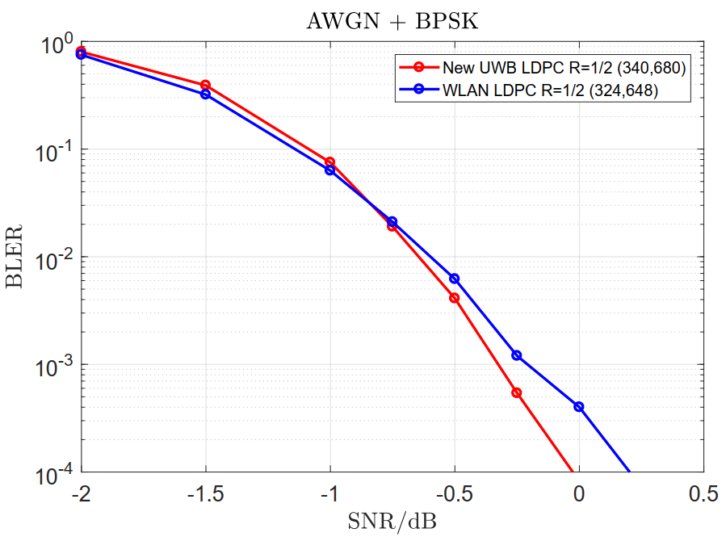
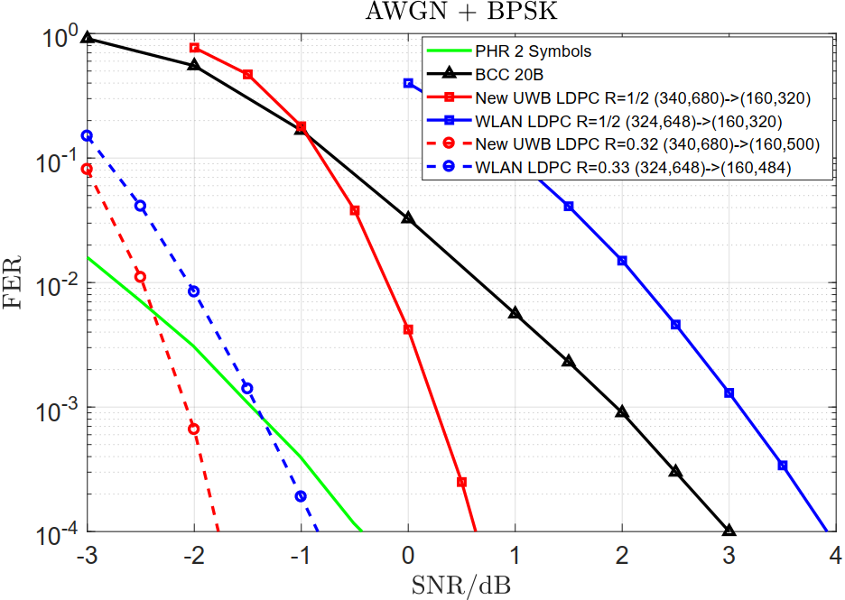
Simulation Results of Transmitting Mode 2
20 Bytes
PER
PER
R=1/2
R~0.32
New LDPC (340,680) vs. WLAN LDPC (324,648) at R = 1/2 → Under same rates, fair for BCC
Can obtain around 0.25dB gain at BLER = 10⁻⁴ and Complexity: 76 CPMS (New LDPC) vs 88 CPMs (WLAN LDPC)
New LDPC (160,320) vs. WLAN LDPC (160,320) at R = ½ → LDPC of same rate of R = 1/2 (Fair)
New LDPC performs very well at short payload (20 bytes) → over 2dB compared with R = ½ WLAN LDPC (Shorten & Punc)
New LDPC (160,500) vs. WLAN LDPC (160,484) at R ~= 0.32
New LDPC performs also very well at short payload (20 bytes) → around 0.45dB compared with shortening WLAN LDPC
All with a single parity-check matrix

Slide 12
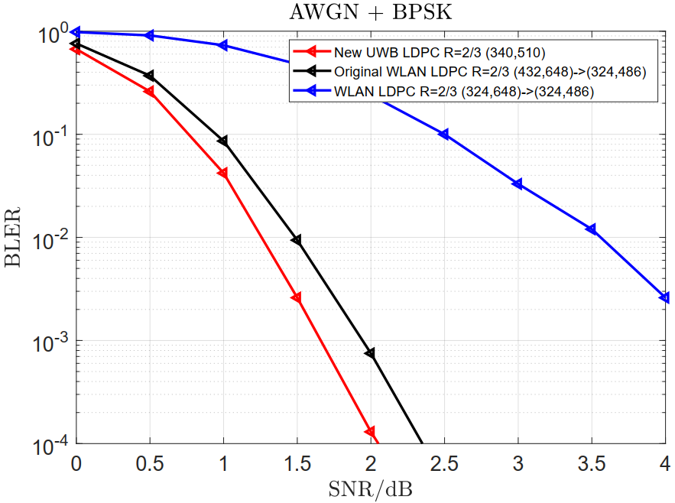
Simulation Results of Transmitting Mode 2
New LDPC (340,510) vs. two WLAN LDPC (324,486) at R = 2/3
WLAN LDPC 01: R = 1/2 WLAN LDPC (324,648) → (324,486)
WLAN LDPC 02: R = 2/3 WLAN LDPC (432,648) → (324,486)
New LDPC can obtain 0.35dB gain compared with original R = 2/3 WLAN LDPC 02 at similar lengths, and over 2.5 dB compared with R = 1/2 WLAN LDPC 01 punctured to R = 2/3
Complexity: 50 CPMS (New LDPC) vs 88 CPMs (WLAN LDPC)
PER
R = 2/3
All with a single parity-check matrix

Slide 13
Conclusions
The Raptor-Like LDPC code can achieve better performances compared with 11n LDPC for short payloads (with or without puncturing operations)
The New Raptor-Like LDPC code have less ‘1’s in H matrix compared with that of 11n LDPC codes → lower decoding complexity
The Raptor-Like LDPC can flexibly adjust the rate through shortening and puncturing to align the performance with that of PHR → keep the performance close but not surpass PHR
The reliability of 15.4z PHR shall be improved
The performance of short payloads is limited by the reliability of 15.4z PHR

Slide 14
Thank You

